Slide 1

Housing Recovery and Reconstruction Platform-Nepal (HRRP) Orientation Program for Partner organizations
on
Dry Stone Masonry Construction
Organized by:
National Reconstruction Authority(NRA)
MOUD/District Project Implementation Unit (DLPIU)
Housing Recovery and Reconstruction Platform-Nepal (HRRP)

Slide 2
Why Dry Stone Masonry ?
This Type of Construction Common in Northern Area of Nepal
In Northern Parts People don’t Prefer Mud mortar
it is difficult to transport cement and steel since these sites are very remote and have no road access
Many Dry Stone Masonry Houses are already under Construction

Slide 3
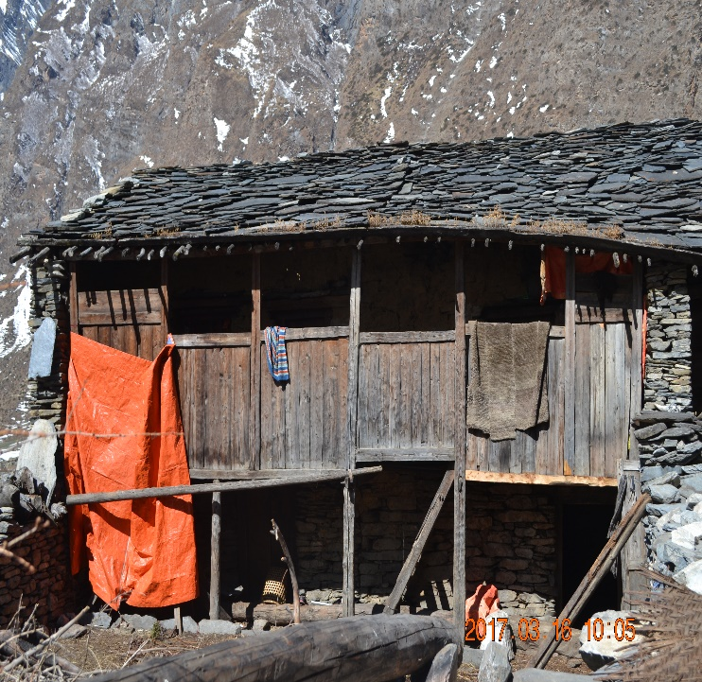
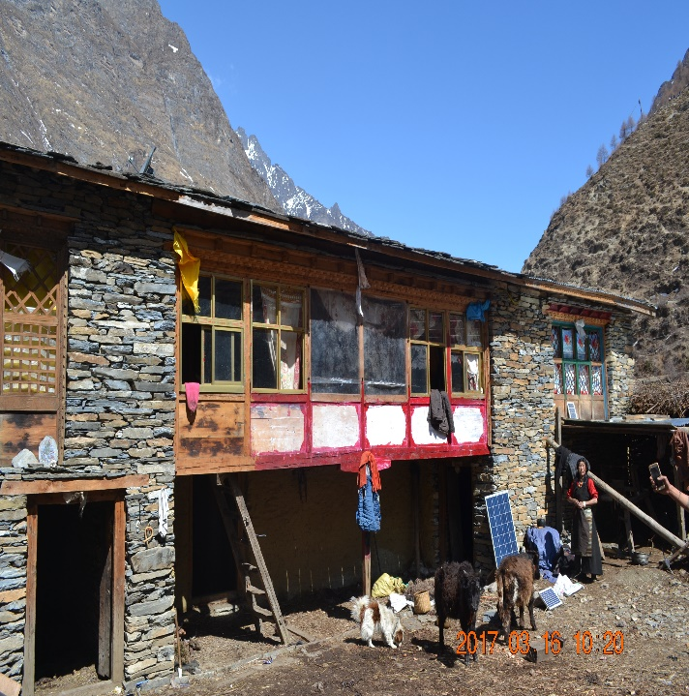
Dry Stone Building Practices
Extensive longitudinal walls and open front
.

Slide 4
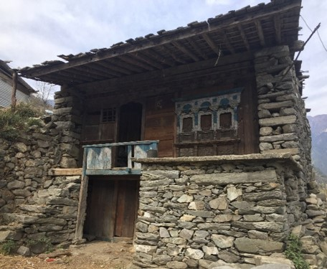
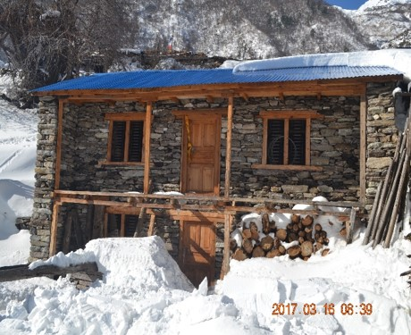
Dry Stone Building Practices
Stand alone, most with open fronts

Slide 5
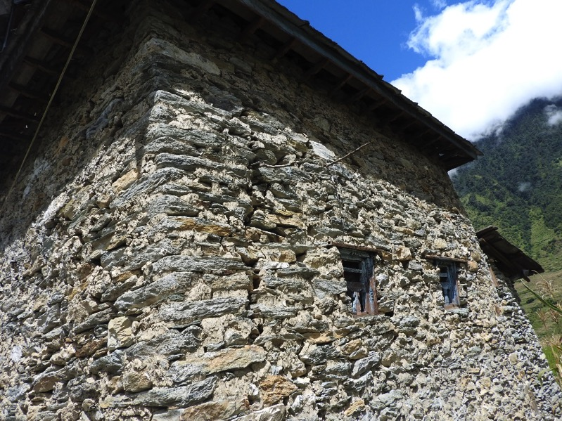
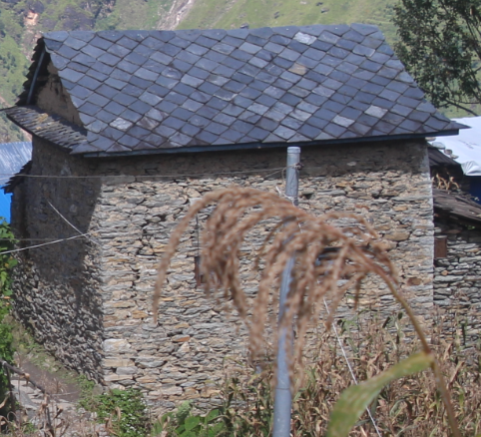
Dry Stone Building Practices
Dry Stone masonry or Stone in mud buildings with heavy Stone roofs
Presence of corner stones

Slide 6
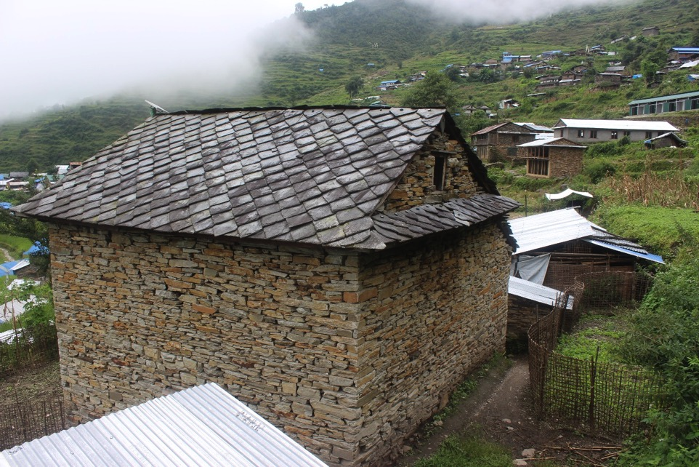
Dry Stone Building Practices
No other Earthquake Resisting Element

Slide 7
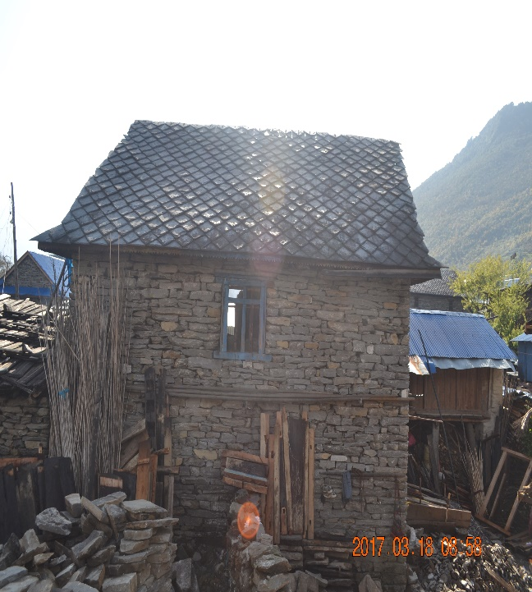
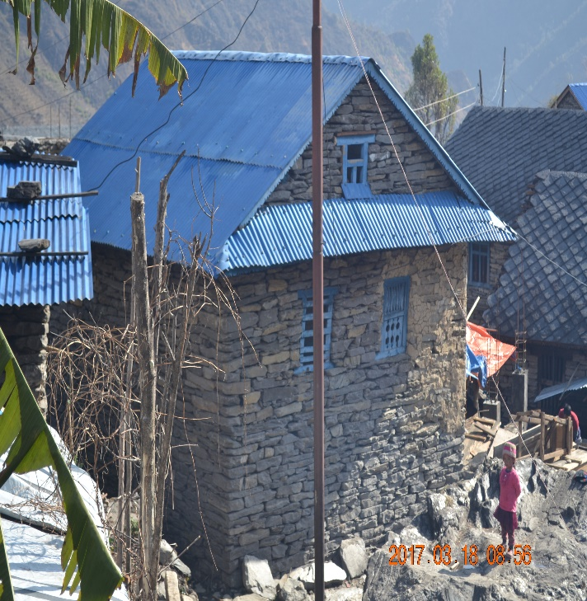
Dry Stone Building Practices
Steep Gable

Slide 8
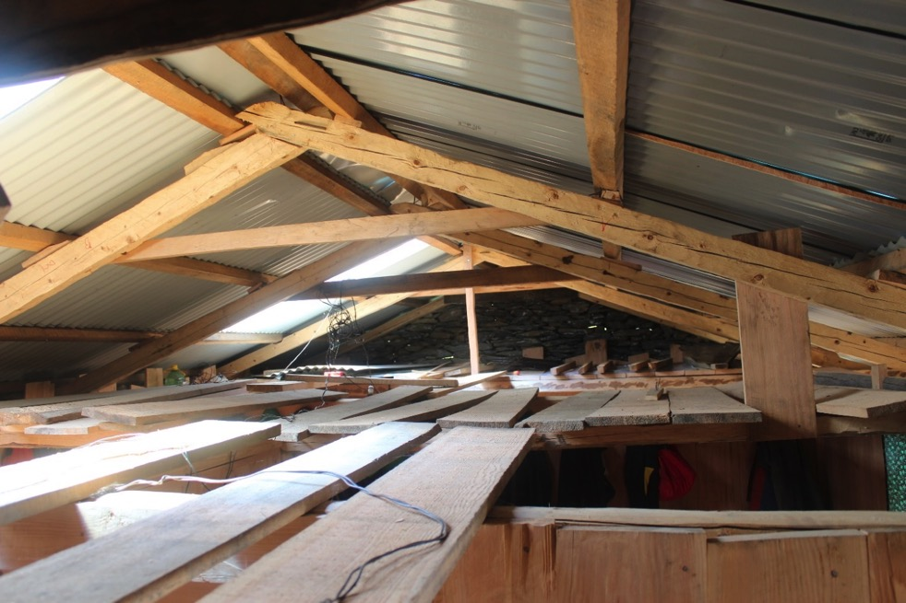
Dry Stone Building Practices
No proper connection of ridge beam, rafter and bottom chord
No proper connection of roof elements with wall

Slide 9
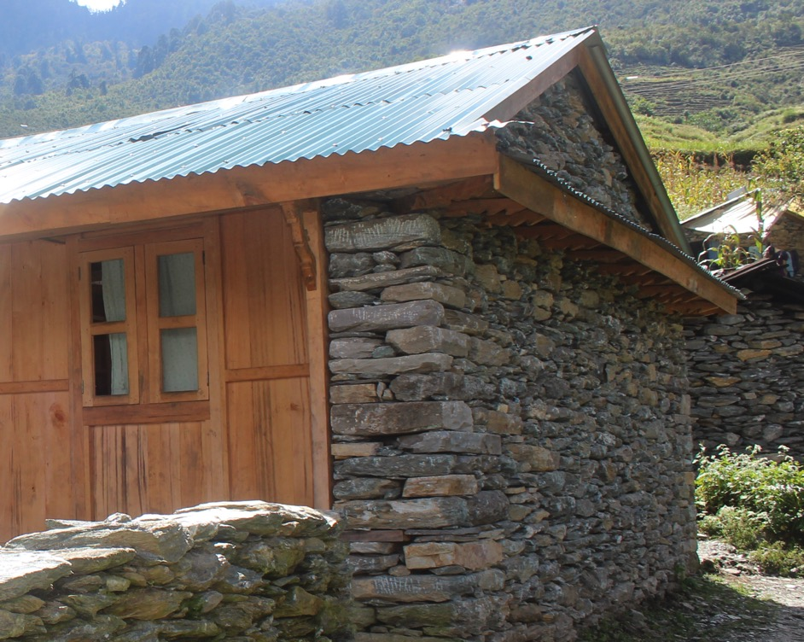
Dry Stone Building Practices
Dry Stone masonry with light CGI sheets
No earthquake resisting elements
Presence of corner stones
Use Gable wall
New Construction after Earthquake

Slide 10
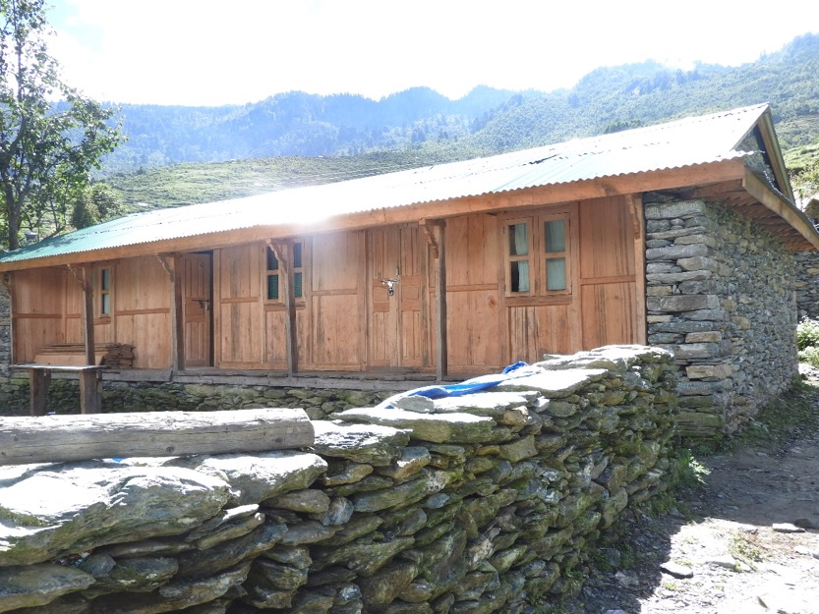
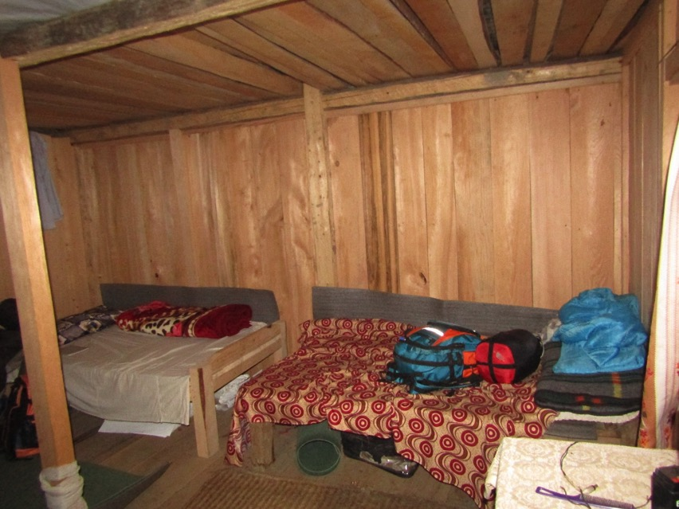
Dry Stone Building Practices
Timber walls at the front part and inner side of all stone walls
New Construction after Earthquake
Many Buildings!

Slide 11
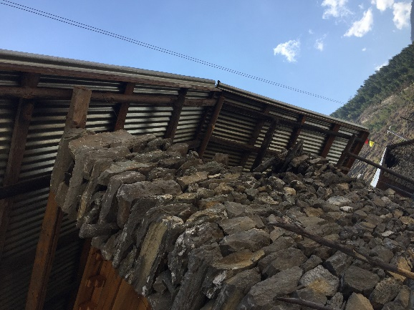
Dry Stone Construction-Deficiencies
Gable End Wall Damage
Heavy masonry gable walls are unsupported and subject to lateral loads from roof.

Slide 12
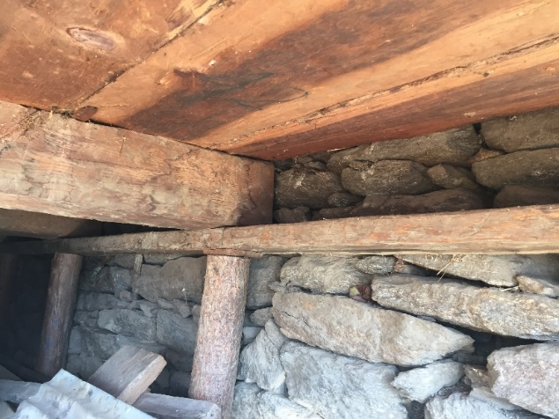
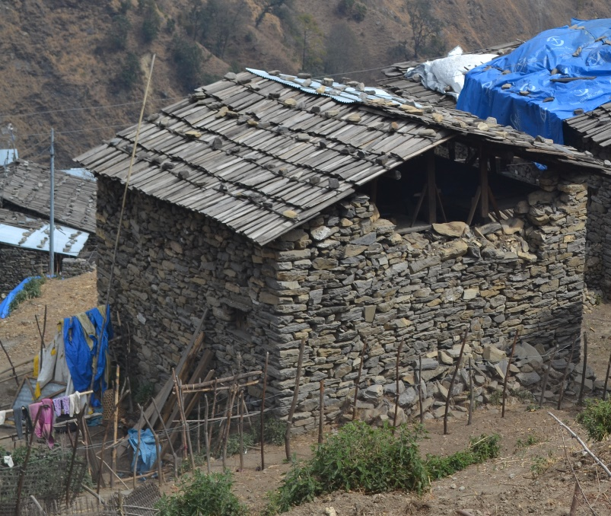
Dry Stone Construction-Deficiencies
Short Wall Out-Of-Plane
Weak attachment between end walls and diaphragms.
Damage to and subsequent collapse of end walls due to out-of-plane demands.
Wooden slab diaphragm unable to transfer Earthquake force Properly.

Slide 13
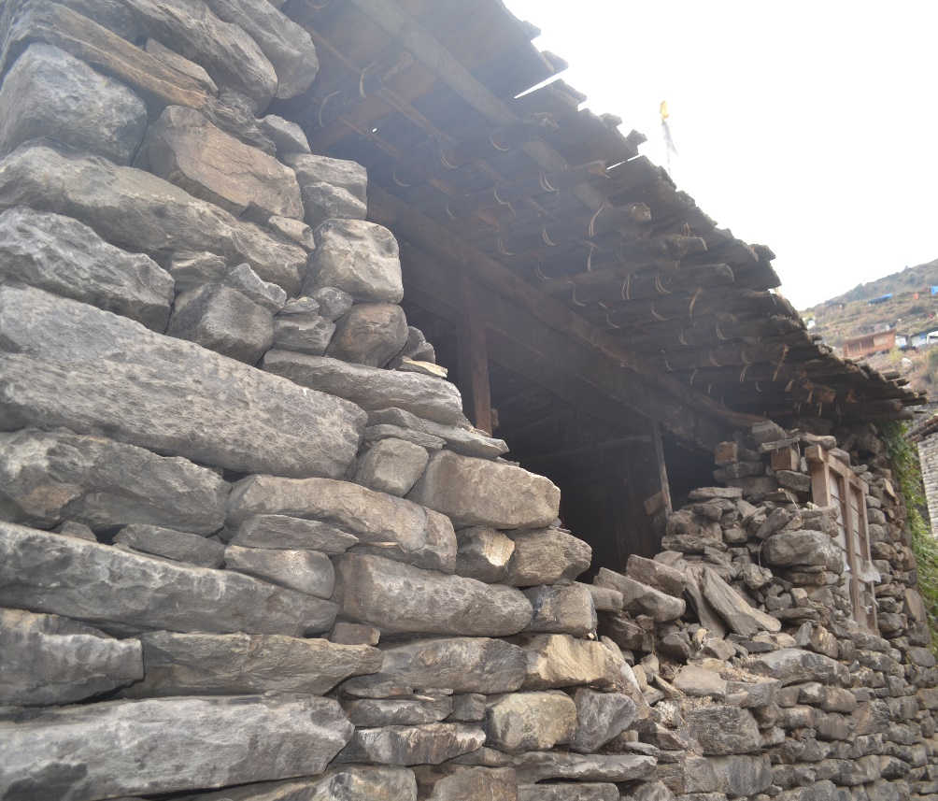
Dry Stone Construction-Deficiencies
Wall Delamination in both directions
The thick walls (>=45cm) constructed of interior and exterior facing stones. Required bonding elements are sometimes missing or inadequate.
Wall delamination occurs, can lead to subsequent collapse.

Slide 14
Type Design On Dry Stone Masonry
Dressed Stone Masonry
Random Rubble Masonry with GI Wire Mesh

Slide 15
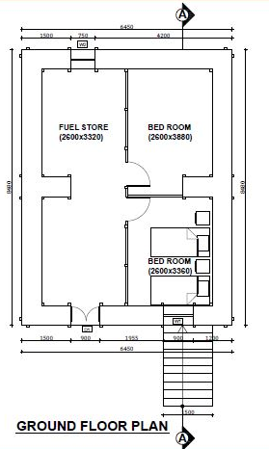
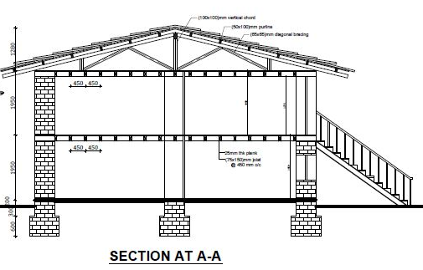
Dressed Stone Masonry
No. of Storey : 2
Flexible Floor & Roof
Plinth Area: 588 sq.ft

Slide 16
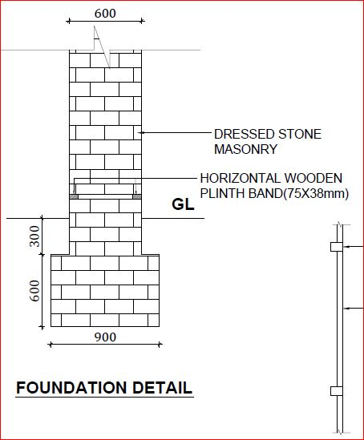
Dressed Stone Masonry
Foundation
Width: 900 mm
Depth : 900 mm

Slide 17
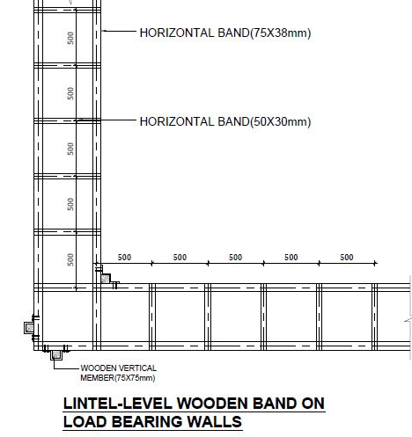
Dressed Stone Masonry
Provide Horizontal Band at Plinth, Sill , Lintel &Roof level
Well Seasoned Locally available hardwood can be used

Slide 18
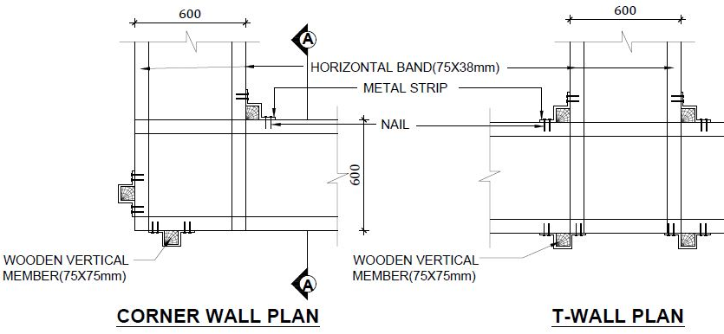
Dressed Stone Masonry
Wall Thickness : 600mm
Spacing of through stone should not be more than more than 1200 mm horizontally & 600 mm Vertically
Provide Vertical Member at Corner of Wall

Slide 19
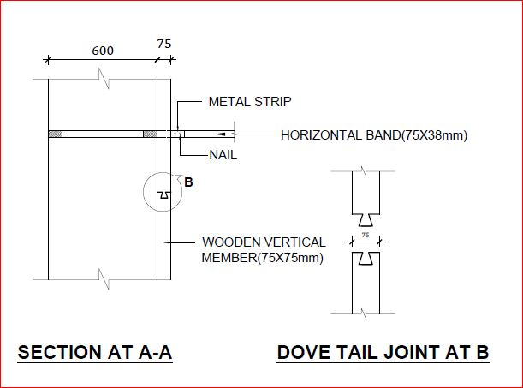
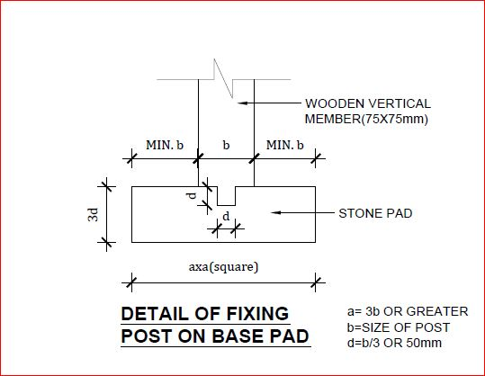
Vertical Member Detailing

Slide 20
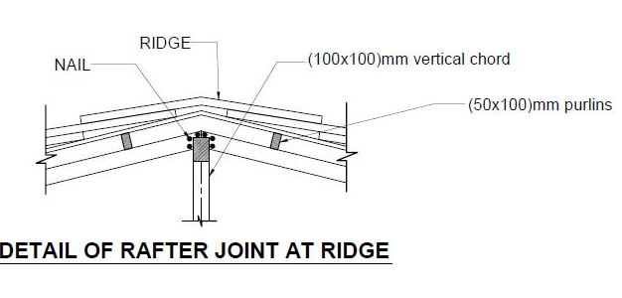
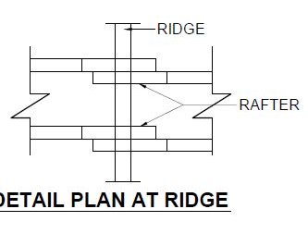
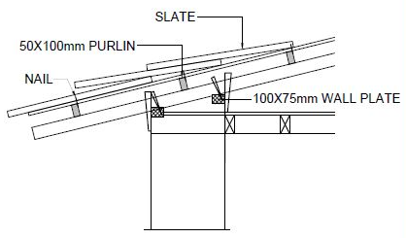
Roof Detailing
In timber connection it need give Special attention in Joint !

Slide 21
Wooden Key

Slide 22
Random Rubble Masonry with GI wire Mesh
No. of Storey : 2
Flexible Floor & Roof
Plinth Area: 588 sq.ft

Slide 23
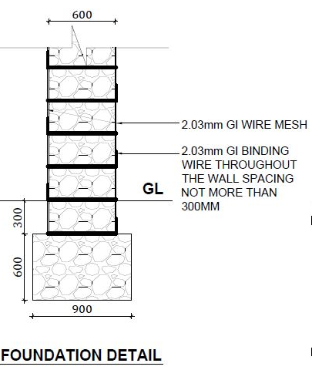
Random Rubble Masonry with GI wire Mesh
Foundation
Width: 900 mm
Depth : 900 mm

Slide 24
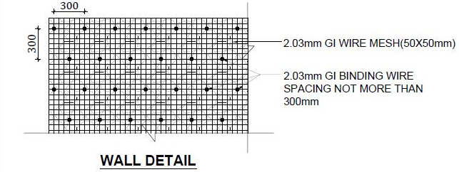
Random Rubble Masonry with GI wire Mesh
Wall Thickness : 600mm
Spacing of through stone should not be more than more than 1200 mm horizontally & 600 mm Vertically

Slide 25
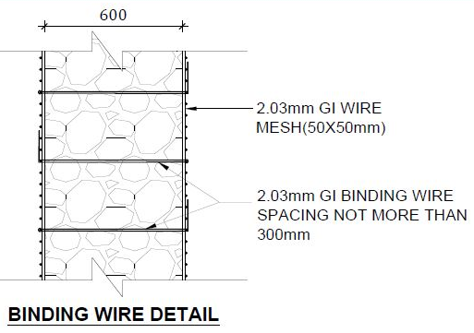
Random Rubble Masonry with GI wire Mesh
The hot dipped galvanized welded wire Shall be used to ensure the Corrosion Protection
The wire mesh shall not be less than 50 Micron

Slide 26
Roof Detailing
In timber connection it need give Special attention in Joint !

Slide 27
Wooden Key

Slide 28
Random Rubble Masonry with GI wire Mesh
The hot dipped galvanized welded wire Shall be used to ensure the Corrosion Protection
The wire mesh shall not be less than 50 Micron

Slide 29
Even with the low compliance rate
We can
still Considered it as a good Initiation !

Slide 30
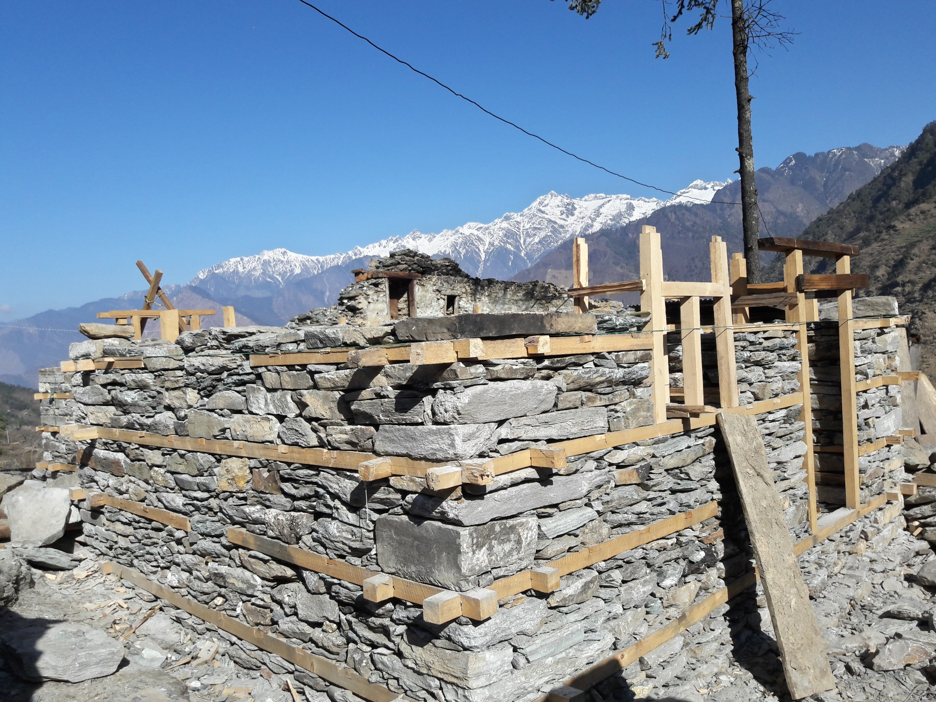
Tipling, Dhading

Slide 31
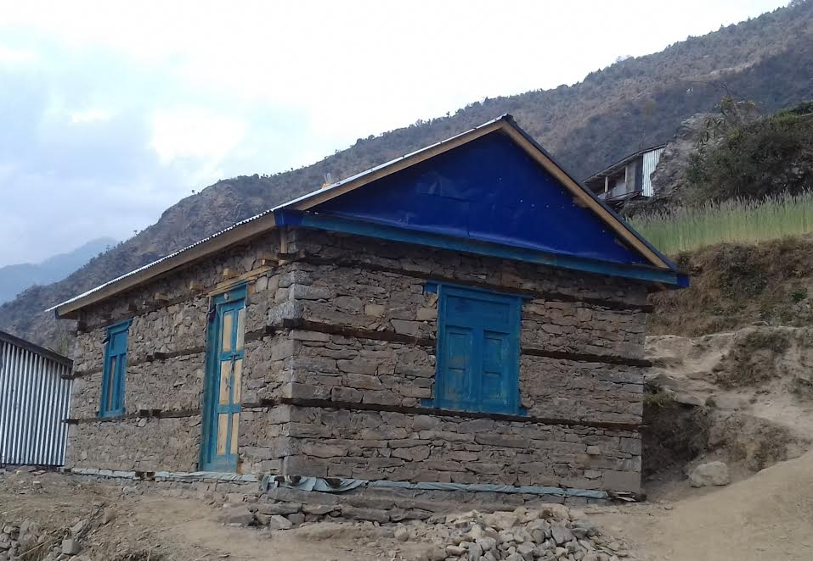
Ramche, Rasuwa

Slide 32
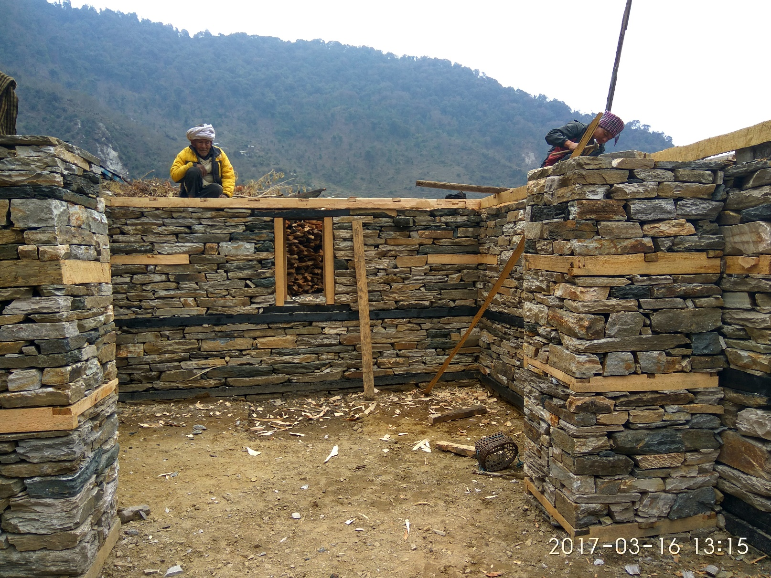
Sertung, Dhading

Slide 33
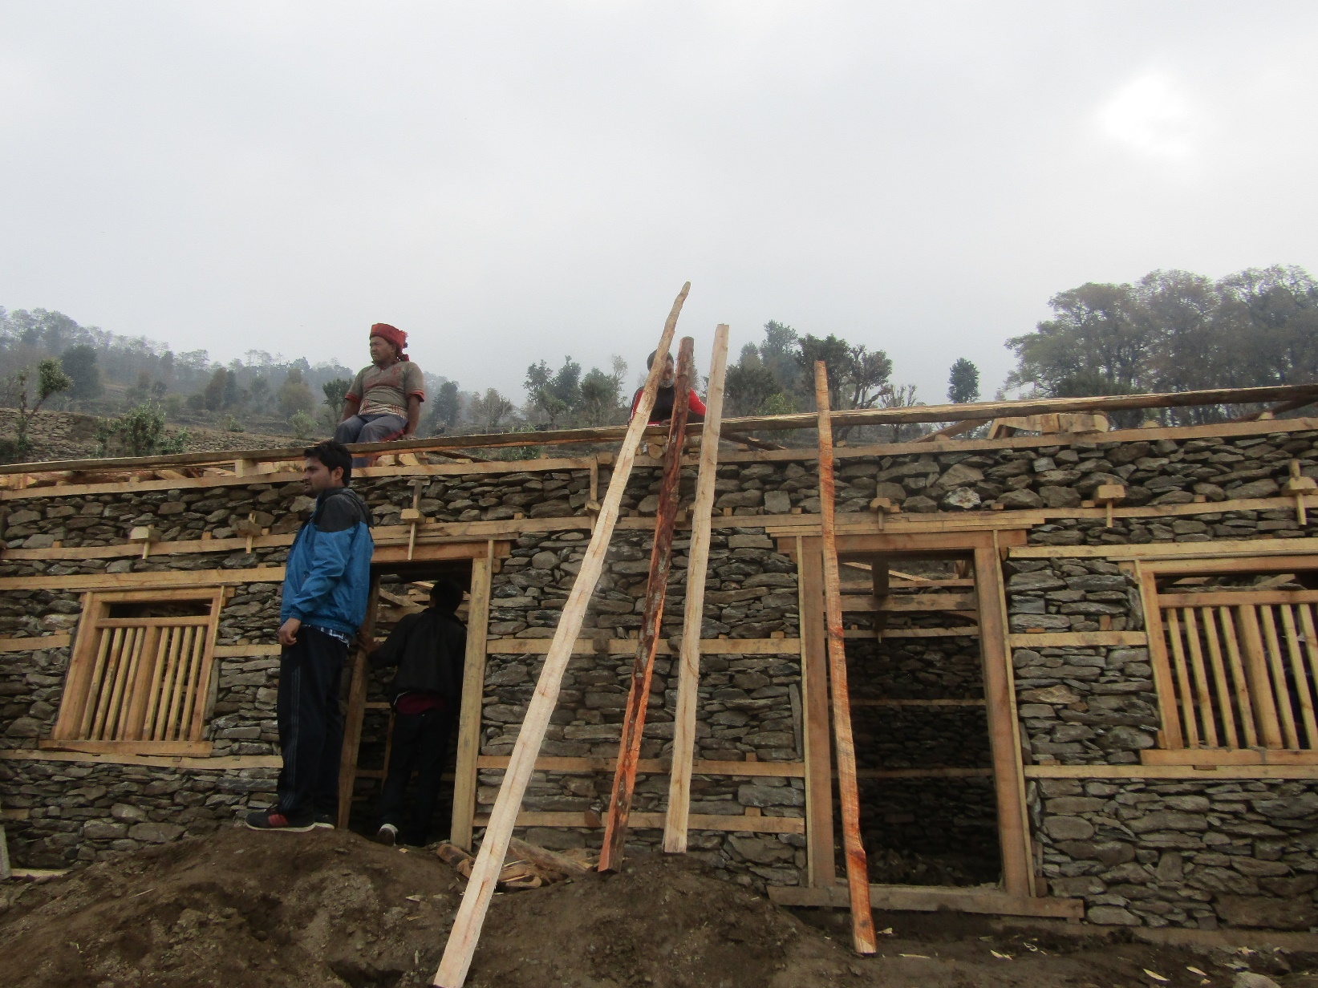
Dhading

Slide 34
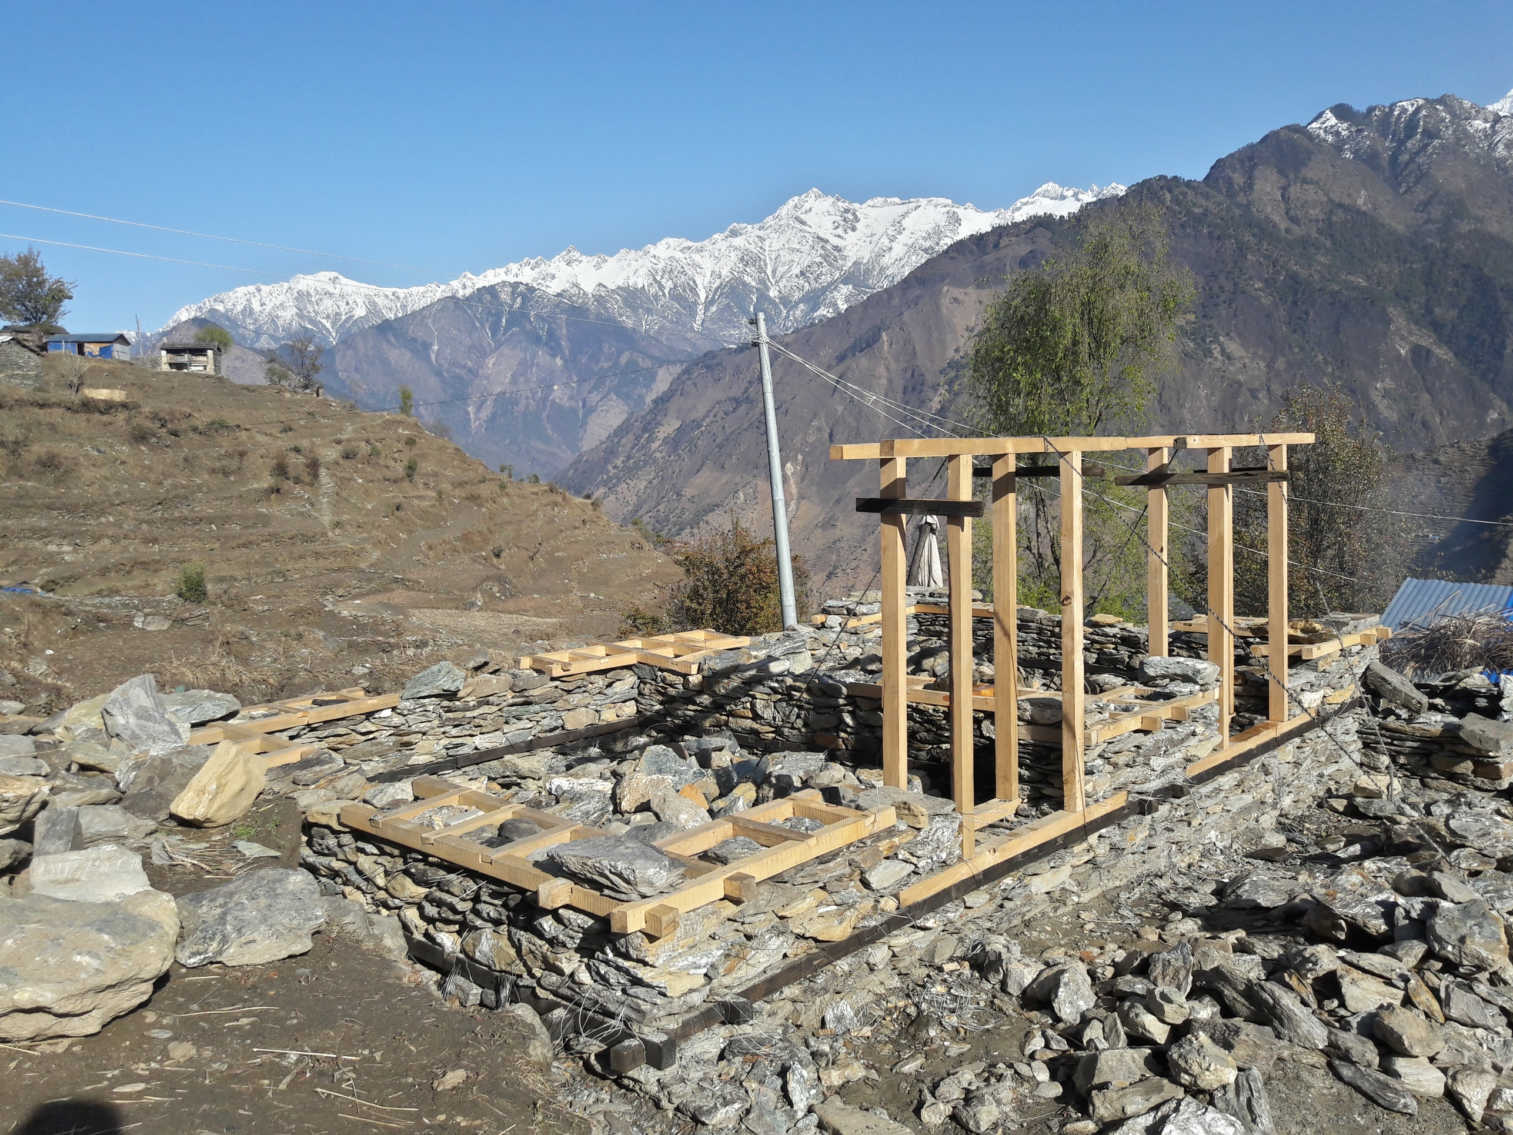
Thank You

