Slide 1
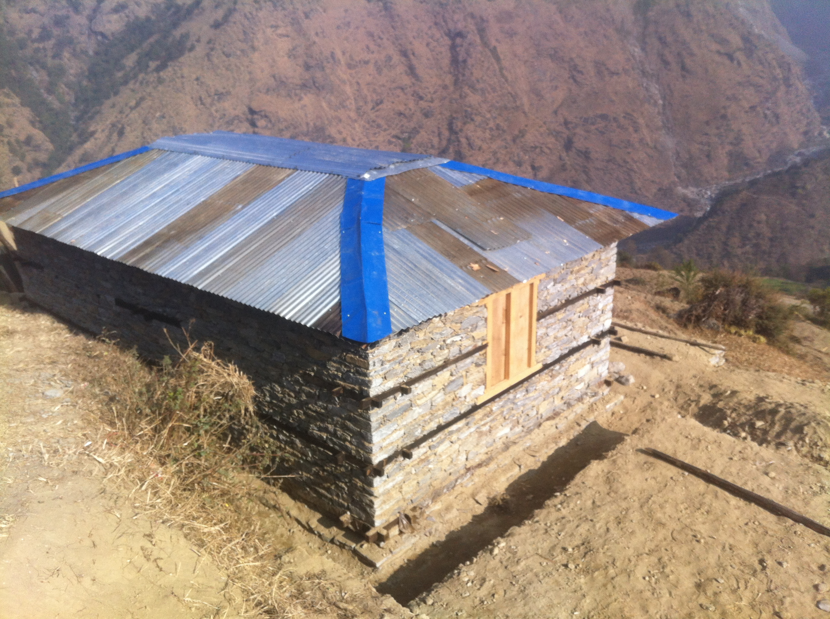
Reconstruction Skills Project
Sanjib Kumar Rai
Cluster Coordinator
Cluster Office: Dhaibung, Kalikasthan, Rasuwa
22 November 2016

Slide 2
Project Background
Project Start/End: June 2016 to Jan 2018 [Funding agency: DFID]
Implemented by: HELVETAS Swiss Intercooperation Nepal
Geography: Rasuwa, Makawanpur, Kavre, Sindhuli, Okhaldhunga
Total Target: 6,500 Moson, 1,000 Construction Carpentry
Rasuwa Target: 770 Mason, 130 Carpentry
Key Features:
  Curriculum revision with EQ resilient element
  50-days on-site training (6,500)
  7-day’s Construction Carpentry training (1,000)
  2 houses by one group in 50 days
  Trainer : Trainee ratio 1:5 (Main Instructor: at least level-2/TSLC Passed, Preferably level-3), Co-instructor : 1-3 years of experience in same trade. [ One of the instructor should hold EQ resilience TOT certificate]

Slide 3
Project Background
Training delivered by private sector/NGO partners
Owner led construction
Result based post financing
  25% upon agreement
  25% upon training completion
  25% after 3-months verification (per month income of at least NRs 9,700)
  25% after 6-months verification (per month income of at least NRs. 9,700)
  Strong monitoring and online database system
  Training management as well as construction quality monitoring
  eMonitoring system in place
People between 16 – 40 years [Around 25 % above the age (Subject to approval)
At least 30% women mandatory
Priority to disadvantaged group

Slide 4
Training and Construction Modality
Pre Training
During Training
Post Training
Curricula Revision
Training Manual
Approval from authorities
ToT for trainers
Service Procurement
Establishing Engineering Unit
Coordination
Announcement
Selection
Orientation
Site Verification
Tools Distribution
On Site Training
Training Monitoring
Construction Monitoring
Review/Reflection
Coordination with other Government line agencies/ organizations/project
Technical support
Technical support
Construction supervision
Income/employment verification

Slide 5
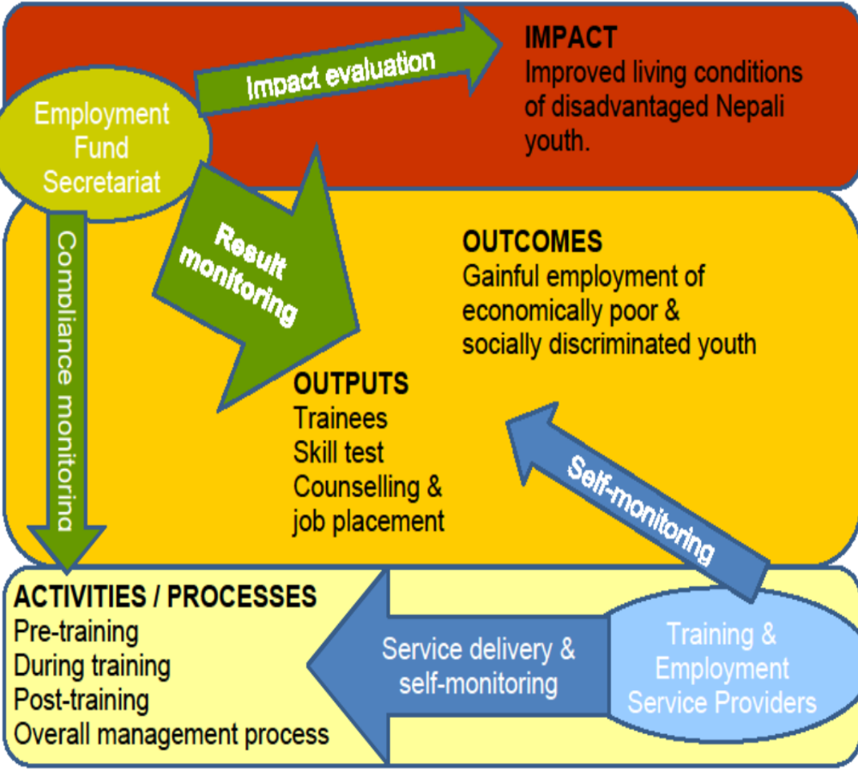
Monitoring to ensure results
Monitoring guideline as a major tool
100% monitoring of quality compliance on activities (pre-during-post)
Sample verification of employment and income
Income is verified face-to-face interview with each sampled graduate
Online database & eMonitoring system

Slide 6
Financial Modality
50 Days
Agreement
Training
completion
3 months
Income or
construction
6 months
Income or
Construction
25% of payment
25% of Output
25% of outcome
25% of outcome

Slide 7

EF-SR- Project Cycle
Training of Trainers/Instructors on EQRT
1 Day
Preparatory work of EFS:
Assessment and Selection of Districts and VDCs
Contracting T&Es, Consultancies
Collaboration with local gvt agencies
Settlement level orientation and trainee selection
(10 per batch)
Announcement and coordination with VDCs
Basic Tools distribution
30 Days
5Days
1Day
Revision of Manuals
Training& Reconstruction
Technical monitoring by engineering team of T&E and EF
(3-month employment verification by EF)
Technical Training (320 hrs, 50 days)
50Days
On the job training in real construction site. Aim: Construction of 2 houses
Construction of own house
Final verification by EF-SR and reporting
[Within 6 months]
Skill upgrading and skills test for interested trainees/trainers
Construction of others’ houses (employment)
Skilled graduates

Slide 8
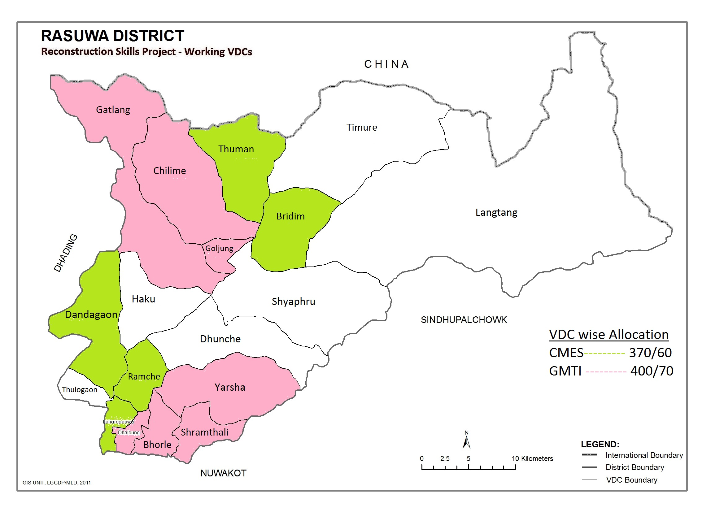
Thank you!!

Slide 9
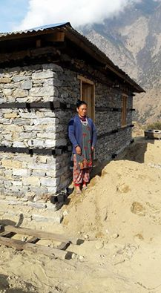
Thank you!!

