Slide 1
HRRP Technical Coordination Meeting
HRRP
2ndJune,2017
Rasuwa

Slide 2
Agendas
HRRP
Welcome/ Introduction
Coverage of Technical Assistance In the district
Design catalogue for reconstruction of earthquake resistant houses- Vol II
Information of design and detailing of 11 typical non-complaint cases on RCC structure
Information on correction and exception manual –
Updated Inspection form on the basis of correction and exception manual
Technical assistance Challenges and Experience Sharing.
Remarks from DUDBC
Closing remarks from NRA

Slide 3
Enrollment Update
Grievances Listed
1,367HH
1st Tranches
9,109HH
Total Eligible
11,236HH
Grievances Addressed
1,318HH
2nd Tranches
488HH
Total Enrolled
9,682HH
3rd Tranches
37HH

Slide 4
Status of Technical Assistance (HRRP 4W)
Technical Assistance
Vocational
Training
Demo Construction
Orientation
D2D
Tech Support
Short Training
Helpdesk
370 individuals trained across 13 VDC
838 individuals trained across 15 VDC
86 Demo Construction across 16VDC
2923 HH reached in 9VDC
4462HH orientated across 14 VDC .
6 helping desk formed in 4 VDC
98 Reconstruction Coordination Committee formed in 12 VDC

Slide 5
Challenges for TA (HRRP Technical Workshop ):
Minimum participants form local community.
Language Barrier.
Community seeks incentives during the participation.
People are not interested in lecture methods of message delivery.
Follows traditional methods of construction.
Insufficient budget for the reconstruction.
Lack of technical knowledge and difficult for the beneficiaries to understand technical terminologies.
Unavailability of house owner during technical inspection.
High expectation of labors.
Political interference regarding selecting masons.
Follow up mechanism .
Lack of understanding regarding help desk.
Design not complied between government and partners.
Hard to convince earthquake resilient technology.
Landslide prone zone area.

Slide 6
TECHNICAL COORDINATION BRIEFING

Slide 7
DUDBC Design Catalogue Vol. 2

Slide 8
Introduction
DUDBC has prepared the document.
It covers seventeen model design following twelve technologies.
The designs provided in this catalogue are based on calculations, model test and analytical tests as these technologies are not covered by Nepal National Building Code, 2060.
It covers mainly Alternative Construction Materials and Technologies.

Slide 9
Alternative Construction Materials and Technologies.
Should be Locally available
Production and correction on construction method from local People.
Strong, Cheap & durable.
Should be Preferred by Customer or house owner

Slide 10
Catalogue Objective
To pave way for use of alternate materials and technologies in the reconstruction process as per the principles set by Post Disaster Needs Assessment (PDNA) for housing and human settlements recovery and reconstruction.

Slide 11
Catalogue Limitation
Designs included in this catalogue can be selected and used as they are, for reconstruction of urban and rural housing . For designs, other than those included in this catalogue, detailed engineering design and approval from concerned authorities shall be done.

Slide 12
Lists of Model
Interlocking Brick Masonry One Storey
One Storey
One Storey
Two Storey
Confined Hollow Concrete Block Masonry
Two Storey
Hollow Concrete Block Masonry
Two Storey
Compressed Stabilized Earth Block Masonry
One Storey
Two Storey
Random Rubble Masonry in Mud mortar with GI wire Containment
One Storey
Two Storey
Bamboo and Stone Masonry Hybrid Structure
Two Storey
Rat Trap Bond Masonry
One Storey
Earth Bag Masonry
One Storey
Light Gauge Steel Structure
One Storey
Two Storey
Steel Structure
Two Storey
Timber Structure
Two Storey
Debris Block Masonry
Two Storey

Slide 13
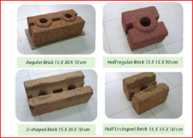
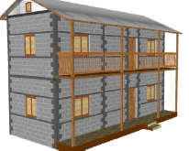
Model details
Interlocking Brick Masonry One Storey
Interlock Brick Technology consists of specially designed unburnt bricks with tongue and groove features that allows bricks to interlock each other in masonry and thereby reduces mortar usage.
Confined Hollow Concrete Block Masonry
Hollow concrete block walls carry the seismic loads and the Reinforced Concrete Columns of minimal size are used to confine the walls.

Slide 14
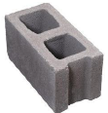
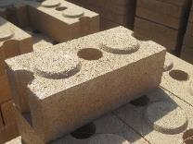
Model details Contd.
Hollow Concrete Block Masonry
Load bearing structure of hollow concrete blocks are seen as a good alternative to conventional brick masonry as they can be locally manufactured, cheaper and environment friendly.
Compressed Stabilized Earth Block Masonry
Compressed Stabilized Earth Block (CSEB) Technology makes use of mud as a predominant building material. The properties of soil used are improved by using stabilizers like cement. This Block is prepared by machine.

Slide 15
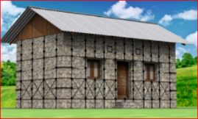
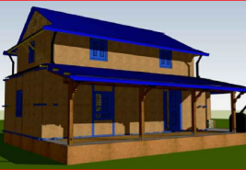
Model details Contd.
Random Rubble Masonry in Mud mortar with GI wire Containment
This technology is an improvement on random rubble masonry structure by introduction of GI containment wires. GI wire prevent from flexural failure and delamination of walls.
Bamboo and Stone Masonry Hybrid Structure
Local bamboo (Banbusa Nutans), seasoned and treated, is used in a structural frame with bamboo wattle and daub panels as walls on the upper floor. The frame is surrounded with a wall in Stone Masonry with Mud Mortar on the ground floor of the house.

Slide 16
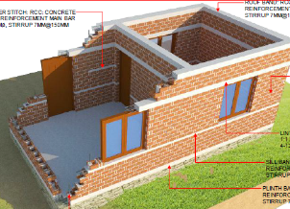
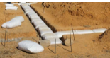
Model details Contd.
Rat Trap Bond Masonry
Rat-Trap Bond is a modular type of masonry construction in which bricks are laid on edge, thereby creating internal cavity within the wall. The cavity improves the thermal behavior of the wall and significantly reduces the quantity of brick and mortar in the masonry
Earth Bag Masonry
Earth bag technology is a simple, inexpensive and sustainable method for building structures using ordinary soil found at construction site.The technology consists of Polypropylene bags filled with locally available soil, laid similarly to masonry with barbed wire serving as a mortar and provides tensile as well as shear strength.

Slide 17
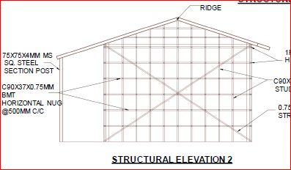
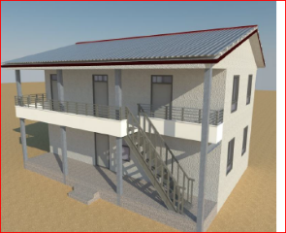
Model details Contd.
Light Gauge Steel Structure
It consisting thin steel sections cladded with light gauge steel panel, Cellular light weight concrete, Cement fiber board, gypsum board or calcium silicate board.
Steel Structure
It’s structural system consisting of mild steel columns and beams to make steel moment resisting frame system. Both the gravity and lateral load is resisted by moment resisting frame. The floor system is made of profile metal decking system over which the thin layer of RCC is laid. The roofing system consists of MS Steel tubes trusswith CGI Sheet.

Slide 18
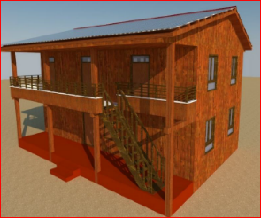
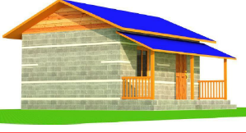
Model details Contd.
It’s structural system consisting of timber studs (vertical members) and horizontal member load bearing system. The timber planks are used as light weight partition walls.
Debris Block Masonry
The technology proposes residence construction with block made from stone or brick debris stabilized with cement.
Timber Structure

Slide 19
Review of Typical Non-Compliant RCC Structures

Slide 20
Content (cases:-
Cantilever 1.5 m long
1x2 , 1x3, 1x4 bays
1x1 bay, two side eccentric footing
Room size (4.5mx4.5m) & (5.5mx3.5m
Column at Centre of grid missing
Passage 1.5m
Footings at differential level
Column size 9”x12”

Slide 21
General Note :
11 building covered
Each building violets single mandatory rules as mentioned in the tittle
Detail FEM analysis were done
Linear Dynamic Analysis per NBC 105:1994, were performed
Detailing were done as per IS code
Design contribution (MoUD-CLPIU, HRRP, Build Change)

Slide 22
limitation
Only architectural dimensions were brought from DL-PIU
No existing structural parameters were available
Structural analysis is unique solution and is varies as the architectural dimensions

Slide 23
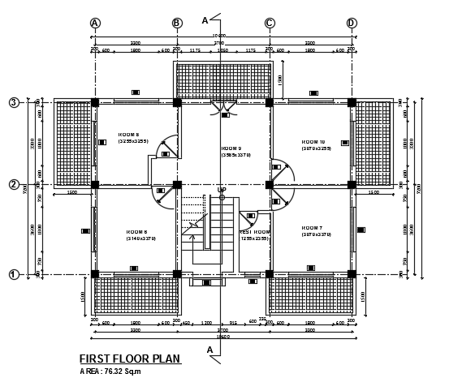
Cantilever 1.5m long

Slide 24
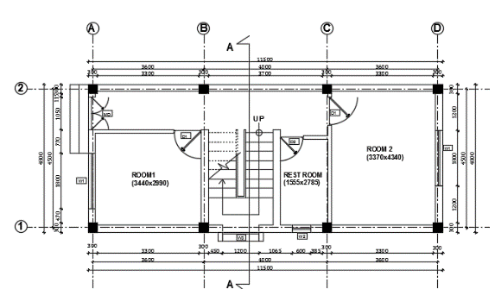
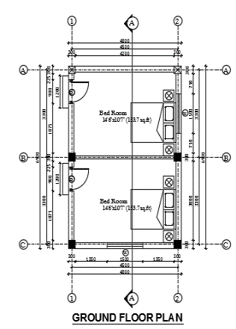
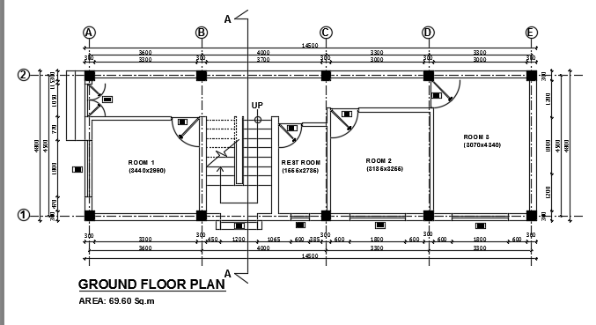
1x2 , 1x3, 1x4 bays

Slide 25
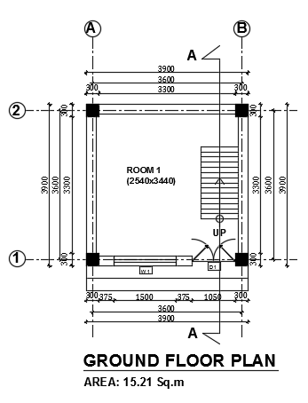
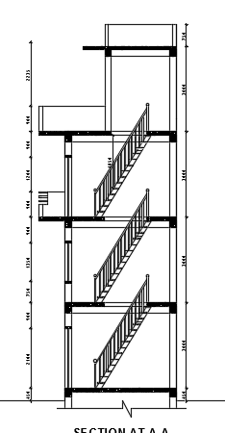
1x1 bay, two side eccentric footing

Slide 26
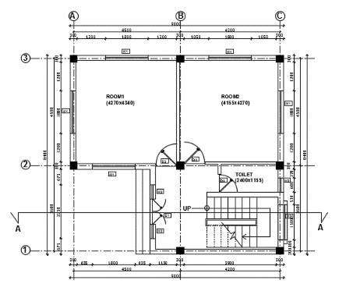
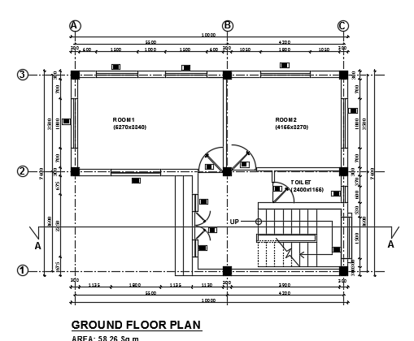
Room size 4.5mx4.5 & 5.5mx3.5m

Slide 27
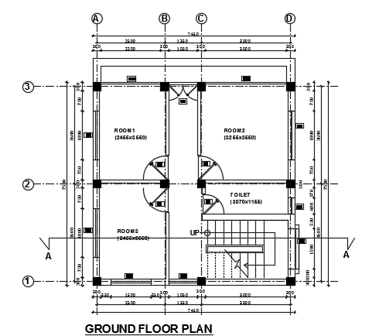
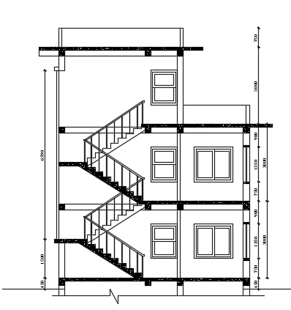
Column at Centre of grid missing

Slide 28
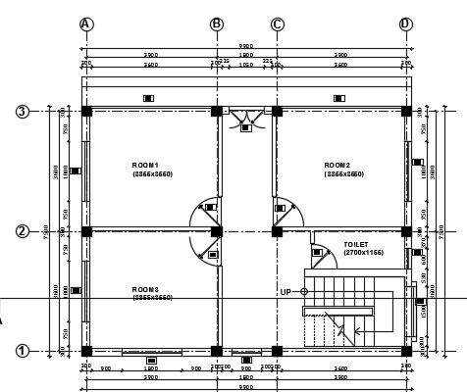
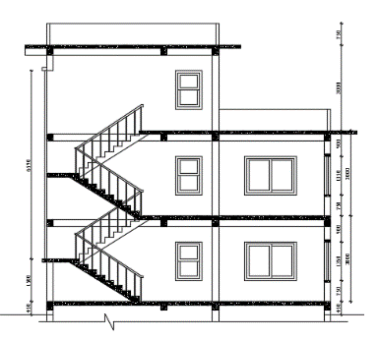
Passage 1.5 m

Slide 29
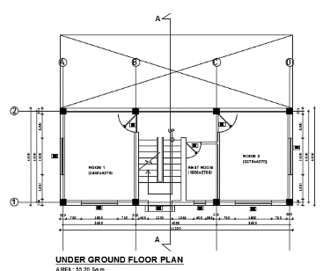
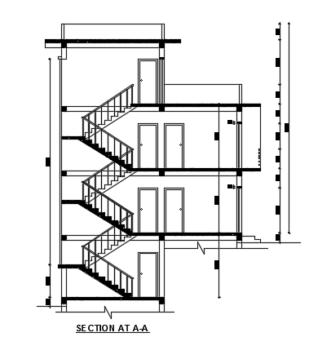
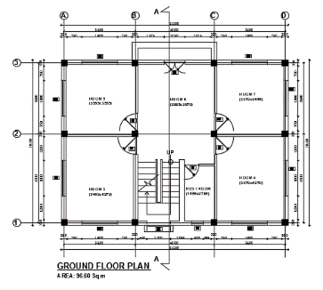
Footings at differential level

Slide 30
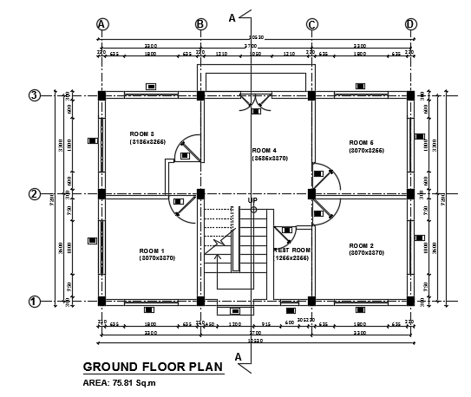
Column size 9”x12”

Slide 31


Government of Nepal
National Reconstruction Authority
Singhadurbar, Kathmandu
Introduction to
Correction and exceptional Manual

Slide 32
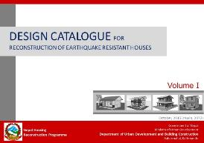
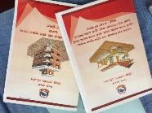
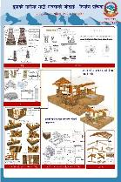
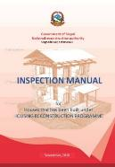
BACKGROUND
Oct, 2015
Design Catalogue Vol. 1
Feb, 2016
Minimum Requirements(MRs)
The seismic requirement is NBC105
Then, the MRs were developed.
Booklet, Poster, Guidebook for training
Dec, 2016
Inspection SOP, Inspection Manual
MTOT at Kathmandu was conducted.
TOT at district level were also conducted.
Under the housing reconstruction programme, a housing reconstruction is based on construction compliance with the MRs and the inspection checklists.
32
Notes:
Slide description:
Background
Under the housing reconstruction programme, the following guidelines were published by GON.
Design catalogue Vol.1, consists of 17 masonry building design along with their construction details
Minimum requirements, based upon the seismic design code NB 105
And for inspection of underconstruction or constructed building under Housing reconstruction programme, Inspection SOP was published.

Slide 33
Inspection guideline
Inspection SOP was prepared based on the clause 31 of Reconstruction Act,2072.
Objective:
To make the inspection easy and systematic for safer and strong construction on the basis of Grant Distribution Guidelines 2015.
To facilitate all the stakeholders- House owners, beneficiaries, Local bodies, Technical Inspection Team.
To create uniformity in the understanding of procedure the grant distribution for construction of safer houses.
Notes:
Slide detail and description:
Inspection SOP:
In order to reconstruct the buildings that was damaged by earthquake occurred on April 25th 2015, National reconstruction authority has prepared the Inspection sop under Earthquake affected building reconstruction Act, 2072.
The building that needs to be strengthen or repair or reconstructed after earthquake needs to have the earthquake resistant feature.
To ensure the reconstructed building to be earthquake resistant, the inspection has been carried out into number of phases where each element of building is checked using inspection sheets. These inspection sheets has been introduced in this SOP.
It consist of the numbers of inspection forms for various typology of the buildings that needs to be used during inspection of each individual buildings.

Slide 34
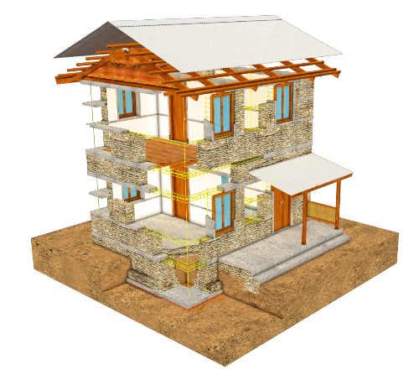
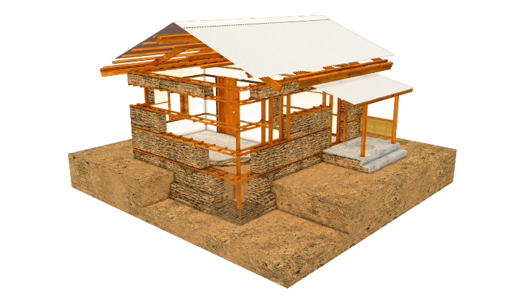
Inspection guidelines
Third Inspection
Third Inspection
Second Inspection
Second Inspection
First Inspection
First Inspection
One storey Masonry building
Two storey Masonry building
Notes:
Slide detail and description:
Inspection steps:
To provide the housing reconstruction grant and to ensure the earthquake resistant elements in newly constructed buildings, the inspection of the building has to be done in number of steps.
For the one and two storey building, the first inspection is carried out after the completion of plinth band and third after the completion of building.
Whereas the second inspection carried out after the completion of roof band for one storey and after completion of floor band for two storey.

Slide 35
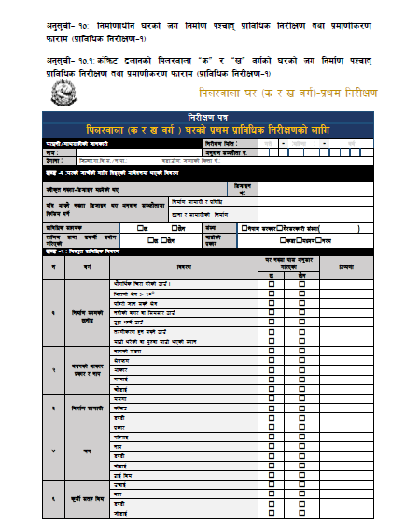
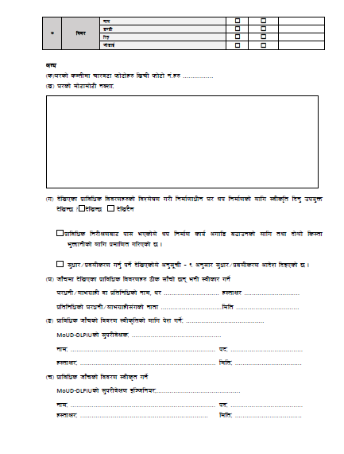
Inspection Forms
Notes:
Slide detail and description:
Sample form of the inspection.

Slide 36
Inspection Forms
u_ ;'wf/kl5 3/sf] df]6fdf]6L gSzfM
g]kfn ;/sf/
;+3Lo dfldnf tyf :yfgLo ljsf; dGqfno
========= uf=lj=;=÷g=kf=sf] sfof{no
;'wf/sf] nflu hfgsf/L÷lgb]{zg lbg] kmf/fd
;'wf/÷k|anLs/0f cfb]z tyf lg/LIf0f kmf/fd
æcfjf; k'glg{df0f sfo{qmd cGtu{t aGg] 3/x?sf] lgdf{0f lg/LIf0f sfo{ljlwÆ cg'?k ldlt ======================== ut], ================================ sf] lgdf{0ffwLg ejgsf] la:t[t lg/LIf0f kZrft\ lghsf] lgdf{0ffwLg ejg n] □8L=kL=;L= ÷□=====================tNNff ÷□5fgf tx ;Ddsf] Go"gtd cfjZostf k"/f gu/]sf] kfOPsf] x'gfn] of] ;'wf/sf] nflu of] lgb]{zgul/Psf] 5 .
-3_ b]lvPsf k|fljlws ljj/0fx?sf] ljZn]if0f u/L lgdf{0ffwLg 3/ yk lgdf{0fsf] nflu :jLsl[t lbg' pko'Qm b]lvG5 <b]lvG5 b]lvb}g
k|fljlws lg/LIf0faf6 kf; ePsf]n] yk lgdf{0f sfo{ cufl8 a9fpgsf] nflu tyf □ bf]>f]÷□t]>f]] ls:tf e"QmfgLsf] nflu k|dfl0ft u/LPsf] 5 .
;'wf/÷k|jnLs/0f ug'{ kg]{ b]lvPsf]n] cg';"rL – ^ cg';f/ k'gM;'wf/÷k|anLs/0f cfb]z lbOPsf] 5 .
-ª_ hfFrdf b]lvPsf k|ljlws ljj/0fx? 7Ls ;fFrf] 5g\ egL :jLsf/ ug]{
3/wgL÷nfeu|fxL jf k|ltlglwsf] gfd, y/ ==================x:tfIf/======================
k|ltlglwsf] 3/wgL÷nfeu|fxL;+usf] gftf =====================ldlt ======================
-r_ k|fljlws hfFrsf] ljj/0f :jLs[ltsf] nflu k]z ug]{M ==============================
MoUD-DLPIUsf] ;'k/Lj]IfsM ======================================
gfdM ========================================================kbM ======================================
x:tfIf/M ===================================================ldltM ===================================
-5_k|fljlws hfFrsf] ljj/0f :jLs[t ug]{
MoUD-DLPIU sf] ;'k/Lj]If0f Ol~hlgo/M============================================
gfdM =========================================================kbM ======================================
x:tfIf/M ====================================================ldltM ===================================
nfeu|fxL 3/wgL sf] gfd==============================
;Demf}tf qm= ; ============================================
gful/stf k|df0fkq gDa/===========================================
s_ 3/sf] hf“rsf] nflu lbOPsf] cfj]bgdf ePsf] ljj/0f
:jLs[t gSzf–l8hfOg dWo]sf] eP l8hfOg g+=M =======================================
cGo cfˆg} gSzf l8hfOgsf] xsdf
uf/f]÷lkn/sf] lsl;d g+=M =========================================================
tnf÷5fgfsf] lsl;d g+=M =========================================================
cGoM ====================================================================================
v_ ;'wf/ jf k|jnLs/0fsf] k|fljlws ljj/0f
k|fljlws lg/LIf0fkl5 ;'wf/ jf k|jnLs/0fsf] nflu lbOPsf] lgb]{zg | ;'wf/kl5sf] cj:yf
Notes:
Slide detail and description:
Sample form of the correction order and re inspection.

Slide 37
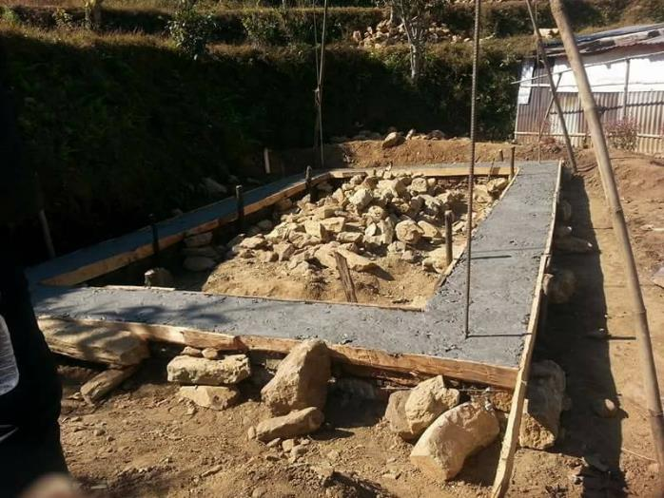
Non-compliant Issues
Notes:
Slide detail and description:
Non compliant issues:
Span of wall is more than 4.5m

Slide 38
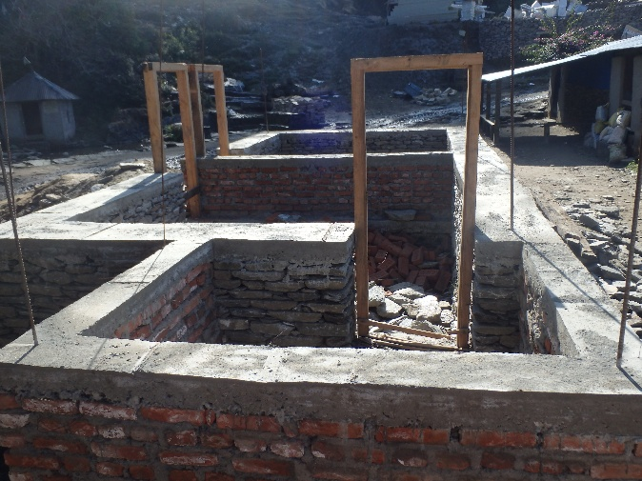
Non-compliant Issues
Notes:
Slide detail and description:
Non compliant issues:
T- shape

Slide 39
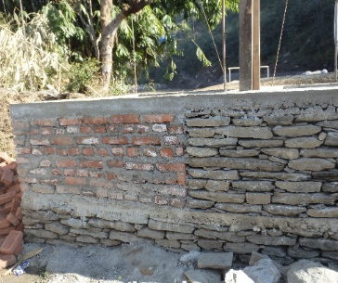
Non-compliant Issues
Notes:
Slide detail and description:
Non compliant issues:
Mix use of Building materials

Slide 40
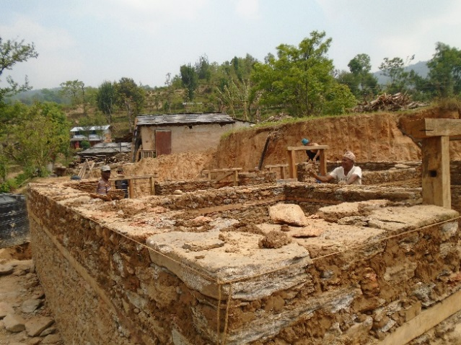
Non-compliant Issues
Absence of Vertical member
Notes:
Slide detail and description:
Non compliant issues:
Absence of vertical member

Slide 41
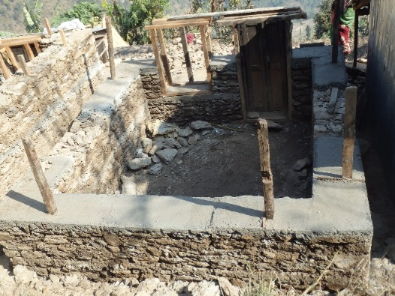
Non-compliant Issues
Notes:
Slide detail and description:
Non compliant issues:
Location of vertical band: Vertical member provided at different locations

Slide 42
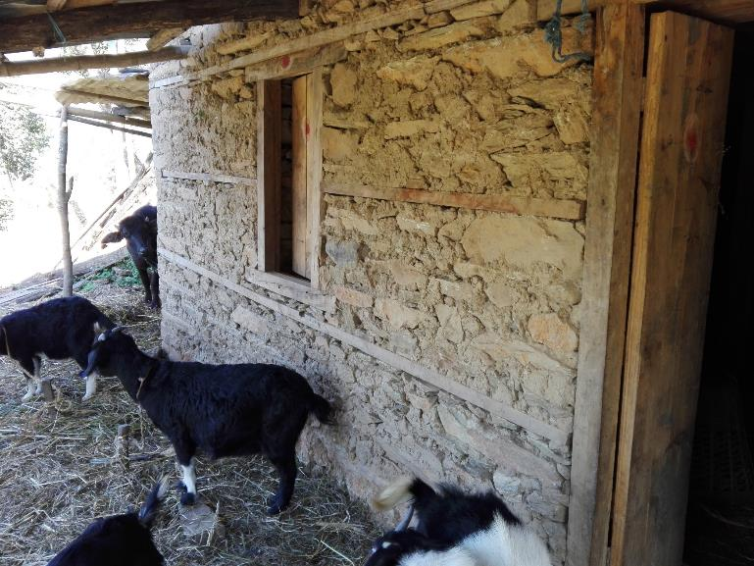
Non-compliant Issues
Notes:
Slide detail and description:
Non compliant issues:
Non-Compliant: Sill band is not below the opening/ No plinth Band

Slide 43
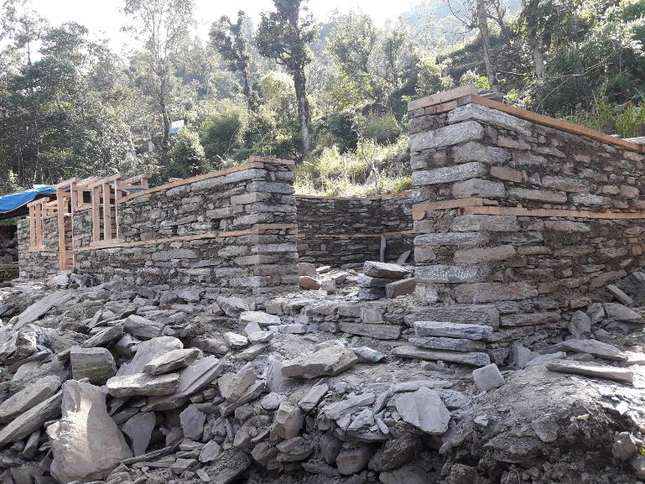
Non-compliant Issues
Notes:
Slide detail and description:
Non compliant issues:
No Plinth band
Height of Lintel band(Door and window level)
Vertical Reinforcement
Position of Opening??

Slide 44
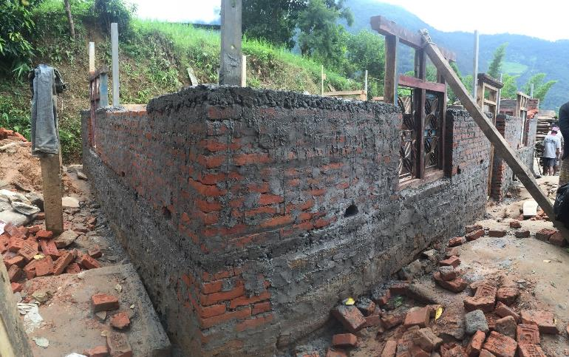
Non-compliant Issues
Notes:
Slide detail and description:
Compliant?? Brick work and Band is ok but
Check the Vertical Reinforcement material. Is it according to the specification on Minimum requirement?
Check also the level of door and window.
Also, it we put vertical reinforcement at corner or at connection of walls, the thickness of wall should be more than 230 mm (9 inch). Copla should be there.
So it cannot be compliant.

Slide 45
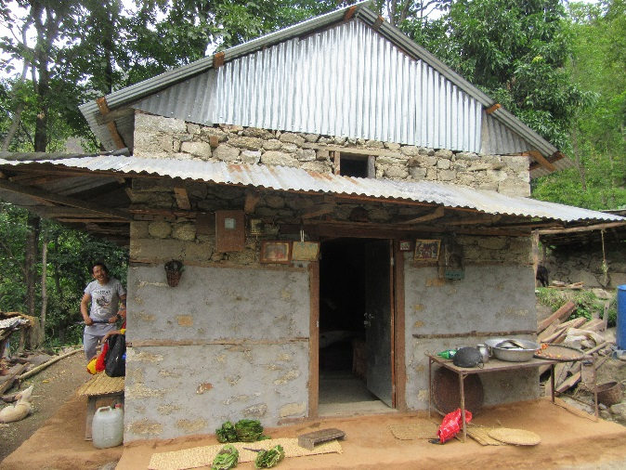
Non-compliant Issues
Notes:
Slide detail and description:
Non compliant issues:
One storey and attic constructed by stone masonry in mud mortar.

Slide 46
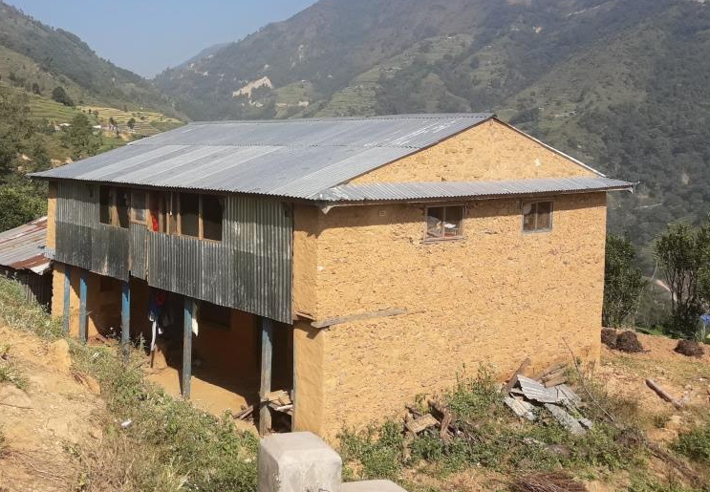
Non-compliant Issues
Notes:
Non compliant issues:
Number of storey.
Absence of band
Construction of load bearing wall in verandah

Slide 47
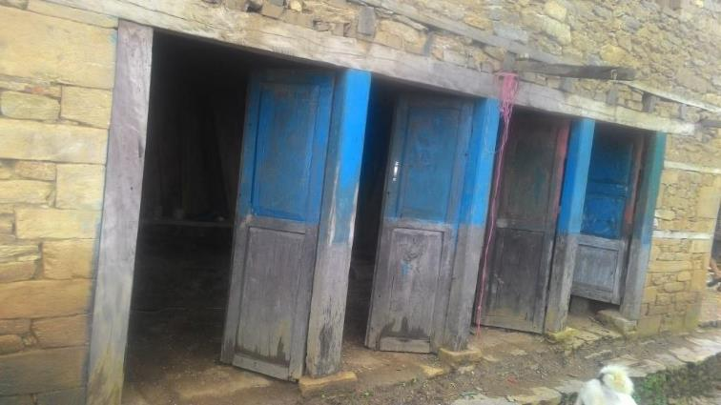
Non-compliant Issues
Notes:
Slide detail and description:
Non compliant issues:
Large openings

Slide 48
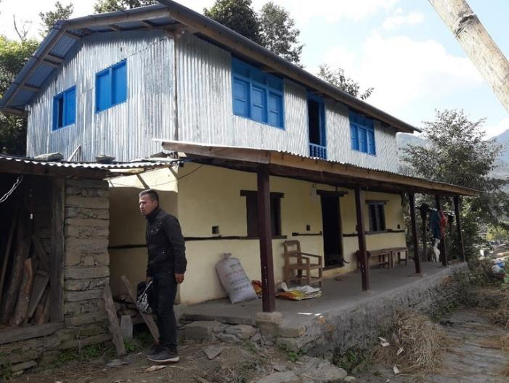
Non-compliant Issues
Notes:
Slide detail and description:
Non compliant issues:
Hybrid structure

Slide 49
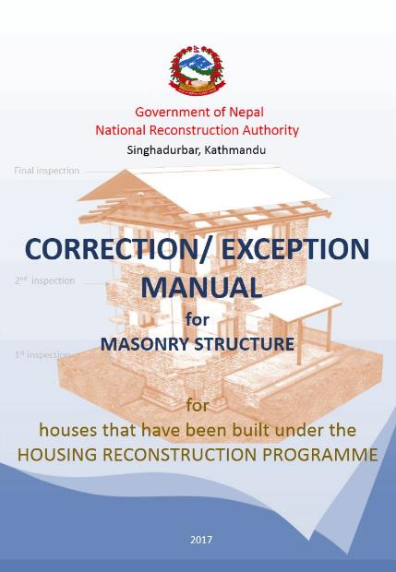
BACKGROUND
May, 2017
Correction / Exception Manual
Many houses have been found during inspection to be non-compliant with MRs.
In order to bring these houses to compliance, corrective measures are required.
Notes:
Slide description:
Many houses have been found during inspection to be non-compliant with MRs.
Some houses were found to be structurally safe but the detail were not covered by MRs.
In order to make these houses compliance, corrective measures are required.

Slide 50
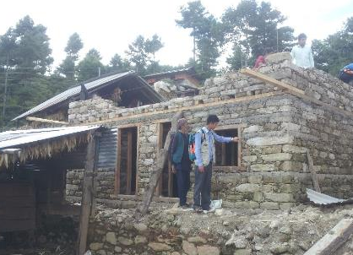
BACKGROUND
This manual has been developed to support engineers responsible for the compliance inspection process.
The engineers will use this manual to provide advice and guidance to households for the implementation of required corrective measures.
Home owners will need to complete these corrective measures in order to be eligible to receive the subsequent tranches of the housing reconstruction grant.
Notes:
Slide description:
This manual has been developed to support engineers responsible for the compliance inspection process.
The engineers will use this manual to provide advice and guidance to households for the implementation of required corrective measures.
Home owners will need to complete these corrective measures in order to be eligible to receive the subsequent tranches of the housing reconstruction grant.

Slide 51

Correction/ Exception Manual
OBJECTIVES
To introduce the exceptional cases, other than mentioned in MRs.
To provide correction measures along with their step by step procedures.
To support households to overcome non-compliance issues and secure approval to receive tranches.
To support engineers working for housing reconstruction programe.
Notes:
Slide detail and description:
Correctional manuals are prepared for supporting those houses which are non compliant to the minimum requirements.

Slide 52
Correction/ Exception Manual
SCOPE
Applicability
This manual is applicable within certain limitations as guided by NBC 202 and NBC 203, which are based on NBC 105 seismic design code.
Limitations
This corrections / exceptions manual covers only load bearing masonry buildings under the GoN housing reconstruction programme. The corrective measures are only for buildings that are newly constructed, or under construction.
Notes:
Slide detail and description:
Correctional manuals are prepared for supporting those houses which are non compliant to the minimum requirements.
*Participants read Scope in P2, Applicability and limitations.
Applicability:
Correction and exception Manual has been drafted to support the non compliant issues to the building which was constructed under housing reconstruction.
The measures that has been provided is based on NBC 105, seismic design code and ensure the structural safety.
These measures are applicable only for masonry residential buildings.
The corrective and exceptional measures that has been introduced in this manual comes after the several vigorous discussion with the technical expert team.
All the measures are ready to use design which was evolved after structural analysis.
Some measures mentioned in this manual are difficult to carry out in the field due to lack of proper skill and inappropriate workmanship hence, some corrective measures introduced in this manual are made only for advisory provision. eg Jacketing.
Slide detail and description:
This corrections/ exception manual covers only load bearing masonry building under GON housing reconstruction programme.
The corrective measures are only for building that are newly constructed or under construction.
Relevant for residential buildings and fall under category ‘C’ and ‘D’.
For the buildings which falls under the category ‘A’ and ‘B’, individual structural analysis is required.

Slide 53
Correction/ Exception Manual
CONTENTS
PART-A: Exception / Correction
PART-B: Mitigation Measures
ANNEX
Notes:
Slide detail and description:
Contents are three sessions. Part-A: Exception and Correction, Part-B: Mitigation Measures and ANNEX.
Part-A: Exception and Correction is following items of minimum requirements.
Part-B: : Mitigation Measures is detail of correction measures, and step by step construction procedure.
And ANNEX is samples of correction measures.

Slide 54
Correction/ Exception Manual
[EXCEPTION]
Exception is the cases of the buildings that do not comply with MRs but are structurally safe as per NBC 105 including the cases mentioned in NBC.
The exceptional cases were drafted by the NRA technical standardization committee on the basis of seismic requirements following NBC 105.
Hence, when all required exception measures have been completed the building can be approved for the subsequent tranche of the housing reconstruction grant.
Notes:
*Participants read definition of exception in P1.
Slide detail and description:
Exception is the cases of the buildings that do not comply with MRs but are structurally safe as per NBC 105 including the cases mentioned in NBC.
The exceptional cases were drafted by the NRA technical standardization committee on the basis of seismic requirements following NBC 105.
Hence, when all required exception measures have been completed the building can be approved for the subsequent tranche of the housing reconstruction grant.

Slide 55
Correction/ Exception Manual
[CORRECTION]
Correction is the corrective measures required to make newly constructed or under construction buildings compliant with the seismic resistance standard as per NBC 105.
The appropriate corrective measures can be carried out on any individual building which is missing earthquake resistant elements as per MRs and at any stage of construction. These measures were drafted by the NRA technical standardization committee on the basis of seismic requirements following NBC 105.
Hence, when all required corrective measures have been completed the building can be approved for the subsequent tranche of the housing reconstruction grant.
Notes:
*Participants read definition of correction in P1.
Slide detail and description:
Correction:
Corrective measured are introduced to make the non compliant cases into compliant along with satisfying the seismic code 105.
Its main objective is to guide the engineers who are involved in reconstruction process and help them to fill up the correction order form.
Depending upon the non compliant cases the engineers can give the correction orders with reference to this correction manual.
The building can be considered as eligible for subsidy if all the corrective measures ordered by the engineers are carried out.
The correction mentioned in this manuals are ready to use design and can be carried out at any phase of under constructed building.

Slide 56
Correction/ Exception Manual
Minimum Requirements
Exception
Problem
Solution
Common Defects
Correction
Notes:
Slide detail and description:
Part-A of manual consists of Exception and Correction
This consists of
Minimum Requirements
Problem
Common Defects
Exception
Solution
Correction

Slide 57




Correction/ Exception Manual
Problem
Problem:
Absence of vertical reinforcement
Correction
Provide vertical reinforcement
Provide bandage
Notes:
Slide detail and description:
Examples 1:
If the vertical reinforcement in the building are missing then the addition of vertical reinforcement either from outside or inside of the buildings can be adopted.
Depending upon the availability of the materials alternative materials of reinforcement can be introduced such as pp band or GI wire mesh.
The detail description of the design and construction procedure is provided in the next part i.e. Part B (Mitigation measures) of the correction manual.

Slide 58








Correction/ Exception Manual
Adding Wooden element
Non complaint
Adding RC Roof Band
Correction
Adding gabion wire mesh
Compliant
Number of Storey
Notes:
Slide detail and description:
Example 2:
According to the minimum requirement the allowable number of storey for mud masonry building with wooden band is limited to one storey whereas in real scenario people wants to construct an additional attic.
These sort of non complaint issues can be corrected by providing RC roof band instead of wooden roof band.
Alternatively, gabion wire mesh can be provided from lintel to roof level in both side of wall.
The wall above the lintel band can be strengthen by providing vertical wooden member at the suggested interval in both direction of the wall. The two wooden member shall be connected with the connector such as gabion wire.
Depending upon the availability of the materials the suitable corrective measures can be adopted.

Slide 59


Correction/ Exception Manual
Problem
Problem:
Mix use of materials
Correction
Mix use of stone and brick in the wall along the same direction.
Provide jacketing
Limitation: The masonry should have all the earthquake resistant features.
Notes:
Slide detail and description:
Example 3:
Mix used of the two materials can be found same building and along the same direction of the wall. Due to the improper connection between these two materials, the building is vulnerable to earthquake. Hence as an corrective measures Jacketing has been introduced with some limitations.
The building shall have all the earthquake resistant elements to use jacketing as corrective measures.

Slide 60

Correction/ Exception Manual
Exception:
Cases of the buildings that do not comply with MRs but are structurally safe as per NBC 105 including the cases mentioned in NBC.
MINIMUM REQUIREMENT:
Place vertical member at all corners, junctions of walls and adjacent to all doors and windows. Steel or timber can be used as vertical member.
EXCEPTION:
If the openings are provisioned with wooden double framed box and properly connected to horizontal bands then vertical members around the openings as well as can be ignored.
Wooden double framed box
Notes:
Slide detail and description:
Exceptions:
Exceptional cases are those cases which satisfy the seismic design code 105 but are not mentioned in minimum requirements.
If the building falls under the exceptional cases it can be consider as eligible for receiving the subsidy and are considered as compliant buildings.

Slide 61
Correction/ Exception Manual
Minimum Requirements: Foundation
Sub-Category |  | Description
 |  | Type of soil | One storey | Two storey
Depth of foundation below GL | SMM | All | > 750mm | -
 | BMM | All | > 750mm | -
 | SMC | All | > 800mm | > 900mm
 | BMC | All | > 800mm | > 900mm
Base width | SMM | Soft soil | > 800mm | -
 |  | Medium soil | > 750mm
 |  | Hard soil | > 750mm
 | BMM | Soft soil | > 750mm | -
 |  | Medium soil | > 650mm
 |  | Hard soil | > 550mm
 | SMC | Soft soil | > 800mm | Not recommended
 |  | Medium soil | > 600mm | > 800mm
 |  | Hard soil | > 600mm | > 600mm
 | BMC | Soft soil | > 650mm | > 900mm
 |  | Medium soil | > 550mm | > 650mm
 |  | Hard soil | > 550mm | > 550mm
Exception
E1. Foundations size can be variable for hard rock bed.
Here, proper levelling of foundation is required with proper anchorage of vertical element to the rock.
Notes:
Slide detail and description:
Exception:
Example 1:
The size of the foundation is governed by the type of masonry, number of storey and the typology of the soil.
The minimum requirement set the limitation for the size of the foundation.
Most of the hilly areas consist of rock bed where it is impossible to go upto the designated depth guided by minimum requirement. Hence, as an exception the depth of the foundation can be variable.
But the bottom level of the foundation must have proper level and the vertical reinforcement shall be properly anchored to the rock.

Slide 62
Correction/ Exception Manual
Minimum Requirements: Doors/Windows
Category | Sub-category |  | Description
Doors / windows. | General |  | Keep lintel level same for all doors and windows. Openings are to be located away from inside corners by a clear distance equal to at least 1/4 of the height of the opening, but not less than 600 mm.
 | Total length | SMM/BMM | The total length of openings in a wall is not to exceed 30 % of the length of the wall between consecutive cross-walls in single-storey construction.
 |  | SMC/BMC | The total length of openings in a wall is not to exceed 50 % of the length of the wall between consecutive cross-walls in single-storey construction, 42 % in two-storey construction.
 | Distance |  | The horizontal distance between two openings is to be not less than one half of the height of the shorter opening, but not less than 600 mm.
Notes:
Slide detail and description:
Minimum requirement for doors and windows.

Slide 63


Correction/ Exception Manual
Exception
< 2 t
Dalan
If wooden double framed door and window with appropriate connection with horizontal band are provided, position and size of openings can be variable.
wooden double framed window
Notes:
Slide detail and description:
Exception
Example 2:
The main aim of providing the vertical band is to create the box effect around the opening so that there is less chance of crack along those openings.
Since the double frame windows/Doors also helps in creating the box effect the vertical band can be ignored. Similarly, these frame shall be properly connected with the horizontal band.

Slide 64


Correction/ Exception Manual
Mitigation measures:
The Mitigation Measures consists of step by step procedure for implementing the correction.
Depending upon the availability of materials and workmanship suitable Mitigation Measures can be adopted.
Notes:
Slide detail and description:
Mitigation measures :
It consist of step by step construction procedure of correcting the individual missing items of earthquake resistant elements.
All the design mentioned in this section are ready to use design.
The detail description of the work need to be carried out to implement the corrective measures has been described along with the construction images.
Depending upon the non-compliant cases, site condition, workmanship and availability of the materials suitable mitigation measures can be adopted.
Example:
Addition of RC Horizontal band:
Description of work:
Surface preparation
Placing of reinforcement
Make holes for anchorage
- For through GI bar
- For anchorage bar
Anchor reinforcing bar mesh
Application of Micro concrete.
Curing of concrete

Slide 65



Correction/ Exception Manual
Mitigation measures:
Addition of bandages on outer faces of wall when plinth/ sill/ lintel/ roof bands are missing
2-10mm Φ bars
4.75mm Φ stirrups @150 mm c/c
50 mm
M15 Concrete
( 1 part cement
2 part sand
4 part 10mm down aggregate)
25 mm
2-10mm Φ bars
Notes:
Slide detail and description:
Mitigation measures:
The detail specification of the materials has also been described in the mitigation measures.

Slide 66







Correction/ Exception Manual
Construction Procedure:
1
2
3
Surface Preparation
Placing of reinforcement
Making holes for anchorage
4
5
6
Anchor reinforcing bar mesh
Application of micro concrete
Curing
Remove stone from one side of wall
Notes:
Slide detail and description:
The illustrative construction procedure is also provided in the mitigation measures.
It will provide the vision of the construction steps to all the technical and non technical people.

Slide 67


Correction/ Exception Manual
ANNEX I
Consist of six corrective measures using different construction materials.
Corrective measures can be adopted according to the locally available materials.
Roof band
Applicability:
Lintel band
Connector
When all the earthquake resistant elements are missing in the building
Stitch band
Vertical post
Sill band
Cover Plinth band with stabilized mud mortar
Notes:
Slide detail and description:
In order to address the building that doesn’t comply with any of the earthquake resistant features, the corrective measures are provided in the separate section of the Manual i.e. Annex-I
It consist of providing the earthquake resistant element externally
The detail specification of the different materials used for as eq resistant element is provided.
Depending upon the availability of the materials and the workmanship suitable corrective measures can be adopted.
After adopting all the mentioned corrective measures the building can be approved for the subsequent tranche of the housing reconstruction grant.

Slide 68


Correction/ Exception Manual
ANNEX II
Applicability:
Hybrid structures
Notes:
Slide detail and description:
Till date the detail requirement for the hybrid structure has not been drafted but according to the real scenario of construction many buildings has been constructed with load bearing masonry at the ground floor and light weight structure in the first floor.
So to address these issues the connection details of these light weight materials has been mentioned in this section i.e. Annex II

Slide 69
UPDATED INSPECTION FORM ON THE BASIS OF CORRECTION AND EXCEPTION MANUAL

Slide 74
Thank You!!!

