Slide 1




Responsive and Adoptive Shelter for Earthquake Affected Communities – RASEAC e'sDk lkl8t ;d'bfosf] nflu pTt/bfoL tyf cg's'n cfjf; sfo{qmd Working VDCs- Yarsa & Ramche
Supporting Organizations
Disaster Emergency Committee
Islamic Relief Worldwide
The Lutheran World Federation Nepal
Implementing Organization
BATAS Foundation

Slide 2
Program Activities:
WASH/DRR
Livelihood
Shelter

Slide 3
Program Activities
3. Shelter
Training to Masons on Earthquake Resilient House Construction (2 events; 60 Beneficiaries; Ramche & Yarsa)- Completed
Training on ICS for Smoke Free Houses (1 event; 40 Beneficiaries- Ramche) Completed
Community Orientation and Awareness- On Progress

Slide 4
Shelter…………….. Contd.
Support for Construction of Earthquake
Resilient Permanent Houses (Target 151 HHs)
Awareness Raising to community
Support to construct in any design of Buildings approved by DUDBC/GOs.)
Technical & quality Construction Material support (equivalent to government support fund + Transportation)
Tri-Parties Agreement for 151 Permanent Shelters Construction- Completed

Slide 5
Shelter…………….. Contd.
Construction activities started in 139 HHs
Site Clearance: 18
E/W Excavation: 6
Vertical Rod Erection: 6
DPC Completed: 20
Sill Band Completed: 21
Stitch Band Completed: 16
Lintel Completed: 52
Toilet under construction: 20 HHs

Slide 6
Documentation
Tri-Parties (Beneficiary, LWF Nepal &
BATAS Foundation) Agreement.
Beneficiary Card (Yellow Card) includes Beneficiary details & materials received by communities from Project Support.
Monitoring Template for House & Toilet Construction- Stepwise Verification from BATAS Foundation Technical Team/ Cross-check/verification by LWF PM/Technical Team
Daily Progress report/Measurement Book- BATAS Technical Official

Slide 7
Documentation……………. Contd.
Daily Attendance Card for Labor involved
in Shelter Construction
Material Quality Report- MQR- Prepared by Technical Team after material inspection.
Goods Receiving Note- GRN: According to MQR.
Stock Book Entry- Daily Updated
Stock Release/Chalan

Slide 8
Materials Support/Supply
Bricks
Sand
Aggregate
Reinforcement Bar
Cement
Truss
CGI Sheet & Plain Sheet
Shovel, Axe Peak, Layout Thread, Measuring Tape, Tagari, etc.
Toilet Construction materials- equivalent to 10,000
And other Masonry equipments

Slide 9
Shelter Construction Support Modality
Agreement: any DUDBC/GOs approved Models
Clusters identification: 4 major working clusters identified.
Working Committee: 1 (or more) formed in each Cluster.
Material delivery: upto beneficiaries nearest road access
Technical Support: Minimum one BATAS Technical official in each cluster at every crucial stage of shelter construction- facilitated by one SM.

Slide 10
Shelter Construction Support Modality…………………contd.
Skilled Mason: minimum 2 Trained/skilled mason present in each HHs during shelter construction
Earthquake Resilient Verification: Stage-wise verification of Shelter Construction (Foundation, Plinth Band, Sill Band, Stitching Band, Lintel Band, etc.) by TO
Field Level Monitoring: frequently by BATAS FC and LWF PM/Engineer- jointly/individually.
Joint/official monitoring from district/center.
Provision of Complain Box at Office premises.

Slide 11
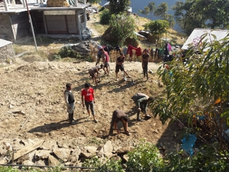
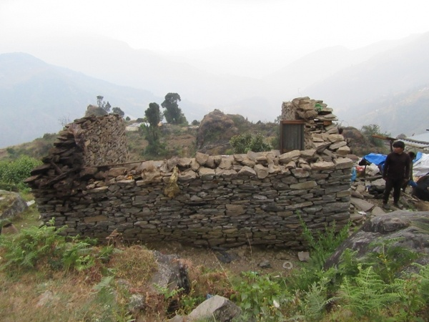
Community participation in site clearance
During Site Clearance (Dismantling existing Old House)

Slide 12
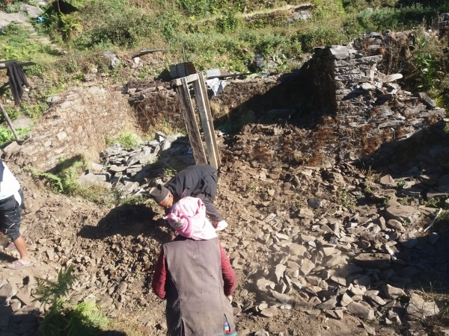
70 Years old Couples actively involved in site clearance (Earthquake damaged building)

Slide 13
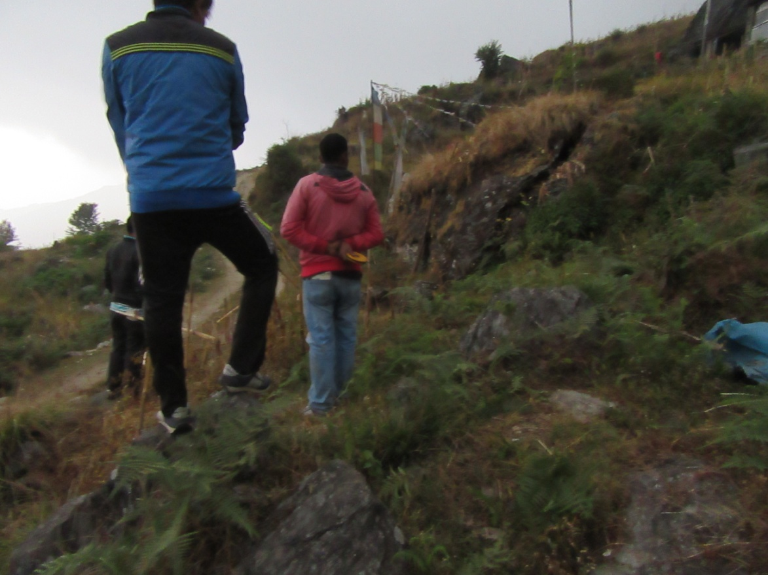
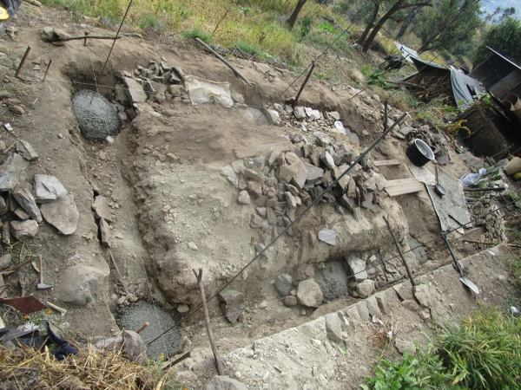
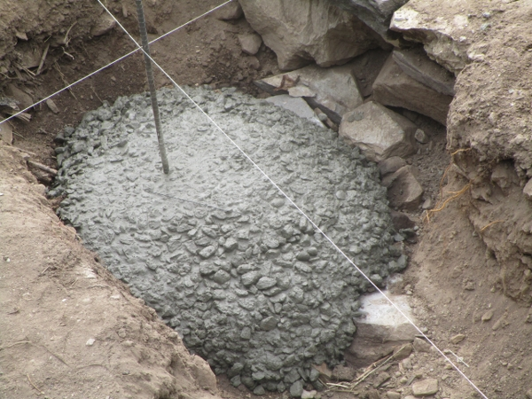
Vertical Rod Erection in Foundation

Slide 14
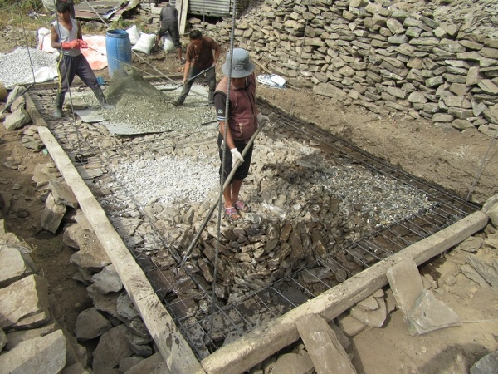
Bar Bending Work at Plinth Level

Slide 15
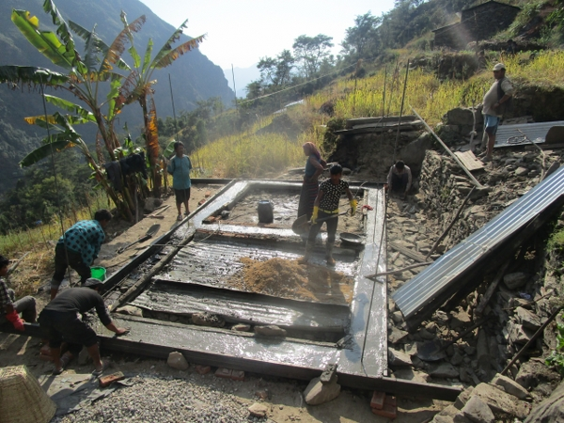
Casting of Plinth Band (DPC)

Slide 16
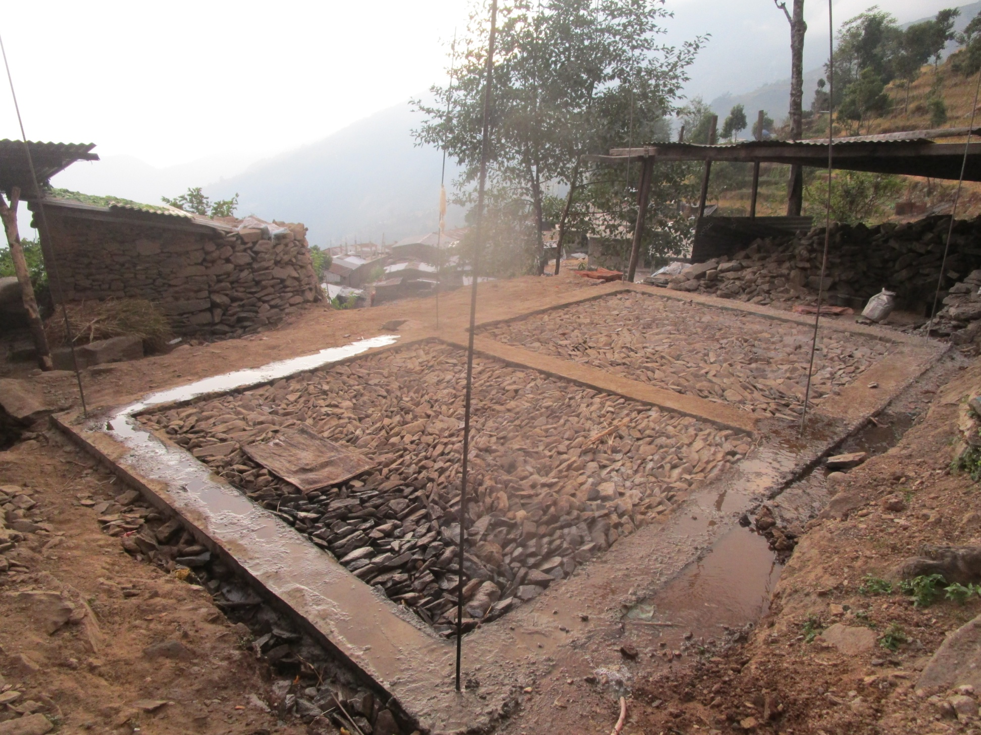
Compacting & Stone Soling in Floor

Slide 17
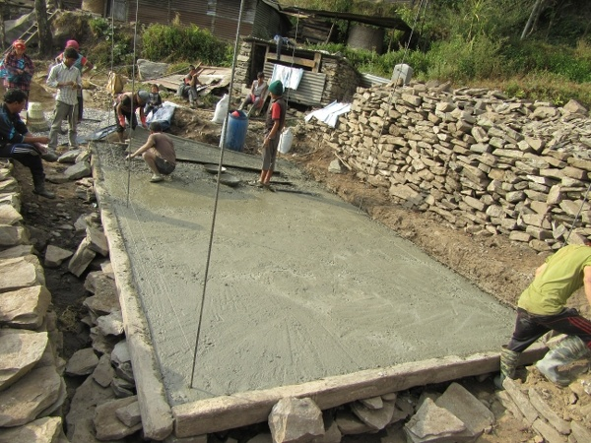
Plain Cement Concrete Work at Floor Level

Slide 18
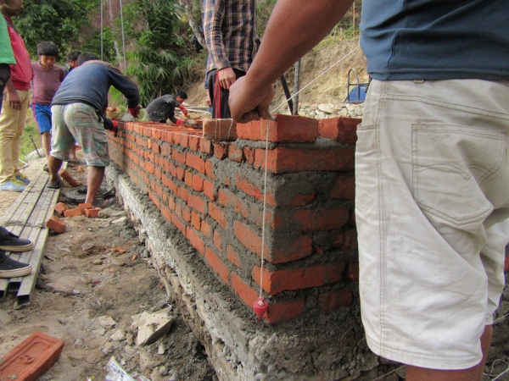
Skilled Mason Ensuring Constructed Wall by Plumbob

Slide 19
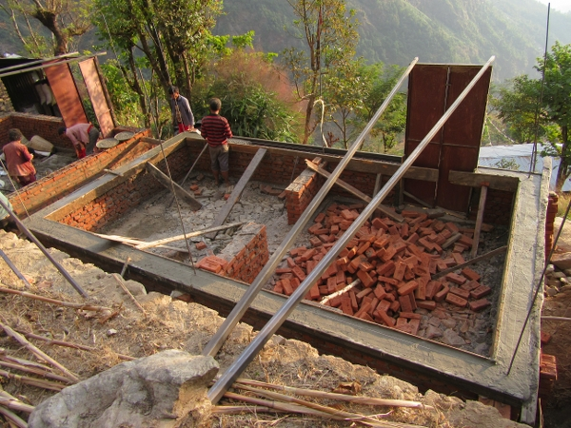
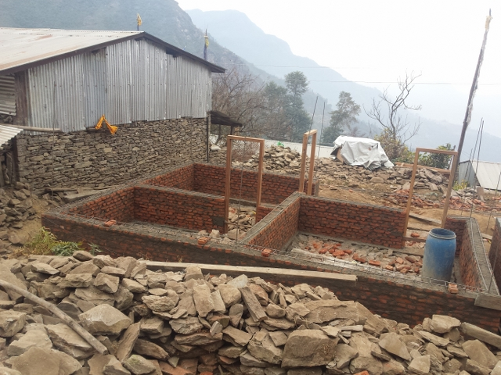
_{Sill Band}

Slide 20
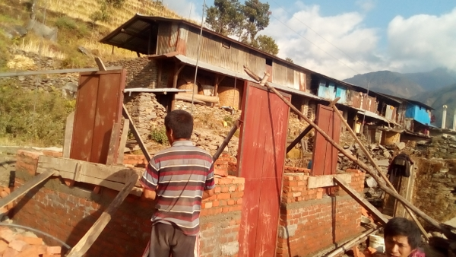
Laying of Window

Slide 21
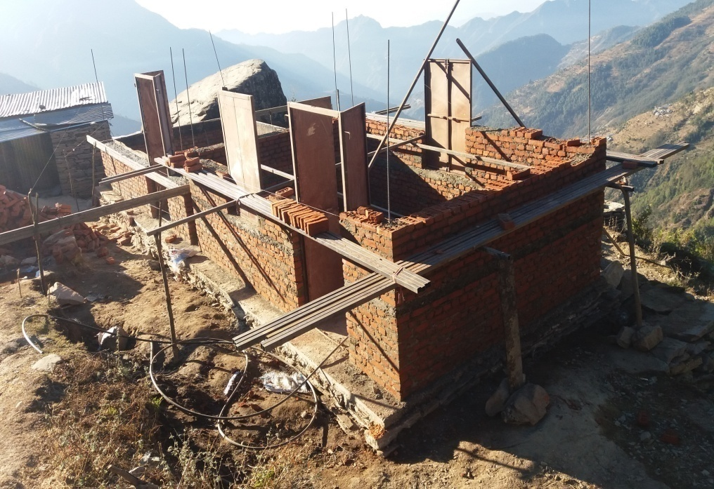
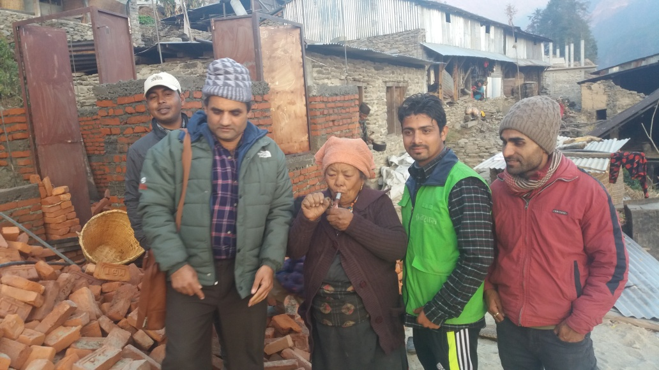
The House Reached At Stitch Band Stage
At Stitch Band Stage Monitored By NRA Chief of Rasuwa District

Slide 22
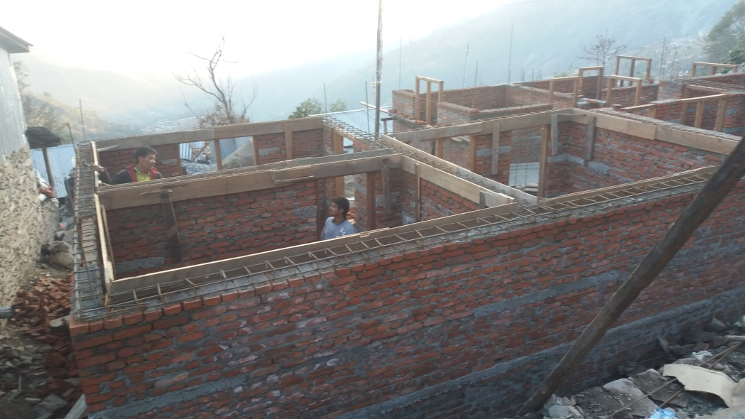
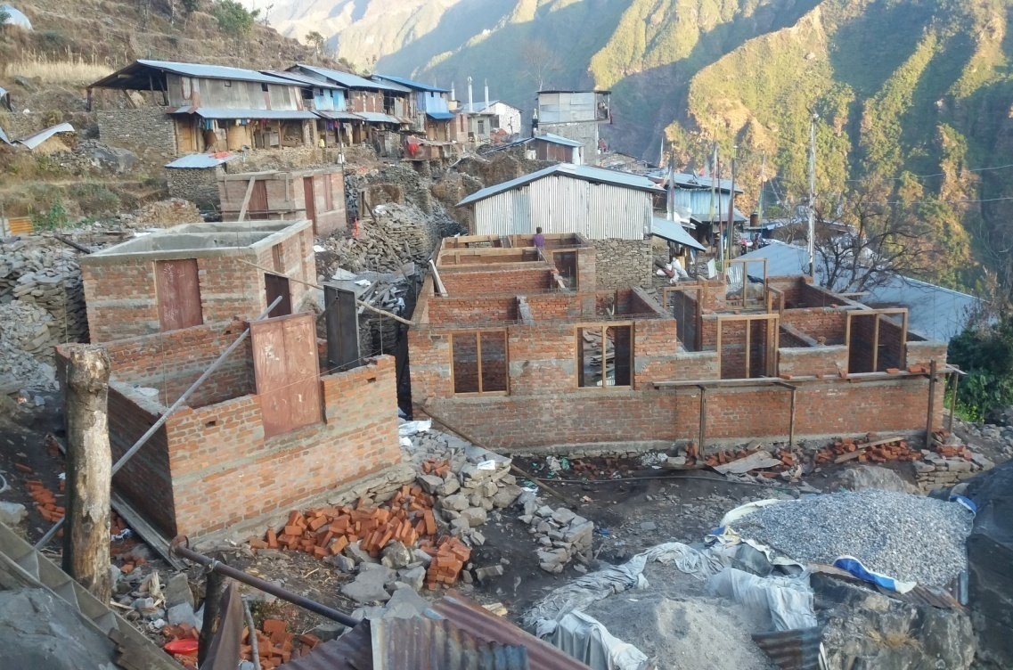
Formwork For lintel Band
Formwork And shuttering Work for lintel Band

Slide 23
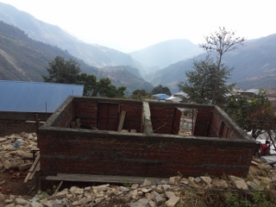
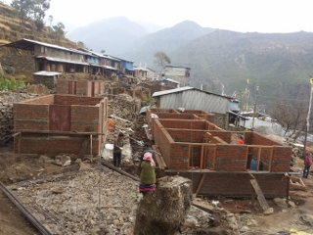
Houses ready for Roofing

Slide 24
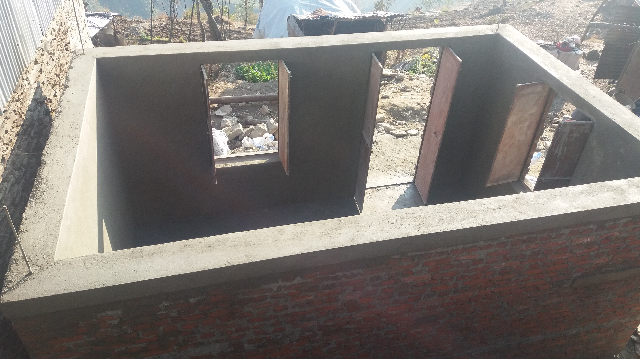
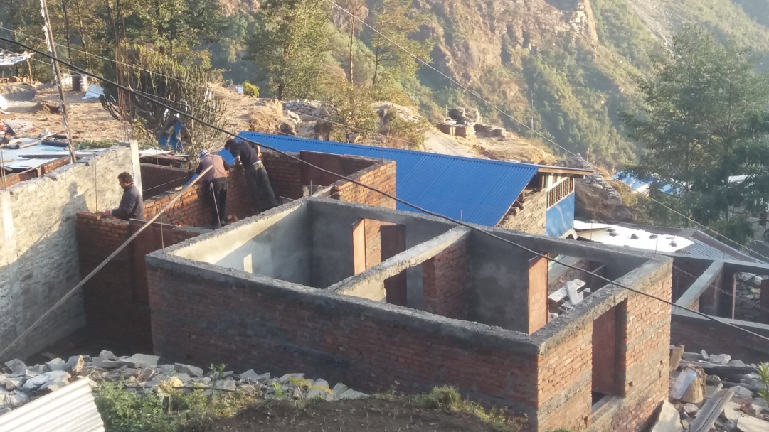
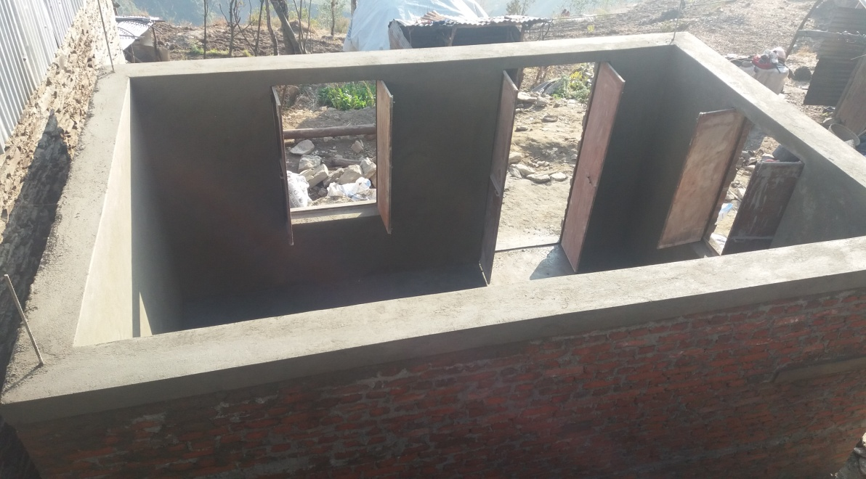
Ready For Roofing After paster
Houses With internal Plaster Competed

Slide 25
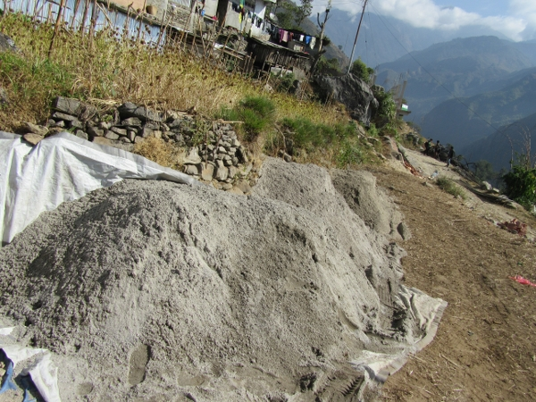
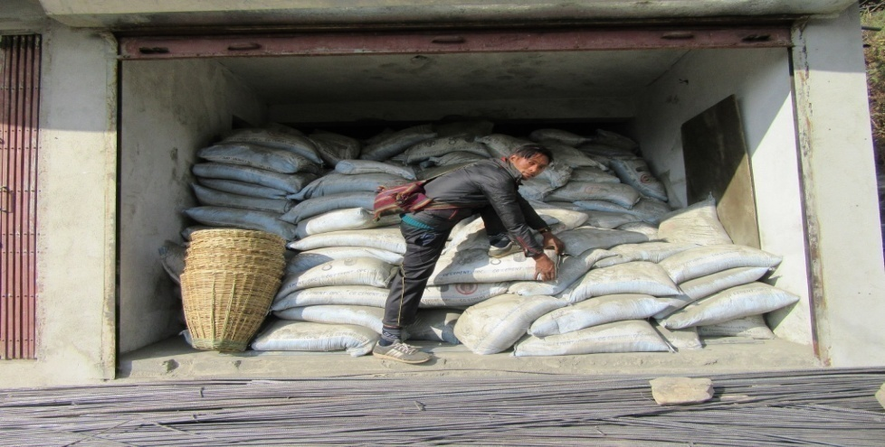
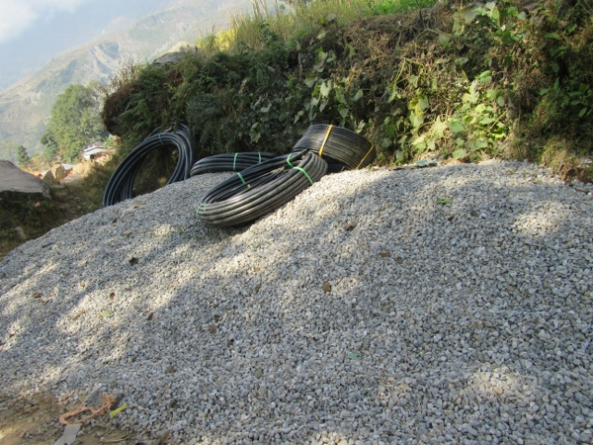
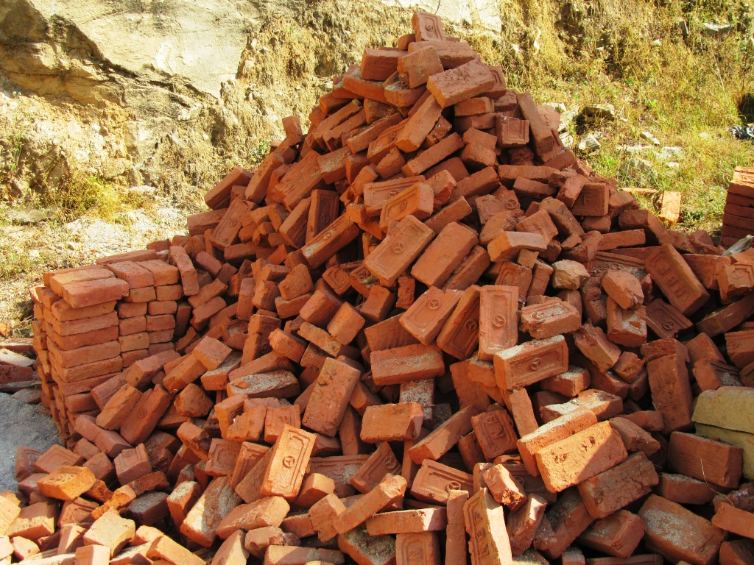
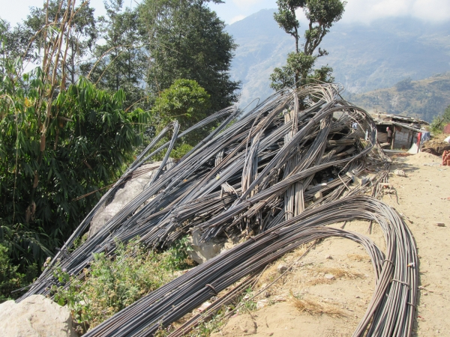
Construction Materials

Slide 26
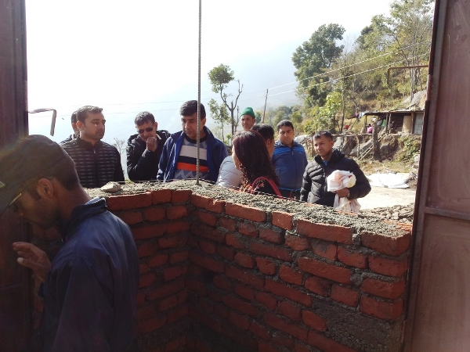
Joint monitoring visit from Government Stakeholders (CDO, LDO, DSP, Program Officer, Monitoring Officer, VDC Secreteriat, etc.)

Slide 27
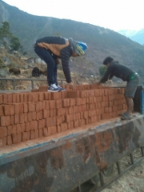
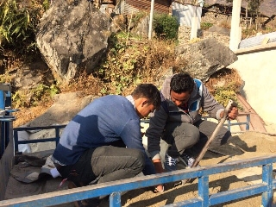
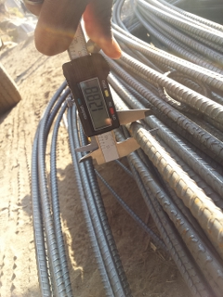
Inspection of construction material quality and quantity by BATAS Foundation Technical Officials

Slide 28
Shelter…………….. Contd.
Challenges :
Access of Road (Earthen, Heavy Boulders throughout alignment)
Geology and Topography of Land (Difficulty on site clearance & Earthwork excavation)
Scarcity of Skilled/Unskilled Labor

Slide 29
Thanks

