Slide 1



dof{lbt / cfTdlge{/ hLjg

Slide 2

hf]lvdo'Qm j:tL :yfgfGt/0f tyf k'g:yf{kgfsf] nflu ;xsfo{

Slide 3
sfo{qmdsf] gfd M lbuf] ;dfwfg -Durable Soluation_ ;xof]u M g]kfnl:yt a]nfotL ;xof]u lgof]u -DFID_
;xsfo{ M /fli6«o k'glg{df{0f k|flws/0f
sfof{Gjog M lkk'n Og lg8 -PIN_ / ;fd'bflos cfTdlge{/ ;]jf s]Gb| -CSRC_ kl/of]hgfsf] cjlw M dfr{, @)!* b]lv km]a|'j/L, @)@) ;Dd
sfo{If]q M /;'jfnufot e"sDk k|efljt #! lhNnf
p2]Zo M e"sDkaf6 k|efljt ePsf hf]vLdo'Qm If]qsf 3/w'/L / ;'s'daf;L kl/jf/nfO{ :j]lR5s k'gjf{;sf] nflu cfjZos ;xof]u / ;xhLs/0f ug{] .

Slide 4

ef}ule{s cWoogsf] cfwf/df juL{s/0f
CAT-1 yk s]xL ug{' gkg{], ;f]xL :yfgdf k'glg{df{0f ug{ ;lsg] If]q
CAT-2 ;+/If0f tyf cfjZos ;'wf/ u/L k'glg{df{0f ug{ ;lsg] If]q
CAT-3 ;f]xL If]qdf a:tL ljsf; ug{ g;lsg], :yfgfGt/0f ug{'kg{] If]q

Slide 5
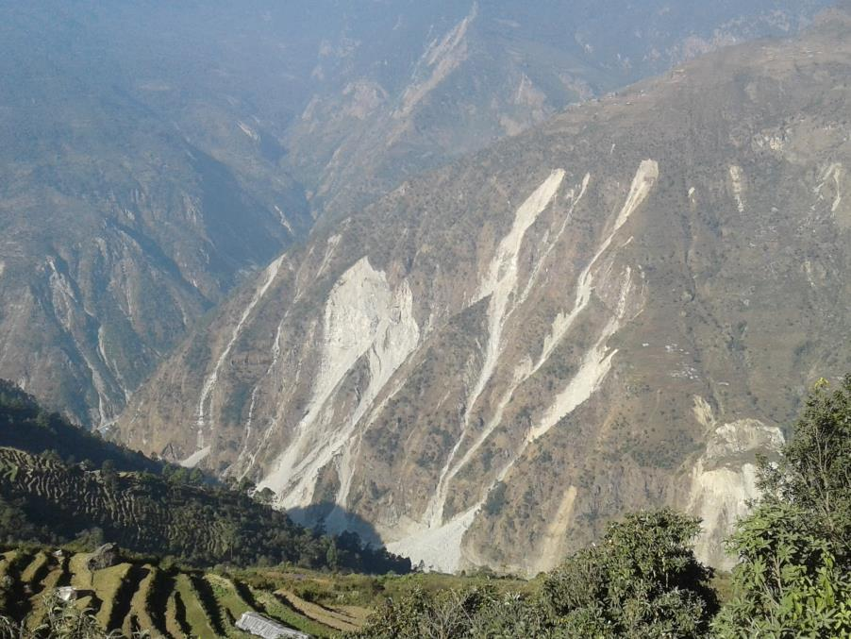

Slide 6
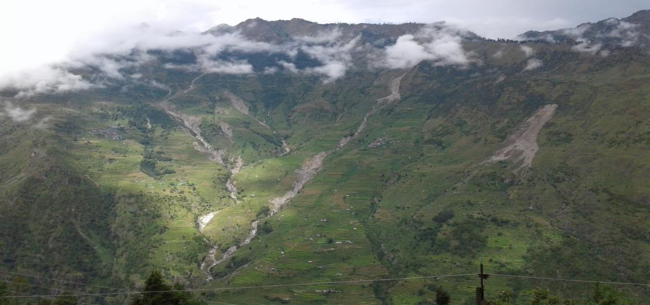

Slide 7
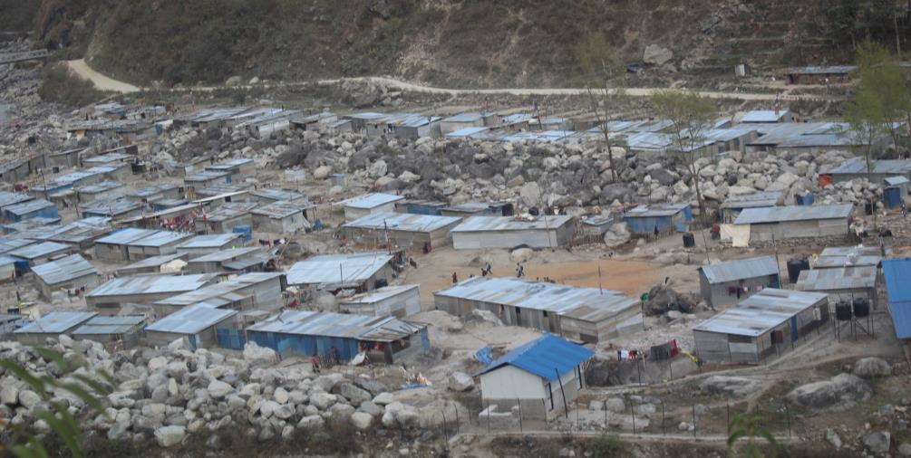

Slide 8
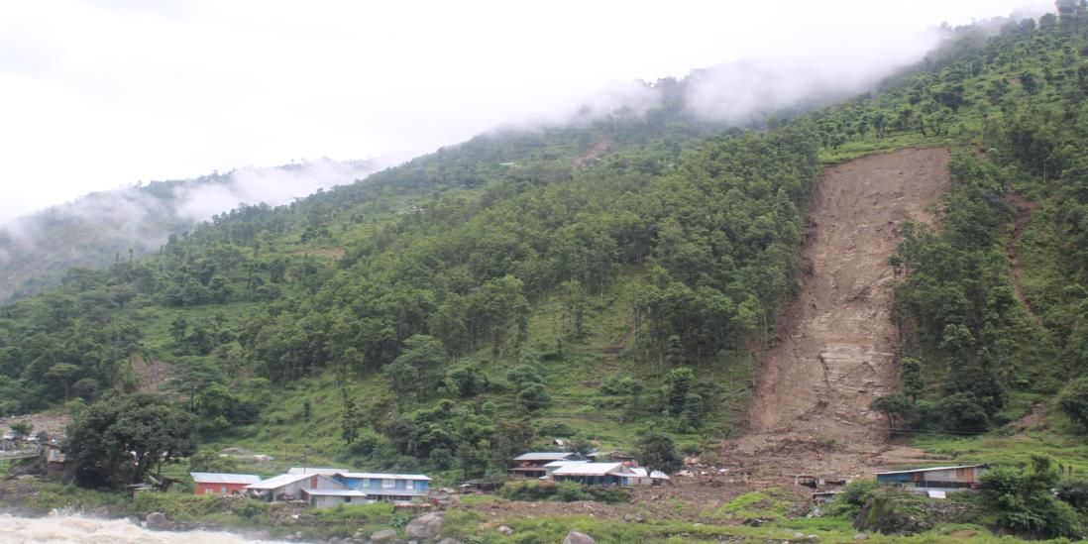

Slide 9
/fli6«o k'glg{df{0f k|flws/0fsf] ef}ule{s cWoog k|ltj]bgcg';f/ /;'jfdf *$$ 3/kl/jf/ hf]vLdo'Qm If]qdf k/]sf] x'Fbf pgLx?nfO{ :yfgfGt/0f u/fpg'kg{] cj:yf 5 .

Slide 10
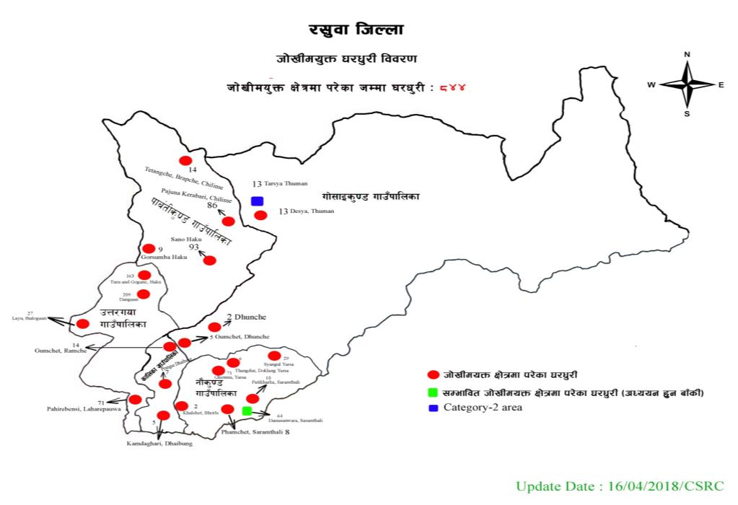

Slide 11

cg'bfg ;DaGwL Aoj:yf
;fljsd} cg'bfg M ;fljsb]lv a;f]af; u/L cfPsf] j:tLdf cfjZos ;'wf/ Pjd\ ;+/If0f u/L a;f]af; of]Uo ePsf] cj:yfdf To:tf j:tLsf nfeu|fxLnfO{ lghL cfjf; k'glg{df{0f cg'bfg /sd pknAw u/fOg] .
;'/lIft :yfgdf :yfgfGt/0fdf cg'bfg M hf]lvdo'Qm j:tL egL Plsg ePsf j:tLsf nfeu|fxLn] cfkm\gf] OR5fcg';f/ ;DalGwt lhNnf jf e"sDk k|efljt lhNnf dWo] glhssf] lhNnfdf a;fO{ ;/fO{ ug{ ;Sg]5g\ . To:tf 3/ kl/jf/nfO{ hUuf vl/bjfkt clwstd\ @ nfv ?lkofF;Dd lnvt d'Nocg';f/sf] /sd pknAw x'g]5 . t/ o:tf] cg'bfg eg] ;fljs:yfgafx]s cGoq slxFst} cfkm\gf] gfddf 3/38]/L gx'g]n] dfq kfpg]5g\ .
hUuf vl/b ;DaGwdff M cg'bfg /sdaf6 vl/b x'g] hUuf 38]/Lsf] nflu pko'Qm x'g'k5{ . o:tf] hUuf vl/b ubf{ >Ldfg\ >LdtL x'g]n] clgjfo{ ;+o'Qm k'hf{ agfpg'k5{ . o:tf] hUuf !) jif{;Dd xs x:tfGt/0f ug{ kfOb}g .

Slide 12
hf]lvdo'Qm a:tL :yfgfGt/0f
;fd"lxs a:tL lgdf{0fdf k|f]T;fxg M hf]lvdo'Qm a:tLsf nfeu|fxLx? dWo]af6 slDtdf bz kl/jf/ x'g] u/L cfkm+}n] pkef]Qmf ;ldlt u7g u/L ;'/lIft :yfgdf PsLs[t j:tL ljsf; ug{ rfx]df lghx?nfO{ ;'/lIft hUuf Joj:yfkg ug{ / lghL cjf;sf nflu /sd pknAw x'g]5 .
Kf"jf{wf/ ljsf; of]hgf M PsLs[t a:tL ljsf;sf nflu hUuf PsLs[t u/L k|flws/0f jf k|flws/0fn] tf]s]sf] sfof{noaf6 :yfgfGt/0f tyf k'g:yf{kgf of]hgf tof/ u/L qmlds ?kdf k"jf{wf/ ljsf; ug]{ . -;8s, vfg]kfgL, ljB't, :jf:Yo s]Gb|, lzIf0f ;+:yf_

Slide 13
cg'bfg lng lgj]bgaf/]
Hff]lvdo'Qm kl/jf/n] hUuf vl/bsf] nflu k'glg{df{0f k|flws/0fsf] lhNnf ;dGjo ;ldltsf] ;lrjfno jf tf]lsPsf] sfof{nodf lgj]bg lbO cg'bfg lng ;Sg]5g\ . o:tf] cg'bfg eg] hUuf vl/b eO;s]kl5 dfq kfpg]5g\ .
ljj/0f v'nfpgkg]{ M lgj]bssf] tLg k':t] ljj/0f, hUuf wgLsf] gfd, hUufwgLsf] 7]ufgf, hUuf /x]sf] 7]ufgf If]qkmn, lsQf g+= :ki6 v'nfpg'k5{ . :yfgLo txaf6 cGoq a;f]af;sf] nflu pko'Qm hUuf eP jf gePsf] Joxf]/fsf] l;kmfl/; kq clgjfo{ k]z ug'{kg]{ .
hUuf vl/b ug{] :yfgsf] kq M hUuf vl/b ul/g] If]qsf] :yfgLo txaf6 h;sf] hUuf vl/b ul/g] xf] ;f] hUuf ef]urngdf s'g} klg ljjfb\ gePsf] / vl/b laqmL ubf{ s'g} ;d:of gkg{] Joxf]/fsf] l;kmfl/; kq .
d'Nofª\sg M vl/b ul/g] hUuf 3/af; ug{ k'Ug] hUuf x'g'k5{ . ;f]sf] nflu @ nfv ?lkofF;Ddsf] x'Fbf pko'Qm x'G5 . t/ o:tf] hUufsf] d'Nofª\sg lng] / lbg] aLrsf] cfk;L ;xdltdf e/ kb{5, t/ sltko 7fpFdf j8f cWoIfx? /f]xa/df /fvL d'Nofª\sg tf]lsg] ul/Psf]5 .

Slide 14
/sd e'QmfgL k|lqmof
e'QmfgL M hUuf btf{ eO;s]kl5 dfnkf]taf6 hUuf /lhi6«];g kf; ul/Psf] lnvt / nfnk'hf{sf] kmf]6f]skL /fvL /fli6«o k'glg{df{0f k|flw/s0faf6 e'QmfgL lng ;lsG5 . o:tf] e'QmfgL eg] hUuf wgLsf] gfddf r]s dfkm{t x'g]5 .
3/ lgdf{0f ;'? M vl/b u/]sf] hUufdf nfeu|fxLn] tLg dlxgfleq 3/ agfpg ;'? ug'{k5{ . 3/ lgdf{0f ug{sf] nflu cGo e"sDk kLl8t ;/x tLg ls:tfdf cg'bfg /sd kfpg]5g\ .

Slide 15
xfn;Ddsf] s]xL pknAwLx?
lj:yflkt tyf hf]vLdo'Qm If]qsf !%$ kl/jf/n] hUuf vl/b u/]sf 5g\ . pgLx?n] pQm hUuf vl/b ug{sf] nflu k|lt kl/jf/ @ nfv ?lkofF;Dd yk cg'bfg k|fKt u/]sf 5g\ .
xfn vl/b ul/Psf] hUufdf >Ldfg\–>LdtLsf] gfddf ;+o'Qm hUufwgL k'hf{ agfpg] !@( kl/jf/ 5g\ .

Slide 16
S.N. | Name of Rural Municipality | Total HH in CAT-3 | LR#Completed
1 | Uttargaya | 470 | 138
2 | Kalika | 26 | 5
3 | Naukunda | 126 | 5
4 | Gosainkunda | 20 | 5
5 | Aamachhodingmo | 202 | 1
 |  | 844 | 154

Slide 17
qmdz M
pQ/uof ufpFkflnsf ! lt? / cfdf5f]lbª\df] ufpFkflnsf j8f g+= @ kfªlnª If]qdf PsLs[t a:tL ljsf;sf] nflu k|lqmof cl3 a9]sf] 5 . xfn ljleGg :yfgdf c:yfoL lzlj/df a;f]af; ul//x]sf ;fljssf] xfs' * / ( lt? / uf]ug]sf] e"sDk kLl8t kl/jf/nfO{ lt?df PsLs[t a:tL ljsf; u/L k'gjf{; u/fpg vf]hLPsf] 5 . o;sf] cWoog sfo{ eO/x]sf] 5 .
o:t}, ;fljs xfs' uflj; @ ;fgf] xfs'af;LnfO{ kfªlnªdf PsLs[t a:tLdf ljsf; u/fpgsf] nflu k|f/DeLs r/0f cl3 a9fOPsf] 5 .
/fli6«o k'glg{df{0f k|flws/0f, o;sf] lhNnfl:yt sfof{no / :yfgLo tx;Fu glhssf] ;DaGw / ;xsfo{df lj:yflktsf] k'gjf{; u/fpg] k|lqmofdf ;xsfo{ eO/x]sf] 5 .

Slide 18
c;n cEof;
/fli6«o k'glg{df{0f k|flws/0f, lhNnf ;dGjo ;ldlt, lhNnf k|zf;g sfof{no, gfkL, dfnkf]t, ufpFkflnsf / j8f sfof{nox?;Fu glhssf] ;DaGw :yflkt u/L lj:yflkt / hf]vLdo'Qm If]qsf 3/w'/LnfO{ k'gjf{; u/fpgsf] nflu k|lqmofdf ;xhLs/0f ul//x]sf 5f}+ .
/fli6«o k'glg{df{0f k|flws/0f;Fu ;dGjo u/L hf]vLdo'Qm If]qdf e'ue{ljb\ / k|fljlws sd{rf/L nlu :ynut cjnf]sg ug{] sfo{df ;xhLs/0f / ;dGjo eO/x]sf] 5 . o;af6 hf]vLdo'Qm If]qsf] 3/w'/L klxrfg / hUuf btf{ ug{] k|lqmofdf ;/ntf cfO/x]sf] 5 .
lj:yflkt tyf hf]vLdo'Qm If]qsf 3/w'/LnfO{ ;d'bfo txdf e]nf u/L a:tL :yfgfGt/0f, hUuf vf]hL ug{] sfo{ / cg'bfg lng] k|lqmofdf ;xhLs/0f eO/x]sf] .

Slide 19
o; cleofg;Fu ;DalGwt s]xL kmf]6f]x?

Slide 20
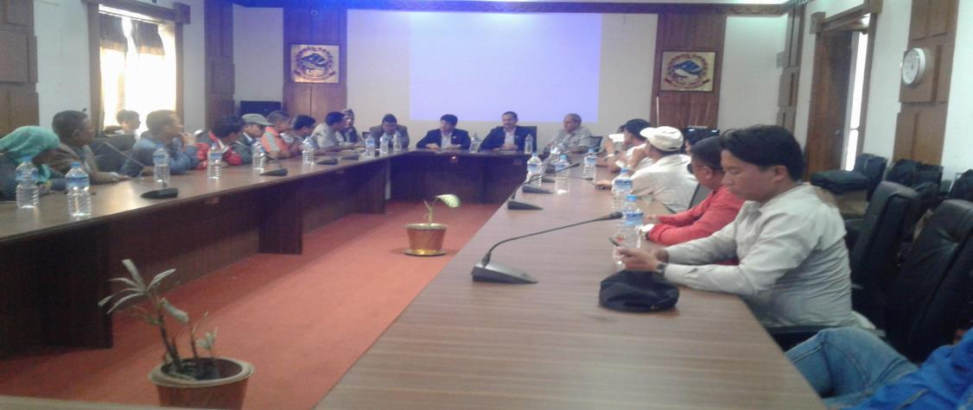
cleofgsf s]xL emnsx?
/fli6«o k'glg{df{0f k|flws/0fdf tTsflng l;Ocf] k|f=8f= uf]ljGb kf]v/]n;Fu l;+xb/af/ 5nkmn ul/Fb}

Slide 21
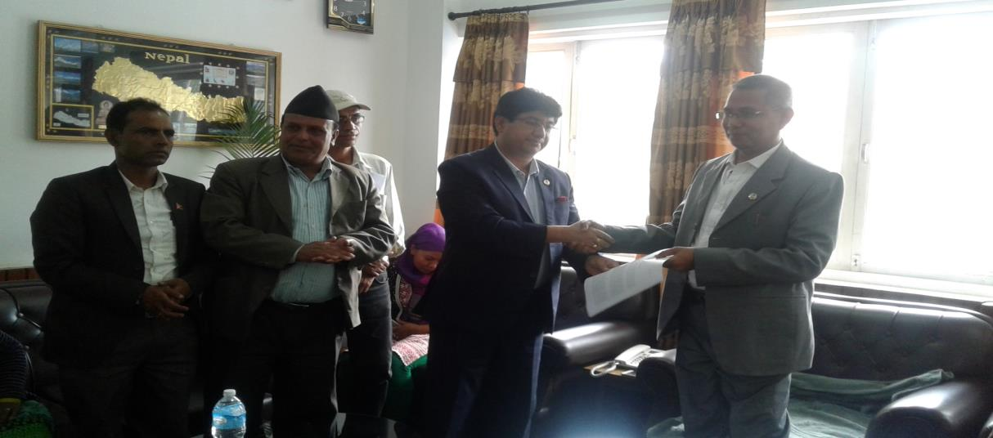
k'glg{df{0fsf] qmddf b]lvPsf e"ld ;DalGw ;d:of ;dfwfgsf] nflu tTsflng e"ld ;'wf/ dGqL 8f=uf]kfn blxtnfO{ dfu kq k]z ul/Fb} .

Slide 22
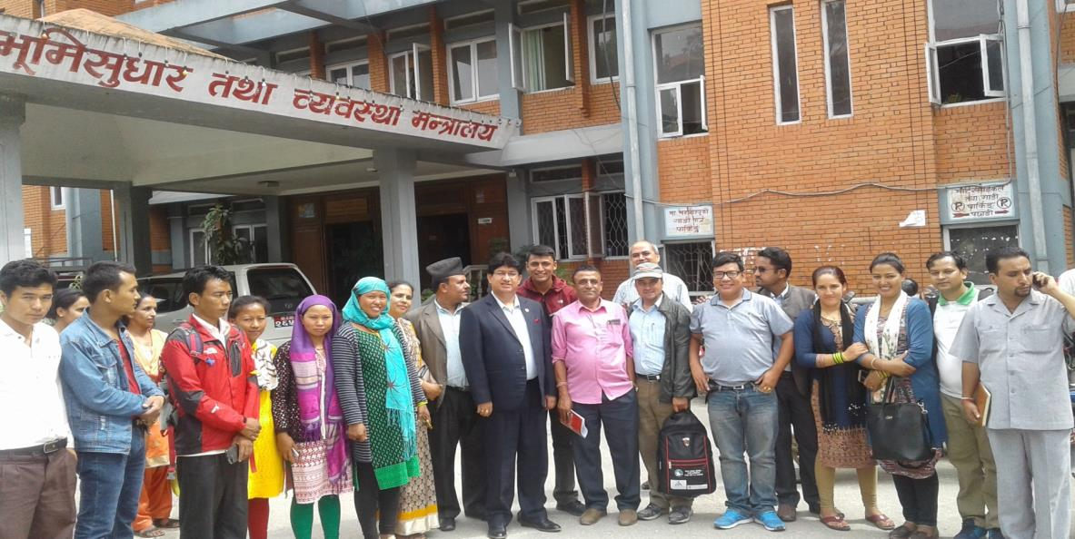
k'glg{df{0f;Fu hf]l8Psf] e"ld;DalGw ;d:of ;dfwfgsf] nflu l;+xb/af/df 8]lnu];g l6ddf ;xefuL .

Slide 23
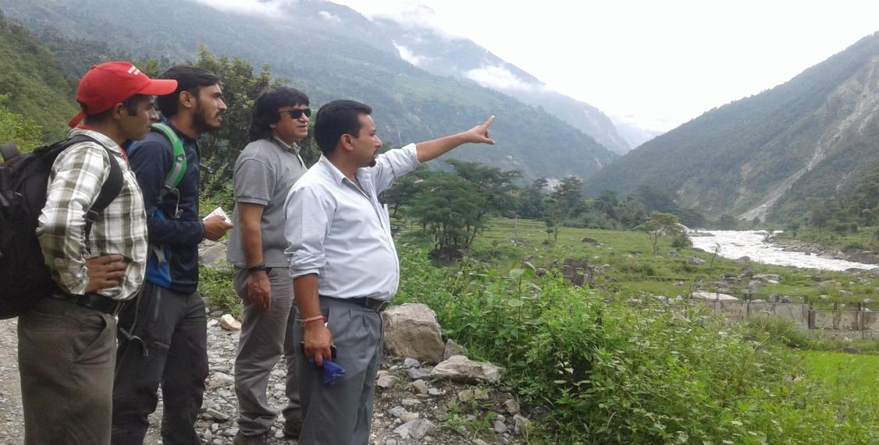
klx/f]sf] sf/0f Iflt ePkl5 nx/]kf}jf % klx/]a]zLdf ef}u{le{s cWoogsf] qmddf k|fljlwx? / ufpFkflnsf .

Slide 24
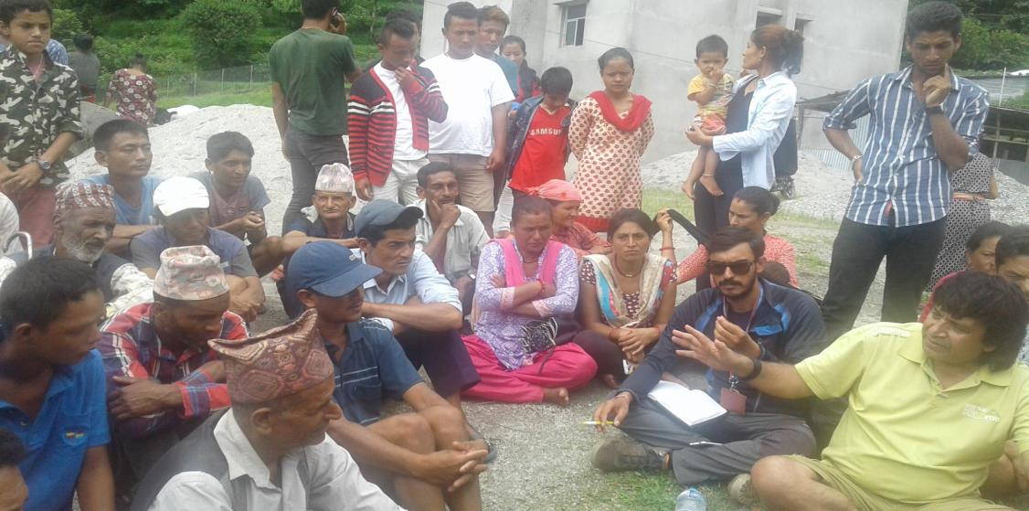
klx/]azLsf] a:tL :yfgfGt/0fsf] ljifodf 5nkmn ul/Fb}, /fli6«o k'glg{df{0f k|flws/0faf6 k|fljlw / e"u{lej\sf] l6d

Slide 25
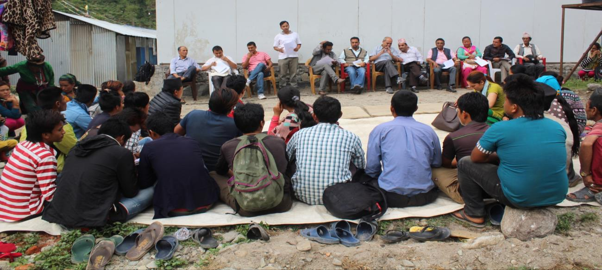
vfN6]df a:tL ljsf;sf] nflu ;/f]sf/jfnfaLr 5nkmn

Slide 26
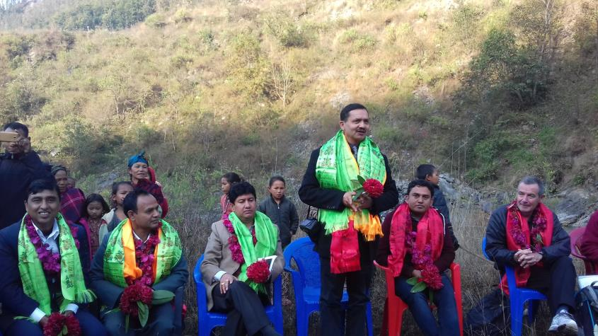
vfN6]df a:tL ljsf;sf] nflu k'glg{df{0f k|flws/0fsf k|d'v sfo{sf/L clws[t k|f=8f= uf]ljGb /fh kf]v/]nsf] e|d0f

Slide 27
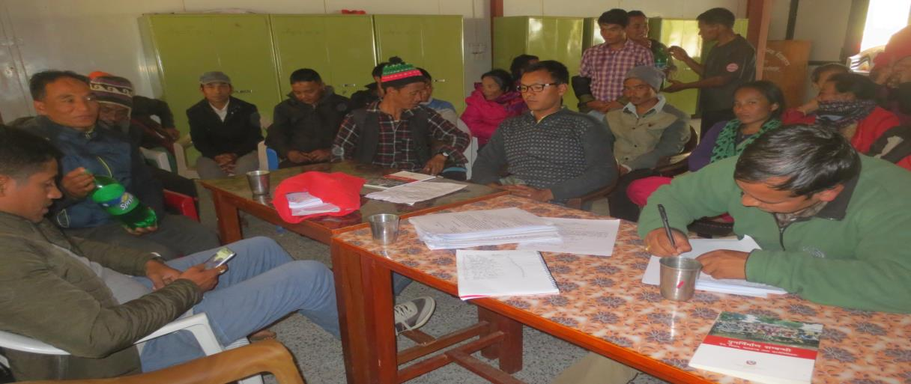
38]/L vl/bsf] nflu lgj]bg lbgsf] nflu k|lqmofut sfo{df ;xof]u

Slide 28
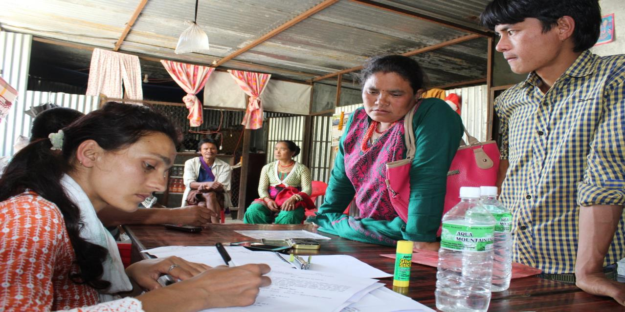
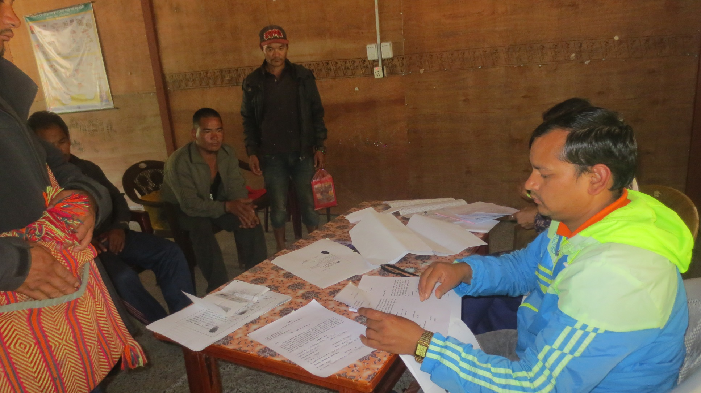
38]/L vl/bsf] nflu lgj]bg lbgsf] nflu k|lqmofut sfo{df ;xof]u

Slide 29
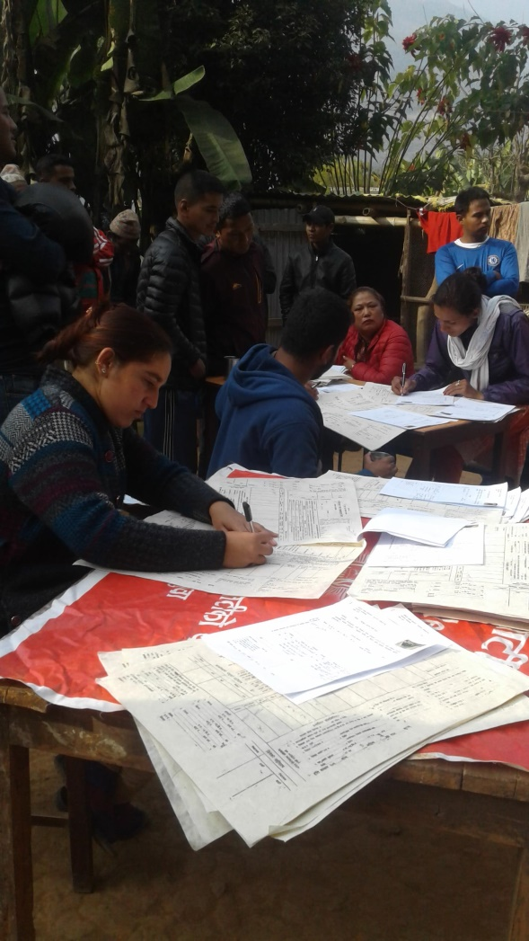
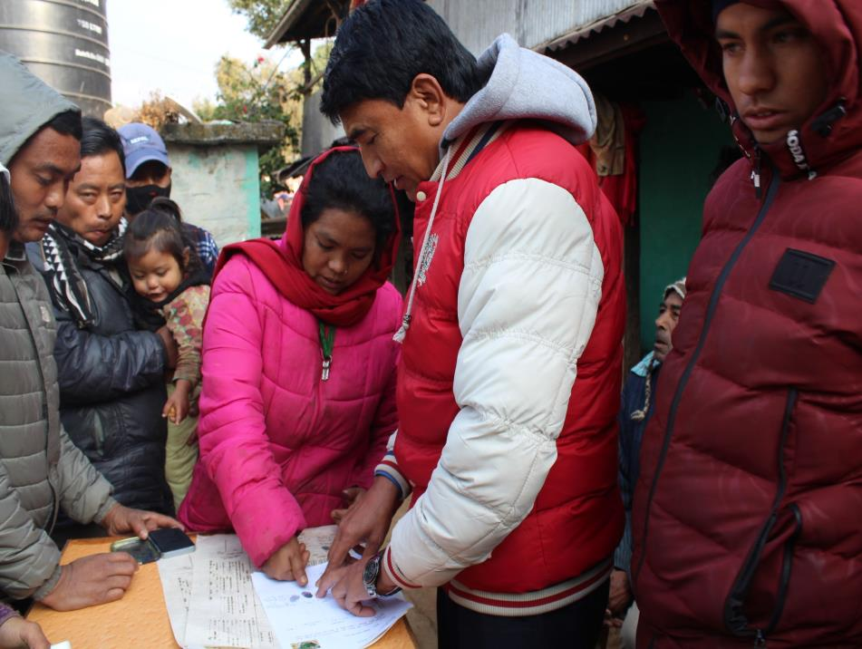
lkmN8d} hUuf kf;sf] nflu sfd ub{}, dfnkf]t sd{r/Lsf] klg ;xeflutf . af]u6L6f/

Slide 30
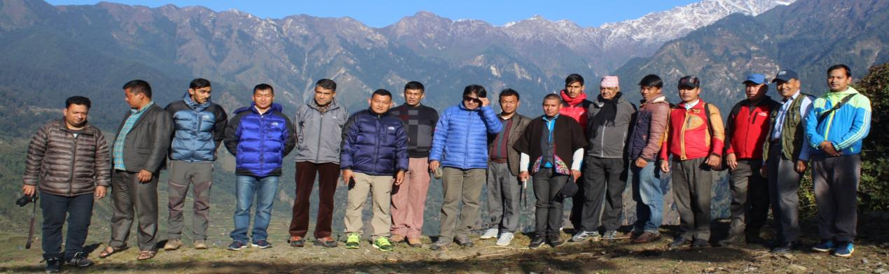
;fgf] xfs'sf] dfly 8fF8fsf] ef}ule{s cWoogsf] qmddf lj1;lxtsf] 6f]nL

Slide 31
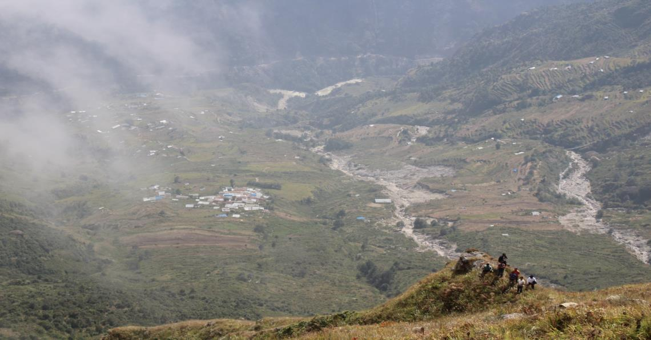
;fgf] xfs'sf] hf]vLdo'Qm If]qsf] cWoogsf] qmddf

Slide 32
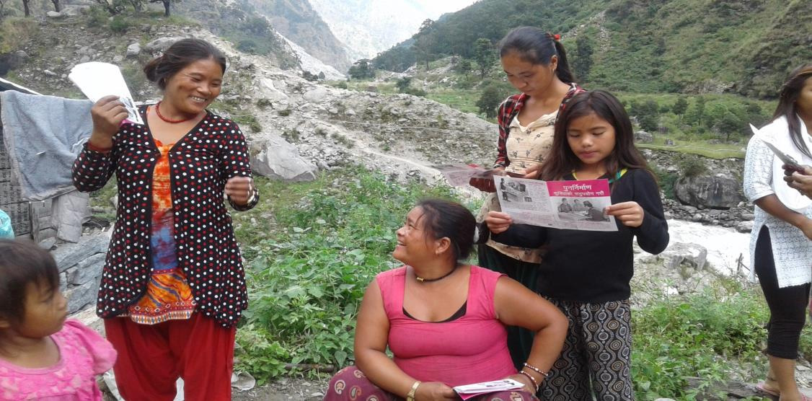
lj:yflkt If]qdf cg'bfg kfpg] ljifodf hfgsf/Ld'ns ;fdu|L ljt/0f

Slide 33
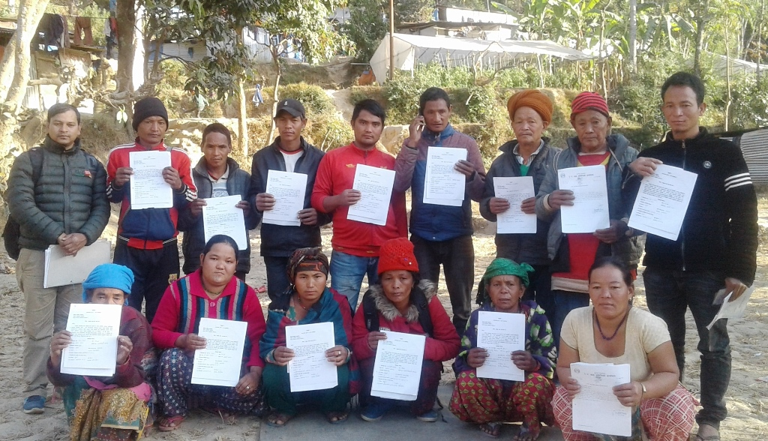
lj:yflkt kl/jf/ hUuf vl/b ug{sf] nflu cg'bfgsf] nflu lgj]bg ;ª\sng

Slide 34
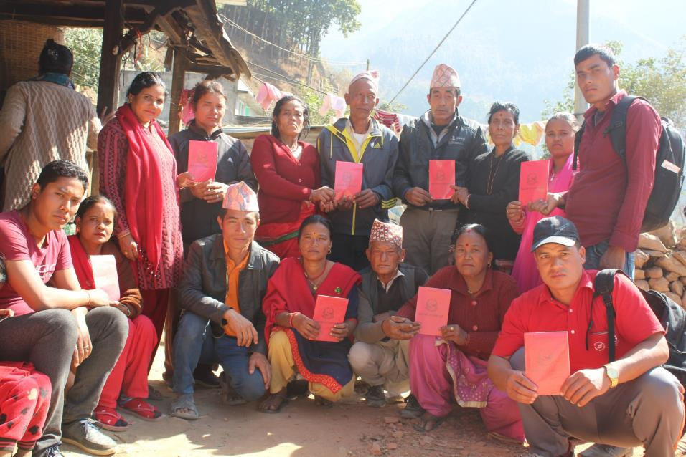
hf]vLdo'Qm If]qsf 3/w'/LnfO{ ;'/lIft:yfgdf hUuf vl/b ul/Pkl5 k'hf{ ljt/0f ul/Fb}, klx/]a]zL

Slide 35
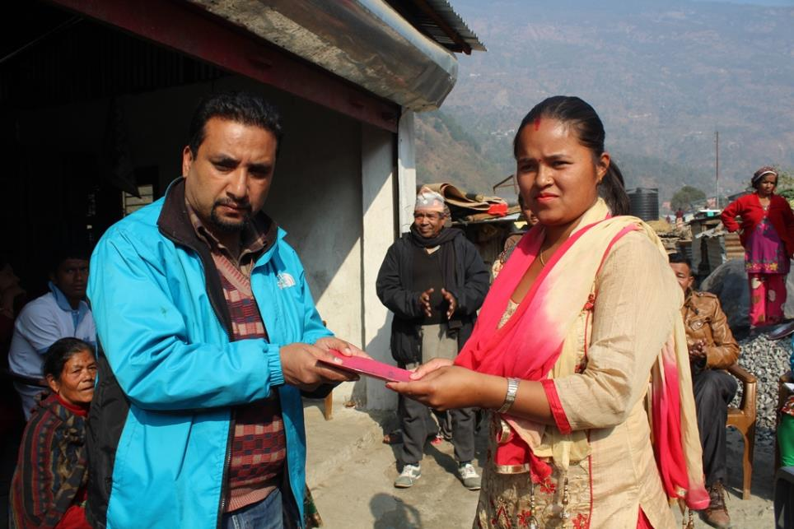
hf]vLdo'Qm If]qsf 3/w'/LnfO{ ;'/lIft:yfgdf hUuf vl/b ul/Pkl5 k'hf{ ljt/0f ul/Fb}, klx/]a]zL

Slide 36
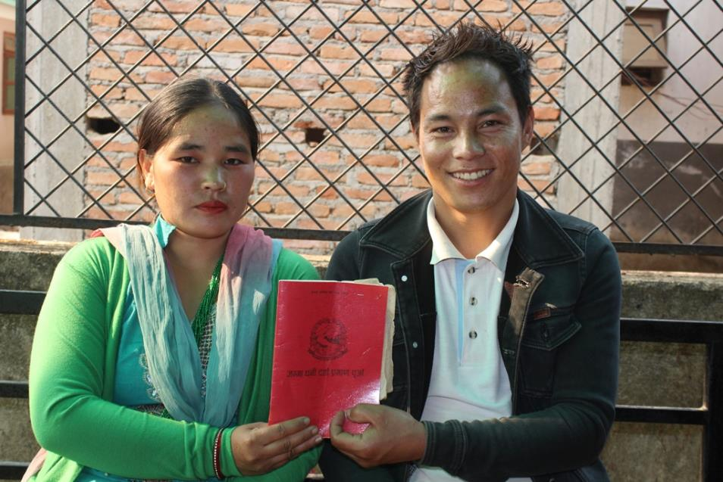
hf]vLdo'Qm If]qsf 3/w'/LnfO{ ;'/lIft:yfgdf hUuf vl/b ul/Pkl5 k'hf{ ljt/0f ul/Fb}, 8f8fFufpF uflj;

Slide 37
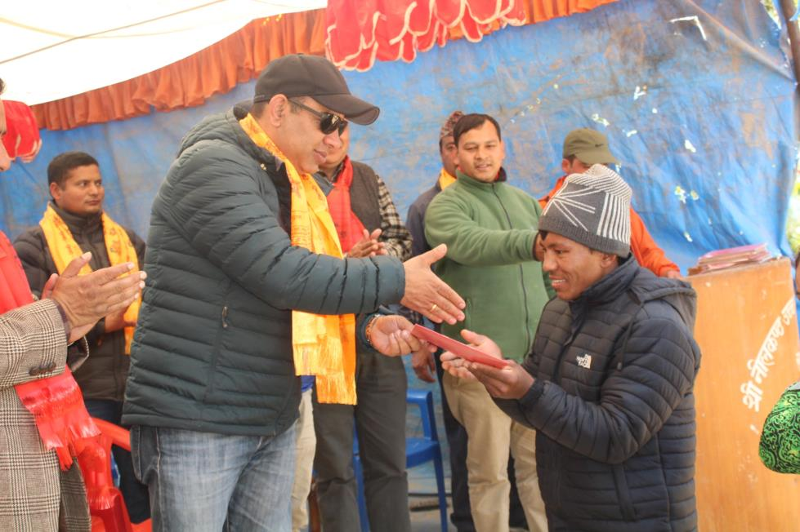
hf]vLdo'Qm If]qsf 3/w'/LnfO{ ;'/lIft:yfgdf hUuf vl/b ul/Pkl5 k'hf{ ljt/0f ul/Fb}, af]u6L6f/

Slide 38
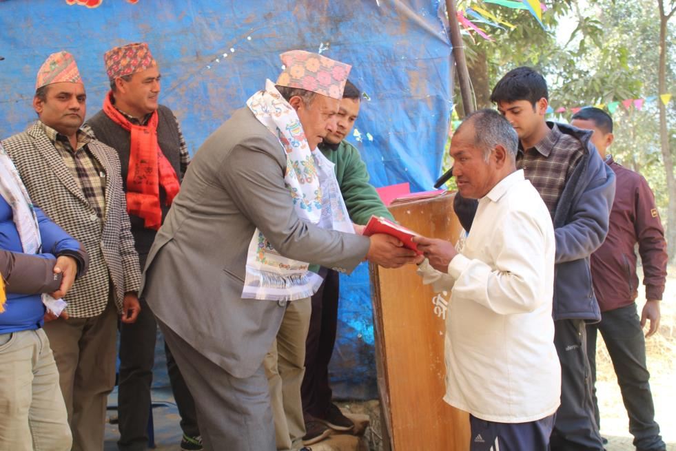
hf]vLdo'Qm If]qsf 3/w'/LnfO{ ;'/lIft:yfgdf hUuf vl/b ul/Pkl5 k'hf{ ljt/0f ul/Fb}, af]u6L6f/

Slide 39
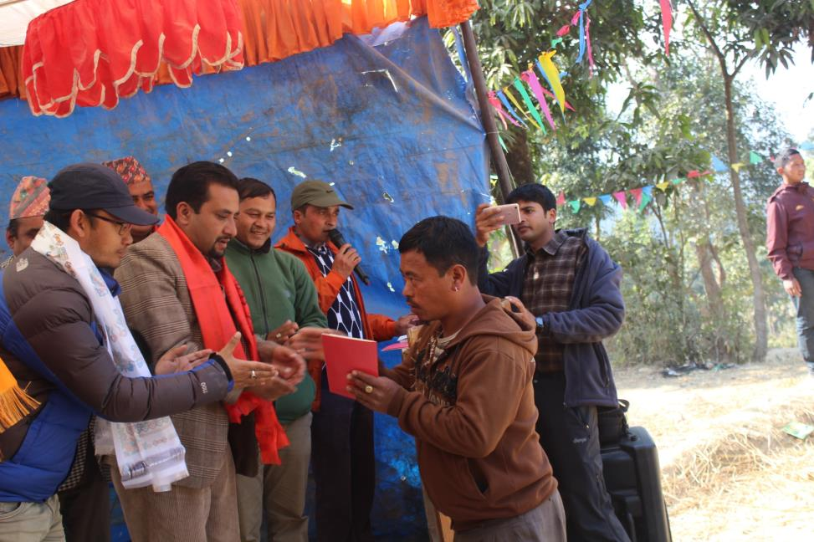
hf]vLdo'Qm If]qsf 3/w'/LnfO{ ;'/lIft:yfgdf hUuf vl/b ul/Pkl5 k'hf{ ljt/0f ul/Fb}, af]u6L6f/

Slide 40
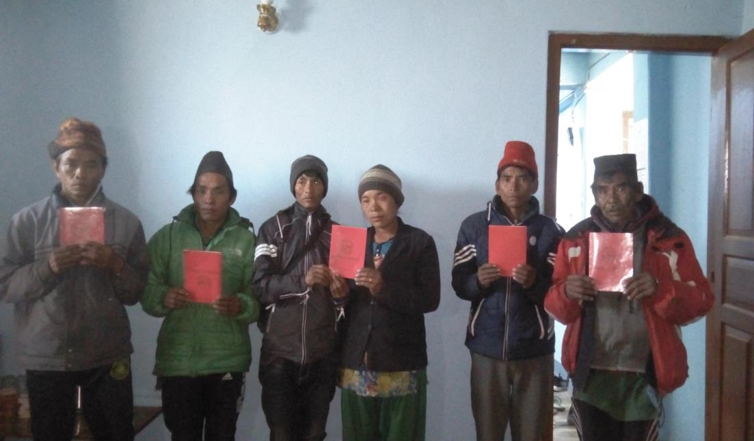
hf]vLdo'Qm If]qsf 3/w'/LnfO{ ;'/lIft:yfgdf hUuf vl/b ul/Pkl5 k'hf{ ljt/0f ul/Fb}, w'Gr]

Slide 41
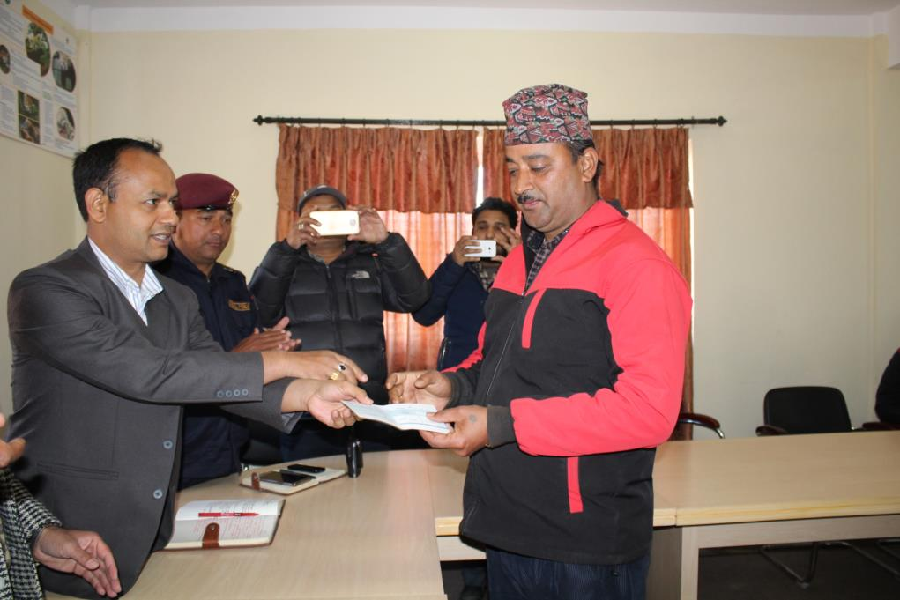
hUufwgLnfO{ r]s x:tfGt/0f ug'{xF'b} k|d'v lhNnf clwsf/L rf]d]Gb| Gof}kfg], w'Gr]

Slide 42
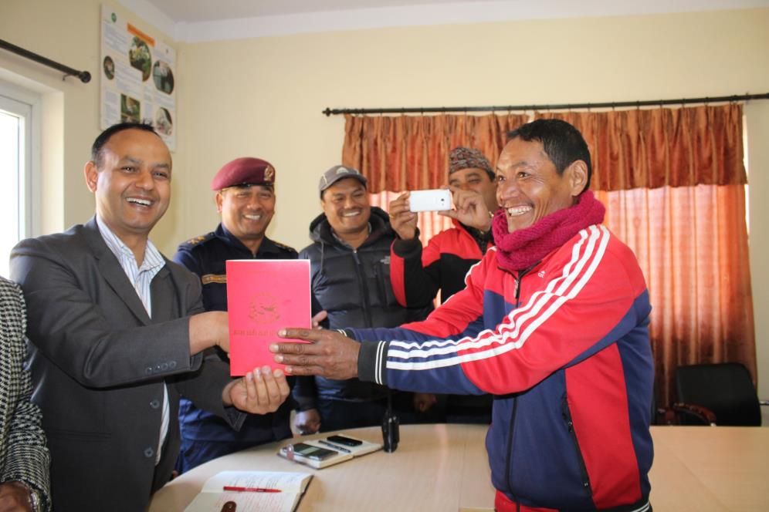
lj:yflkt kl/jf/nfO{ nfnk'hf{ x:tfGt/0f ug'{xF'b} k|d'v lhNnf clwsf/L rf]d]Gb| Gof}kfg], w'Gr]

Slide 43
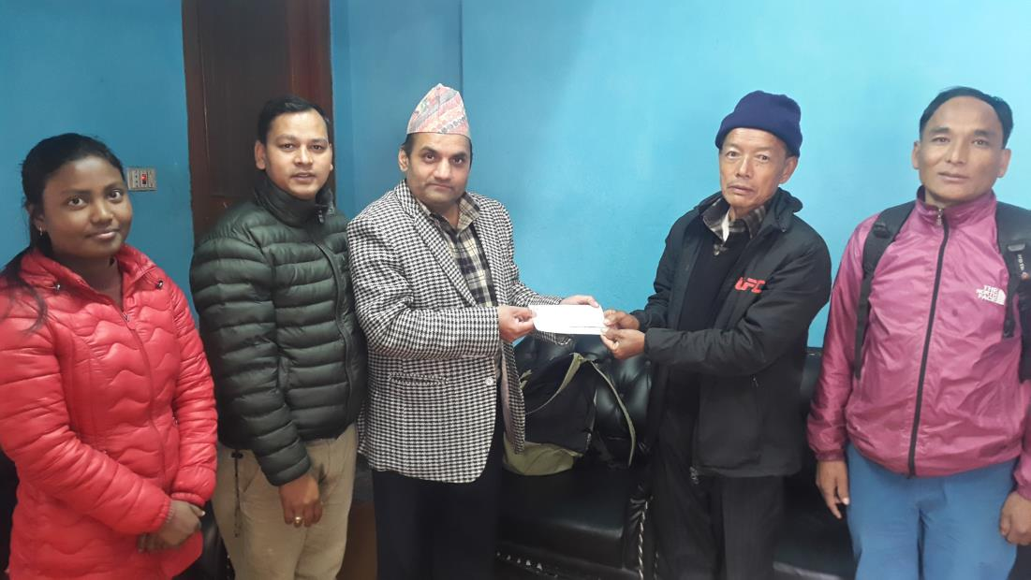
hUufwgLnfO{ r]s x:tfGt/0f ug'{x'Fb} k'glg{df{0f k|flws/0f /;'jfsf k|d'v s[i0fsfGt pkfWofo, w'Gr]

Slide 45
s]xL r'gf}tL tyf ;d:ofx?
lj:yflkt kl/jf/nfO{ k'gjf{; u/fpgsf] nflu /;'jf lhNnfdf kof{Kt / ;'/lIft hldg kof{Kt gePsf] cj:yf 5 . /;'jfdf hUuf pknAw gx'Fbf g'jfsf]6df uO{ hUuf vl/b ug'{kg{] afWotfx? a9\b} 5g\ . o; cl3 !%$ dWo] ^( kl/jf/n] g'jfsf]6df hUuf vl/b ul/;s]sf 5g\ . pgLx? pt} 3/ agfP/ a:g'kg{] afWotf 5 .
;/sf/n] lbg] @ nfv ?lkofF cg'bfgn] hUuf vl/b ug{ ;Sg] cj:yfx¿ Go'g x'Fb} uPsf] 5 . ePsf] hldgsf] klg hUufwgLx¿ d'No a9fpb} hfg yfn]sf 5g\ . @ nfvdf $ cfgf hUuf gkfpg] ;d:ofx? 5g\ .

Slide 46
r'gf}tL tyf ;d:of
o; cl3 hUuf vl/b u/L;s]sf kl/jf/nfO{ k'glg{df{0f k|flws/0faf6 cg'bfg lbOPsf] 5}g . k|lqmof gldn]sf] eGb} /sd e'QmfgL gePkl5 hUufwgL / hUuf vl/b u/]sf To:tf] kl/jf/aLr ljjfb\ pTkgGg ePsf] 5 . pgLx¿ emg ;d:ofdf k/]sf 5g\ . o:tf] kl/jf/ #^ eGbf a9L 5g\ .
hf]vLdo'Qm If]qsf s]xL 3/w'/Lsf] ;"rLdf k/]sf kl/jf/n] o; cl3 k'/fg} 7fpFdf 3/ agfO;s]sf], klxnf], bf];|f] ls:tfx¿ a'lem;s]sf] kfOof] . o;/L k'/fg} 7fpFdf 3/ agfpg cg'bfg lnO{ vr{ ul/;s]sf kl/jf/nfO{ k'gM gofF 7fpFdf :yfgfGt/0f ubf{ k'gM 3/ agfpg cg'bfg cfpg] xf] jf xf]Og hfgsf/L gx'Fbf k'glg{df{0fdf ;d:of pTkGg ePsf] 5 .

Slide 47
r'gf}tL tyf ;d:of
vfN6]df xfn sl/j @^) kl/jf/ lj:yflktx¿ a;f]af; ul//x]sf 5g\ . pgLx¿ c:yfoL cfjf; agfO{ a;f]af; ul//x]sf 5g\ . pgLx¿ ToxLF a:g] of]hgfdf 5g\ . pQm If]q c;'/lIft elgsf] 5 . nfeu|fxL ;"rLdf k/]sfx¿ klg cGoq hUuf gvf]hL ToxLF al;/x]sf 5g\ . pgLx? ToxL a;f]af; ug{] elg/x]sf 5g\ . pgLx¿nfO{ ToxfFaf6 cGoq :yfgfGt/0f u/fpg r'gf}tL b]lvPsf] 5 .
k'glg{df{0f k|flws/0f, lhNnf dfnkf]t / gfkL sfof{nodf hgzlQm cefj ePsf] x'Fbf ;]jfu|fxL dsf{df 5g\ . lkmN8df hfg] kof{Kt sd{rf/L gx'Fbf k'gjf{;sf] nflu vl/b ug{] hUufx? gfkL ug{, e]l/lkms];g ug{ l9nf x'Fb} uPsf 5g\ .
;'s'daf;L ;d:ofsf, cfkm\gf] gfddf hldg gePsf / xfn;Dd klg lghL cfjf; k'glg{df{0fsf] nflu cg'bfg ;xof]u kfpg g;s]sf kl/jf/n] xfn;Dd klg 38]/L vl/b ug{sf] nflu yk cg'bfg kfpg ;s]sf 5}gg\ . o;f] x'Fbf pgLx?sf] k'glg{df{0f k|lqmof l9nf eO/x]sf] 5 .

Slide 48
;'emfj tyf l;kmfl/;
lj:yflkt tyf hf]vLdo'Qm If]qsf 3/kl/jf/ ;d:ofdf 5g\ . pgLx?nfO{ hlt;Sbf] rf8f] -oxL jvf{ cl3_ gofF agfpg ;Sg] u/L :yfgfGt/0f k|lqmofdf ;xof]u ug'{ cfjZos 5 . o;sf] nflu lhNnf ;dGjo ;ldlt, /fli6«o k'glg{df{0f k|flws/0f, gfkL, dfnkf]t / :yfgLo txn] ;dGjo u/L lj:yflkt kl/jf/nfO{ hUuf vf]hL ug{] / /lhi6«];g kf; u/fpg] k|lqmofdf ;xhLs/0f ug'{ cfjZos 5 . of] sfo{df k'glg{df{0f / k'g:yf{kgfsf] If]qdf lqmofzLn cGo ;+3 ;+:yfx?sf] klg ;xsfo{sf] plQs} cfjZos 5 .
lj:yflkt tyf hf]vLdo'Qm If]qsf 3/w'/L e'uf]ncg';f/ 5l/P/ /x]sf] cj:yfdf 5 . lhNnfsf] % j6} ufpFkflnsfdf of] ;d:of b]lvPsf] 5 . l;ldt hgzlQmsf] sf/0f lkmN8df ul/g'kg{] sfdx? h:t} M pko'Qm hUufsf] vf]hL, To;sf] ef}ule{s cWog, gfkL ug{], lsQfsf6 ug{], lhNnf;Dd cfpg g;Sg] kl/jf/sf] xsdf lkmN8df uO{ ;gfvt u/fpg] sfo{df ;xof]u ug'{kg{] cfjZostf 5 .

Slide 49
;'s'daf;L kl/jf/sf] cfkm\gf] :jfldTjdf hUuf hldg gePsf] x'Fbf xfn;Dd 3/ agfpg kfPsf 5}gg\ . pgLx?sf] nflu hUuf vl/b ug{sf] nflu lbOg] cg'bfgsf] k|lqmof cl3 a9fpgsf] nflu k'glg{df{0f k|flws/0f / lhNnf ;dGjo ;ldltn] k|fyldstf lbg'k5{ .

Slide 50
s]xL yk lh1f;f jf ;'emfj 5 eg] s[kof=====

