Slide 1
Housing Recovery and Reconstruction Platform-Nepal (HRRP)-Rasuwa
Coordination Meeting
Organized by:
National Reconstruction Authority(NRA)-Rasuwa
MOUD/District Project Implementation Unit (DLPIU)-Rasuwa
Housing Recovery and Reconstruction Platform-Nepal (HRRP)-Rasuwa

Slide 2
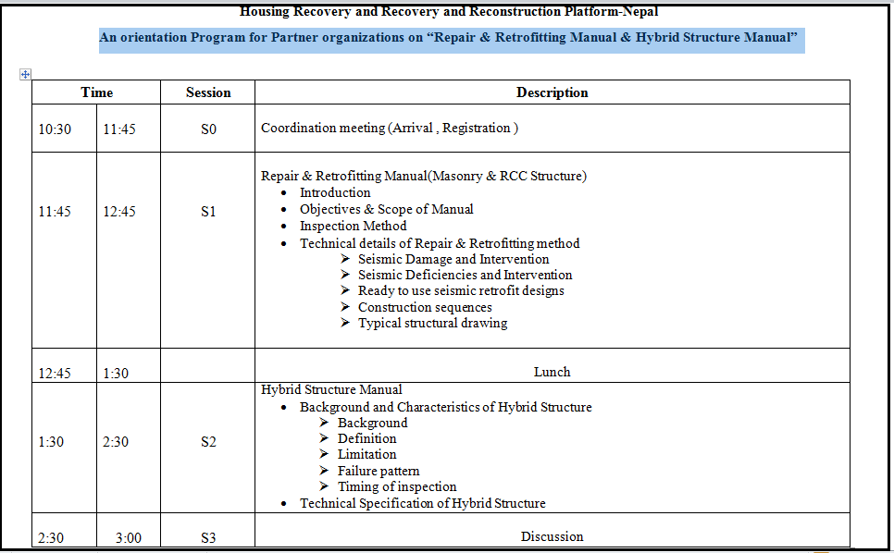
Program Schedule

Slide 3
Agenda
Introduction and Welcome
Reconstruction Update - HRRP
Partners Update - Partners Organization (Presentation is most appreciated if possible )
Remarks ,Update from DLPIU .
Remarks ,Update from NRA .
District Issue ,challenges and Way forward .
AOB.

Slide 4
Background
Rasuwa is one of the 14 most earthquake affected districts which comprise of 5 Rural Municipality. More than 63% of the district’s territory is at an elevation of more than 3000 meters. Of the remaining territory, most parts are located at an elevation between 1000 – 3000 meters.
Total Population: 43,385
(Female: 21,825 and Male: 21,475)
Total Area: 1544 square km
Rural Municipality: 5
Total Wards: 27

Slide 5
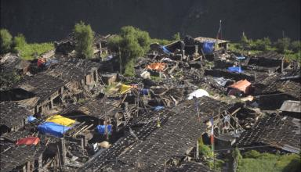
Destruction by earthquake 25 April, 2017
Number of Death =656
Number of Injured People =694
Number of Damaged Houses = 12,224
Number of Partially Damaged Houses=620
Number Damaged Schools = 98
Number of Damaged Health center=16
Photo: Gatlang Village after EQ (Black Village)

Slide 6
Achievement with in 2 years
As per CBS Survey, 12,024 houses are totally damaged and 620 are partially damaged ( HRRP_ Rasuwa_ District Profile ). 11,629 HHs were listed as the eligible beneficiaries for the Enrolment. 11,629 HHs have been enrolled in which 10,078 HHs have received the first tranche, 2,517 HHs received second tranche and 1,440 HHs received 3rd tranche.
SN | Rural Municipality | Eligible HH | First tranche Received HHs | second Tranche Received HHs | Third Tranche Received HHs
1 | Gosaikunda RM | 1772 | 1568 | 425 | 110
2 | Naukunda RM | 3228 | 2732 | 424 | 314
3 | Parbatikunda RM | 1779 | 1599 | 262 | 184
4 | Kalika RM | 2342 | 2174 | 679 | 383
5 | Uttargaya RM | 2508 | 2005 | 727 | 449
 | Total | 11,629 | 10,078 | 2,517 | 1,440
Table : Housing Grant Update ,Rasuwa
Data Source : EHRP Rasuwa (as of 27th Dec,2017)

Slide 7
Partners Support for Housing Grant
Five Partners Organization are supporting government for housing grant support on different Rural Municipality of district. 1078 HHs eligible HHs were planned to support by Po’s in which 1044 HHs received 1st tranche, 754 HHs received 2nd tranche and 588 HHs received 3rd Tranche from five different partner’s organization.
SN | Partners Organization | Eligible HH | First tranche Received HHs | second Tranche Received HHs | Third Tranche Received HHs | Construction Complete HH
1 | Nepal Red Cross Society | 455 | 435 | 188 | 135 | 50
2 | LWF/Manakor | 101 | 101 | 101 | 91 | 91
3 | Lumanti/ Cordaid | 351 | 349 | 306 | 215 | 215
4 | LWF/Batash | 152 | 152 | 152 | 152 | 152
5 | SP | 19 | 7 | 7 | 7 | 7
 | Total | 1078 | 1044 | 754 | 588 | 515
Table : Housing Grant support by Partners Organization ,Rasuwa
Data Source : EHRP Rasuwa (as of 27th Dec,2017)

Slide 8
Technical Assistances Status (as of 25th Dec ,2017 )
Technical Assistance for housing reconstruction has been highly stressed by NRA for reconstruction as ultimately it is the only way to achieve the targeted compliance for building back better and safer. The coverage of Technical Assistance (TA) is defined according to the presence (planned and on-going) of the following 6 activities and the table below shows the status of the activities in Rural Municipality level (Data source HRRP_Rasuwa_4W).

Slide 9
Tech…..

Slide 10
Tech….

Slide 11
Trainings

Slide 12
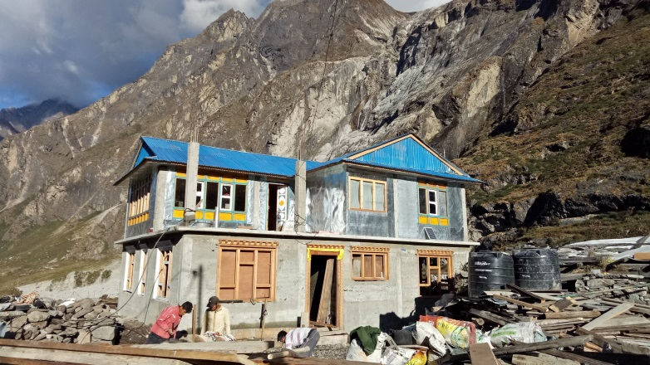
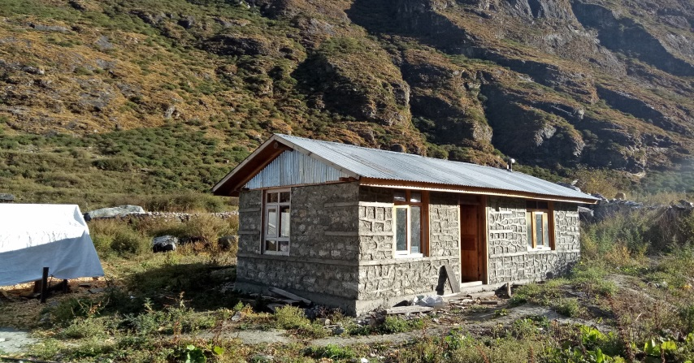
Constructed Houses
Caption: Gosaikunda Gaupalika ward no 4 ,Rasuwa .Received 1st tranche from GoN housing support .
Caption: Gosaikunda Gaupalika wards no 4, Rasuwa. Support by samaratan purse .

Slide 13
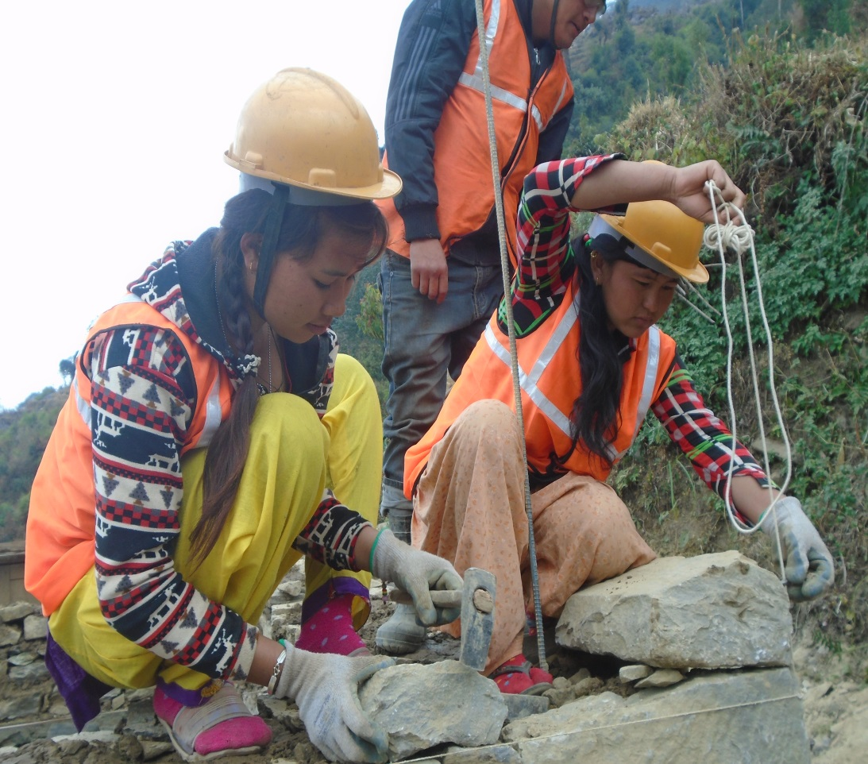
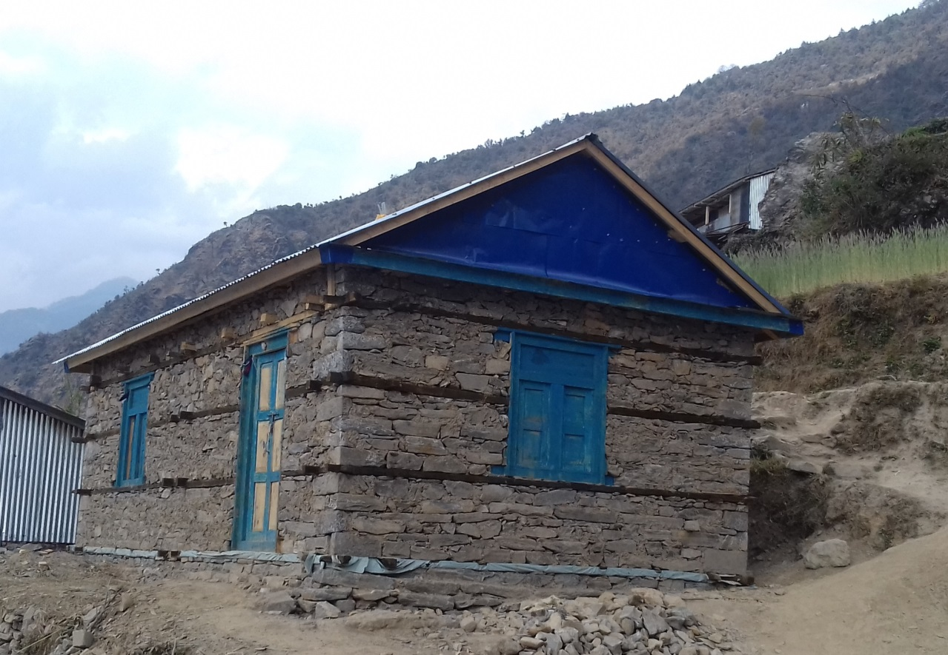
Constructed Houses …..
Caption:Kalika Gaupalika Ramche , Rasuwa. Constructed during OJT
Training by Helvetas .
Caption:Kalika Gaupalika Dhabung , Rasuwa.During OJT Training by Helvetas .

Slide 14
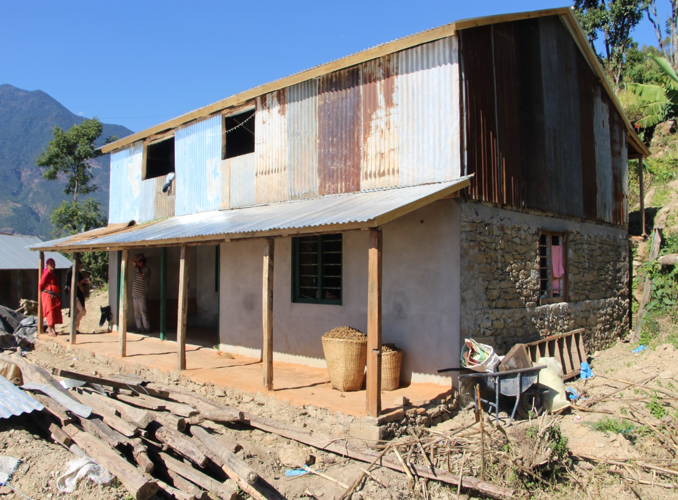
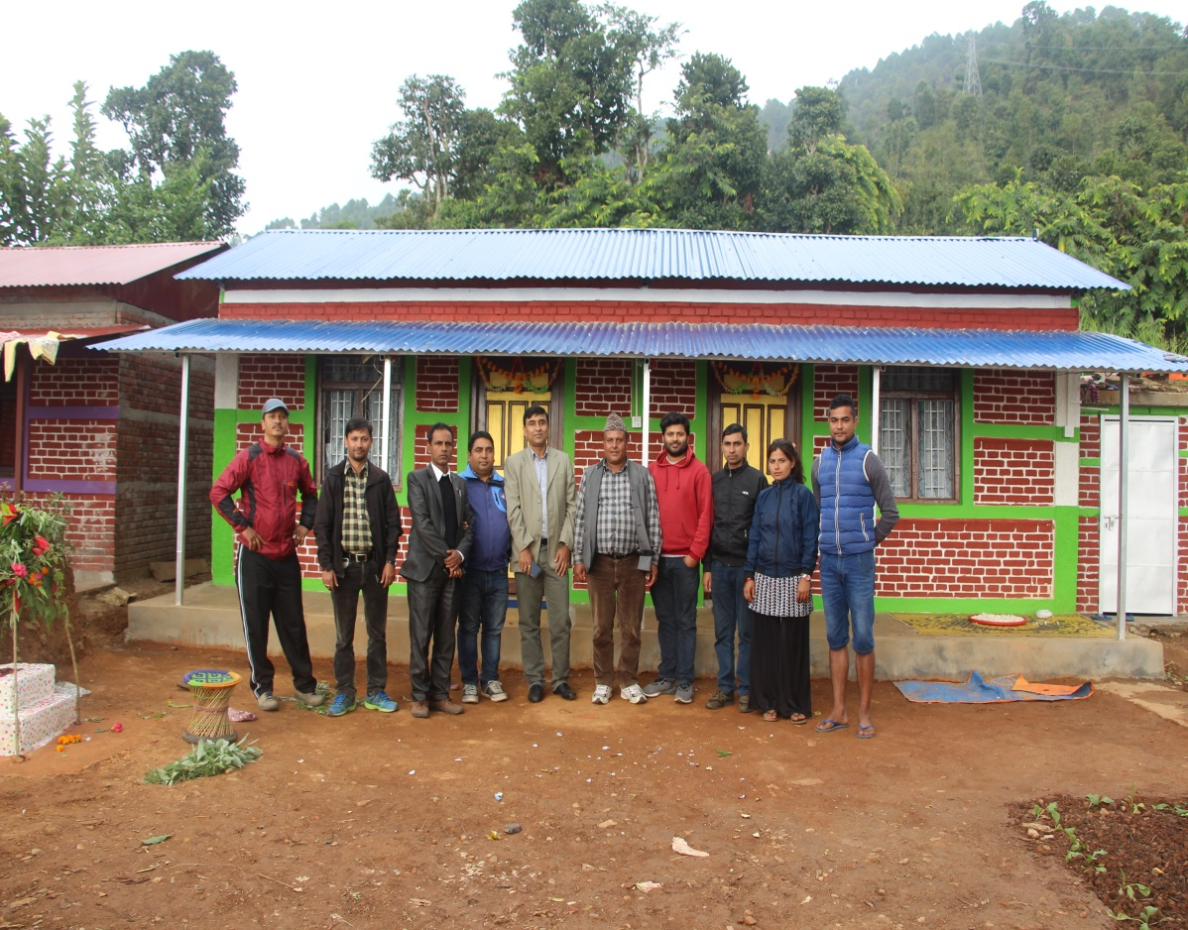
Constructed Houses …..
Caption:Kalika Gaupalika Dhaibung , Rasuwa. Support by Lumanti /Cordaid .Recived all three grant .
Caption:Kalika Gaupalika Dhaibung , Rasuwa. Support by Lumanti /Cordaid .Recived all three grant .Monitoring visit by DCC team .

Slide 15
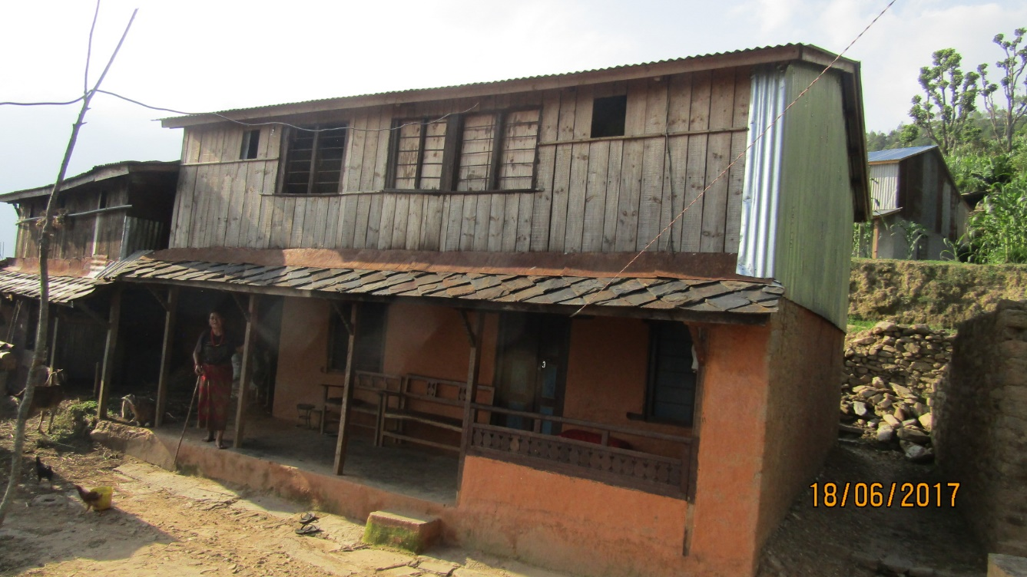
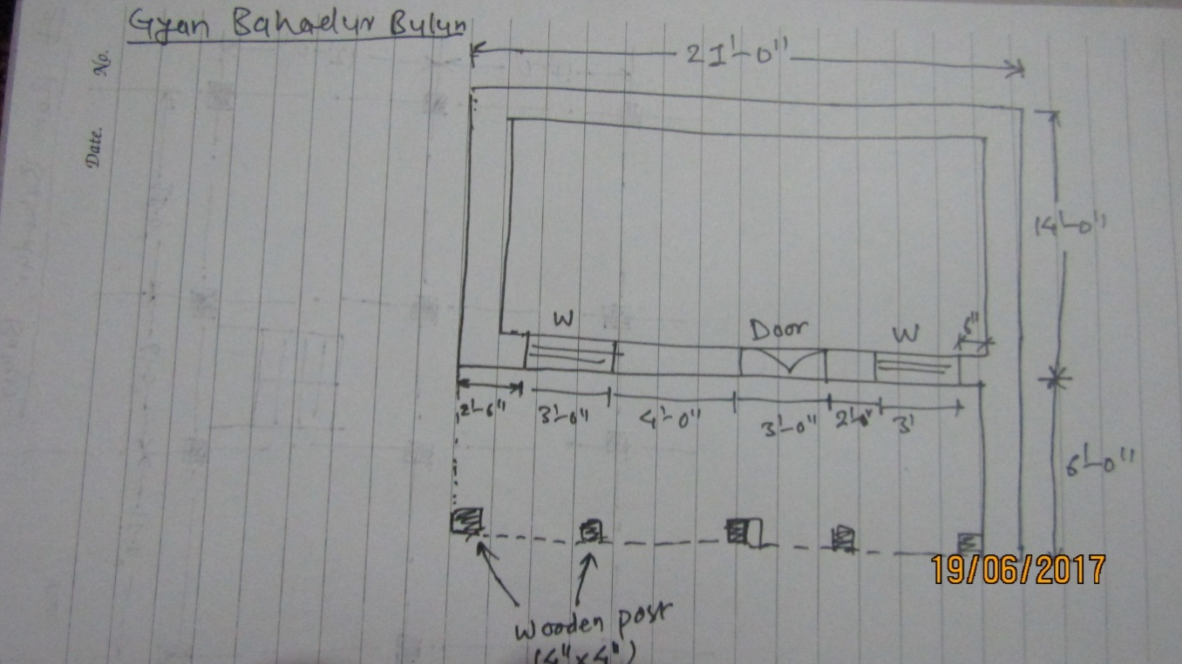
Non Compliance Issue
Name: Gyan Bahadur Bulun GoN Housing Reconstruction Programme ID No: 29-10-7-0-1
Load bearing hybrid structure (stone and mud mortar masonry and timber); foundation = 3’-0’’ deep; absence of seismic bands; Room size=21’-0’’ X 19’-0’’ (Compliance requirements=145ft sq.) Height= 14’-6’’ (7’-6’’ up to first floor and 7’-0’’ up to roof) Cost of construction: 4 lakh
Source :District Support Engineer

Slide 16
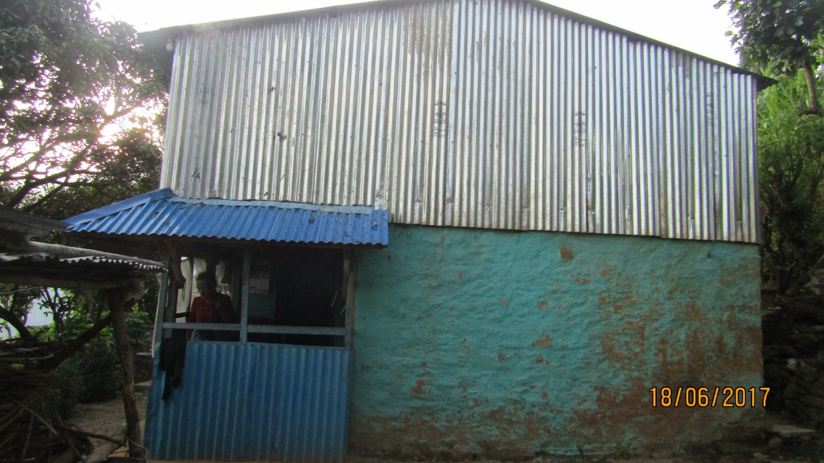
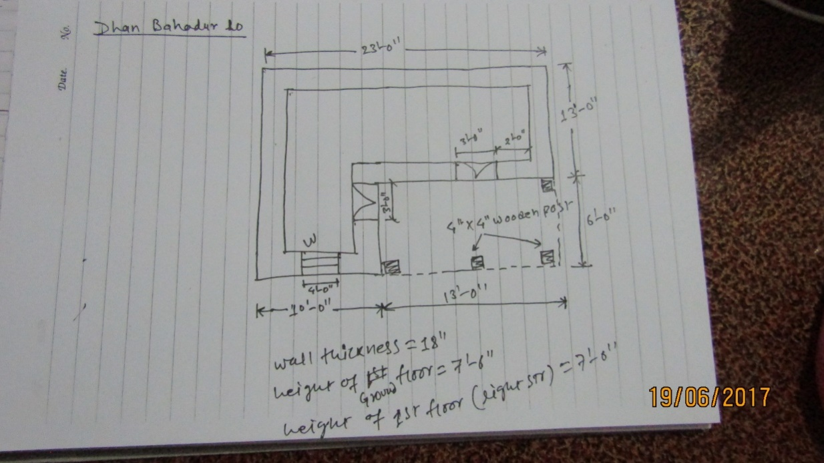
Non Compliance Issue
Name :DhanBahadur lo / GoN Housing Reconstruction Programme ID No :29-10-7-0-67/ SMM (Hybrid structure)
Foundation= 3’-0’’ deep, Absence of seismic bands, Room size=23’-0’’ X19’;Height= 14’-6’’ (7’-6’’ up to first floor and 7’-0’’ up to roof)Cost Of Construction =4 lakh 50 thousand
Source :District Support Engineer

Slide 17
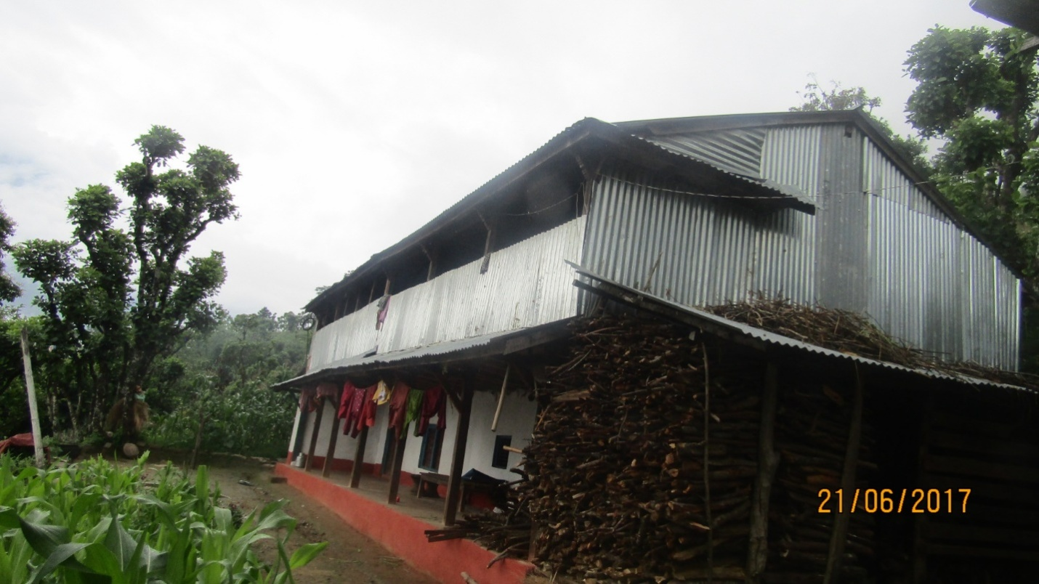
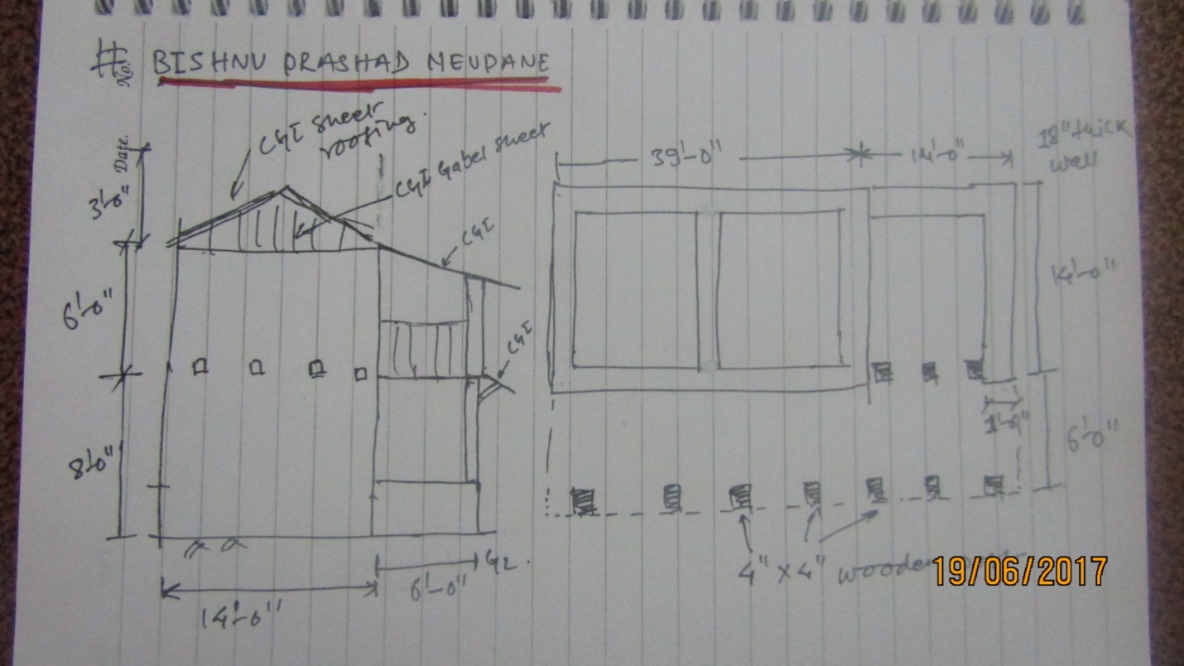
Non Compliance Issue
Name :Bishnu Prasad Neupane / GoN Housing Reconstruction Programme ID No :29-10-7-0-84
Load bearing structure (stone with mud mortar); Foundation= 3’-0’’ deep; No any seismic band; Room size=39’-0’’ X 14’ (with additional room on side 14’-0’’X14’-0’’), Height= 15’-0’’ (7’-0’’ up to first floor and 5’-0’’ attic and gable part=3’-0’’ with light STR); Cost of Construction =5 lakh
Source :District Support Engineer

Slide 18
Partners Update
LWF /Manakor
Lumanti /Cordaid
Nepal Red cross society (NRCS)
OM Nepal
SP
Helvetas
Paurakhi Nepal /ASF
Batash Foundation
Pratical Action / JJMS
GIZ

Slide 19
Thank You

