Slide 1
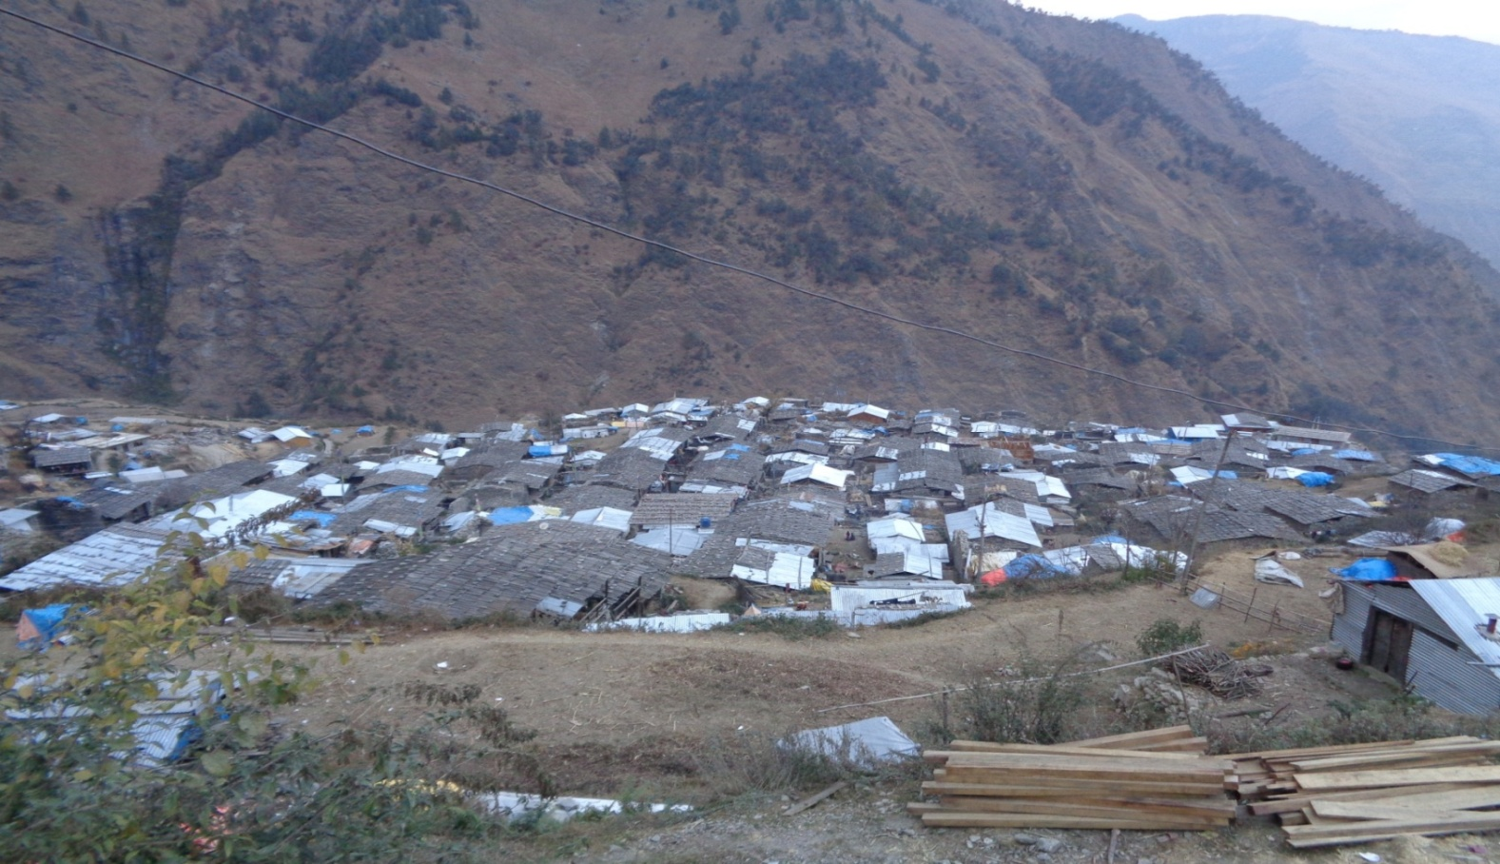
Repair and reconstruction project (Technical support) Gatlang Rasuwa
Welcome
District exhibition
18th April,2018
Dhunche Rasuwa

Slide 2
Briefing of the Project
Title :- CarLUX Project
Donor :- Caritas Luxemburg
Implementing By: ASF Nepal
CRATerre Pourakhi,Nepal
Duration :- 2 years (upto May 2019)
Working Area :- Gatlang, Rasuwa
Supporting Partner:

Slide 3
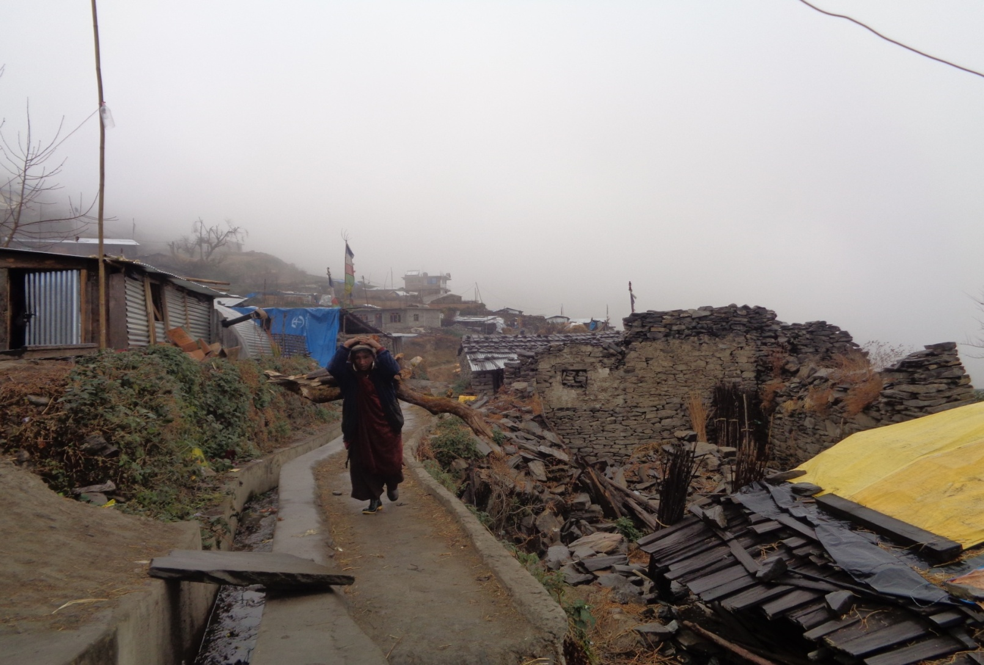
Objectives of the Project
Improve housing conditions in earthquake affected
communities.
Capacity building of mason and carpenter.
Assist people to follow the NRA / DUDBC guidelines for construction of houses.
Minimized internal and international migration.

Slide 4
What we do ……
Construction
Construction of Demo house.
Local Building Culture assessment.
Provide Building Design to the beneficiaries
Monitoring and Supervision of house
Technical assistance to the households.
2. Capacity Building
Study Local Engineering/Technique
Strengthen the capacity of Masons, Carpenters and labors through on the job trainings

Slide 5
Continue ……
Creating awareness in community people about safer and better construction
Training specific for repairing/retrofitting techniques.
3. Financial support
To assure Financial support from government to the beneficiaries.
Support for the most vulnerable people

Slide 6
Scenario of Gatlang
Remote part of Rasuwa; altitude of 2222m
Popular Tamang Heritage Trail
Black Beans (Tamra) and Potato are the staple food
Black roof (wooden roof) and Dry masonry wall
Unique methodology and construction tradition
Farming, Home stay tourism and trekking is their main occupation
Local construction materials are Stone and wood
Houses are arranged in one cluster(ward 1-6)

Slide 7
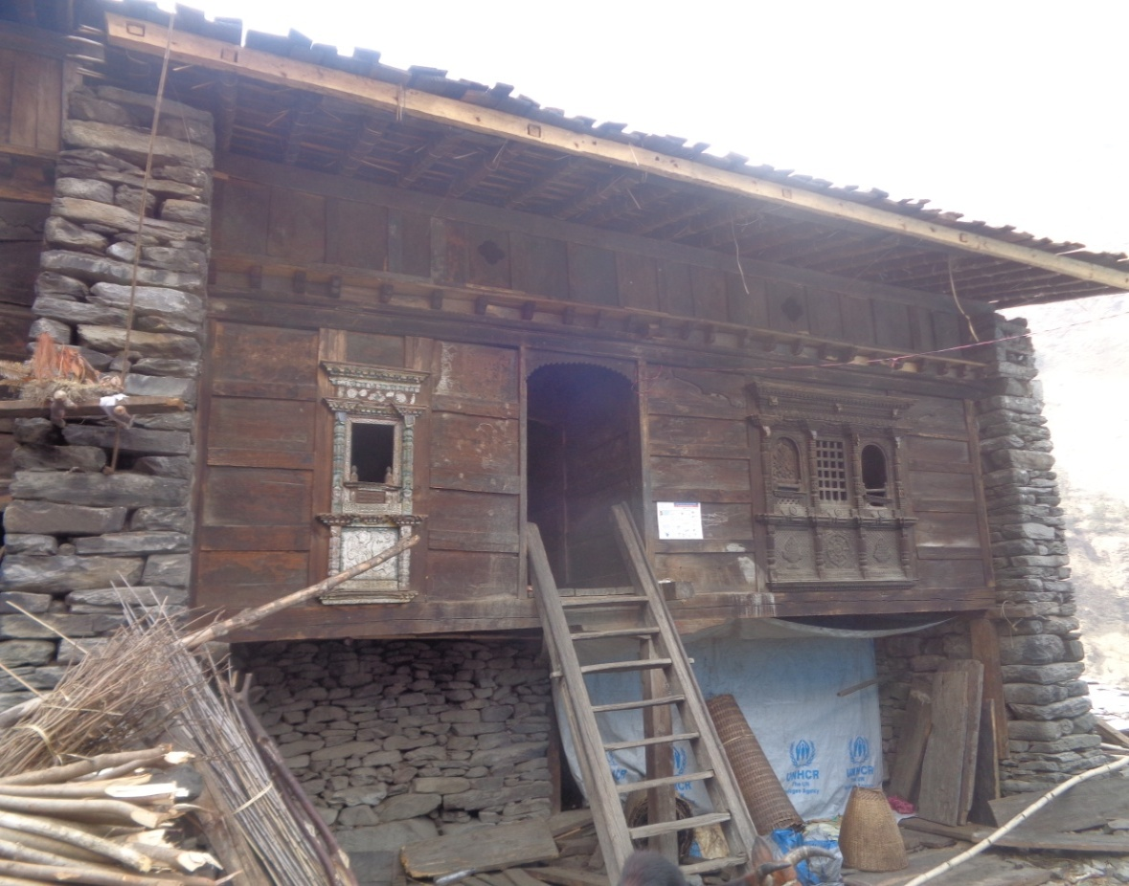
Local Building Culture of Gatlang
Black wooden planks
on roof.
Stone masonry wall
(Dry)
Common wall between
adjacent houses.
Big Stones in wall
Floor of wooden planks
Ground floor for animal shed

Slide 8
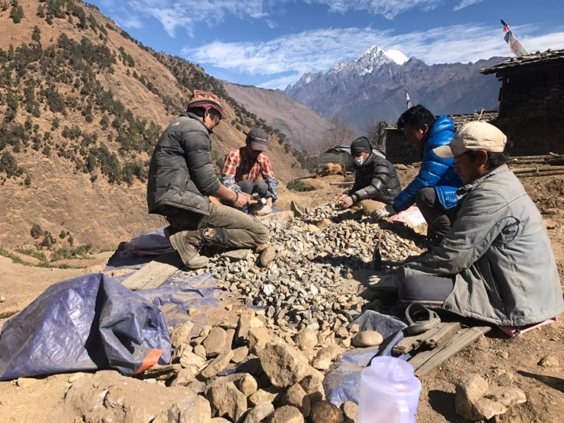
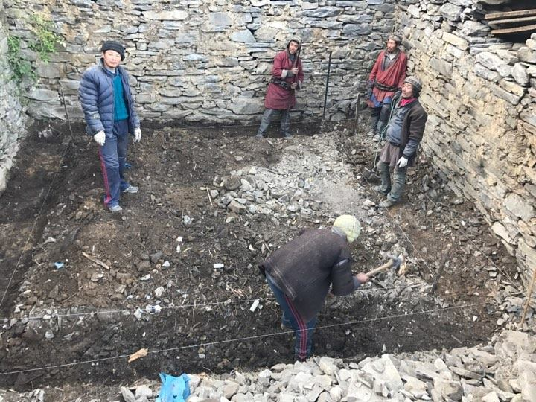
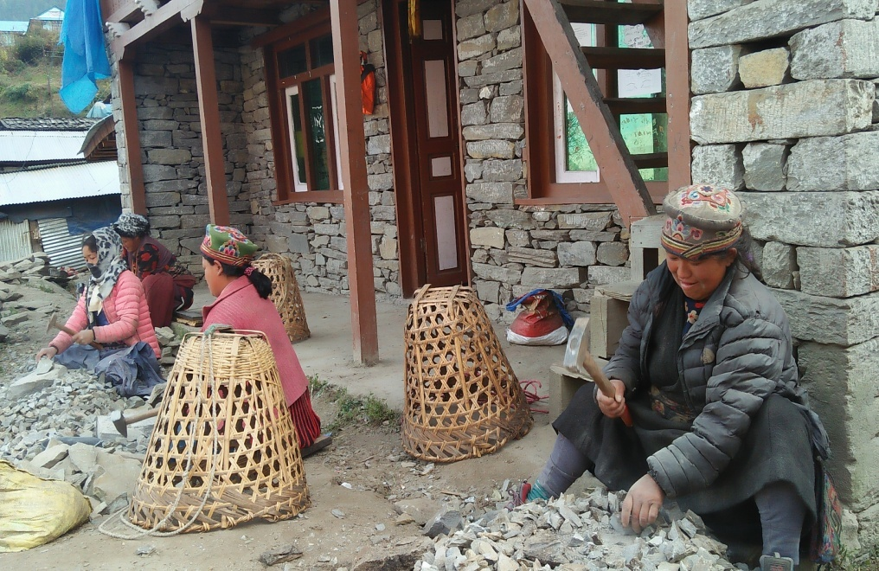
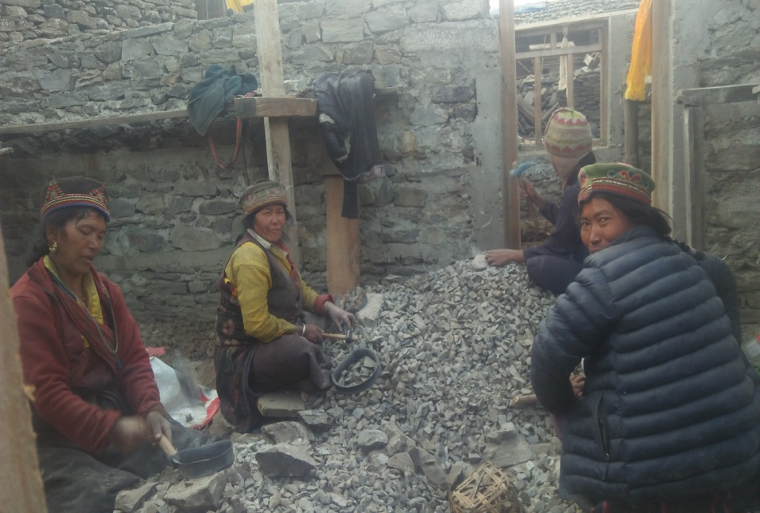
Activities ……..
1. Continuous of Parma system

Slide 9
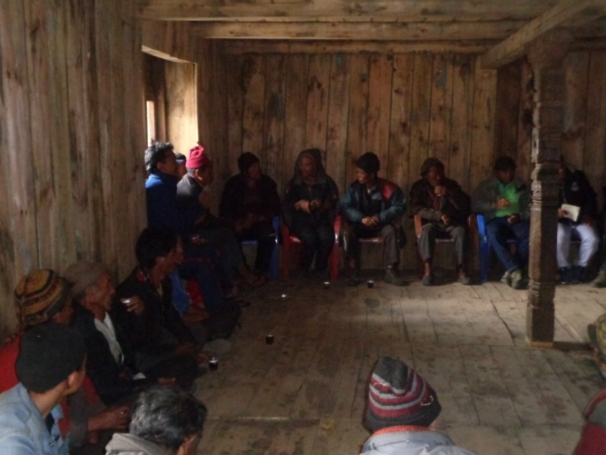
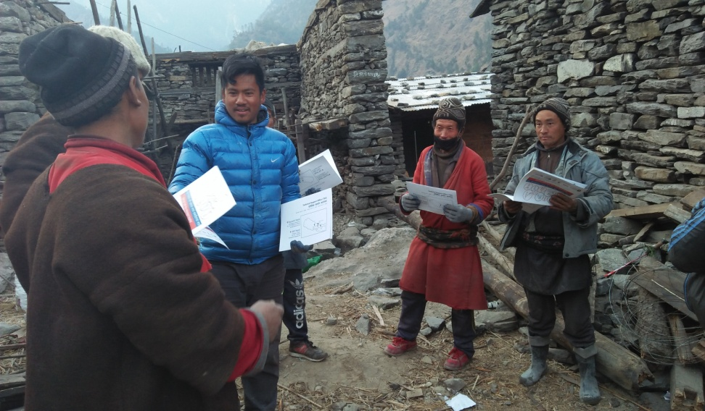
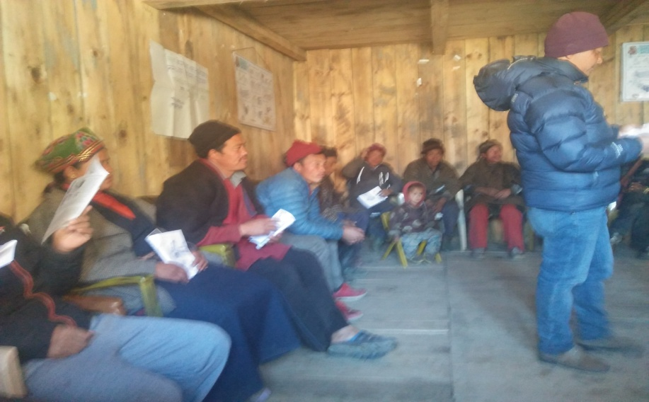
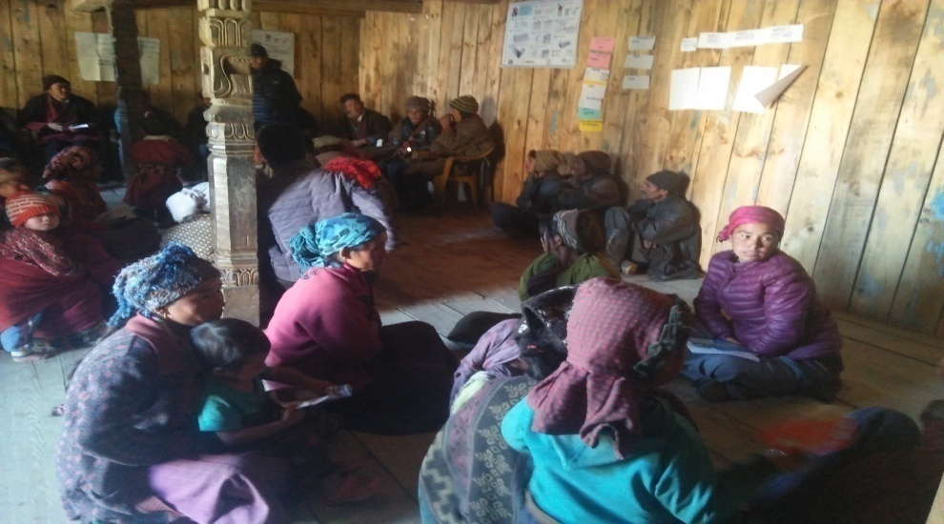
Sensitize and aware People for healthy and safer house regarding LBC
/Leaflet/Ten Key message distribution
.

Slide 10
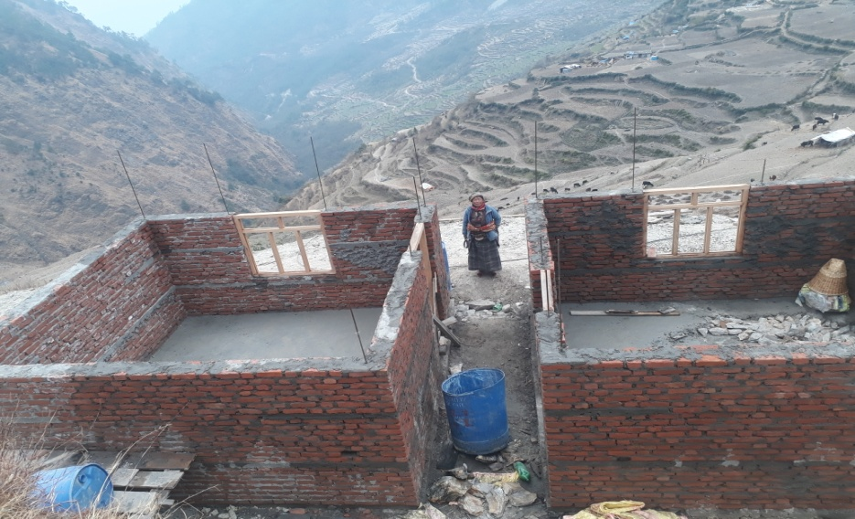
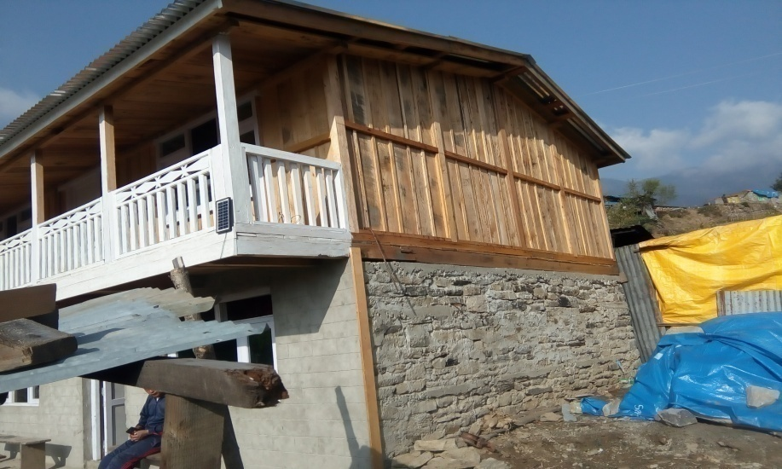
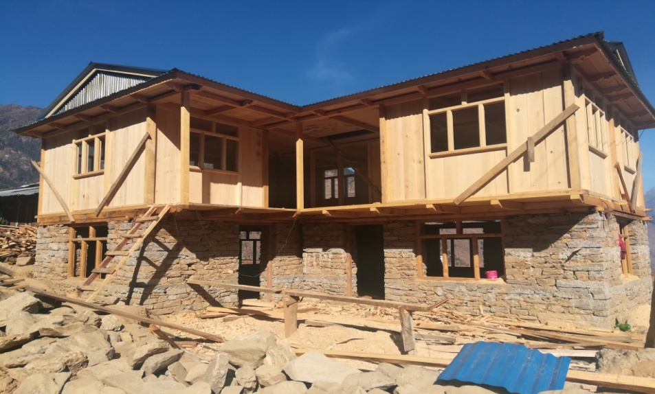
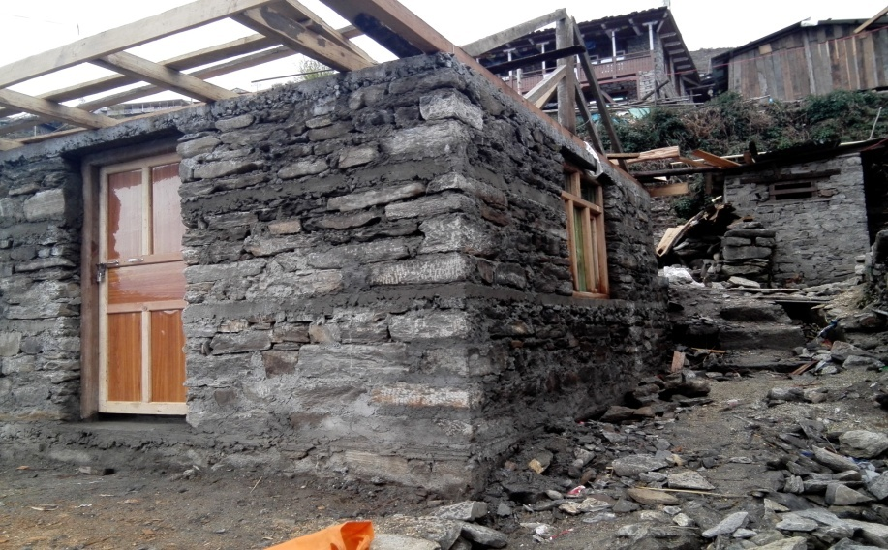
3. Technical assistance for reconstruction.

Slide 11
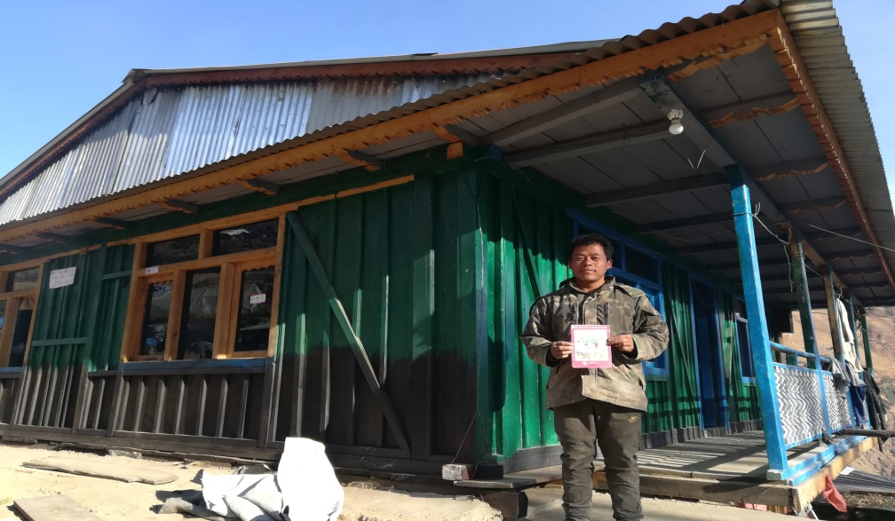
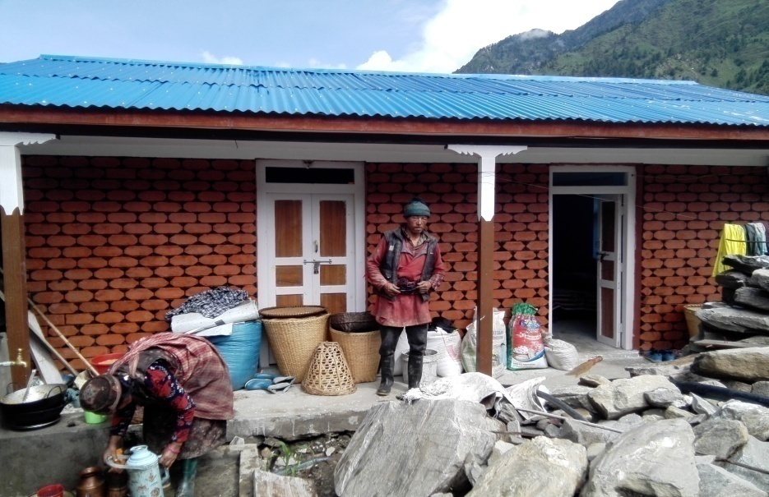
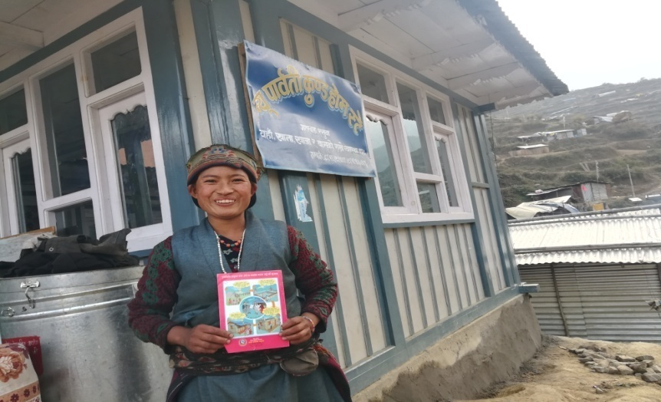
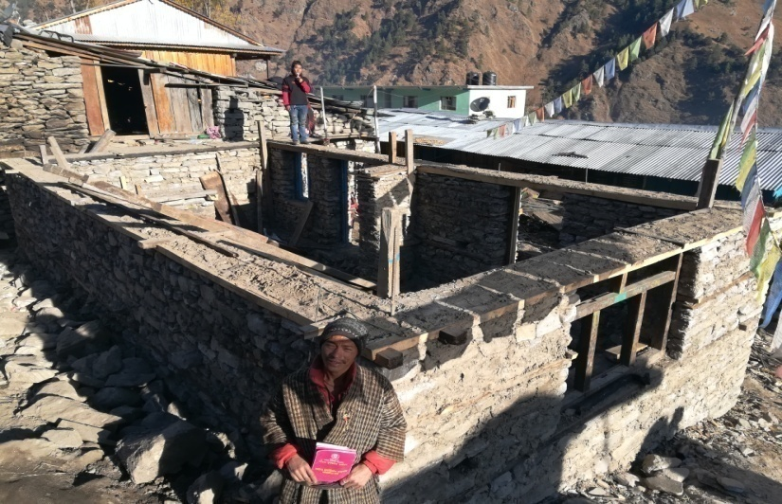
4. Happy beneficiaries.

Slide 12
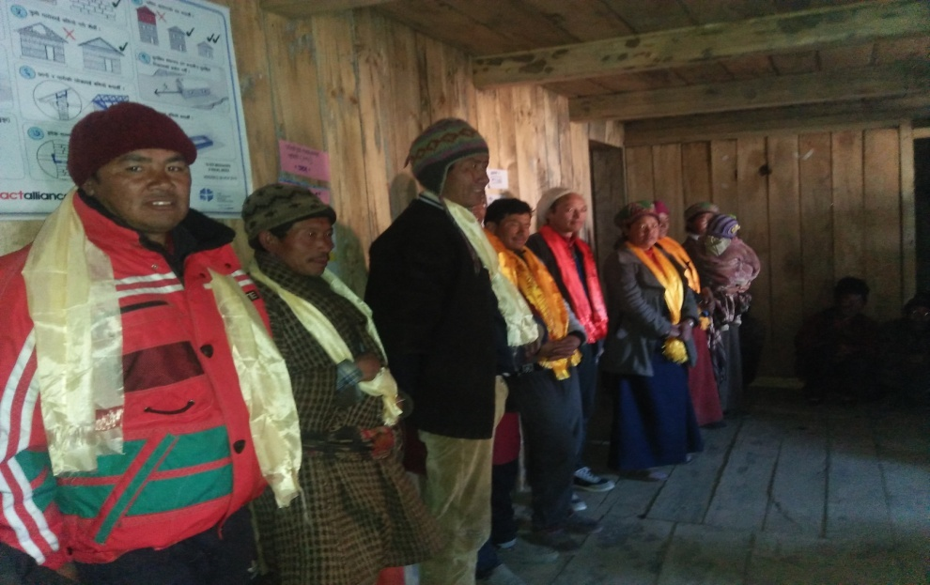
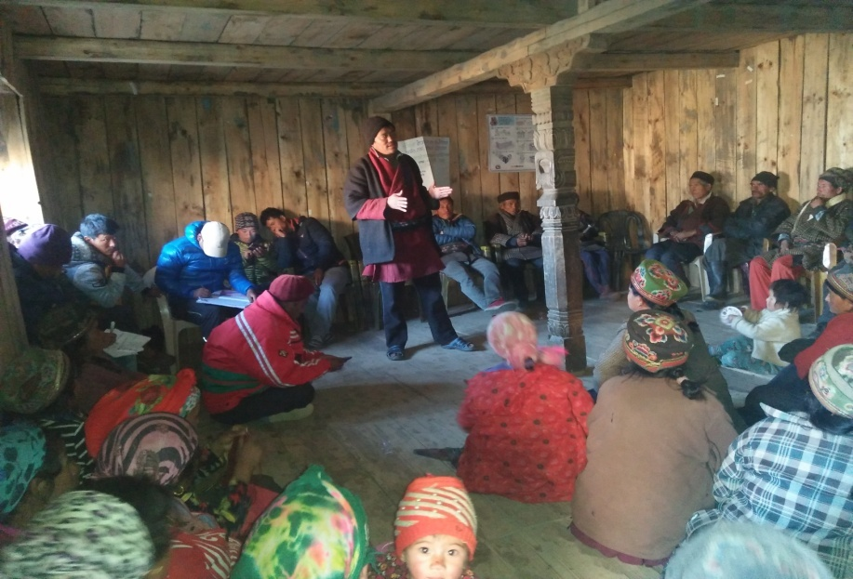
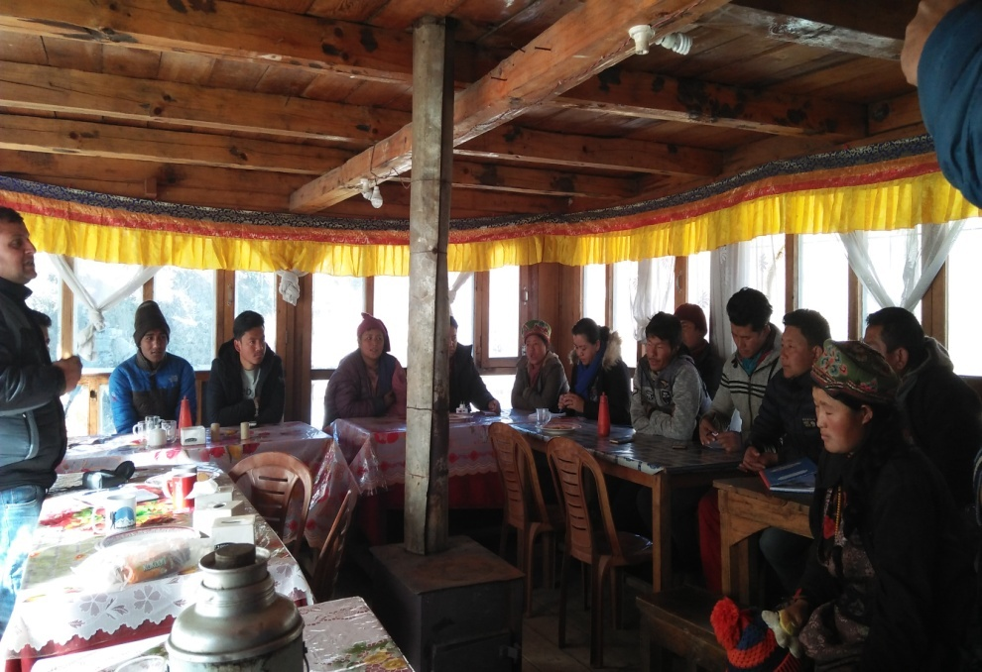
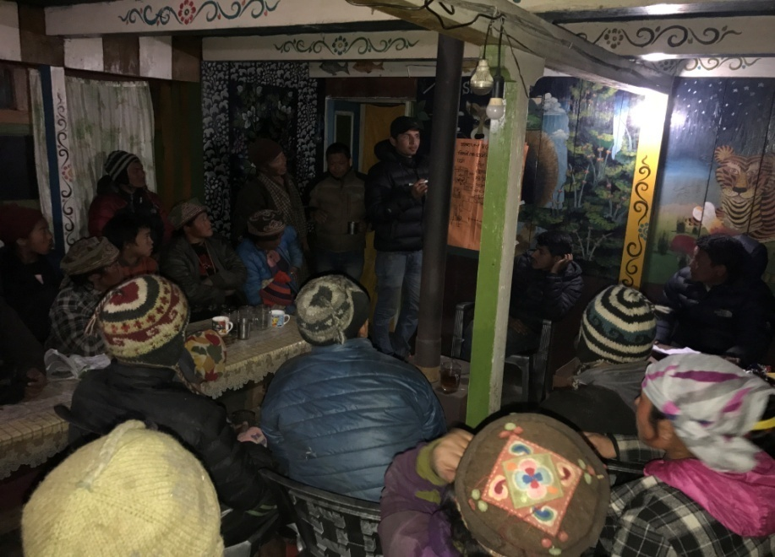
5. PMC /Cluster committee formation & Mass meeting.

Slide 13
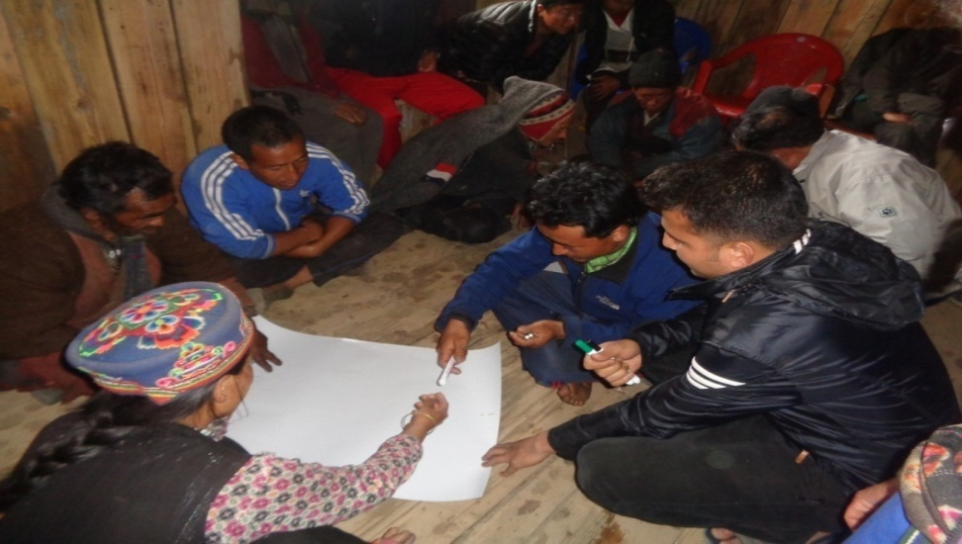
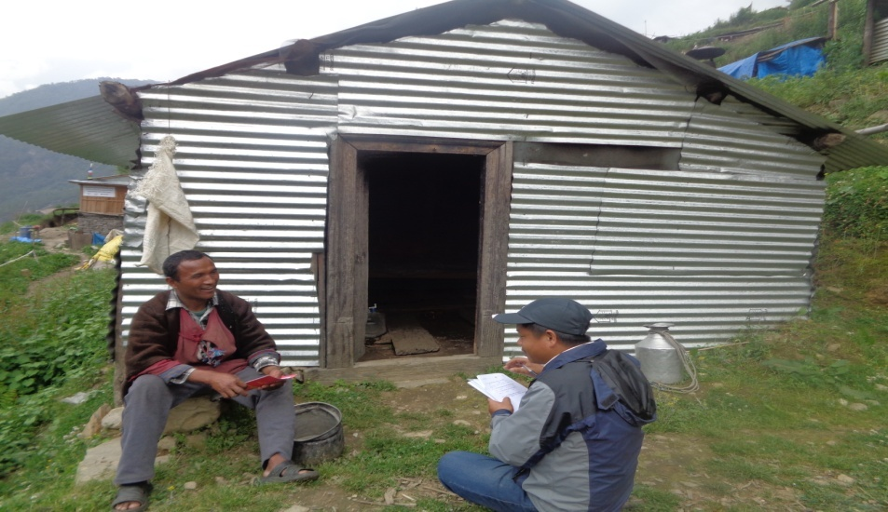

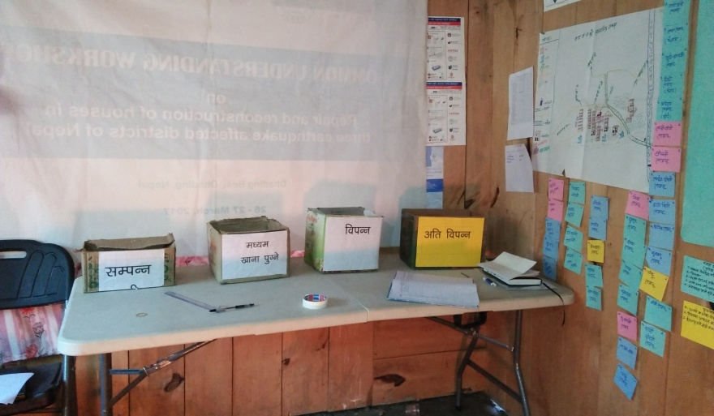
6. Social Mapping
7. Household survey
8. Well being ranking

Slide 14
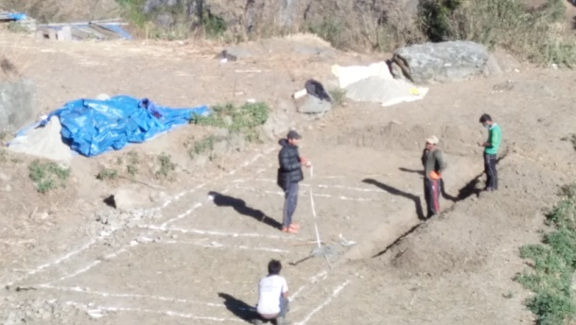
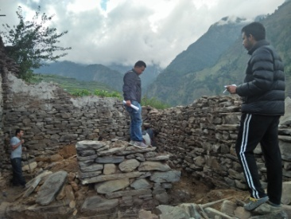
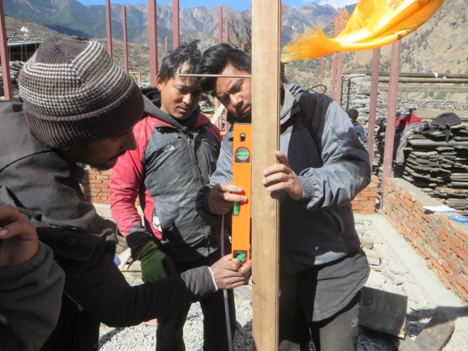
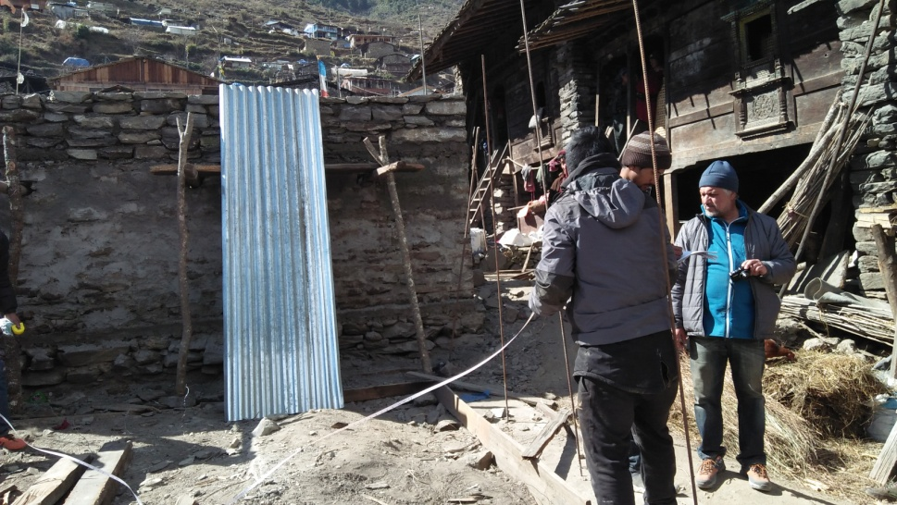
9. Site supervision and support

Slide 15
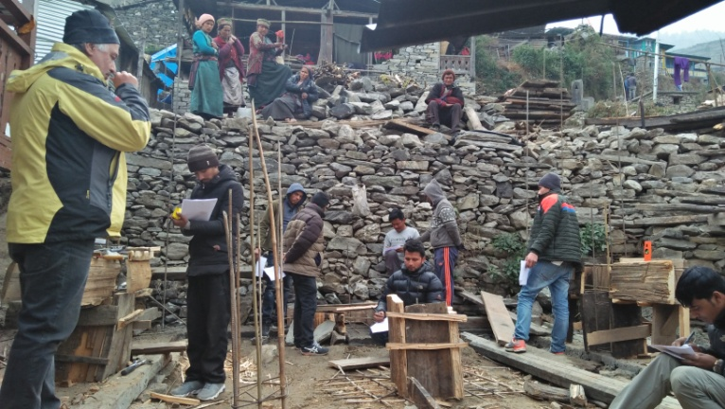
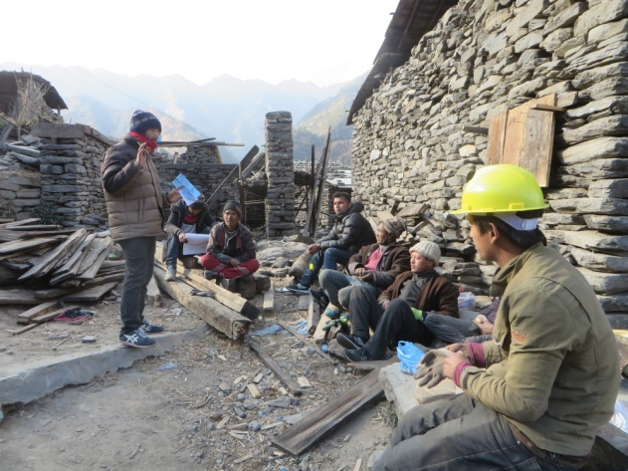
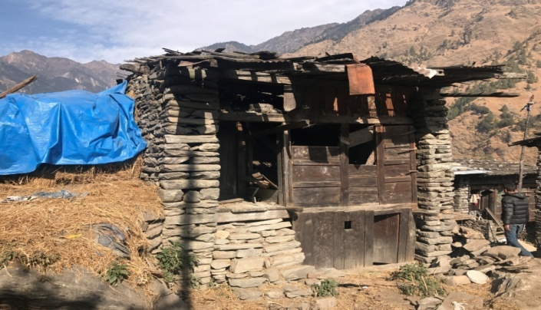
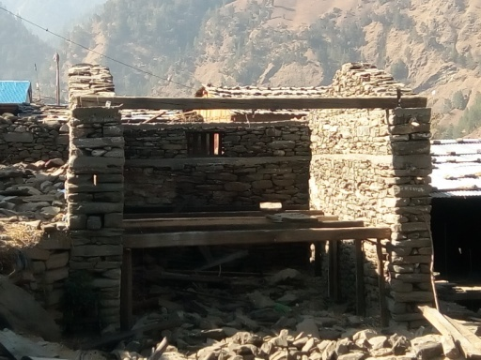
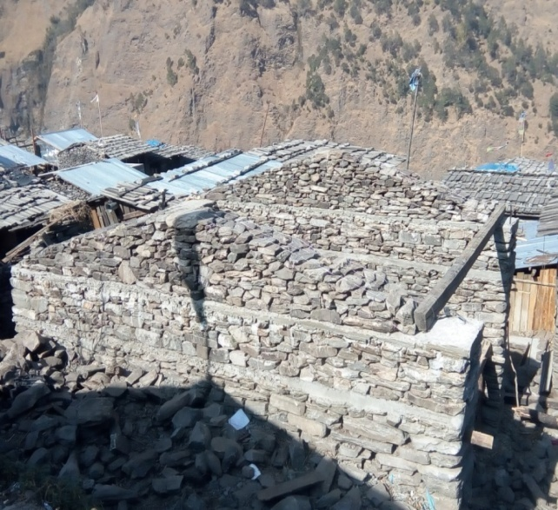
10. Training of repairing houses
Before
After

Slide 16
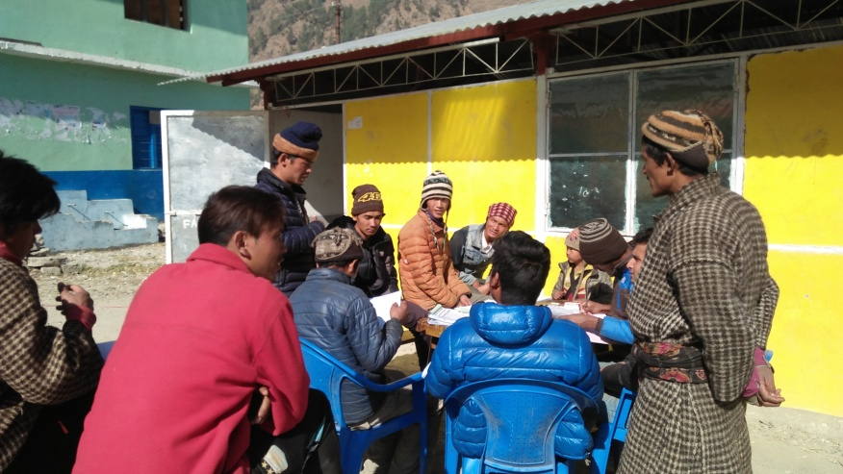
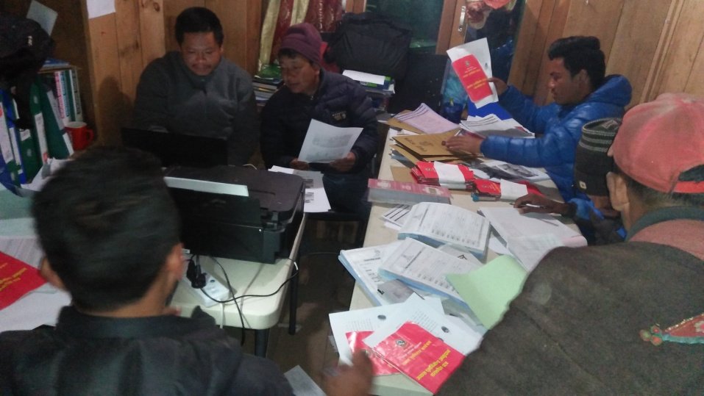
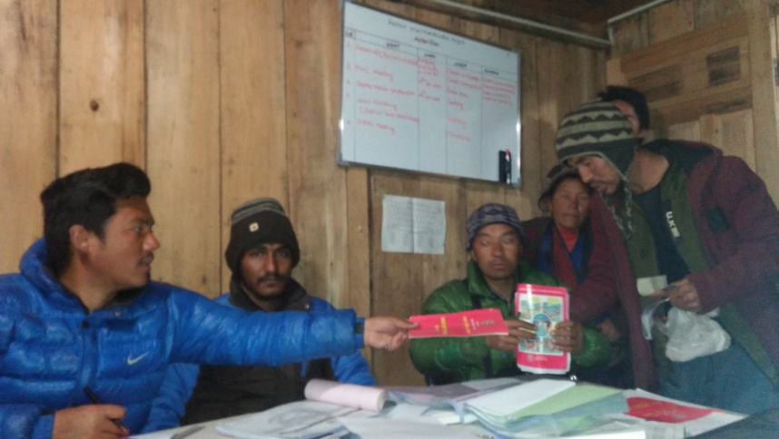
8. Campaign/joint service with Local GoN bodies

Slide 17
Reconstrution update
Source: EHRP Rasuwa
2074/12/28

Slide 18
II tranche
Tranche received:287 HHs
Recommendation(on process): 80 HHs
Not started: 11 HHs
Source: EHRP Rasuwa
2074/12/28

Slide 19
New update
I tranche received: 378 HHs
II Tranche received and recom: 371 HHs
III Tranche received and recom: 107 HHs
Construction not restarted: 7 HHs

Slide 20
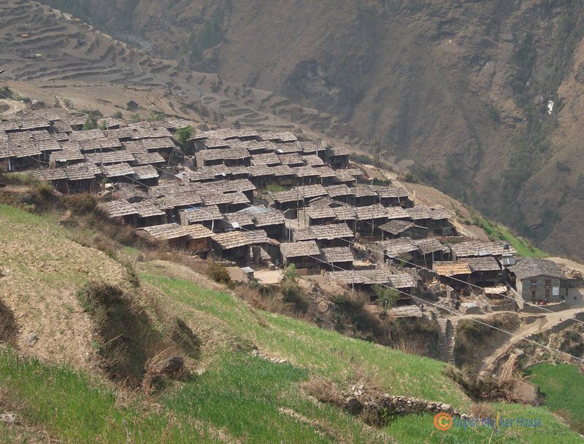
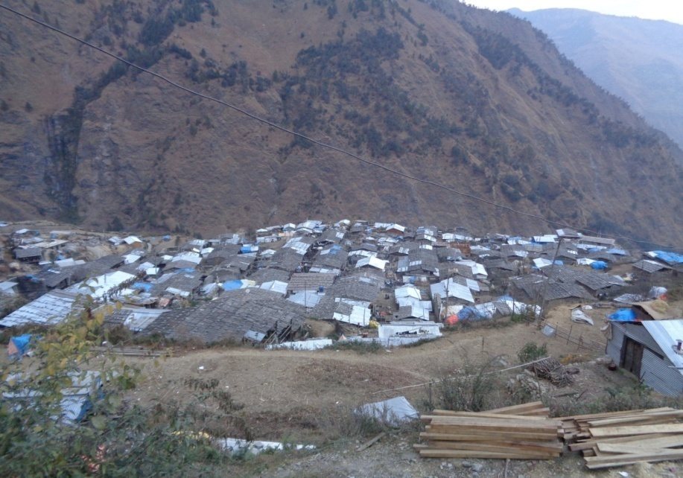
Challenges
Old identity
New identity
VS
Black Village
Silver Village

Slide 21
Challenges
Appropriative design for Gatlang
Highly Increased in mason rate.
Scarcity of skill mason and carpenter
Inadequate land inside cluster
Scarcity of good quality of wood
Lack of quality construction materials
High transportation rate

Slide 22
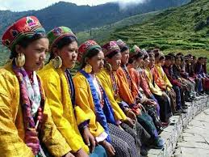
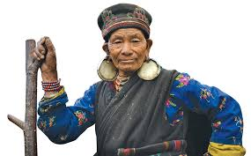
Thank You

