Slide 1
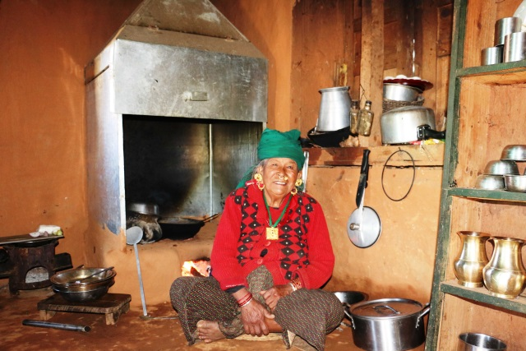
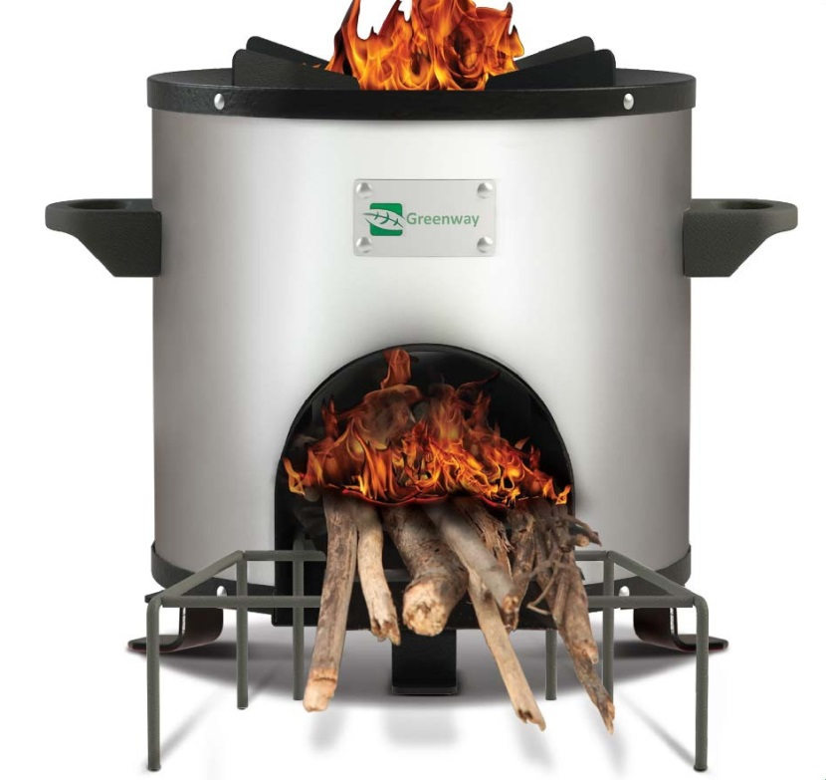
Result Based Financing for
Sustainable Improved Cookstoves Market in Nepal Project
12.03.14

Slide 2
Main objective of sharing session
Strengthening Synergies with HRRP Partners for achieving indoor air pollution free healthy kitchen in reconstructed houses

Slide 3
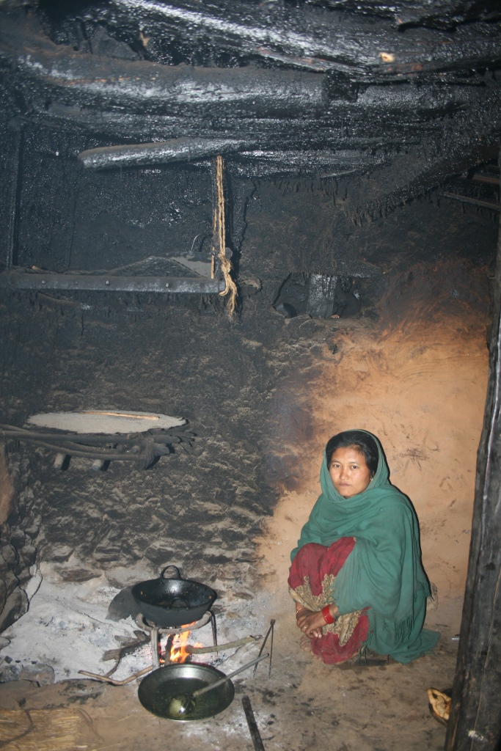
Background/Context
In Nepal
More than 22,000 persons (mainly women and children) die prematurely due to household air pollution. Around 225,558 DALYs.
4.5 hours of exposure to smoke from traditional stove is equivalent to smoking approximately 20 packs of cigarettes per day
Significant time (around 100days/HH) is spent for fuel collection & processing
Women are most vulnerable to household air pollution and drudgery related to fuel collection/processing.
Nepal Government is committed for providing Clean Cooking Solutions for All

Slide 4
Project Objectives
Develop sustainable market of clean Cookstoves
Strengthen private-sector led clean Cookstoves marketing approach
Contribute to minimize respiratory health problems in rural Nepal
Target: Benefit 34,900 HHs.
Duration: 5 years (Aug. 2014- July 2019)

Slide 5
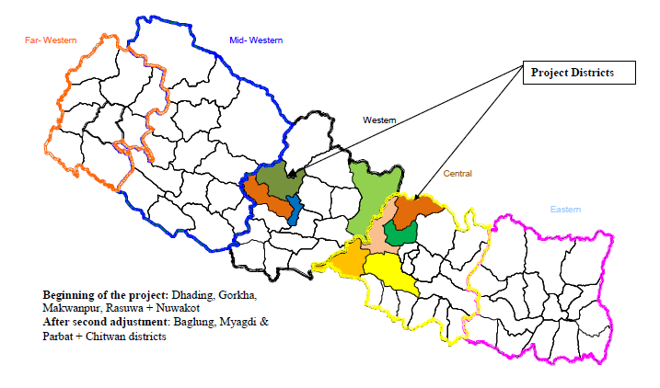
Geographic locations
Expanding to adjoining districts also

Slide 6
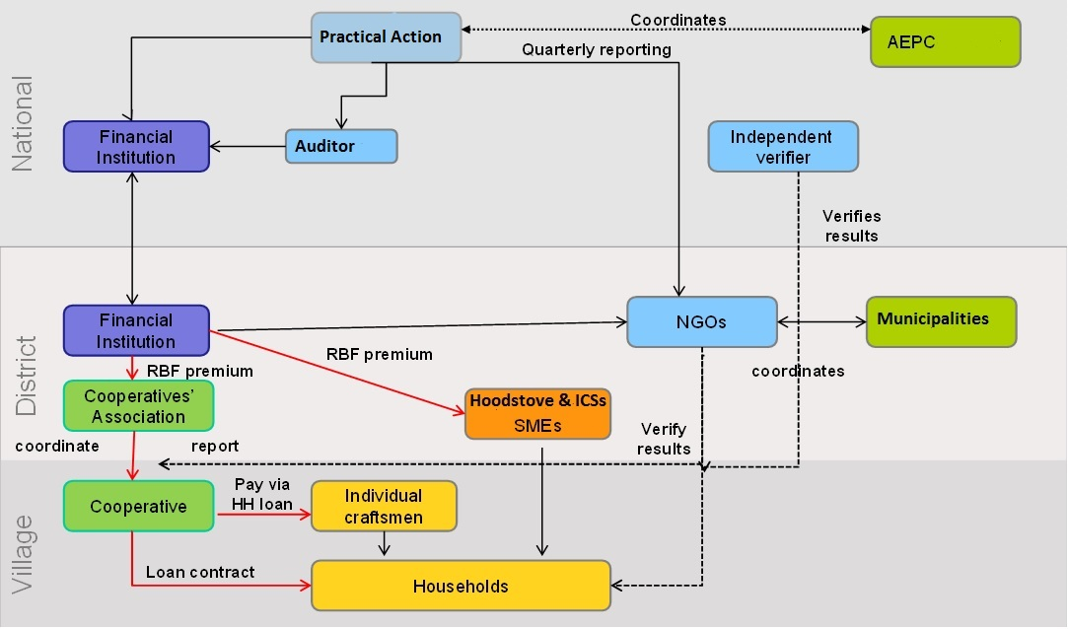
Institutional set-up

Slide 7
Key features of the project

Slide 8
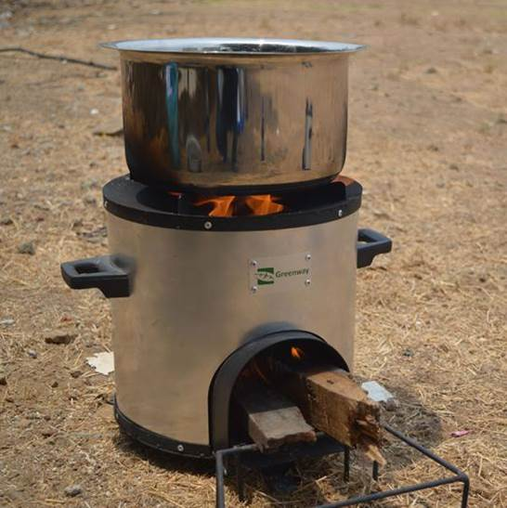
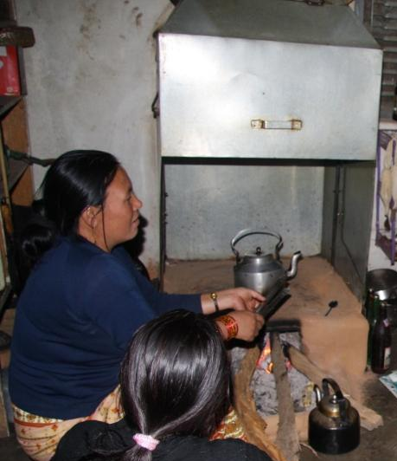
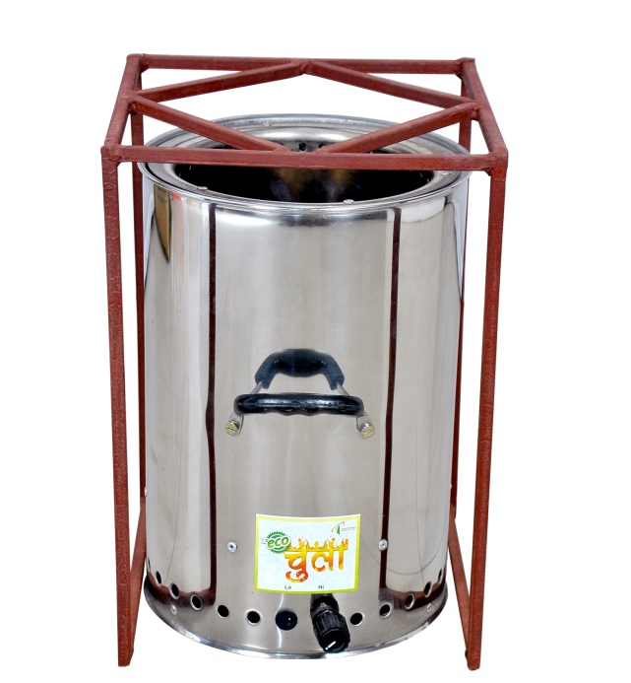
1. Focus on Consumer’s choice (21 types, RETS certified stoves)
Natural draft cookstove
Forced draft cookstove
Fixed type – Hood stove

Slide 9
Benefits of the Cookstoves
Reduction in household air pollution by 60-90%.
Significant health benefits of ICS resulting in reduction in treatment cost and savings in days loss due to ill health.
Fuel savings – on average 50% – leading to time saving in firewood collection and drudgery reduction (50 days/year).
About 2.0 - 2.5 tones of greenhouse gases emission reduction per stove annually
Cooking time saving – around 30 minutes per day.
Other benefits include:
Cleaner kitchen & other indirect benefits

Slide 10
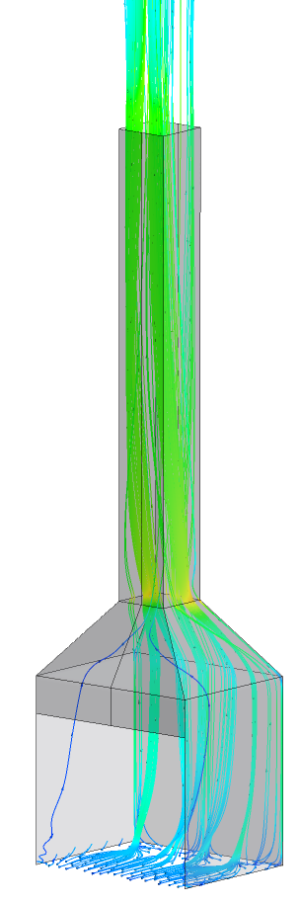
Benefits of Hood-stoves
Helps to increase combustion efficiency
Due to good extraction of smoke and air, air flow to stove is better with hood-stove
Flexibility in stove choices
Simple technology, possible to fabricate and maintain locally
Flexible design to meet local needs (meat drying, Small smoke duct directs smoke to beams)
Heat radiation keeps kitchen warm
Notes:
To change the layout of the slide click on Format/Slide layout and the options will appear in the task pane on the right
To change the picture select the picture and choose Insert/Picture from file. Select your picture and insert. Remember that if you wish to use a landscape format picture you will need to change the layout of the slide.

Slide 11
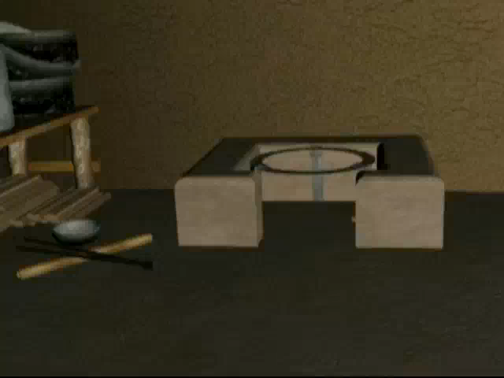
Hoodstoves
Notes:
To change the layout of the slide click on Format/Slide layout and the options will appear in the task pane on the right
To change the picture select the picture and choose Insert/Picture from file. Select your picture and insert. Remember that if you wish to use a landscape format picture you will need to change the layout of the slide.

Slide 12
2. Incentives to inspire Key Market Actors
RBF Incentives
Cookstoves Distributors
Cooperatives/MFIs
Incentives for up-front investment and taking risk
Discount to users
(40% of MRP)
Management, documentation reporting and marketing cost
(Rs. 500/stove)
Marketing & documentation cost (Rs.400/stove)
Incentives for creating credit- lines for cookstoves
Provide soft loan to borrowers
(50% of interest rate)

Slide 13

3. Systemic Market Development Approach
Enabling Environment
AEPC
Local Governments
Supply Chain
Retailers
Customer Segments
Manufacturers
Distributors
Residential
Marketing
Agents
Importers
Rs
Commercial
Installers
Installers
Support Services
Cooperatives
or MFIs
Cooperative
Association/MFI
RBF Fund
Manager Bank
Rs
3rd party verifier & Audit company
NGO
National
Local
District

Slide 14
4. Strong Monitoring & Verification
Local cook-stove retailers do upfront investment and take risk for developing clean cook-stove market (marketing, sales and provide warantee)
Local cooperatives or MFIs provide loan to customers
Result Creation
3rd party Independent Verification (Annually)
Result verification by NGO partners (on monthly basis)
RBF Fund Manager: NMB Bank
95% Payment of RBF Incentives to Local distributors based on results
Balanced 5% payment

Slide 15
Achievements and Impacts

Slide 16
Cookstoves sales, Job Creation and Women Participation
Enabling Environment
Total
29
Women
8.7%
Total
26,000
Women
26,000
Supply Chain
Retailers
Customer Segments
Manufacturers
Distributors
Residential
Marketing
Agents
Importers
Commercial
Installers
Installers
Total
12
Women
0
Support Services
Total
72
Women
36 (50%)
Cooperatives
or MFIs
Total
124
Women
40 (48%) 52% Mixed
Total Job Creation
Total
216
Women
30%

Slide 17
Value for Money
Very high positive externalities and health and time saving benefits to poor families mainly to women and children.
€ per person gaining access - €7.33
EUR per t CO2e avoided - €3.90
Target of 343,200 t CO2e avoided (over the lifetime of products sold during project)
private sector leverage ratio – 1:1
EIRR of 148% & Benefit cost ratio of 9.4.
Created sustainable market of improved cookstoves
35 enterprises created/upgraded
178 jobs created. Among them 38.8% are female.

Slide 18
Case Study-1
“After living all my life in a smoke filled house, I finally can feel my days of suffering are over,” Sona says.
“I might not live longer to enjoy the smoke free life but my coming generations will and I am glad my life is better now.”

Slide 19
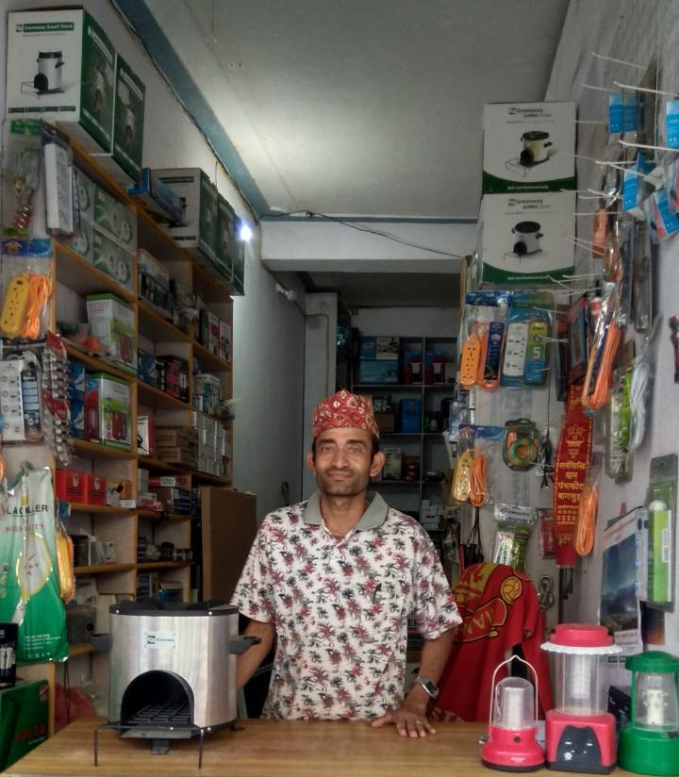
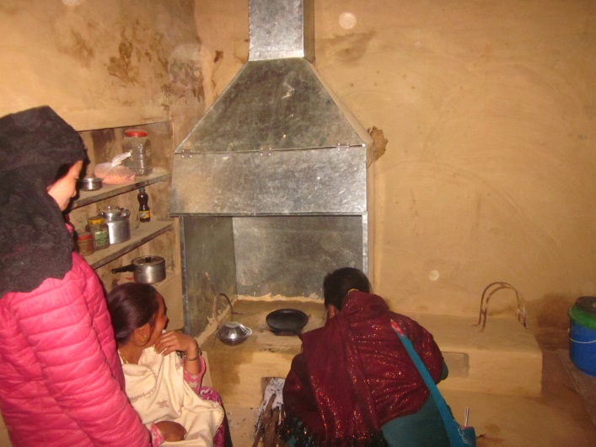
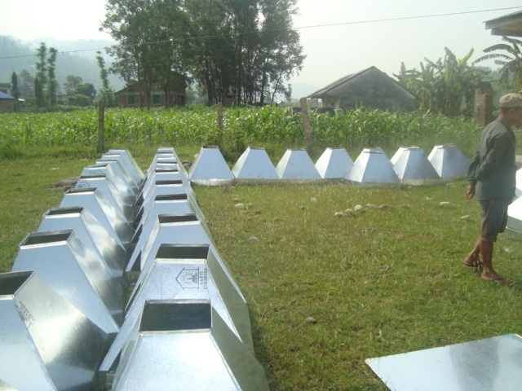
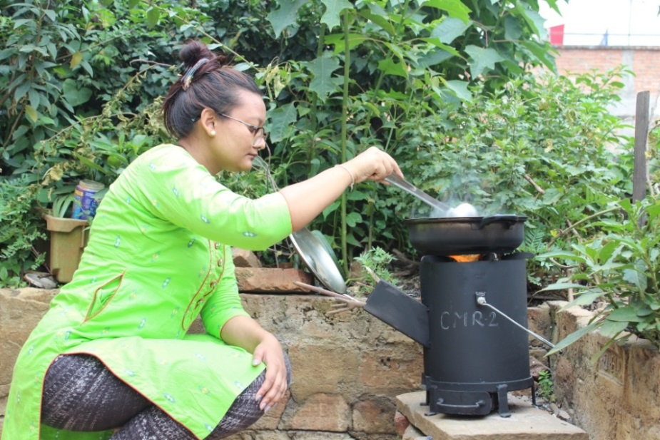

Slide 20
Strengthening Synergies with HRRP Partners

Slide 21
Possible areas of supports
Creating awareness on negative health and environmental impacts of household air pollution and make home free of it;
Make people aware about the project and available RBF incentives from the project;
Design kitchen suitable enough to install a hoodstove and make kitchen free of household air pollution. Promote separate kitchen construction.
Support entrepreneurs promoted by our project to organize marketing campaigns in the reconstruction project villages
Facilitate linkage between the masons, other skilled human resources and the RBF project, existing entrepreneurs to install hood-stove also.

Slide 22
Thank you
For further information:
min.malla@practicalaction.org.np
www.practicalaction.org

Slide 23

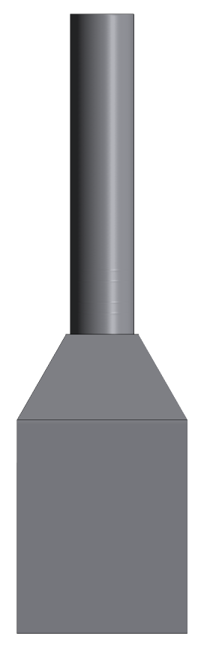
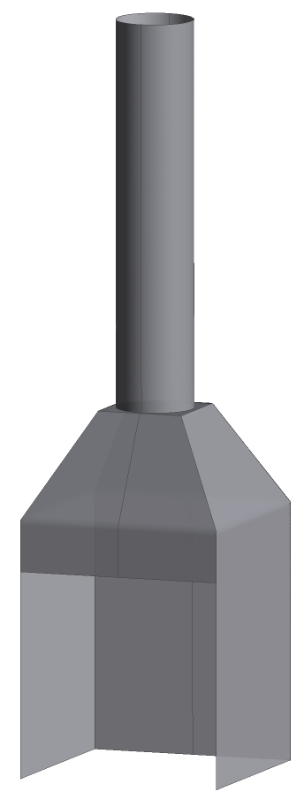
Dimensions of Smoke Hood
Config 1: medium
Ø 0.3m
L ≥ 1.5m
0.34m
0.34m
1.4m
1m
0.8m
0.8m
0.8m
3D view
front view
side view

Slide 24

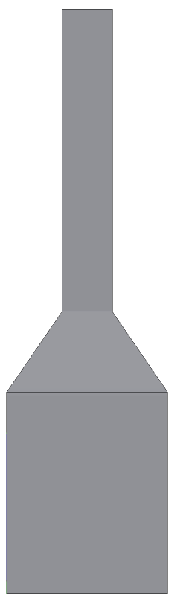
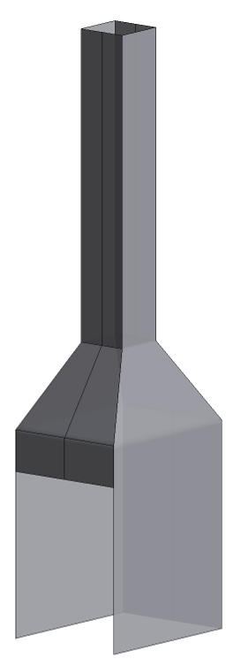
Dimensions of Smoke Hood
Config 2: small
□ 0.25m
L ≥ 1.5m
1.4m
1m
0.8m
0.6m
0.8m
3D view
front view
side view

Slide 25
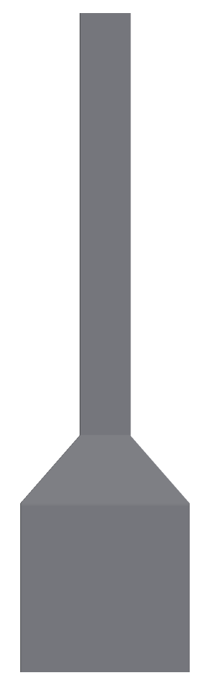
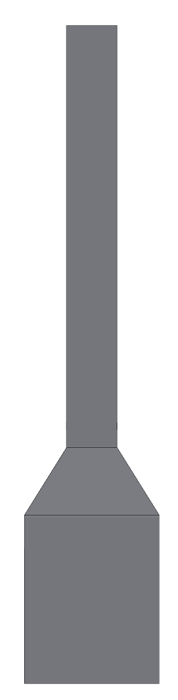
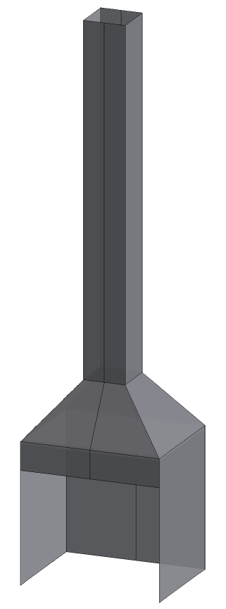
Dimensions of Smoke Hood
Config 3: big
□ 0.3m
L ≥ 2.5m
1.4m
1.0m
0.8m
1m
0.8m
3D view
front view
side view

