Slide 1
HRRP Information Management
HRRP
Date: 5 May 2016
Venue: Rasuwa, DDC

Slide 2
Agenda
1. Information Management Overview
Coordination Mechanism
3. Information Analysis
Product Showcase and Demo
5. Q & A

Slide 3
Introduction
Information management (IM) is the collection and management of information from one or more sources and the distribution of that information to one or more audiences.
an integral part of preparing for and responding to needs and challenges (development/humanitarian contexts).
an integral part of every day work of local government to best serve the population.

Slide 4
A cliché , but true
Its no less true for being repeated, but for many organization their information and knowledge
Is there greatest assets.
Unfortunately is it often under utilized. Many organizations don’t recognize information as an assess or entity in itself, and they don’t know
how to manage it effectively

Slide 5
!!!
Lack of knowledge and information is an obvious causes
For the inability to forecast plan, assess and identify community needs.
In addition , lack of information is a major handicap to solve problems and effective
coordination

Slide 6
HRRP IM process continuum
HRRP information management unit working with key partners to produce standard information products to support housing and reconstruction to NRA, DUDBC
and on the response operation
These include the Who does What Where and When (4W) project tracking database , contact list, and meeting schedules.

Slide 7
Why is a good information management Important
IM is a central component of coordination
Key element of planning /decision-making
Processing adds values
Confirms /Negates rumors
To increase productivity and saves money
To retain corporate memory ! Records are irreplaceable asset
Enables colleagues to share work in each other to avoid re-doing work

Slide 8
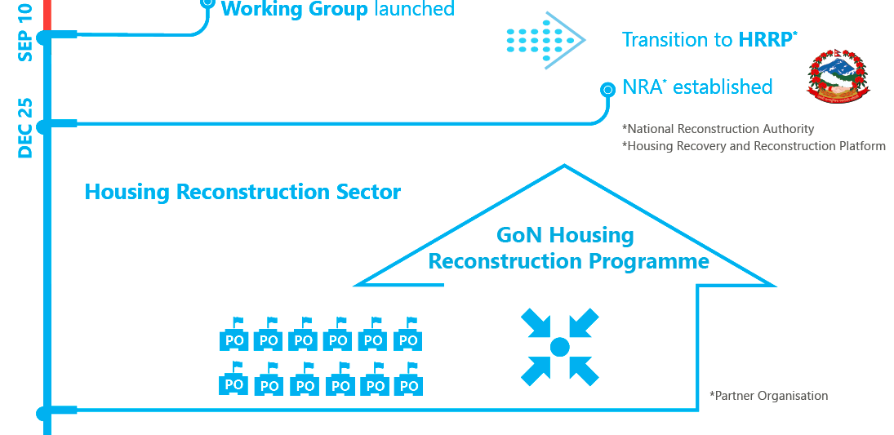
National Coordination Mechanism
HRRP
Partners Organizations

Slide 9
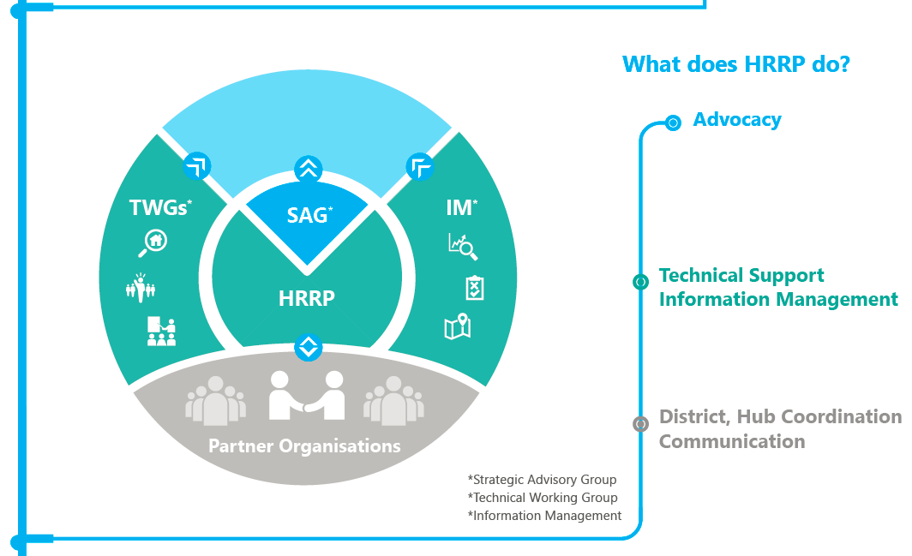
Structural Mechanism

Slide 10
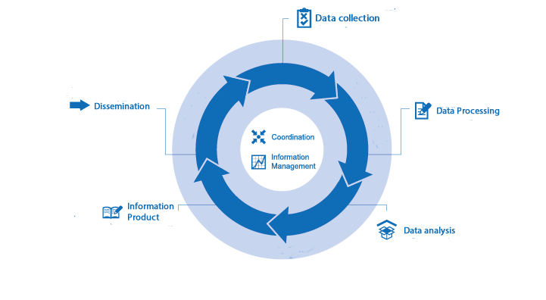
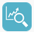
Information Flow

Slide 11






Goal
what
timely decision + action!
when
where
relevant idea!
how far
proper analysis!
who
why
how long
how many

Slide 12
Data to decision-making
8,000 , 22
8,000 households in need of housing grant in 22 VDCs.
There are 2 enrollment centers which covers 6 VDCs.
Need to establish enrollment centers to cover 16 VDCs(coordination, advocacy, coordinated action)
Data
Information
Knowledge
Action
SOURCE: Protection Cluster, Nepal

Slide 13

Analysis
The data can be analyzed further in order to know:
Identify Gaps of services
Future planning for housing related assistance
Compare,
Prioritize
Advocacy at national level

Slide 14
HRRP Information Products
Contact directories/lists
Meeting schedules
Inventory of relevant documents
Guidelines, policies, assessment, evaluations etc.
Who does What Where and When (database)
Its derivative products – coordination tool
Mapping
Inventory of datasets (e.g CoDs and FoDs)
Dashboard – Key figures
Newsletter
Bulletin Boards (eg.BBS materials)

Slide 15
Data analysis software

Slide 16
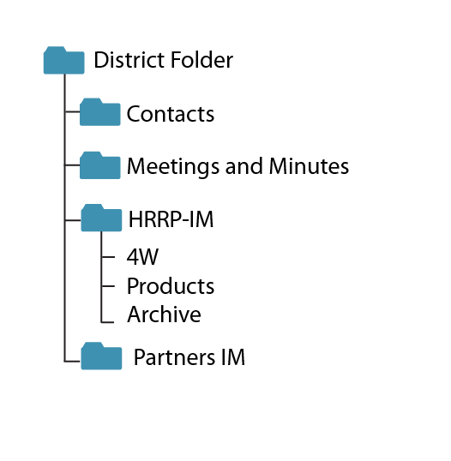
Google Drive Structure

Slide 17
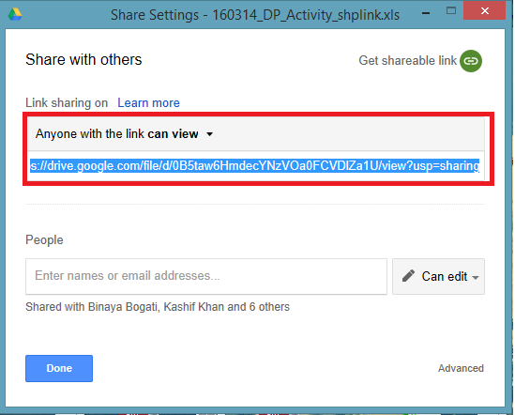
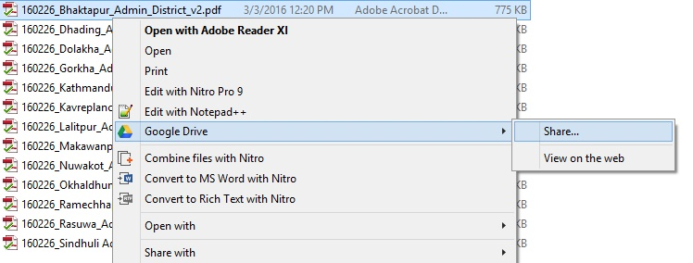
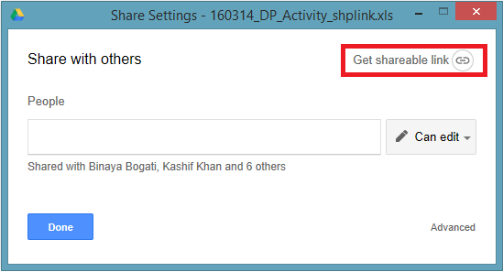
Getting the Share Link

Slide 18
Dissemination
Right to information for all:
Meetings or group discussion or ……at central, district or VDC or ward level
Phone calls
Email
Hard copy
Soft copy
Website
Update and disseminate the information on a timely basis
FOLLOW UP

Slide 19
Products Demo

Slide 20
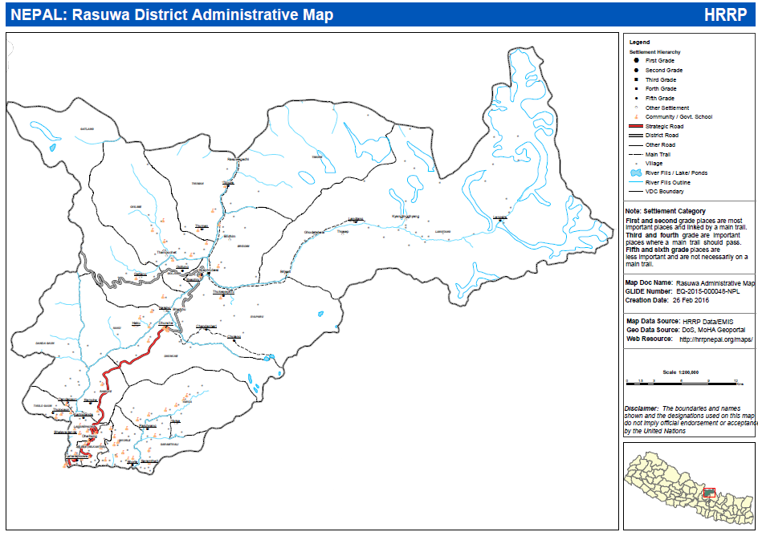

Slide 21
Administrative - Map Layer Demo

Slide 22
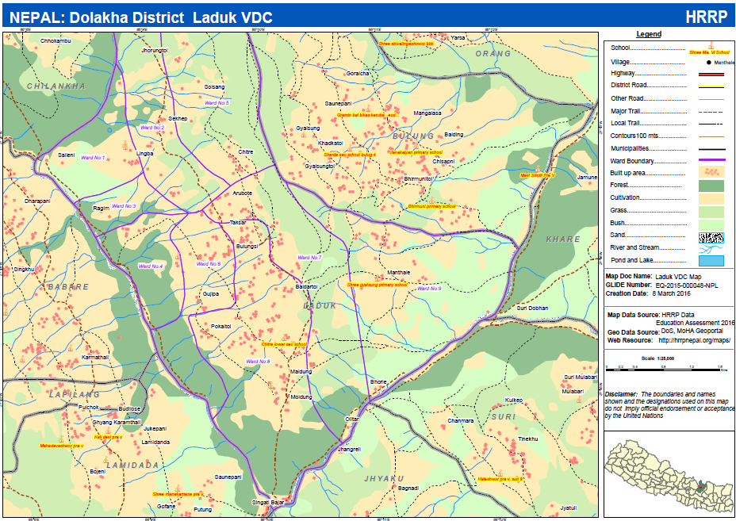

Slide 23
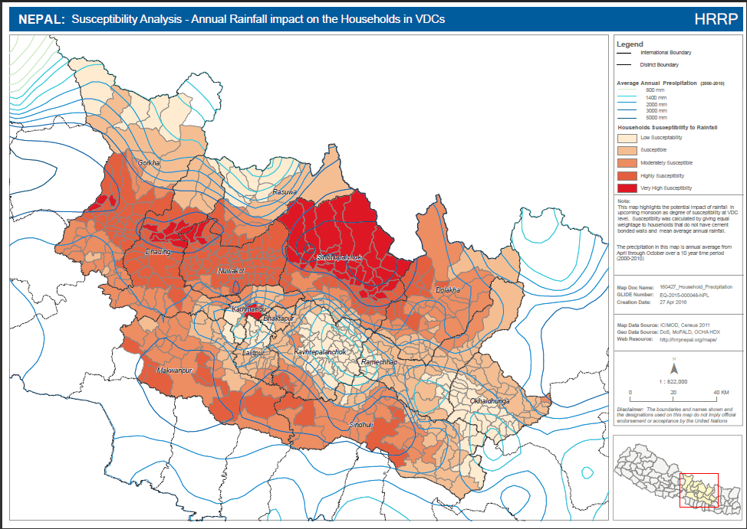
Administrative - Map Layer Demo

Slide 24
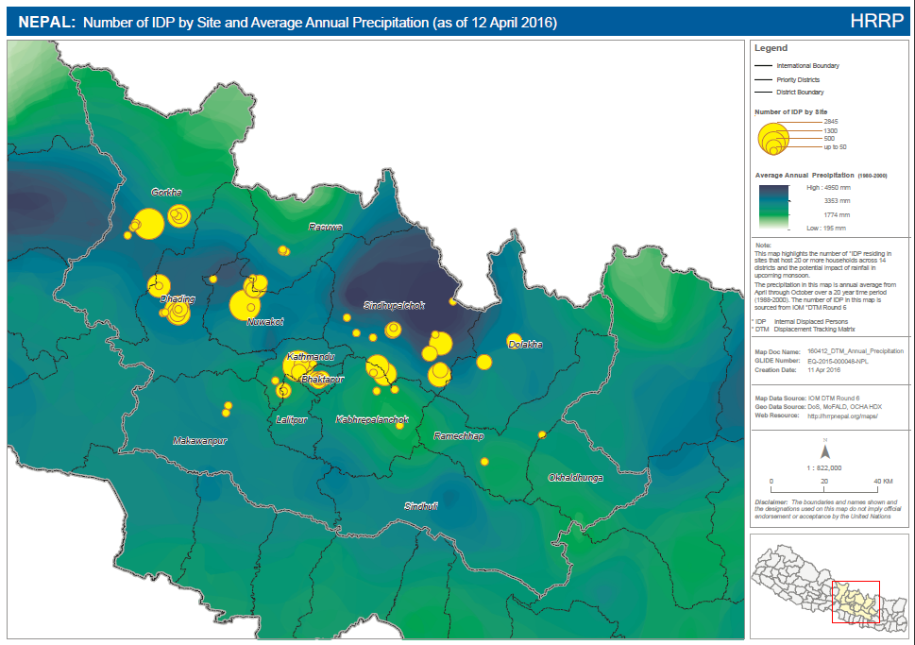
Administrative - Map Layer Demo

Slide 25
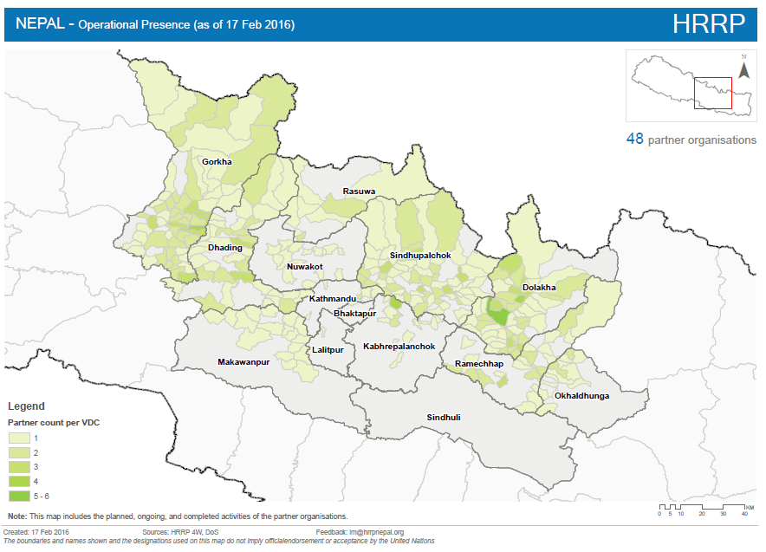

Slide 26
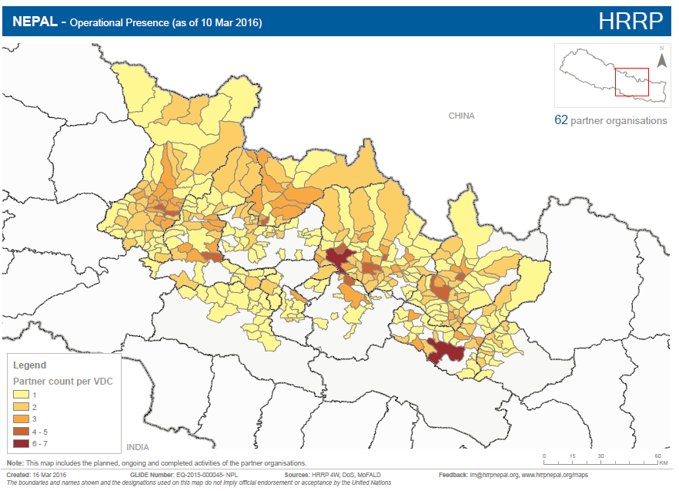

Slide 27
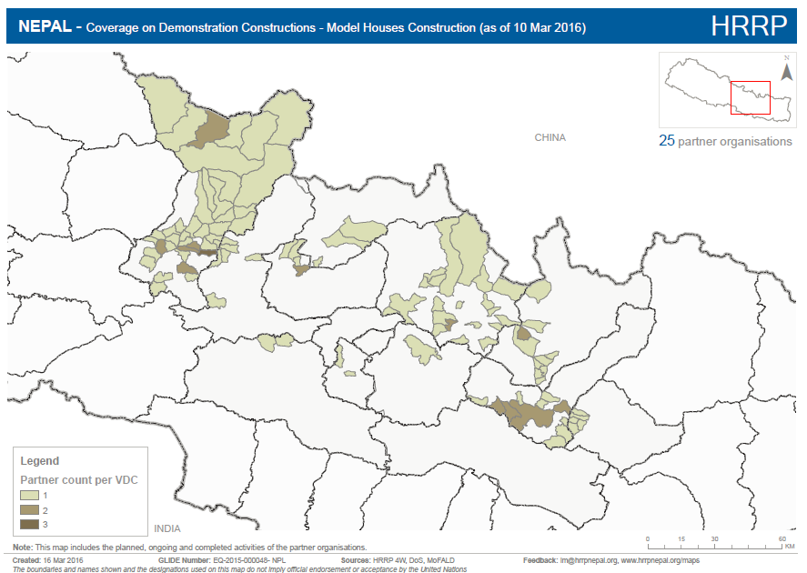

Slide 28
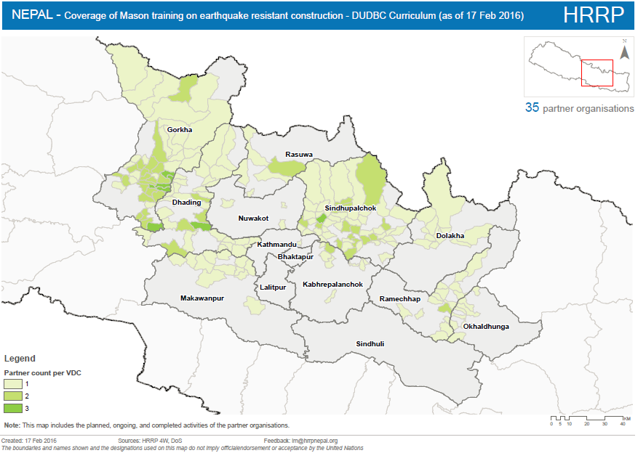

Slide 29
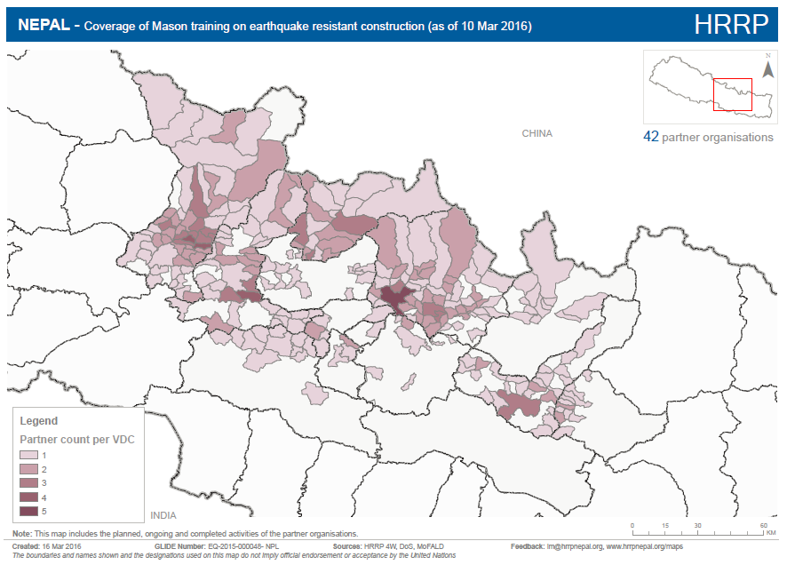

Slide 30
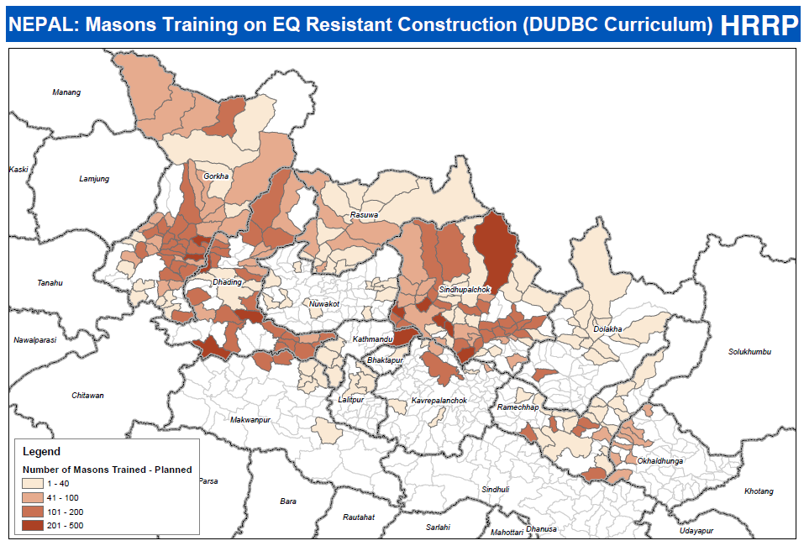

Slide 31
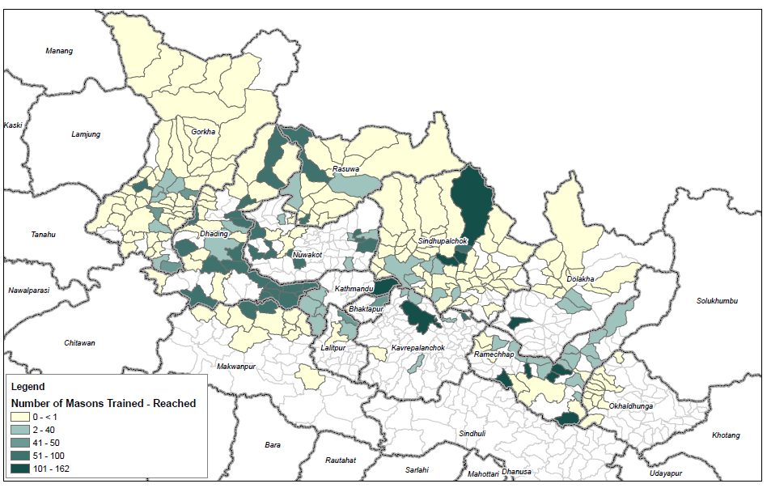

Slide 32
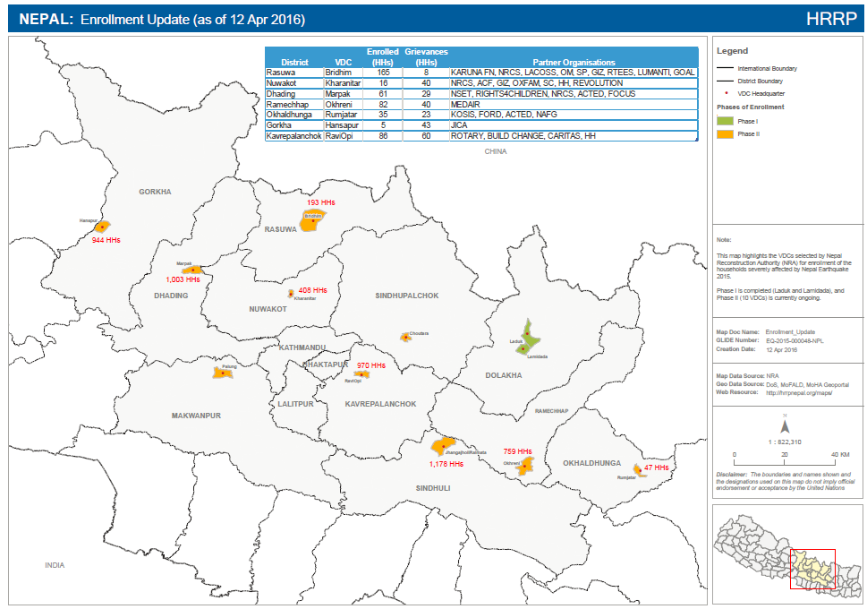

Slide 33
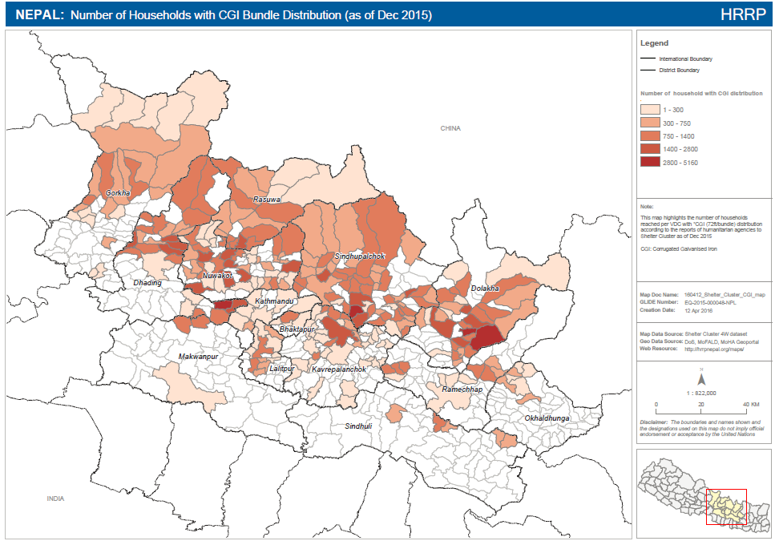

Slide 34
District Profile www.hrrpnepal.org/maps/districtprofile

Slide 35
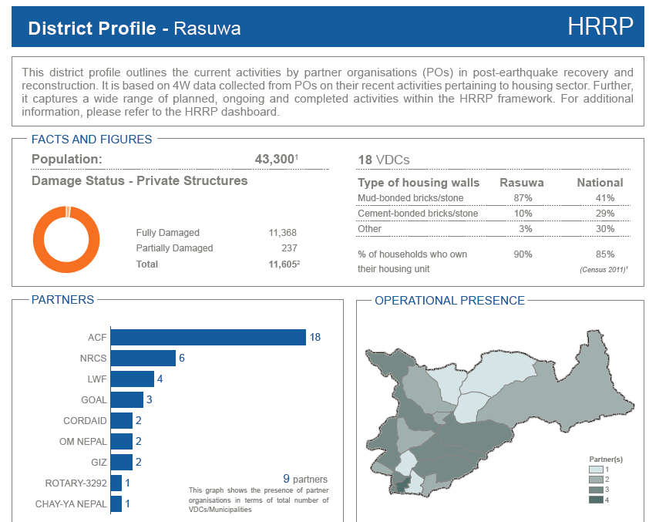
(as of 10 Mar 2016)

Slide 36
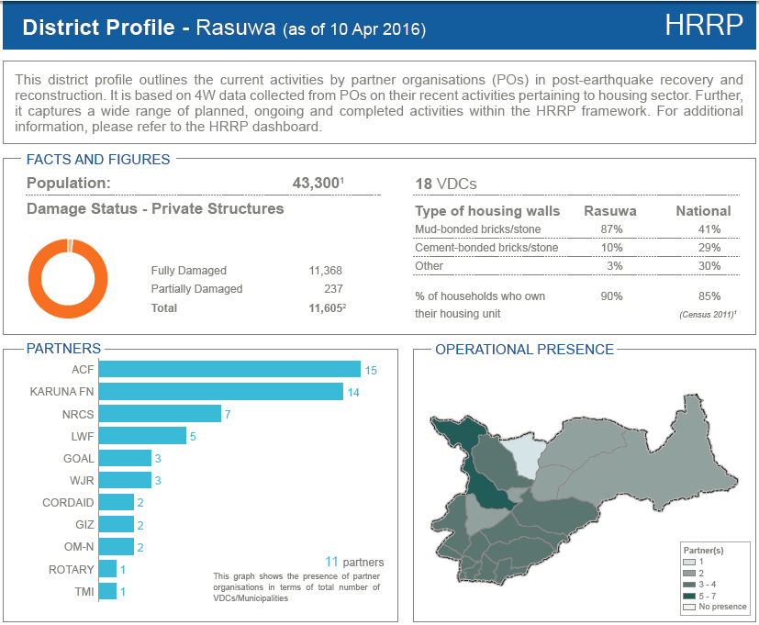

Slide 37
Dashboard - Map Layer Demo
www.hrrpnepal.org/dashboard

Slide 38
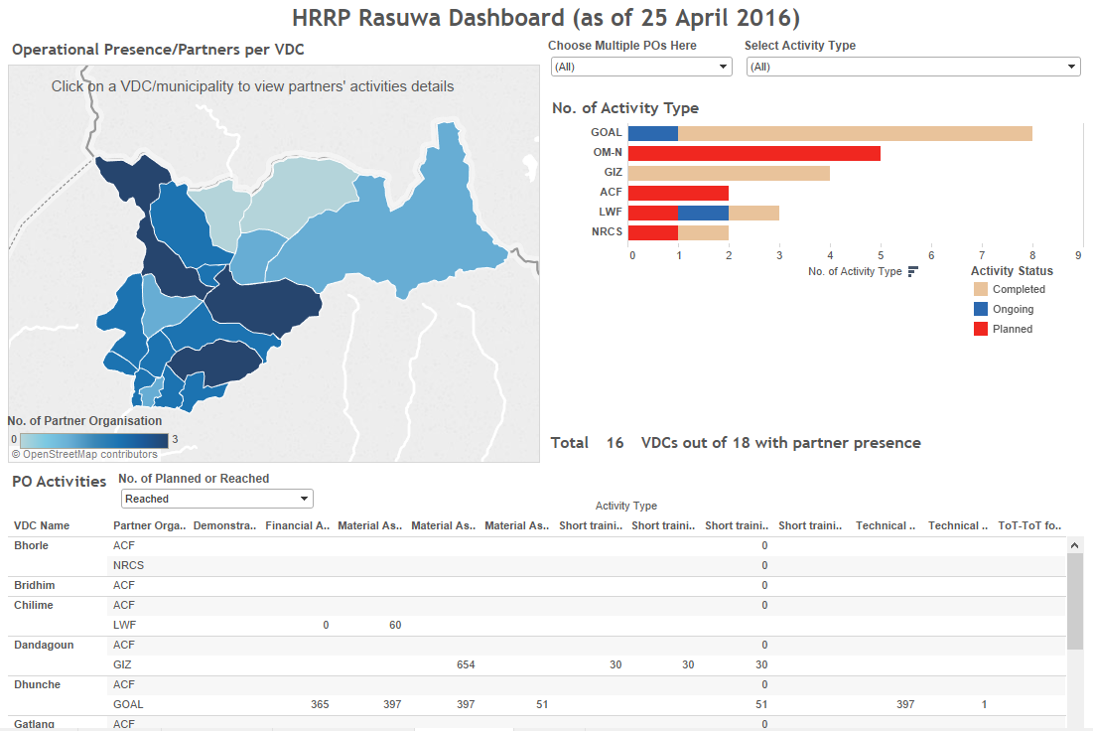

Slide 39
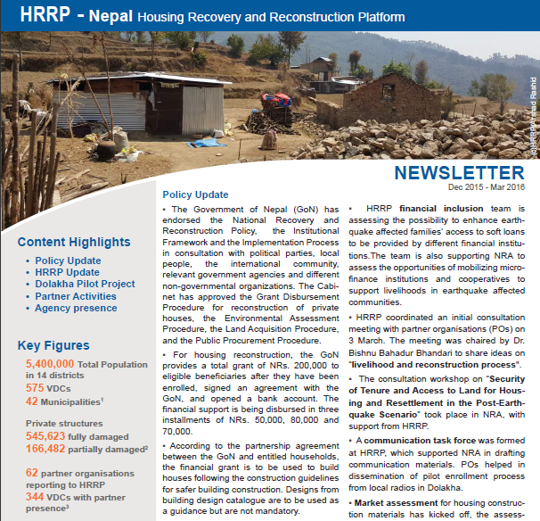

Slide 40
4W – Know how- Demo
www.hrrpnepal.org/4W

Slide 41
Thankyou Any Questions

