Slide 1

Housing Recovery and Reconstruction Platform-Nepal (HRRP) Orientation Program for Partner organizations
on
Confined Masonry Construction
Organized by:
National Reconstruction Authority(NRA)
MOUD/District Project Implementation Unit (DLPIU)
Housing Recovery and Reconstruction Platform-Nepal (HRRP)

Slide 2
Why Confined Masonry ?
Poor performance of unreinforced masonry and non ductile reinforced concrete (RC) frame construction caused unacceptably high human and economic losses in past earthquakes
This prompted a need for developing and/or promoting alternative building technologies
The goal is to achieve enhanced seismic performance using technologies which require similar (preferably lower) level of construction skills and are economically viable

Slide 3
Why Confined Masonry in Nepal?
An opportunity for improved seismic performance both for unreinforced masonry and reinforced concrete frame construction in low- and medium-rise buildings

Slide 4
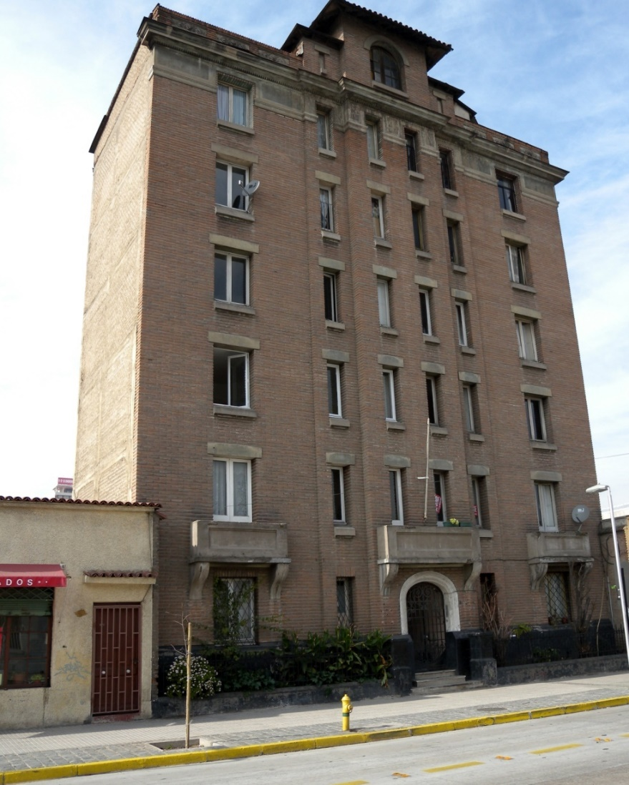
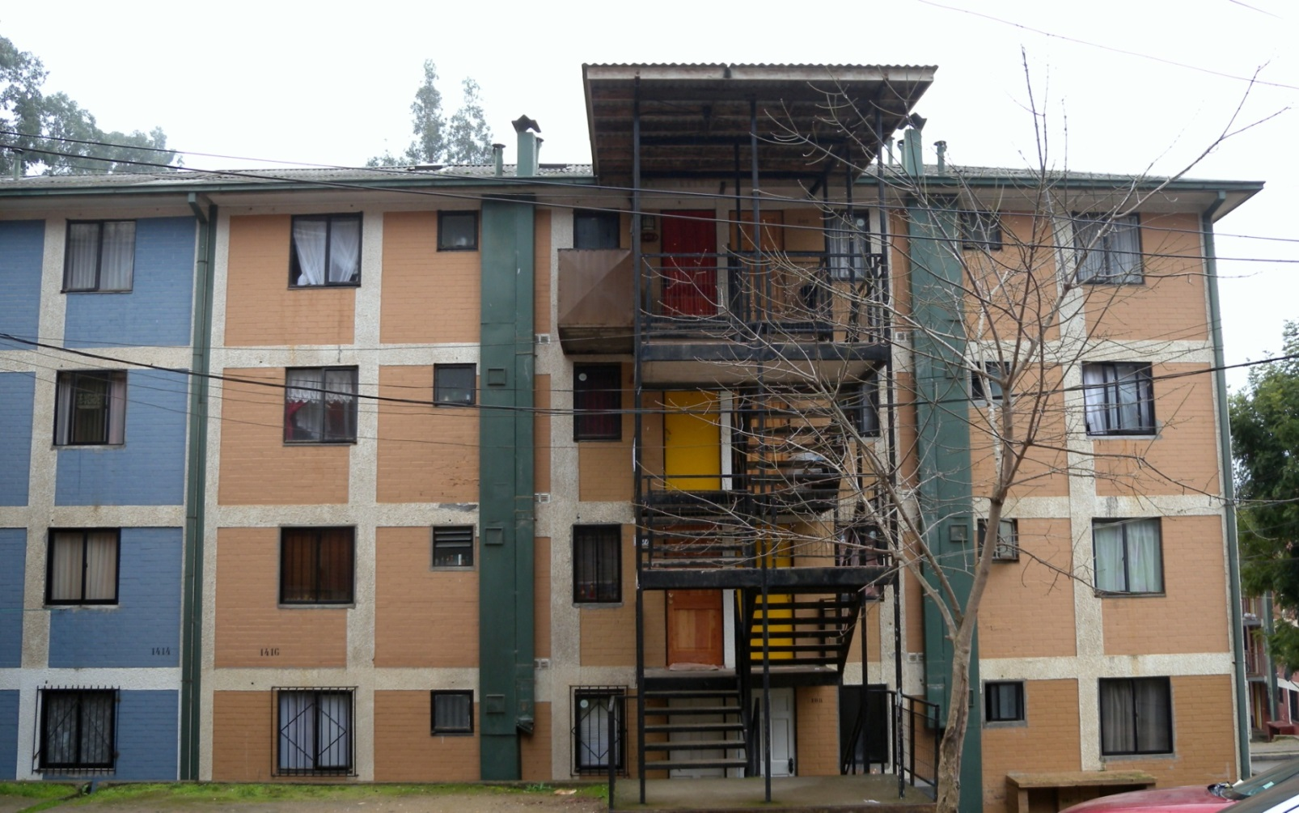
An Alternative to RC Frame Construction

Slide 5
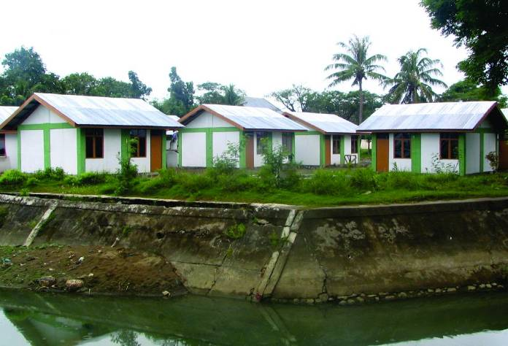
An Alternative to Unreinforced Masonry Construction

Slide 6
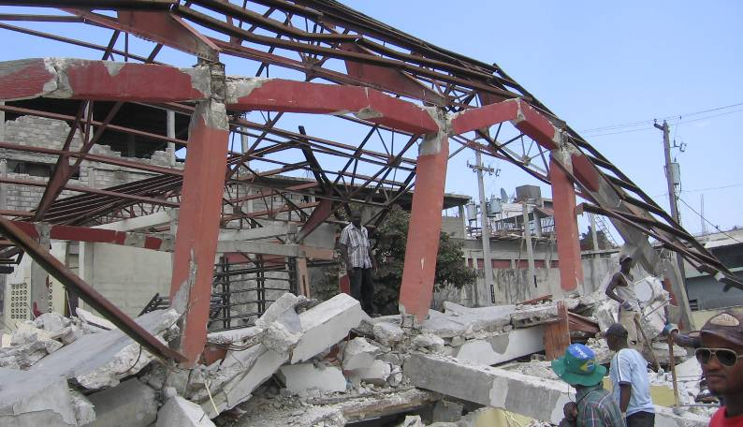

Confined Masonry and RC Frame Construction: Performance in Recent Earthquakes
January 2010, Haiti
M 7.0
300,000 deaths
February 2010, Chile
M 8.8 521 deaths
(10 due to confined masonry construction)

Slide 7
Beginnings
Evolved though an informal process based on its satisfactory performance in past earthquakes
The first reported use in the reconstruction after the 1908 Messina, Italy earthquake (M 7.2) - death toll 70,000
Practiced in Chile and Columbia since 1930’s and in Mexico since 1940’s
Currently practiced in several countries/regions with high seismic risk, including Latin America, Mediterranean Europe, Middle East (Iran), South Asia (Indonesia), and the Far East (China).

Slide 8
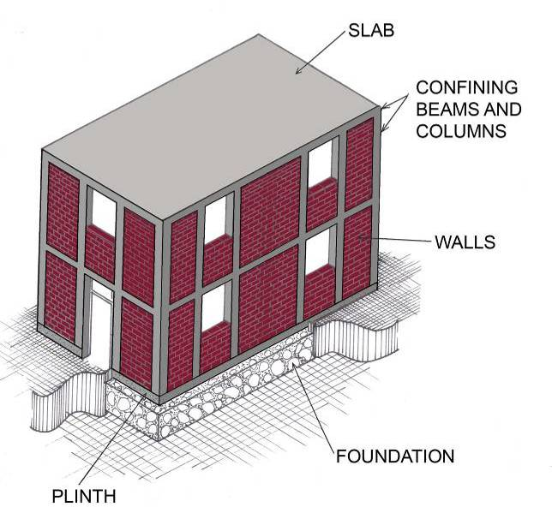
Confined Masonry (CM) Construction)
It consists of masonry walls and horizontal and vertical RC confining members built on all four sides of a masonry wall panel.

Slide 9
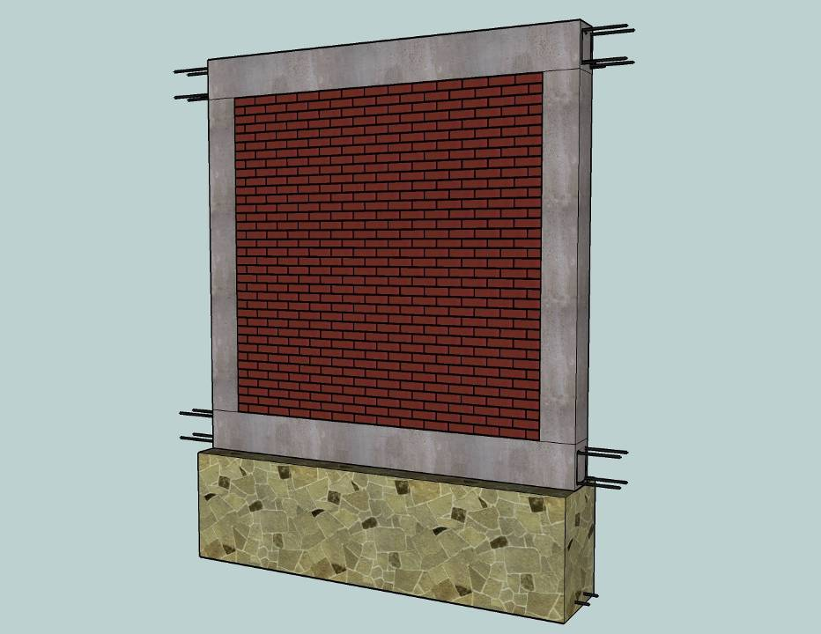
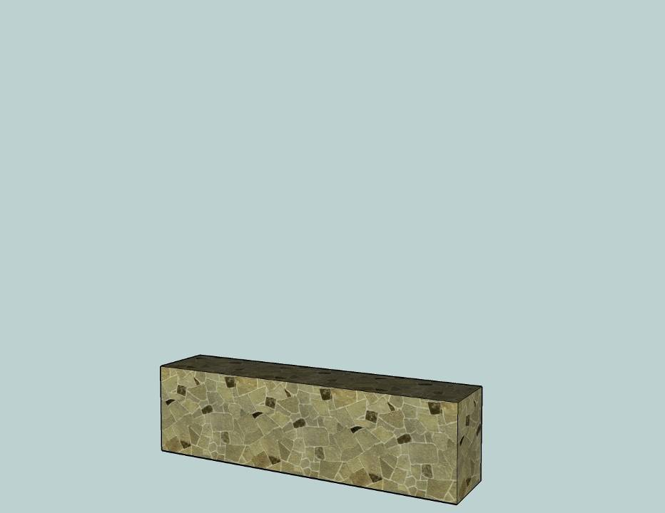
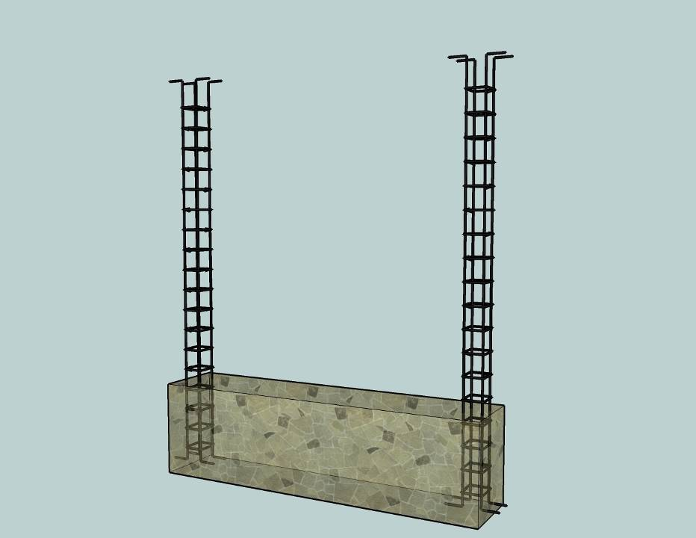
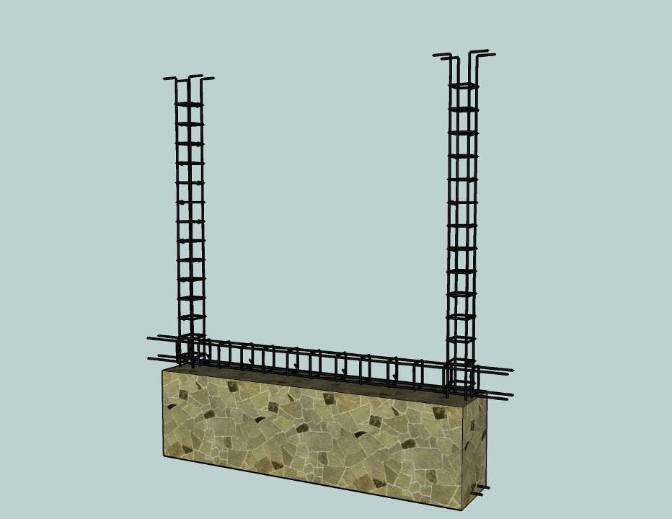
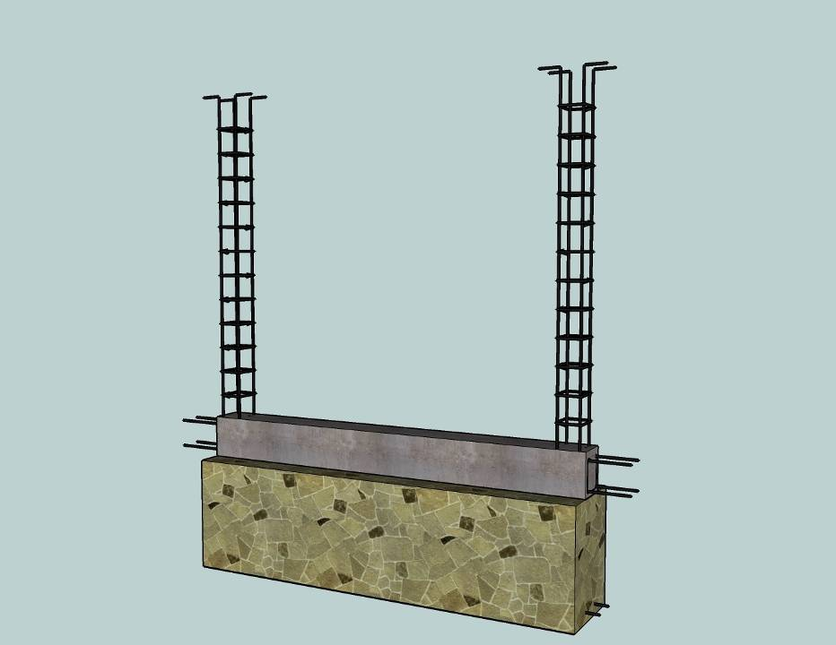
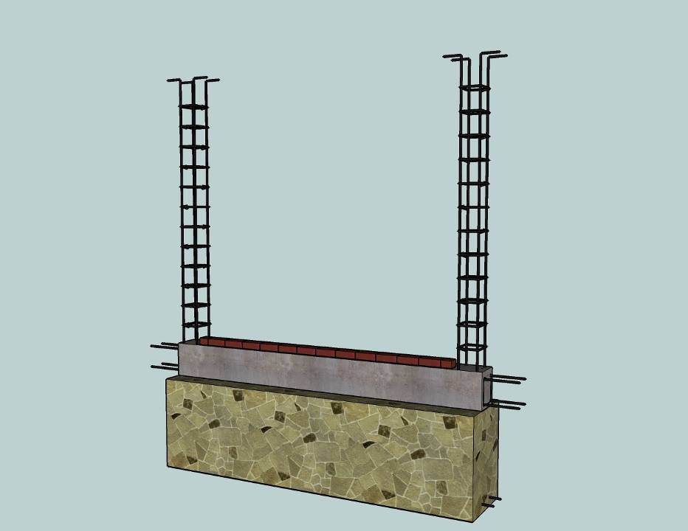
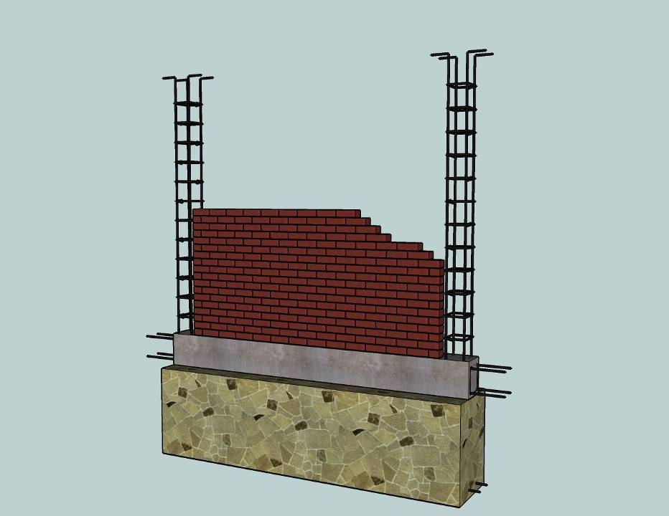
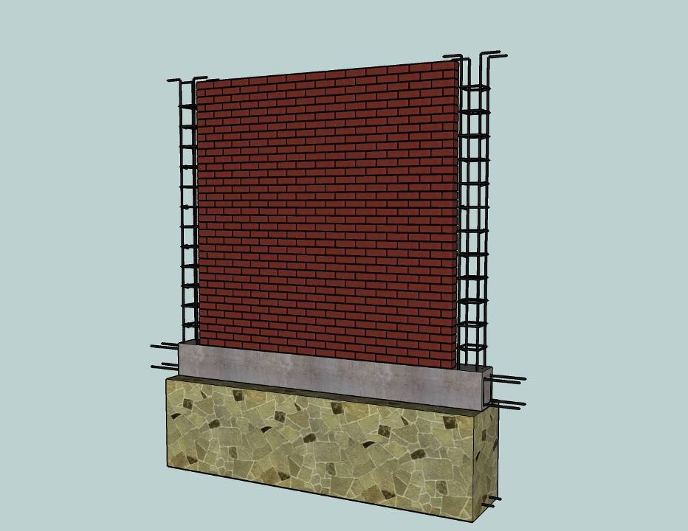

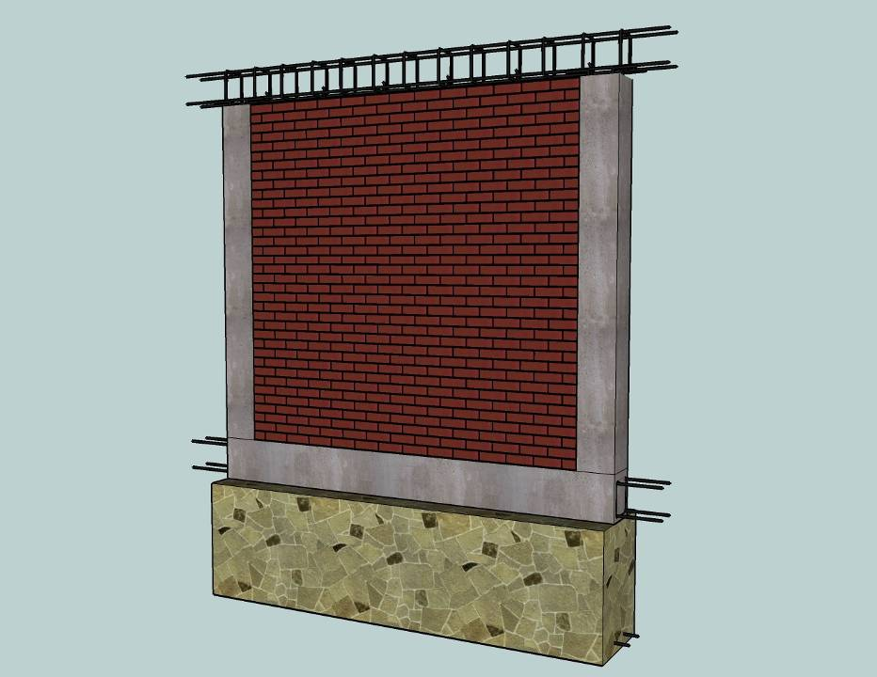
Confined Masonry Construction
Notes:
`

Slide 10
Components of CM
Confined Masonry
Masonry wall
Confining Elements
(RC-Columns & RC-Tie beams
Plinth Band
Floor and Roof
Slabs
Foundation

Slide 11
Key features
of
Structural Component

Slide 12
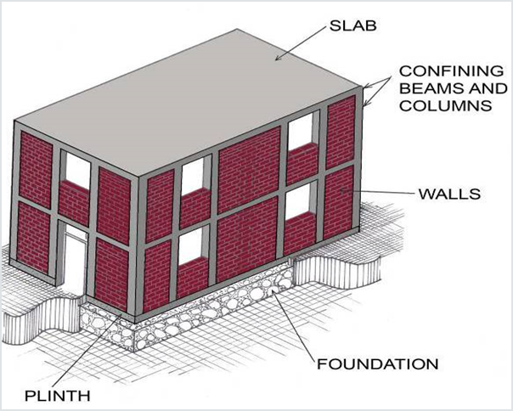
Confining elements (RC tie-columns and RC tie-beams)
Horizontal(tie-beams) & Vertical(tie-columns) RC confining members built in all four side of wall
Provide restraint to masonry walls and protect them from complete disintegration even in major earthquakes
Enhance the stability and integrity of masonry walls for in-plane & out- of- plane earthquake loads.

Slide 13
Confining elements (RC tie-columns and RC tie-beams)
Enhance the strength(resistance) of masonry wall under lateral earthquake loads
Reduce the brittleness of masonry walls under earthquake hence improving their earthquake performance

Slide 14
Masonry Wall
Made of solid clay bricks, hollow clay tiles, or concrete blocks
Confined by tie-columns & tie-beams
Transmit the gravity load from the slab(s) above down to the foundation
Act as bracing panels, which resist horizontal earthquake forces

Slide 15
Floor & roof Slabs
Transmit both gravity & lateral loads to the wall
In Earthquake slab behave lake a horizontal beam & Called diaphragm
Plinth band
Transmit the load from wall to the foundation
Foundation
Transmit the load from the structure to the ground

Slide 16
Confined Masonry versus Reinforced Masonry
Reinforcement is concentrated in vertical and horizontal RC confining elements whereas the masonry walls are usually free of reinforcement
Vertical and horizontal reinforcing bars are provided to enhance the strength and ductility of masonry walls

Slide 17
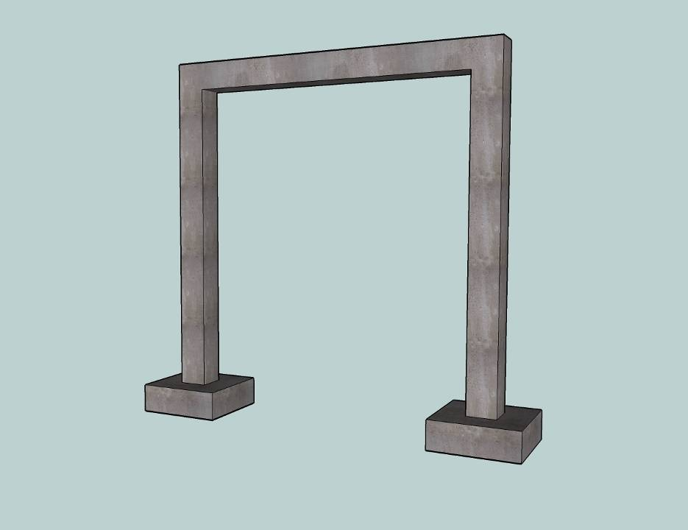
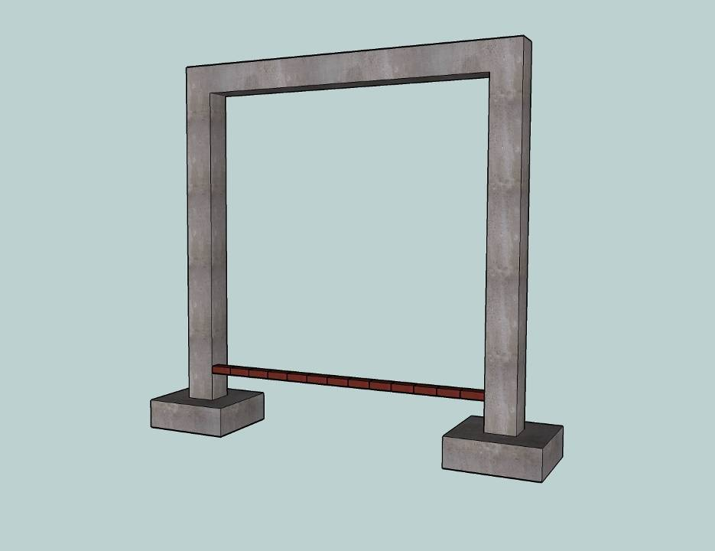
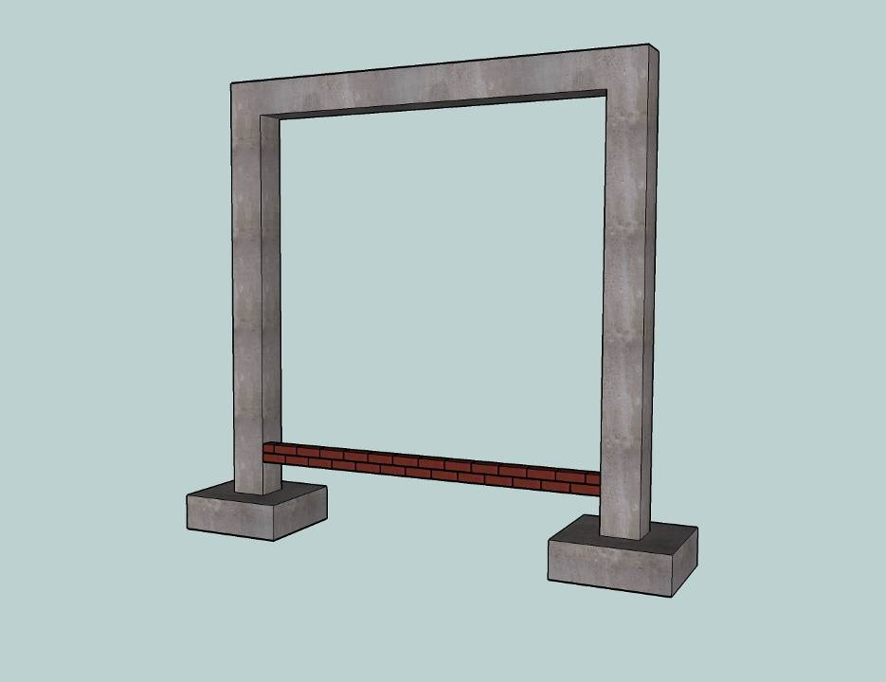
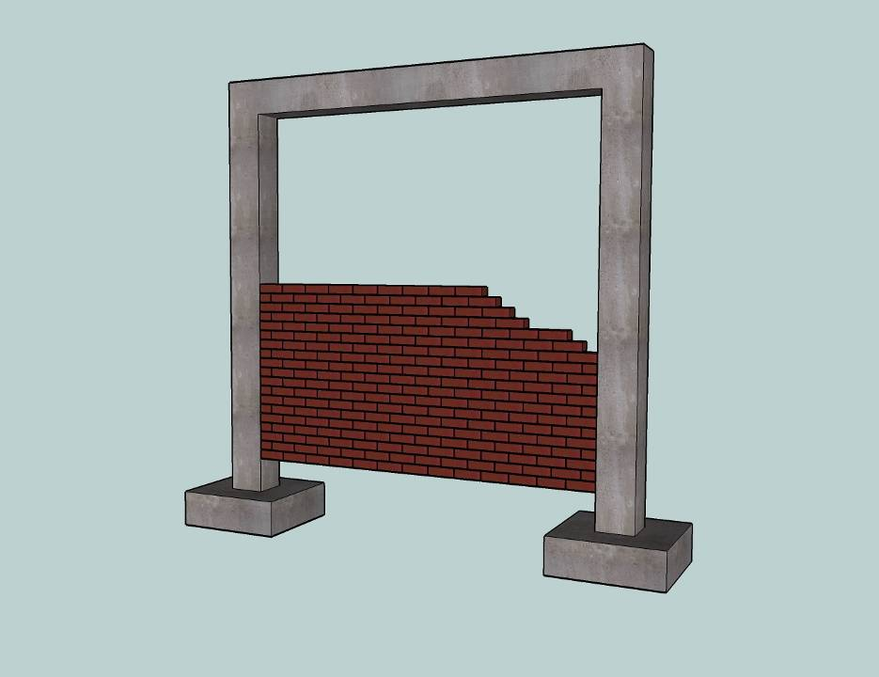
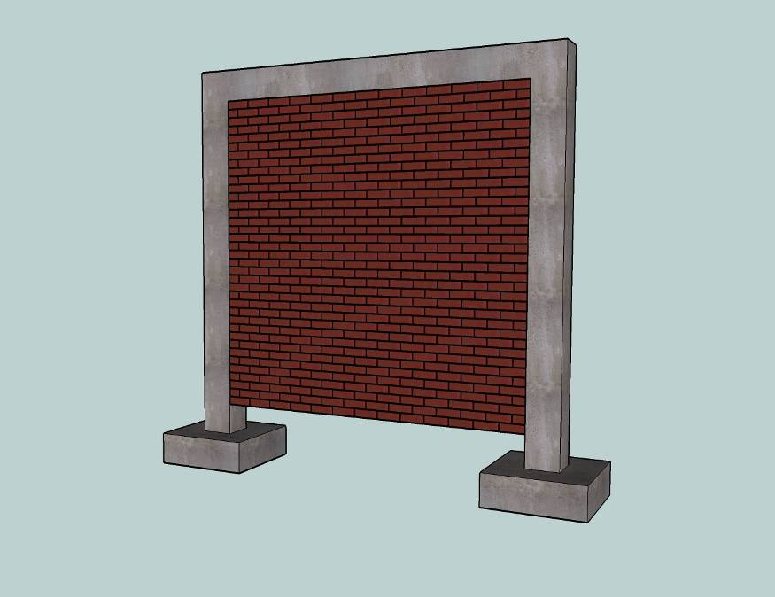
Reinforced Concrete Frame Construction

Slide 18
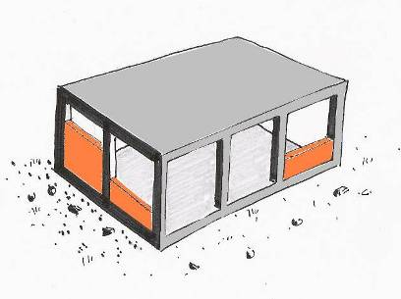
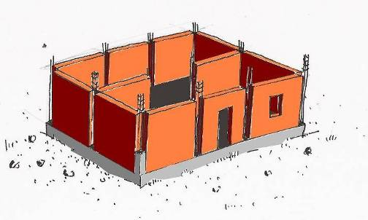
Confined Masonry versus Infilled RC frames:
- construction sequence
- integrity between masonry and frame
Confined Masonry
Walls first
Concrete later
Reinforced Concrete Infilled Frame
Concrete first
Walls later

Slide 19
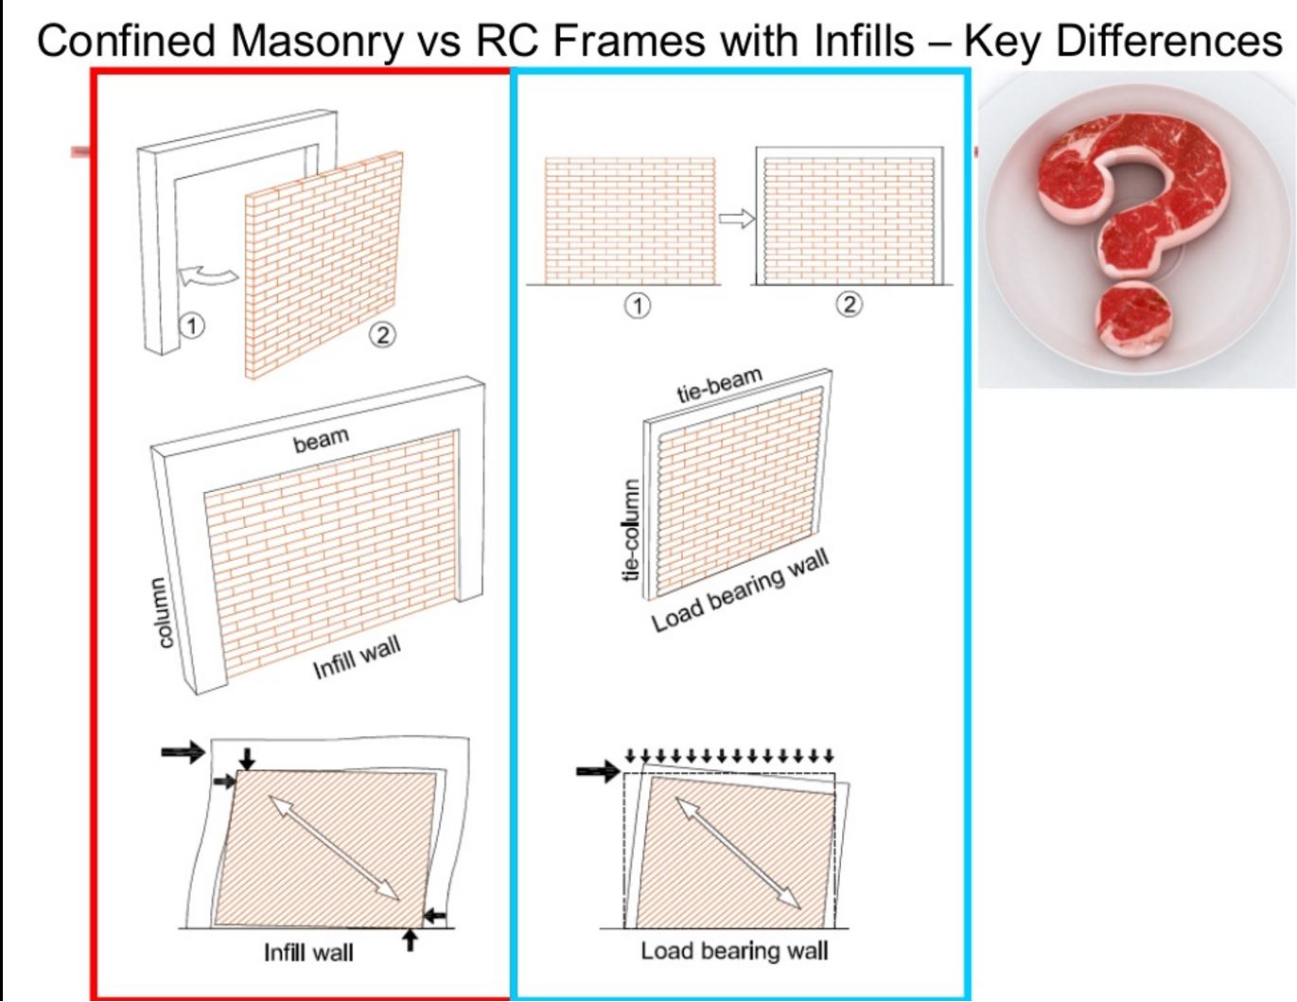
Confined Masonry vs RC Frames with Infills – Key Differences

Slide 20
Seismic Forces vs Confined Masonry wall

Slide 21
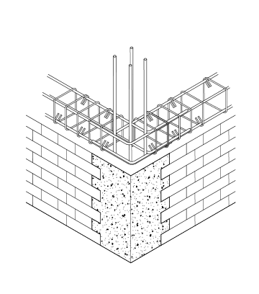
Monolithic action of a masonry wall & RC confining elements

Slide 22
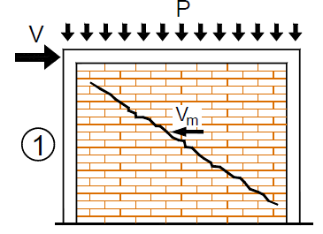
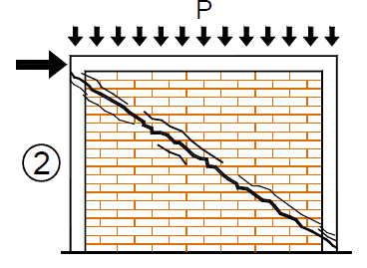
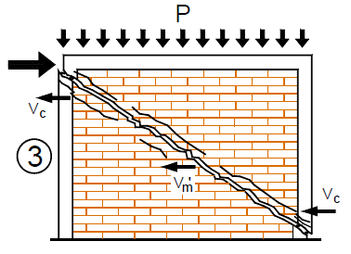
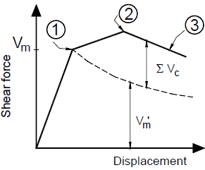
Mechanism of shear resistance

Slide 23
Mechanism of shear resistance
Three stages:
Onset of diagonal cracking
Cracking propagated through RC tie-columns
Failure

Slide 24
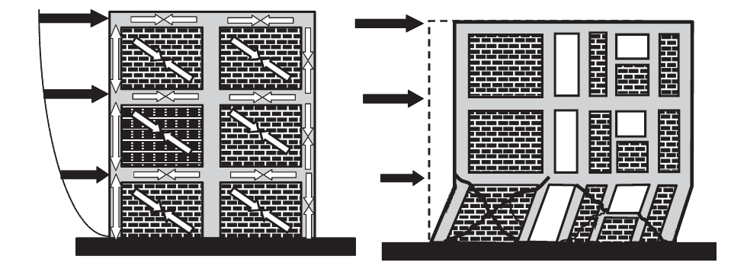
Confined Masonry Building : Vertical Truss Model (left) and Collapse at the Ground Floor Level (right)

Slide 25
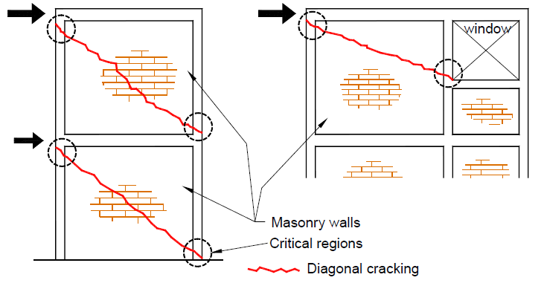
Critical Region

Slide 26
Failure modes of Confined Masonry buildings (not well designed or constructed)
Masonry damage (in- and out-of-plane)
RC tie-columns
Tie-beam-to-tie-column joints
Confining elements around openings

Slide 27
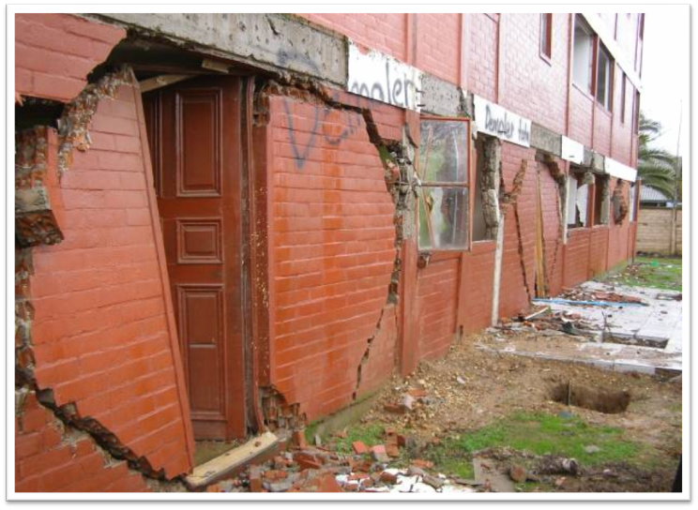
In-plane shear failure of masonry wall
Earthquake ground shaking in the direction parallel with the longitudinal wall axis

Slide 28
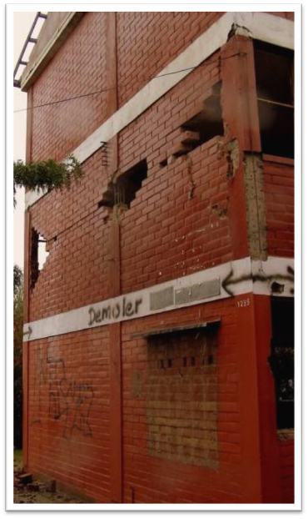
Out-of-Plane Wall Damage
An example of out-of-plane damage observed in a three-storey building
The damage concentrated at the upper floor levels
The building had concrete floors and timber truss roof
The same building suffered severe in-plane damage
Earthquake ground shaking perpendicular to the longitudinal wall axis

Slide 29
Out-of-Plane Wall Failure

Slide 30
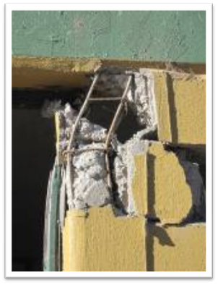
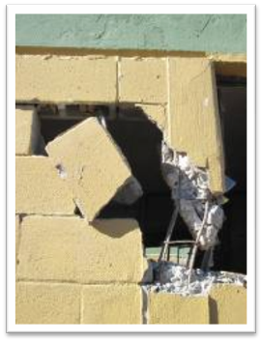
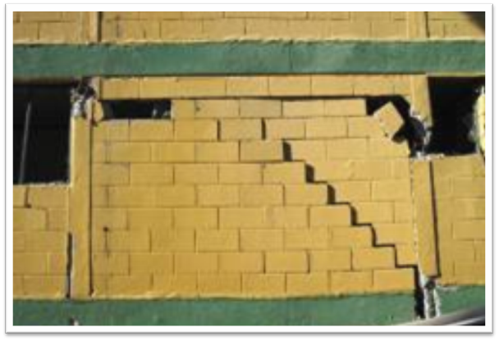
Tie-Column Failure

Slide 31
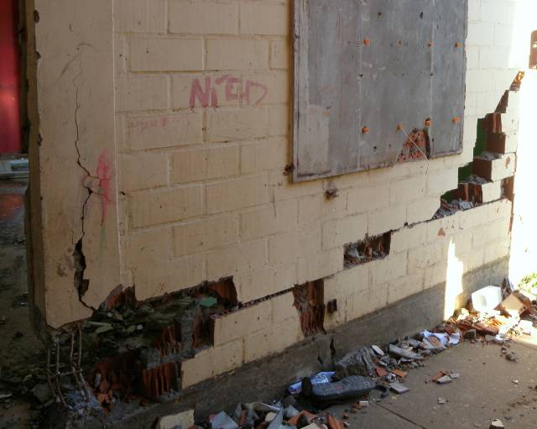
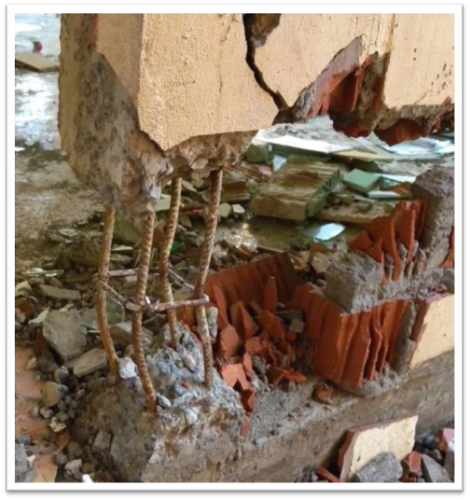
Buckling of a RC Tie-Column

Slide 32
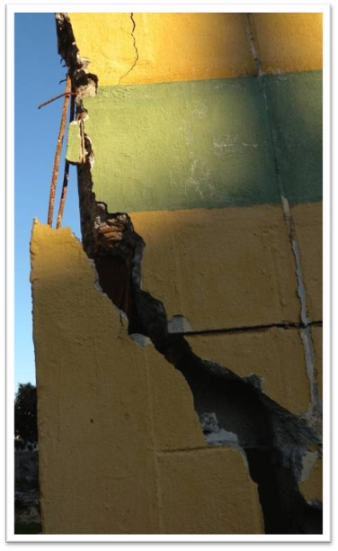
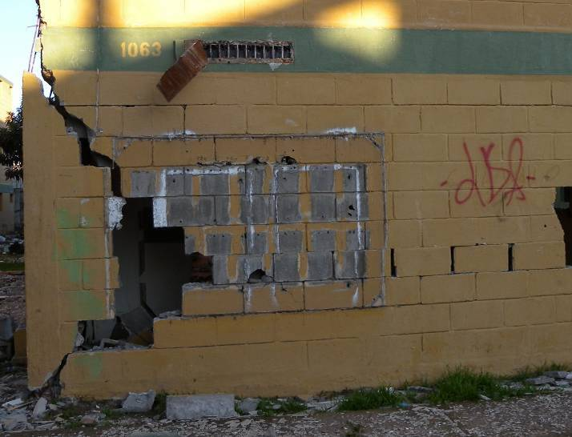
Shear Failure of RC Tie-Columns

Slide 33
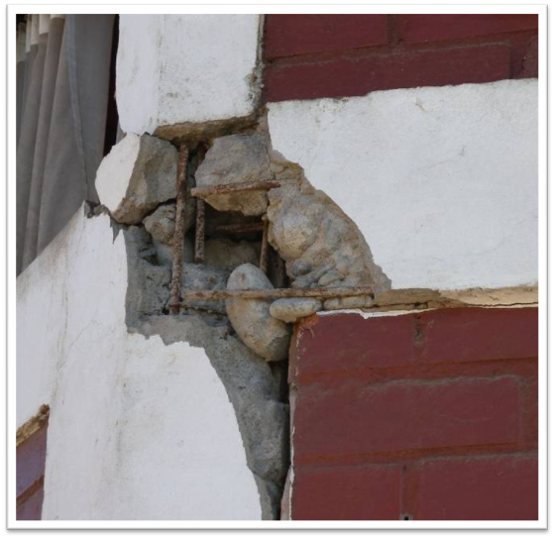
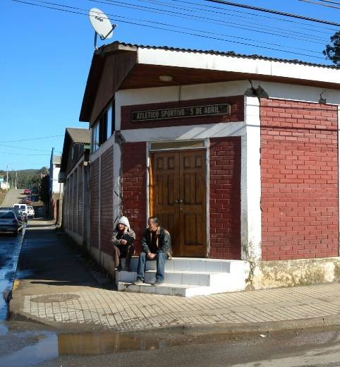
Tie-beam-to-tie-column joints
Inadequate anchorage of tie-beam reinforcement

Slide 34
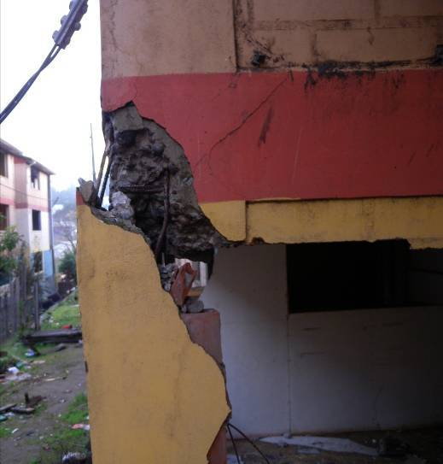
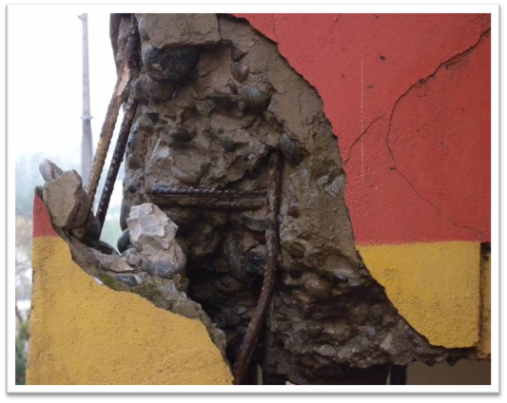
Tie-beam-to-tie-column joints
Due to Poor reinforcements detailing

Slide 35
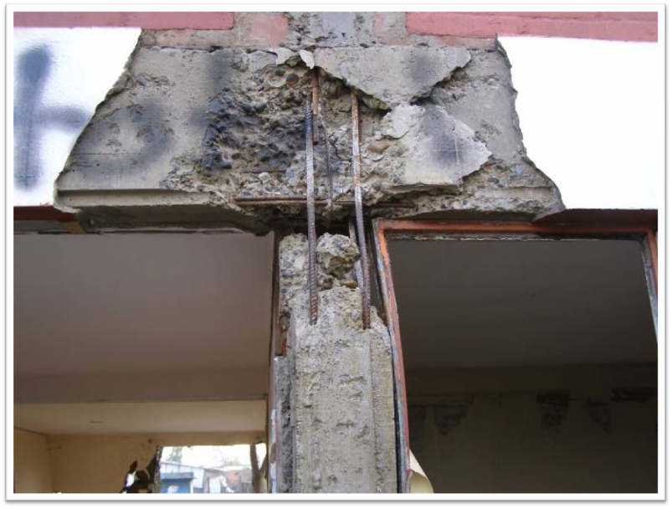
Tie-beam-to-tie-column joints
Absence of of ties in joint Area

Slide 36
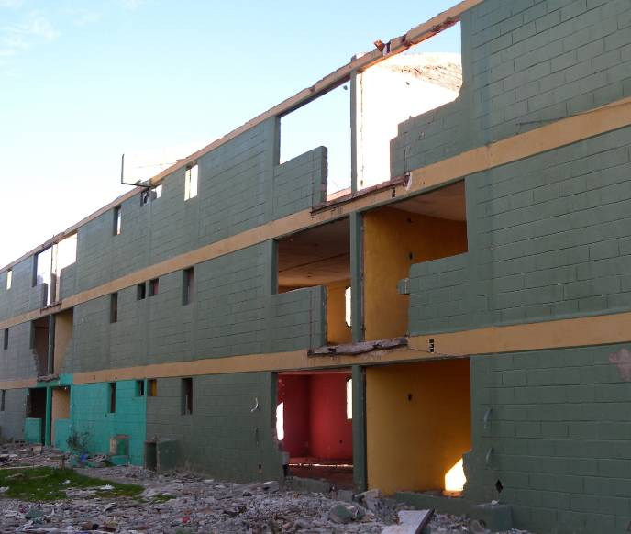
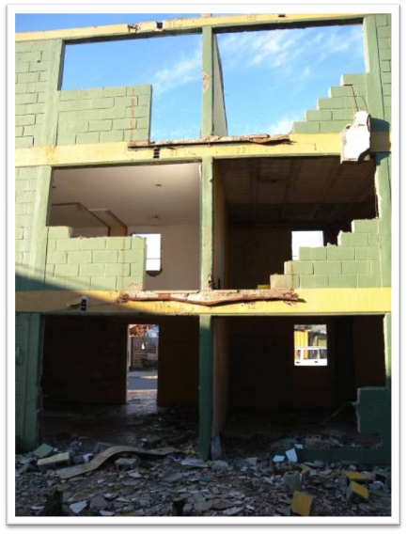
Absence of Confining elements around openings

Slide 37
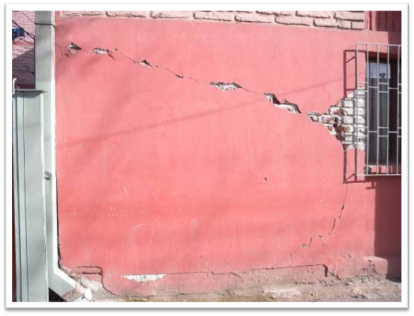
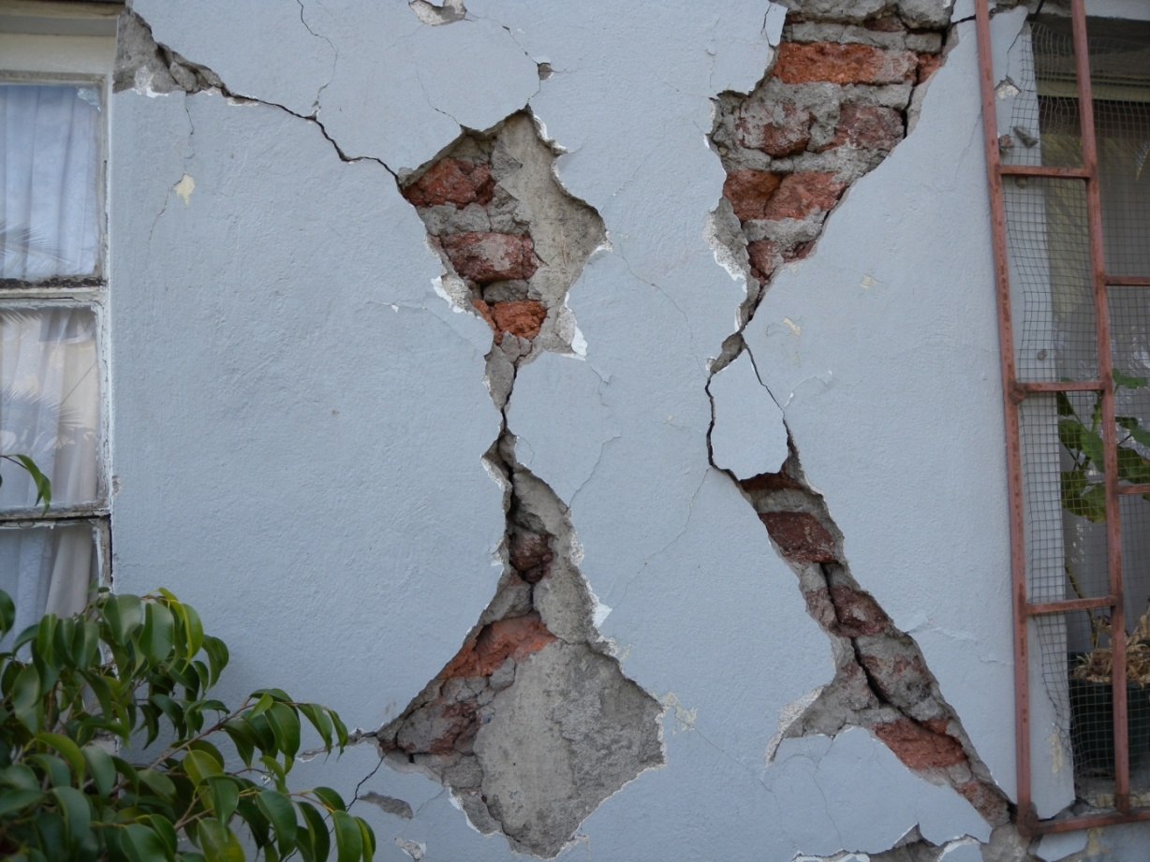
In-Plane Shear Cracking – the Effect of Confinement
Unconfined openings | Confined openings

Slide 38
Key Causes of Damages
Inadequate wall density
Poor quality of masonry materials and construction
Inadequate detailing of reinforcement in confining elements
Absence of confining elements at openings

Slide 39
Construction Guideline for CM Construction
Non-engineered Building
(Inspection form is for One storey only)
Architectural Guideline
Construction Guideline

Slide 40
Architectural Guideline

Slide 41
Symmetrical wall
X
√
Inadequate plan : layout
Adequate shape

Slide 42
Regular Building Plan
X
√
Irregular
Symmetrical

Slide 43
Plan Shape : Length-to-width ratio less than 3 times
X
√
Poorly proportioned plan
Well proportioned plan

Slide 44
Walls should be continuous up the building height
X
√
Load path not clear
Load path clear
Wall height: 3m for Non-Designed Building.

Slide 45
Opening
X
√
Poor Location of Window and door opening
Good location of window and door
opening
Opening Should be placed in the same same position up the building height

Slide 46
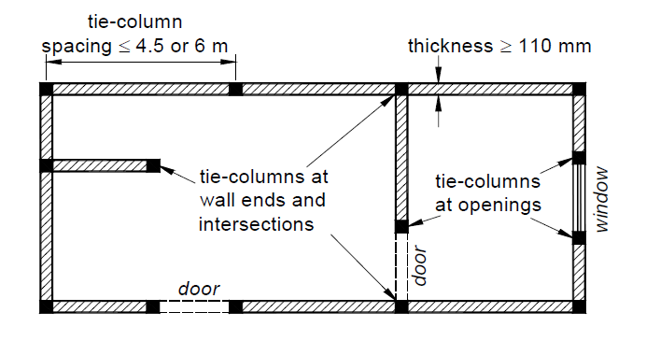
Location of Confining Elements
Vertical Spacing of tie- beam should not exceed 3m & Should be at every floor
Tie-columns should be placed at a maximum spacing of less than 4.5 at wall to wall intersections , free end of wall & within wall if its lengths exceed than MRS

Slide 47
Wall Distribution
X
√
Inadequate Wall Distribution
Adequate Wall Distribution
At least three fully confined walls should be provided in each direction

Slide 48
Walls Density
At least 5 % in each of two orthogonal direction
$${Wall Density}^{}=\frac{Total X−sectional Area of all walls in one direction}{Sum of Floor plan area for all floors in a building}$$
Eurocode 8 (1996)
At least 2% for a site with a design ground accln up to 0.2g (corresponding to seismic zone II of India
At least 4% for a site with a design ground accln up to 0.3g (corresponding to seismic zone III of India
At least 5% for a site with a design ground accln up to 0.4g (corresponding to seismic zone IV of India

Slide 49
Construction Guideline

Slide 50
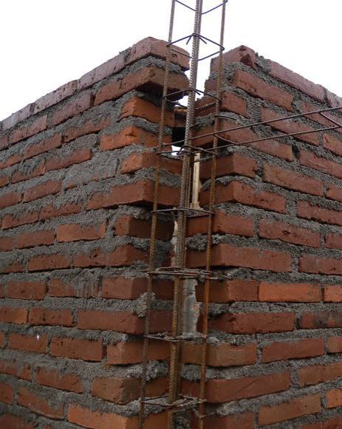

Wall (Constructing method)
Wall thickness: 230 mm
Toothing enhances interaction between masonry walls and RC confining elements

Slide 51

Tie -Column
Tie-column reinforcement set in the position prior to the Construction of Foundation and wall
Should be Place at wall ends, intersection & Opening

Slide 52

Tie –Column (Reinforcements)
Tie Column Size : (230 X 230 )mm at Corner & wall Section
230 X 115) mm at Opening
Longitudinal reinforcements: 4 φ 12mm bar at corner & wall section
2 φ 12mm bars at Opening
Stirrups: 6 mm @ 150 c/c

Slide 53

Tie-beam
Team-Beam are constructed atop the wall of each floor level
Horizontal ties Size : (230 X 150 )mm
Longitudinal reinforcements: 4 φ 12mm bar at corner & wall section
Stirrups: 6 mm @ 150 c/c

Slide 54
Tie-beam
Horizontal Size : (230 X 150 )mm
Longitudinal reinforcements: 4 φ 12mm bar at corner & wall section
Stirrups: 6 mm @ 150 c/c

Slide 55
Joint Detailing
Χ
√
It is preferred to place beam reinforcement outside the column reinforcement cage

Slide 56


Foundation and Plinth Construction
Similar as traditional masonry construction
Minimum foundation depth & width 900 mm

Slide 57

Slab
Should be on uniform level
Minimum thickness: 125 mm
Reinforcement: 8mm bar @ 150mm c/c
Minimum Cover: 15 mm

Slide 58
Construction Process

Slide 59
Confined Masonry Construction
Notes:
`

Slide 60
Thank You !

