Slide 1

Housing Recovery and Reconstruction Platform-Nepal (HRRP) Orientation Program for Partner organizations
on
Treatment Process: Timber & Bamboo
Organized by:
National Reconstruction Authority(NRA)
MOUD/District Project Implementation Unit (DLPIU)
Housing Recovery and Reconstruction Platform-Nepal (HRRP)

Slide 2
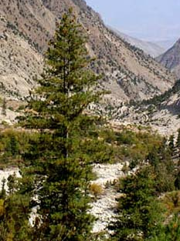
Lists of Hard wood & Soft Wood
HARD Wood | SOFT WOOD
Babul | Chir
Black Siris | Deodar
Dhaman | Jack
Indian Rose Wood(Shisam) | Mango
Jaman | Gobre Salla
Mesua | Simal
Oak | Uttis (Red)
Sain | Uttis (White)
Sal
Sandan
Sisso
Teak
Khair
Gobre Salla
(Very soft )

Slide 3
Timber Treatment
All measures that are taken to ensure a long life of wood

Slide 4
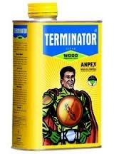
Treatment Process
Let the wood dry for 3-4 month, in shed
After that, Varnish Anti-termites(Terminator, Borax etc.) chemical on the wood
Varnishing Method as follows:
Clean surface of wood
Varnish one layer anti-termites on the surface.
(For this brush and soft cloth can be used)
After that Leave the wood for 6-8 hours
(Rs. 300 –400 Per liter)

Slide 5
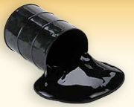
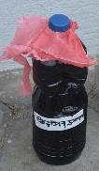
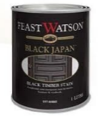
Treatment Process Contd.
After that apply water proof layer of mix. of bitumen & Kerosene. For this boil the bitumen and mix it with Kerosene. Ratio of bitumen and kerosene is 2:1. Put bitumen on Kerosene but never pour Kerosene in bitumen.
Rs. 75-80 Per liter
Rs.300-400 per liter
Liquid bitumen also available in market
Or
Rs.300-400 per liter
Use black Japan Paint
Normally in two storey residential building it cost roughly 10000 for timber treatment

Slide 6
Treatment Process Contd.
Dry 3-4 month on stacking
Apply anti termites chemical
Dry 6-8 hour
Apply bitumen on timber
Mix bitumen with kerosene oil
Semi-liquid bitumen
Heat the bitumen

Slide 7
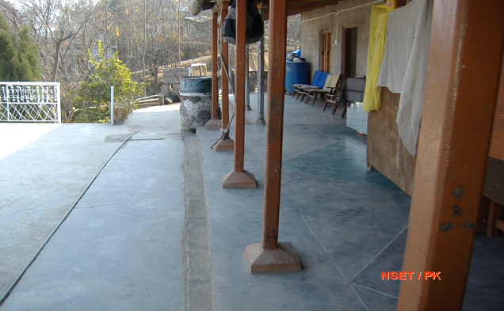
Stone Pad Base of the Timber Post

Slide 8
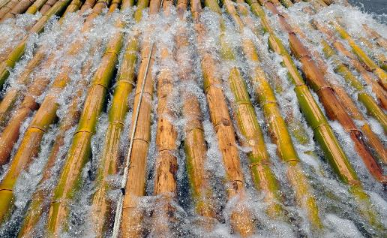
Bamboo Treatment
At least three-years old before harvesting.
Harvest at the beginning of dry Season
Leave culms standing four to eight weeks in the groves, propped on stakes or rocks, with branches and leaves uncut so as to increase evaporation surface and diminish insect entry points offered by freshly cut skin
Some of the treatment methods
Water Leaching method:
Put bamboo completely under water, weighted down in water, preferably in a in running water than Stagnant water . `
Reference NBC 204

Slide 9
Bamboo Treatment Contd.
White Wash and Other Coatings:
Tar coating
Lime wash coating
Note: these are effective only to the extent that they gave continuous coating at cut surfaces, exposed internodes, abrasion and slits.

Slide 10
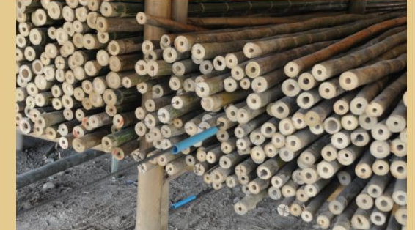
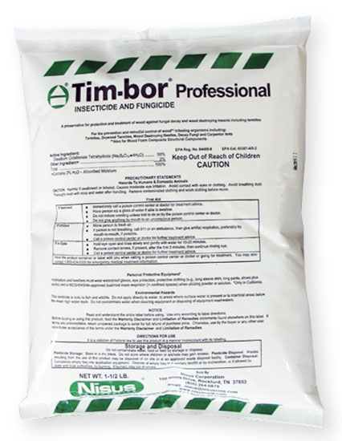
Bamboo Treatment Contd.
Boric-Borax Solution
Place the bamboo against wall & insert the iron rod punch holes through the nodes. Make sure the last nodes is not punctured.
Prepare Boric-Borax Solution or Tim-bor Solution
(Normally Mix ratio Boric Acid and Borax is 1:1.5 with water for Boric -Solution)
Mix 1 bag of Tim-bor (25kg) with 225 litres of water for tim bar solution.

Slide 11
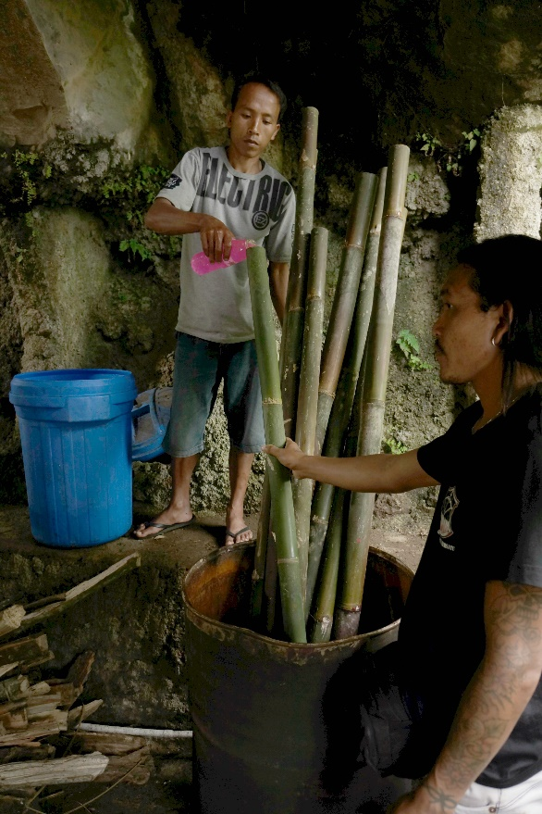
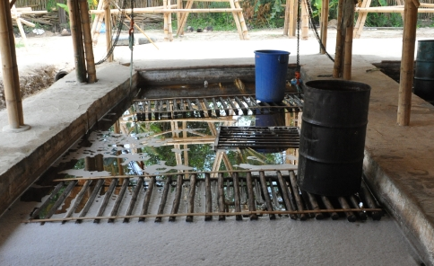
Bamboo Treatment Contd.
Fill the bamboo with this Solution by arranging bamboo in vertical position and allow the soak for two weeks.
Or
Add Borate Solution to water tight pool and keep the culms submerged by placing weights on top of the poles for two weeks.
Remove all solution from poles and allow the Bamboo to dry on Prone Position for 4-6 weeks

Slide 12
Thank You!

