Slide 1



Strengthening Supply Chain of Construction Materials in Earthquake Affected Districts, Rasuwa
18 April 2018
Dhunche

Slide 2
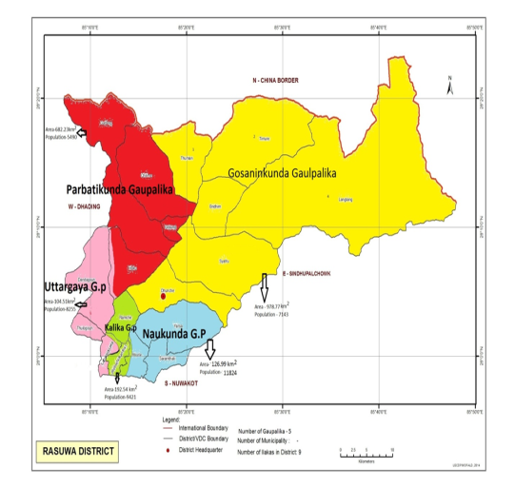
Project Area
Cluster no-6
Fig : New Administrative division Map

Slide 3
Major activities and output
8 resource centers established 921 HHs benefited
7 CSEBs enterprises established 56 HHs benefited
7 Stone cutting enterprise established 30 HH benefited
6 Timber treatment enterprise established 30 HH benefited
5 aggregate production group established 176 HH benefited
1 mini crusher enterprise established 12 HH benefited
1 Center level ware house constructed
7 ware house constructed in resource center

Slide 4
Status of Demand Aggregation
Name of Resource Centers | No Of Total HH | No. of Targeted HHs | No. of HHs benefitted | Major products
Namuna kirsi sahakari sastha | 1892 | 600 | 98 | Cement ,rod
Kalika sahakari | 1034 | 350 | 173 | Cement , rod
Chedenmo mahila bikash sahakari | 1725 | 580 | 78 | Cement ,rod
Om mane padme sahakari | 1746 | 560 | 172 | Cement ,rod
Gosaikunda sahakari | 1351 | 550 | 64 | Cement , rod
Mahalaxmi mahila sahakari | 1377 | 550 | 269 | Cement , rod
Janahit sahakari | 915 | 350 | 51 | Cement , rod
Surya sahakari | 1220 | 460 | 16 | Cement , rod
Total | 11629 | 4000 | 921

Slide 5
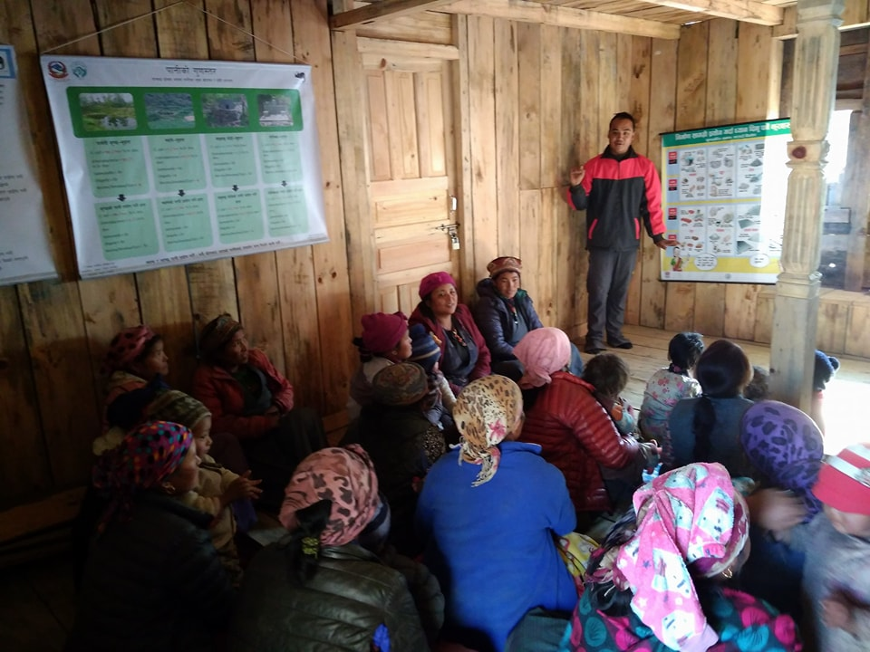
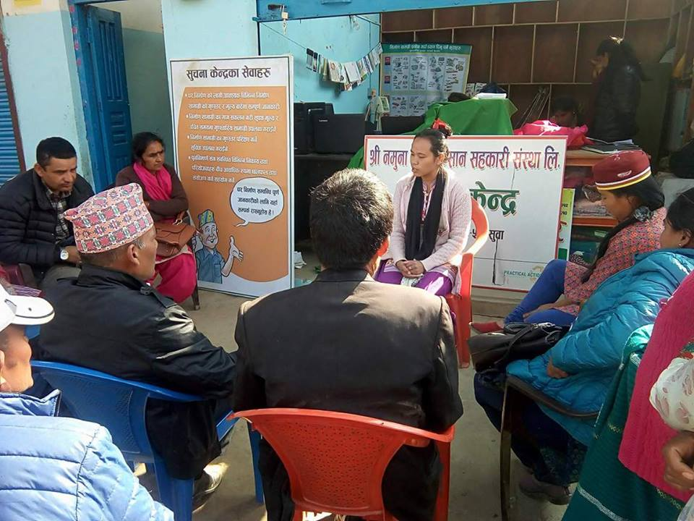
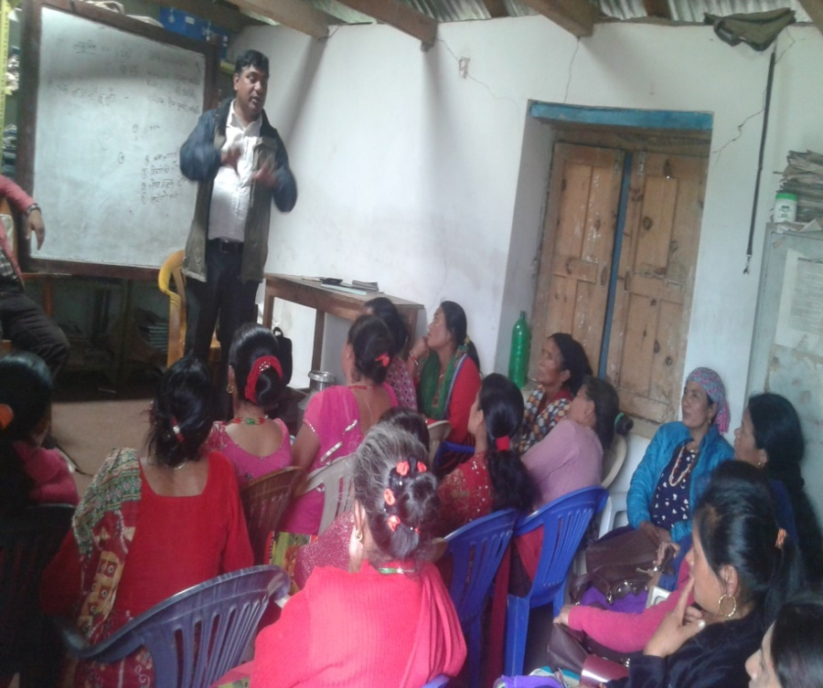
Demand Aggregation

Slide 6
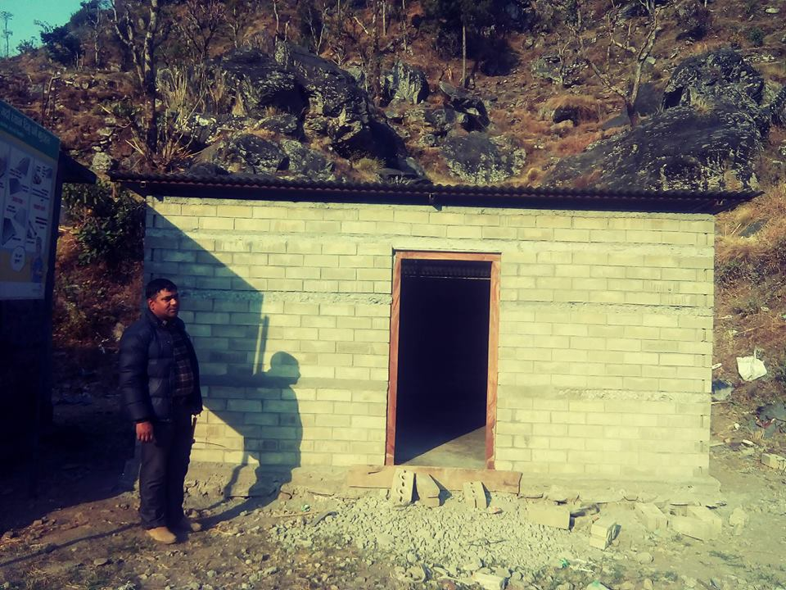
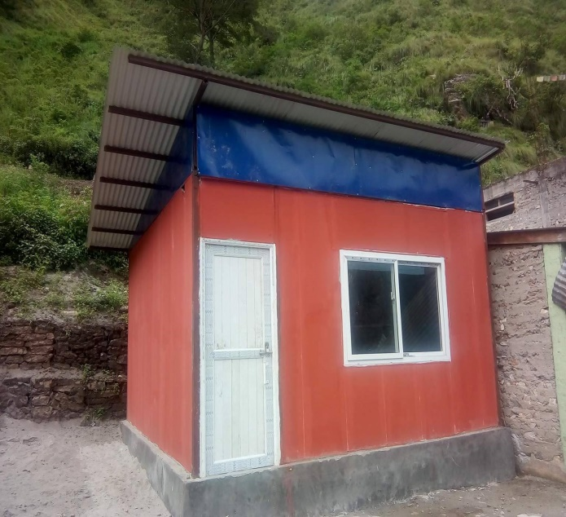
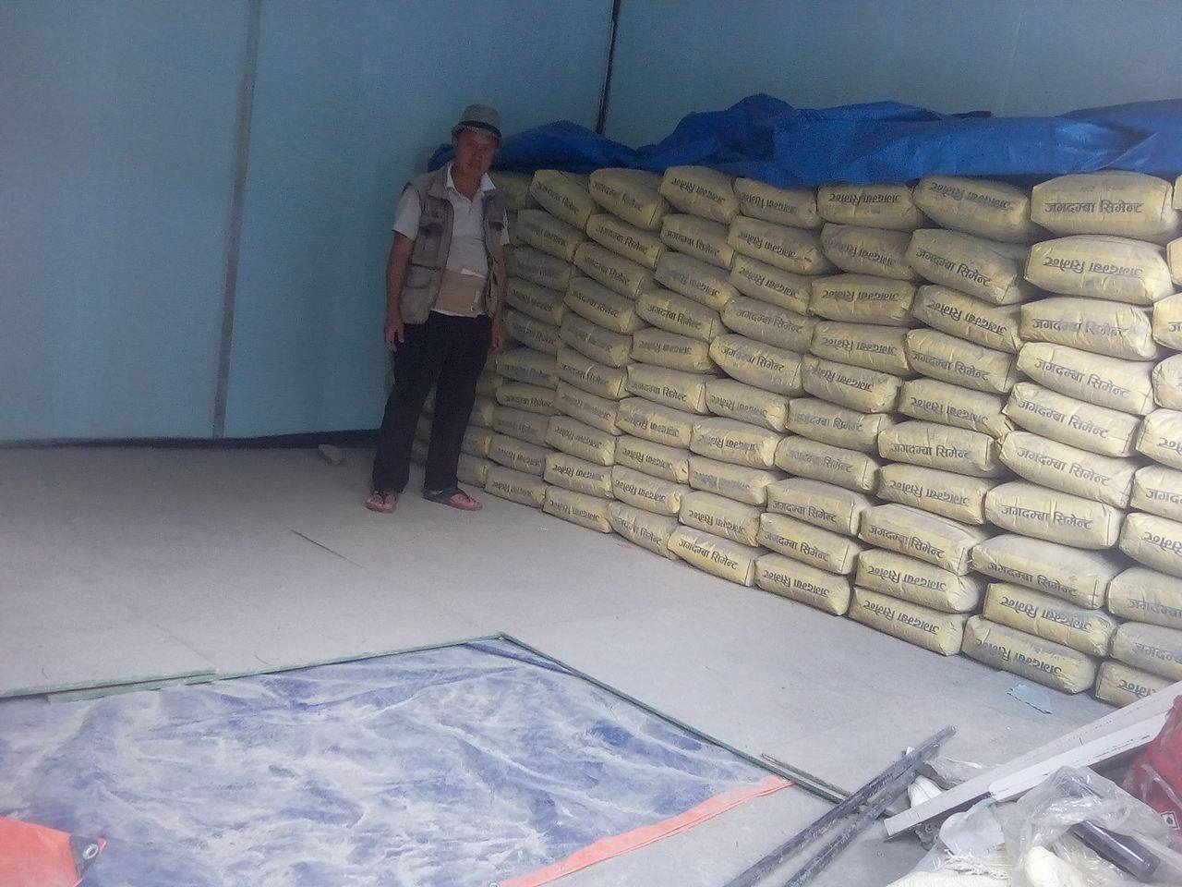
Center ware house-1 Ware house in RC-7

Slide 7
Enterprise Development (CSEB)
Types of Enterprises | No. | No. of Targeted Houses | No. of Houses built | Sales (Qty) | No. of Employment
 |  |  |  |  | Male | Female | Total
Uttargaya CSEB udhyog | 1 | 60 | 24 | 26661 | 1 | 3 | 4
Raju and Dawa CSEB | 1 | 60 | 20 | 21608 | 5 | 0 | 5
Liglig CSEB udhyog | 1 | 60 |  |  | 1 | 3 | 4
Gosaikunda CSEB udhyog | 1 | 60 | 6 | 4300 | 4 |  | 4
Bhumedevi CSEB udhyog | 1 | 60 | 3 | 2200 | 2 | 2 | 4
New star CSEB udhyog | 1 | 60 |  |  | 3 |  | 3
Kalika CSEB udhyog | 1 | 60 | 3 | 1800 | 2 | 2 | 4

Slide 8
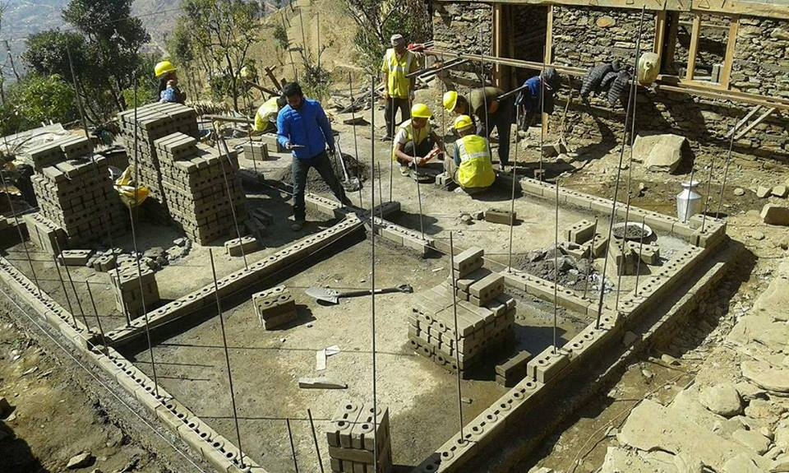
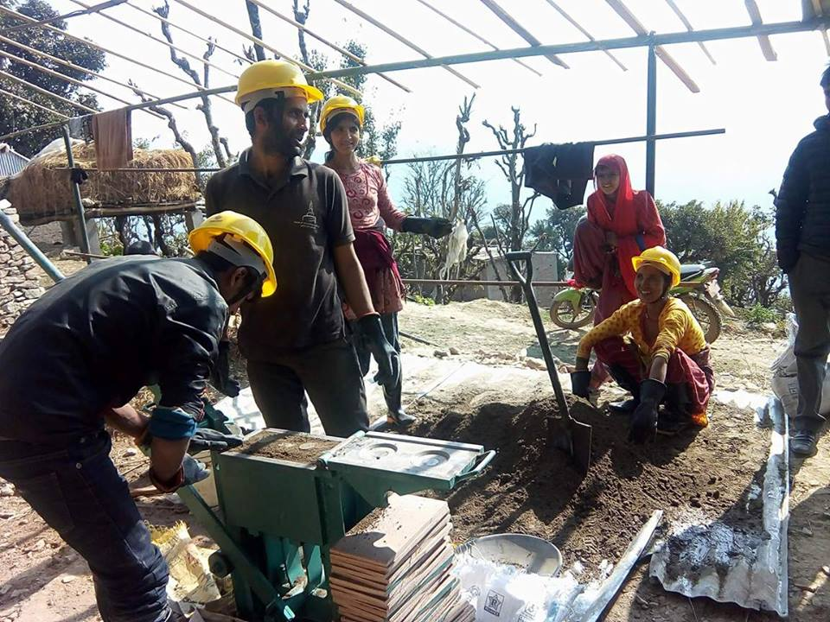
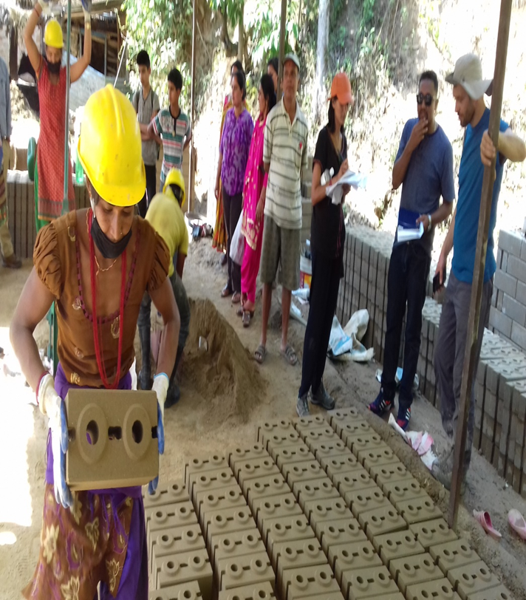
–
Glimpse of
CSEB enterprise

Slide 9
Enterprise Development (Stone cutting)
Types of Enterprises | No. | No. of Targeted Houses | No. of Houses built | Sales (Qty) | No. of Employment
 |  |  |  |  | Male | Female | Total
Langtang sur dhunga udhyog | 1 | 200 | 1 | 100 | 4 |  | 4
Goljung namuna sur dhunga udhyog | 1 | 200 | 10 | 2600 | 3 | 1 | 4
Namuna sur dhunga Udhyog | 1 | 200 | 10 | 940 | 2 |  | 2
Bhadaure sur dhunga udhyog | 1 | 200 | 4 | 6550 | 4 |  | 4
Parbatikunda sur dhunga udhyog | 1 | 200 | 1 | 50 | 4 | 1 | 5
Kanjin sur dhunga udhyog | 1 | 200 | 1 | 80 | 6 |  | 6
Bhumedevi sur dhunga udhyog | 1 | 200 | 3 | 450 | 3 |  | 3

Slide 10
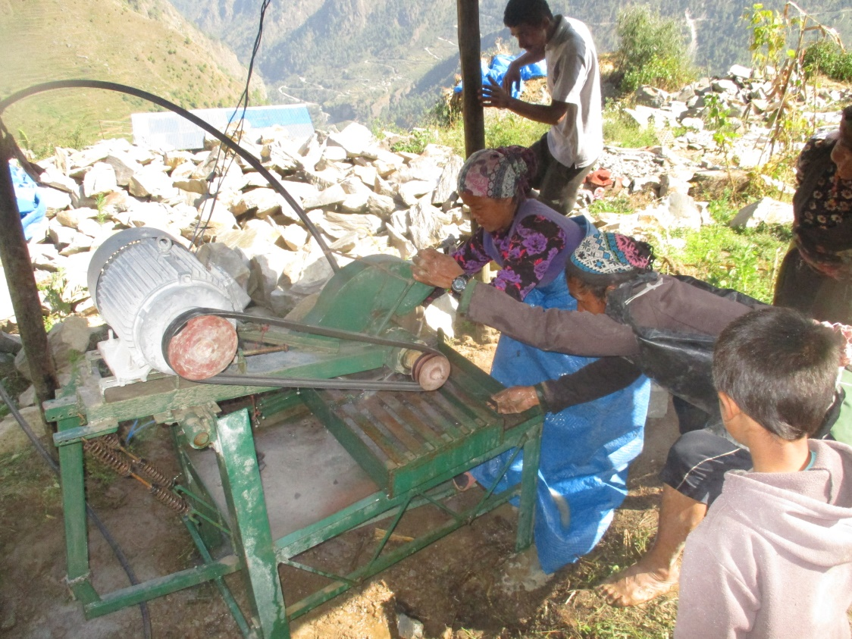
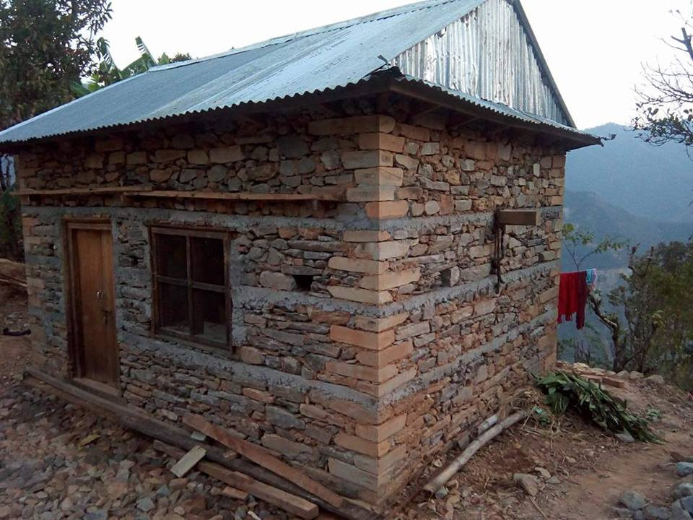
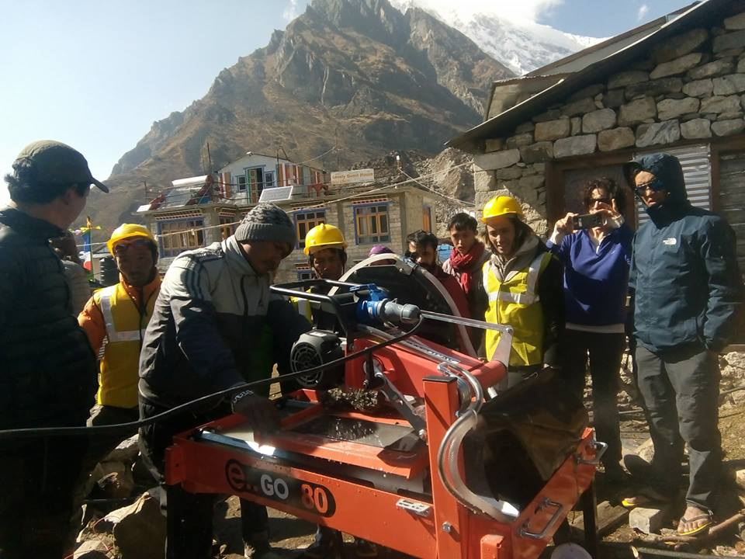
Glimpse of stone cutting enterprise

Slide 11
Enterprise Development (Timber treatment)
Types of Enterprises | No. | No. of Targeted Houses | No. of Houses built | Sales (Qty) | No. of Employment
 |  |  |  |  | Male | Female | Total
Ser furniture udhyog | 1 | 100 | 25 | 325 | 4 |  | 4
Ghale furniture udhyog | 1 | 100 | 13 | 185 | 3 |  | 3
Hari furniture udhyog | 1 | 100 | 17 | 200 | 3 |  | 3
New sirjana furniture udhyog | 1 | 100 | 21 | 245 | 3 |  | 3
Katunje timber tirtment udhyog | 1 | 100 | 25 | 390 | 3 |  | 3
Saramthali furniture udhyog | 1 | 100 | 31 | 415 | 3 |  | 3

Slide 12
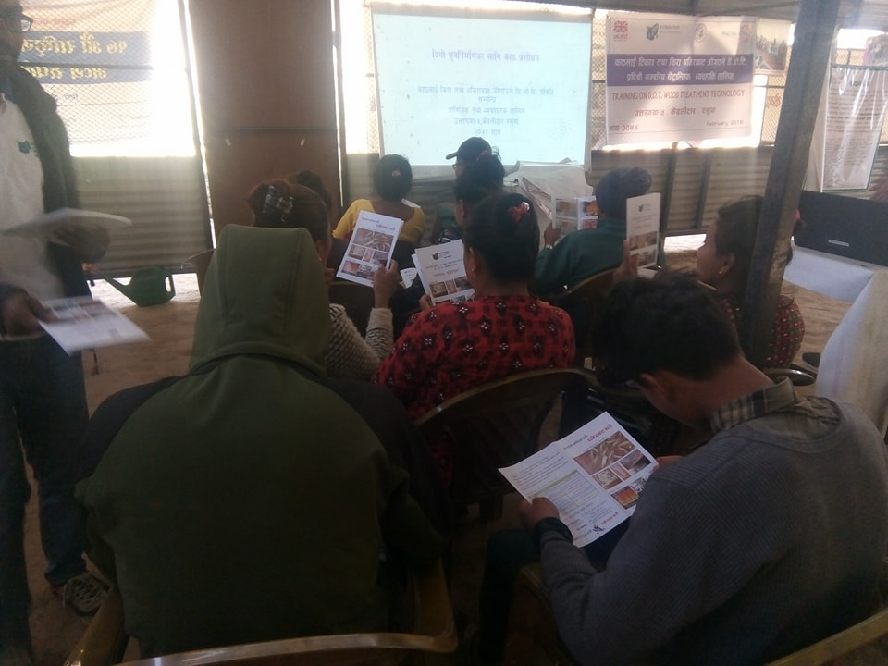
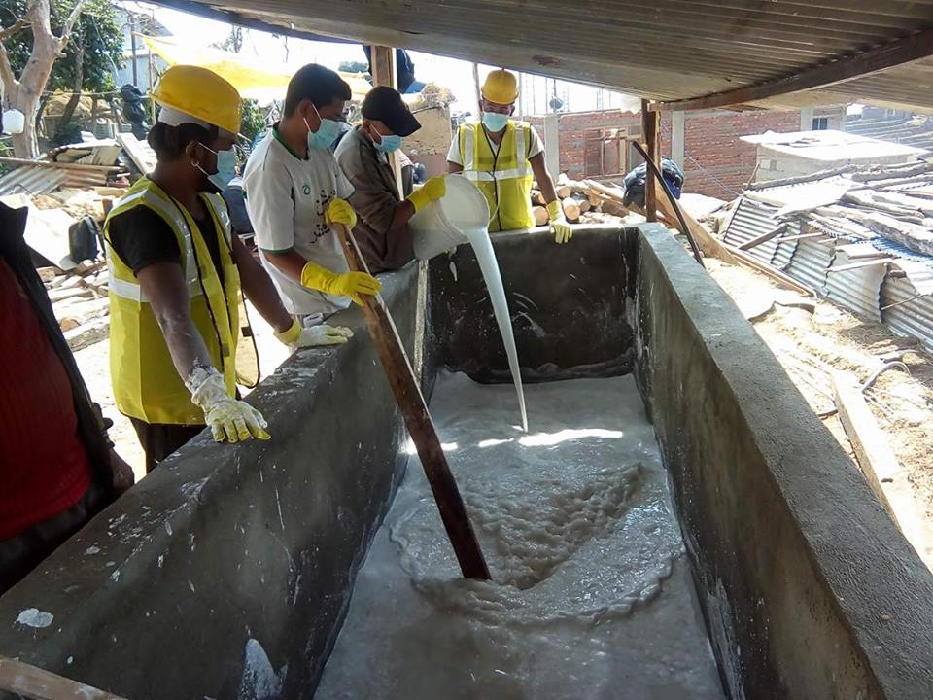
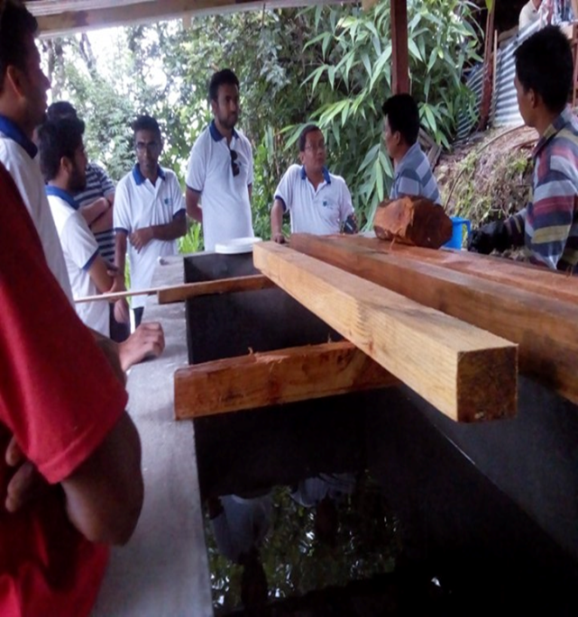
Glimpse of timber treatment plant

Slide 13
Enterprise Development (Status Aggregate producing group)
Types of Enterprises | No. | No. of Targeted Houses | No. of Houses built | Sales (Qty) | No. of Employment
 |  |  |  |  | Male | Female | Total
Mane Ghumti gitti utpadan samuha | 6 | 100 | 49 | 9900 | 1 | 22 | 23
Dhunche gitti utpadan samuha | 6 | 100 | 66 | 8605 | 8 | 16 | 24
Chileme gitti utpadan samuha | 2 | 30 | 16 | 3350 | 1 | 5 | 6
Goljung gitti utpadan samuha | 3 | 40 | 33 | 3700 | 4 | 7 | 11
Adherikhola gitti utpadan samuha | 4 | 50 | 12 | 1800 | 8 | 4 | 12

Slide 14
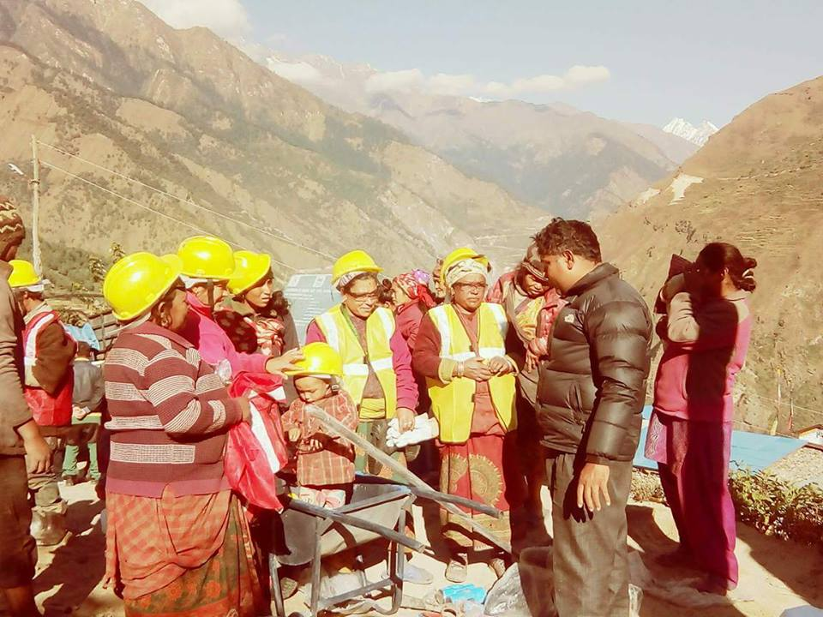
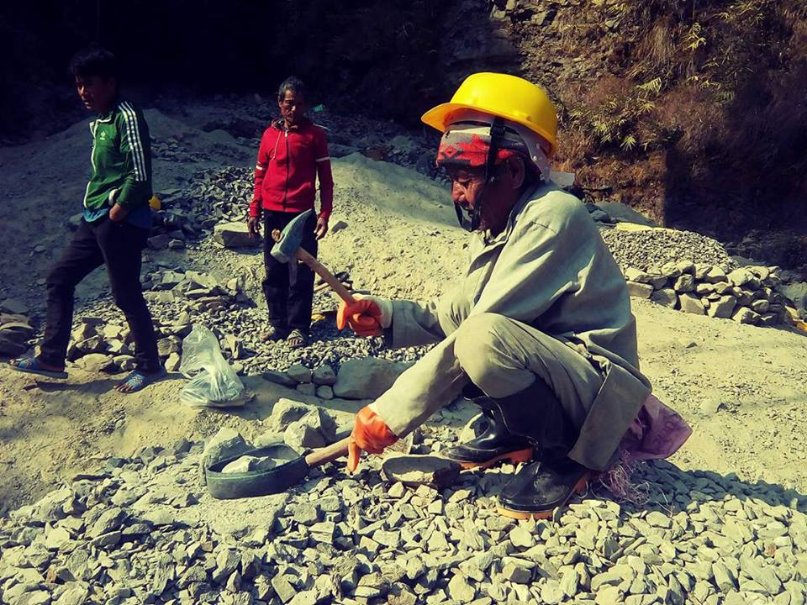
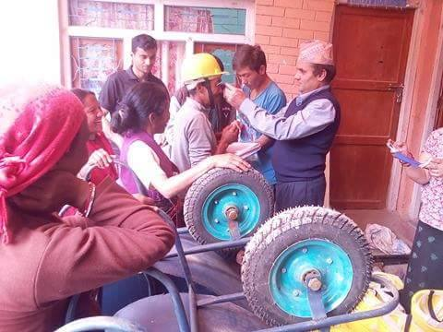
Glimpse of aggregate producing group

Slide 15
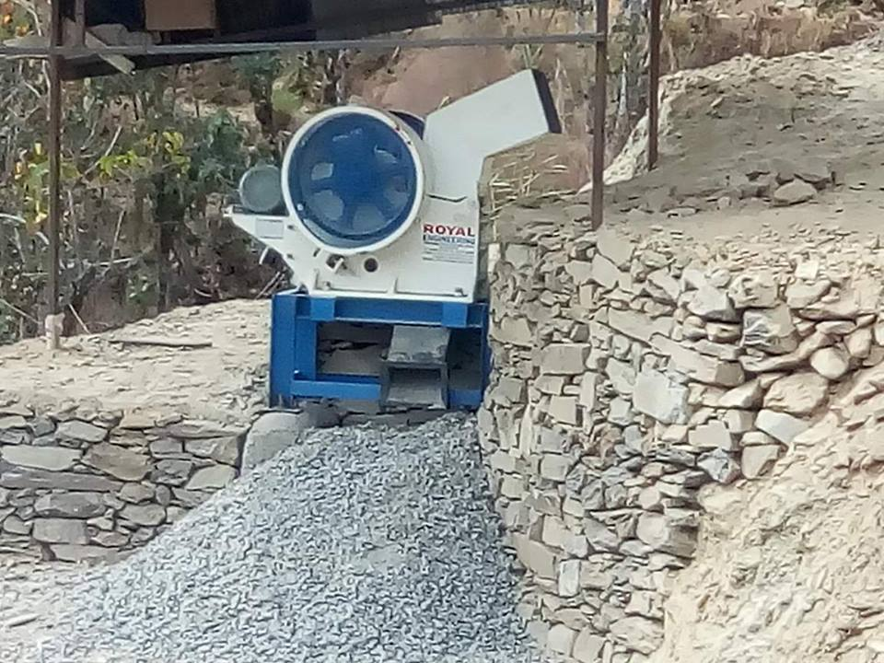
Enterprise Development Status of mini crusher
Types of Enterprises | No. | No. of Targeted Houses | No. of Houses built | Sales (Qty) | No. of Employment
 |  |  |  |  | Male | Female | Total
Kalika mini crasser udhyog | 1 | 200 | 12 | 1800 Qfit | 5 | 1 | 6

Slide 16
Enterprise Development
Types of Enterprises | No. | No. of Targeted Houses | No. of Houses built | Sales (Qty) | No. of Employment
 |  |  |  |  | Male | Female | Total
Mini crasser udhyog | 1 | 200 | 12 | 1800 Qfit | 5 | 1 | 6
Stone Cutting udhyog | 8 | 1600 | 30 | 10770 | 26 | 2 | 28
CSEB udhyog | 7 | 420 | 56 | 56569 | 18 | 10 | 28
Timber tirtment | 6 | 600 | 132 | 1760 | 19 |  | 19
Aggregate group | 5 | 320 | 176 | 27355 | 22 | 54 | 76
Total |  | 3140 | 304 |  | 90 | 67 | 157

Slide 17
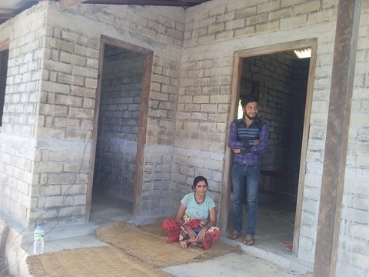
;kmntfsf] syf
hfg'sf clg pgsf] gd'gf 3/
lhjg ;+3if{ xf] of] s'g} bfz{lgs Pjd ;dfh zf:qLsf] egfO{ xf]Og of] t xfd|} /;'jf lhNnf pt/uof ufpFkfnLsf j8f g+ % ag'jf ufp a:g] hfg'sf Gof}kfg] sf] lhjgsf] ;f/ xf] pd]/ sf] lx;fan] $% aif{ k'/f ePsf] z}lIfs of]Uotf ;fdfGo ;lxdfq ug{ ;Sg] pgsf] klxnf % hgfsf] ;fgf] kl/jf/ lyof]. TotL a]nf kgL ul/aL eP/ kgL lhag lg{efx eO{/x]sf] pgsf] kl/jf/df @ 5f]/L !5f]/f / l>dfg >LdtL lyP. TotL a]nf kgL 5f]/f 5f]/L k9fpg / 3/ Joaf/ rnfpg s7LgfO{ x'Gyf]. Toxf dfyL ;fx'sf] C0f n] ;tfO{ /xGyf] crfgs pgsf] >Ldfgsf] sfn utLn] $@ aif{sf] pd]/df d[To' x'g uof] To; kl5 emg 3/ Jojf/ rnfpg sl7gfO{ eof] 5f]/f kgL ;fg} lyof] s]xL ;do kl5 5f]/Lx?sf] ljafx kgL ul/of] To; kl5 pgsf] cfdf 5f]/fdfq a:g] u/by]}F .crfgs pgnfO{ Kof/fnfO;L; /f]u nfuf] To;k5Lt emg} ;d:of ykL+bO uof] 5f]/fnfO{ k9g hfg kgL ;d:of eof] b'v d]nf] u/]/ eokgL 5f]/f SLC kf; eof.] To;kl5 5f]/f kgL ;x/ k9g uPkl5 pgL oSn} 3/df a:g' k/\of]. 5f]/fn] ;x/df ;fgf] sfd ub}{ cfkmgf] k9fOnfO{ lg/Gt/ cuf8L a8fO cfdfnfO{ 3/vr{ kgL k7fpg' k/yf]. v]tL kftL af6 vfg kgL cfkm' a;]sf] 3/ kgL dfOtLn] hUuf lbO{P/ agfPsf] lyof.] lgd]u u/]/ kl/jf/ sf] u'hf/f rnfpg' k/yf]. ufpdf ;'s'daf;L eO{ cfkmgf] lhjg rnfO /x]sL lyOg
crfgs @)&@;fn a}zfv !@ ut] uPsf] dxfljgf;sf/L e'sDkn] ToxL dfOtLsf] hUufdf eosf] 3/ klg tx;gx; eof.] To;kl5 pgL / pgsf] 5f]/fsf] emg ljhf]u eof]. otLsO{ ;fgf] h:tfsf] 6x/f] pgsf] 5f]/f cfo/ agfP To;}df pgsf] af; x'g] u/byf] @ aif{;Dd pgL To; 6x/f]df 3fd kfgL af6 tfTb} leHb} a;L/x]sL lyOg. crfgs Ps lbg pgn] To; ufpdf o; k'g lgdf0f{ sf nfuL lgdf0f ;fdfu|L cfk'tL{ >"vnf ;jnLs/0f kl/of]hgf sfos|d cGt{ut hghfu"tL dlxnf ;d'x af6 ufpdf sfo{s|d eO/xbf pgL klg To; sfo{s|ddf ;xefuL x'g kfPFsf] / Toxfaf6 pgn] o;sfo{s|d af/] hfgsf/L kfOg. pgnfO{ Toxfsf] ;d'bfon] klg gd'gf 3/sf] nflu pgnfOgO l;kmf/L; u/]sf]n] pgL cTofGtO{ v';L eOg .pgn] ;x/df ePsf] 5f]/fnfO{ 3/df af]nfOg / ahf/ ;xhstf{ ;+u e]6fOg sfo{s|d af6 klg pgL 5gf]6df c?eGbf pgL kg]{ ePsf]n] pgL gd'gf 3/ agfpg tof/ eOg t/ cf6 5f]/fsf] lyof] . 3/ agfpg w]/} vr{ nfUg] x'bf sfo{s|dn] Hofnf dfq a]xf]g]{ x'bf 5f]/L x?sf] ;xof]u af6 3/ agfpg nfUg] /sd hDdf u/Lg\ . h;f] t;f] u/L pgn] 3/ lgdf0f{ u/Lg\ . sfo{s|dn] pgnfO{ Hofnf tyf cf}hf/x? ;xof]u u/]/ pxfsf] 3/ ;DkGg agfO{ lbP k:rft pxfsf] ud]sf] cf]7sf] xf;f] lj:tf/} kmlsPsf] 5 . pgn] pgsf] nfuL o; sfo{s|dn] ;xof]u u/]sf]df o; ;:yfnfO{ d'/L d'/L wGojfb lbb} v'zL Jotm ubl5g .

Slide 18
r'gf}lt / ;dfwfg
;d:of / r'gf}ltx? | ;dfwfgsf pkfPx?
lgdf{0f ;fdu|L pTkfbg pBf]u :yfkgf ug{ sfg'gL jfwfx? -btf{_ . | pBf]u :yfkgf ug{ sfg'gL jfwfx? x6fpg kflnsf / lhNnf ;+u ;dGjo ug]{ .
pBd :yfkgfsf] nflu cfjZos ljB't Ifdtf pknJw gx'g' . | pBd :yfkgfsf] nflu cfjZos ljB't Ifdtf a9fpg ljB't k|lws/0f ;+u ;+dGjo ul/ s]lx ;xof]u ug]{ / sfo{ cufl8 a9fpg] .
df+u / cfk'lt{ stf{ lar tfnd]n gvfg' . | 3/ lgdf{0f ug]{ AolQ / >f]t AolQ lar ;dGjosfl/ e'ldsf agfpg' kg]{ .
CSEB af6 3/ agfpg] tflnd lnPsfn] lgodLt ;f]lx sfd gug‘{' | ;d'x u7g u/L ;Dk{sdf /fVg' kg]{ .

Slide 19
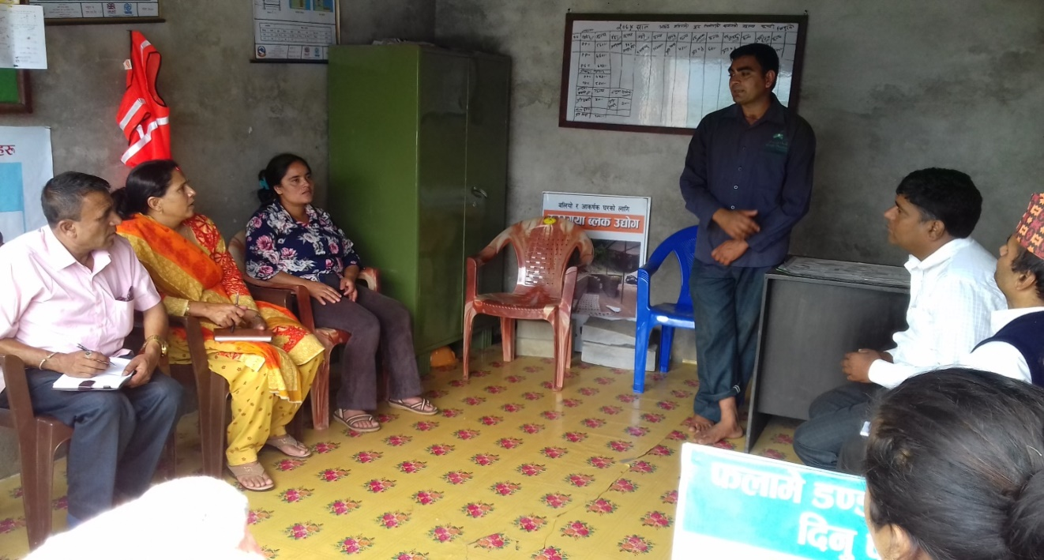
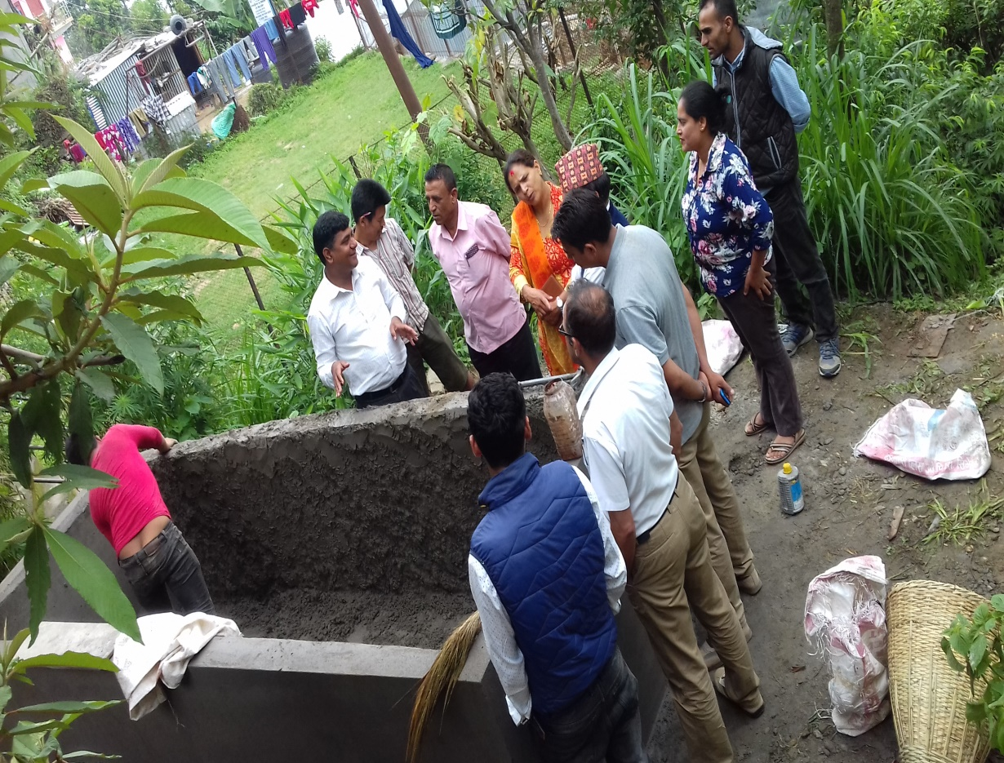
;/sfl/ lgsfo tyf hgk|ltlgwL ; ;u+sf] dfu ;+sng s]Gb|sf] cjnf]sg
;/sfl/ lgsfo tyf hgk|ltlgwL ;u+sf] sf7sf] pkrf/ k|0fflnsf] cjnf]sg

Slide 20
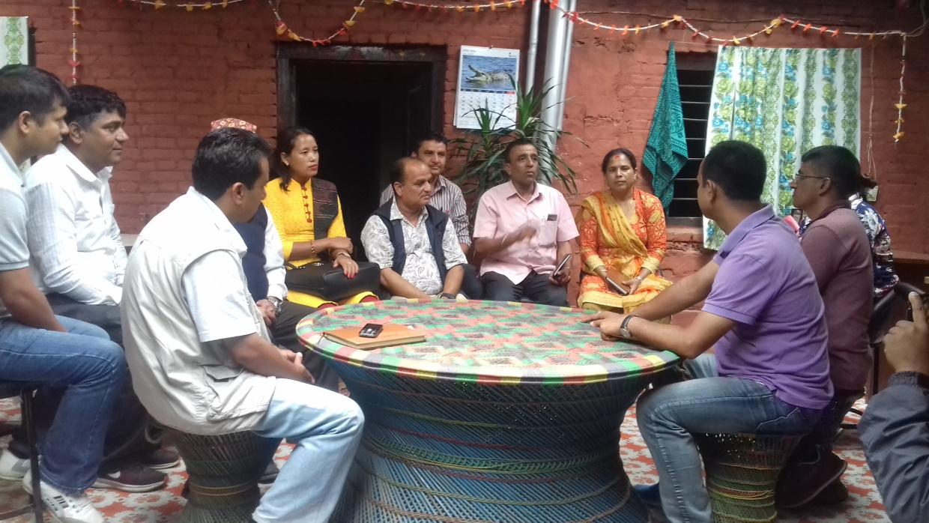
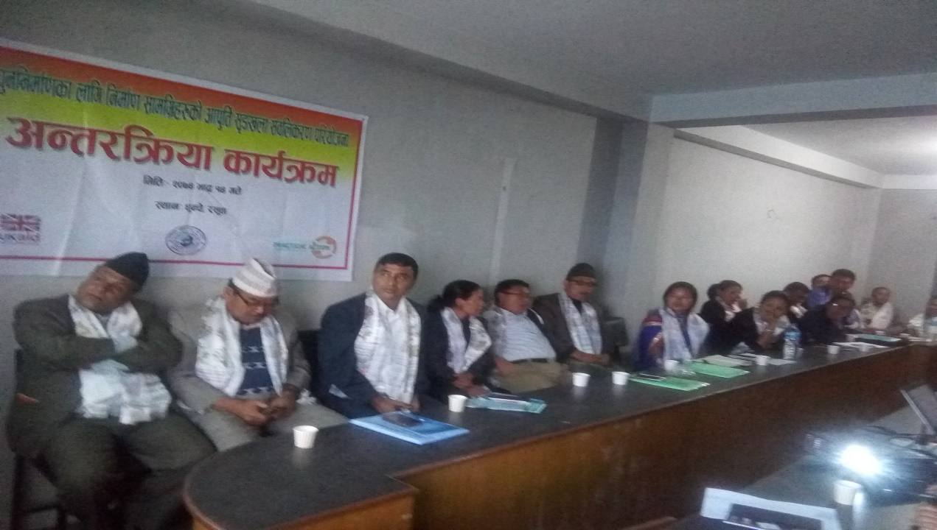
;/sfl/ lgsfo tyf hgk|ltlgwL ; ;+u k'g lgdf{0f sf laifodf 5nkmn
;/sfl/ lgsfo tyf hgk|ltlgwL ;+u k'g lgdf{0f ;DalGw cGt/lqmof{ sfo{qmd

Slide 21
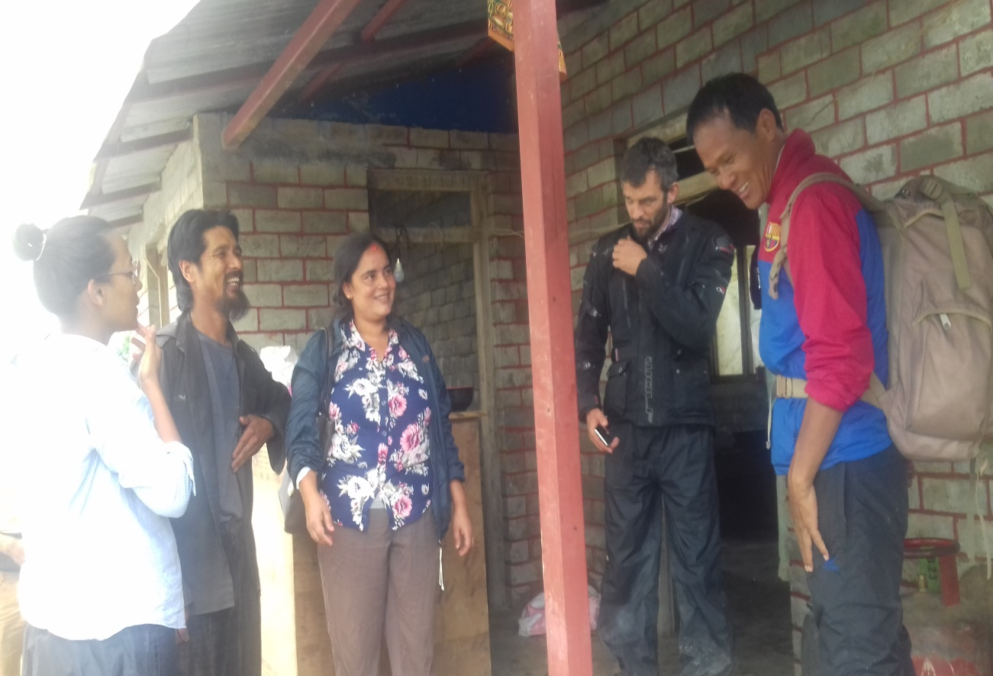
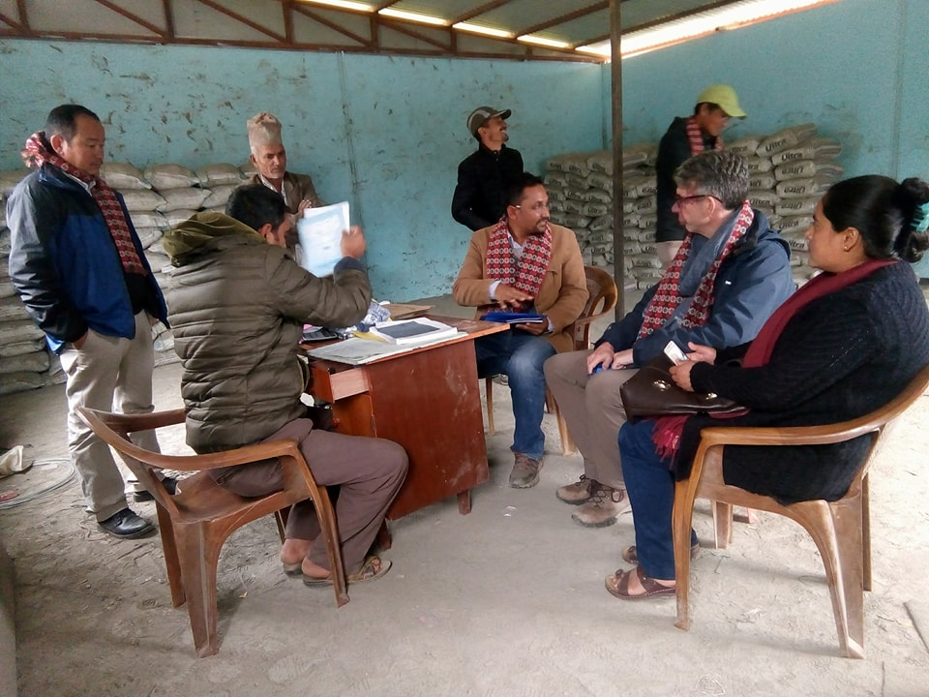
CSEB k|of]u ul/ lgdf{0f ul/Psf] 3/sf] cjnf]sg ub}{
a]nfotsf /fhb't sfo{qmdsf] cgu'dg ub}{

Slide 22
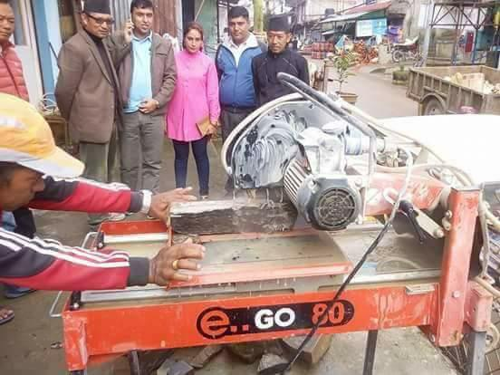
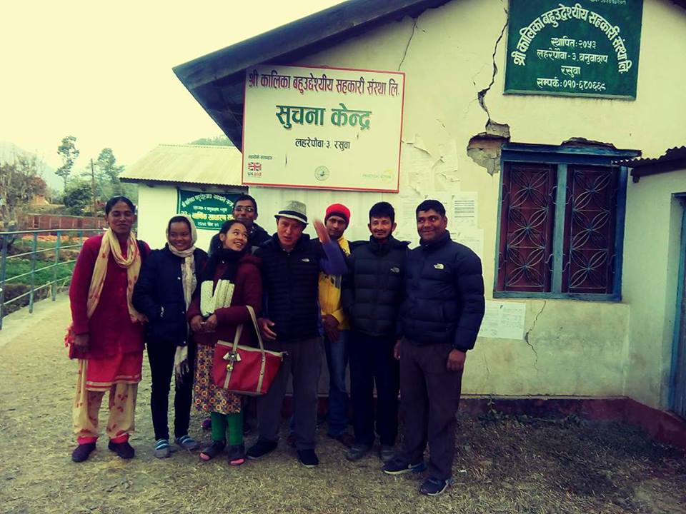
;/sf/L lgsfosf k|ltgLlwx? 9'Ëf sf6\g] ld;Lgsf] canf]sg ub}{
>f]t AoflQx? cGt/ >f]ts]b| cjnf]sg ub}{ }{

Slide 23
wGojfb

