Slide 1

Government of Nepal
Ministry of Urban Development (MoUD)
Central Level Project Implementation Unit (CLPIU)
Earthquake Housing Reconstruction Project (EHRP)
Monitoring and Evaluation of
Reconstruction Activities

Slide 2
Monitoring and Evaluation
Monitoring is the collection and analysis of information about a project or program, undertaken while the project/program is ongoing.
Evaluation is the periodic, reviewing assessment of an organization, project or program that might be conducted internally
or by external independent evaluators.

Slide 3
Comparison-Monitoring and Evaluation
Item | Monitoring | Evaluation
Frequency | Regular, Ongoing | Episodic
Main Action | Keeping Track/Oversight | Assessment
Basic Purpose | Improving Efficiency Adjusting work plan | Improve Effectiveness, Impact, Future Plan
Focus | Input-Output, Process, Outcomes, Work Plan | Effectiveness, Efficiency, Relevance, Impact, Sustainability
Information Source | Routine System, Field Visits, Stakeholder meetings, Output Reports, Rapid Assessment | Survey (Pre-Post Project)
Undertaker by | Program Managers Community Workers Supervisors Beneficiaries Funders Other Stakeholders | External Evaluators Beneficiaries Program Managers Funders Supervisors

Slide 4
Commonalities - M&E
Both monitoring and evaluation must be planned at the program/ project level
Baseline data and appropriate indicators of performance and results must be established

Slide 5
Monitoring
In practice, covers a wide range of activities and requires data collection, but data collection is not synonymous with monitoring
Monitoring also implies analysis and use of the data
Generally, the level that records information should be able to use it
Designing data collection systems with this principle in mind helps improve chances that the data will be collected carefully and put to use.

Slide 6
Planning a Monitoring System
What should be monitored?
Keep information requirements to a bare minimum
Collect info that will be most helpful to those who will use it
How?
Select methods to track indicators /report on progress
Observations, interviews, routine reporting, sentinel sites
Both formal/informal and quantitative/qualitative methods
Decide how information will be recorded systematically and reported clearly
Consider the time and skills of those who will collect the data

Slide 7
Planning a Monitoring System
Who should be involved when?
Clearly identifying who will collect information on indicators, when (frequency) and who will receive it
The monitoring plan should also identify who will be involved in reviewing progress and providing feedback
What resources are needed and available?
The human and financial cost of gathering, reporting and reviewing data should be identified
Needed funding and time should be set aside for this work

Slide 8
Planning a Monitoring System
Consultation and Training
Discuss the monitoring program with a representative group from each level before it is put into effect
Provide training to those who will be using the monitoring systems
Prepare a work plan
for each year (Daily, Weekly, Monthly)
listing the main activities to be carried out, their output, timing and parties involved

Slide 9
How should I monitor?

Slide 10
The first step is observation, but talking and analysis help you understand the cause
Observe |  | Talk |  | Analyse
Actions |  | Attitudes |  | Consistency
Processes |  | Understanding |  | Accuracy
Conditions |  | Morale |  | Effectiveness

Slide 11
Communication

Slide 12
Find Out More from People
Communication
Through communicating we can:
❶
Test level of knowledge
❷
Gauge attitude and morale
❸
Seek guidance on priority areas

Slide 13
Some Communication Tips
DO’s:
Listen and be prepared to learn
Take notes – it’s your job. Don’t be embarrassed!
Ask follow up questions and explore the issues
Compare one story against another! “Triangulate”

✗
DONT’s:
Don’t worry if the person knows more than you
Don’t take anything at face value – CHECK all verbal information against the data
Don’t threaten or intimidate the people you speak to

Slide 14
MOUD- CLPIU FUNCTIONS
Support through DLPIU in 14 affected Districts
Inspection and certification of rural and urban Housing built through owner driven approach and built back better concept
Train mason and house owner and technician about Earthquake Resistant Technology

Slide 15
Functional Modality
MOUD –CLPIU
Project Director,
Deputy Project Directors / Chief Finance Controller
M & E Specialist - Central
NRA
DLPIU
M & E Specialist - Districts
POs
Support to Earthquake affected house owners for build back better & Train Mason, HHs and Technicians.

Slide 16
MoUD CLPIU Monitoring Team
S N | Name | Mobile
1 | Dr. Diwat Kumar Shrestha Team Leader Central | 9851196789
2 | Janak Raj Joshi Ramechhap/ Dolakha | 9851101041
3 | Khagendra Awasti Gorkha/ Dhading | 9741063150
4 | Kiran Kumar Mahat Sindhuli/ Okhaldhunga | 9841500163
5 | Narakanta Sapkota Kathmandu/ Bhakatpur | 9851090721
6 | Prabhu Ram Pokheral Rasuwa/ Nuwakot | 9851224243
7 | Roshan Giri Lalitpur/ Makawanpur | 9841335744
8 | Roshan Keshari Kavre/ Sindhupalchowk | 9841640357

Slide 17
Main Activity
Monitor and evaluate the training activities conducted by the CLPIU / DLPIUs / Partner Organizations.
Support MOUD in monitoring and evaluation of owner driven housing construction.

Slide 18
Specific Activities
Develop and implement M & E framework with detail Log Frame.
Coordinate with NRA, POs, GOs and Earthquake Affected Households.
Conduct periodic site visit of owner driven housing construction in earthquake affected region.
Inspection and monitoring of housing construction and training activities by various partner organizations.

Slide 19
Specific Activities
Collection and Consolidation of data related to owner driven housing construction and training activities and report to MOUD-DLPIU/ CLPIU and NRA.
Design and development of M&E methods, M&E tools and implement/ timely modify it.
Carrying out training need assessments.
Provide technical assistance/ Advices related to Monitoring and Evaluation.

Slide 20
Specific Activities
Be the focal person at MOUD- CLPIU/ DLPIU for coordination between project level M&E and EHRP program level M&E.
Develop and maintain a M&E database for the project and contribute to the maintenance of a database of EHRP project.
Coordinate and cooperate with NRA and all Stakeholders for promoting and information sharing on all aspects related to project activities.

Slide 21
Specific Activities
Ensuring mentoring and training of project team to foster capacity building on M & E knowledge.
Review monitoring and evaluation system/ mechanism, process and procedures of the project and forms and formats for project activities under its various components.
Monitor project progress through field visit, offer feedback and keep regular communication with related field and center level staff.

Slide 22
Specific Activities
Focal point for providing M&E inputs on Implementation Progress Reports (IPRs).
Prepare and submit M&E inputs as per the Results Framework to the consolidated trimester/ annual project implementation progress as per the requirement of project and World Bank.

Slide 23
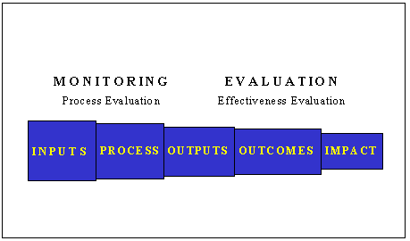
Monitoring and Evaluation System
Inputs Resources used to implement activities (financial, materials, human) | Activities /Process Regular efforts needed to produce the outputs | Outputs Products or services needed to achieve the outcomes | Outcomes Set of beneficiary and population-level changes needed to achieve the goal (usually knowledge, attitudes and practices) | Impact Simple clear statement of the impact or results to achieve by the project

Slide 24
MOUD - CLPIU Reconstruction Framework
Function | Input | Process | Output | Outcomes
Inspection and certification of rural and urban Housing built through owner driven approach and built back better concept | Engineers, Sub Engineers and Asst Sub Engineers (Hiring with Motivational Packages) | Capacity Development of Engineers. Inspection of Houses. Awareness Campion for safer construction. Input to database Timely fill up forms and formats. Reporting to Village Council and DLPIU. Coordination POs/ GOs./ HHs | Timely updated Database / Compliance houses increased. | Safer infrastructure to resist disasters with better lives of people.
 | Policies, Guidelines | Dissemination of Policies and guidelines. Implementations of Policies and guidelines. Feedbacks and rectifications. | Public aware about Policies and Guidelines.
 | Designs, Drawings/ Catalogues/ Manuals / Awareness Creating Materials | Disseminations, Implementations, getting Feedbacks and corrections according to NBC. | People are encouraged to safer construction and built back better.
 | DLPIUs / NRA district | Deployment of Engineers. Follow up Engineers’ performance. Reporting MoFALD/ CLPIU and others Coordination POs/ GOs. | Safer and better houses in District / Compliance houses increased
 | Partner Organizations | Reconstruction programs. Training programs. Supports to Earthquake victims. Livelihood programs Other infrastructure development programs. | Recovery from the disasters/ safer better houses

Slide 25
MOUD - CLPIU Reconstruction Framework
Function | Input | Process | Output | Outcomes
Training mason and house owner and technician about earthquake Resistant Technology | Training Venues | Training hall. Workshop. Sample house construction. | Skilled Workers in Earthquake Resistance Building Construction fulfilled. | Self Employment and Living standard of the people increased.
 | Training Materials (Hardware) | Uses of Training Materials as per Curriculum.
 | Trainers/ Training Managers | Quality Training delivery as per curriculum. Training Plan, Lesson Plan, Log Book, Visitors feedback, Attendance. Evaluation of Participants. Training Evaluation/ feedback. Management of training. Skill Testing.
 | Curriculums | Appropriate Uses of Training Curriculum (DUDBC/ CTEVT).
 | Training Materials (Software) | Uses of Training Materials developed by DUDBC/ CLPIU/ NRA/ CTEVT and others.
 | Training Participants | Selection of Training Participants as per DUDBC/ CLPIU/ CTEVT requirements.

Slide 26
Monitoring Framework

Slide 27
Monitoring Framework
1. Inspection and certification of rural and urban Housing built through owner driven approach and built back better concept.
Engineers, Sub Engineers and Asst. Sub Engineers
DLPIU
Partner Organizations
Dissemination and availability of Housing Reconstruction Materials

Slide 28
Monitoring Framework
Engineers, Sub Engineers and Asst. Sub Engineers
(Receive the information from DLPIU, DLPIU focal person, Engineers, MIS database, Community HHs and different authentic medium).
VDC wise data of Engineers, Sub Engineers and Asst. Sub Engineers and find gap if there is some post are vacant.
Attendance of Engineers in the VDC and their effort in earthquake resistance building construction and housing inspection to distribute housing grant.
HHs data: received housing grant 1st installment/ started to construct/ eligible to receive 2nd installment/ No of Grievance handling and passed in Grievance handling in each VDC.
Capacity development of Technical personnel.
Positive Trends in safer house construction/ housing grant distribution.
Improvements needed in safer house construction/ housing grant distribution.

Slide 29
Monitoring Framework
DLPIU
(Receive the information from DLPIU Chief, Deputy Chief, Focal Person, other Engineers and Staffs, MIS database, NRA, POs and Community HHs)
Human resources (Engineers) working in reconstruction.
Existing Monitoring and communication Mechanisms of HR.
Physical and financial resources.
Coordination between GOs in reconstruction.
POs working in the districts.
Coordination with POs.
Positive Trends.
Improvements needed.

Slide 30
Monitoring Framework
Partner Organizations
(Receive the information from POs - first individual PO and conducting all PO’s meeting/ DLPIU Chief, Deputy Chief, Focal Person, other Engineers and Staffs, MIS database, NRA and Community HHs).
Programs related to reconstruction (housing, training, livelihood, infrastructure development and others)
Human resources working in reconstruction from PO.
Physical and financial resources.
Coordination with CLPIU/ CLPIU Engineers in Field/ other GOs./ other POs.
Positive Trends.
Improvements needed.

Slide 31
Monitoring Framework
Dissemination and availability of Housing Reconstruction Materials
(Receive the information from DLPIU and Community HHs).
Policies, laws, guidelines, standards related to Reconstruction.
Design Catalogues and other revised building designs.
Public awareness on materials.
Inspections forms and formats.
Use of FM Radio, TV, Newspapers and other Medias for safer building construction.
Positive Trends.
Improvements needed.

Slide 32
Monitoring Framework
2. Training mason and house owner and technician about earthquake Resistant Technology.
Visiting the Training Activities the information from direct observation will be based / necessary tools to note the observations will be developed accordingly for each component.
Training Venues
Training Materials (Hardware)
Trainers/ Training Managers
Curriculums
Training Materials (Software)
Training Participants
Training Need Assessment

Slide 33
Monitoring Framework
Training Venues
Training hall.
Workshop.
Sample house construction.
Comments and Suggestions.
Training Materials (Hardware)
Uses of Training Materials as per Curriculum.
Comments and Suggestions.

Slide 34
Monitoring Framework
Trainers/ Training Managers
Quality Training delivery as per curriculum.
Training Plan, Lesson Plan, Log Book, Visitors feedback, Attendance.
Evaluation of Participants.
Training Evaluation/ feedback.
Management of training.
Skill Testing.
Comments and Suggestions.
Curriculums
Appropriate Uses of Training Curriculum (DUDBC/ CTEVT).
Comments and Suggestions

Slide 35
Monitoring Framework
Training Materials (Software)
Uses of Training Materials developed by DUDBC/ CLPIU/ NRA/ CTEVT and others.
Comments and Suggestions.
Training Participants
Selection of Training Participants as per DUDBC/ CLPIU/ CTEVT requirements.
Comments and Suggestions.
Training Need Assessment
Data Analysis
Recommendation

Slide 36
MoUD CLPIU Monitoring Activities
Observations/ Inspections.
Collect information from Engineers.
Information from Households.
Interactions with Stakeholders.
Data collection.
Progress Review
Data Analysis, Preparation and submission of Monthly Report.
Take Action through MOUD-CLPIU/ DLPIU/ NRA.

Slide 37
Recent Performance of M & E Team in Coordination of CLPIU/ DLPIU/ NRA
Development of Monitoring Framework.
Meeting with DLPIU officials in the districts.
Coordination meeting with Partner Organizations in Districts.
Monitoring of training/ reconstruction activities performed by POs.
Collection of the Status of Tablets for data collection.

Slide 38
Master Training of Trainers on Retrofitting Techniques and Correction/ Exception Manual.
Training on Retrofitting Techniques and Correction/ Exception Manual ongoing in 6 districts center.
Development of Monitoring tools on input and process monitoring ongoing.
7 days Mason Training for 2334 existing Masons in 14 districts.
Training on Building Inspection and public Procurement.

Slide 39
Sample Tools developed for M & E

Slide 44
The Monitoring report

Slide 45
THE MONITORING REPORT
The purpose of monitoring reports is to provide :
Updates on achievements against indicators
Guidance on the elements that should be adjusted

Slide 46
MINIMUM STRUCTURE OF MONITORING REPORT
Introduction
Monitoring of situation
Monitoring of objectives and indicators
Progress of activites
Conclusions
Recommandations
Annexes

Slide 47
Reconstruction Status

Slide 48
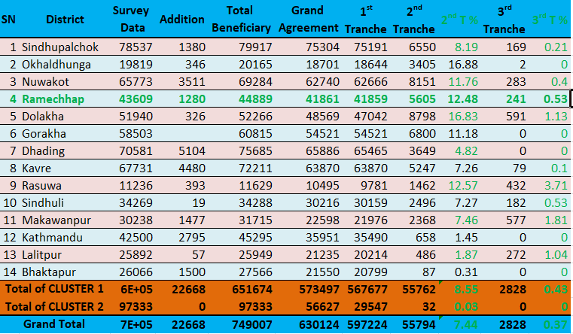
Reconstruction Status (National)
Source: MoFALD CLPIU; http://mofald-clpiu.gov.np/page/78; Date: 2074/04/25

Slide 49
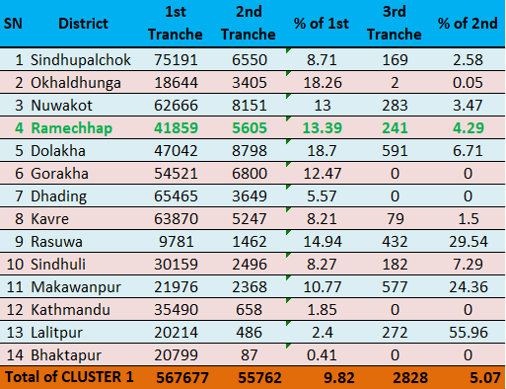
Reconstruction Status (14 District)
Source: MoFALD CLPIU; http://mofald-clpiu.gov.np/page/78; Date: 2074/04/25

Slide 50
Reconstruction Status
(at Local Level)
Notes:
Present MIS Data (Excel sheet, VDC wise )
Compare with other VDC status
Ranking as reconstruction progress
Discussion:
Why any one is at first rank
Why any one is at last
What should we do to accelerate reconstruction rate??
Case study for others

Slide 51
IF A MONITORING DOES NOT LEAD TO ANALYSIS
AND THEN TO
DECISION MAKING
(ADAPTATIONS)
IT IS
USELESS

Slide 52
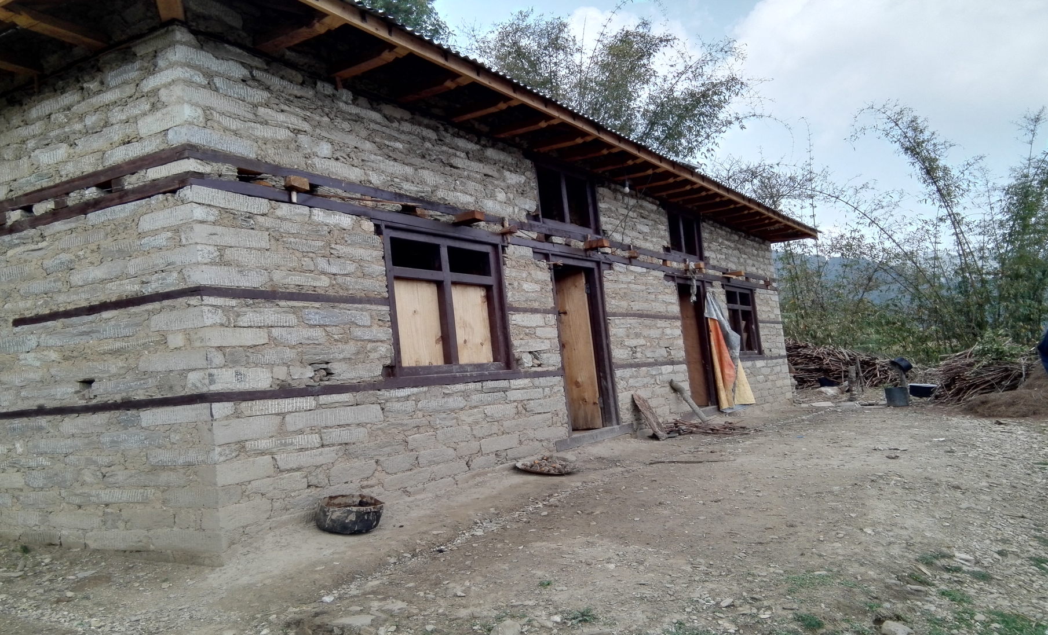
Thank You

