Slide 1
Smart Card Security
Xufen Gao
CS 265
Spring, 2004
San Jose State University

Slide 2
Overview
Introduction
Security Technologies
  Physical structure and life cycle
  Communication with the outside world
  Operating system
Attacks on Smart Card
Conclusion

Slide 3
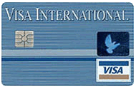
Introduction
Smart card is a credit card sized plastic card embeds an integrated circuit chip.
Smart card provides memory capacity and computational capabilities.
It is used in the applications that require high security protection and authentication.

Slide 4
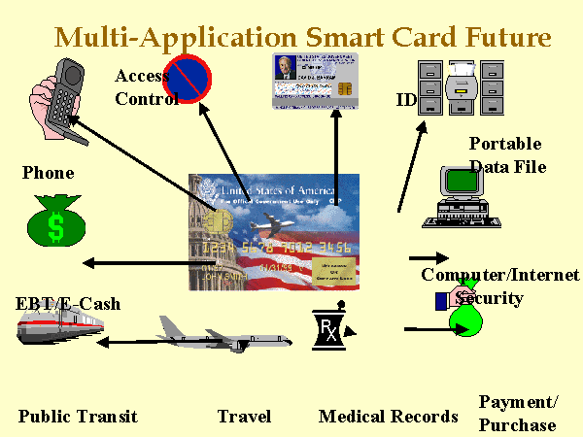
Introduction (Cont.)
Main applications of smart card
  Credit/debit card
  Medical card
  Identification card
  Entertainment card
  Voting card

Slide 5
Security Technologies
Three Points of Views
  Physical Structure and Life Cycle
  Communication with Outside World
  Operating System

Slide 6
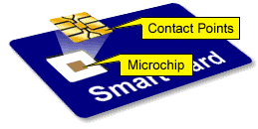
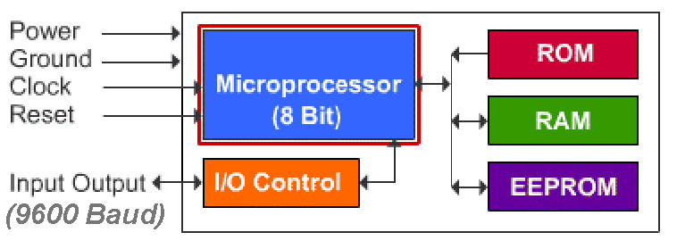
Physical Structure
Three basic elements
  A plastic card
  A printed circuit
  An integrated circuit chip
Notes:
1. Plastic card has a dimension of 85.60mm x 53.98mm x 0.80mm. It must be able to bent in a certain degree
without any damages
2. Printed circuit is gold plate that provides the communication between the external power or data and the internal chip. Moreover, it prevents the circuit chip from mechanical stress and static electricity.
3. Integrated circuit chip is The most important component in smart card. It contains microprocessor, read only memory (ROM), non-static random access memory (RAM), and electrically erasable programmable read only memory (EEPROM). The size of the integrated circuit chip is a few millimeters because it is made of silicon, which is easy to break

Slide 7
Life Cycle of the Smart Card
Five phases in smart card’s life cycle
  Fabrication phase
  Pre-personalization phase
  Personalization phase
  Utilization phase
  End-of-lift phase
Every phase has its own limitations on
transferring and accessing data

Slide 8
Fabrication Phase
The chip manufacturer makes and tests the integrated circuit chip
A unique fabrication key (FK) is added to prevent chip from modifying
  FK stays in the chip until it is assembled into the plastic card
  FK is derived from a master manufacture key

Slide 9
Pre-personalization Phase
Controlled by the card suppliers
Circuit chip is mounted on the plastic card
A personalization key (PK) replaces the fabrication key
A personalization lock V_{PER} is set to prevent further modification
The card only can accessed by the logical memory addressing

Slide 10
Personalization Phase
Card issuer writes the data files and application data to the card
Stores identity of card holder, PIN, and unblocking PIN
Set a utilization lock V_{UTIL} to indicate the card is in the utilization phase

Slide 11
Utilization Phase
For normal use of the card by the card holder
Application system and logical file access controls are available
There are application security policies to rule the access of the information

Slide 12
End-of-Life Phase
Also called invalidation phase
There are two ways to move the card into this phase
  Set an invalidation lock to an individual or master file.
    Operating system disables all operations except read for analysis
  Block all the PINs to disable all operations
    Operating system disables all operations including read

Slide 13
Communication with Outside World
Smart card usually needs external peripherals to cooperate
  e.g. needs to connect to card acceptor device to obtain power and input/output information
The untrusted external peripherals reduce the security

Slide 14
Communication with Outside World (Cont.)
To prevent massive data attack
  Data exchange limits to 9600 bits/second
  Use half duplex mode
Mutual authentication protocol is used between smart card and CAD
Use message authentication code (MAC) to protect integrity

Slide 15
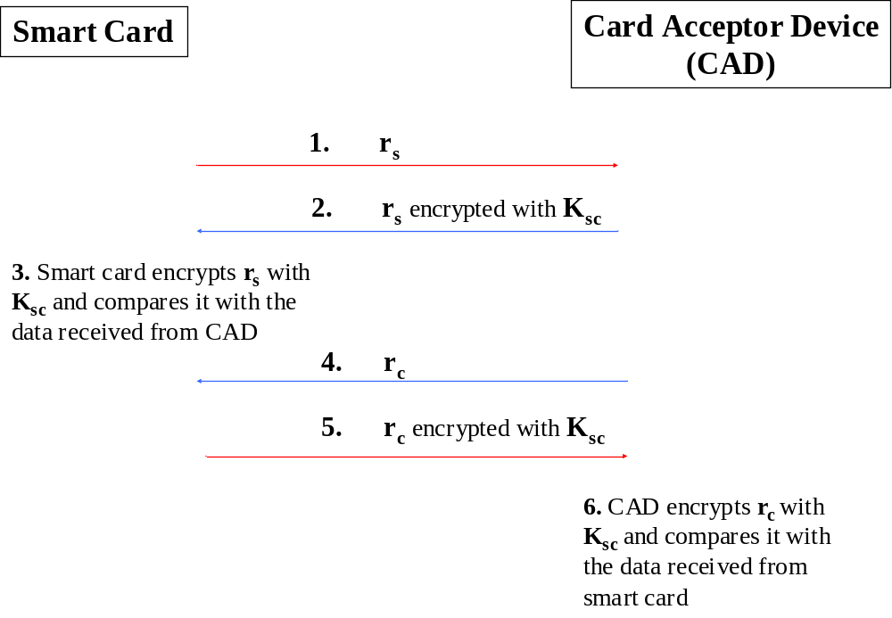
Authentication between Smart Card and CAD

Slide 16
Operating System
Logical File Structure
Access Controls

Slide 17
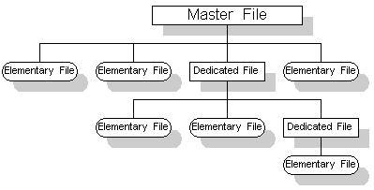
Logical File Structure
Files are in a hierarchal tree form
  Master file (MF)
  Dedicated file (DF)
  Elementary file (EF)
Every file has header and body
  Header consists security attributes to indicate user’s rights
  Body stores all the headers of its immediate children or data
Application can access files only it has the appropriate right

Slide 18
Access Controls
Depends on the correct presentation of PIN and their management
5 Levels of access conditions
  Always (ALW)
  Card holder verification 1 (CHV1)
  Card holder verification 1 (CHV1)
  Administrative (ADM)
  Never (NEV)
PIN presentation and management
  Counter
  Maximum number
  Unblocking PIN

Slide 19
Attacks on Smart Card
Logical attacks
  Control the voltage or temperate on EEPROM
Physical attacks
  Wash away the surface of circuit chip and Examine it
  Use UV light
Logical and physical attacks are expensive. They are only available in well-funded laboratories.

Slide 20
Attacks on Smart Cart (Cont.)
Functional attacks
  Smart card consists five parties
    Cardholder, terminal, data owner, card issuer, card manufacturer, and software manufacturer
  There are potential attacks between any two parties
  Solutions
    Use strong cryptographic protocols to increase tamper resistance
    Reduce the party number
    Make the system more transparent
    Consider the security issue at the beginning of the system design

Slide 21
Conclusion
Smart card uses integrated circuit chip rather than magnetic strip to store data
Smart card can be programmed to compute the cryptographic keys
Smart card is a good device to store important information
  Private key
  Account numbers
  Biometrics information
Smart card has weakness, but it is secure enough for present requirements

Slide 22
Q & A
???

