Slide 1
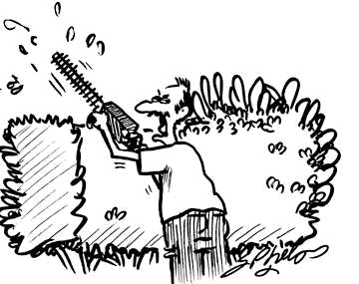
Smart Cards: Technology for Secure Management of Information
Rajat Moona
Computer Science and Engineering
IIT Kanpur
moona@iitk.ac.in

Slide 2
Agenda
Machine readable plastic cards
What are smart cards
Security mechanisms
Applications
SCOSTA experience
Indian Driving License application

Slide 3
Plastic Cards
Visual identity application
  Plain plastic card is enough
Magnetic strip (e.g. credit cards)
  Visual data also available in machine readable form
  No security of data
Electronic memory cards
  Machine readable data
  Some security (vendor specific)

Slide 4
Smart Cards
Processor cards (and therefore memory too)
Credit card size
  With or without contacts.
Cards have an operating system too.
The OS provides
  A standard way of interchanging information
  An interpretation of the commands and data.
Cards must interface to a computer or terminal through a standard card reader.

Slide 5
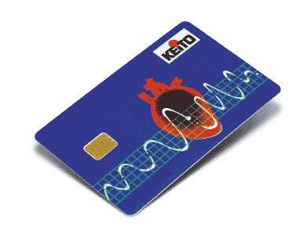
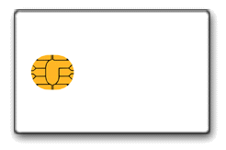
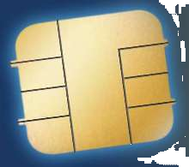
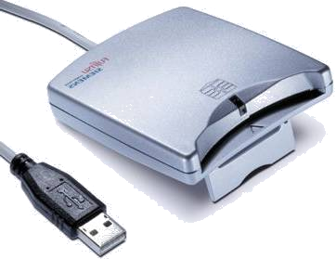
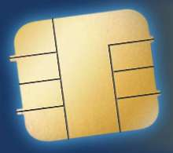
Smart Cards devices
GND
VCC
VPP
Reset
I/O
Clock
Reserved

Slide 6
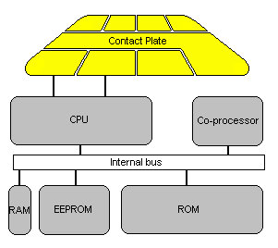
What’s in a Card?
CLK
RST
Vcc
RFU
GND
RFU
Vpp
I/O

Slide 7
Typical Configurations
256 bytes to 4KB RAM.
8KB to 32KB ROM.
1KB to 32KB EEPROM.
Crypto-coprocessors (implementing 3DES, RSA etc., in hardware) are optional.
8-bit to 16-bit CPU. 8051 based designs are common.
The price of a mid-level chip when produced in bulk is less than US$1.

Slide 8

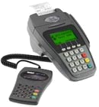
Smart Card Readers
Computer based readers
Connect through USB or COM (Serial) ports
Dedicated terminals
Usually with a small screen, keypad, printer, often also
have biometric devices such as thumb print scanner.

Slide 9
Terminal/PC Card Interaction
The terminal/PC sends commands to the card (through the serial line).
The card executes the command and sends back the reply.
The terminal/PC cannot directly access memory of the card
  data in the card is protected from unauthorized access. This is what makes the card smart.

Slide 10
Communication mechanisms
Communication between smart card and reader is standardized
  ISO 7816 standard
Commands are initiated by the terminal
  Interpreted by the card OS
  Card state is updated
  Response is given by the card.
Commands have the following structure
Response from the card include 1..Le bytes followed by Response Code
CLA | INS | P1 | P2 | Lc | 1..Lc | Le

Slide 11
Security Mechanisms
Password
  Card holder’s protection
Cryptographic challenge Response
  Entity authentication
Biometric information
  Person’s identification
A combination of one or more

Slide 12
Password Verification
Terminal asks the user to provide a password.
Password is sent to Card for verification.
Scheme can be used to permit user authentication.
  Not a person identification scheme

Slide 13
Cryptographic verification
Terminal verify card (INTERNAL AUTH)
  Terminal sends a random number to card to be hashed or encrypted using a key.
  Card provides the hash or cyphertext.
Terminal can know that the card is authentic.
Card needs to verify (EXTERNAL AUTH)
  Terminal asks for a challenge and sends the response to card to verify
  Card thus know that terminal is authentic.
Primarily for the “Entity Authentication”

Slide 14
Biometric techniques
Finger print identification.
  Features of finger prints can be kept on the card (even verified on the card)
Photograph/IRIS pattern etc.
  Such information is to be verified by a person. The information can be stored in the card securely.

Slide 15
Data storage
Data is stored in smart cards in E²PROM
  Card OS provides a file structure mechanism
MF
File types
Binary file (unstructured)
Fixed size record file
Variable size record file
DF
DF
EF
EF
DF
EF
EF
EF

Slide 16
File Naming and Selection
Each files has a 2 byte file ID and an optional 5-bit SFID (both unique within a DF). DFs may optionally have (globally unique) 16 byte name.
OS keeps tack of a current DF and a current EF.
Current DF or EF can be changed using SELECT FILE command. Target file specified as either:
  DF name
  File ID
  SFID
  Relative or absolute path (sequence of File IDs).
  Parent DF

Slide 17
Basic File Related Commands
Commands for file creation, deletion etc., File size and security attributes specified at creation time.
Commands for reading, writing, appending records, updating etc.
  Commands work on the current EF.
  Execution only if security conditions are met.
Each file has a life cycle status indicator (LCSI), one of: created, initialized, activated, deactivated, terminated.

Slide 18
Access control on the files
Applications may specify the access controls
  A password (PIN) on the MF selection
    For example SIM password in mobiles
  Multiple passwords can be used and levels of security access may be given
Applications may also use cryptographic authentication

Slide 19
An example scenario (institute ID card)
Read: Free
Write: upon verification by K1, K2 or K3
What happens if the user forgets his password?
Solution1: Add supervisor password
Solution2: Allow DOSA/DOFA/Registrar to modify EF3
Solution3: Allow both to happen
Select: P2 verification
Security requirements:
EF1:
Should be modified only by the DOSA/DOFA/Registrar
Readable to all
EF2:
Card holder should be able to modify
EF1 (personal data)
Name: Rajat Moona
PF/Roll: 2345
MF
Read: Free
Write: Password Verification (P1)
EF2 (Address)
#320, CSE (off)
475, IIT (Res)
EF3 (password)
P1 (User password)
EF3 (password)
P1 (User password)
P2 (sys password)
EF4 (keys)
K1 (DOSA’s key)
K2 (DOFA’s key)
K3 (Registrar’s key)
Read: Never
Write: Once
Read: Never
Write: Password Verification (P1)

Slide 20
An example scenario (institute ID card)
EF1 (personal data)
Library manages its own keys in EF3 under DF1
Institute manages its keys and data under MF
Thus library can develop applications independent of the rest.
EF2 (Address)
MF
EF3 (password)
EF4 (keys)
Modifiable: By admin staff. Read: all
DF1 (Lib)
EF2 (Privilege info)
Max Duration: 20 days
Max Books: 10
Reserve Collection: Yes
EF1 (Issue record)
Bk#
dt issue
dt retn
EF3: Keys
K1: Issue staff key
K2: Admin staff key
Bk#
dt issue
dt retn
Modifiable: By issue staff. Read all
Bk#
dt issue
dt retn
Bk#
dt issue
dt retn

Slide 21
How does it all work?
Card is inserted in the terminal
Card gets power. OS boots up. Sends ATR (Answer to reset)
ATR negotiations take place to set up data transfer speeds, capability negotiations etc.
Terminal sends first command to select MF
Card responds with an error (because MF selection is only on password presentation)
Terminal prompts the user to provide password
Terminal sends password for verification
Card verifies P2. Stores a status “P2 Verified”. Responds “OK”
Terminal sends command to select MF again
Card responds “OK”
Card supplies personal data and responds “OK”
Terminal sends command to read EF1

Slide 22
Another Application Scenario
Terminal with
two card
readers
Application
software runs
here
1. Authenticate user to bank officer card:
1a. Get challenge from banker card.
1b. Obtain response for the challenge from passport (IAUTH).
1c. Validate response with officer card (EAUTH)
2. Authenticate officer card to passport.
3. Transfer money to the user’s card
Banker’s card
User’s card
The terminal itself does not store any keys, it’s the two cards that really authenticate each other. The terminal just facilitates the process.

Slide 23
Status of smart card deployments
Famous Gujarat Dairy card
  Primarily an ID card
GSM cards (SIM cards for mobiles)
  Phone book etc. + authentication.
Cards for “credit card” applications.
  By 2007 end all credit cards will be smart.
  EMV standard
Card for e-purse applications
  Bank cards
Card technology has advanced
  Contactless smart cards,
  32-bit processors and bigger memories
  JAVA cards

Slide 24
SCOSTA Experience
Part of E-governance initiative of the Government.
Government decided to
  Create Smart driving licenses/registration certificate
  Backend system is already in place
Various smart card vendors in the country
  All with their own proprietary solutions
  In a national case, proprietary solution was not acceptable.
NIC decides to ask IIT Kanpur to help.
SCOSTA: Smart Card OS for Transport Applications

Slide 25
Goals of this Project
To define a standard set of commands for smart cards for use in Indian applications.
To provide a reference implementation of this standard.
Transport Applications (Driving License and Vehicle Registration Certificate) were the pilot projects.
Hence the OS standard is named SCOSTA.
SCOSTA is defined by IIT Kanpur along with a technical subcommittee of SCAFI (Smart Card Forum of India).
The OS is not really restricted to the transport applications and can be used in any ID application

Slide 26
The SCOSTA Standard
Based on ISO 7816-4, -8, and -9.
Removes ambiguities in ISO 7816.
Has support for symmetric key cryptography (Triple DES algorithm) and internal and external authentication.
Encryption/decryption and crypto checksum computation and verification using 3DES are also supported.

Slide 27
SCOSTA Implementation - Challenges
Portability – should be easy to port to different processors.
Resource Constraints – very limited memory (32 KB ROM, 512 byte RAM are typical). Usually 8 bit processors are used.
Government processes
Vendors and their business interests.

Slide 28
Challenges of the application
System must work nation wide
Cards are issued by the RTO
RTO officials may not be all that “clean”
Challans are done by police “on behalf of” RTO
  “Clean”??
Challans are settled by the Judiciary.
RTOs are administered by the STA
  But under the Union Ministry

Slide 29
Solution
A robust key management scheme was needed.
Solution was based on
  Key derivations, usage counters etc.

Slide 30
Solution
The entire system is based on few “nation wide” generator keys.
Safely housed with the government.
Say the keys are k1, k2, k3, k4.
Keys are themselves never stored any where.
  Instead five out of seven card scheme is used.

Slide 31
5 out of 7 scheme
Consider a polynomial
k1 + k2.x + k3.x² + k4.x³ + k5.x⁴ = b
If b1, b2, b3, b4, b5 are known for x = 1, 2, 3.., the system of equations can be solved and all k’s can be found.
We use the SCOSTA cards to store (x1, b1), (x2, b2) etc.
At any point in time, five such pairs are needed.
For robustness, seven cards are generated and kept at 7 different locations.

Slide 32
Operations
At RTOs, two RTO officers are required to create a DL
  These two work in pair.
  Have a usage counter of key built in.
  RTO keys are generated and given in the RTO cards
STA can revalidate the usage counter.
STA keys are also generated.

Slide 33
Operations
DL can be completely given by the RTO.
Some information is public readable on the DL.
Some information is once writable by the police (challans) and readable by the police.
The same information is updatable by the judiciary. (but can not be deleted)

Slide 34
Operations
Therefore the DLs must carry
  Police key, RTO keys and judiciary keys.
    A big security risk.
  Instead these keys for the DL are card specific.
  Police has a master key to generate DL specific police key. Ditto with RTO and Judiciary.
NIC generates the cards (and therefore master keys) for RTO, Police and Judiciary.

Slide 35
Current State
DL/RC are being issued in Calcutta, Delhi on SCOSTA cards (pilot basis)
Governments such as Jharkhand, Maharastra, Gujarat, WB have already started the process rolling.
Various other states will follow.

Slide 36
Acknowledgements
Prof. Deepak Gupta and Manindra Agrawal (CSE)
S. Ravinder and Kapileshwar Rao (MTech students of CSE who worked on this project)
National Informatics Centre (NIC) Delhi
MCIT and MoST
References:
Smart Card Handbook
ISO7816 standards
www.parivahan.nic.in

