Slide 1
Dependence and Data Flow Models
(c) 2007 Mauro Pezzè & Michal Young
Ch 6, slide <number>

Slide 2
Why Data Flow Models?
Models from Chapter 5 emphasized control
    Control flow graph, call graph, finite state machines
We also need to reason about dependence
    Where does this value of x come from?
    What would be affected by changing this?
    ...
Many program analyses and test design techniques use data flow information
  Often in combination with control flow
    Example: “Taint” analysis to prevent SQL injection attacks
    Example: Dataflow test criteria (Ch.13)
(c) 2007 Mauro Pezzè & Michal Young
Ch 6, slide <number>
Notes:
Data flow models complement models of the control flow of a program, including the control flow graphs (CFGs) and call graphs described in the previous chapter.
We often need to reason about information flow, or how a value at one point in the program depends on values of the same or different variables at some prior point in execution. For example, natural questions to ask about a variable x at some point in program execution are “where did this value come from?” and “where could it be used?”. Data flow models capture this dependence information naturally. Often we use some data flow information and some control information together, and this chapter also includes some combined models, e.g., the program dependence graph.
An example of using a data flow model is building an automatic analysis to detect vulnerability to “SQL injection” or “command injection” attacks. If the contents of a web form are later used in forming a database query, we need to be sure that there is no way for an attacker to use malformed SQL to obtain privileged information or destroy the database. [Illustrative examples of SQL injection can be found on Wikipedia, among other sources.] A program analysis to detect this vulnerability must use information about how information that is input from the web form is checked, transformed, and finally used in the query; in other words, it must be based on a data flow model of the application.
Chapter 13 of this book also describes how program tests can be designed to “cover” the information flows in a program, so that if variable x can get a value in two or more different ways, we test all of them.

Slide 3
Learning objectives
Understand basics of data-flow models and the related concepts (def-use pairs, dominators…)
Understand some analyses that can be performed with the data-flow model of a program
  The data flow analyses to build models
  Analyses that use the data flow models
Understand basic trade-offs in modeling data flow
  variations and limitations of data-flow models and analyses, differing in precision and cost
(c) 2007 Mauro Pezzè & Michal Young
Ch 6, slide <number>

Slide 4
Def-Use Pairs (1)
A def-use (du) pair associates a point in a program where a value is produced with a point where it is used
Definition: where a variable gets a value
  Variable declaration (often the special value “uninitialized”)
  Variable initialization
  Assignment
  Values received by a parameter
Use: extraction of a value from a variable
  Expressions
  Conditional statements
  Parameter passing
  Returns
(c) 2007 Mauro Pezzè & Michal Young
Ch 6, slide <number>
Notes:
A definition-use (of def-use) pair is the most basic data flow relationship: A value was “defined” (produced or stored) at one point and “used” (referenced or retrieved from a variable) at another point.
For students who have taken a compiler construction course, it is useful to note that “def-use pairs” in testing and program analysis captures exactly the same information as “reaching definitions” dataflow analysis in compilers.

Slide 5
Def-Use Pairs
...
if (...) {
x = ... ;
...
}
y = ... + x + ... ;
...
if (...) {
Definition: x gets a value
x = ...
...
Use: the value of x is extracted
Def-Use
path
y = ... + x + ...
...
(c) 2007 Mauro Pezzè & Michal Young
Ch 6, slide <number>
Notes:
The control flow graph (Ch. 5) is shown in black; the def-use relation between a definition of x and a use of x is shown in red.

Slide 6
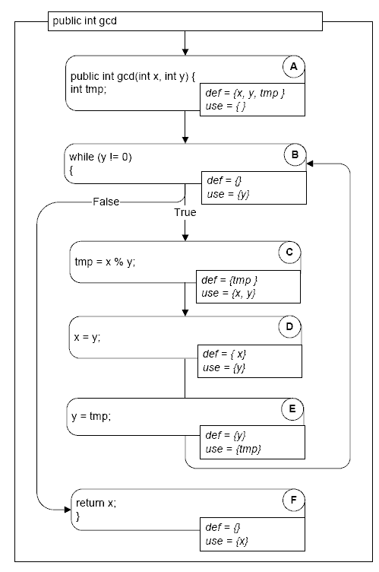
Def-Use Pairs (3)
/** Euclid's algorithm */
public class GCD
{
public int gcd(int x, int y) {
int tmp; // A: def x, y, tmp
while (y != 0) { // B: use y
tmp = x % y; // C: def tmp; use x, y
x = y; // D: def x; use y
y = tmp; // E: def y; use tmp
}
return x; // F: use x
}
Figure 6.2, page 79
(c) 2007 Mauro Pezzè & Michal Young
Ch 6, slide <number>
Notes:
Data flow information is associated with locations in the program, or equivalently, with nodes in the program control flow graph. We mark each location with the sets of variables defined and used at those locations. Note that in node A (beginning of the procedure) x, y, and tmp are defined. x and y receive the values passed to them through parameters, while the declaration of tmp is treated like an assignment of a special value “uninitialized”.
Line c (node c in the graph at right) shows how an assignment statement typically defines one thing (tmp, in this case) and uses all the variables that are used in computing that value (x and y, in this case).
Line F (node f at right) shows that returning a value from a method or function is also a use of that value. Essentially we are considering that the return value will be used where the function or method is called.

Slide 7
Def-Use Pairs (3)
A definition-clear path is a path along the CFG from a definition to a use of the same variable without* another definition of the variable between
  If, instead, another definition is present on the path, then the latter definition kills the former
A def-use pair is formed if and only if there is a definition-clear path between the definition and the use
*There is an over-simplification here, which we will repair later.
(c) 2007 Mauro Pezzè & Michal Young
Ch 6, slide <number>
Notes:
Strictly speaking, we should say “possibly without”, because sometimes it is impossible to know for sure whether two definitions affect the same variable or storage location. Treatment of uncertainty in data flow analysis is covered a little later; it’s simpler to ignore it for now.

Slide 8
Definition-Clear or Killing
x = ... // A: def x
q = ...
x = y; // B: kill x, def x
z = ...
y = f(x); // C: use x
...
Definition: x gets a value
x = ...
A
...
Definition: x gets a new value, old value is killed
Path A..C is
not definition-clear
x = y
B
Path B..C is
definition-clear
...
Use: the value of x is extracted
y = f(x)
C
(c) 2007 Mauro Pezzè & Michal Young
Ch 6, slide <number>
Notes:
When x gets a new value in line B, we say the earlier definition at line A is “killed”. This means a def-use path with A as the definition cannot pass through B.
Question for class: What are the def-use pairs involving x in this program fragment?
Answer: There is one def-use pair (B,C), with the definition at B and the use at C.
(A,C) is NOT a def-use pair in this program fragment, because the definition at A is killed at B.

Slide 9
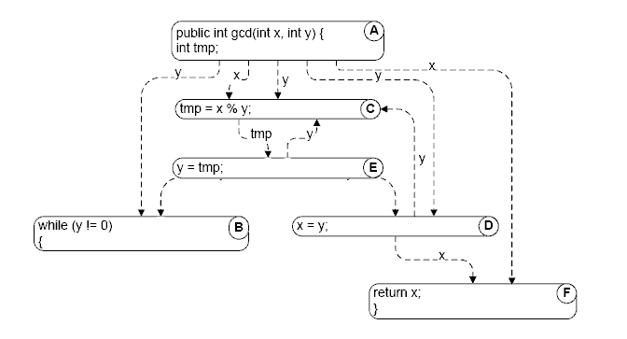
(Direct) Data Dependence Graph
A direct data dependence graph is:
  Nodes: as in the control flow graph (CFG)
  Edges: def-use (du) pairs, labelled with the variable name
Dependence edges show this x value could be the unchanged parameter or could be set at line D
(Figure 6.3, page 80)
(c) 2007 Mauro Pezzè & Michal Young
Ch 6, slide <number>
Notes:
Sometimes it is useful to represent def-use pairs in the form of a directed graph. All we have done here is draw one arc for each def-use pair. Representing the def-use pairs in this way makes it easy to ask questions like “where could that value returned in line F come from?”.
In practice, the data dependence graph is most useful when combined with control flow information in graph form, as we’ll see in a minute.

Slide 10
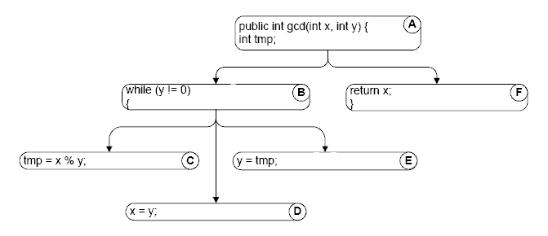
Control dependence (1)
Data dependence: Where did these values come from?
Control dependence: Which statement controls whether this statement executes?
  Nodes: as in the CFG
  Edges: unlabelled, from entry/branching points to controlled blocks
(c) 2007 Mauro Pezzè & Michal Young
Ch 6, slide <number>
Notes:
Dependence often involves both flow of information (data flow) and flow of control. On this slide we are dealing just with the control flow part of dependence, but we’ll put it back together with data flow in a few slides.
So where did we get this control dependence information? The basic idea is that a node controls another node if it determines whether that node executes (e.g., the “while” loop head determines wheter the statements in the body execute). We’ll need to introduce the concept of “dominators” to make this more precise.

Slide 11
Dominators
Pre-dominators in a rooted, directed graph can be used to make this intuitive notion of “controlling decision” precise.
Node M dominates node N if every path from the root to N passes through M.
  A node will typically have many dominators, but except for the root, there is a unique immediate dominator of node N which is closest to N on any path from the root, and which is in turn dominated by all the other dominators of N.
  Because each node (except the root) has a unique immediate dominator, the immediate dominator relation forms a tree.
Post-dominators: Calculated in the reverse of the control flow graph, using a special “exit” node as the root.
(c) 2007 Mauro Pezzè & Michal Young
Ch 6, slide <number>
Notes:
The basic concept of dominance is “To get to B, you must pass through A”. Pre-dominators describes the “you must pass through” relation in the order of execution, and post-dominators describes the analogous “you must have already passed through” relation.
This is best explained using the example on the next slide.

Slide 12
Dominators (example)
A pre-dominates all nodes; G post-dominates all nodes
F and G post-dominate E
G is the immediate post-dominator of B
  C does not post-dominate B
B is the immediate pre-dominator of G
  F does not pre-dominate G
A
B
C
E
D
F
G
(c) 2007 Mauro Pezzè & Michal Young
Ch 6, slide <number>
Notes:
A pre-dominates all nodes: To get to any of the other nodes, control flow must pass through A.
C pre-dominates D, but C does not pre-dominate G because we could take the path ABEFG.
Likewise, F does not pre-dominate G because we could take the path ABCDG.
G post-dominates all nodes.
C does not post-dominate B because we could take the path ABEFG.

Slide 13
Control dependence (2)
We can use post-dominators to give a more precise definition of control dependence:
  Consider again a node N that is reached on some but not all execution paths.
  There must be some node C with the following property:
    C has at least two successors in the control flow graph (i.e., it represents a control flow decision);
    C is not post-dominated by N
    there is a successor of C in the control flow graph that is post-dominated by N.
  When these conditions are true, we say node N is control-dependent on node C.
    Intuitively: C was the last decision that controlled whether N executed
(c) 2007 Mauro Pezzè & Michal Young
Ch 6, slide <number>
Notes:
Now that we have dominators, we can be more precise about what we mean by “control dependence”. The intuition is that some node N is “control dependent” on the last decision that controlled whether N executes.
We use post-domination for this, looking for the point at which post-domination begins. Essentially this means, “execution of node N becomes inevitable at this point.” The last point where execution of node N was NOT inevitable must be the decision that determined whether N would execute.

Slide 14
Control Dependence
A
Execution of F is
not inevitable at B
B
Execution of F is
inevitable at E
C
E
D
F
G
F is control-dependent on B,
the last point at which its
execution was not inevitable
(c) 2007 Mauro Pezzè & Michal Young
Ch 6, slide <number>
Notes:
Here is an intuitive way of looking at the definition on the prior slide. The conditions for F being control dependent on B are:
B is a decision: It has at least two successors (C and E)
B is not post-dominated by F (it’s still possible to pass through B and not execute F)
One of B’s successors (E, in this case) is post-dominated by F. In other words, whether we execute F depends on the decision at B.

Slide 15
Data Flow Analysis
Computing data flow information
(c) 2007 Mauro Pezzè & Michal Young
Ch 6, slide <number>
Notes:
The next few slides describe the algorithms used to compute data flow information. These are basic algorithms used widely in compilers, test and analysis tools, and other software tools.
It is worthwhile to understand basic data flow analysis algorithms, even though we can usually use tools without writing them ourselves. The basic ideas are applicable to other problems for which tools are not readily available. Moreover, a basic understanding of how they work is key to understanding their limitations and the trade-offs we must make between efficiency and precision.

Slide 16
Calculating def-use pairs
Definition-use pairs can be defined in terms of paths in the program control flow graph:
  There is an association (d,u) between a definition of variable v at d and a use of variable v at u iff
    there is at least one control flow path from d to u
    with no intervening definition of v.
  v_{d} reaches u (v_{d} is a reaching definition at u).
  If a control flow path passes through another definition e of the same variable v, v_{e} kills v_{d} at that point.
Even if we consider only loop-free paths, the number of paths in a graph can be exponentially larger than the number of nodes and edges.
Practical algorithms therefore do not search every individual path. Instead, they summarize the reaching definitions at a node over all the paths reaching that node.
(c) 2007 Mauro Pezzè & Michal Young
Ch 6, slide <number>
Notes:
Although we define def-use pairs in terms of paths in the control flow graph, it would be impractical to trace all paths individually.

Slide 17
Exponential paths
(even without loops)
A
B
C
D
E
F
G
V
2 paths from A to B
4 from A to C
8 from A to D
16 from A to E
...
128 paths from A to V
Tracing each path is not efficient, and we can do much better.
(c) 2007 Mauro Pezzè & Michal Young
Ch 6, slide <number>

Slide 18
DF Algorithm
An efficient algorithm for computing reaching definitions (and several other properties) is based on the way reaching definitions at one node are related to the reaching definitions at an adjacent node.
Suppose we are calculating the reaching definitions of node n, and there is an edge (p,n) from an immediate predecessor node p.
  If the predecessor node p can assign a value to variable v, then the definition v_{p} reaches n. We say the definition v_{p} is generated at p.
  If a definition v_{p} of variable v reaches a predecessor node p, and if v is not redefined at that node (in which case we say the v_{p} is killed at that point), then the definition is propagated on from p to n.
(c) 2007 Mauro Pezzè & Michal Young
Ch 6, slide <number>

Slide 19
Equations of node E (y = tmp)
public class GCD {
public int gcd(int x, int y) {
int tmp; // A: def x, y, tmp
while (y != 0) { // B: use y
tmp = x % y; // C: def tmp; use x, y
x = y; // D: def x; use y
y = tmp; // E: def y; use tmp
}
return x; // F: use x
}
Calculate reaching definitions at E in terms of its immediate predecessor D
Reach(E) = ReachOut(D)
ReachOut(E) = (Reach(E) \ {y_{A}}) ∪ {y_{E}}
Reach(E): Variables that were defined before and reaches node (E). (Y in E killes Y from A and started a new Y (i.e. Kill Y and Gen Y)
Variables in E are those reached from previous + modified in E
(c) 2007 Mauro Pezzè & Michal Young
Ch 6, slide <number>
Notes:
We don’t want to trace out all the program paths. Instead, at each node, we reuse information from preceding nodes, making note of changes.
The reaching definitions (“def” parts of potential def-use pairs) are based on those of the preceding node D.
The first (simple) equation says that values can reach E by going through D.
The second equation describes what happens at D. The previous definition of y at node A is overwritten. A new value of y is defined here at line E.
We can associate two data flow equations of this form (what reached here, and what this node changes) for every line in the program or node in the control flow graph.

Slide 20
Equations of node B (while (y != 0))
public class GCD {
public int gcd(int x, int y) {
int tmp; // A: def x, y, tmp
while (y != 0) { // B: use y
tmp = x % y; // C: def tmp; use x, y
x = y; // D: def x; use y
y = tmp; // E: def y; use tmp
}
return x; // F: use x
}
This line has two predecessors:
Before the loop,
end of the loop
Reach(B) = ReachOut(A) ∪ ReachOut(E)
ReachOut(A) = gen(A) = {x_{A}, y_{A}, tmp_{A}}
ReachOut(E) = (Reach(E) \ {y_{A}}) ∪ {y_{E}}
(c) 2007 Mauro Pezzè & Michal Young
Ch 6, slide <number>
Notes:
Data flow information from two sources come together at line B, the head of the loop.
The incoming data flow information at B is a combination of the information from its predecessors A and E.
The outgoing data flow information from node A comes from the definitions at that line (including the “uninitialized” value that tmp gets where it is declared).
The outgoing data flow information from node E (the end of the loop) is calculated as we saw before: The old value of y (from line A) is replaced by a new value of y (at line E)
Note that these flow equations are circular: The dataflow equations at line E depend on those at line D, which depend on line C, which depend on line B, which depend on line E again. This is ok. We will have to apply them more than once, but eventually they will converge on an answer.

Slide 21
General equations for Reach analysis
Reach(n) = ∪ ReachOut(m)
m∈pred(n) (n is reached by m)
ReachOut(n) = (Reach(n) \ kill (n)) ∪ gen(n)
gen(n) = { v_{n} | v is defined or modified at n }
kill(n) = { v_{x} | v is defined or modified at x, x≠n }
∪ For (any path)
(c) 2007 Mauro Pezzè & Michal Young
Ch 6, slide <number>
Notes:
Each node of the control flow graph (or each line of the program) can be associated with set equations of the same general form, with “gen” and “kill” sets based on what happens at that line.
For reaching definitions, the “gen” set (the set of definitions that are added to the reaching definitions at that point) is just the variable that gets a new value there. It could be the empty set if no variable is changed in that line.
The “kill” set is the set of values that will be replaced.
The subscripts here are the lines or nodes where the assignment takes place, so that we can keep track of different assignments to the same variable. For example, v₉₉ would represent a value that v received at node (or line) 99.
[Students who have taken a compiler construction course may have seen these two flow equations combined into one. The meaning is unchanged; we keep them separate just for understandability.]

Slide 22
Example – Quadratic
25 ok = Root (X, Y, Z);
26 if (ok)
27 System.out.println
28 (“Quadratic: ” + Root1 + Root2);
29 else
30 System.out.println (“No Solution.”);
31 }
32
33 // Three positive integers, finds quadratic root
34 private static boolean Root (int A, int B, int C)
35 {
36 float D;
37 boolean Result;
38 D = (float) Math.pow ((double)B,
(double2-4.0)*A*C );
39 if (D < 0.0)
40 {
41 Result = false;
42 return (Result);
43 }
44 Root1 = (float) ((-B + Math.sqrt(D))/(2.0*A));
45 Root2 = (float) ((-B – Math.sqrt(D))/(2.0*A));
46 Result = true;
47 return (Result);
48 } / /End method Root
49
50 } // End class Quadratic
1 // Program to compute the quadratic root for two numbers
2 import java.lang.Math;
3
4 class Quadratic
5 {
6 private static float Root1, Root2;
7
8 public static void main (String[] argv)
9 {
10 int X, Y, Z;
11 boolean ok;
12 int controlFlag = Integer.parseInt (argv[0]);
13 if (controlFlag == 1)
14 {
15 X = Integer.parseInt (argv[1]);
16 Y = Integer.parseInt (argv[2]);
17 Z = Integer.parseInt (argv[3]);
18 }
19 else
20 {
21 X = 10;
22 Y = 9;
23 Z = 12;
24 }
Introduction to Software Testing (Ch 2)
© Ammann & Offutt

Slide 23
1 // Program to compute the quadratic root for two numbers
2 import java.lang.Math;
3
4 class Quadratic
5 {
6 private static float Root1, Root2;
7
8 public static void main (String[] argv)
9 {
10 int X, Y, Z;
11 boolean ok;
12 int controlFlag = Integer.parseInt (argv[0]);
13 if (controlFlag == 1)
14 {
15 X = Integer.parseInt (argv[1]);
16 Y = Integer.parseInt (argv[2]);
17 Z = Integer.parseInt (argv[3]);
18 }
19 else
20 {
21 X = 10;
22 Y = 9;
23 Z = 12;
24 }
shared variables
last-defs
Introduction to Software Testing (Ch 2)
© Ammann & Offutt

Slide 24
25 ok = Root (X, Y, Z);
26 if (ok)
27 System.out.println
28 (“Quadratic: ” + Root1 + Root2);
29 else
30 System.out.println (“No Solution.”);
31 }
32
33 // Three positive integers, finds the quadratic root
34 private static boolean Root (int A, int B, int C)
35 {
36 float D;
37 boolean Result;
38 D = (float) Math.pow ((double)B, (double2-4.0)*A*C);
39 if (D < 0.0)
40 {
41 Result = false;
42 return (Result);
43 }
44 Root1 = (float) ((-B + Math.sqrt(D)) / (2.0*A));
45 Root2 = (float) ((-B – Math.sqrt(D)) / (2.0*A));
46 Result = true;
47 return (Result);
48 } / /End method Root
49
50 } // End class Quadratic
first-use
first-use
last-def
last-defs
Introduction to Software Testing (Ch 2)
© Ammann & Offutt

Slide 25
Quadratic – Coupling DU-pairs
Pairs of locations: method name, variable name, statement
(main (), X, 15) – (Root (), A, 38)
(main (), Y, 16) – (Root (), B, 38)
(main (), Z, 17) – (Root (), C, 38)
(main (), X, 21) – (Root (), A, 38)
(main (), Y, 22) – (Root (), B, 38)
(main (), Z, 23) – (Root (), C, 38)
(Root (), Root1, 44) – (main (), Root1, 28)
(Root (), Root2, 45) – (main (), Root2, 28)
(Root (), Result, 41) – ( main (), ok, 26 )
(Root (), Result, 46) – ( main (), ok, 26 )
Introduction to Software Testing (Ch 2)
© Ammann & Offutt

Slide 26
Types of Def-Use Pairs
def
def
A ()
last-def
A ()
use
inter-procedural data flow
B () use
first-use
B ()
A ()
intra-procedural data flow
(within the same unit)
full
coupling
def
A()
A()
M ()
A()
M()
def
A()
B()
use
B()
N()
B()
N()
use
B()
F ()
F()
object-oriented direct coupling data flow
object-oriented indirect coupling data flow
Introduction to Software Testing (Ch 2)
© Ammann & Offutt

Slide 27
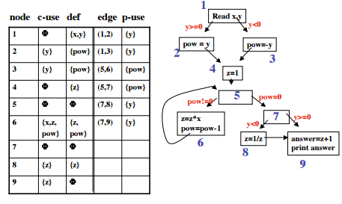
Examples
(c) 2007 Mauro Pezzè & Michal Young
Ch 6, slide <number>

Slide 28
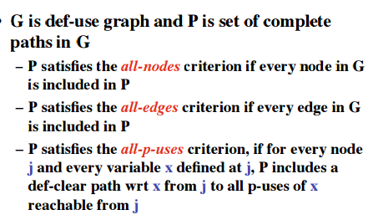
Coverage Criteria
(c) 2007 Mauro Pezzè & Michal Young
Ch 6, slide <number>

Slide 29
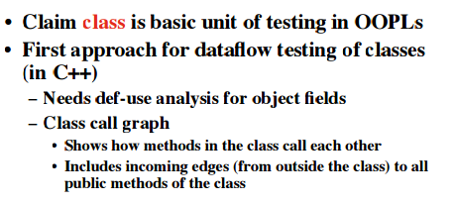
Testing of classes
(c) 2007 Mauro Pezzè & Michal Young
Ch 6, slide <number>

Slide 30
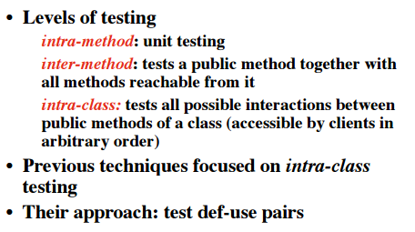
(c) 2007 Mauro Pezzè & Michal Young
Ch 6, slide <number>

Slide 31
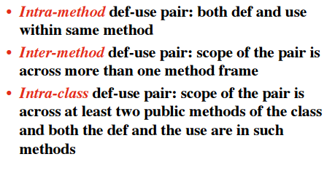
Def_Use Pairs
(c) 2007 Mauro Pezzè & Michal Young
Ch 6, slide <number>

Slide 32
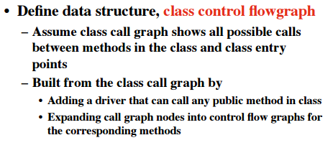
Intra-class def-use pairs
(c) 2007 Mauro Pezzè & Michal Young
Ch 6, slide <number>

Slide 33
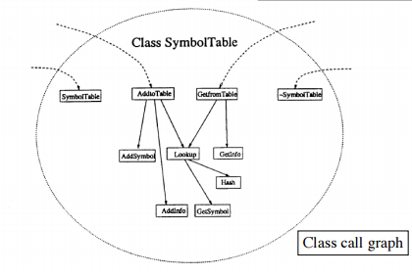
Example
(c) 2007 Mauro Pezzè & Michal Young
Ch 6, slide <number>

Slide 34
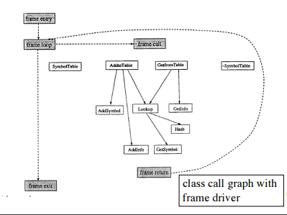
(c) 2007 Mauro Pezzè & Michal Young
Ch 6, slide <number>

Slide 35
Summary
Data flow models detect patterns on CFGs:
  Nodes initiating the pattern
  Nodes terminating it
  Nodes that may interrupt it
Often, but not always, about flow of information (dependence)
Pros:
  Can be implemented by efficient iterative algorithms
  Widely applicable (not just for classic “data flow” properties)
Limitations:
  Unable to distinguish feasible from infeasible paths
  Analyses spanning whole programs (e.g., alias analysis) must trade off precision against computational cost
(c) 2007 Mauro Pezzè & Michal Young
Ch 6, slide <number>

