Slide 1
Topics in Software Dynamic White-box Testing
Part 1: Control-flow Testing
[Reading assignment: Chapter 7, pp. 105-122 plus many things in slides that are not in the book …]

Slide 2
Control-Flow Testing
Control-flow testing is a structural testing strategy that uses the program’s control flow as a model.
Control-flow testing techniques are based on judiciously selecting a set of test paths through the program.
The set of paths chosen is used to achieve a certain measure of testing thoroughness.
  E.g., pick enough paths to assure that every source statement is executed as least once.

Slide 3
Motivation
Control-flow testing is most applicable to new software for unit testing.
Control-flow testing assumptions:
  specifications are correct
  data is defined and accessed properly
  there are no bugs other than those that affect control flow
Structured and OO languages reduce the number of control-flow bugs.

Slide 4
Control Flowgraphs
The control flowgraph is a graphical representation of a program’s control structure.

Slide 5
Flowgraphs Consist of
Three Primitives
  A decision is a program point at which the control can diverge.
    (e.g., if and case statements).
  A junction is a program point where the control flow can merge.
    (e.g., end if, end loop, goto label)
  A process block is a sequence of program statements uninterrupted by either decisions or junctions. (i.e., straight-line code).
    A process has one entry and one exit.
    A program does not jump into or out of a process.

Slide 6
Exponentiation Algorithm
1 scanf(“%d %d”,&x, &y);
2 if (y < 0)
pow = -y;
else
pow = y;
3 z = 1.0;
4 while (pow != 0) {
z = z * x;
pow = pow - 1;
5 }
6 if (y < 0)
z = 1.0 / z;
7 printf (“%f”,z);
1
2
3
4
5
6
7

Slide 7
Bubble Sort Algorithm
1 for (j=1; j<N; j++) {
last = N - j + 1;
2 for (k=1; k<last; k++) {
3 if (list[k] > list[k+1]) {
temp = list[k];
list[k] = list[k+1];
list[k+1] = temp;
4 }
5 }
6 }
7 print(“Done\n”);
1
2
3
4
5
6
7

Slide 8
Paths
A path through a program is a sequence of statements that starts at an entry, junction, or decision and ends at another (possible the same), junction, decision, or exit.
A path may go through several junctions, processes, or decisions, one or more times.
Paths consist of segments.
The smallest segment is a link. A link is a single process that lies between 2 nodes.

Slide 9
Paths (Cont’d)
The length of a path is the number of links in a path.
An entry/exit path or a complete path is a path that starts at a routine’s entry and ends at the same routine’s exit.

Slide 10
Paths (Cont’d)
Complete paths are useful for testing because:
  It is difficult to set up and execute paths that start at an arbitrary statement.
  It is difficult to stop at an arbitrary statement without changing the code being tested.
  We think of routines as input/output paths.

Slide 11
Path Selection Criteria
There are many paths between the entry and exit points of a typical routine.
Even a small routine can have a large number of paths.

Slide 12
How do we define
“complete” testing?
1) Exercise every path from entry to exit.
2) Exercise every statement at least once.
3) Exercise every branch (in each direction) at least once.
Clearly, 1 implies 2 and 3
However, 1 is impractical for most routines.
Also, 2 is not equal to 3 in languages with goto statements.

Slide 13
Demonstration that
2 does not imply 3
2.Statement Coverage: For x < 0 the program produces the correct result AND every statement has been executed.
3.Branch Coverage: Would have found the bug! Therefore 2 does not imply 3.
Correct Code
1 if (x >= 0 ) {
x = x + A;
}
2 x = x + A
1
2
Buggy Code
1 if (x >= 0 ) {
/* missing statement */
}
2 x = x + A

Slide 14
Demonstration that
3 Does not Imply 2
1 if (x < 0) {
2 goto 200;
x = x + A
} else
x = x + A
3 200: x = x + A
Branch Coverage: Does not exercise dead code. Therefore 3 does not imply 2.
However, 3 implies 2 for programs written in a structured programming language without goto statements.
1
2
3

Slide 15
Control-flow Testing Criteria
We have explored 3 testing criteria from an infinite set of strategies:
  1) Path Testing ( ):
    100% path coverage.
    Execute all possible control flow paths through the program.

Slide 16
Control-flow Testing
Criteria (Cont’d)
  2) Statement Testing ( ):
    100% statement coverage.
    Execute all statements in a program at least once under some test.
  3) Branch Testing ( ):
    100% branch coverage.
    Execute enough tests to assure that every branch alternative has been exercised at least once under some test.

Slide 17
Common Sense Strategies
Statement and branch coverage have been used for over two decades as a minimum mandatory unit test requirement for new code developed at IBM and other companies.
Insisting on statement and branch coverage is based on common sense rather than theory.

Slide 18
Common Sense Strategies (Cont’d)
It makes sense to use branch coverage because software has a high density of conditional branches, loop, etc. (25% in most PLs)
It is better to leave out untested code than to include it in a product release.

Slide 19
Quote
“The more we learn about testing, the more we realize that
statement and branch coverage are minimum floors below
which we dare not fall, rather that ceilings to which we
should aspire.”
- B. Beizer.

Slide 20
Which Paths?
You must pick enough paths to achieve statement and branch coverage.
Question: What is the fewest number of paths to achieve statement and branch coverage?
Answer: Unask the question.
  It is better to take many simple paths than a few complicated ones.
  There is no harm in taking paths that will exercise the same code more than once.

Slide 21
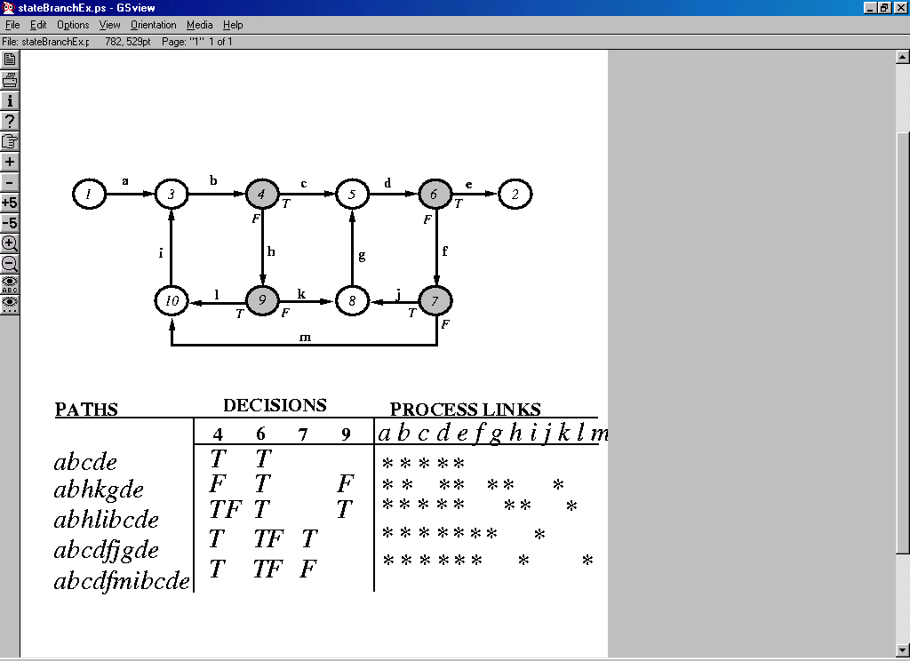
Example of P1 and P2 Coverage
1
a
3
b
4
c
5
d
6
e
2
i
h
g
f
10
l
9
k
8
j
7
T
F
T
F
m

Slide 22
Branch and Statement Coverage
Question: Does every decision have a T (true) and a F (false) in its column?
Answer: Yes implies branch coverage.
Question: Is every link covered at least once?
Answer: Yes implies statement coverage.

Slide 23
Guidelines
Select paths as small variations of previous paths.
Try to change one thing in each path at a time.

Slide 24
Effectiveness of
Control-flow Testing
About 65% of all bugs can be caught in unit testing.
Unit testing is dominated by control-flow testing methods.
Statement and branch testing dominates control-flow testing.

Slide 25
Effectiveness of
Control-flow Testing (Cont’d)
Studies show that control-flow testing catches 50% of all bugs caught during unit testing.
  About 33% of all bugs.
Control-flow testing is more effective for unstructured code than for code that follows structured programming.
Experienced programmers can bypass drawing flowgraphs by doing path selection on the source.

Slide 26
Limitations of
Control-flow Testing
Control-flow testing as a sole testing technique is limited:
  Interface mismatches and mistakes are not caught.
  Not all initialization mistakes are caught by control-flow testing.
  Specification mistakes are not caught.

Slide 27
Test Outcomes
The outcome of test is what we expect to happen as a result of the test.
Test outcomes include anything we can observe in the computer’s memory that should have (not) changed as a result of the test.
Since we are not “kiddie testing” we must predict the outcome of the test as part of the test design process.

Slide 28
Testing Process
run the test
observe the actual outcome
compare the actual outcome to the expected outcome.

Slide 29
Questions About Test Outcomes
Question: If the predicted and actual outcomes match, can we say that the test has been passed?
Answer: No! The desired outcome could have been achieved for the wrong reason. (coincidental correctness)

Slide 30
Questions About Test Outcomes
Question: Assume that we ran a covering set of tests and achieved the desired outcomes for each case. Can we say that we’ve covered all branches?
Answer: No! The desired outcome could have been reached by the wrong path!
  Path instrumentation is necessary to confirm that the outcome was achieved by the intended path.

Slide 31
Path Instrumentation
All instrumentation methods are a variation on a theme of an interpretive trace.
An interpretive trace program executes every statement in order and records:
  the intermediate values of all calculations
  the statement labels traversed
  ...

Slide 32
Path Instrumentation (Cont’d)
If we run the tested routine under a trace, then we have all the information we need to confirm:
  the outcome of the test
  whether the outcome was achieved by the intended path.

Slide 33
Two Detailed Examples
Of Control-flow Testing

Slide 34
Using Control-flow Testing to Test Function ABS
Consider the following function:
/* ABS
This program function returns the absolute value of the integer
passed to the function as a parameter.
INPUT: An integer.
OUTPUT: The absolute value if the input integer.
*/
1 int ABS(int x)
2 {
3 if (x < 0)
4 x = -x;
5 return x;
6 }

Slide 35
The Flowgraph for ABS
/* ABS
This program function returns the absolute value of the integer
passed to the function as a parameter.
INPUT: An integer.
OUTPUT: The absolute value if the input integer.
*/
1 int ABS(int x)
2 {
3 if (x < 0)
4 x = -x;
5 return x;
6 }

Slide 36
Test Cases to Satisfy Path Coverage for ABS
Complete path testing of ABS is theoretically possible but not practical.
ABS takes as its input any integer. There are many integers (depending on the maximum size of an integer for the language) that could be input to ABS making it impractical to test all possible inputs to ABS.

Slide 37
Test Cases to Satisfy Statement Testing Coverage for ABS
PATHS
PROCESS LINKS
TEST CASES
a
b
c
d
INPUT
OUTPUT
abc
√
√
√
A Negative Integer, x
-x
adc
√
√
√
A Positive Integer, x
x

Slide 38
Test Cases to Satisfy Branch Testing Coverage for ABS
PATHS
DECISIONS
TEST CASES
INPUT
OUTPUT
abc
T
A Negative Integer, x
-x
adc
F
A Positive Integer, x
x

Slide 39
Example: Using Control-flow Testing to Test Program COUNT
Consider the following program:
/* COUNT
This program counts the number of characters and lines in a text file.
INPUT: Text File
OUTPUT: Number of characters and number of lines.
*/
1 main(int argc, char *argv[])
2 {
3 int numChars = 0;
4 int numLines = 0;
5 char chr;
6 FILE *fp = NULL;
7

Slide 40
Program COUNT (Cont’d)
8 if (argc < 2)
9 {
10 printf(“\nUsage: %s <filename>”, argv[0]);
11 return (-1);
12 }
13 fp = fopen(argv[1], “r”);
14 if (fp == NULL)
15 {
16 perror(argv[1]); /* display error message */
17 return (-2);
18 }

Slide 41
Program COUNT (Cont’d)
19 while (!feof(fp))
20 {
21 chr = getc(fp); /* read character */
22 if (chr == ‘\n’) /* if carriage return */
23 ++numLines;
24 else
25 ++numChars;
26 }
27 printf(“\nNumber of characters = %d”, numChars);
28 printf(“\nNumber of lines = %d”, numLines);
29 }

Slide 42
The Flowgraph for COUNT
The junction at line 12 and line 18 are not needed because if you are at these lines then you must also be at line 14 and 19 respectively.

Slide 43
Test Cases to Satisfy Path Coverage for COUNT
Complete path testing of COUNT is impossible because there are an infinite number of distinct text files that may be used as inputs to COUNT.

Slide 44
Test Cases to Satisfy Statement Testing Coverage for COUNT

Slide 45
Test Cases to Satisfy Statement Testing Coverage for COUNT
PATHS
PROCESS LINKS
TEST CASES
a
b
c
d
e
f
g
h
i
j
k
l
INPUT
OUTPUT
ab
√
√
None
“Usage: COUNT <filename>”
agc
√
√
√
Invalid Input Filename
Error Message
aghdjkli
√
√
√
√
√
√
√
√
Input File with one character and no Carriage Return at the end of the line
Number of characters = 1
Number of lines = 0
aghdefli
√
√
√
√
√
√
√
√
Input file with no characters and one carriage return
Number of characters = 0
Number of lines = 1

Slide 46
Test Cases to Satisfy Branch Testing Coverage for COUNT
PATHS
DECISIONS
TEST CASES
8
14
19
22
INPUT
OUTPUT
ab
T
None
“Usage: COUNT <filename>”
agc
F
T
Invalid Input Filename
Error Message
aghdjkli
F
F
T,F
F
Input File with one character and no Carriage Return at the end of the line
Number of characters = 1
Number of lines = 0
aghdefli
F
F
T,F
T
Input file with no characters and one carriage return
Number of characters = 0
Number of lines = 1

Slide 47
Summary
The object of control-flow testing is to execute enough tests to assure that statement and branch coverage has been achieved.
Select paths as deviation from the normal paths. Add paths as needed to achieve coverage.
Use instrumentation (manual or using tools) to verify paths.
Document all tests and expected test results.
A test that reveals a bug has succeeded, not failed.

Slide 48
You now know …
… control flow testing
… statement coverage
… branch coverage

