Slide 1
Email Security Enhancements
what do we want ?
confidentiality
  protection from disclosure
authentication
  of sender of message
message integrity
  protection from modification
non-repudiation of origin
  protection from denial by sender
Notes:
CS 634/534 Cryptography
16 Spring, Week 10
CS 634/534 Cryptography
Winter 09, Week 8
7

Slide 2
Pretty Good Privacy (PGP)
PGP provides a confidentiality and authentication service that can be used for electronic mail and file storage applications.
  widely used de facto secure email
developed by Phil Zimmermann in 1991
used best available cryptographic algorithms
integrated into a single program
available on Unix, PC and Apple systems
originally free now also commercial versions
Edward Snowden sent files to journalists using PGP
Notes:
CS 634/534 Cryptography
16 Spring, Week 10
CS 634/534 Cryptography
Winter 09, Week 8
7

Slide 3
Why Is PGP Popular?
It is available free on a variety of platforms.
Based on well known algorithms.
Wide range of applicability
Not controlled by governments
Open PGP : internet standard Gnu Privacy Guard GnuPG: open source alternative
  designed to interoperate with PGP
  contains no patented algorithms
  Supports limited set of crypto algorithms
  OpenPGP card : smartcard, GnuPG functions
Notes:
CS 634/534 Cryptography
16 Spring, Week 10
CS 634/534 Cryptography
Winter 09, Week 8
7

Slide 4
PGP [Wikipedia]
In February 1993 Zimmermann became the formal target of a criminal investigation by the US Government for
  "munitions export without a license".
  Cryptosystems using keys larger than 40 bits were then considered munitions within the definition of the US export regulations
  Law changed in 2000
In 1996, Bruce Schneier
  "the closest you're likely to get to military-grade encryption."
Notes:
CS 634/534 Cryptography
16 Spring, Week 10
CS 634/534 Cryptography
Winter 09, Week 8
7

Slide 5
PGP [Wikipedia]
An incident in December 2006 involving US customs agents and a seized laptop PC indicates that US Government agencies find it
  "nearly impossible" :access PGP-encrypted files.
A judge ruling on the same case in November 2007 stated that forcing the suspect to reveal his PGP pass-phrase would violate his Fifth Amendment rights i.e. a suspect's constitutional right not to incriminate himself.
Subsequently, ruling got reversed
  “similar to having documents in a safe”
Notes:
CS 634/534 Cryptography
16 Spring, Week 10
CS 634/534 Cryptography
Winter 09, Week 8
7

Slide 6
PGP [Wikipedia]
PGP encryption applications now include
  e-mail and attachments
  digital signatures
  laptop full disk encryption
  file and folder security
  protection for IM sessions
  batch file transfer encryption
  encrypted and/or signed HTTP request/responses by means of a client side and a server side plugin.
PGP Support Package for BlackBerry which enables RIM BlackBerry devices sender-to-recipient messaging encryption.
Notes:
CS 634/534 Cryptography
16 Spring, Week 10
CS 634/534 Cryptography
Winter 09, Week 8
7

Slide 7
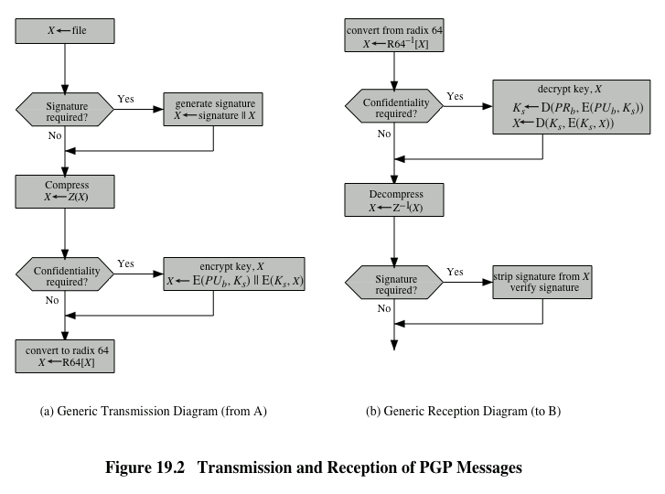
Fig. 19.2 PGP Operation – Summary
Notes:
CS 634/534 Cryptography
16 Spring, Week 10
CS 634/534 Cryptography
Winter 09, Week 8
Stallings Fig 15-2.

Slide 8
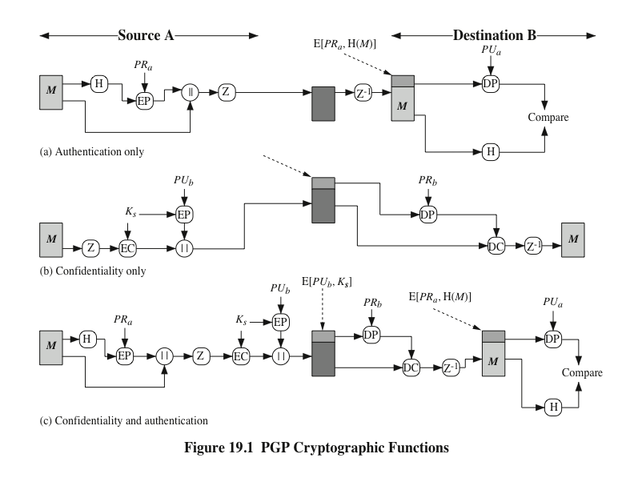
Fig. 19.1 PGP Crypto functions
Notes:
CS 634/534 Cryptography
16 Spring, Week 10
CS 634/534 Cryptography
Winter 09, Week 8
Stallings Fig 15-2.

Slide 9
PGP Operation – Authentication
sender creates a message
SHA used to generate 160-bit hash code of message
hash code is signed with RSA/DSS using sender's private key, and result is attached to message
receiver uses RSA/DSS with sender's public key to decrypt and recover hash code
receiver generates new hash code for message and compares with decrypted hash code, if match, message is accepted as authentic
Notes:
CS 634/534 Cryptography
16 Spring, Week 10
CS 634/534 Cryptography
Winter 09, Week 8
7

Slide 10
PGP Operation – Confidentiality
sender generates message and random number to be used as session key for this message only
message is encrypted, using CAST-128 / IDEA/3DES (now also AES) with session key
session key sent encrypted using RSA/Diffie-Hellman with recipient's public key, then attached to message
receiver uses RSA/Diffie-Hellman with its private key to decrypt and recover session key
session key is used to decrypt message
Notes:
CS 634/534 Cryptography
16 Spring, Week 10
CS 634/534 Cryptography
Winter 09, Week 8
7

Slide 11
PGP Operation – Confidentiality & Authentication
uses both services on same message
create signature & attach to message
encrypt both message & signature
A sends to B:
E_{KUB}(K_{S}), E_{KS}(M, E_{KRa}(H(M)))
Why signature before encryption ?
Better to store signed version of M. Why ?
If third party arbitrating, does not have to get involved with secret-key decryption.
Notes:
CS 634/534 Cryptography
16 Spring, Week 10
CS 634/534 Cryptography
Winter 09, Week 8
7

Slide 12
PGP Operation – Compression
Uses ZIP compression algorithm (CSCI 6632)
PGP compresses message after signing but before encrypting.
Why compress after signing rather than before ?
So can store uncompressed message & signature for later verification
Also, compression is non deterministic
  Parameterized, so can be different depending on parameter
  Don’t have to worry about this since storing uncompressed message & signature
Notes:
CS 634/534 Cryptography
16 Spring, Week 10
CS 634/534 Cryptography
Winter 09, Week 8
7

Slide 13
PGP Operation – Compression
Why encrypt after compression rather than before?
  Think about how compression and encryption work and where we would like more structure
Compression works better with structured data
  If we encrypt before compression, encrypted data would look more random, less structure
For encryption, want less structure in plaintext
  Harder for BG to figure out
  Compressed data has less structure as compared to uncompressed data
Notes:
CS 634/534 Cryptography
16 Spring, Week 10
CS 634/534 Cryptography
Winter 09, Week 8
7

Slide 14
PGP Operation – Email Compatibility
when using PGP will have binary data to send (encrypted message etc)
however email was designed only for text
hence PGP must encode raw binary data into printable ASCII characters
uses radix-64 algorithm
  maps 3 bytes to 4 printable chars
  also appends a CRC (checksum)
PGP also segments messages if too big
Notes:
CS 634/534 Cryptography
16 Spring, Week 10
CS 634/534 Cryptography
Winter 09, Week 8
7

Slide 15
Summary of PGP Algorithms
https://en.wikipedia.org/wiki/GNU_Privacy_Guard#Process
Pubkey: RSA, ElGamal, DSA
Cipher: IDEA , 3DES, CAST5, Blowfish, AES-128, AES-192, AES-256, Twofish, Camellia-128, Camellia-192, Camellia-256
Hash: MD5, SHA-1, RIPEMD-160, SHA-256, SHA-384, SHA-512, SHA-224
Compression: Uncompressed, ZIP, ZLIB, BZIP2
Notes:
CS 634/534 Cryptography
16 Spring, Week 10
CS 634/534 Cryptography
Winter 09, Week 8
7

Slide 16
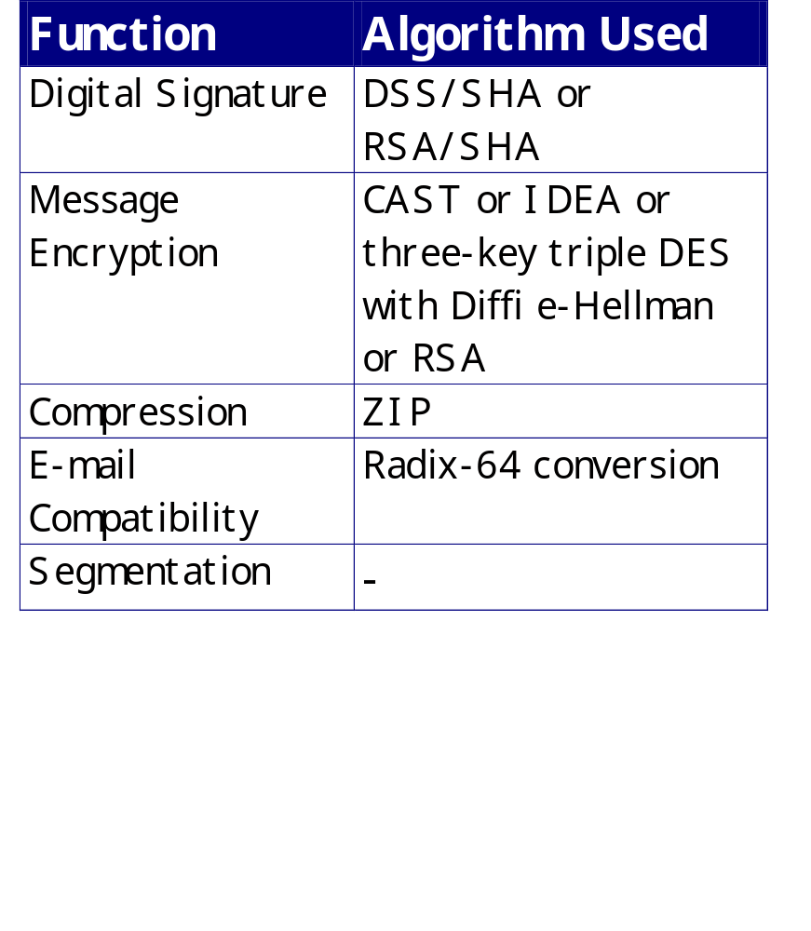
Summary of PGP Algorithms

Slide 17
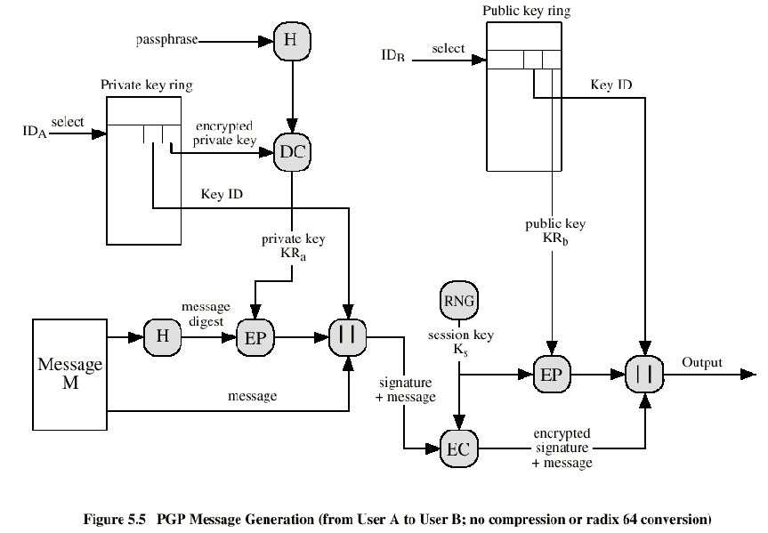
PGP Message Generation

Slide 18
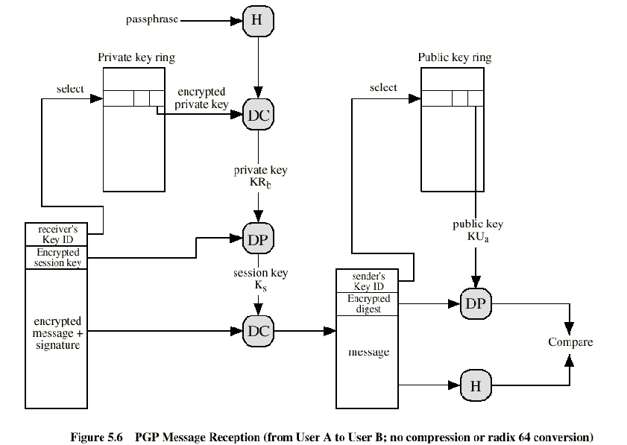
PGP Message Reception
Notes:
CS 634/534 Cryptography
16 Spring, Week 10
CS 634/534 Cryptography
Winter 09, Week 8

Slide 19
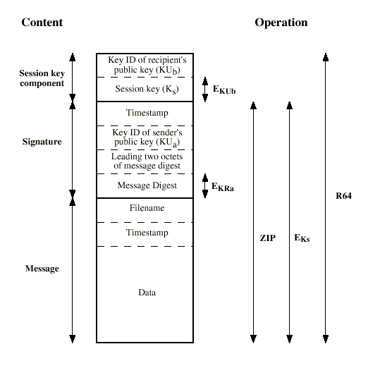
Format of PGP Message

Slide 20
PGP Session Keys
need a session key for each message
  of varying sizes: 56-bit DES, 128-bit CAST or IDEA, 168-bit Triple-DES
generated using ANSI X12.17 mode
  Uses secret key algorithm (twice if need 128 bits)
    Encrypting “P” with “K”
“P” : ask user for input.
  Also depends on keystroke timing of user
“K” : Depends on pseudo-random numbers, old sessions keys, keystroke timing of user
“C” : gives session key
Notes:
CS 634/534 Cryptography
16 Spring, Week 10
7

Slide 21
Key ID: Public Keys
Users may have multiple public/private keys pairs. Why ?
May update keys but other users might still have obsolete keys
  Want to be able to decrypt msgs from them
May want one for work, one for personal use
If multiple keys, need to identify which is actually used. How ?
Notes:
CS 634/534 Cryptography
16 Spring, Week 10
CS 634/534 Cryptography
Winter 09, Week 8
7

Slide 22
Key ID: Public Keys
Send full public-key with message. Problem ?
Inefficient (2000 bits). So what to do ?
Use a key identifier based on key
  is least significant 64-bits of the key
  But can there be confusion: “collision”
Will very likely be unique
Key IDs used when
  sending session keys
  signing.
Notes:
CS 634/534 Cryptography
16 Spring, Week 10
CS 634/534 Cryptography
Winter 09, Week 8
7

Slide 23
PGP: Storing Private Keys
KR_{A} needs to be kept safe on hard drive
  Why ?
  How ?
Ask human user to remember KR_{A} ?
No – KR_{A} is 1000-2000 bits ! How ?
Keep it encrypted. Encrypted with what ?
Use secret-key scheme like CAST. What will be the key to CAST: ask user to remember ?
Same problem. Then how ?
Notes:
CS 634/534 Cryptography
16 Spring, Week 10
CS 634/534 Cryptography
Winter 09, Week 8
7

Slide 24
PGP: Storing Private Keys
User selects passphrase P and remembers.
K_{S} = 128 bits of 160 bits of SHA(P)
Store E_{KS} (KR_{A})
When KR_{A} needed ?
PGP asks user to input P, then
  Calculates K_{S} = 128 bits of 160 bits of SHA(P)
  Recovers KR_{A} = D_{KS} (E_{KS} (KR_{A}))
Notes:
CS 634/534 Cryptography
16 Spring, Week 10
CS 634/534 Cryptography
Winter 09, Week 8
7

Slide 25
PGP Key Rings
each PGP user has a pair of keyrings:
public-key ring contains all the public-keys of other PGP users known to this user, indexed by key ID
private-key ring contains the public/private key pair(s) for this user, indexed by key ID & encrypted
Notes:
CS 634/534 Cryptography
16 Spring, Week 10
CS 634/534 Cryptography
Winter 09, Week 8
7

Slide 26
PGP Key Management/Web of Trust
Uses X.509 certificates or PGP certificates
PGP certificates : every user is own certificate authority
  can sign keys for users they know directly
  rather than relying on certificate authorities
forms a “web of trust”
  can trust keys others have signed if have a chain of signatures to them
key ring includes trust indicators
  Key legitimacy field
  Signature trust field
Notes:
CS 634/534 Cryptography
16 Spring, Week 10
CS 634/534 Cryptography
Winter 09, Week 8
7

Slide 27
PGP Key Management/Web of Trust
Zimmermann in 1992
  “As time goes on, you will accumulate keys from other people that you may want to designate as trusted introducers. Everyone else will each choose their own trusted introducers. And everyone will gradually accumulate and distribute with their key a collection of certifying signatures from other people, with the expectation that anyone receiving it will trust at least one or two of the signatures. This will cause the emergence of a decentralized fault-tolerant web of confidence for all public keys.”
[W]:
  “In cryptography, a web of trust is a concept used in PGP, GnuPG, and other OpenPGP-compatible systems to establish the authenticity of the binding between a public key and a user. Its decentralized grass roots trust model is an alternative to the centralized trust model of a public key infrastructure (PKI), which relies exclusively on a certificate authority (or a hierarchy of such). As with computer networks, there are many independent webs of trust, and any user (through their identity certificate) can be a part of, and a link between, multiple webs.”
Notes:
CS 634/534 Cryptography
16 Spring, Week 10
CS 634/534 Cryptography
Winter 09, Week 8
7

Slide 28
Revoking Public Keys
Users can also revoke their keys. How ?
The owner issue a key revocation certificate.
Normal signature certificate with a revoke indicator.
Corresponding private key is used to sign the certificate !
Notes:
CS 634/534 Cryptography
16 Spring, Week 10
CS 634/534 Cryptography
Winter 09, Week 8
7

