Slide 1
Web Security/SSL/TLS [RB]
[RB] : Vwani P. Roychowdhury and P. Oscar Boykin “Practical Cryptography and Network Security: Short Course”
The most common use of cryptography on the internet today is for buying products on the Web.
Web stores use a standard called SSL (secure sockets layer).
  This secure layer encrypts all traffic both to and from the store.
  SSL requires more processing power than normal web connections.
Notes:
CS 634/534 Cryptography
16 Spring, Week 11
7

Slide 2
Eavesdropping on the Internet [RB]
The fear for shoppers is that BG will get their financial records, credit card numbers, sell their stocks or worse.
One general method for a BG to eavesdrop on all communications to and from the vendor.
The internet is fundamentally insecure in its current architecture.
  “Private” information often passes through as many as 30 computers before reaching its intended destination.
Encrypting the link between buyer and seller solves this problem.
Notes:
CS 634/534 Cryptography
16 Spring, Week 11
7

Slide 3
What Is Identity? [RB]
What does identity mean for a store/vendor?
  Stores have a reputation for products and services and proving identity associates them with the established reputation.
What does identity mean for a customer?
  When purchasing, customers give a promise to pay, usually in the form of a credit card number. Stores need a way to identify customers with credit card numbers from visit to visit.
Notes:
CS 634/534 Cryptography
16 Spring, Week 11
7

Slide 4
Authenticating the Store [RB]
Store Amazon.com A and customer Bob B.
One general method for a BG to get data is to impersonate A
  By posing as A to B, the BG might obtain the B’s password and credit card number.
  How can B be sure he is talking to A?
Authentication solves this problem by using trusted authorities
  Who are these trusted authorities ?
Certificate authorities CA
  (Eg: Symantec/Verisign, Comodo)
Notes:
CS 634/534 Cryptography
16 Spring, Week 11
7

Slide 5
Authenticating the Store [RB]
CA signs the public keys of web stores.
Web browser comes with the public keys of CA
B trusts his browser
  B trusts that browser has correct CA public key
Hence B believes A when they can show they have a key signed by CA.
Notes:
CS 634/534 Cryptography
16 Spring, Week 11
7

Slide 6
Authenticating the Customer [RB]
How can A make sure it is indeed B placing an order
  To make sure BG is not ordering a 1000 copies of “Harry Potter” on B’s behalf !
Assume that B does not have a certificate
  true of nearly 100% of customers
Web stores use accounts. How does this help?
When B sets up an account with Amazon
  he sets up “username” and “password”.
  In the future, when B returns, Amazon will ask for this information to authenticate B
Notes:
CS 634/534 Cryptography
16 Spring, Week 11
7

Slide 7
SSL (Secure Socket Layer) TLS (Transport Layer Security)
SSL (Secure Socket Layer) : provides secure services for a TCP/IP connection
  Data encryption
  Server authentication
  Message integrity
  Optional client authentication
SSL originally developed by Netscape
  but non-proprietary now: Internet standard
  version 3 designed with public input
TLS (Transport Layer Security) very similar to (and backward compatible with) SSLv3
Notes:
CS 634/534 Cryptography
16 Spring, Week 11
7

Slide 8
Setting Up a Secure Website [RB]
Secure pages differ from insecure pages only in the transfer protocol
  https (http over ssl) vs. http
Has to be SSL-enabled server Eg: Apache-SSL
  Also, SSL-enabled browser Eg: IE, Mozilla, Chrome
Based on the notion that servers have certificates signed by CA.
  The certificate is delivered to clients on initiation of the SSL connection.
Notes:
CS 634/534 Cryptography
16 Spring, Week 11
7

Slide 9
An Attack “www.paypaI.com” [RB]
Paypal is web financial service that allows users to send money to other users or stores.
Some years ago, BG registered the domain “paypaI.com” and got SSL certificates from Verisign with the same name.
With “i” capitalized, in many fonts (Eg: Arial )
  paypaI (paypaI ) looks like paypal (paypal )
Users were sent email messages with web links telling them to check their paypaI (paypaI ) accounts.
When they entered their passwords at paypaI.com?
Password collected, money moved. Moral of story?
Don’t click on links in emails
Notes:
CS 634/534 Cryptography
16 Spring, Week 11
7

Slide 10
Encrypting Connections to SQL Server
https://technet.microsoft.com/en-us/library/ms189067(v=sql.105).aspx
“Microsoft SQL Server can use Secure Sockets Layer (SSL) to encrypt data that is transmitted across a network between an instance of SQL Server and a client application. The SSL encryption is performed within the protocol layer and is available to all SQL Server clients except …
SSL can be used for server validation when a client connection requests encryption. If the instance of SQL Server is running on a computer that has been assigned a certificate from a public certification authority, identity of the computer and the instance of SQL Server is vouched for by the chain of certificates that lead to the trusted root authority. Such server validation requires that the computer on which the client application is running be configured to trust the root authority of the certificate that is used by the server.”
Notes:
CS 634/534 Cryptography
16 Spring, Week 11
7

Slide 11
Encrypting Connections to SQL Server
“Encryption with a self-signed certificate is possible and is described in the following section, but a self-signed certificate offers only limited protection.
The level of encryption used by SSL, 40-bit or 128-bit, depends on the version of the Microsoft Windows operating system that is running on the application and database computers.
Enabling SSL encryption increases the security of data transmitted across networks between instances of SQL Server and applications. However, enabling encryption does slow performance …”
Notes:
CS 634/534 Cryptography
16 Spring, Week 11
7

Slide 12
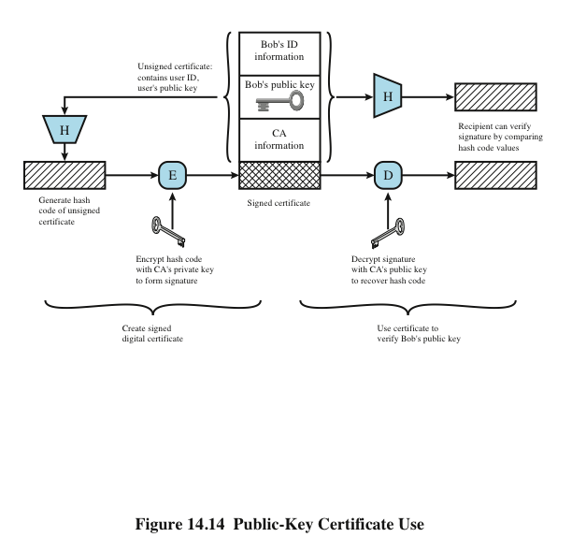
Fig 14.14 Public-Key Certificate Use
Notes:
CS 634/534 Cryptography
16 Spring, Week 11
10

Slide 13
X.500, X.509, PKI [W]
“X.500 is a series of computer networking standards covering electronic directory services. The X.500 series was developed by ITU-T, formerly known as CCITT. The directory services were developed in order to support the requirements of X.400 electronic mail exchange and name lookup. ISO was a partner in developing the standards, incorporating them into the Open Systems Interconnection suite of protocols. ISO/IEC 9594 is the corresponding ISO identification.
The Telecommunication Standardization Sector (ITU-T) coordinates standards for telecommunications on behalf of the International Telecommunication Union (ITU) and is based in Geneva, Switzerland.”
X.509 part of X.500 directory service standards
“In cryptography, X.509 is an ITU-T standard for a public key infrastructure (PKI) … X.509 specifies, amongst other things, standard formats for public key certificates, certificate revocation lists, attribute certificates, and a certification path validation algorithm.”
Notes:
CS 634/534 Cryptography
16 Spring, Week 11
10

Slide 14
X.500, X.509, PKI [W]
X.509 … assumes a strict hierarchical system of certificate authorities (CAs) for issuing the certificates. This contrasts with web of trust models, like PGP, where anyone (not just special CAs) may sign and thus attest to the validity of others' key certificates.
Public Key Infrastructure (PKI) is a set of hardware, software, people, policies, and procedures needed to create, manage, distribute, use, store, and revoke digital certificates. In cryptography, a PKI is an arrangement that binds public keys with respective user identities by means of a certificate authority (CA). The user identity must be unique within each CA domain. The binding is established through the registration and issuance process, which, depending on the level of assurance the binding has, may be carried out by software at a CA, or under human supervision. For each user, the user identity, the public key, their binding, validity conditions and other attributes are made unforgeable in public key certificates issued by the CA.”
Notes:
CS 634/534 Cryptography
16 Spring, Week 11
10

Slide 15
X.509 Authentication Service
Distributed servers maintain a database about users.
Each certificate contains the public key of a user and is signed with the private key of a CA.
Also defines authentication protocols
Uses public-key crypto & digital signatures
  algorithms not standardised, but RSA recommended
Used in S/MIME, IP Security, SSL/TLS, SET
Used in TDE : [W] : ``Transparent Data Encryption is a technology employed by both Microsoft and Oracle to encrypt database content. TDE offers encryption at a column, table, and tablespace level. “
  http://www.oracle.com/technology/obe/11gr1_db/security/tde/tde.htm#t2
  http://technet.microsoft.com/en-us/library/ms189586.aspx
Notes:
CS 634/534 Cryptography
16 Spring, Week 11
CS 634/534 Cryptography
Winter 09, Week 8
7

Slide 16
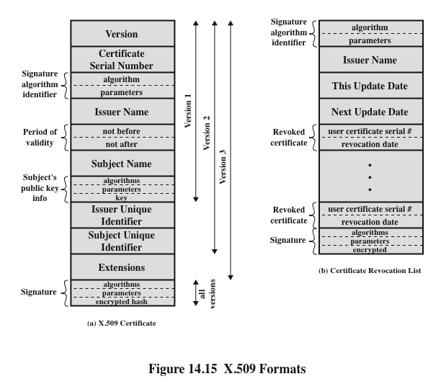
Figure 14.15 X.509 Formats
Notes:
CS 634/534 Cryptography
16 Spring, Week 11
CS 634/534 Cryptography
Winter 09, Week 8
Stallings Fig 14.3

Slide 17
X.509 Certificates
issued by a Certification Authority (CA), containing:
  version (1, 2, or 3)
  serial number (unique within CA) identifying certificate
  signature algorithm identifier
  issuer X.500 name (CA)
  period of validity (from - to dates)
  subject X.500 name (name of owner)
  subject public-key info (algorithm, parameters, key)
  issuer unique identifier (v2+) : in case of name conflict
  subject unique identifier (v2+) : in case of name conflict
  extension fields (v3) : Eg: postal address/photograph
  signature (of hash of all fields in certificate)
notation CA<<A>> denotes certificate for A signed by CA
Notes:
CS 634/534 Cryptography
16 Spring, Week 11
CS 634/534 Cryptography
Winter 09, Week 8

Slide 18
Sample X.509 Certificate
Wikipedia: example of X.509 certificate
Certificate:
Data: Version: 1 (0x0)
Serial Number: 7829 (0x1e95)
Signature Algorithm: md5WithRSAEncryption
Issuer: C=ZA, ST=Western Cape, L=Cape Town, O=Thawte Consulting cc, OU=Certification Services Division, CN=Thawte Server CA/emailAddress=server-certs@thawte.com
Validity Not Before: Jul 9 16:04:02 1998 GMT
Not After : Jul 9 16:04:02 1999 GMT
Subject: C=US, ST=Maryland, L=Pasadena, O=Brent Baccala, OU=FreeSoft, CN=www.freesoft.org/emailAddress=baccala@freesoft.org
Subject Public Key Info: Public Key Algorithm: rsaEncryption
RSA Public Key: (1024 bit) Modulus (1024 bit): 00:b4:31:98:0a:c4:bc:62:c1:88:aa:dc:b0:c8:bb: 33:35:19:d5:0c:64:b9:3d:41:b2:96:fc:f3:31:e1: 66:36:d0:8e:56:12:44:ba:75:eb:e8:1c:9c:5b:66: 70:33:52:14:c9:ec:4f:91:51:70:39:de:53:85:17: 16:94:6e:ee:f4:d5:6f:d5:ca:b3:47:5e:1b:0c:7b: c5:cc:2b:6b:c1:90:c3:16:31:0d:bf:7a:c7:47:77: 8f:a0:21:c7:4c:d0:16:65:00:c1:0f:d7:b8:80:e3: d2:75:6b:c1:ea:9e:5c:5c:ea:7d:c1:a1:10:bc:b8: e8:35:1c:9e:27:52:7e:41:8f
Exponent: 65537 (0x10001)
Signature Algorithm: md5WithRSAEncryption 93:5f:8f:5f:c5:af:bf:0a:ab:a5:6d:fb:24:5f:b6:59:5d:9d: 92:2e:4a:1b:8b:ac:7d:99:17:5d:cd:19:f6:ad:ef:63:2f:92: ab:2f:4b:cf:0a:13:90:ee:2c:0e:43:03:be:f6:ea:8e:9c:67: d0:a2:40:03:f7:ef:6a:15:09:79:a9:46:ed:b7:16:1b:41:72: 0d:19:aa:ad:dd:9a:df:ab:97:50:65:f5:5e:85:a6:ef:19:d1: 5a:de:9d:ea:63:cd:cb:cc:6d:5d:01:85:b5:6d:c8:f3:d9:f7: 8f:0e:fc:ba:1f:34:e9:96:6e:6c:cf:f2:ef:9b:bf:de:b5:22: 68:9f
Notes:
CS 634/534 Cryptography
16 Spring, Week 11
10

Slide 19
X.509 Certificates
Any user with access to the public key of the CA can recover the user public key that was certified.
only the CA can modify a certificate
because cannot be forged, certificates can be placed in a public directory
CAs by market share:
  Symantec (bought)VeriSign 38%
  Comodo 29%, Go Daddy 13% , GlobalSign 10%
One year certificates costs 500$ to 2000$
Notes:
CS 634/534 Cryptography
16 Spring, Week 11
CS 634/534 Cryptography
Winter 09, Week 8
7

Slide 20
CA Hierarchy
if both users share a common CA then they are assumed to know its public key
otherwise CA's must form a hierarchy
  See next slide
use certificates linking members of hierarchy to validate other CA's
  each CA has certificates for clients (forward) and parent (backward)
each client trusts parents certificates
enable verification of any certificate from one CA by users of all other CAs in hierarchy
Notes:
CS 634/534 Cryptography
16 Spring, Week 11
CS 634/534 Cryptography
Winter 09, Week 8
7

Slide 21
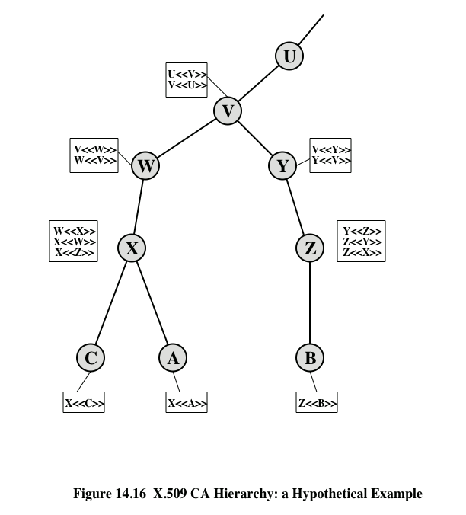
Fig 14.16 CA Hierarchy Eg
M<<N>>: certificate of N issued by CA M
How will B get A’s certificate ?
Notes:
CS 634/534 Cryptography
16 Spring, Week 11
CS 634/534 Cryptography
Winter 09, Week 8
7

Slide 22
Authentication Procedures
X.509 includes three alternative authentication procedures:
One-Way Authentication
Two-Way Authentication
Three-Way Authentication
all use public-key signatures
Why is nonce included in One-Way
  because the steps are common
  Two-Way is an extension of One-Way
Notes:
CS 634/534 Cryptography
16 Spring, Week 11
CS 634/534 Cryptography
Winter 09, Week 8
7

Slide 23
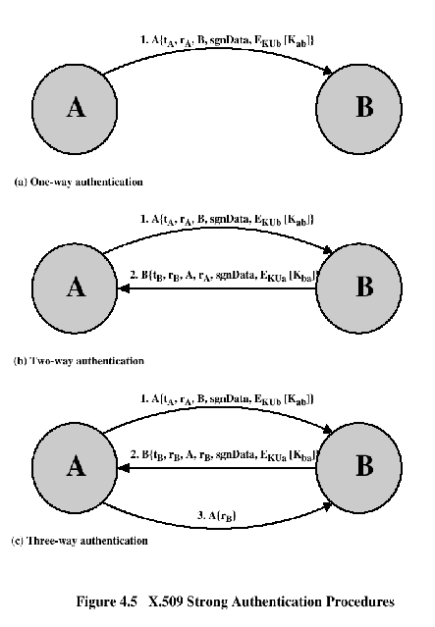
Authentication Procedures
r_{a} and r_{b} are nonces
Timestamps prevent delayed delivery of messages
Nonces stored till they expire
Optional session keys
Three-way: does not need synchronized clocks

Slide 24
One-Way Authentication
1 message ( A->B) used to establish
  the identity of A and that message is from A
  message was intended for B
  integrity & originality of message
message must include timestamp, nonce, B's identity and is signed by A
Notes:
CS 634/534 Cryptography
16 Spring, Week 11
CS 634/534 Cryptography
Winter 09, Week 8
7

Slide 25
Two-Way Authentication
2 messages (A->B, B->A) which also establishes in addition:
  the identity of B and that reply is from B
  that reply is intended for A
  integrity & originality of reply
reply includes ?
reply includes original nonce from A, also timestamp and nonce from B
Session key only needed if not included in Round (1).
Notes:
CS 634/534 Cryptography
16 Spring, Week 11
CS 634/534 Cryptography
Winter 09, Week 8
7

Slide 26
Three-Way Authentication
3 messages (A->B, B->A, A->B)
What is in the 3rd message ?
has reply from A back to B containing signed copy of nonce from B. Advantage ?
means that timestamps need not be checked or relied upon. Advantage ?
which enables above authentication without synchronized clocks
Notes:
CS 634/534 Cryptography
16 Spring, Week 11
CS 634/534 Cryptography
Winter 09, Week 8
7

Slide 27
SSL/TLS [Klander]
Different approaches – next slide. Why needed?
Klander : “The internet’s designers did not anticipate the need for secure transmissions within its protocols.”
Klander :“Neither TCP/IP nor HTTP provide a means for encrypting and protecting individual transmissions.”
SSL sits between applications like HTTP, FTP, telnet and TCP/IP : the advantage of this ? Klander : “SSL takes advantage of the existing Internet communications standards without limiting SSL to a specific application protocol
Notes:
CS 634/534 Cryptography
16 Spring, Week 11
7

Slide 28
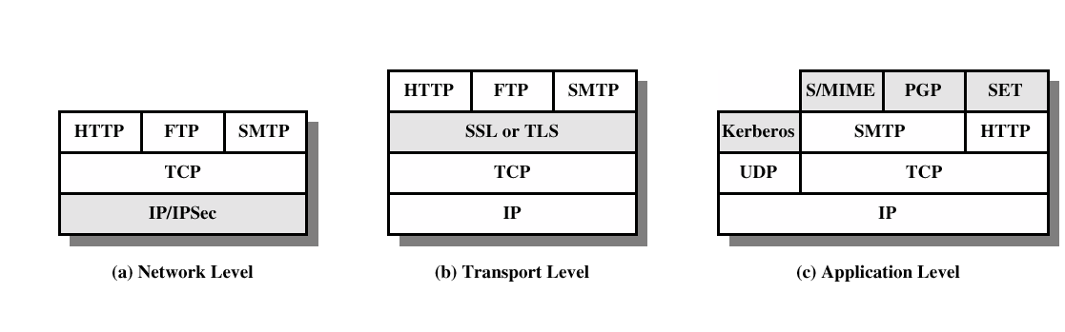
Different Security Approaches : Fig 17.1
(a) using Ipsec : advantage : transparent to users and applications
(b) SSL sits on top of TCP, TCP handles reliability of packets, etc
  https is http sitting on top of SSL
  SSL also used for secure FTP, secure telnet: we focus on SSL for https
(c) Application-specific security services are embedded within the particular application: service can be tailored to the specific needs of a given application
We study (b) now

Slide 29
SSL/TLS [Wikipedia]
SSL involves three basic parts:
Client/server negotiation for algorithm support
Key exchange and authentication
Symmetric cipher encryption and message authentication
During first part the client and server negotiate
  which ciphers are to be used
  the key exchange and authentication algorithms
  message authentication codes (MACs).
Notes:
CS 634/534 Cryptography
16 Spring, Week 11
7

Slide 30
SSL/TLS [Wikipedia]
Typical algorithms could be:
For key exchange: RSA, Diffie-Hellman,
For authentication: RSA, DSA
Symmetric ciphers: RC4, Triple DES, AES.
  In older versions of SSL the ciphers RC2, IDEA and DES were also used.
For cryptographic hash function: HMAC-MD5 or HMAC-SHA are used for TLS
  MD5 and SHA for SSL
  older versions of SSL also used MD2 and MD4.
Notes:
CS 634/534 Cryptography
16 Spring, Week 11
7

Slide 31
SSL/TLS authentication
Typically, only the server authenticated via SSL
  Client authentication via SSL is possible
    but requires extra steps
  If not through SSL, how is the client authenticated ?
The client is usually authenticated using a password which was established when the user’s account was created
  Not part of SSL protocol as such
  Though password transmitted in an encrypted fashion using SSL (SSL record protocol).
Notes:
CS 634/534 Cryptography
16 Spring, Week 11
7

Slide 32
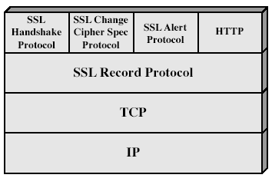
SSL Architecture
SSL has two layers of protocols
SSL Record Protocol is used for application data
  But also for other SSL protocols
Notes:
CS 634/534 Cryptography
16 Spring, Week 11
Stallings Fig 17-2.

Slide 33
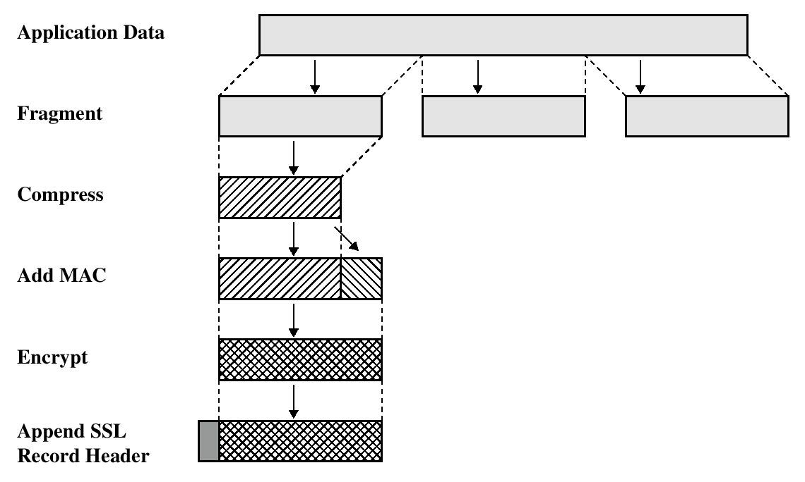
SSL Record Protocol Operation
Application data is fragmented into blocks
  214 (16K) bytes or less.
Optional compression
Message Integrity:
  MAC with shared secret key
  SHA or MD5
  HMAC in TLS
Confidentiality : fragment and MAC encrypted
  using secret key encryption with a shared secret key defined by Handshake Protocol

Slide 34
SSL Change Cipher Spec Protocol
one of 3 SSL protocols which use the SSL Record protocol
single msg for updating cipher suite in use
Eg: after ciphers have been negotiated (as part of handshake protocol)
  Then ChangeCipherSpec invoked
  Will see again later
Notes:
CS 634/534 Cryptography
16 Spring, Week 11
7

Slide 35
SSL Alert Protocol
conveys SSL-related alerts
severity
    warning or fatal
specific alert
    unexpected message, bad record mac, decompression failure, handshake failure, illegal parameter
    no certificate, bad certificate, unsupported certificate, certificate revoked, certificate expired, certificate unknown
compressed & encrypted like all other SSL data
Notes:
CS 634/534 Cryptography
16 Spring, Week 11
7

Slide 36
SSL/TLS Handshake Protocol [S], [W]
The SSL (record) protocol exchanges records encapsulate the data to be exchanged.
  When the connection starts, the record encapsulates another protocol
    the handshake protocol
Since handshake protocol is the most complex part of SSL/TLS
  We first look high-level, mostly from Wikipedia [W]
  Then look at details, mostly from [S], [RB] ,[W]
Used before any application data is transmitted
A SSL client and server negotiate a connection by using a handshaking procedure.
During this handshake, client + server agree on various parameters used to establish connection's security.
  server authenticated to client
  optional: client authenticated to server
  server & client negotiate encryption & MAC algorithms
  server & client negotiate cryptographic keys to be used
Notes:
CS 634/534 Cryptography
16 Spring, Week 11
7

Slide 37
SSL/TLS Handshake Overview [S], [W]
comprises a series of messages in phases
  Establish Security Capabilities
  Server Authentication and Key Exchange
  Optional Client Authentication and Key Exchange
  Finish
The handshake begins when a client connects to a SSL-enabled server and requests a secure connection
  presents a list of supported ciphers and hash functions.
From this list, the server picks the strongest cipher and hash function that it also supports
  notifies the client of the decision.
Notes:
CS 634/534 Cryptography
16 Spring, Week 11
7

Slide 38
SSL/TLS Handshake Overview [Wikipedia]
The server sends back its identification in the form of a digital certificate
  contains the server name and the server's public encryption key, signed by the trusted certificate authority (CA),
The client confirms that the certificate is authentic before proceeding.
In order to generate the session keys used for the secure connection, the client encrypts a random number with the server's public key, and sends the result to the server.
  Only the server can decrypt it (with its private key)
Notes:
CS 634/534 Cryptography
16 Spring, Week 11
7

Slide 39
SSL/TLS Handshake Overview [Wikipedia]
From the random number, both parties generate key material for encryption and decryption.
This concludes the handshake
  If client authentication, then extra steps
If any of above steps fails, the TLS handshake fails, and the connection is not created.
Now begins the secured connection
  Application data encrypted and decrypted with the key material until the connection closes.
We now look at details of handshake protocol
Notes:
CS 634/534 Cryptography
16 Spring, Week 11
7

Slide 40
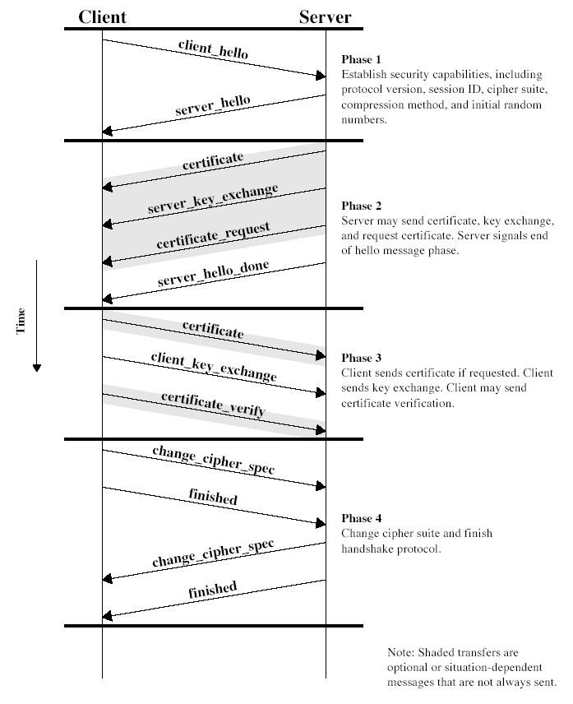
SSL/TLS Handshake Details Fig 17.6,
Notes:
CS 634/534 Cryptography
16 Spring, Week 11
Stallings Fig 17-6.

