Slide 1
Digital Signatures
Want to electronically sign a document
  Is it same as Authentication ?
No – also need Non-repudiation
Via secret-key crypto ?
  A, B share key K for AES. A sends :
    M, E_{K}(M). Why E_{K}(M). ?
Is this idea good for Digital Signatures ?
  Is there non-repudiation ?
Can get DS with secret-key crypto
  Requires trusted 3rd party
Use public-key crypto. How ?
Notes:
CS 634/534 Cryptography
16 Spring, Week 2
7

Slide 2
Digital Signatures
Signed with
  sender’s private key
Signature verified with
  sender’s public key
Why does this work
  because encryption, decryption similar
Provides
  Authentication
  Non-repudiation. Why ?
Can combine signatures with encryption
RSA, Digital Signature Standard

Slide 3
Cryptographic Hashing
Motivation: public key crypto is slow
  Long time to sign large document
Crypto hash function H :
  maps arbitrary size messages M to fixed size (a couple of hundred bits) h
  H is public and does not have a key
Use in a digital signature
  H(M) as a “representation” of M
Has to be hard to reverse o/w if BG finds M’, such that H(M’) = H(M), problem
  MD5
Notes:
CS 634/534 Cryptography
16 Spring, Week 2
7

Slide 4
Cryptanalysis
C = E_{K}(M): What does BG want ?
Maybe only M, maybe K so can get future M
Assume BG knows pub. algorithm, knows C
Types of attacks: What can BG do/know ?
ciphertext only
  Can identify plaintext M when he sees it.
known plaintext
  Knows one or more M, C pairs
chosen plaintext
  Can pick M. Allies picked sites to be attacked.
Notes:
CS 634/534 Cryptography
16 Spring, Week 2
7

Slide 5
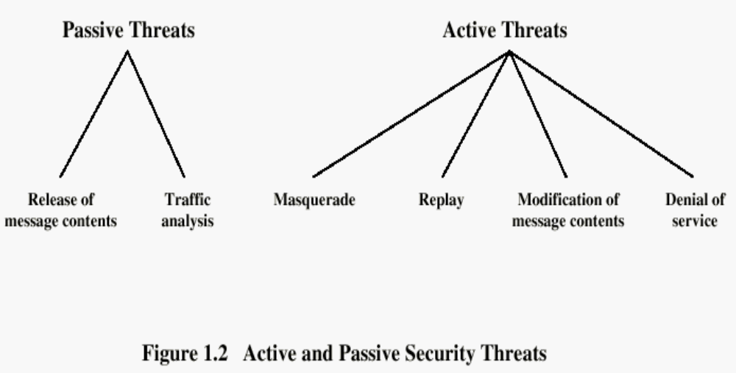
Passive/Active Threats
Masquerade
  Takes place when one entity pretends to be a different entity
Replay
  Involves the passive capture of a data unit and its subsequent retransmission
Modification of messages
  Some portion of a legitimate message is altered, or messages are delayed or reordered to produce an unauthorized effect

Slide 6
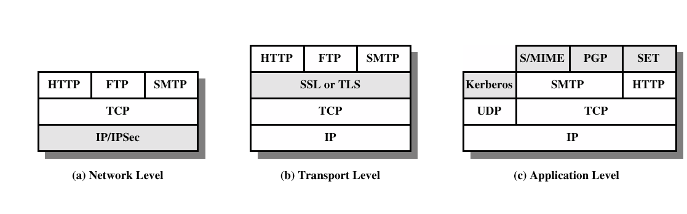
More Basic Terminology, TCP/IP protocol stack
Protocols:
  Cryptographic Protocols
  Eg: UNH protocol
Trusted Third Parties:
  Aka Arbitrators
Steps for Providing Security Services:
Security facilities in the TCP/IP protocol stack
Notes:
CS 634/534 Cryptography
16 Spring, Week 2
7

Slide 7
Classical Cryptography
Can all be broken with computers, so why study ?
Illustrates some basic idea behind modern secret key crypto
Learn about some cryptanalytic techniques
In use in some current low security systems
  CRYPT in UNIX based on Enigma
  ROT13 [Schneir page 11] : not for security
  Caeser cipher with shift 13. Why 13 ?
Notes:
CS 634/534 Cryptography
16 Spring, Week 2
7

Slide 8
Steganography
Hides existence of message
  using only a subset of letters/words in a longer message marked in some way
    Eg: gin or tonic
  using invisible ink
[W]: “Herodotus tells us of secret messages physically concealed beneath wax on wooden tablets or as a tattoo on a slave's head concealed by regrown hair”
Drawbacks ?
High overhead to hide relatively few info bits
Modern example: hiding in Least Significant Bit in graphic image or sound file
  Done with images on the internet
Can combine with encryption
Notes:
CS 634/534 Cryptography
16 Spring, Week 2
7

Slide 9
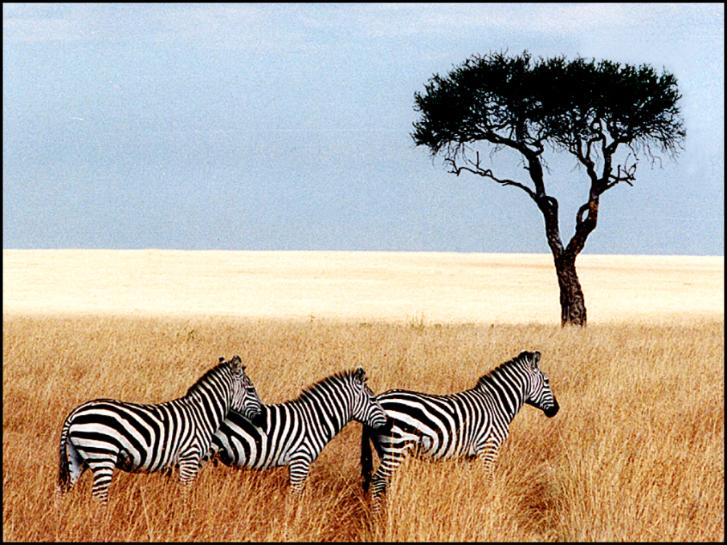
Steganography /Covert Channels
[TAN]
Pictures appear the same
Picture on right has text of 5 Shakespeare plays
  encrypted, inserted into low order bits of color values
Hamlet, Macbeth, Julius Caesar
Merchant of Venice, King Lear
Zebras

Slide 10
One-time Pad [MS]
Modified from Mark Stamp [MS]: http://cs.sjsu.edu/~stamp/crypto/PowerPoint_Mac/
A provably secure cipher
  The only provably secure cipher we will study
Why not use one-time pad for everything?
  Impractical for most applications
  But it does have its uses
  Will see later how to modify idea in one of the modes of operations we will study
P,C,K are all equally long bit strings
  C = P XOR K, how to recover P ?
Notes:
7

Slide 11
One-time Pad Encryption [MS]
e=000 h=001 i=010 k=011 l=100 r=101 s=110 t=111
Encryption: Plaintext ⊕ Key = Ciphertext
h | e | i | l | h | i | t | l | e | r
001 | 000 | 010 | 100 | 001 | 010 | 111 | 100 | 000 | 101
Plaintext:
Key:
111 | 101 | 110 | 101 | 111 | 100 | 000 | 101 | 110 | 000
110 | 101 | 100 | 001 | 110 | 110 | 111 | 001 | 110 | 101
s | r | l | h | s | s | t | h | s | r
Ciphertext:

Slide 12
One-time Pad Decryption [MS]
e=000 h=001 i=010 k=011 l=100 r=101 s=110 t=111
Decryption: Ciphertext ⊕ Key = Plaintext
s | r | l | h | s | s | t | h | s | r
110 | 101 | 100 | 001 | 110 | 110 | 111 | 001 | 110 | 101
Ciphertext:
Key:
111 | 101 | 110 | 101 | 111 | 100 | 000 | 101 | 110 | 000
001 | 000 | 010 | 100 | 001 | 010 | 111 | 100 | 000 | 101
h | e | i | l | h | i | t | l | e | r
Plaintext:

Slide 13
One-time Pad [MS]
Double agent claims sender used “key”:
s | r | l | h | s | s | t | h | s | r
110 | 101 | 100 | 001 | 110 | 110 | 111 | 001 | 110 | 101
Ciphertext:
“key”:
101 | 111 | 000 | 101 | 111 | 100 | 000 | 101 | 110 | 000
011 | 010 | 100 | 100 | 001 | 010 | 111 | 100 | 000 | 101
k | i | l | l | h | i | t | l | e | r
“Plaintext”:
e=000 h=001 i=010 k=011 l=100 r=101 s=110 t=111
Why can’t pad be repeated?

Slide 14
Real-world One-time Pad [MS]
Project VENONA
  Soviet spy messages from U.S. in 1940’s
  Thousands of messages
Spy carried one-time pad into U.S.
Spy used pad to encrypt secret messages
Repeats within the “one-time” pads made cryptanalysis possible
Classic Crypto <number>

Slide 15
VENONA Decrypt (1944) [MS]
[C% Ruth] learned that her husband [v] was called up by the army but he was not sent to the front. He is a mechanical engineer and is now working at the ENORMOUS [ENORMOZ] [vi] plant in SANTA FE, New Mexico. [45 groups unrecoverable]
detain VOLOK [vii] who is working in a plant on ENORMOUS. He is a FELLOWCOUNTRYMAN [ZEMLYaK] [viii]. Yesterday he learned that they had dismissed him from his work. His active work in progressive organizations in the past was cause of his dismissal. In the FELLOWCOUNTRYMAN line LIBERAL is in touch with CHESTER [ix]. They meet once a month for the payment of dues. CHESTER is interested in whether we are satisfied with the collaboration and whether there are not any misunderstandings. He does not inquire about specific items of work [KONKRETNAYa RABOTA]. In as much as CHESTER knows about the role of LIBERAL's group we beg consent to ask C. through LIBERAL about leads from among people who are working on ENOURMOUS and in other technical fields.
“Ruth” == Ruth Greenglass
“Liberal” == Julius Rosenberg
“Enormous” == the atomic bomb
Classic Crypto <number>

Slide 16
One-Time Pad
Advantages
  Provably secure
Disadvantages ?
Long key: as long as plaintext
  Because no repetition
[W]: “The one-time pad is, in most cases, impractical as it requires that the key material be as long as the plaintext, actually random, used once and only once, and kept entirely secret from all except the sender and intended receiver. When these conditions are violated, even marginally, the one-time pad is no longer unbreakable. Soviet one-time pad messages sent from the US for a brief time during WWII used non-random key material. US cryptanalysts, beginning in the late 40s, were able to, entirely or partially, break a few thousand messages out of several hundred thousand.”
Notes:
CS 634/534 Cryptography
16 Spring, Week 2
7

Slide 17
Substitution/Transposition Ciphers
Substitution: where letters of plaintext are replaced by other letters
  Eg: Caesar, monoalphabetic, ROT13
transposition (aka permutation) ciphers
  These hide the message by rearranging the letter order
  without altering the actual letters used
Modern secret key crypto uses both
  Substitution
  Transposition
Notes:
CS 634/534 Cryptography
16 Spring, Week 2
7

Slide 18
Monoalphabetic Cipher [B]
rather than just shifting the alphabet
could shuffle (jumble) the letters arbitrarily
each plaintext letter maps to a different random ciphertext letter
hence key is 26 letters long
  Plain: abcdefghijklmnopqrstuvwxyz
  Cipher: DKVQFIBJWPESCXHTMYAUOLRGZN
  Plaintext: ifwewishtoreplaceletters
  Ciphertext: WIRFRWAJUHYFTSDVFSFUUFYA
Notes:
CS 634/534 Cryptography
16 Spring, Week 2
7

Slide 19
Monoalphabetic Cipher Security
How many keys ?
26! = 4 x 10²⁶ keys
  So secure
From brute force, but …
Not from cryptanalytic
  Problem is language characteristics
    i.e. the fact that in English there are patterns which can be used by the cryptanalyst
Frequency analysis
  Letters are not equally commonly used
Notes:
CS 634/534 Cryptography
16 Spring, Week 2
7

Slide 20
English frequencies: Cryptanalysis
Which letter most commonly used in English?
E. Other common letters ?
T, R, N, I, O, A, S
Rare letters ?
Z, J, K, Q, X
Have tables of single letter frequencies
How to use these frequencies ?
Key concept ?
Notes:
CS 634/534 Cryptography
16 Spring, Week 2
7

Slide 21

English Letter Frequencies
[S] Fig 2.5
Notes:
CS 634/534 Cryptography
16 Spring, Week 2

Slide 22
Using frequencies in Cryptanalysis
monoalphabetic substitution ciphers do not change relative letter frequencies
  [W] “ It was probably religiously motivated textual analysis of the Qur'an which led to the invention of the frequency analysis technique for breaking monoalphabetic substitution ciphers by al-Kindi sometime around AD 800 (Ibrahim Al-Kadi -1992). It was the most fundamental cryptanalytic advance until WWII. Essentially all ciphers remained vulnerable to this cryptanalytic technique until the development of the polyalphabetic cipher by Leone Battista Alberti (ca 1465),”
calculate letter frequencies for ciphertext
compare counts/plots against known values
Eg: most commonly occurring letter may go to E (or T or S or …_)
Then
  diagrams (double letter)
  trigrams (triple letter) frequencies …
Notes:
CS 634/534 Cryptography
16 Spring, Week 2
7

Slide 23
Monoalphabetic Eg [S] pg 37
given ciphertext:
  UZQSOVUOHXMOPVGPOZPEVSGZWSZOPFPESXUDBMETSXAIZ
  VUEPHZHMDZSHZOWSFPAPPDTSVPQUZWYMXUZUHSX
  EPYEPOPDZSZUFPOMBZWPFUPZHMDJUDTMOHMQ
Count frequencies
  p: 13.33%
  z : 11.67%
  Guess ?
In English, e (12.75%) and t (9.25%) are most common.
  Good chance that {p,z} = {e,t}
Diagrams, Trigrams
Message is:
  it was disclosed yesterday that several informal but
  direct contacts have been made with political
  representatives of the viet cong in moscow
Notes:
CS 634/534 Cryptography
16 Spring, Week 2
7

Slide 24
Rail Fence cipher [B]
write message letters out diagonally over a number of rows
then read off cipher row by row
Eg: “meet me after the toga party”
  Write out as
  m e m a t r h t g p r y
  e t e f e t e o a a t
giving ciphertext
  MEMATRHTGPRYETEFETEOAAT
Trivial to break
Notes:
CS 634/534 Cryptography
16 Spring, Week 2
7

Slide 25
Row Transposition Ciphers [B]
write letters out in rows , reorder the columns according to some key , read off the rows
  Key: 3 4 2 1 5 6 7 ([S] has 4 3 1 2 5 6 7: inv. perm.)
  Plaintext:
  A T T A C K P
  O S T P O N E
  D U N T I L T
  WO A M X Y Z
Cipher text: TTNAAPTMTSUOAODWCOIXKNLYPETZ
Why TTNA ? 3 in 1st column so 3rd column comes first
How to break ?
Notes:
CS 634/534 Cryptography
16 Spring, Week 2
7

Slide 26
Product Ciphers
Product cipher: use several ciphers in succession to make more complex. How ?
Substitution followed by a transposition. Advantage ?
Better than doing
  2 successive substitutions or
  2 successive transpositions
modern ciphers use this idea
Notes:
CS 634/534 Cryptography
16 Spring, Week 2
7

Slide 27
Math Preliminaries:
Ceiling ⎡ ⎤ : ⎡x ⎤ = smallest int ≥ x, ⎡1.2⎤= 2
Floor ⎣ ⎦ : ⎣ x ⎦ = biggest int ≤ x,⎣ 1.2 ⎦ = 1
∑, ∏ : ∑ = sum, ∏ = product
factorial: n! = 1*2*3*… n
  4! = 1*2*3*4 = 24
Notes:
CS 634/534 Cryptography
16 Spring, Week 2
7

Slide 28
Math Preliminaries:
Exponential:
  a^{x+y} = a^{x}a^{y}
  a^{xy} = (a^{x})^y
  a^{-x}= 1/a^{x}
Log: If a^{x} = y then log_{a} y = x.
  log₂ 8 = 3, log₁₀ 100 = 2,log₂ 1 =0
  base 2, base e, e is Euler’s number, ln
  log xy = log x + log y
  log x^{y} = y log x
Notes:
CS 634/534 Cryptography
16 Spring, Week 2
7

Slide 29
Mod/Matrices
a mod b = c : short hand for saying that when we divide a by b, the remainder is c
7 mod 5 = 2, 19 mod 4 = 3
a mod b ≡ c or a = c mod b or a ≡ c mod b
7 = 2 mod 5, 19 = 3 mod 4
More from handout
Matrices from handout : multiplication, inverse
Notes:
CS 634/534 Cryptography
16 Spring, Week 2
7

