Slide 1
Hill Cipher [modified MS]
Modified from Mark Stamp [MS]: http://cs.sjsu.edu/~stamp/crypto/PowerPoint_Mac/
Invented by Lester Hill in 1929: a pre-modern block cipher
Idea is to create a substitution cipher with a large “alphabet”
  So instead of 1 letter being mapped to another letter
  Groups of letters are mapped to other groups of letters
    Eg: abc mapped to UMT, abd mapped to LVA
    Advantage?
Single letter frequencies flattened. Advantage
Frequency analysis becomes much harder
Notes:
10

Slide 2
Hill Cipher [modified MS]
Plaintext, p₀, p₁, p₂, …
Each p_{i} is block of n consecutive letters
  As a column vector
Let K be n x n invertible matrix, mod 26
Then ciphertext block c_{i} is given by
  c_{i} = K p_{i} (mod 26)
  Decryption: p_{i} = K^{–1}c_{i} (mod 26)
The matrix K is the key
We will do our Eg in detail from handout, but first we look at basic idea from [MS]
Notes:
7

Slide 3



Hill Cipher Example [MS]
Let n = 2, key K = A
Plaintext
MEETMEHERE = (12,4,4,19,12,4,7,4,17,4)
Ciphertext
(4,22,23,9,4,22,24,19,10,25) = EWXJEWYTKZ

Slide 4
Hill Cipher Cryptanalysis [MS]
BG knows Alice , Bob using Hill cipher, n x n K
Known plaintext attack: BG knows n plaintext blocks
  Plaintext blocks p₀,p₁,…,p_{n-1}
  Ciphertext blocks c₀,c₁,…,c_{n-1}
Let P be matrix with columns p₀,p₁,…,p_{n-1}
Let C be matrix with columns c₀,c₁,…,c_{n-1}
Then KP = C and K = CP^{–1} if P^{–1} exists
Now we do our example from handout
Moral of story: Strong cipher must have nonlinearity
  Linear components are useful but
  Can’t be only linear, linear equations easy to solve
Non-linearity influences modern systems
Notes:
7

Slide 5
Block vs Stream Ciphers
Block ciphers: entire block of bits is encrypted/decrypted at a time
Like a substitution on very big characters
  64-bits or more
  Think of as a generalization of Hill Cipher
  Most current ciphers are block ciphers
Stream ciphers: process messages a bit or byte at a time when en/decrypting
Notes:
CS 634/534 Cryptography
16 Spring, Week 3
7

Slide 6
Block Cipher Principles
Block ciphers look like a large substitution
  Suppose using 64-bit blocks. How to do ?
Suppose try to generalize idea of monoalphabetic cipher:
  Mapping: 64-bit block to 64-bit block. OK ?
How many 64-bit blocks are there ?
Need table of 2⁶⁴ entries !
Instead create from smaller building blocks
  Use idea of a product cipher
Will look at DES (Data Encryption Standard)
  modern block cipher
Notes:
CS 634/534 Cryptography
16 Spring, Week 3
7

Slide 7
Data Encryption Standard (DES)
widely used block cipher
  Being replaced by AES
  Still in use, 3-DES
adopted in 1977 by NBS (now NIST)
DES is a block cipher, 64-bit blocks
  The plaintext is processed in 64-bit blocks, one block at a time
Uses 56-bit key
Same key used for block 1, block 2, ...
Notes:
CS 634/534 Cryptography
16 Spring, Week 3
7

Slide 8
Simplified DES - S-DES
DES is complex to understand
  Explain basic idea with S-DES
    Not a secure algorithm: trivial to break
  Developed 1996 as a teaching tool
    Santa Clara University: Prof. Edward Schaefer
Encryption:
  8-bit block plaintext
  10 –bit key
  produces an 8-bit block of ciphertext
Decryption similar
tp://www.cs.binghamton.edu/~steflik/cs455/Simplified_DES.ppt
Notes:
CS 634/534 Cryptography
16 Spring, Week 3
7

Slide 9
Binary basics, S-DES
(A ⊕ B) ⊕ B = ?
(A ⊕ B) ⊕ B = A
Decimal to binary : Eg: convert 13 to binary
S-DES scheme described in earlier edition of Stallings (not there in current edition)
  Photocopies in handout
We will use earlier edition example, page 57
  8-bit plaintext: 10111101
  10-bit key: 1010000010
Notes:
CS 634/534 Cryptography
16 Spring, Week 3
7

Slide 10
S-DES Scheme [Steflik]
Encryption
Decryption
P10
8-bit plaintext
8-bit plaintext
SHIFT
IP
IP ⁻ ¹
P8
K₁
K₁
f_{k}
f_{k}
SHIFT
SW
SW
K₂
P8
K₂
f_{k}
f_{k}
IP ⁻ ¹
IP
8-bit ciphertext
8-bit ciphertext
Notes:
CS 634/534 Cryptography
16 Spring, Week 3

Slide 11
S-DES Functions [Steflik]
IP – an initial permutation
f_{k} - a complex, 2-input function
SW – a simple permutation that swaps the two halves
f_{k} - with a different subkey
IP⁻¹ – inverse permutation of the initial permutation

Slide 12
S-DES Key Generation [Steflik]
10
P10
5
5
LS-1
LS-1
5
5
P8
8
K₁
LS-2
LS-2
5
5
P8
8
K₂

Slide 13
S-DES Key Generation P10 Permutation [Steflik]
k1 k2 k3 k4 k5 k6 k7 k8 k9 k10
k3 k5 k2 k7 k4 k10 k1 k9 k8 k6
P10: permute 10 elts: 3 5 2 7 4 10 1 9 8 6
Eg: 10-bit key: 1010000010 . After P10 ?
1000001100

Slide 14
S-DES Key Generation LS-1 [Steflik]
Left circular shift 1 each 5 bit group
k3 k 5 k 2 k 7 k 4
k10 k1 k9 k8 k6
k5 k 2 k 7 k 4 k 3
k1 k9 k8 k6 k10
LS-1: Left circular shift - each 5 bit separately
Eg: After P10 1000001100. After LS- 1?
0000111000 : 10000 01100 each left shifted

Slide 15
S-DES Key Generation P8 Permutation [Steflik]
P8: pick 8 out of 10 and permute
k1 k2 k3 k4 k5 k6 k7 k8 k9 k10
k6 k3 k7 k4 k8 k5 k10 k9
P8: 6 3 7 4 8 5 10 9
Eg: After LS- 1 : 0000111000. After P8 ?
10100100 : This is subkey K₁

Slide 16
S-DES Key Generation K₂ [Steflik]
LS-2: 2 left circular shifts - each 5 bit separately
Eg: After LS- 1 : 0000111000. After LS-2 ?
Left circular shift 2 each 5 bit group
k3 k 5 k 2 k 7 k 4
k10 k1 k9 k8 k6
k2 k7 k4 k3 k5
k9 k8 k6 k10 k1
0010000011 : 00001 11000 left shifted twice
P8 = 6 3 7 4 8 5 10 9. After P8 ?
01000011: This is subkey K₂

Slide 17
S-DES Encryption Detail [Steflik]
I P
4
E/P
8
K ₁
4
4
4
S0
S1
2
2
P4
4
SW
E/P
K ₂
S0
S1
P4
I P ⁻¹

Slide 18
SDES Encryption Steps
f_{Ki} uses two 4-bit L & R halves
  L_{i} = L ⊕ F(R, K_{i}), R remains unchanged
  Then do the SW to swap L_{i} and R_{i}
How does F work ?
Take 4-bit R, expand to 8-bits using perm E/P
Then ⊕ with 8-bit subkey
passes through 2 S-boxes to get 4-bit result
finally permutes this using 4-bit perm P
This is the 4 bit F( ) which is XORed with L
Notes:
CS 634/534 Cryptography
16 Spring, Week 3
7

Slide 19
S-DES permutations, S-boxes
IP = 2 6 3 1 4 8 5 7
E/P = 4 1 2 3 2 3 4 1
Original S0 Original S1:
  1 0 3 2 0 1 2 3
  3 2 1 0 2 0 1 3
  0 2 1 3 3 0 1 0
  3 1 3 2 2 1 0 3
P4: 2 4 3 1
IP⁻¹ = 4 1 3 5 7 2 8 6
Notes:
CS 634/534 Cryptography
16 Spring, Week 3
10

Slide 20
SDES Encryption Eg, round 1
8-bit plaintext: 10111101. After IP ?
  IP = 2 6 3 1 4 8 5 7
01111110. L = 0111 , R = 1110. Expand R to 8 bits using E/P = 4 1 2 3 2 3 4 1. Will be = ?
0 1 1 1 1 1 0 1. XOR with K1 = 10100100. Gives?
11011001. Write this in 2 rows.
1st row looks up S0, 2nd row looks up S1
1st and 4th bit row number
2nd and 3rd bit give column number
Notes:
7

Slide 21
SDES Encryption Eg, round 1
  11011001. Write this in 2 rows.
    1101 : 11 = 3, 10 = 2, S0[3,2] = 3 = 11
    1001 : 11 = 3, 00 = 0, S1[3,0] = 2 = 10
1110 , 4-bit permutation P4: 2 4 3 1. Gives?
1011 : This is the 4 bit F( ) which is XORed with L
  L = L ⊕ F(R, K_{i})
  L = 0111 ⊕ 1011 = 1100. R unchanged = 1110
Now we get L,R 1100 1110. Swap them
L = 1110 R =1100
Notes:
7

Slide 22
SDES Encryption Eg, round 2
  Expand R = 1100 E/P = 4 1 2 3 2 3 4 1. Will be = ?
  0 1 1 0 1 0 0 1. XOR with K₂ = 01000011. Gives?
  00101010. Write this in 2 rows.
    0010 : 00 = 0, 01 = 1, S0[0,1] = 0 = 00
    1010 : 10 = 2, 01 = 1, S1[2,1] = 0 = 00
0000 , 4-bit permutation P4: 2 4 3 1. Gives?
0000 : This is the 4 bit F( ) which is XORed with L = 1110. Gives ?
L = 1110, R unchanged at 1100. 11101100
  Permuted with IP⁻¹ = 4 1 3 5 7 2 8 6. Gives?
01110101 This is the cipher text
Notes:
7

Slide 23
S-DES
What is known to the world ?
Why does decryption work ?
Is S-DES secure ?
Brute force attack : how long ?
Cryptanalytic attack ?
  Along lines similar to Hill cipher attack ?
Non-linearity
  Saw with Hill cipher why linearity could be a problem
  Is S-DES linear ?
Notes:
CS 634/534 Cryptography
16 Spring, Week 3
7

Slide 24
General ideas for secret-key encryption [KPS 57-59]
Suppose 64-bit blocks. How to do ?
  Try to generalize from monoalphabetic cipher
  Map 64-bit blocks to 64-bit blocks.
  Problem ?
Key is too large
  How to overcome ?
Have reasonable size key.
Many M to one C or only one M to a C ?
One to one
Should C be predicable from M ?
Notes:
CS 634/534 Cryptography
16 Spring, Week 3
7
C

Slide 25
General ideas for secret-key encryption [KPS 57-59]
Results to look “random”. Why ?
So hard for BG to break. Can they be truly random ?
No : can’t decrypt
Suppose P1, P2 differ in 1 bit, C1 = E(P1), C2 = E(P2)
  what should be difference between C1 and C2 i.e. should C1 and C2 also differ in only one bit or lots of bits ?
Notes:
CS 634/534 Cryptography
16 Spring, Week 3
7

Slide 26
Avalanche Effect
C1,C2 should differ in a lot of bits. Why ?
Otherwise, if know one P1,C1 pair, can maybe guess about P2 by seeing another C2
Avalanche effect :
  Single input bit should influence all output bits
  If we flip one input bit, the probability that any single output bit flips is 50%
Notes:
CS 634/534 Cryptography
16 Spring, Week 3
7

Slide 27
General ideas for secret-key encryption [KPS 57-59]
How to transform input block ?
  Substitutions
  Permutations
Using rounds
  Advantage of this
Why block length of 64-bits
  AES uses 128-bit blocks
Notes:
CS 634/534 Cryptography
16 Spring, Week 3
7

Slide 28
Feistel Cipher Structure
Most block ciphers are based on a Feistel Cipher Structure
  based on concept of invertible product cipher
  DES (and S-DES) is a Feistel cipher
  AES is not
partitions input block into two halves
process through multiple rounds
perform a substitution on left data half
based on round function of right half & subkey
then have permutation swapping halves
Notes:
CS 634/534 Cryptography
16 Spring, Week 3
7

Slide 29
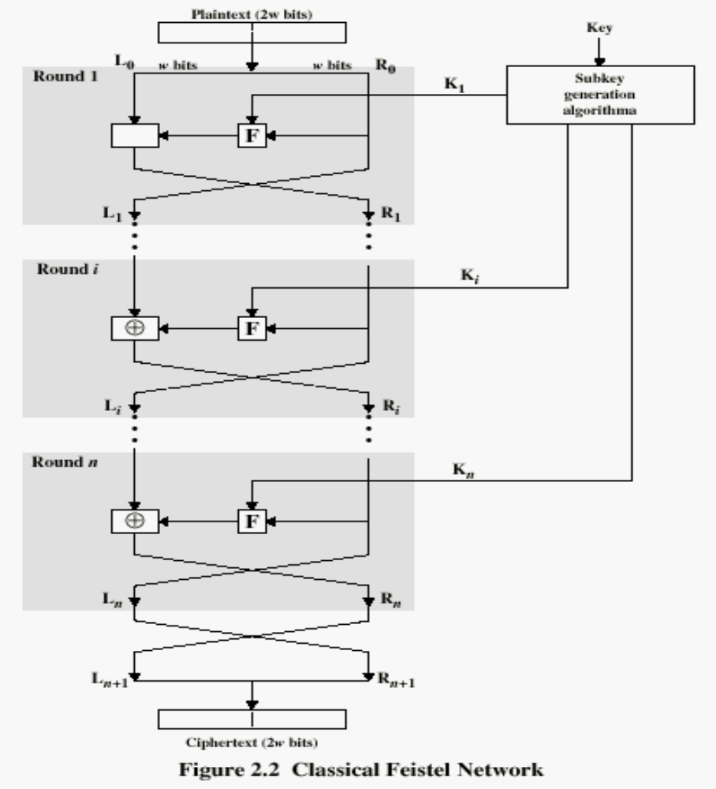
Feistel Cipher Structure

Slide 30
Tradeoffs in Feistel Ciphers
Block size: larger block sizes mean greater security
Key Size: larger key size means greater security
Number of rounds: multiple rounds offer increasing security
Subkey generation algorithm: greater complexity will lead to greater difficulty of cryptanalysis.
Round function : greater complexity can make analysis harder, but slows cipher
Notes:
CS 634/534 Cryptography
16 Spring, Week 3
7

Slide 31
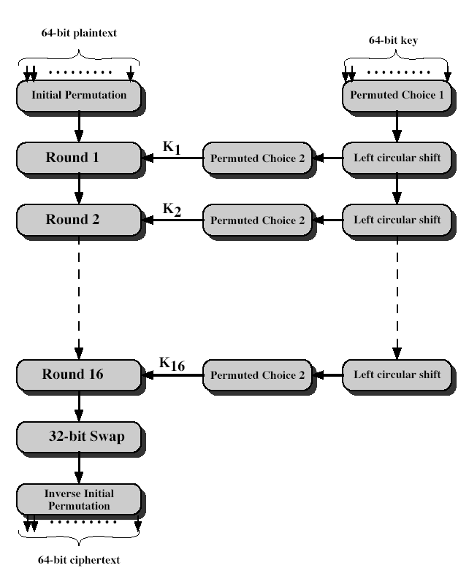
DES Encryption
Notes:
CS 634/534 Cryptography
16 Spring, Week 3
The basic process in enciphering a 64-bit data block using the DES, shown on the left side, consists of:
- an initial permutation (IP)
- 16 rounds of a complex key dependent round function involving substitution and permutation functions
- a final permutation, being the inverse of IP
The right side shows the handling of the 56-bit key and consists of:
- an initial permutation of the key (PC1) which selects 56-bits in two 28-bit halves
- 16 stages to generate the subkeys using a left circular shift and a permutation

Slide 32
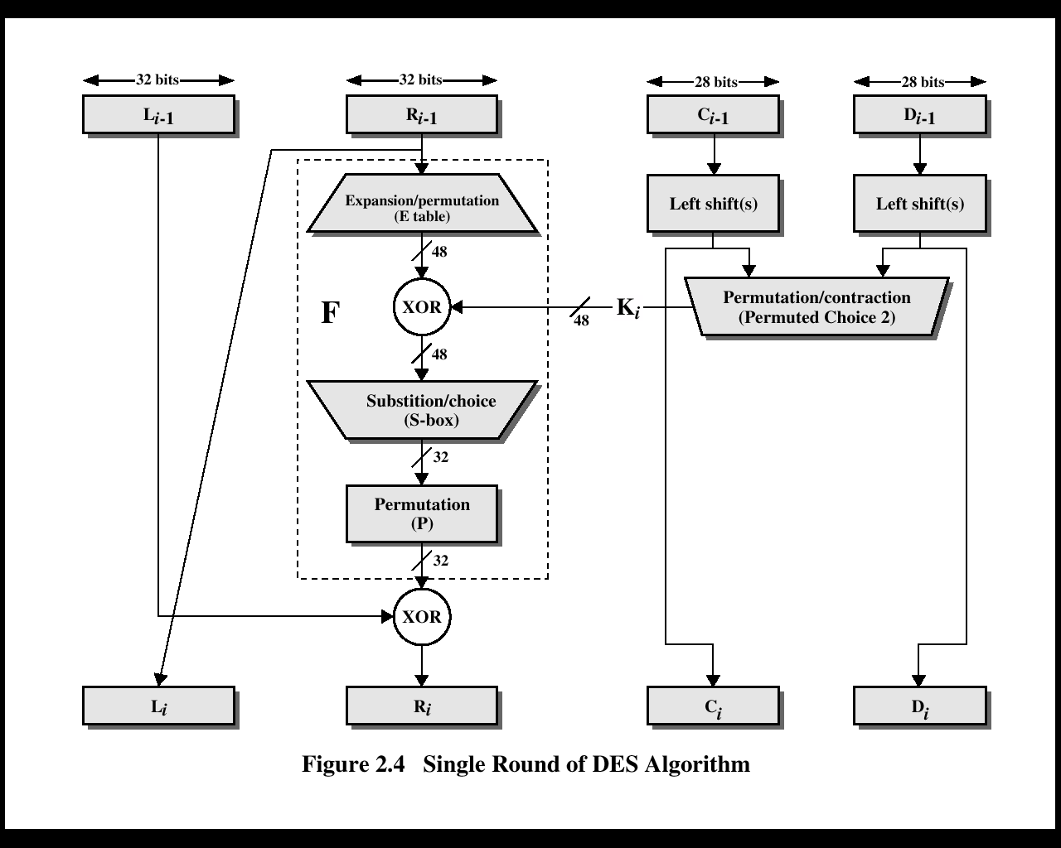
Single Round of DES

Slide 33
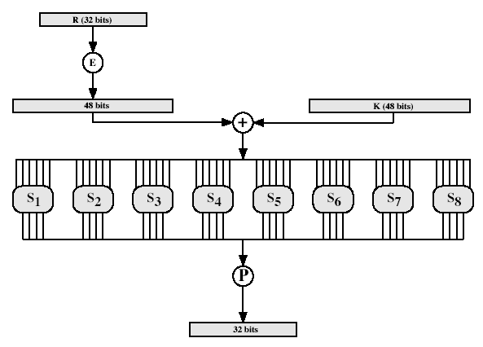
DES Round Structure
Notes:
CS 634/534 Cryptography
16 Spring, Week 3
Stallings Fig 3.9

Slide 34
From S-DES to DES
S-DES has 8 bit blocks, DES 64 bit blocks
S-DES has 10 bit key, DES 56 bit key
F function
have eight S-boxes which map 6 to 4 bits
  result is 8 lots of 4 bits, or 32 bits
Each S-box : 4 rows, 16 columns
  P0,0 … 8 rows, 6 columns.
  Each row for one S-box
  outer bits 1 & 6 (row bits) select row
  inner bits 2-5 (col bits) select column
Notes:
CS 634/534 Cryptography
16 Spring, Week 3
7

