Slide 1
DES Background [Schneir pg 265]
What did the world look like before 1973
In 1973 NBS issued request for proposals for a national cipher standard. Design criteria
  High level of security
  Security should be in key, not secret algorithm
  Efficient
IBM developed Lucifer cipher
  by team led by Feistel
  used 64-bit data blocks with 128-bit key
input from NSA and others
Notes:
CS 634/534 Cryptography
16 Spring, Week 4
7

Slide 2
DES
Much criticism
  NSA trapdoor
  56-bit key (vs Lucifer 128-bit)
  S-box design criteria were not released
Adopted in 1976
DES became widely used
  especially in financial applications
Hardware vs software
Does IP, IP⁻¹ add to security ?
Notes:
CS 634/534 Cryptography
16 Spring, Week 4
7

Slide 3
Differential Cryptanalysis
One of the most significant (public) advances in cryptanalysis
  Murphy, Biham & Shamir published 1990
powerful method to analyse block ciphers
used to analyse most current block ciphers
  with varying degrees of success
known by NSA in 70's
  DES reasonably resistant to it
Notes:
CS 634/534 Cryptography
16 Spring, Week 4
7

Slide 4
How secure is DES ?
Why 56-bit key [KPS 61]
DES exhibits strong avalanche :Stallings Eg
Brute force attacks
  Assuming can recognize plaintext. Eg: ASCII
  56-bit keys have 2⁵⁶ = 7.2 x 10¹⁶ values
  in 1999 with dedicated hardware in 22hrs
Resists differential cryptanalysis quite well
  S-box design issues [Schneir 293]
Number of rounds
Does not resist linear cryptanalysis well
Notes:
CS 634/534 Cryptography
16 Spring, Week 4
7

Slide 5
Padding
Suppose last block not complete ?
Padding [Schneir page 190], [B]:
  at end of message
  handle possible last short block
  How to do ?
Add regular pattern at end. Eg: 0s
Or pad last block with count of pad size
  eg. [ b1 b2 b3 0 0 0 0 5]
  3 data bytes
  5 bytes pad + count
Notes:
CS 634/534 Cryptography
16 Spring, Week 4
7

Slide 6
Modes of Operation
modes of operation:
  How to use cryptographic algorithm
  Maybe some type of feedback
  Maybe some other operations
We look at DES, same ideas for others
4 modes were defined for DES in ANSI standard ANSI X3.106-1983 Modes of Use
  Now have 5 for DES (also for AES)
  We will study 3
  [Schneir 189], [KPS 82] : better coverage than [S]
Notes:
CS 634/534 Cryptography
16 Spring, Week 4
7

Slide 7
Issues: Modes of Operation
Security
  Switching blocks
  Replay attacks
Efficiency
  Parallelizable
  Random access
Fault tolerance
  1 bit switch
  1 bit added/deleted
Notes:
CS 634/534 Cryptography
16 Spring, Week 4
7

Slide 8
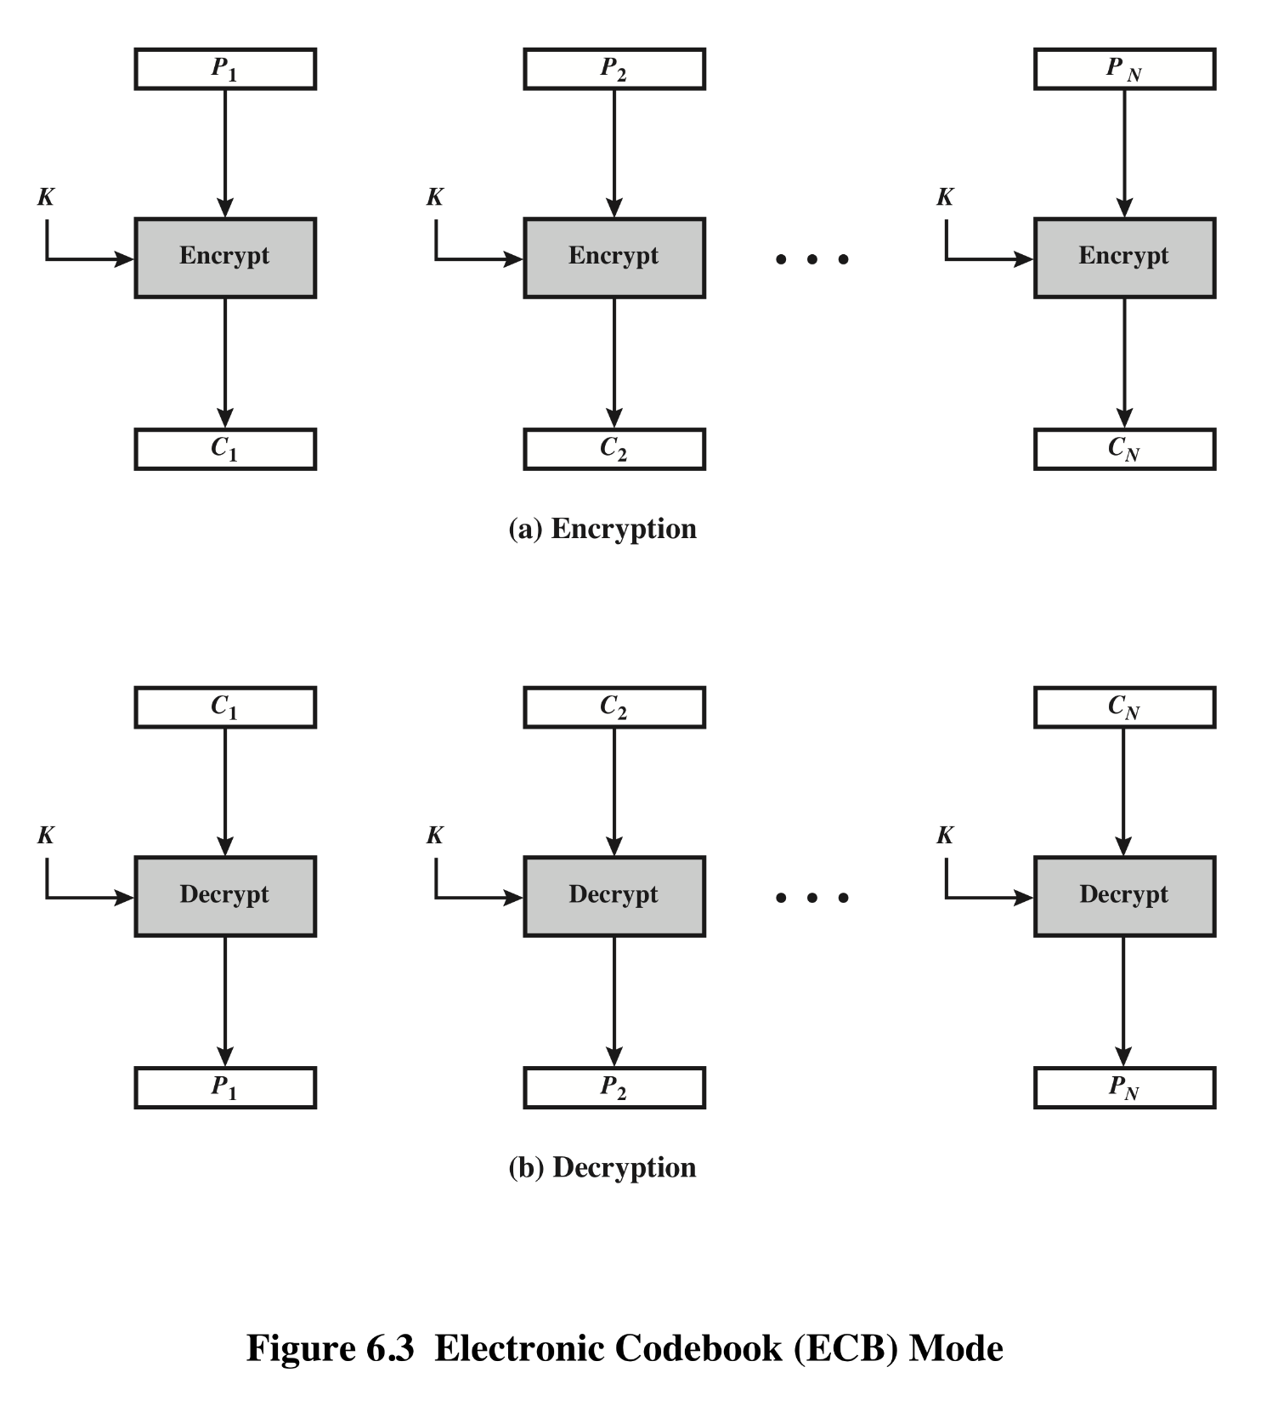
Electronic Code Book (ECB)
Notes:
CS 634/534 Cryptography
16 Spring, Week 4
Stallings Fig 3.11

Slide 9
Electronic Codebook Book (ECB)
each block is en/decrypted independently of all the other blocks
  C_{i} = DES_{K1} (P_{i})
Efficiency ?
  Parallelizable ?
  Random access for decryption ?
Fault tolerance ?
Problems ?
Notes:
CS 634/534 Cryptography
16 Spring, Week 4
7

Slide 10
ECB
Same P always mapped to same C. Why does this happen ?
C1, C2, … are independent of each other.
Why is this a problem ?
  Repetitions in message may show in ciphertext
  if aligned with message block
  particularly with data such graphics
  or with messages that change very little,
BG can build a code-book
Notes:
CS 634/534 Cryptography
16 Spring, Week 4
7

Slide 11
ECB
Can rearrange blocks
Block replay
  Will using time stamps stop this ?
  Bank example
When to use ?
When sending a few blocks of data uses. Eg?
Session key encrypted using a master key
Notes:
CS 634/534 Cryptography
16 Spring, Week 4
7

Slide 12
Using random bits
Why ?
Look at “fake idea” : modified from [KPS 82]
  Not a real or practical protocol
  Good lead into CBC
Problem with fake idea
Too many random bits
How to fix ?
Try to implement same type of idea but
  With fewer random bits
Notes:
CS 634/534 Cryptography
16 Spring, Week 4
7

Slide 13
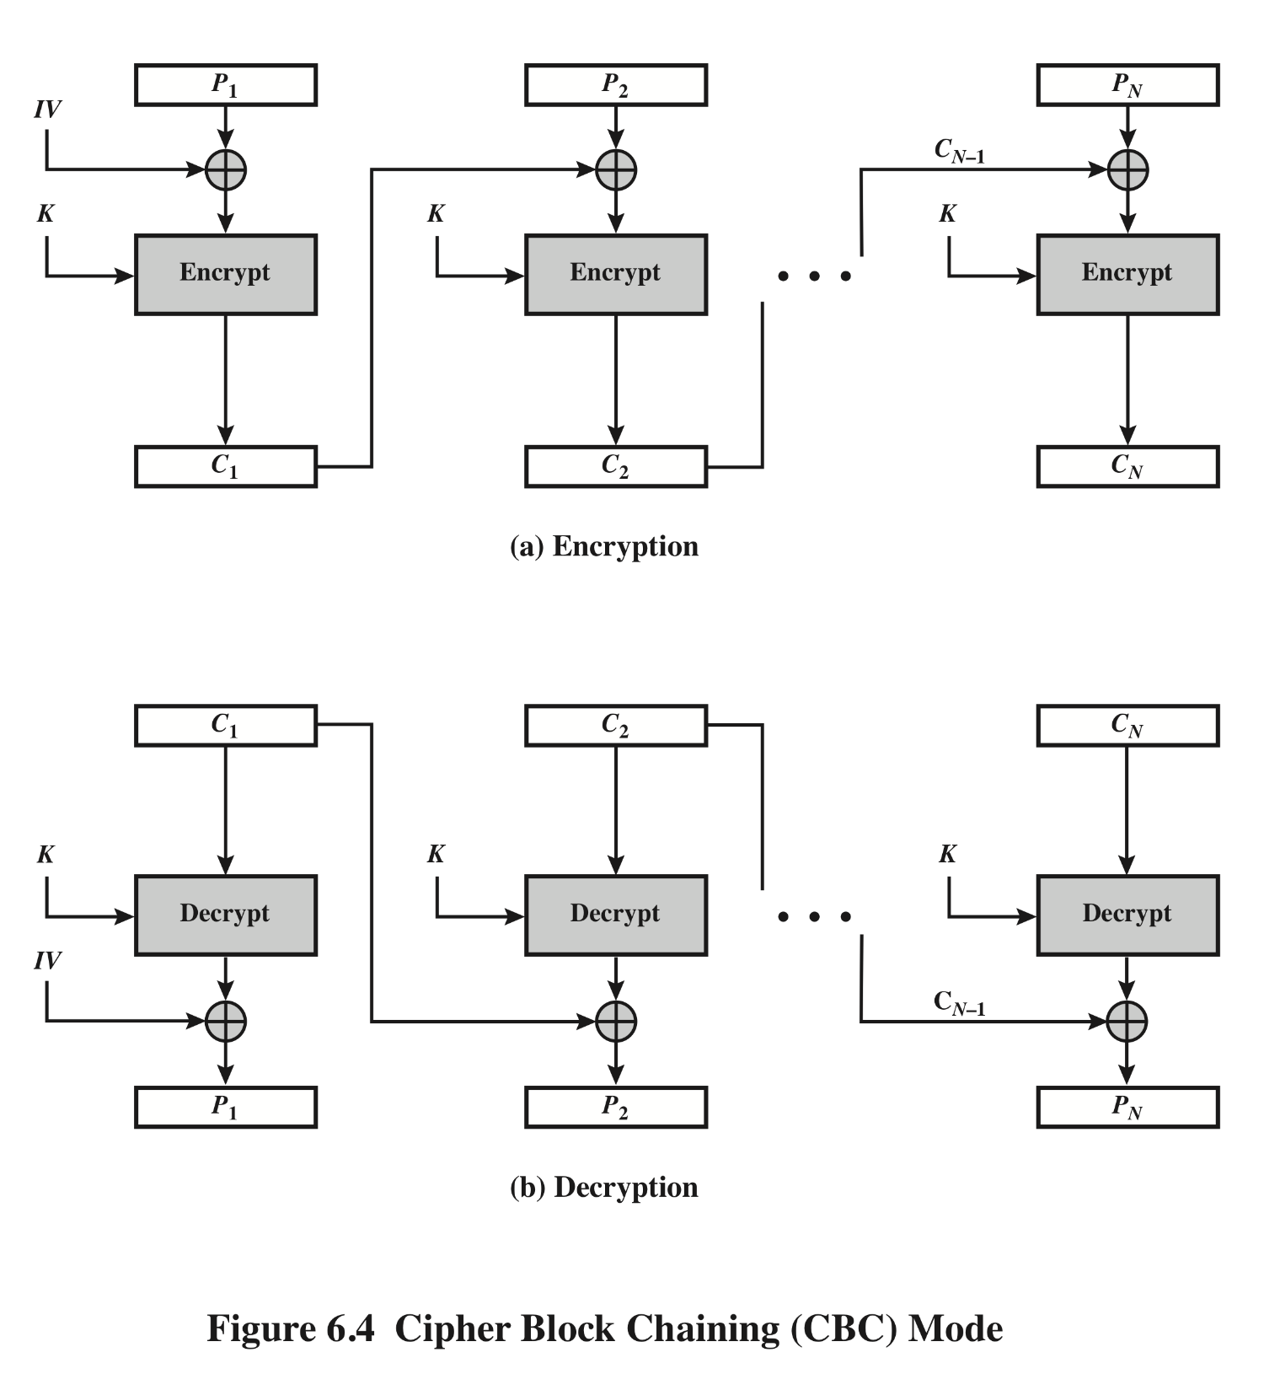
Cipher Block Chaining (CBC)
Notes:
CS 634/534 Cryptography
16 Spring, Week 4
Stallings Fig 3.12

Slide 14
Cipher Block Chaining (CBC)
message is broken into blocks
blocks linked together in encryption
each previous cipher blocks is chained with current plaintext block and then encrypted
  C_{i} = DES_{K1}(P_{i} XOR C_{i-1})
  Previous cipher block similar to random bits
Where to start, what should C₀ be ?
  use Initial Vector (IV) to start process
  C_{i} = DES_{K1}(P_{i} XOR C_{i-1})
  C₀ = IV
How to do decryption ?
Notes:
CS 634/534 Cryptography
16 Spring, Week 4
7

Slide 15
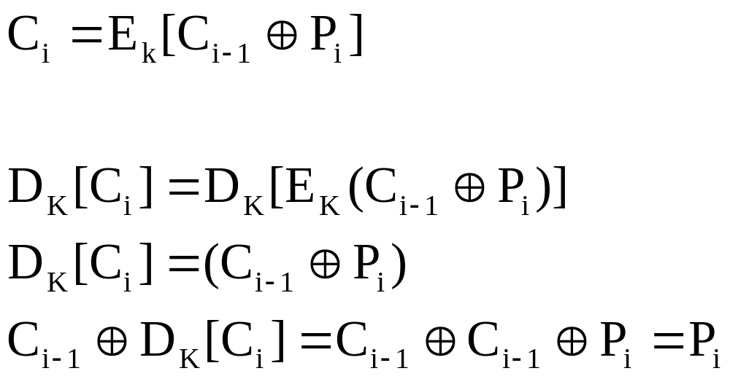
CBC Decryption [J]
How to recover plaintext?
Decrypt current cipher block and xor with previous cipher block
  Why does this work
Notes:
CS 634/534 Cryptography
16 Spring, Week 4
7

Slide 16
CBC
need Initial Value (IV) known to sender & receiver
  IVfixed (Eg: 000…00) or changed every time ?
Keep secret or not ?
Better to keep secret
  How to keep secret ?
Send encrypted
  How to send encrypted ?
In ECB mode before rest of message
Other points about IV
Notes:
CS 634/534 Cryptography
16 Spring, Week 4
7

Slide 17
CBC
Security ?
  Are repeating pattern of 64-bits exposed ?
  Can BG build a codebook ?
  Block replay ?
Efficiency ?
  Parallelizable ?
  Random access for decryption ?
Fault tolerance ?
Uses:
  bulk data encryption
  authentication
Notes:
CS 634/534 Cryptography
16 Spring, Week 4
7

Slide 18
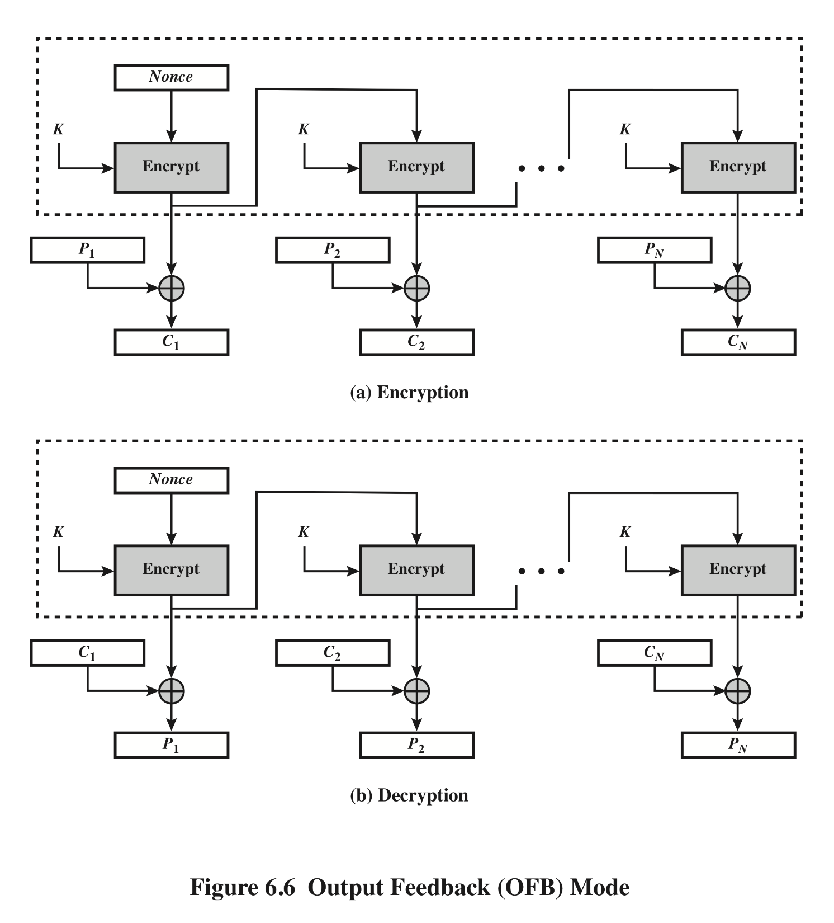
Output Feed Back (OFB)
Notes:
CS 634/534 Cryptography
16 Spring, Week 4
Stallings Fig 3.14

Slide 19
Output Feedback (OFB)
Basic idea : [KPS 86]
Like a one-time pad but with pseudorandom bits
Efficiency ?
  Parallelizable ?
  Random access for decryption ?
Fault tolerance ?
Stream cipher
Security ?
uses: stream encryption over noisy channels
Notes:
CS 634/534 Cryptography
16 Spring, Week 4
7

Slide 20
Combining block ciphers
Why ?
How to do with DES
Double DES with 2 keys : how ?
C = E_{K2}[E_{K1}[P]]
  How to decrypt ?
P = D_{K1}[D_{K2}[C]]
Key length ?
112 bits
Can 2 encryptions become one
  E_{K2}[E_{K1}[P]] = E_{K3}[P]
Notes:
CS 634/534 Cryptography
16 Spring, Week 4
7

Slide 21
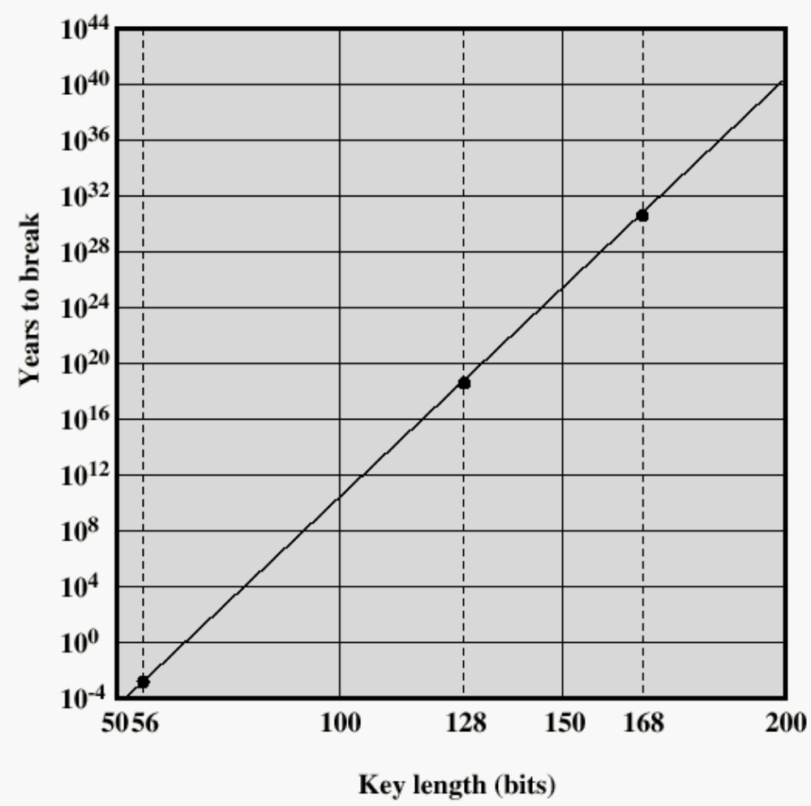
Time to break a code (10⁶ decryptions/µs)

Slide 22
Why not Double-DES?
meet-in-the-middle attack
since X = E_{K1}[P] = D_{K2}[C]
attack by encrypting P with all keys and store
then decrypt C with keys and match X value
How many steps ?
can show takes O(2⁵⁶) steps
Practical ?
Storage requirement is large: 2⁵⁶ entries
  Not practical, but still troubling
Notes:
CS 634/534 Cryptography
16 Spring, Week 4
7

Slide 23
Triple-DES
Use 3 encryptions. How many keys ?
Could be 2 or 3 distinct keys. Key length?
112 bits or 168 bits
Use 2 keys with E-D-E sequence
  C = E_{K1}[D_{K2}[E_{K1}[P]]]
  Advantage of E-D-E sequence ?
Backwards compatibility
  if K1=K2 then can work with single DES
standardized in ANSI X9.17 & ISO8732
Notes:
CS 634/534 Cryptography
16 Spring, Week 4
7

Slide 24
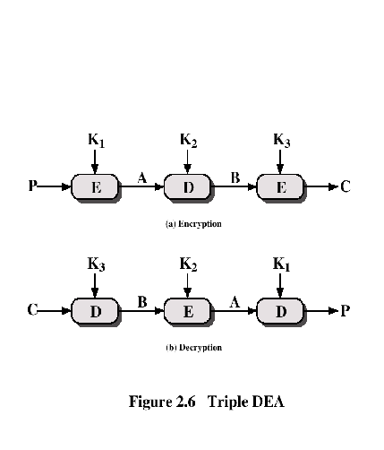
Triple-DES with Three-Keys

Slide 25
Triple-DES with Three-Keys
How secure is two-key Triple-DES :
  theoretical attacks, no known practical attacks
Some experts believe 2-key Triple-DES OK
  Some experts believe should use 3-key Triple-DES
Triple-DES with Three-Keys
  C = E_{K3}[D_{K2}[E_{K1}[P]]]
  Why this pattern ?
Backwards compatibility with both single DES and 2-key triple-DES
Used in some applications, eg PGP, S/MIME
Triple-DES is slow !
Notes:
CS 634/534 Cryptography
16 Spring, Week 4
7

