Slide 1

Public-Key Cryptography
Notes:
CS 634/534 Cryptography
16 Spring, Week 5
Stallings Fig 9.1

Slide 2
Public-Key Cryptography
public-key/two-key/asymmetric cryptography involves the use of two keys:
  public-key
    known to everybody
    used to encrypt messages, verify signatures
  private-key
    known only to the recipient
    used to decrypt messages, create signatures
is asymmetric because
  those who encrypt messages or verify signatures cannot decrypt messages or create signatures
Notes:
CS 634/534 Cryptography
16 Spring, Week 5
7

Slide 3
Why Public-Key Cryptography?
developed to address two key issues:
  key exchange
    how to securely exchange key (Eg: DES key)
  digital signatures –
    message authentication, non-repudiation
public invention due to Whitfield Diffie & Martin Hellman at Stanford in 1976
  now known [Simon Singh] researchers in a British signals intelligence agency invented it few years earlier but kept it classified
  We will study Diffie-Hellman
Some algorithms (Eg: RSA) good for both uses
  others specific to one (Eg: Diffie-Hellman, DSA)
Notes:
CS 634/534 Cryptography
16 Spring, Week 5
7

Slide 4
Public-Key Characteristics
Easy to generate keys
computationally easy to en/decrypt messages when the relevant (en/decrypt) key is known
computationally infeasible to find decryption key knowing only algorithm & encryption key
computationally infeasible to find P knowing only C and public key: one way function: details
In some schemes, either of the two related keys can be used for encryption, with the other used for decryption
  Useful for digital signatures
Notes:
CS 634/534 Cryptography
16 Spring, Week 5
7

Slide 5
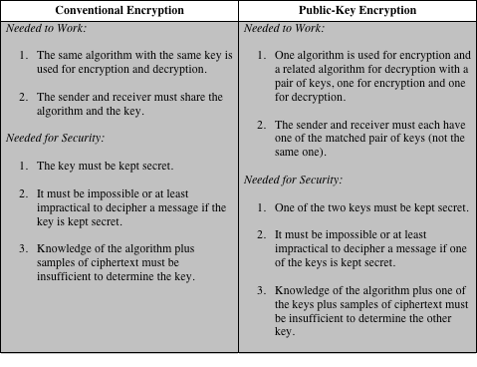
Table 9.2
Conventional and Public-Key Encryption

Slide 6
RSA
Rivest, Shamir & Adleman of MIT in 1977
Most widely used public-key scheme
Can be used for both key exchange and digital signatures
Too slow to encrypt large amounts of data
We look at some math preliminaries and then get to RSA
Notes:
CS 634/534 Cryptography
16 Spring, Week 5
7

Slide 7
Divisors, Prime Numbers
a non-zero number b divides a (denoted as b|a ) if for some m have a=mb (a,b,m all integers)
  that is b divides into a with no remainder
  we say that b is a divisor of a
  eg. all of 1,2,3,4,6,8,12,24 divide 24
Prime numbers: only have divisors of 1 and self
  can’t be written as product of other numbers
  eg. 2,3,5,7 are prime, 4,6,8,9,10 are not
list of prime number less than 200 is:
  2 3 5 7 11 13 17 19 23 29 31 37 41 43 47 53 59 61 67 71 73 79 83 89 97 101 103 107 109 113 127 131 137 139 149 151 157 163 167 173 179 181 191 193 197 199
Notes:
CS 632/CS 326 Algorithms
16 Spring, Week 5
7

Slide 8
Relatively Prime Numbers & GCD
Greatest Common Divisor GCD (a,b) of a and b is the largest number that divides evenly into both a and b
  GCD(60,24) = 12
two numbers a,b are relatively prime if have no common divisors apart from 1
  Eg. 8 & 15 are relatively prime since factors of 8 are 1,2,4,8 and of 15 are 1,3,5,15 and 1 is the only common factor
  Eg. 8, 22 not relatively prime since have common factor of 2
Notes:
CS 632/CS 326 Algorithms
16 Spring, Week 5
7

Slide 9
Euler Totient Function ø(n)
ø(n) : # numbers < n relatively prime to n
  Eg: ø(12) = ?
  Which numbers < 12 are relatively prime to 12
1,5, 7, 11 so ø(12) = 4
ø(7) = ?
for p (p prime) ø(p) = ?
for p (p prime) ø(p) = p-1
for p*q (p,q prime) ø(p*q)=(p-1)(q-1)
  Eg: 15 = 3*5, ø(p*q)=(3-1)(5-1)=8
  1,2,4,7,8,11,13,14
Notes:
CS 632/CS 326 Algorithms
16 Spring, Week 5
7

Slide 10
RSA Key Generation
users generate public/private key pair as follows :
Select two large primes at random : p, q
N = p.q
Totient function ø(N)=(p-1)(q-1)
Select at random the encryption key e such that
    1<e<ø(N), gcd(e,ø(N))=1
Decryption key d is inverse of e i.e.
  e.d=1 mod ø(N) and 1≤d≤ø(N)
public key: KU={e,N}
private key: KR={d,N}
p, q kept secret
Notes:
CS 632/CS 326 Algorithms
16 Spring, Week 5
7

Slide 11
RSA Encryption/Decryption
message M must be smaller than N
  Otherwise split into blocks
Encryption:
  C=Me mod N, where 0≤M<N
Decryption
  M=C^{d} mod N
Notes:
CS 632/CS 326 Algorithms
16 Spring, Week 5
7

Slide 12
RSA Small Example
Select primes: p=5 & q=3
Compute n = pq =5×3=15
Compute ø(n)=(p–1)(q-1)=4×2=8
Select e : gcd(e,8)=1; choose e=3
Determine d: de= 1 mod 8 and d < 8 Value is d=3 since 3×3=9 = 1 mod 8. d = e: coincidence
Publish public key KU={3,15}
Keep secret private key KR={3,15}.
sample RSA encryption/decryption
given message M = 2
encryption:
  C = 2³ mod 15 = 8
decryption:
  M = 8³ mod 15 = 64 *8 mod 15 = 4 *8 mod 15 = 2
Notes:
CS 632/CS 326 Algorithms
16 Spring, Week 5
7

Slide 13
RSA Example [Stallings]
Select primes: p=17 & q=11
Compute n = pq =17×11=187
Compute ø(n)=(p–1)(q-1)=16×10=160
Select e : gcd(e,160)=1; choose e=7
Determine d: de=1 mod 160 and d < 160 Value is d=23 since 23×7=161= 10×160+1
Publish public key KU={7,187}
Keep secret private key KR={23,187}
sample RSA encryption/decryption is:
given message M = 88
encryption:
  C = 88⁷ mod 187 = 11
decryption:
  M = 11²³ mod 187 = 88
Notes:
CS 632/CS 326 Algorithms
16 Spring, Week 5
7

Slide 14
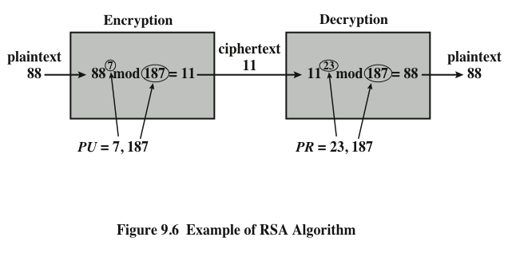
Example of RSA Algorithm
Notes:
An example from [SING99] is shown in Figure 9.6.

Slide 15
Why does RSA Work ?
What do we need to see to determine that RSA works ?
Encryption, decryption works correctly
  When decrypting get back M
  Corollary to Euler’s theorem
Good guys can do what they need to do quickly
Bad guys can’t break it quickly
Notes:
CS 634/534 Cryptography
16 Spring, Week 5
7

Slide 16
Why good guys can work quickly
What do we need for the good guys to do?
Find two large primes at random : p, q
  How to do ? Discussed in next slide.
Find e and d fast
  Extended Euclidean algorithm: we won’t discuss but covered in [Stallings] and in [CLR]
Do modular exponentiation fast
  C = Me mod n, M =C^{d} mod n
  How to do ?
Discussed in 6632/3326
Notes:
CS 634/534 Cryptography
16 Spring, Week 5
7

Slide 17
Finding large primes quickly
How to find large prime numbers ?
Traditional method too slow
idea :
  Generate large numbers (of the “right size”)
  Test if prime
  If not, then repeat
  In order for this to work, what do we need ?
Prime numbers have to be dense
  Occur frequently enough
Have to quickly determine if prime
Notes:
CS 634/534 Cryptography
16 Spring, Week 5
7

Slide 18
Prime Numbers are dense
Prime number theorem states that primes occur roughly every (ln n) integers
So if 200 decimal digits
  1000 binary bits
  How many numbers will we have to look at ?
Approximately log ₂ 2^1000 = ?
= 1000. Means what ?
Generate about 1000 numbers of the right size
  and will likely hit a prime number
Notes:
CS 634/534 Cryptography
16 Spring, Week 5
7

Slide 19
Randomized algorithms (6632/3326)
Idea: toss coins : random number generator. Two types:
always correct, not always fast – speed depends on coin tosses. Called:
Las Vegas
always fast, not always correct – correctness depends on coin tosses. Called:
Monte Carlo

Slide 20
Testing for primality
How to do ?
Can do deterministically
  But slow
Probabilistic primality testing
  Eg: Miller-Rabin (6632/3326). Probabilistic?
Might give a wrong result : Monte Carlo
  If prime, will come back and say prime.
  But false positives: might say prime for composite
But can make chance of error very small
  Eg: repeat 10 times, prob. false positive < 0.00001
Notes:
CS 634/534 Cryptography
16 Spring, Week 5
7

Slide 21
RSA Security – why BG can’t break
Not know for sure that can’t break, so why do people think of this as secure ?
Have looked at for many years, not published
Three approaches to attacking RSA:
brute force key search. Will work ?
infeasible : big numbers : 1024 bits or more
timing attacks
mathematical attacks : how ?
Notes:
CS 634/534 Cryptography
16 Spring, Week 5
7

Slide 22

Factoring
Factor N=pq, then what ?
Find ø(N), then what ?
Find d
How to factor N i.e. find p, q so N=pq
No poly-time algorithm currently known
  Quantum computing
Best known factorization algorithm (Brent-Pollard) takes
Notes:
CS 634/534 Cryptography
16 Spring, Week 5
7

Slide 23
Time Estimates for Factorization [RB 03]
Decimal Digits in N #Bit Operations to Factor N
20 7200
40 3.11e+06
60 4.63e+08
80 3.72e+10
100 1.97e+12
120 7.69e+13
140 2.35e+15
160 5.92e+16
180 1.26e+18
200 2.36e+19

Slide 24
Key size for RSA
232-digit number factored in 2009
  hundreds of machines, 2 years
How big should RSA keys (n) be
  matters if care if decrypted many years later. Why?
Key length recommendations
  1024 considered potentially vulnerable
  2048 bits considered safe till 2030
  3072 bits recommended if need beyond 2030
  Long root key for Certificate Authority
  Keys should be changed every 2 years
Ensure p, q of similar size and other constraints
Notes:
CS 634/534 Cryptography
16 Spring, Week 5
7

Slide 25
Discrete Logarithms, Taking Roots
What can BG do to find d directly ?
Pick M, calculate C = Me mod n
Now what can BG try ?
  Knows M = C^{d} mod n Knows M, C
  Can find d ?
This is the discrete log problem
  Find x where a^{x} = b mod r
  Written as x=log_{a} b mod r
  Is inverse of modular exponentiation
In regular arithmetic, finding logs:
  If 2^x = 64, x = log₂ 64 = 6
In modulo arithmetic, exponentiation is easy
  finding discrete logarithms is hard
Taking Roots: solve C = Me mod n
Notes:
CS 634/534 Cryptography
16 Spring, Week 5
7

Slide 26
RSA satisfies Public-Key Characteristics ?
Easy to generate keys
computationally easy to en/decrypt messages when the relevant (en/decrypt) key is known
computationally infeasible to find decryption key knowing only algorithm & encryption key
computationally infeasible to find P knowing only C and public key: one way function
In some schemes, either of the two related keys can be used for encryption, with the other used for decryption
  Useful for digital signatures
Notes:
CS 634/534 Cryptography
16 Spring, Week 5
7

