Slide 1
Diffie-Hellman Key Exchange
a public-key distribution scheme
  not meant for confidentiality (to securely exchange an arbitrary message)
    But can be modified to do this
  establishes a common session key
    known only to the two participants
used in a number of commercial products
  PGP, SSL, IPSec
Notes:
CS 634/534 Cryptography
16 Spring, Week 6
7

Slide 2
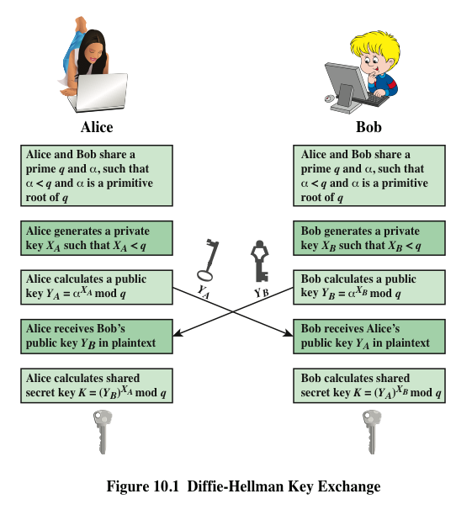
Notes:
Figure 10.1 summarizes the Diffie-Hellman key exchange algorithm. For this
scheme, there are two publicly known numbers: a prime number q and an integer a
that is a primitive root of q .

Slide 3
Primitive Roots
α is a primitive root of q if α¹, α², … α^{q-1} mod q generate all the values in 1, 2, …, q-1
  i.e. α¹, α², … α^{q-1} mod q : no repeated values
Eg: q = 7, is α = 3 a primitive root ?
3¹ = 3 mod 7, 3² = 2 mod 7, 3³ = 6 mod 7,
3⁴ = 4 mod 7, 3⁵ = 5 mod 7, 3⁶ = 1 mod 7
Eg: q = 7, is α = 2 a primitive root ?
2¹ = 2 mod 7, 2² = 4 mod 7, 2³ = 1 mod 7,
2⁴ = 2 mod 7, 2⁵ = 4 mod 7, 2⁶ = 1 mod 7
3 is a primitive root, 2 is not
Notes:
CS 634/534 Cryptography
16 Spring, Week 6
7

Slide 4
Key Exchange
global parameters shared by all users:
  large prime integer q
  α a primitive root of q
A & B wish to establish session key
select random private keys:
  A chooses x_{A}< q, B chooses x_{B} < q
compute public keys:
  A: y_{A} = α ^{xA} mod q
  B: y_{B} = α ^{xB} mod q
compute shared session key as:
  A: K_{AB}= y_{B}^{xA} mod q
  B: K_{AB}= y_{A}^{xB} mod q
Notes:
CS 634/534 Cryptography
16 Spring, Week 6
7

Slide 5
Small Example
global parameters q=7 and α=5
users A & B wish to swap keys:
select random private keys:
  A chooses x_{A}=2, B chooses x_{B}=3
compute public keys:
  A: y_{A}= 5² mod 7 = 4
  B: y_{B}= 5³ mod 7 = 6
compute shared session key as:
  A: K_{AB}= y_{B}^{xA} mod q = 6² mod 7 = 1
  B: K_{AB}= y_{A}^{xB} mod q = 4³ mod 7 = 1
Notes:
CS 634/534 Cryptography
16 Spring, Week 6
7

Slide 6
Textbook Example
global parameters prime q=353 and α=3
users A & B wish to swap keys:
select random private keys:
  A chooses x_{A}=97, B chooses x_{B}=233
compute public keys:
  A: y_{A}=3⁹⁷ mod 353 = 40
  B: y_{B}=3²³³ mod 353 = 248
compute shared session key as:
  A: K_{AB}= y_{B}^{xA} mod 353 = 248⁹⁷ = 160
  B: K_{AB}= y_{A}^{xB} mod 353 = 40²³³ = 160
Notes:
CS 634/534 Cryptography
16 Spring, Week 6
7

Slide 7
Diffie-Hellman Key Exchange
K_{AB} is used as session key in private-key encryption scheme between A and B
if A and B subsequently communicate
  they will have the same key as before
  unless they choose new public-keys
Why does Diffie-Hellman work
  Alice: y_{A} = α ^{xA} mod q
  Bob: y_{B} = α ^{xB} mod q
  Alice: K_{AB}= y_{B}^{xA} mod q
  Bob: K_{AB}= y_{A}^{xB} mod q
2 calculations of session key give same value ?
Notes:
CS 634/534 Cryptography
16 Spring, Week 6
7

Slide 8
Diffie-Hellman Key Exchange
A’s calculation :
  K_{AB}= y_{B}^{xA} mod q
  =(α ^{xB} mod q) ^{xA} mod q
  = α ^{xBxA} mod q
B’s calculation :
  K_{AB}= y_{A}^{xB} mod q
  =(α ^{xA} mod q) ^{xB} mod q
  = α ^{xAxB} mod q
2 calculations of session key give same value
Notes:
CS 634/534 Cryptography
16 Spring, Week 6
7

Slide 9
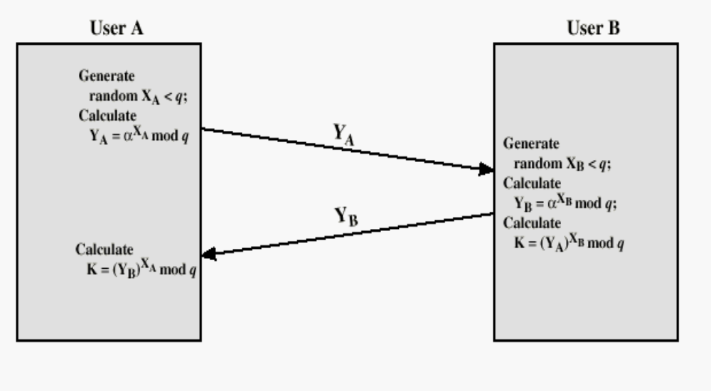
Anonymous Diffie-Hellman
q, α known to both A, B or sent by A
This is subject to man in the middle attack

Slide 10
Problems with Anonymous DH
BG : man in the middle attack
  BG tells A he is B, sends A y_{BG} claiming is y_{B}
  BG tells B he is A, sends B y_{BG} claiming is y_{A}
Now he has exchanged session keys with A,B
  BG decrypts M from A, re-encrypts, sends to B
  BG decrypts M’ from B, re-encrypts, sends to A
Basic problem with anonymous DH ?
No authentication. Details next slide. Solution ?
Authenticated DH
  Different protocols have been developed
    Eg: Certificates
Notes:
CS 634/534 Cryptography
16 Spring, Week 6
7

Slide 11
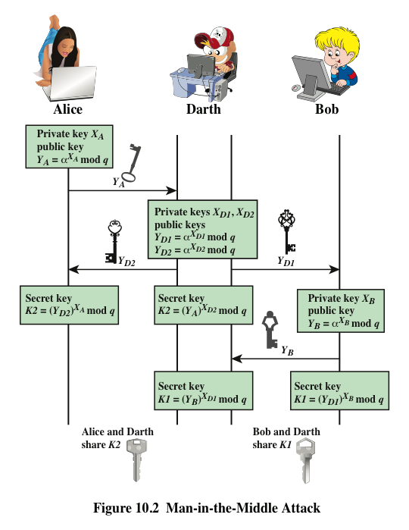
Notes:
The protocol depicted in Figure 10.1 is insecure against a man-in-the-middle attack.
Suppose Alice and Bob wish to exchange keys, and Darth is the adversary. The
attack proceeds as follows (Figure 10.2).
Darth prepares for the attack by generating two random private keys X_{D1} and X_{D2} and then computing the corresponding public keys Y_{D1} and Y_{D2}
Alice transmits Y_{A} to Bob.
Darth intercepts Y_{A} and transmits Y_{D1} to Bob. Darth also calculates K2 = (Y_{A} )^ X_{D2} mod q
Bob receives Y_{D1} and calculates K1=(Y_{D1} )^ X_{B} mod q
Bob transmits Y_{B} to Alice.
Darth intercepts Y_{B} and transmits Y_{D2} to Alice. Darth calculates K1=(Y_{B} )^ X_{D1} mod q
Alice receives Y_{D2} and calculates K2=(Y_{D2} )^ X_{A} mod q .
At this point, Bob and Alice think that they share a secret key, but instead Bob and Darth share secret key K1 and Alice and Darth share secret key K2. All future communication between Bob and Alice is compromised in the following way:
Alice sends an encrypted message M: E(K2, M).
Darth intercepts the encrypted message and decrypts it, to recover M.
Darth sends Bob E(K1, M) or E(K1, M'), where M' is any message. In the first case, Darth simply wants to eavesdrop on the communication without altering it. In the second case, Darth wants to modify the message going to Bob.
The key exchange protocol is vulnerable to such an attack because it does not authenticate the participants. This vulnerability can be overcome with the use of digital signatures and public- key certificates.

Slide 12
Efficiency, Security
Efficiency ? What do we need to do fast ?
mod exponentiation fast
Security : what does it depend on ?
y_{A} = α ^{xA} mod q
  What is not known in this equation?
x_{A} : can BG find this from above equation ?
Discrete Log
  As we saw with RSA, hard to do
If α is not a primitive root : DH still works
  But more secure with primitive root
Notes:
CS 634/534 Cryptography
16 Spring, Week 6
7

Slide 13
RSA vs DH
Security:
  What does it take to break RSA ?
  What does it take to break DH ?
If discrete log can be solved:
  Both RSA and DH broken
If factoring can be solved: RSA broken
Considered to be about equally hard
Performance :For big keys, for same security, DH slight performance advantage
[Klander 114] has more discussion
Notes:
CS 634/534 Cryptography
16 Spring, Week 6
7

Slide 14
Key Distribution
Public-key algorithms are slow
  Use secret-key crypto for confidentiality
  Need a session key for secret-key crypto
    Session key: used in single session, discarded
Some issues to consider here:
How to distribute Public Keys ?
How to distribute session key (secret-key)
  Can use secret-key crypto to distribute session keys
  Can use public-key crypto to distribute session keys
Often secure system failure due to a break in the key distribution scheme
  Easier to do instead of attacking strong algorithm
Notes:
CS 634/534 Cryptography
16 Spring, Week 6
7

Slide 15
Distribution of Public Keys
Some different ways:
  Public announcement
  Public-key authority
  Public-key certificates

Slide 16
Public Announcement
users distribute public keys to recipients or broadcast to community at large
  Eg: append PGP keys to email messages
  Eg: post to your web site
Problems ?
Major weakness is forgery. How ?
BG can create a key claiming to be someone else and broadcast it
  until forgery is discovered can masquerade as claimed user
Notes:
CS 634/534 Cryptography
16 Spring, Week 6
10

Slide 17
Faulty Secret Key Dist. Scheme
Simple scheme
  proposed by Merkle 1979
A generates: KU_{A} , KR_{A}
A sends B : ID_{A} , KU_{A}
B generates : session key K_{S}
B sends to A : K_{S} encrypted with KU_{A}
A decrypts with KR_{A} to recover session key
Problem ?
Notes:
CS 634/534 Cryptography
16 Spring, Week 6
7

Slide 18
Faulty Secret Key Dist. Scheme
Man in the middle attack:
  BG poses as A to B and as B to A and intercept messages. How ?
BG generates: KU_{BG} , KR_{BG}
A sends B : ID_{A} , KU_{A}
BG intercepts and sends B : ID_{A} , KU_{BG}
B sends : K_{S} encrypted with KU_{BG}
BG decrypts with KR_{BG} to recover K_{S}
BG sends to A : K_{S} encrypted with KU_{A}
Now A and B will use K_{S}
  BG know K_{S} , can intercept all communication
Notes:
CS 634/534 Cryptography
16 Spring, Week 6
7

Slide 19
Public-Key Authority
central authority trusted by all users
  improve security by tightening control over distribution of keys
requires users to know public key of authority
then users interact with authority to obtain any desired public key securely.
Notes:
CS 634/534 Cryptography
16 Spring, Week 6
7

Slide 20
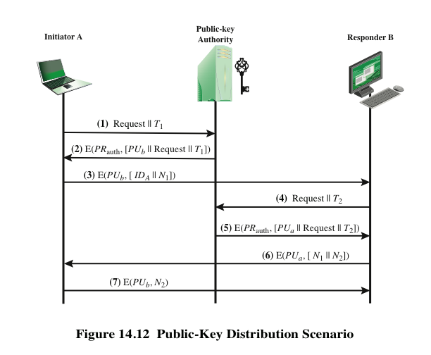
Public-Key Authority
Fig. 14.12: Distributing Public Keys
Request : ID_{B}
What is every step doing and why are different things included. How would BG attack if we left out:
T1 in 1,2 T2 in 4,5
Request in 2,5
Not signed by auth in 2
N1 in 3,6 N2 in 6,7
Drawback: authority bottleneck – have to go to authority for every user whose public key you need.
Drawback: authority might be vulnerable to attack
Notes:
10

Slide 21
Public-Key Certificates
Problem with Public-Key Authority protocol is that have go to Authority every time we want to talk to somebody. Alternative ?
certificate created by CA
Contain public key and other info : Eg: period of validity
Given to user along with private key
  Signed by CA
  Can be given by one user to another
  Can be verified by anyone who knows CA’s public-key
If trust CA will believe in security of a key signed by CA
Eg of CA: Symantec
Will study X.509 certificates
Notes:
CS 634/534 Cryptography
16 Spring, Week 6
7

Slide 22
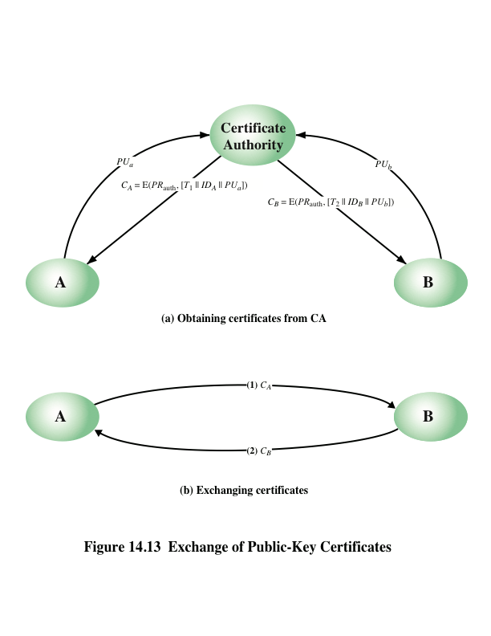
Fig. 14.13: Public-Key Certificates
How do the timestamps help ?
Prevents BG from using old keys. Authentication ?
No : In Round (1) BG could send C_{A} to B

Slide 23
Key Distribution using Secret-Key Crypto
Many users : want to communicate with each other securely
  How can secret keys be distributed?
A can select key and physically deliver to B
third party can select & deliver key to A & B
if A & B have communicated previously can use previous key to encrypt a new key
if A & B have secure communications with a third party C, C can relay key between A & B
Notes:
CS 634/534 Cryptography
16 Spring, Week 6
7

Slide 24
Master key/session keys
Why have 2 keys ?
Session key:
  Data encrypted with a one-time session key.
  At conclusion of session, key destroyed i.e. not reused
Master key:
  Used between entities for distributing session keys
  Changed infrequently. Why is this OK ?
session key (not msg) encrypted with master key
  Not much ciphertext for BG to work with
  Not in English; less structure for BG
How many master keys needed ?
Notes:
CS 634/534 Cryptography
16 Spring, Week 6
10

Slide 25
Using secret-key Encryption to exchange session keys
Basic idea
  Want to securely distribute a new session key for communications between A & B
  can use a two-level hierarchy of keys
trusted Key Distribution Center (KDC)
  A, KDC share master key
  B, KDC share master key
KDC generates session keys used between A,B
What are master keys used for ?
master keys used to distribute session keys
Notes:
CS 634/534 Cryptography
16 Spring, Week 6
7

Slide 26
Authentication Protocols
A,B need to convince each other of who they are (2-way authentication) and to exchange session keys
  Eg: user (client) and file server
  Client needs to convince file server of identity
  File server needs to convince client of its identity
    Client does not get sent files from fake server
Or 1-way authentication might be enough
Need to exchange session keys
  So files can be sent in an encrypted fashion
Can be done with secret-key or public-key
Notes:
CS 634/534 Cryptography
16 Spring, Week 6
7

Slide 27
Preventing Replay attacks
How to stop replay attacks ?
Timestamps or challenge/response (nonces)
Timestamps
  A puts timestamp T
  B accepts only if T within some window
  What is needed in order for this to work ?
Clocks need to be synchronized
  May be difficult in distributed environment
If not synchronized ?
If not synchronized, subject to replay attacks
Notes:
CS 634/534 Cryptography
16 Spring, Week 6
7

Slide 28
Preventing Replay attacks
Challenge Response: have a handshake
  A sends nonce N to B
  B encrypts N with key and returns E_{K}(N)
  A decrypts E_{K}(N) and compares with N
    accepts that it is B on the other end. Why ?
Because he knew the key
Can BG do replay attack : resend E_{K}(N) ?
No: nonces diff. each time.
Possible problems?
Require extra rounds of communication
  Will this work in email ?
Notes:
CS 634/534 Cryptography
16 Spring, Week 6
7

Slide 29
Needham-Schroeder Secret-Key Distribution
Needham-Schroeder
  original third-party key distribution protocol
  Some improvements (we will study)
  Kerberos uses similar scheme
    We will study in detail
Notes:
CS 634/534 Cryptography
16 Spring, Week 6
7

Slide 30
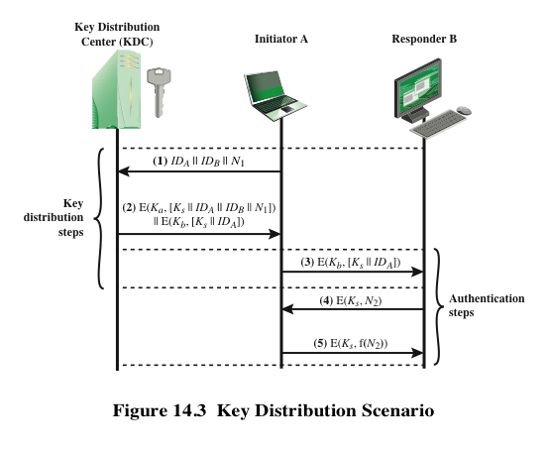
Needham-Schroeder Secret-Key Distribution Figure 14.3
K_{a} is master key shared between A and KDC
K_{b} is master key shared between B and KDC
f(n) is a simple function Eg: f(n) = n +1
What is every step doing and why are different things included.
Two way authentication ?
Notes:
CS 634/534 Cryptography
16 Spring, Week 6
Stallings Fig 7.9.
Based on concept of having a “Key Distribution Center” (KDC) which shares a unique key with each party (user).
See text for details of steps in distribution process.

Slide 31
Needham-Schroeder Protocol
protocol overview is:
  1. A→KDC: ID_{A} || ID_{B} || N₁
  2. KDC→A: E_{Ka}[Ks || ID_{B} || N₁ || E_{Kb}[Ks||ID_{A}] ]
  3. A→B: E_{Kb}[Ks||ID_{A}]
  4. B→A: E_{Ks}[N₂]
  5. A→B: E_{Ks}[f(N₂)]
Is vulnerable to a replay attack if an old session key has been compromised
  BG can resend (3) : convince B that he is A
Notes:
CS 634/534 Cryptography
16 Spring, Week 6
7

Slide 32
Denning [82] Protocol
To address this with timestamps (Denning 82):
    bottom page 455
protocol overview is:
  1. A→KDC: ID_{A} || ID_{B}
  2. KDC→A: E_{Ka}[Ks || ID_{B} || T || E_{Kb}[Ks ||ID_{A} ||T] ]
  3. A→B: E_{Kb}[Ks ||ID_{A} ||T]
  4. B→A: E_{Ks}[N₁]
  5. A→B: E_{Ks}[f(N₁)]
  What is the role of timestamp T ?
Tells A, B that this is a fresh exchange
  Not a replay
  Requires synchronized clocks
Notes:
CS 634/534 Cryptography
16 Spring, Week 6
7

Slide 33
Public-Key Distribution of Secret Keys
Suppose public-keys have been distributed
Now want to distribute secret (session) keys
  Want both confidentiality and authentication
  How to do ?

Slide 34
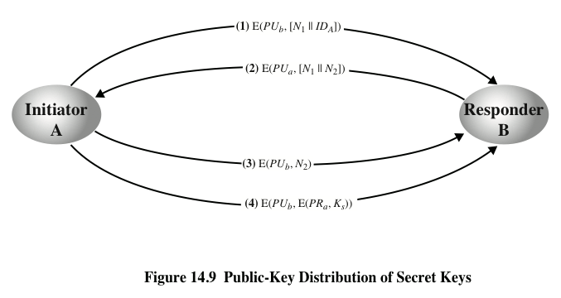
Public-Key Dist. of Secret Keys. Fig. 14.9
Assumes public-keys have been securely exchanged
Why N₁ in rounds (1), (2) ?
Why N₂ in rounds (2), (3) ?
Could BG re-send an old session key ?
Prevents replays, does 2-way authentication
Encrypting first, signing later : possible attack, maybe see later
Notes:
CS 634/534 Cryptography
16 Spring, Week 6

Slide 35
Authentication + Session Key Exchange with Public-Key Crypto
Now assume that public keys not distributed
With timestamps [Denning 81] : top page 476
  AS: authentication server
  1. A→AS: ID_{A} || ID_{B}
  2. AS→A: E_{KRAS}[ID_{A}||KU_{A}||T] || E_{KRAS}[ID_{B}||KU_{B}||T]
  3. A→B: E_{KRAS} [ID_{A}||KU_{A}||T] || E_{KRAS} [ID_{B}||KU_{B}||T] || E_{KUB}[E_{KRA} [K_{s}||T]]
  Session key chosen by A
Notes:
CS 634/534 Cryptography
16 Spring, Week 6
7

Slide 36
Authentication + Session Key Exchange with Public-Key Crypto
Why is it called AS and not KDC ?
Because not generating K_{s}
  Who generates K_{s}?
A. Why is KU_{B} being sent to B ?
Authentication steps not shown in protocol, but can happen because A, B have now exchanged K_{s}
Different method with nonces [Woo92a]
  middle page 476
Notes:
CS 634/534 Cryptography
16 Spring, Week 6
7

Slide 37
Woo 92a Method with Nonces
Different method with nonces [Woo92a]
  middle page 476
  1. A→KDC: ID_{A} || ID_{B}
  2. KDC →A: E_{KRAUTH}[ID_{B}||KU_{B}] ||
  3. A→B: E_{KUB} [N_{A} ||ID_{A} ]
  4. B→KDC: ID_{A} || ID_{B} || E_{KUAUTH}[N_{A}] ]
  5. KDC →B: E_{KRAUTH}[ID_{A}||KU_{A}] E_{KUB} [E_{KRAUTH}[N_{A}||K_{S} || ID_{B}] ]
  6. B →A: E_{KUA}[E_{KRAUTH}[N_{A}||K_{S} || ID_{B}] || N_{B} ]
  7. A →B: E_{KS}[N_{B} ]
More rounds, but no clock synchonization
Notes:
CS 634/534 Cryptography
16 Spring, Week 6
7

