Slide 1

KERBEROS
In Greek mythology, a many headed dog, the guardian of the entrance of Hades
Notes:
CS 634/534 Cryptography
16 Spring, Week 7

Slide 2
KERBEROS: introduction
Kerberos is used to
  To authenticate users in a network
  To maintain the integrity and privacy of network communications
Freely available, open-source protocol
  developed at MIT
Used in Unix, Windows, Apple's Mac OS X
Subject to US export controls
Notes:
CS 634/534 Cryptography
16 Spring, Week 7
7

Slide 3
What problem is Kerberos solving
Distributed system:
  Servers on the network (eg: file server, email server, web server)
  Users log on to work stations on the network and access these servers
We want to restrict access to authorized users
Three threats exist:
  User pretend to be another user.
  User alter the network address of a workstation.
  User eavesdrop on exchanges and use a replay attack.
Notes:
CS 634/534 Cryptography
16 Spring, Week 7
7

Slide 4
Kerberos assumptions
BG intercepts all transactions
One single computer is secure
  Called a trusted server or Kerberos server
  Perhaps in a locked room with 24-hour guard
This secure server contains all the password information and access privileges for every user
All computers and users trust secure server
  Every thing else on network is untrustworthy
  Keep it simple: keep one server truly secure
Notes:
CS 634/534 Cryptography
16 Spring, Week 7
7

Slide 5
Kerberos assumptions
Authentication should not rely on
Authentication performed by the workstation OS
Only on the host address (eg: IP address)
  This can be used, but should not depend solely on this
Physical security of computers
Security of transmission
Notes:
CS 634/534 Cryptography
16 Spring, Week 7
7

Slide 6
Kerberos Model
Centralized Authentication Server (AS) keeps a database of clients and servers and their secret keys
  For human users secret key is encrypted password
AS knows secret key of all entities and is trusted by all entities , can convince one entity of another entity’s identity
Kerberos also creates a session key which can be used if client-server communication is to be kept confidential
Notes:
CS 634/534 Cryptography
16 Spring, Week 7
7

Slide 7
Kerberos General Description
Kerberos sits on the network as a trusted arbitraror
Does all authentication at centralized AS
  Instead of building complex authentication protocols at every server
What is a client ?
  We will use client to refer to both users and workstations
  Can disambiguate from context
  We will try to use user/workstation for clarity
Notes:
CS 634/534 Cryptography
16 Spring, Week 7
7

Slide 8
Kerberos General Description
Uses secret-key encryption
  Optionally uses public-key encryption in some parts
    We will not study
Implemented using an authentication protocol based on Needham-Schroeder
Two versions: version 4 and 5
  We study v4 in detail and briefly discuss differences
Notes:
CS 634/534 Cryptography
16 Spring, Week 7
7

Slide 9
KERBEROS: 3 protocols
We take Stallings approach
  Protocol is complex
  Difficult to understand all at once
We look at 3 protocols
  Last one is the real one
First two are not real
  Are simpler than the real one
  They have weaknesses. Then why look at these?
Once we understand weaknesses, we can see why the real one works the way it does
Notes:
CS 634/534 Cryptography
16 Spring, Week 7
7

Slide 10
Kerberos terminology
C = Client
AS = authentication server
V = server
IDc = id of user on C (user id, not workstation id)
IDv = id of V
P_{c} = password of user on C
ADc = network address of C
Kv = secret encryption key shared by AS and V
TS = timestamp
|| = concatenation
Notes:
CS 634/534 Cryptography
16 Spring, Week 7
10

Slide 11
1st fake protocol Simple Auth. Dialogue [S pg 460]
C  AS: IDc || P_{c} || IDv
AS  C: Ticket
  Ticket = E_{Kv}[IDc || AD_{c} || IDv]
C  V: IDc || Ticket
One authentication server AS.
  AS know passwords of all users
  AS shares unique secret key with each server
User logs on to workstation and requests access to server V
AS checks : does user have privileges for V and is password OK
Notes:
CS 634/534 Cryptography
16 Spring, Week 7
7

Slide 12
1st fake protocol Simple Auth. Dialogue [S pg 460]
If OK gives Ticket to user. What will V do when gets Ticket from C?
Will check IDc to see that for correct C. Ad_{c} ?
Prevent BG from capturing (2), logging in from another workstation and sending (3)
  Can try to forge network address, but making life more difficult
Why E_{Kv} ? This is secret key shared AS,V
So BG can’t modify along the way
Why IDv ?
So V has something to check against.
Notes:
CS 634/534 Cryptography
16 Spring, Week 7
7

Slide 13
Problems with 1st fake protocol Simple Authentication Dialogue and Solutions
Password sent in clear. What is wrong?
If BG captures password … Solution ?
Have a key derived from password
  C can only decrypt messages if know key
Have to go back every time we want service from a different server
  Got ticket for file server
  Now want service from a database server
  File server ticket does not work for database server , have to get a different ticket
  Have to enter password every time. Solution ?
Notes:
CS 634/534 Cryptography
16 Spring, Week 7
7

Slide 14
Problems with 1st fake protocol Simple Authentication Dialogue and Solutions
Separate authentication from ticket granting
Have an Authentication Server (AS)
  users initially negotiate with AS to identify self
  AS provides a non-corruptible authentication credential (ticket granting ticket TGT)
  All AS is doing now is checking C is indeed C
  How is this check being performed
By doing encryption with key derived from password. Advantage ?
Password not transmitted
Users enter password once per login session
Notes:
CS 634/534 Cryptography
16 Spring, Week 7
7

Slide 15
Problems with 1st fake protocol Simple Authentication Dialogue and Solutions
Have a Ticket Granting Server (TGS)
  users subsequently request access to other services from TGS on basis of user’s TGT
  TGS know users have privileges to which servers
Can Ticket be reused later ?
Convenient (don’t have to keep on going back for Ticket) but potential concern. What ?
Worry is that B captures ticket and gets on to the same workstation later. Solution ?
Timestamps, lifetime
Notes:
CS 634/534 Cryptography
16 Spring, Week 7
7

Slide 16
Kerberos notes by Jeff Blaine
Next few animated slides are from Jeff Blaine’s notes:
http://www.kickflop.net/archive/jblaine_Kerberos_for_Users.ppt
Notes:
CS 634/534 Cryptography
16 Spring, Week 7
10

Slide 17
XYZ Service
Key
Distribution
Center
Ticket
Granting
Service
Think “Kerberos Server” and don’t let yourself get mired in terminology.
Authen-
Tication
Service
Susan’s
Desktop
Computer
Susan
Notes:
CS 634/534 Cryptography
16 Spring, Week 7

Slide 18
XYZ Service
Key
Distribution
Center
Ticket
Granting
Service
Represents something requiring Kerberos authentication (web server, ftp server, ssh server, etc…)
Authen-
Tication
Service
Susan’s
Desktop
Computer
Susan
Notes:
CS 634/534 Cryptography
16 Spring, Week 7

Slide 19
XYZ Service
Key
Distribution
Center
Ticket
Granting
Service
“I’d like to be allowed to get tickets from the Ticket Granting Server, please.
Authen-
Tication
Service
Susan’s
Desktop
Computer
Susan
Notes:
CS 634/534 Cryptography
16 Spring, Week 7

Slide 20

XYZ Service
Key
Distribution
Center
Ticket
Granting
Service
“Okay. I locked this box with your secret password. If you can unlock it, you can use its contents to access my Ticket Granting Service.”
Authen-
Tication
Service
Susan’s
Desktop
Computer
Susan
Notes:
CS 634/534 Cryptography
16 Spring, Week 7

Slide 21

XYZ Service
Key
Distribution
Center
Ticket
Granting
Service
Authen-
Tication
Service
Susan’s
Desktop
Computer
TGT
myPassword
Susan
Notes:
CS 634/534 Cryptography
16 Spring, Week 7

Slide 22
Because Susan was able to open the box (decrypt a message) from the Authentication Service, she is now the owner of a shiny “Ticket-Granting Ticket”.
The Ticket-Granting Ticket (TGT) must be presented to the Ticket Granting Service in order to acquire “service tickets” for use with services requiring Kerberos authentication.
The TGT contains no password information.
TGT
Notes:
CS 634/534 Cryptography
16 Spring, Week 7

Slide 23
XYZ Service
“Let me prove I am Susan to XYZ Service.
Here’s a copy of my TGT!”
Key
Distribution
Center
Ticket
Granting
Service
Authen-
Tication
Service
TGT
TGT
Susan’s
Desktop
Computer
use XYZ
Susan
Notes:
CS 634/534 Cryptography
16 Spring, Week 7

Slide 24
XYZ Service
Hey XYZ:
Susan is Susan.
CONFIRMED: TGS
Key
Distribution
Center
Ticket
Granting
Service
You’re Susan.
Here, take this.
Authen-
Tication
Service
TGT
Susan’s
Desktop
Computer
Susan
Notes:
CS 634/534 Cryptography
16 Spring, Week 7

Slide 25
XYZ Service
Key
Distribution
Center
Ticket
Granting
Service
I’m Susan. I’ll prove it. Here’s a copy of my legit service ticket for XYZ.
Authen-
Tication
Service
Hey XYZ:
Susan is Susan.
CONFIRMED: TGS
Hey XYZ:
Susan is Susan.
CONFIRMED: TGS
TGT
Susan’s
Desktop
Computer
Susan
Notes:
CS 634/534 Cryptography
16 Spring, Week 7

Slide 26
XYZ Service
That’s Susan alright. Let me determine if she is authorized to use me.
Key
Distribution
Center
Ticket
Granting
Service
Hey XYZ:
Susan is Susan.
CONFIRMED: TGS
Authen-
Tication
Service
Hey XYZ:
Susan is Susan.
CONFIRMED: TGS
TGT
Susan’s
Desktop
Computer
Susan
Notes:
CS 634/534 Cryptography
16 Spring, Week 7

Slide 27
Authorization checks are performed by the XYZ service…
Just because Susan has authenticated herself does not inherently mean she is authorized to make use of the XYZ service.
Notes:
CS 634/534 Cryptography
16 Spring, Week 7

Slide 28
One remaining note:
Tickets (your TGT as well as service-specific tickets) have expiration dates configured by your local system administrator(s). An expired ticket is unusable.
Until a ticket’s expiration, it may be used repeatedly.
Notes:
CS 634/534 Cryptography
16 Spring, Week 7

Slide 29
XYZ Service
Key
Distribution
Center
Ticket
Granting
Service
ME AGAIN! I’ll prove it. Here’s another copy of my legit service ticket for XYZ.
Authen-
Tication
Service
Hey XYZ:
Susan is Susan.
CONFIRMED: TGS
Hey XYZ:
Susan is Susan.
CONFIRMED: TGS
TGT
Susan’s
Desktop
Computer
use XYZ
Susan
Notes:
CS 634/534 Cryptography
16 Spring, Week 7

Slide 30
XYZ Service
That’s Susan… again. Let me determine if she is authorized to use me.
Key
Distribution
Center
Ticket
Granting
Service
Hey XYZ:
Susan is Susan.
CONFIRMED: TGS
Authen-
Tication
Service
Hey XYZ:
Susan is Susan.
CONFIRMED: TGS
TGT
Susan’s
Desktop
Computer
Susan
Notes:
CS 634/534 Cryptography
16 Spring, Week 7

Slide 31
Kerberos 4 Different Steps: real protocol. 2ND Fake protocol has no step 6
AS
(authentication
server)
TGS
(ticket-
granting
server)
1
2
3
4
C
(client)
S
(server)
5
6
Notes:
CS 634/534 Cryptography
16 Spring, Week 7

Slide 32
2nd fake protocol [S pg 462]
Once per user logon session:
  (1) C  AS: ID_{c} || ID_{tgs}
  (2) AS  C: E (K_{c} ,Tickettgs)
  Tickettgs = E(Ktgs[ID_{c}, AD_{c}, ID_{tgs}, TS₁ , Lifetime₁])
Once per type of service:
  (3) C  TGS: ID_{c} || ID_{v} || Tickettgs
  (4) TGS  C: Ticketv
  Ticketv = E(Kv[ID_{c}, AD_{c}, ID_{v}, TS₂ , Lifetime₂ ])
Once per service session:
  (5) C  V: ID_{c} || Ticketv
Notes:
CS 634/534 Cryptography
16 Spring, Week 7
7

Slide 33
2nd fake protocol fixed problems?
Password sent in clear ?
Have to enter password and go back to AS every time we want service from a different server ?
Re-usable Tickets ?
BG captures ticket and gets on to the same workstation later ?
Notes:
CS 634/534 Cryptography
16 Spring, Week 7
7

Slide 34
Problems :2nd fake protocol
If Lifetime₁ too short ?
Have to go back for tickets too often
  i.e. have to enter password often
If Lifetime₁ too long ?
Replay attacks:
  BG captures ticket
  waits for A to logout
  does login on same workstation
  is able to re-use the same ticket
  similar issues for Lifetime₂
BG poses as V to C, gets wrong files to C.
Notes:
CS 634/534 Cryptography
16 Spring, Week 7
7

Slide 35
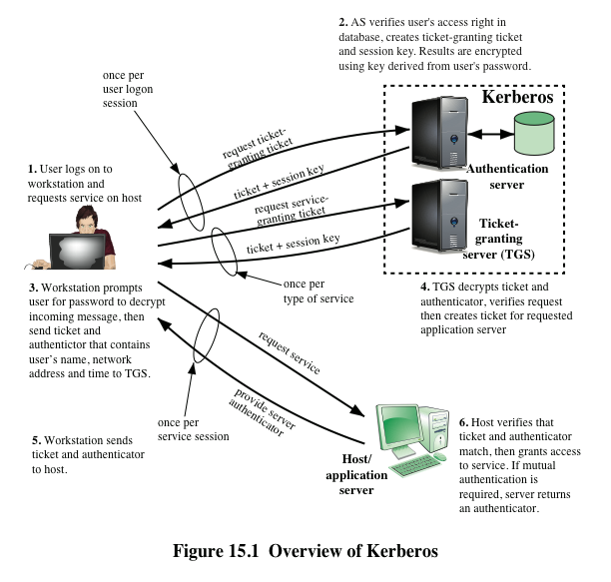
Kerberos 4 Overview
Fig 15.1

Slide 36
Real Protocol Version 4 Table 15.1
Auth. Service Exchange: To Get Ticket-Granting Ticket
  (1) C  AS: ID_{c} || ID_{tgs} || TS₁
  (2) AS  C: E(K_{c}, [K_{c,tgs}|| IDtgs || TS₂ || Lifetime₂ || Tickettgs])
  Tickettgs = E(K_{tgs}, [K_{c,tgs}, ID_{c}, AD_{c}, ID_{tgs}, TS₂ , Lifetime₂])
Ticket-Granting Service Echange: To Get Service-Granting Ticket
  (3) C  TGS: ID_{v} || Tickettgs || Authenticatorc
  (4) TGS  C: E(K_{c,tgs}, [K_{c,v}|| IDv || TS₄ || Ticketv])
  Ticketv = E(Kv, [K_{c,v}, ID_{c}, AD_{c}, ID_{v}, TS₄ , Lifetime₄ ])
  Authenticatorc = E(K_{c,tgs}, [ID_{c}, AD_{c}, ID_{v}, TS₃])
Client/Server Auth. Exchange: To Get Service
  (5) C  V: Ticketv || Authenticatorc
  (6) V  C: E(K_{c,v}, [TS₅ + 1]) (for mutual authentication)
  Authenticatorc = E(K_{c,v}, [ID_{c}, AD_{c}, TS₅])
Notes:
CS 634/534 Cryptography
16 Spring, Week 7
7

Slide 37
Kerberos Version 4: keys
What will be short-term and what will be long-term: K_{c} ? K_{c,tgs} ? K_{tgs} ? K_{c,v} ? K_{v} ?
K_{c} long term since derived from password
  Stored on workstation only for a short time
  Minimizes risk of it being exposed
K_{c,tgs} short term key generated by AS
K_{tgs} long term: shared between AS and TGS
K_{c,v} short term secret key generated by TGS
K_{v} long term: shared between TGS and V
Client interactions with TGS and servers
  use keys/tickets with fixed lifetimes.
Notes:
CS 634/534 Cryptography
16 Spring, Week 7
7

Slide 38
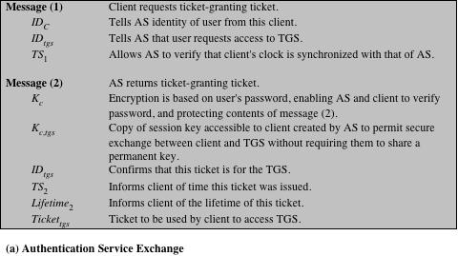
Kerberos Table 15.2: notation/details
Notes:
Table 15.2
summarizes the justification for each of the elements in the Kerberos protocol.
Page 1 – authentication service exchange

Slide 39
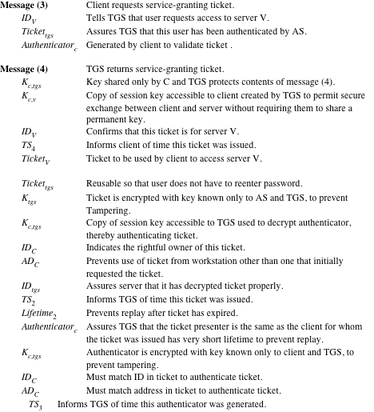
Notes:
Page 2 – ticket-granting service exchange

Slide 40
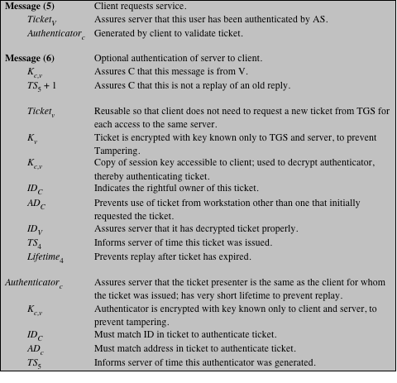
(page 3 of 3)
Notes:
Page 3 – client/server authentication exchange

Slide 41
Kerberos v4: Lifetime
Lifetime₂ : should be short or long ?
Lifetime₂ : default is 10 hours.
  User enters password
  Will get Tickettgs
  Will be good for Lifetime₂
    Will not have to enter password till expires
  Workstation does not have to remember K_{c}
Notes:
CS 634/534 Cryptography
16 Spring, Week 7
7

Slide 42
Kerberos v4: Authenticator
Authenticator takes care of the problem that
  if Tickettgs or Ticketv valid for short time, will have to keep on going back for tickets too often
  if valid for long time, replay attacks
In v4 Authenticator only valid for 5 minutes
  But Tickettgs or Ticketv valid for long time
  How does this help ? Can BG do a replay attack ?
BG can’t do a replay attack with expired Authenticator. What about legitimate client C ?
Has to generate a new Authenticator. Problem ?
No: C can do by itself, doesn’t need to go to AS
Notes:
CS 634/534 Cryptography
16 Spring, Week 7
7

Slide 43
Kerberos v4 vs v5
V4: DES.
  V5: lets you specify which secret key algorithm, including 3DES, AES
V4: non-standard mode, weaknesses discovered
  V5: CBC
V4: does not use salt , V5: uses salt
    Stops off-line dictionary attacks
Many other differences also
  we will not study, [S] covers
  Renewable tickets, forwardable tickets, user to user authentication ...
Notes:
CS 634/534 Cryptography
16 Spring, Week 7
7

