Slide 1
Using Passwords
When user wants service, types in password
  Password compared to stored password
  Any vulnerabilities here?
If BG gains access to the password list
  Can impersonate any user. To prevent ?
Passwords stored encrypted (or hashed) password (system doesn’t even know password)
  As user logs in, enters password P
  P then encrypted
  compared to stored, encrypted password
If BG sees encrypted/hashed password E_{K}(P)?
Can’t enter E_{K}(P) : needs P
Notes:
CS 634/534 Cryptography
16 Spring, Week 8
7

Slide 2
UNIX password checking
Password converted into DES secret key
  Pack 7-bit ASCII of first 8 char into 56-bit key and then add 8 bits of parity
  Passwords can be longer than 8 char, but everything after 8 char is ignored
Use this key with modified DES to encrypt “0”
  This is what is stored in Password file
When a user enters a password ?
Do same and compare to stored value
Passwords recoverable by system administrator?
No : new password has to be created

Slide 3
Offline Dictionary Attacks
Why modified DES ?
  To stop Offline dictionary attacks
Most users will choose simple variants of standard strings, (e.g. birthday, city names, spouse name, famous dates)
If BG can access entire encrypted password list
  Will hash all commonly used passwords (from “dictionary”) till find one that matches
  Is simultaneously attacking all passwords
To stop, use “salt”
Also, don’t make password file public

Slide 4
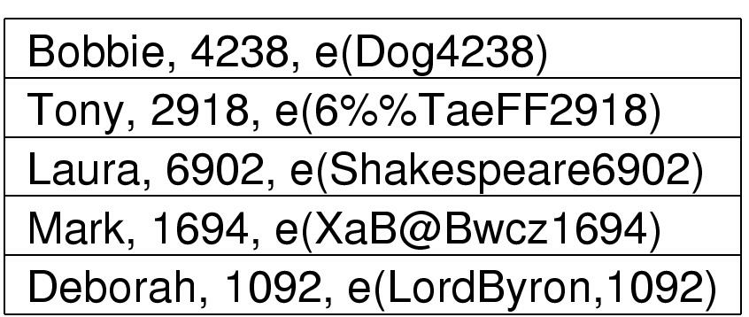
Password Salt [TAN] Fig. 9.6
,
,
,
,
Salt
Password
Notes:
CSCI 6634/4534 Cryptography
16 Spring, Week 8

Slide 5
UNIX Password Salt
12-bit random number stored with password
Salt determines how 32 bits are expanded into 48 bits in DES
  Which bits are duplicated
  How does this help ?
BG can’t just hash all common passwords
  Has to incorporate different salts
  Can only target one password at a time
  Salt makes offline dictionary attack much harder
Also, BG can’t use standard DES hardware
Notes:
CS 634/534 Cryptography
16 Spring, Week 8
7

Slide 6
Message Authentication
message authentication is concerned with ?
protecting the integrity of a message
validating identity of originator
To also get Digital Signatures ?
If also have non-repudiation then Digital Signatures
Notes:
CS 634/534 Cryptography
15 Spring, Week 7
7

Slide 7
Message Authentication with Secret-Key Encryption
A calculates C = E_{K}(M) and sends M,C to B
B checks is D_{K}(C) = M ?
  Provides authentication ?
Yes. Problem ?
No confidentiality. How to fix ?
Send only C. Provides confidentiality.
  Problem ?
No authentication
  How to know D_{K}(C) is real message or not ?
How to fix ?
Notes:
CS 634/534 Cryptography
15 Spring, Week 7
7

Slide 8
Message Authentication with Secret-Key Encryption
Add some structure to message which will let B figure out whether real message or not.
Error-detecting codes, error-correcting codes
Eg: parity, majority
Notes:
CS 634/534 Cryptography
15 Spring, Week 7
7

Slide 9
Message Authentication Code(MAC)
In this context also known as Checksum/Frame Check Sequence FCS.
  create a small fixed-sized block
  depending on both message and some key
1st way: A calculates MAC = E_{K}(FCS(M))
  A to B: M, MAC
  What will B do ?
B checks if D_{K}(MAC) = FCS(M) ?
MAC appended to message
  similar to a signature
  MAC is not a digital signature. Why not ?
Suppose want confidentiality also ?
Notes:
CS 634/534 Cryptography
15 Spring, Week 7
7

Slide 10
MAC
can also use encryption for secrecy
2nd way: use separate keys for each
  A calculates MAC = E_{K2}(FCS(M)
  A to B: E_{K1}(M), MAC
3rd way:
  A to B: E_{K}(M,FCS(M))
Advantage of 1st way (the one using MAC) ?
sometimes only authentication is needed
  A to B: M, MAC
sometimes need authentication to persist longer than the encryption (eg. archival use)
Notes:
CS 634/534 Cryptography
15 Spring, Week 7
7

Slide 11
Hash Functions
H maps arbitrary size messages to fixed size
H is public and does not have a key
  As opposed to MAC which has a key
Eg of simple hash function : XOR
  Split message into b-bit blocks
  XOR the blocks together
  Eg: b=4 M=011010100111
  H(M) = 0110 ⊕ 1010 ⊕ 0111 = 1011
Is this a good (i.e. secure) hash function ?
Will look at later
Notes:
CS 634/534 Cryptography
15 Spring, Week 7
7

Slide 12
MACs via Keyed Hash Functions
Would like to create a MAC using a hash function rather than a block cipher. Why ?
Hash functions faster
Not limited by export controls
Have a hash but incorporate a key
  How to do this ?
Notes:
CS 634/534 Cryptography
15 Spring, Week 7
7

Slide 13
MACs via Keyed Hash Functions
Incorporating a key with hasing to get a MAC
  MAC = E_{K}(H(M))
A to B: M, E_{K}(H(M)). What will B do ?
B checks if D_{K}( 2nd part ) =H(1st part ) ?
  H( ) is acting like a checksum
Alternatives
  A to B: E_{K1} (M) , E_{K2}(H(M)).
  A to B: E_{K}(M, H(M))
Will look at HMAC in more detail later
Notes:
CS 634/534 Cryptography
15 Spring, Week 7
7

Slide 14
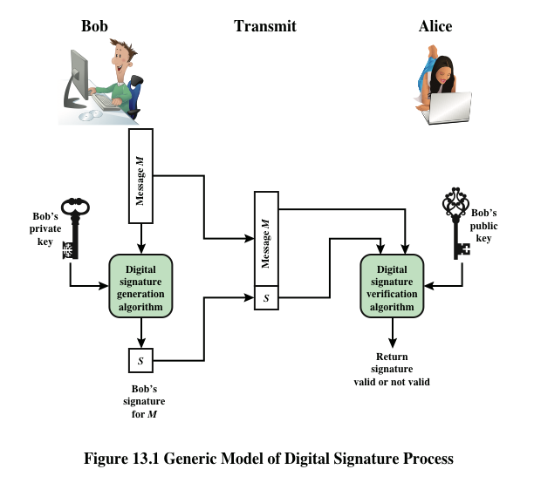
Digital Signatures without Hashing

Slide 15
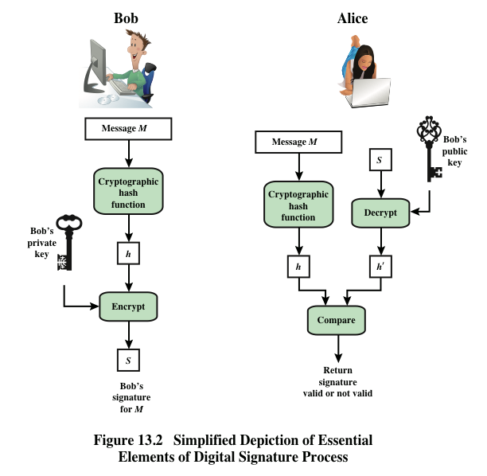
Digital Signatures with Hashing
Advantage compared to M, E_{KR} (M) ?
Faster

Slide 16
Message Fingerprinting: Hashing application
There is some small tamper proof storage and another separate large storage which is not so safe i.e. not tamper proof
Have a large file we need to store
  Want to make sure not modified. Eg: by virus
  How to do ?
Keep hash (file) in tamper proof storage
Before using the file, check hash value
Notes:
CS 634/534 Cryptography
15 Spring, Week 7
7

Slide 17
Requirements for Hash Functions
can be applied to any sized message M
produces fixed-length output h=H(M)
easy (fast) to compute h=H(M) for any message M
given h is infeasible to find x s.t. H(x)=h
  one-way property
given x is infeasible to find y s.t. H(y)=H(x)
  weak collision resistance
is infeasible to find any x,y s.t. H(y)=H(x)
  strong collision resistance
Why are these properties desirable ?
What is the connection between these properties ?
Notes:
CS 634/534 Cryptography
15 Spring, Week 7
7

Slide 18
Size of Hash/Birthday Attacks
Why should hash functions have large output?
Brute force attack on 32-bit hash: analysis
64-bit hash: same type analysis. Looks better:
  Have to generate half of 2⁶⁴ to get collision
Birthday Paradox (might study later)
  64-bit hash: 2³² is enough to attack, don’t need 2⁶⁴
To break strong collision resistance property for a m-bit hash function i.e. to find a collision using birthday attack
  BG brute force needs only 2^{m/2} and not 2^{m}/2
  128-bit hash looks vulnerable, 160-bits better
Notes:
CS 634/534 Cryptography
15 Spring, Week 7
7

