Slide 1
Simple Hash Functions
Several proposals for simple functions
Eg: XOR we looked at earlier
  not secure
  look at an attack
Technique proposed by NBS
Need a stronger cryptographic function
Goals of a hash function
  Security
  Speed
  Simplicity
Notes:
CS 634/534 Cryptography
16 Spring, Week 9
7

Slide 2
Hash Functions
Similarities in evolution of hash functions & block ciphers
Increasing power of brute-force attacks led to evolution in algorithms
  from DES to AES in block ciphers
  from MD4 & MD5 to SHA-1 (then SHA-2 and SHA-3) & RIPEMD-160 in hash algorithms
Hash functions tend to use iterative structure
  as do block ciphers
General structure of a hash function
Notes:
CS 634/534 Cryptography
16 Spring, Week 9
7

Slide 3
MD5
designed by Ronald Rivest (the R in RSA)
  latest in a series of MD2, MD4
  produces a 128-bit hash value
based on the Merkle design (next slide)
until recently most widely used hash function
specified as Internet standard RFC1321
in recent times have both brute-force & cryptanalytic concerns
  now considered vulnerable
  SSL fake certificate attacks in 2008
  now SHA is recommended
Notes:
CS 634/534 Cryptography
16 Spring, Week 9
7

Slide 4
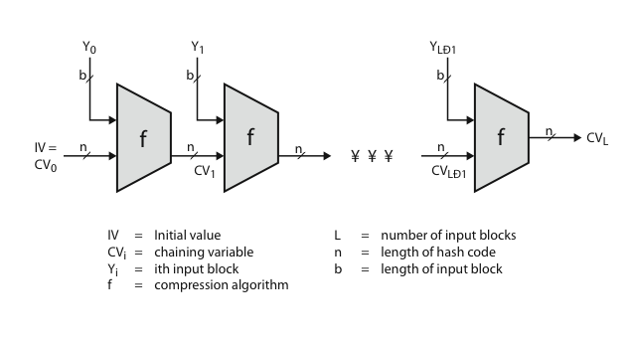
Merkle Design: General Structure of a Secure Hash Code
If compression function collision-resistant then so is iterated hash function
Notes:
CS 634/534 Cryptography
16 Spring, Week 9
10

Slide 5
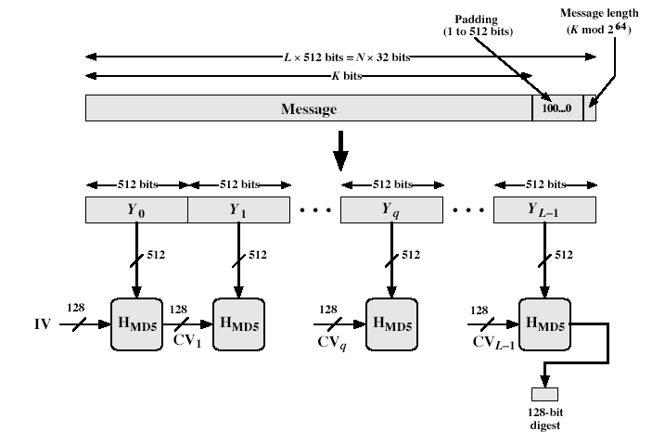
MD5 Overview
Notes:
CS 634/534 Cryptography
16 Spring, Week 9
Stallings Fig 12.1

Slide 6
MD5 Overview
pad message so its length is 448 mod 512
append a 64-bit length value to message
initialise 4-word (128-bit) MD buffer (A,B,C,D)
process message in 16-word (512-bit) blocks:
  using 4 rounds of 16 bit operations on message block & buffer
  Move output to buffer input to form new buffer
output hash value is the final buffer value
We skip compression fn, interesting point
  for “pseudorandom” bits uses sine function. Why ?
Notes:
CS 634/534 Cryptography
16 Spring, Week 9
7

Slide 7
Attacks on MD5
Berson 92 attacked round 1 (but can’t extend)
Boer & Bosselaers 93 found a pseudo collision
  unable to extend
Dobbertin 96 created collisions on MD compression fn (initial constants prevent exploit)
Wang, Feng, Lai, Yu 2004: collision on full MD5, but not preimage
  destroy strong collision resistance , not weak
Different extensions, Kilma 2006
  better algorithm found collision 1 minute on laptop
Recent results
Notes:
CS 634/534 Cryptography
16 Spring, Week 9
7

Slide 8
Secure Hash Algorithm (SHA-1)
SHA was designed by NIST & NSA in 1993, revised 1995 as SHA-1
US standard for use with DSA signature scheme
  standard is FIPS 180-1, also Internet RFC3174
  the algorithm is SHA, the standard is SHS
produces 160-bit hash values
based on design of MD4 with key differences
Notes:
CS 634/534 Cryptography
16 Spring, Week 9
7

Slide 9
SHA-1 vs MD5
brute force attack is harder (160 vs 128 bits for MD5)
5 rounds instead of 4
Extra transformation
a little slower than MD5
Widely used
SHA-1 also somewhat vulnerable to cryptanalytic attacks similar to those on MD5
  Attacks faster than brute force birthday attack
  Considered vulnerable, so shift to SHA-2
Notes:
CS 634/534 Cryptography
16 Spring, Week 9
7

Slide 10
SHA-2, SHA-3
2 main hash algorithms
  SHA-256, SHA-512
  Collectively known as SHA-2
Similar algorithm as SHA-1
  Have been theoretical attacks
  No practical attack
  NIST looked for new algorithm in 2008
  Winner announced in 2012
SHA-3 (based on hashing algorithm Keccak)
  Quite different from SHA-1 and SHA-2
Notes:
CS 634/534 Cryptography
16 Spring, Week 9
7

Slide 11
MACs via Keyed Hash Functions
Incorporating a key with a hash
  Original proposal:
  KeyedHash = Hash(Key|Message)
  some weaknesses were found with this
Eventually led to development of HMAC
Notes:
CS 634/534 Cryptography
16 Spring, Week 9
7

Slide 12
HMAC Design Objectives
Hash functions used as black boxes
  Advantages ?
Existing implementations of hash functions can be used
If more secure hash found, can replace
MAC should not be much slower than hash
Should be able to analyze security of MAC in terms of security of hash
  Would like to be able to argue that if hash is secure then MAC is secure
Notes:
CS 634/534 Cryptography
16 Spring, Week 9
7

Slide 13
HMAC
Specified as Internet standard FIPS PUB 198
  Used in SSL/TLS, IPsec
Uses hash function on message, with a key
Meets design criteria specified earlier, uses hash function as black box.
  Different hash function can be used
  SHA-1, SHA-2, RIPEMD-160
  SHA-3 still being looked at for HMAC
  Can use existing implementation
  If new improved hash function designed in future, can use that
Notes:
CS 634/534 Cryptography
16 Spring, Week 9
7

Slide 14
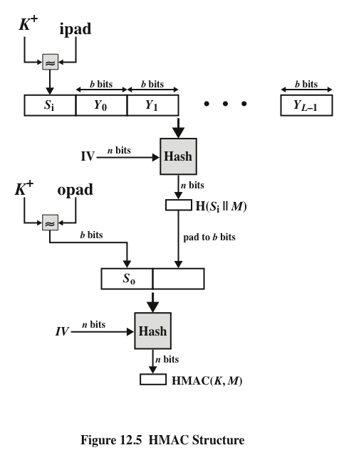
HMAC Overview
  HMAC_{K} = Hash[(K⁺ XOR opad) || Hash[(K⁺ XOR ipad)||M)]]
K⁺ is key padded up to b bits; opad, ipad are specified padding constants
  Opad = 01011100 repeated b/8 times, Ipad = 00110110 repeated b/8 times,
Notes:
CSCI 6634/4534 Cryptography
16 Spring, Week 9

Slide 15
HMAC Security
Can prove the security of HMAC relates to that of the underlying hash function
  Intuition: can’t break HMAC without breaking hash function
We know that hash functions are vulnerable to birthday attacks ?
  Is HMAC vulnerable to same type of attack ?
  When look at birthday attacks in detail later will see HMAC not vulnerable to birthday attacks in the same way as basic hash functions
Notes:
CS 634/534 Cryptography
16 Spring, Week 9
7

Slide 16
Digital Signature Properties
must depend on the message signed
must use information unique to sender
  to prevent both forgery and denial
must be relatively easy to produce
must be relatively easy to recognize & verify
be computationally infeasible to forge
  new message with new signature
  new message for existing signature
be practical to store digital signature
Notes:
CS 634/534 Cryptography
15 Spring, Week 8
CS 634/534 Cryptography
Winter 09, Week 8
7

Slide 17
Direct Digital Signatures
involves only sender & receiver
  No third party (Arbitrated Digital Signatures)
assumes receiver has sender’s public-key
digital signature made by sender
  signing entire message or hash with private-key
Notes:
CS 634/534 Cryptography
15 Spring, Week 8
CS 634/534 Cryptography
Winter 09, Week 8
7

Slide 18
NIST Digital Signature Standard (DSS)
uses the SHA hash algorithm
designed by NIST & NSA in early 90's
DSS is the standard, DSA is the algorithm
The latest version, FIPS 186-3, also incorporates digital signature algorithms based on RSA and on elliptic curve cryptography
a variant on ElGamal and Schnorr schemes
security depends on difficulty of computing discrete logarithms
Notes:
CS 634/534 Cryptography
15 Spring, Week 8
CS 634/534 Cryptography
Winter 09, Week 8
7

Slide 19
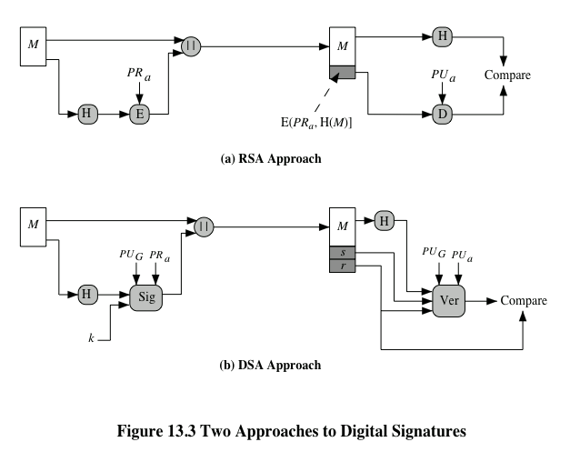
Fig 13.3 RSA vs DSA approach
Notes:
CS 634/534 Cryptography
15 Spring, Week 8
CS 634/534 Cryptography
Winter 09, Week 8
7

Slide 20
DSA Key Generation
Hand written sheet Eg
shared global public key values (p, q, g):
  choose p: a large prime
  choose q: a prime factor of p-1
  choose h: h<p-1, h^{(p-1)/q} (mod p) > 1
  compute g = h^{(p-1)/q} (mod p)
users choose private key & compute public key:
  choose private key x: x < q
  compute public key y: y = g^{x} (mod p)
Notes:
CS 634/534 Cryptography
15 Spring, Week 8
CS 634/534 Cryptography
Winter 09, Week 8
7

Slide 21
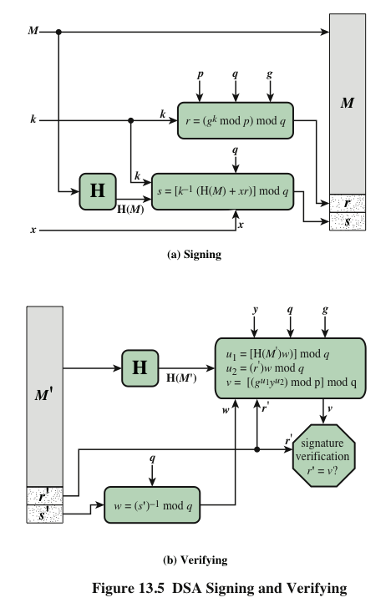
DSA Signature Creation
to sign a message M the sender:
  generates a random per message secret number k, k<q
  k must be random
  and never be reused
computes signature pair:
  r =(g^{k} mod p ) mod q
  s = (k⁻¹ [ H(M)+ x.r])mod q
  If r=0 or s=0, try diff. k
send (r,s) with M
Notes:
CS 634/534 Cryptography
15 Spring, Week 8
CS 634/534 Cryptography
Winter 09, Week 8
7

Slide 22
DSA Signature Verification
having received M &
signature (r,s)
to verify a signature, recipient
  computes:
  w = s⁻¹(mod q)
  u1=(H(M).w)(mod q), u2= (r.w)(mod q)
  v = (g^{u1}.y^{u2}(mod p)) (mod q)
if v=r then signature is verified
  Why does this work : book web site/we might study
BG forgery attempt: handwritten Eg
Why does k have to be kept secret: handwritten Eg
Notes:
CS 634/534 Cryptography
15 Spring, Week 8
CS 634/534 Cryptography
Winter 09, Week 8
7

Slide 23
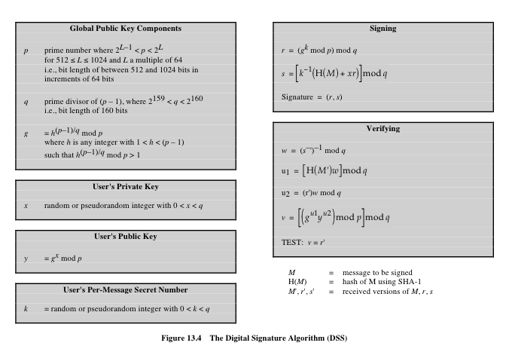
Fig 13.4 DSA
Notes:
CS 634/534 Cryptography
15 Spring, Week 8
CS 634/534 Cryptography
Winter 09, Week 8
7

Slide 24
DSA evolution
History + reaction
original size of p : 512 to 1024 bits
  Then changed to: 1024 bits
Later, NIST 800-57 recommends
  lengths of 2048 for keys with security lifetimes extending beyond 2010
  lengths of 3072 for keys with security lifetimes extending beyond 2030
  using correspondingly longer hashes and q.
Original DSS: SHA-1, now SHA-2 approved
  SHA-3 under consideration
Notes:
CS 634/534 Cryptography
15 Spring, Week 8
CS 634/534 Cryptography
Winter 09, Week 8
7

