Slide 1
Prediction of Soil Health Using Machine Learning and IoT

Slide 2
How we can use this :-
Prediction of soil health using Machine Leaning and IoT.
Once soil health is predicted. We can use it for sending notifications to farmers across regions.
Can provide automatic soil health updates and suggestions.
For fertilizers, irrigation and other advices.
This can be combined with land owners.

Slide 3
Architecture of Approaching the Problem
Data Collection
Sensory Data
Data pre-processing
Data cleaning
Data analysis
Applied ML Algorithms
Rainfall
Normalization
Testing and validation
Testing

Slide 4
Sensors Data used for Prediction:-
Nitrogen Level
Temperature
Rainfall
Potassium Level
Phosphorus Level
pH Level of Soil
Humidity

Slide 5
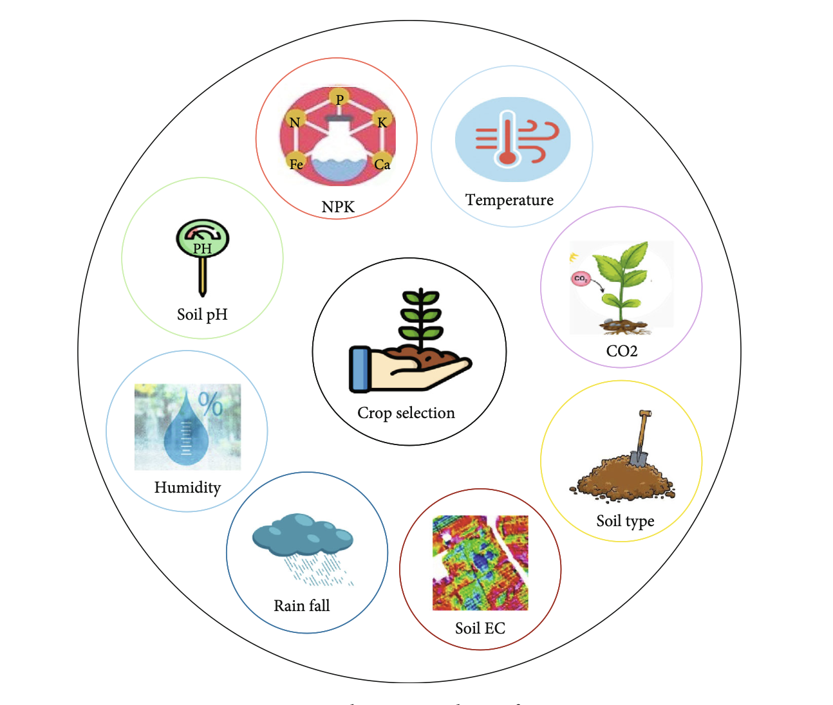
Essential Inputs :-
Soil health

Slide 6
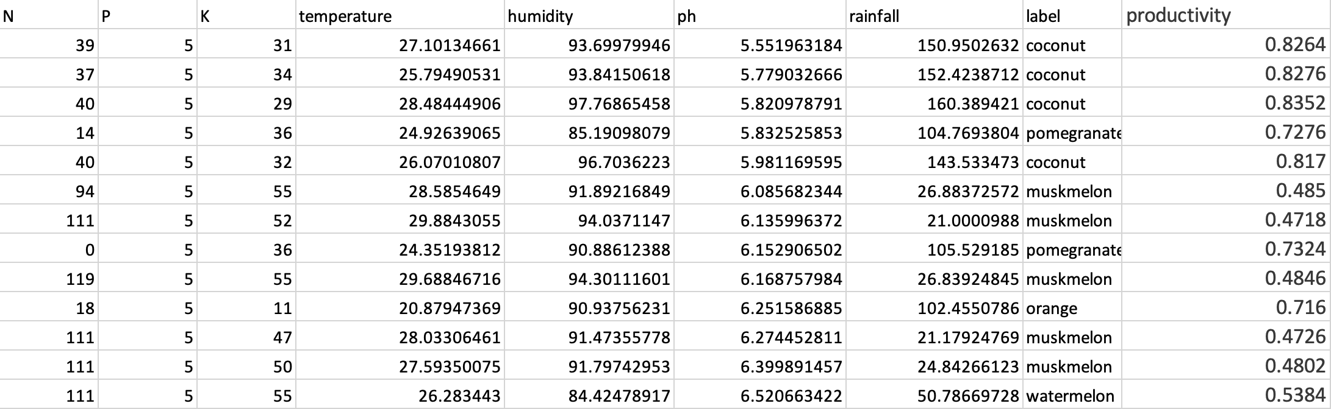
Dataset :-
This will be predicted
For 22 Different Crops
Input variables

Slide 7
Further Approaches :-
Creating an Interface/API for soil Health measuring.
Implementation on a large scale.
Accumulation of Data from different regions for more precise predictions i.e. increasing the dataset for training purpose.
Prediction of Yield of crop.

