Slide 1

Alarm Clock App using Flutter
RNS INSTITUTE OF TECHNOLOGY
BENGALURU - 98
DEPARTMENT OF INFORMATION SCIENCE & ENGINEERING
Presentation on Internship
HARSH GUPTA
USN: 1RN18IS049
ENMAZ Engineering Services Pvt. Ltd.
Internal Guide
Mrs. Vinutha G K
Assistant Prof, Dept of ISE, RNSIT
External Guide
Mr. Akshay D R
Co-Founder & CEO, Enmaz Engineering Services Pvt. Ltd., Bangalore

Slide 2
AGENDA
Abstract
About the Company
Introduction
Literature survey
Requirements
System Design
Implementation
Results
Testing
Conclusion and Future Enhancements
References
Q & A

Slide 3
ABSTRACT
The goal of this app is to enable us to set alarm in mobile phones.
We can set the alarm for any time and the alarm with remind us of our task.
It has an additional feature that shows an analog clock which tells us Indian time, day and date.

Slide 4
ABOUT THE COMPANY
Enmaz Engineering Pvt. Ltd is a Service based company founded in the year 2019.
It specializes in
Embedded H/W Development
Embedded Firmware Development
Cloud support
Big Data Analysis and Reporting
Dashboard UX/UI design and development
Model Analysis.

Slide 5
INTRODUCTION
Social media and other easily accessible online distractions makes it hard for us to stay focused on our tasks and make it difficult for us to do our work efficiently.
It is more important for us to get a reminder for our tasks and so we can use this app to get those reminders by setting up alarm.
It also helps us to do the most basic task of waking us up.
Such an app is helpful in coordinating our daily schedules. This app with impressive layout makes it easy for us to set alarm.
It also makes it easy for us to know the current time, day and date using the Analog Clock.

Slide 6
LITERATURE SURVEY
BEDRUNNER: AN INTELLIGENT RUNNING ALARM CLOCK by Lee Kien Ee, Norshuhani Zamin, Izzatdin Abdul Aziz, Nazleeni Samiha Haron, Mazlina Mehat and Norzatul Natrah Ismail(Department of Computer and Information Sciences, Universiti Teknologi Petronas, Malaysia).
Firstly, there is a problem of oversleeping which is a common problem which affects everyone. Oversleeping refers to an intentional or unintentional act of sleeping beyond one’s intended time for waking or intended time for getting up.
Alarm Clock can also be used to remind us to do our tasks at a particular time. This will help us to concentrate on our task.

Slide 7
REQUIREMENTS
Hardware Requirements
CPU: Pentium processor and above
RAM: 4 GB
HDD: 40 GB
Software Requirements
Operating System: Windows 8 and above
Editor: Visual Studio Code
IDE: VS Code
Front-end Language: Dart
Minimum Android Version : Froyo (API Level 8)

Slide 8
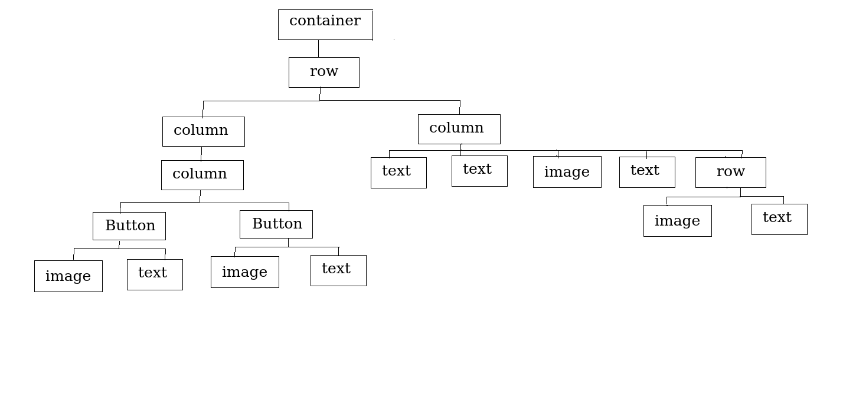
SYSTEM DESIGN
Widget Tree for Clock Page

Slide 9
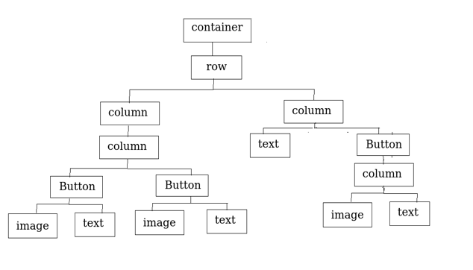
Widget Tree for Alarm Page

Slide 10
IMPLEMENTATION/CODING
main.dart
import 'package:clock_app/enums.dart';
import 'package:clock_app/models/menu_info.dart';
import 'package:flutter/material.dart';
import 'package:flutter_local_notifications/flutter_local_notifications.dart';
import 'package:provider/provider.dart';
import 'views/homepage.dart'; final FlutterLocalNotificationsPlugin flutterLocalNotificationsPlugin =
FlutterLocalNotificationsPlugin();
void main() async {
WidgetsFlutterBinding.ensureInitialized();
var initializationSettingsAndroid =
AndroidInitializationSettings('codex_logo');

Slide 11
var initializationSettingsIOS = IOSInitializationSettings(
requestAlertPermission: true,
requestBadgePermission: true,
requestSoundPermission: true,
onDidReceiveLocalNotification:
(int id, String title, String body, String payload) async {});
var initializationSettings = InitializationSettings(
initializationSettingsAndroid, initializationSettingsIOS);
await flutterLocalNotificationsPlugin.initialize(initializationSettings,
onSelectNotification: (String payload) async {
if (payload != null) {
debugPrint('notification payload: ' + payload);
}
});
runApp(MyApp());
}

Slide 12
class MyApp extends StatelessWidget {
// This widget is the root of your application.
@override
Widget build(BuildContext context) {
return MaterialApp(
title: 'Flutter Demo',
theme: ThemeData(
primarySwatch: Colors.blue,
visualDensity: VisualDensity.adaptivePlatformDensity,
),
home: ChangeNotifierProvider<MenuInfo>(
create: (context) => MenuInfo(MenuType.clock),
child: HomePage(),
),
);
}
}

Slide 13
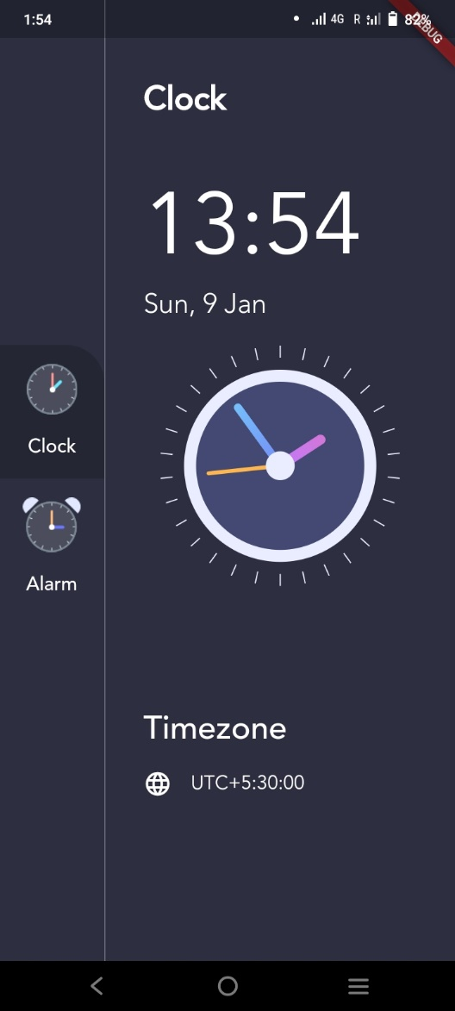
RESULTS
1. Clock Page

Slide 14
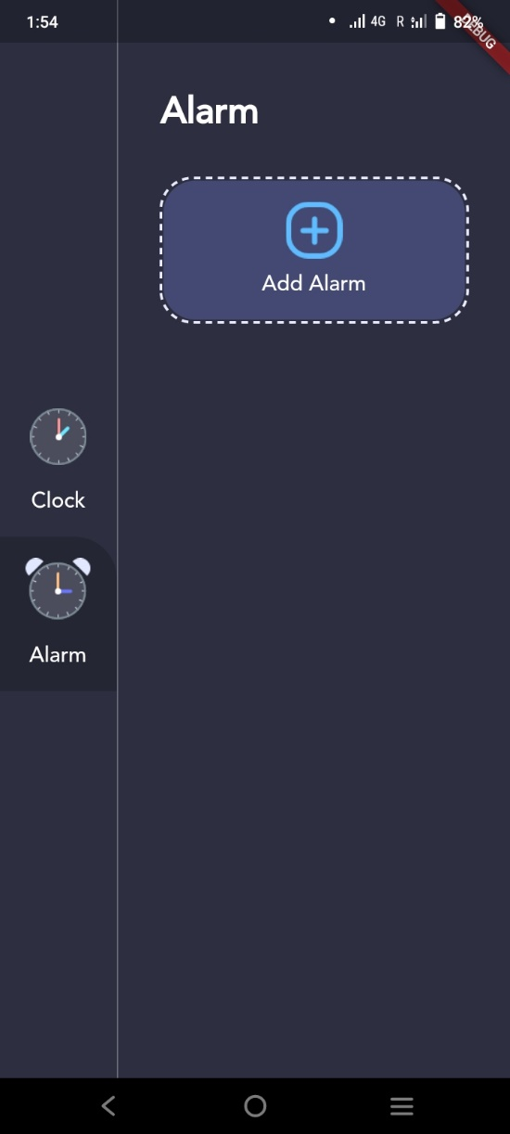
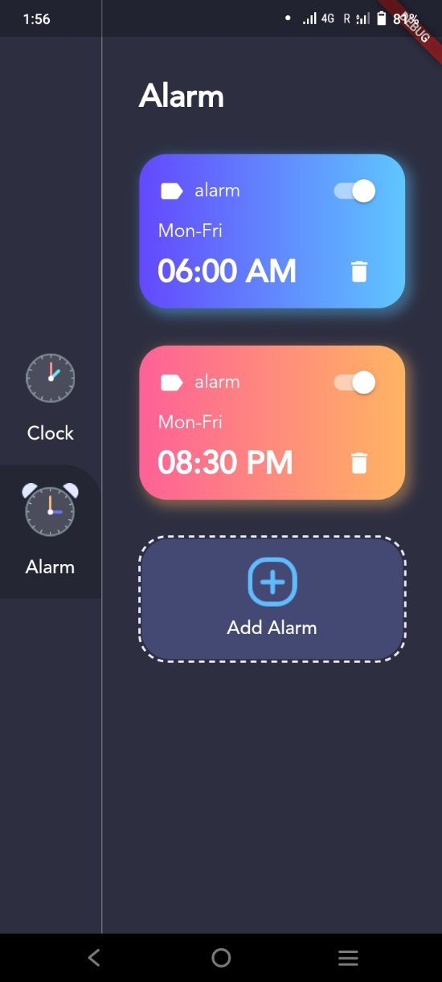
2. Alarm Page

Slide 15
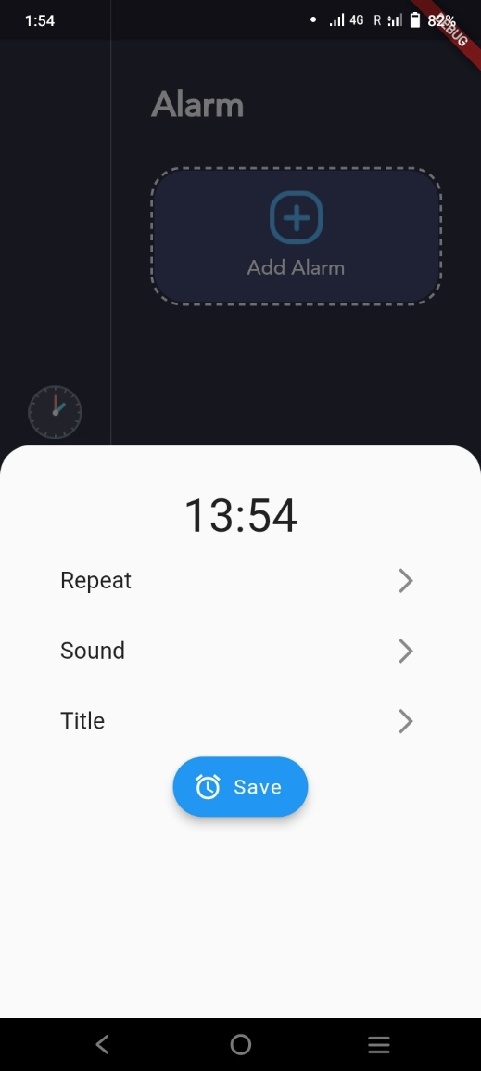
3. Creating Alarm
VIII Semester, Department of ISE, RNSIT
2021 - 2022
‹#›

Slide 16
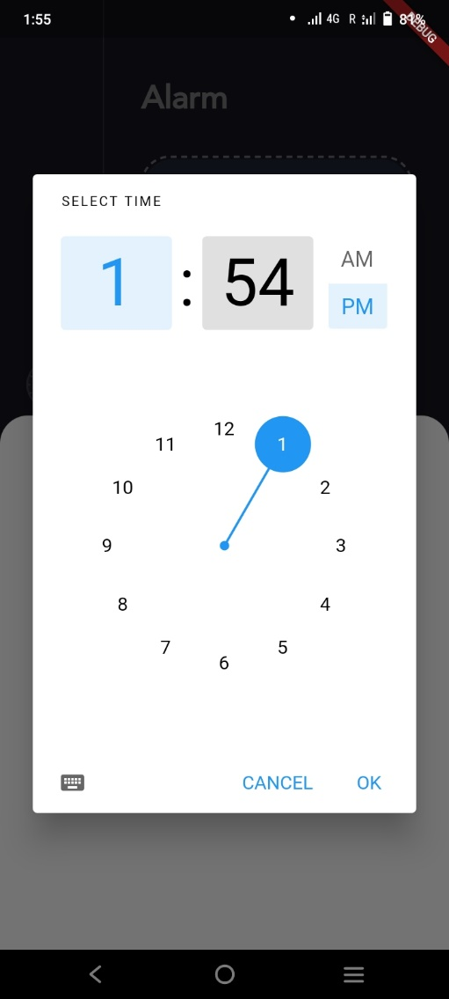
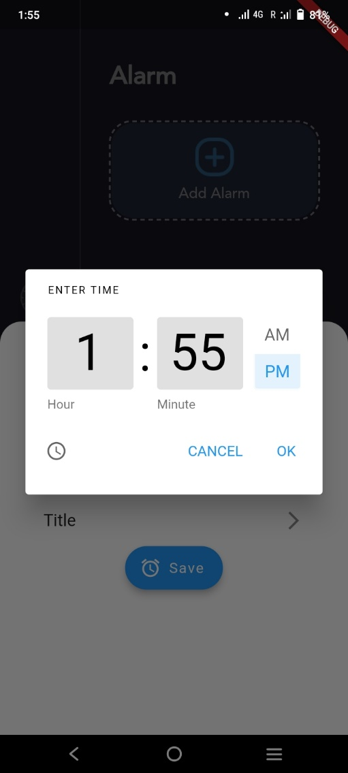
3a. By pointing directly to time
3b. By using keyboard
VIII Semester, Department of ISE, RNSIT
2021 - 2022
‹#›

Slide 17
TESTING
Testing is a process of executing a program with the interest of finding an error. Levels Of Testing
Unit Testing
Integration Testing
Validation Testing
Output Testing
User Acceptance Testing

Slide 18
CONCLUSIONS
This application is beneficial for the us as we can get a reminder for our tasks.
It is helpful in planning our daily schedules. We can add and delete the alarms.
It also helps us to know the current day, date and time.

Slide 19
FUTURE ENHANCEMENTS
We can add some extra buttons for stop and snooze.
We can further add features like changing different songs for the alarm.
We can add the ability to change the time zones to see the time of different countries in Analog Clock.
We can add pages like Stopwatch and Timer.

Slide 20
REFERENCES
[1] https://flutter.dev/
[2] https://developers.google.com/learn/pathways/intro-to-flutter
[3] Beginning Flutter: A Hands On Guide to App Development by Marco L
Napoli
[4] https://stackoverflow.com/

Slide 21
QUESTION AND ANSWERS

Slide 22
THANK YOU

