Slide 1
Linux Kernel Optimization Package
Md. Habibur Rahman
ID:103-15-1106
Md Jabed Morshed Chowdhury
Senior Lecturer
Department of CSE
Daffodil International University
Sunday,11 May 2014

Slide 2
Agenda
  Introduction
  Benefits of the project
  Features
  Existing applications & drawbacks
  Proposed Package
  Development language & Tools used
  Limitations
  Future suggested work
  Conclusion
Linux Kernel Optimization Package

Slide 3
Linux Kernel Optimization Package
Introduction :
Linux Kernel Optimization Package that auto configure and build linux kernel from source code according to current hardware is present on the system.The main point of developing this application is to help users to make their linux base machines more faster,less memory use,decrease boot time.

Slide 4
Linux Kernel Optimization Package
Benefits of the Project:
Users can configure,compile and build linux kernel very easily
Reduce the kernel size
Use less RAM than provided stock kernel with distributions
Support for new devices and old devices
Boot up the machines fast
Increase the performance of the system

Slide 5
Linux Kernel Optimization Package
Features :
File menu
  Open Log
  Hardware info
  Operating system info
  Exit
Actions menu
  Start operation
  Stop operation
Help menu
  Contents
  Online help
  Bug reports
  About

Slide 6
Linux Kernel Optimization Package
Existing application and Drawbacks :
Like my package “Linux kernel optimization package”, there is an existing script Namely “kernel autoconfigure”.
There are many problems of this existing script according to users needs.
  Its just a script file,no GUI is present
  Need to download kernel manualy

Slide 7
Linux Kernel Optimization Package
Proposed Package :
  Tried to reduce drawbacks of existing application “kernel autoconfigure”.
  Introduced GUI for end-users
  Store log,view os and hardware information

Slide 8
Development languages & Tools used
Linux Kernel Optimization Package
Qt framewore 5.2.1
Cmake 2.8.12.2
GCC 4.8.2
Qt C++
Bash Script
Qt creator 3.0.84
Gedit

Slide 9
Linux Kernel Optimization Package
Limitations
User can not build kernel with out internet connectivity.
Only super user privilaged members can build the kernel.

Slide 10
Linux Kernel Optimization Package
Future work
Make support for other GNU/Linux distribution(RPM,Slackware).
Manualy kernel source adding option can be added.

Slide 11
Linux Kernel Optimization Package
Project Demo

Slide 12
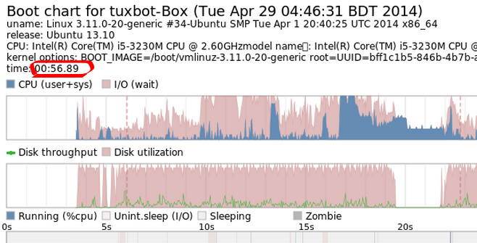
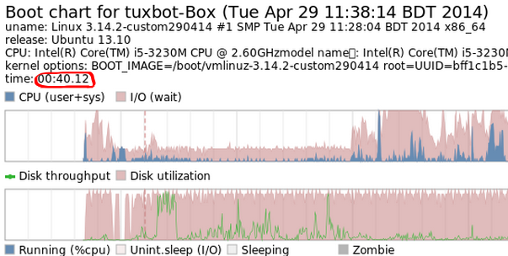
Linux Kernel Optimization Package
Comparison between stock & custom kernel boot time
(a) Stock Kernel
(b) Custom Kernel

Slide 13
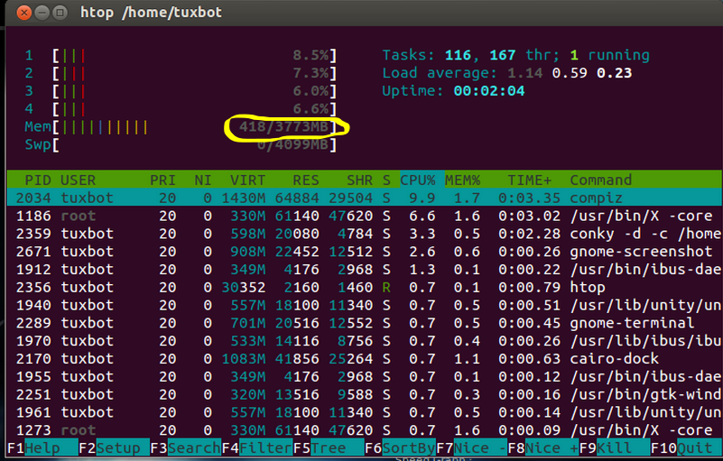
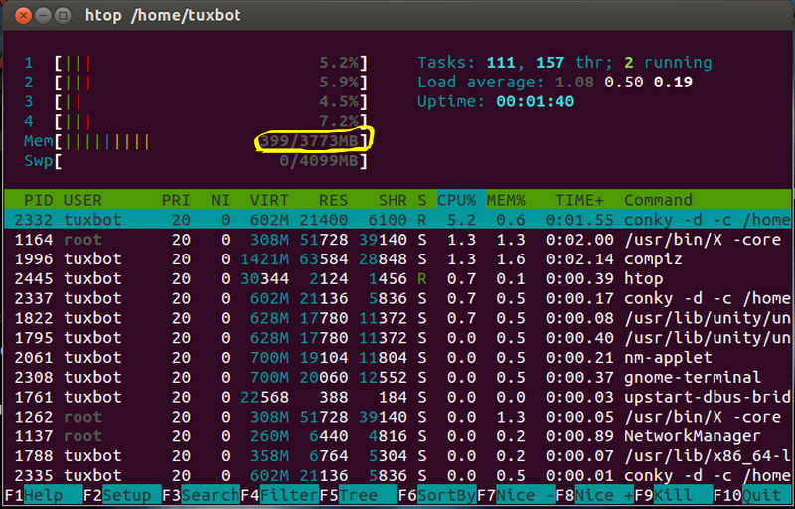
Linux Kernel Optimization Package
Memroy usage after boot
(a) Stock Kernel
(b) Custom Kernel

Slide 14
Conclusion
Now a days,we are mostly depended on linux based system. A kernel is the heart of an operating system. It is a piece of software that securely controls access to hardware. This package has strong information where the users will get a number of benefits such as knowing linux kernel,freedom of open OS and build their custom kernel acording their needs.

Slide 15
Thank You
Any Question?

