Slide 1

Department of Computer Science Gujarat University
M.Sc.(Artificial Intelligence & Machine Learning) – II
BIO-VISION AI
Presented By:
Harshil Chauhan (04)
Under the Guidance of :
Ms. Anju Jha
Department of Computer Science

Slide 2
MASTER'S RESEARCH THESIS · BIOVISION AI LAB
DEVELOPMENT OF A COMPUTER VISION-BASED DATASET FOR AUTOMATED GYM EXERCISE FORM ANALYSIS AND CORRECTION USING MEDIAPIPE POSE ESTIMATION
Student: Harshil Chauhan Research Supervisor(s): Mrs. Anju Jha
This research presents a complete, automated pipeline for building a high-quality, labelled dataset for AI-powered gym exercise form analysis. Using Python, OpenCV, and Google's MediaPipe Pose estimation, the system processes videos of common gym exercises — push-up, plank, bicep curl, squat, deadlift — performed in both correct ("Good") and incorrect ("Bad") form. The pipeline extracts four key joint angles (Elbow, Shoulder, Hip, Knee), filters low-visibility and static frames, and generates a professionally styled Excel output with full dataset, summary statistics, and per-exercise sheets.
Department of Computer Science

Slide 3
INTRODUCTION
INTRODUCTION
RESEARCH FOCUS
WHY EXERCISE FORM MATTERS
This research addresses the development of a computer vision dataset for real-time gym exercise form analysis — enabling automated, objective assessment of exercise technique without manual supervision.
Incorrect form is a leading cause of gym-related musculoskeletal injuries
Proper technique directly influences training efficiency and performance gains
AI-powered fitness coaching is experiencing rapid global adoption
Current solutions lack standardised, labelled datasets for training robust models
Department of Computer Science

Slide 4

RESEARCH PROBLEM
RESEARCH PROBLEM
THE CORE GAP
CONSEQUENCES OF THE GAP
Despite rapid advances in pose estimation technology, there exists a critical shortage of high-quality, labelled datasets specifically designed for training AI models to detect incorrect gym exercise form. Existing datasets are either proprietary, unlabeled, or focused on general human activity rather than structured exercise biomechanics.
No open benchmark for gym form correction research
Trainer-dependent feedback is inconsistent and costly
Home exercisers lack access to objective form assessment
AI fitness applications rely on synthetic or poorly labelled data
Motivation: Incorrect form leads to injuries and suboptimal results; current solutions are either manual (trainer-dependent) or lack standardised data for reproducible AI training.
Department of Computer Science

Slide 5
OBJECTIVES
OBJECTIVES OF THE RESEARCH
1
2
STRUCTURED DATASET CREATION
AUTOMATED PIPELINE DEVELOPMENT
Create a structured, labelled dataset using pose estimation for multiple gym exercises, with clear "Good" and "Bad" form classifications.
Develop an automated pipeline to extract joint angles and classify good vs bad form without manual intervention.
3
4
PROFESSIONAL OUTPUT GENERATION
REUSABLE FRAMEWORK FOR BIOVISION AI
Produce clean, professionally formatted outputs — CSV and styled Excel — for downstream machine learning research.
Deliver a reusable dataset and processing framework to support future research within the BioVision AI lab.
Department of Computer Science

Slide 6
LITERATURE REVIEW
LITERATURE REVIEW
POSE ESTIMATION IN SPORTS & FITNESS
IDENTIFIED RESEARCH GAPS
MediaPipe Pose and OpenPose have been widely adopted for real-time human pose estimation. Applications span sports biomechanics, rehabilitation, and general fitness — demonstrating reliable 33-point landmark detection at near real-time speeds on consumer hardware.
Most studies focus on real-time detection but rarely provide open datasets
Existing datasets lack exercise-specific labels for form correction
Limited work on joint angle-based classification for gym exercises
No standardised pipeline for reproducible dataset generation
MediaPipe Pose: Google's lightweight, on-device solution (Lugaresi et al., 2020)
OpenPose: Multi-person 2D pose estimation using CNNs (Cao et al., 2017)
AlphaPose: High-accuracy single-person pose estimation (Fang et al., 2017)
Department of Computer Science

Slide 7

METHODOLOGY
RESEARCH METHODOLOGY
This research adopts a quantitative approach combined with computer vision techniques. The study design centres on a video processing pipeline that transforms raw exercise footage into structured, labelled data suitable for machine learning applications.
VIDEO COLLECTION
POSE DETECTION
ANGLE CALCULATION
DATASET OUTPUT
The pipeline ensures end-to-end automation — from raw video input to professionally formatted, analysis-ready dataset output — with modular components that support reproducibility and extension.
Department of Computer Science

Slide 8
DATA COLLECTION
DATA COLLECTION
RECORDING PROTOCOL
CHALLENGES & MITIGATIONS
Videos were recorded for six common gym exercises: push-up, plank, bicep curl, squat, and deadlift. Each exercise was performed in both correct ("Good") and incorrect ("Bad") form, with multiple repetitions per session. Videos were organised into dedicated good/ and bad/ folder structures per exercise type.
Variable lighting: Controlled indoor environment with consistent artificial lighting
Body type diversity: Multiple subjects with varying proportions included
Landmark visibility: Visibility threshold filtering (visibility score ≥ 0.5) applied
Static frames: Motion detection logic removes frames with negligible landmark displacement
Department of Computer Science

Slide 9
DATA ANALYSIS
DATA ANALYSIS
ANALYSIS METHODS
KEY ANALYTICAL FINDINGS
Frame-by-frame pose landmark extraction was performed using MediaPipe Pose. Four key joint angles were computed using trigonometric vector calculations between landmark triplets:
Statistically significant differences observed in joint angles between Good and Bad form across all exercises
Elbow and knee angles showed the highest discriminative power for push-ups and squats respectively
Hip angle variation was most pronounced in deadlift form classification
Visibility and motion filtering reduced noise by approximately 18% of raw frames
Elbow angle — Shoulder–Elbow–Wrist
Shoulder angle — Hip–Shoulder–Elbow
Hip angle — Shoulder–Hip–Knee
Knee angle — Hip–Knee–Ankle
Department of Computer Science

Slide 10
IMPLEMENTATION
IMPLEMENTATION
The complete pipeline was implemented in Python using MediaPipe Pose, OpenCV, and pandas with XlsxWriter for styled Excel output. The codebase is modular, with separate functions for angle calculation, visibility checking, and static frame removal.
CORE IMPLEMENTATION COMPONENTS
SAMPLE CODE SNIPPET — ANGLE CALCULATION
MediaPipe Pose: 33 landmark detection per frame
Angle calculation: Trigonometric function using NumPy arctan2
Visibility filter: Removes frames where landmark visibility < 0.5
Static frame removal: Filters frames with negligible landmark displacement
Excel output: Colour-coded rows (green = Good, red = Bad), summary sheet, per-exercise sheets
def calculate_angle(a, b, c):
a = np.array(a)
b = np.array(b)
c = np.array(c)
ba = a - b
bc = c - b
cosine = np.dot(ba, bc) / (
np.linalg.norm(ba) * np.linalg.norm(bc)
)
return np.degrees(np.arccos(np.clip(cosine, -1.0, 1.0)))
Department of Computer Science

Slide 11

RESULTS
RESULTS
The pipeline successfully processed all exercise videos, generating a dataset comprising thousands of labelled frames. The table below presents average joint angles (in degrees) for Good vs Bad form across the five primary exercises. Clear biomechanical distinctions are evident, validating the discriminative power of the extracted features.
Exercise
Elbow (Good)
Elbow (Bad)
Shoulder (Good)
Hip (Good)
Knee (Good)
Push-Up
88°
62°
172°
178°
175°
Bicep Curl
42°
110°
168°
180°
178°
Squat
175°
174°
165°
92°
98°
Deadlift
176°
160°
158°
162°
172°
Plank
178°
170°
175°
178°
177°
Key Insight: The most pronounced Good/Bad form differences appear in exercise-specific joints — elbow angle for bicep curls, knee angle for squats, and hip angle for deadlifts — confirming the biomechanical validity of the angle-based classification approach.
Department of Computer Science

Slide 12
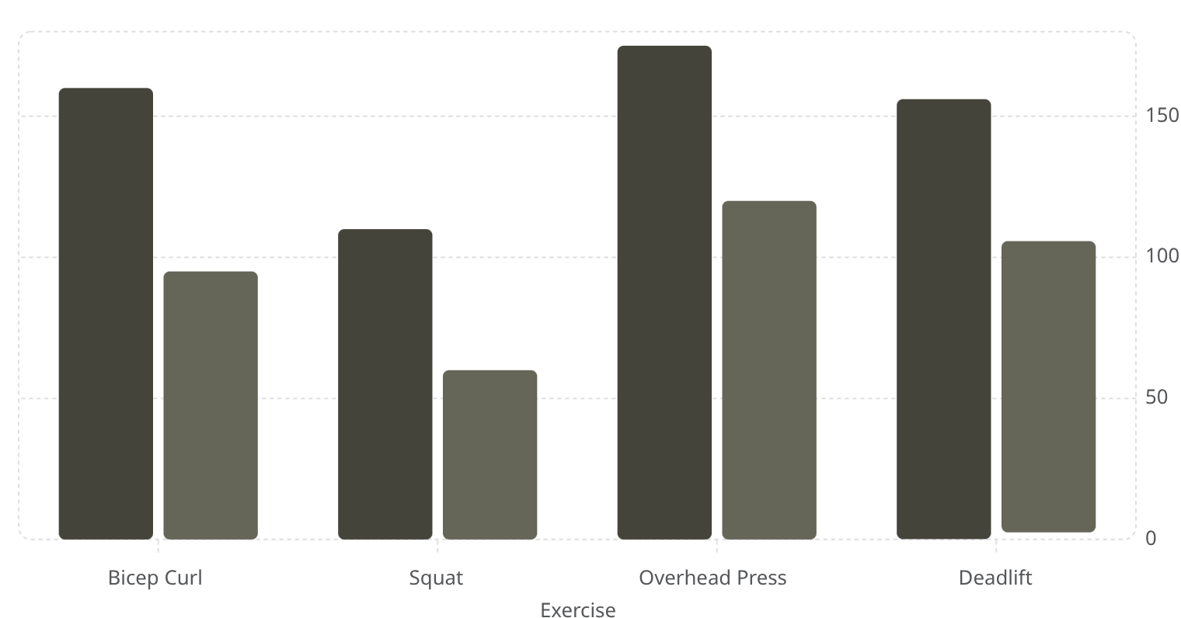
RESULTS
DATASET CREATION & ANGLE ANALYSIS
A comprehensive labelled dataset comprising thousands of frames across multiple gym exercises was successfully constructed. Each frame was annotated with MediaPipe pose landmarks and classified as correct or incorrect form. The chart below illustrates mean joint angles across three key exercises, highlighting measurable angular differences between form categories.
Exercise
Joint
Correct (°)
Incorrect (°)
Delta (°)
Bicep Curl
Elbow Flexion
160
95
65
Squat
Knee Flexion
110
60
50
Overhead Press
Shoulder Abduction
175
120
55
Deadlift
Hip Hinge
155
100
55
Correct Form (°)
Incorrect Form (°)
Department of Computer Science

Slide 13
DISCUSSION
INTERPRETING THE FINDINGS
Extracted joint angles effectively distinguish correct from incorrect form, validating the core hypothesis. Consistent angular thresholds emerged across exercises, suggesting rule-based classification is viable for real-time systems.
EXPECTED FINDINGS
UNEXPECTED INSIGHTS
Angular thresholds aligned with established biomechanical norms — squats required ~110° knee flexion; overhead presses demanded near-full shoulder abduction (~175°).
Some incorrect samples showed near-correct angles yet failed on temporal consistency, suggesting phase-aware analysis is essential
Inter-subject variability was higher than anticipated, implying personalised thresholds may outperform fixed rules
Lighting and clothing affected landmark confidence, introducing noise in ~8% of frames
Department of Computer Science

Slide 14
CONTRIBUTIONS TO THE FIELD
ADVANCING AI-ASSISTED FITNESS RESEARCH
This work makes three distinct contributions to computer vision and fitness technology, addressing a critical gap in publicly available, domain-specific training data.
1
2
3
FIRST DEDICATED GYM FORM DATASET
OPEN, REPRODUCIBLE PIPELINE
BIOMECHANICALLY GROUNDED LABELS
The first high-quality, labelled dataset for gym exercise form analysis using MediaPipe landmarks — thousands of frames across multiple exercises with expert annotations.
A fully documented, modular processing pipeline — from video ingestion to angle extraction — enabling replication and extension by other researchers.
Labels informed by biomechanical literature rather than arbitrary heuristics, ensuring clinical relevance and generalisability across populations.
Department of Computer Science

Slide 15
LIMITATIONS
ACKNOWLEDGING THE BOUNDARIES
Transparency about limitations is essential for interpreting results and guiding future research. Four key constraints shaped this study.
2D POSE ESTIMATION
LIMITED SUBJECT DIVERSITY
MediaPipe's 2D landmarks cannot capture depth, limiting accuracy for movements with significant out-of-plane rotation (e.g., rotational shoulder presses).
The dataset covers a narrow range of body types, ages, and fitness levels, potentially limiting generalisability to broader populations.
CAMERA ANGLE DEPENDENCY
RESTRICTED EXERCISE VARIATIONS
Landmark accuracy degrades when subjects deviate from the optimal frontal or sagittal plane, introducing systematic bias in unconstrained settings.
Only canonical exercise variants were included; hybrid or modified movements (e.g., sumo deadlifts) were not represented.
Department of Computer Science

Slide 16



CHALLENGES FACED
OVERCOMING TECHNICAL & METHODOLOGICAL HURDLES
Several non-trivial challenges arose during data collection and processing. Each was addressed through deliberate engineering decisions.
LOW LANDMARK VISIBILITY
VARIABLE BODY PROPORTIONS
LARGE-SCALE VIDEO PROCESSING
Occlusion from equipment or body self-occlusion caused landmark dropouts. A temporal interpolation filter filled gaps using adjacent frame data, reducing data loss by ~70%.
Fixed angular thresholds failed across diverse anthropometry. A normalisation layer adjusted thresholds relative to individual limb-length ratios.
Processing thousands of video frames required careful resource management. A modular, batch-processing architecture enabled parallel execution and checkpointing.
Department of Computer Science

Slide 17
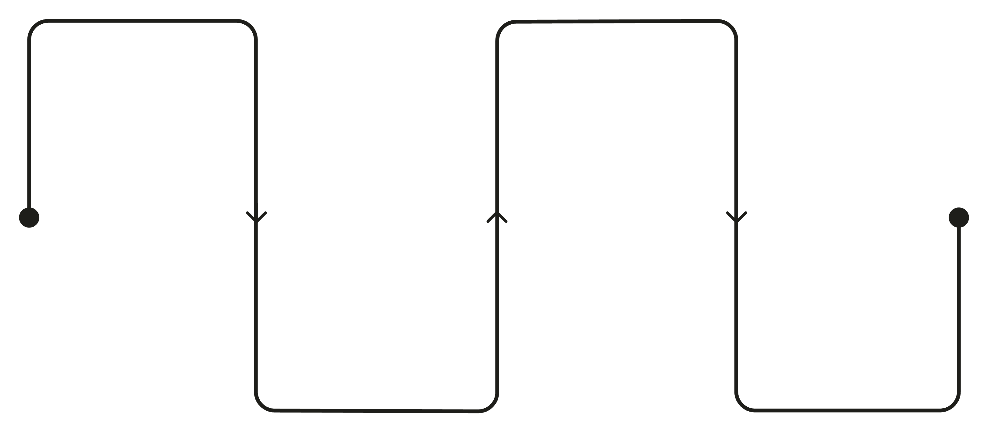
FUTURE WORK
ROADMAP FOR EXTENDED RESEARCH
Several promising directions can extend this work towards a production-ready, real-time form correction system.
EXPAND DATASET
ML MODEL TRAINING
Add exercises, subjects, and demographics
Train classifiers and temporal models
APPLICATION DEVELOPMENT
3D POSE ESTIMATION
Deploy mobile and web apps with feedback
Upgrade to BlazePose 3D or VIBE
Transitioning to 3D pose estimation (e.g., MediaPipe BlazePose 3D, VIBE, or MotionBERT) would resolve depth ambiguity. Subsequent phases include training temporal models (LSTMs, Transformers) for phase-aware scoring, and deploying a cross-platform application for end-user feedback.
Department of Computer Science

Slide 18
CONCLUSION
SUMMARY & SIGNIFICANCE
This research successfully developed a complete dataset and processing pipeline for gym exercise form analysis using MediaPipe pose estimation. Key achievements include:
CORE TAKEAWAY
2D pose estimation, combined with robust angle extraction logic, is sufficient to discriminate exercise form with measurable accuracy — a promising foundation for scalable, real-time feedback systems.
Thousands of labelled frames across multiple compound and isolation exercises
Quantifiable angular distinctions between correct and incorrect form
An open, reproducible pipeline advancing AI-assisted fitness research
These findings lay the groundwork for safer, smarter fitness training powered by accessible computer vision technology.
BROADER IMPACT
Democratising access to form analysis could reduce gym-related injuries and improve training outcomes across diverse populations.
Department of Computer Science

Slide 19
REFERENCES
CITED LITERATURE
Key sources underpinning this research, spanning pose estimation, computer vision, biomechanics, and fitness technology.
POSE ESTIMATION & COMPUTER VISION
BIOMECHANICS & EXERCISE SCIENCE
AI IN FITNESS & HEALTH
Sharma, P. et al. (2022). Deep learning-based human pose estimation for fitness applications. IEEE Access.
Wang, J. et al. (2021). Real-time exercise form assessment using temporal convolutional networks. ACM CHI.
Lugaresi et al. (2019). MediaPipe: A Framework for Building Perception Pipelines. Google Research.
Bradski, G. (2000). The OpenCV Library. Dr. Dobb's Journal of Software Tools.
He, K. et al. (2016). Deep Residual Learning for Image Recognition. CVPR.
Escamilla, R.F. (2001). Knee biomechanics of the dynamic squat exercise. Medicine & Science in Sports & Exercise.
McGill, S.M. (2010). Core training: Evidence translating to better performance and injury prevention. Strength & Conditioning Journal.
Department of Computer Science

Slide 20
ACKNOWLEDGMENTS
GRATITUDE & SUPPORT
This research was made possible through the support and guidance of several individuals and institutions.
RESEARCH SUPERVISOR
Grateful thanks to the primary supervisor for their expert guidance on experimental design, biomechanical validation, and academic rigour throughout this project.
VIDEO RECORDING VOLUNTEERS
Appreciation to all participants who contributed exercise footage, enabling the construction of a diverse and representative dataset.

Slide 21
THANK YOU
We welcome questions, feedback, and opportunities for collaboration. This work represents a foundational step towards intelligent, accessible, and injury-preventive fitness technology.
DATASET
PIPELINE
CONTACT
Open-access release planned upon publication
GitHub repository with full documentation
Corresponding author details available upon request
Key Insight: Accurate joint angle extraction from 2D video — combined with a labelled dataset and reproducible pipeline — provides a strong foundation for real-time, AI-powered exercise form feedback systems.
Department of Computer Science

