Slide 1
Image Super-Resolution
using
Bayesian Methods
Course Project for CS 736: Medical Image Computing, Spring 2021
By:
Harshit Varma (190100055)
Gaurav P (190050037)

Slide 2
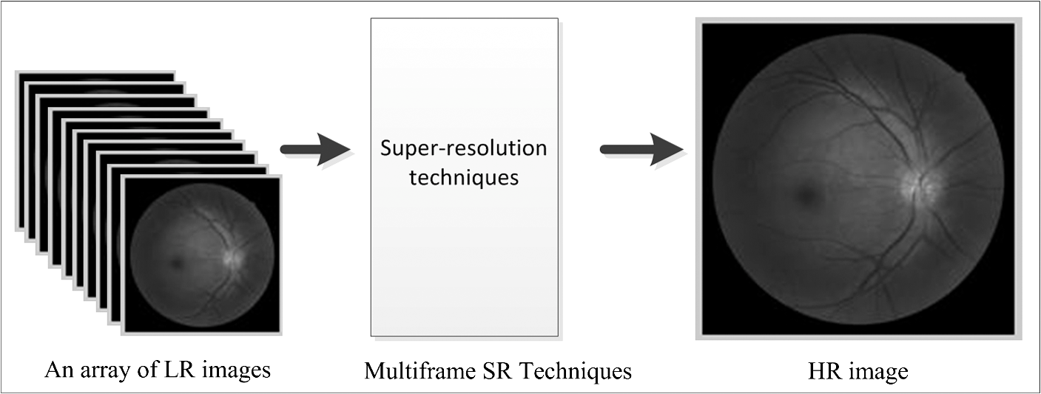
Problem Introduction
Given a set of non-aligned low-resolution (LR) images of the same scene, estimate a single high-resolution (HR) image of the scene
Also known as the “Multi-Frame Super-Resolution” (MFSR) problem
https://doi.org/10.1117/1.JBO.19.5.056002

Slide 3
Motivation
Many vision applications like satellite imaging, medical imaging etc. require HR images which usually exceed the abilities of available digital cameras
HR cameras are limited by high price, large size, or sensor limitations
The set of LR images can also correspond consecutive frames in a LR video
Thus, the use of image processing techniques to estimate the HR image from a set of low-quality LR images can act as a powerful and cheaper alternative

Slide 4
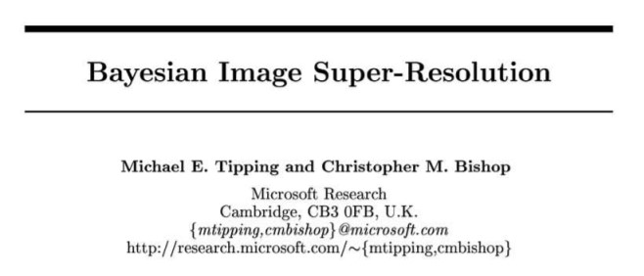
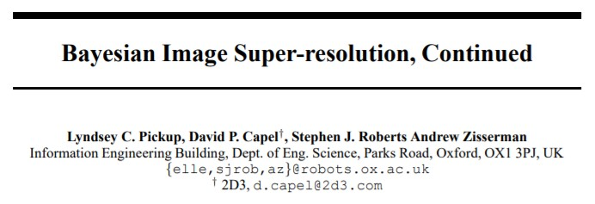
Background
Tipping et al. suggested a Bayesian approach that estimates the registration parameters by marginalizing the likelihood over the unknown HR image
Pickup et al. improved upon this by marginalizing over the registration parameters, which allowed the use of more suitable priors
Our approach largely follows the approach suggested by Tipping et al.

Slide 5
Bayesian Formulation

Slide 6
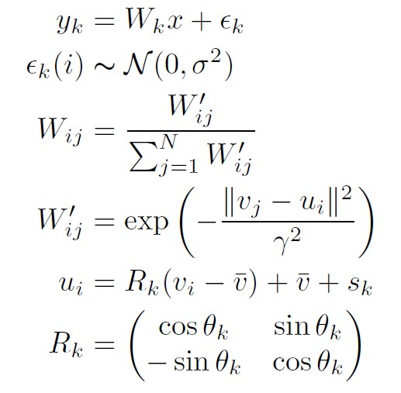
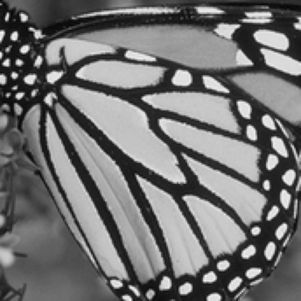
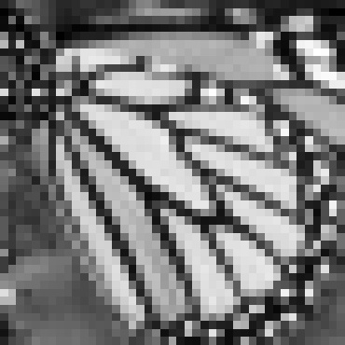
Observation / Acquisition Model
HR
LR

Slide 7
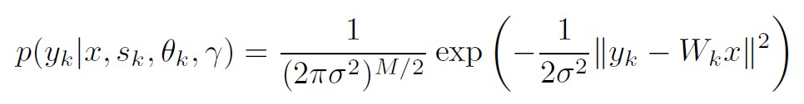
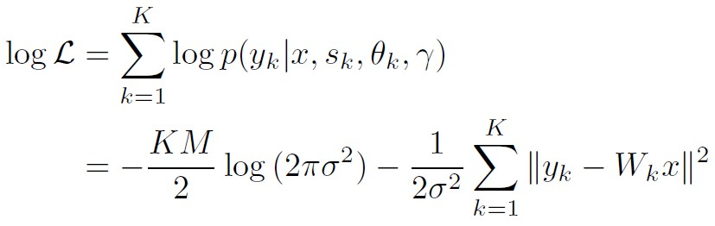
Likelihood
From the observation model, we get:
Thus, the log likelihood becomes:

Slide 8
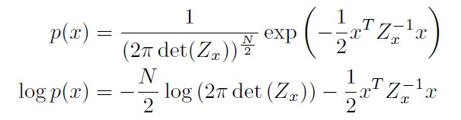
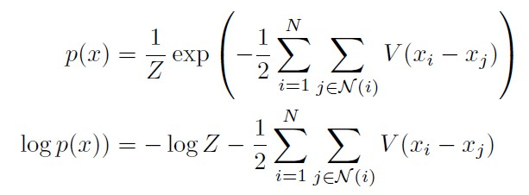

Prior
Gaussian Prior
MRF Prior

Slide 9


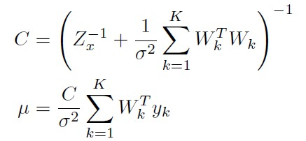
Posterior
Using the Gaussian prior, we can exactly compute the posterior, as both the likelihood and the prior are Gaussians, thus the posterior is also a Gaussian with the covariance and mean as follows

Slide 10
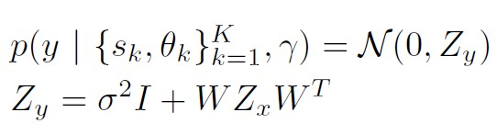
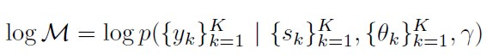
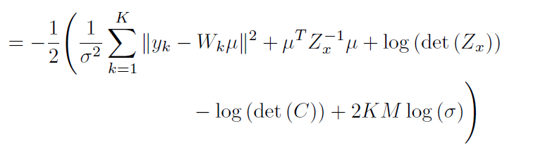
Marginal Likelihood
When using the Gaussian prior, we know the posterior, prior and the likelihood in closed form. Thus, we can get the marginal likelihood in closed form.

Slide 11


Optimization Strategy
Extract patches
Minimize negative log marginal to estimate the registration parameters
Set of LR Images
Minimize the negative log posterior to estimate the HR image, keeping the registration parameters fixed
Optimization performed using AdamW and PyTorch Autograd
Estimated HR Image

Slide 12
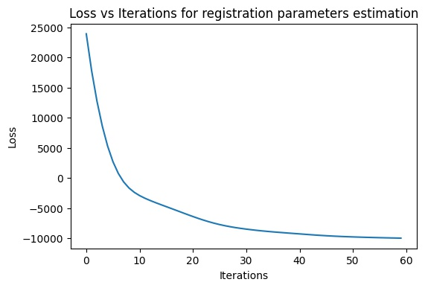
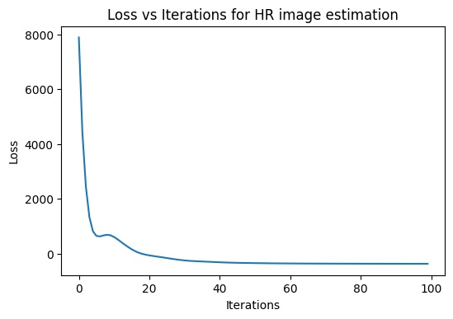
Results

Slide 13
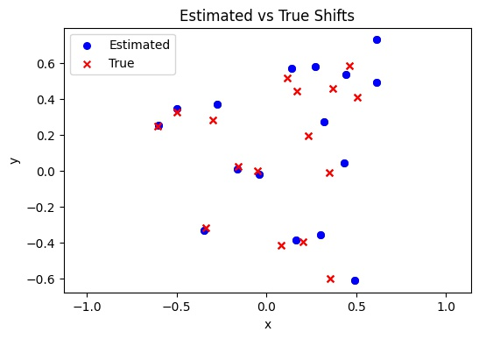
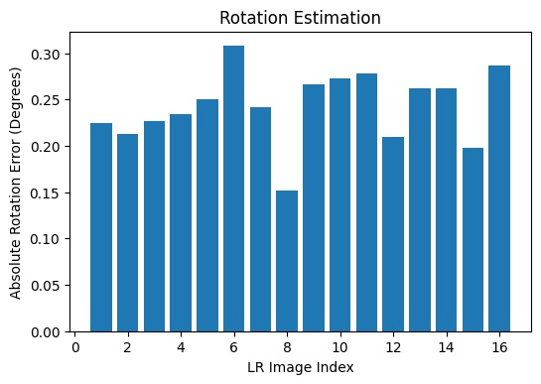

Slide 14
Original HR Image
One of the LR Images

Slide 15

One of the patches used for estimating the registration parameters
Initial Estimate for the HR Image
(Using Bicubic Interpolation)
PSNR: 15.57

Slide 16
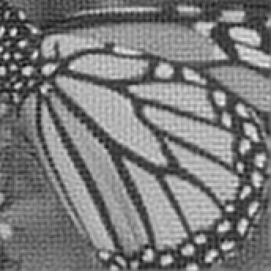
Using Gaussian Prior
Using MRF Prior
PSNR: 18.62
PSNR: 22.05

Slide 17
Original HR Image
Using MRF Prior
PSNR: 22.05

Slide 18
Challenges Faced
Memory requirements: The marginal requires computing C, the covariance matrix of the posterior. If the original HR image has N pixels, C is of size NxN. Even for small images (eg. 300x300), this is projected to occupy > 50 GB!
Solution 1: Since the marginal is used only for estimating the registration parameters, use small sized patches instead of the entire image
Solution 2: Use sparse matrices for operations, but PyTorch Autograd currently doesn’t work with sparse matrices
Solution 3: Divide the original images into different regions and run the algorithm per region, then combine the super-resolved regions
The HR image estimated using the Gaussian prior has some periodic artifacts which we were unable to debug/remove

Slide 19
Conclusion
We formulated and analysed the MFSR problem in a Bayesian way
Using a Gaussian prior for computing the marginal likelihood allows us to:
Estimate the registration parameters more accurately
Use better priors (eg. MRF) while estimating the HR image, which improve the visual quality of the estimated image by a lot

Slide 20
Thank You

