Slide 1
Assignment-Discussion HMM POS Tagging
Harshit Varma, 190100055
Himanshu Gupta, 17D100016
21/08/2021

Slide 2
Problem Statement
Given a sequence of words, produce the POS tag sequence
Technique to be used: HMM-Viterbi
Use Universal Tag Set (12 in number)
5-fold cross validation
., ADJ, ADP, ADV, CONJ, DET, NOUN, NUM, PRON, PRT, VERB, X

Slide 3
Overall performance
Accuracy: 0.959
Precision: 0.942
Recall: 0.913
F-score (3 values)
F1-score: 0.924
F0.5-score: 0.934
F2-score: 0.917

Slide 4
Per POS performance
Precision values: .: 0.996, ADJ: 0.921, ADP: 0.950, ADV: 0.909, CONJ: 0.993, DET: 0.968, NOUN: 0.962, NUM: 0.971, PRON: 0.954, PRT: 0.908, VERB: 0.972, X: 0.804
Recall values: .: 1.000, ADJ: 0.911, ADP: 0.968, ADV: 0.896, CONJ: 0.995, DET: 0.987, NOUN: 0.952, NUM: 0.913, PRON: 0.985, PRT: 0.907, VERB: 0.951, X: 0.493
F1 scores: .: 0.998, ADJ: 0.916, ADP: 0.959, ADV: 0.902, CONJ: 0.994, DET: 0.977, NOUN: 0.957, NUM: 0.941, PRON: 0.969, PRT: 0.907, VERB: 0.962, X: 0.609

Slide 5
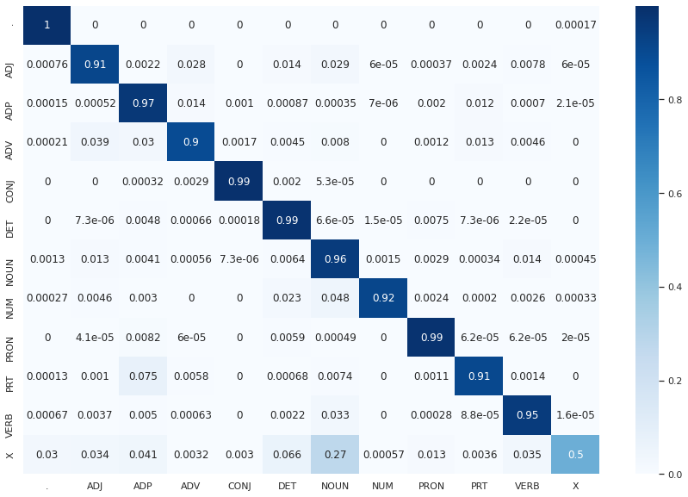
Confusion Matrix (12 X 12)

Slide 6
Interpretation of confusion (error analysis)
X is confused with NOUN the most
This could be since X is the ‘other’ tag and is usually used for words which aren’t in the english vocabulary, thus may end up looking a lot like nouns to the model
There is some confusion between NUM and NOUN since sometimes NUM may be used as a noun (eg: “Ten” in the bigram “Windows Ten”)
There is also some confusion between PRT and ADP, which may be since the two have similar definition and uses

Slide 7
Data Processing Info (Pre-processing)
‘-’ was added at start of each POS tag sequence and ‘^’ was added at the start of each word sequence
First created dictionaries of emission counts,transition counts and tag counts
Transition matrix was created using transition counts and tag counts
Emission matrix was created using emission counts and tag counts
Used smoothing to counter unseen bigram
Lowercasing was not used

Slide 8
Viterbi Decoding
In three steps, following the pseudo-code given in the lecture slides
Initialisation
Forward Pass
Backward Pass
Used log values of probabilities to prevent very small values

Slide 9
Any thoughts on generative vs. discriminative POS tagging
The difference between discriminative and generative models is that while discriminative models try to model conditional probability distribution, i.e., P(T|W), generative models try to model a joint probability distribution, i.e., P(W,T).

