Slide 1
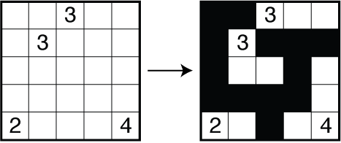
Nurikabe Puzzle
binary logic puzzle
Haris Krasniqi

Slide 2
Overview
Name comes from Japanese Folklore (an invisible wall that blocks roads and delays foot traveling)
Sometimes called as Cell Structure or Islands in the Stream
Played on a Grid of Cells, some of which contain numbers
Only Black and White colors are used
Initially cells are white (sometimes a black dot)
When cells are adjacent and same color, they are considered as connected
Black color: sea/water
White color: island

Slide 3
Rules
Numbered cells should remain white
Every white cell belongs to the island
Every island should contain only one numbered cell
Every island should contain the same number of white cell number it contains
In every island, white cells should be horizontally or vertically connected (land/ island)
Two islands cannot be connected
All black cells should be connected orthogonally (water/ sea)
There cannot be any 2x2 block of cells (pools)

Slide 4
Input
Output
Two list of values
Tuples for the rows and columns to express the position of the numbered cells
atoms: col(X), row(X)
Values of the numbered cells
atoms: numbered(X, Y, Z) => grid cell located at column X and row Y contains number Z and belongs to the island of size Z
Binary matrix board [i, j]
If [i, j] is 1 if cell is painted white
[i, j] is 0 otherwise
atoms: black(X, Y) => grid cell painted in black

Slide 5
References
https://en.wikipedia.org/wiki/Nurikabe
http://cs.swan.ac.uk/~csoliver/ok-sat-library/OKplatform/ExternalSources/sources/SAT/Potassco/GringoManual.pdf
https://en.wikipedia.org/wiki/Adjacency_matrix
http://stackoverflow.com/questions/23545477/clingo-create-custom-function
http://www.logicgamesonline.com/nurikabe/tutorial.html
http://krr.sabanciuniv.edu/projects/gridpuzzleASP/puzzles-final.pdf

