Slide 1
Explaining and Predicting Oil Prices Using OPEC Communication
Krisztina Gyarmati
Wilhelm Hartung
Leo Sturmlechner
R&P Seminar
Money Credit & Finance
JANUARY 2025

Slide 2
Motivation and Research Question
Why forecast oil markets?
Oil prices matter for inflation, growth, financial markets, energy policy
Challenge: Prices react to new information & expectations → hard to predict
Role of OPEC:
Announces production decisions & policy guidance.
Markets closely follow OPEC speeches & press releases.
Research question:
Do OPEC communications contain information that helps us explain and predict oil prices, beyond standard numerical fundamentals?

Slide 3
Framework & Approach
Channel: OPEC communication revises expectations about
future production, cooperation with non-OPEC, geopolitical risks
→ These expectation changes move futures prices, spot prices, inventories, production
Our approach:
Extract text from speeches & press releases.
Turn it into high-dimensional text features.
Combine with numerical oil market fundamentals.
Use LASSO and other models to see whether the text adds predictive power.

Slide 4
Literature: OPEC Announcements & Oil Supply News
Känzig (2021, AER) – Oil Supply News Shocks
Uses high-frequency changes in oil futures around OPEC announcements as an external instrument in a VAR.
Identifies oil supply news shocks:
Negative news (expected lower future supply) → immediate oil price increase, fall in production, higher inventories.
Explain a meaningful share of oil price variation over time.
Relevance for us
Confirms: OPEC announcements contain forward-looking information.
We similarly treat OPEC communication as a signal about future supply

Slide 5
Literature II: OPEC Narratives & Text
Brunetti et al. (2024) – “Reasons Behind Words: OPEC Narratives and the Oil Market”
Use text methods to build narrative measures from OPEC communication.
Show that some narratives have only small direct effects on prices,
but they help identify which type of shock (demand, supply, expectations) is driving the market.
Why this matters for us
Shows that OPEC text can be measured systematically, not just read qualitatively.
Motivates our approach: use bag-of-words + LASSO and let the data pick which words/phrases carry information.

Slide 6
Textual Data & Corpus
Textual data:
OPEC speeches (2003–2025)
Scraped from yearly archive pages on opec.org.
After cleaning: about 383 unique speeches.
OPEC press releases (2003–2025)
Scraped from press section.
After cleaning: about 572 unique releases.

Slide 7
Numerical Data & Transformation
Sources: U.S. Energy Information Administration, Yahoo Finance
Variables:
Spot prices: WTI Crude Oil, CBOE Volatility Index, US Dollar Index
Fundamentals: US field production, net imports, refinery utilization, total product supplied, inventories (crude oil, gasoline, distillate), strategic petroleum reserve
Transformations:
Weekly fundamental data is propagated forward to daily rows (LOCF)
Data is filtered to exclude weekends
WTI Crude Oil and DXY are transformed into Daily Log-Returns
VIX is used as a raw level proxy for market fear
Fundamental data is transformed into 5-day percent changes (one week)

Slide 8
Text Collection (Scraping Pipeline)
Sources: OPEC press releases + speeches from official website (2003–2025)
Scraping: For each year-page, collect links to individual documents and download
Extracted info:
date
main text (paragraphs and tables)
URL

Slide 9
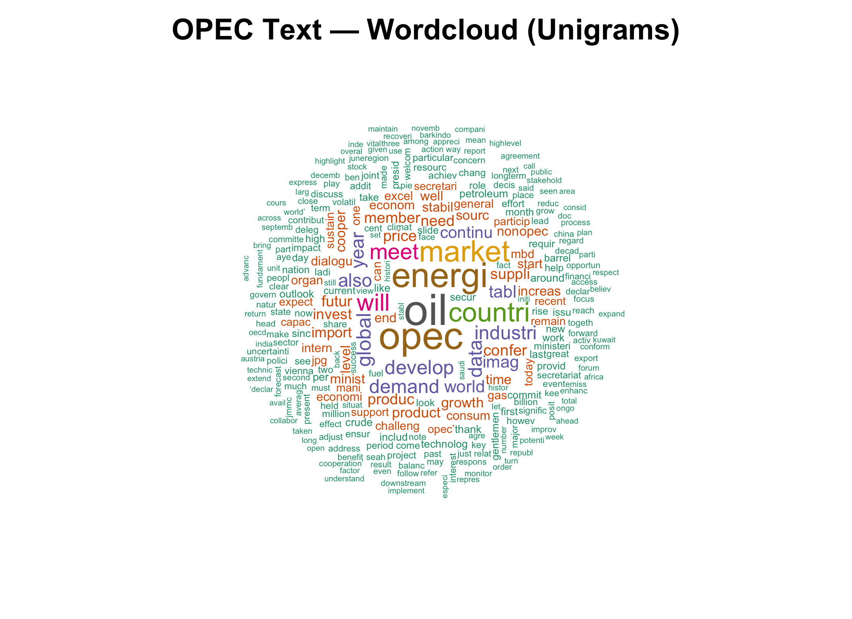

Text Descriptive and Wordclouds

Slide 10
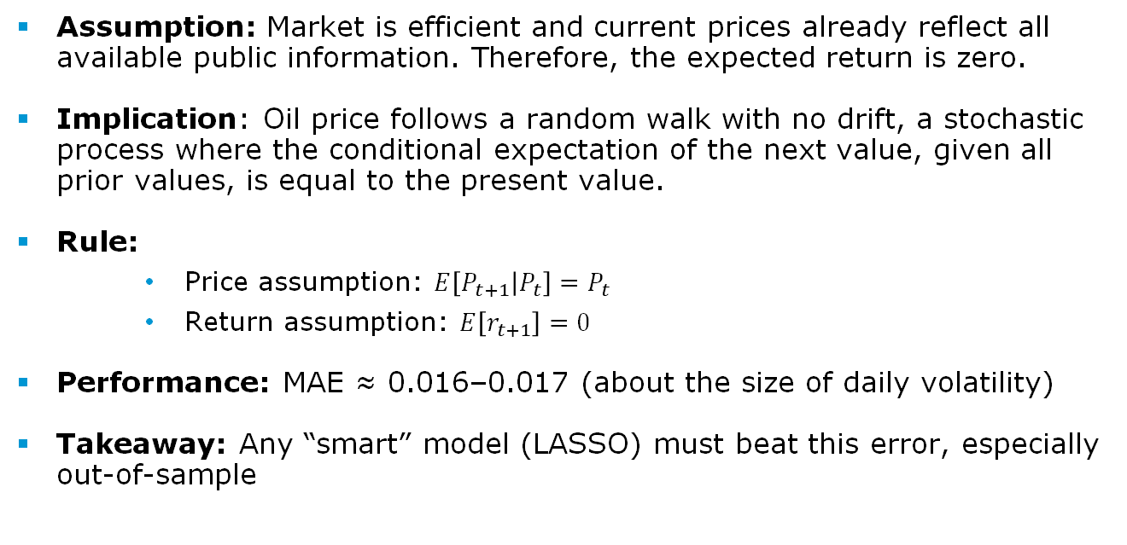
Naïve model
Assumption: Market is efficient and current prices already reflect all available public information. Therefore, the expected return is zero.
Implication: Oil price follows a random walk with no drift, a stochastic process where the conditional expectation of the next value, given all prior values, is equal to the present value.
Rule:
Price assumption: $E\left[P_{t+1} | P_{t}\right]=P_{t}$
Return assumption: $E\left[r_{t+1}\right]=0$
Performance: MAE ≈ 0.016–0.017 (about the size of daily volatility)
Takeaway: Any “smart” model (LASSO) must beat this error, especially out-of-sample

Slide 11
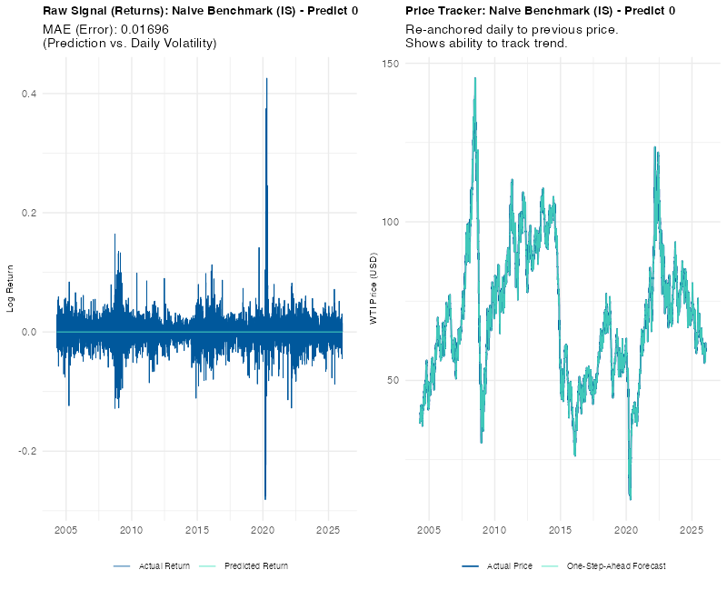
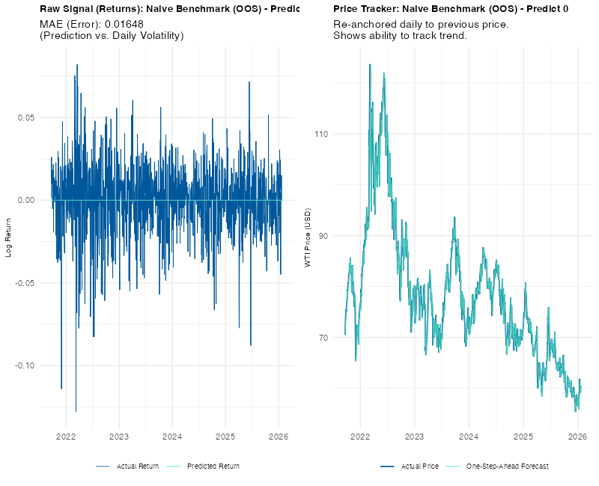
Naïve model

Slide 12
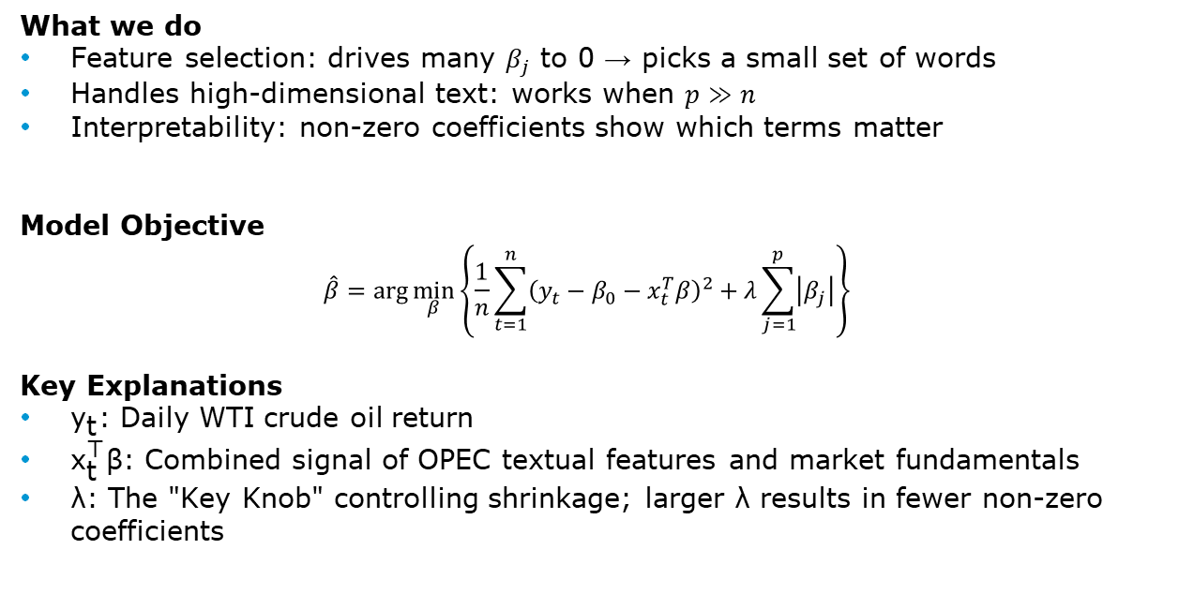
LASSO – Model Explanation
What we do
Feature selection: drives many $β_{j}$ to 0 → picks a small set of words
Handles high-dimensional text: works when $p≫n$
Interpretability: non-zero coefficients show which terms matter
Model Objective
$$\hat{β}=\arg{\min_{β}\left\{\frac{1}{n}\sum_{t=1}^{n}{{\left(y_{t}−β_{0}−x_{t}^{T}β\right)}^{2}+λ\sum_{j=1}^{p}{\left|β_{j}\right|}}\right\}}$$
Key Explanations
${\text{y}}_{\text{t}}$: Daily WTI crude oil return
${\text{x}}_{\text{t}}^{\text{⊤}}\text{β}$: Combined signal of OPEC textual features and market fundamentals
$\text{λ}$: The "Key Knob" controlling shrinkage; larger $\text{λ}$results in fewer non-zero coefficients

Slide 13
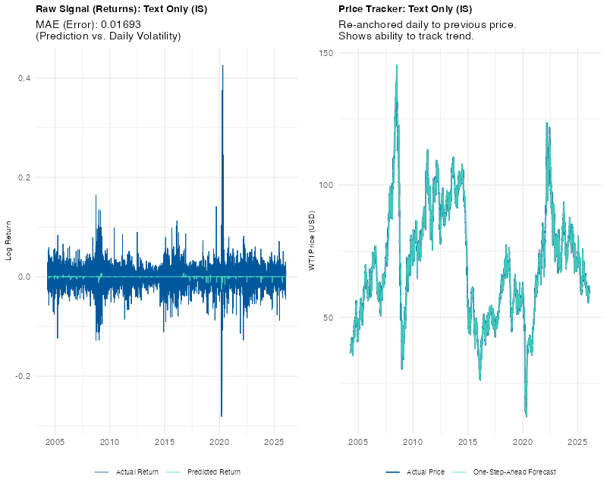
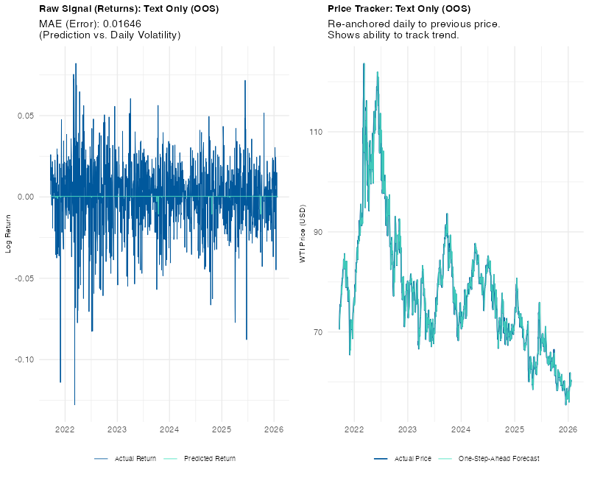
Lasso (text only)

Slide 14
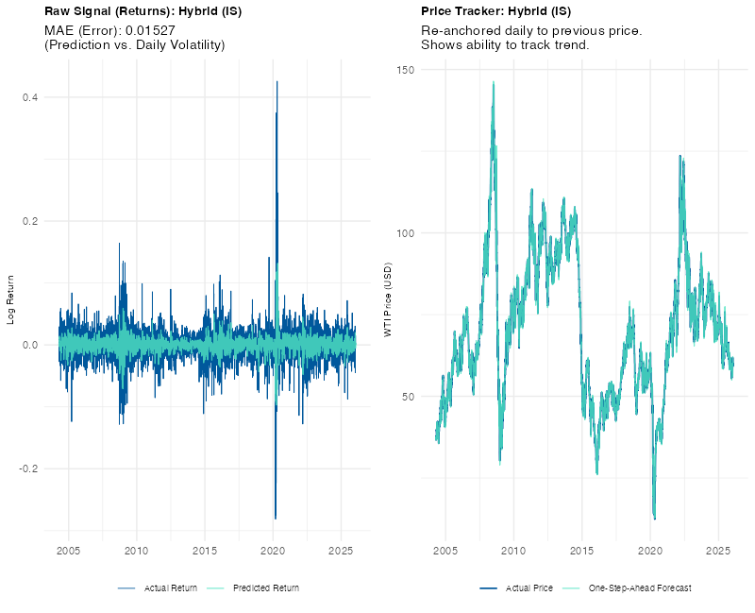
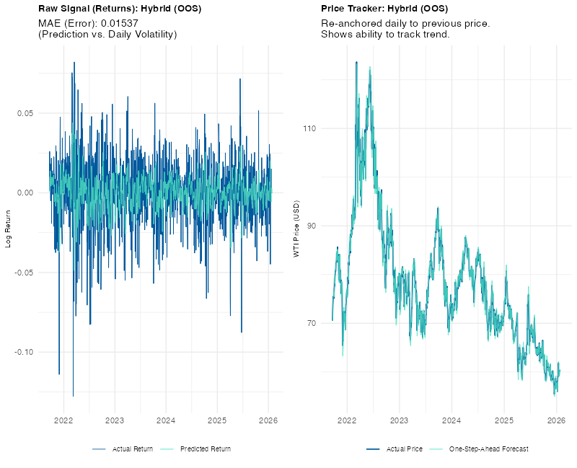
Lasso hybrid

Slide 15
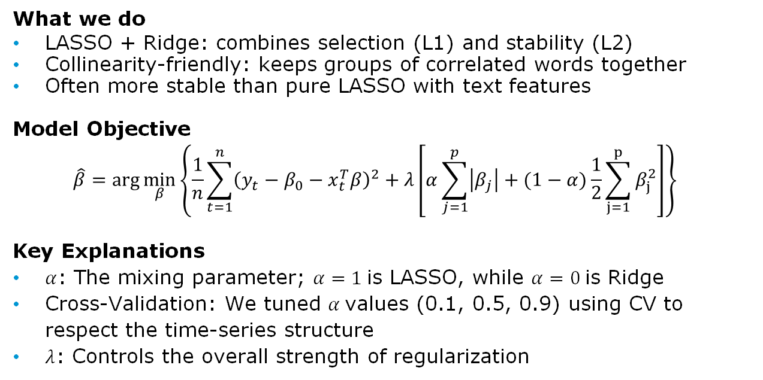
Elastic Net – Model Explanation
What we do
LASSO + Ridge: combines selection (L1) and stability (L2)
Collinearity-friendly: keeps groups of correlated words together
Often more stable than pure LASSO with text features
Model Objective
$$\hat{β}=\arg{\min_{β}\left\{\frac{1}{n}\sum_{t=1}^{n}{{\left(y_{t}−β_{0}−x_{t}^{T}β\right)}^{2}+λ\left[α\sum_{j=1}^{p}{\left|β_{j}\right|}+(1−α)\frac{1}{2}\sum_{j=1}^{p}{β_{j}^{2}}\right]}\right\}}$$
Key Explanations
$α$: The mixing parameter; $α=1$is LASSO, while $α=0$is Ridge
Cross-Validation: We tuned $α$values (0.1, 0.5, 0.9) using CV to respect the time-series structure
$λ$: Controls the overall strength of regularization

Slide 16
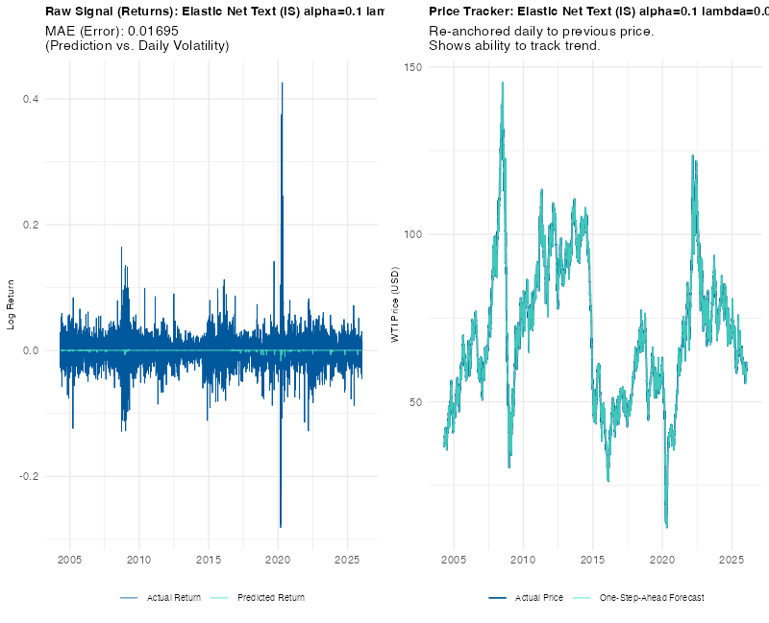
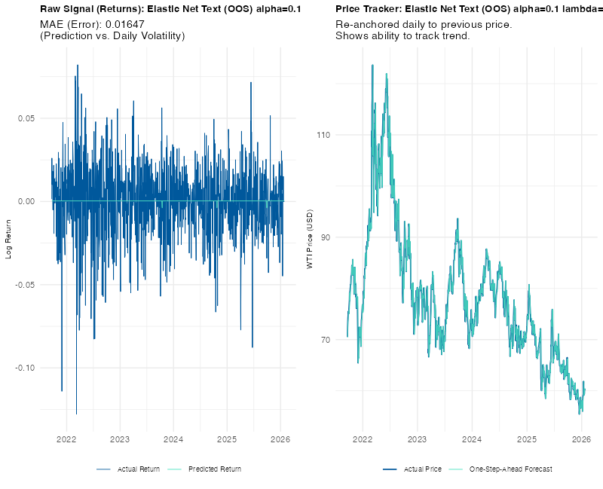
Elastic Net (text only)

Slide 17
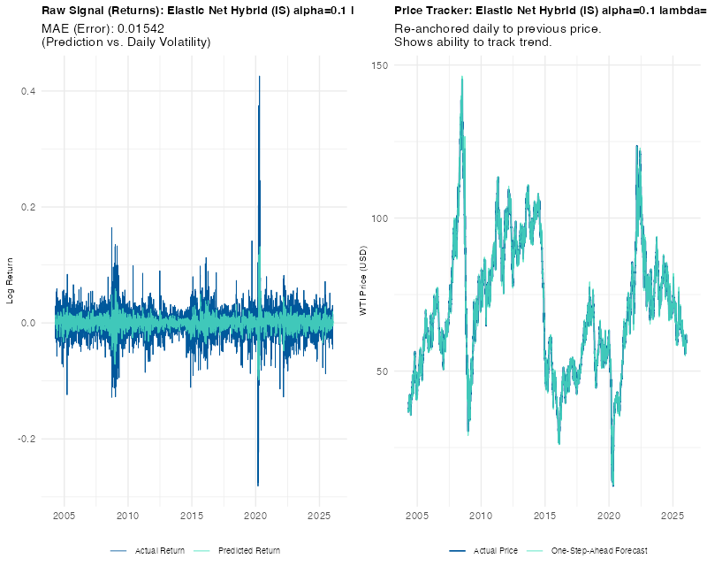
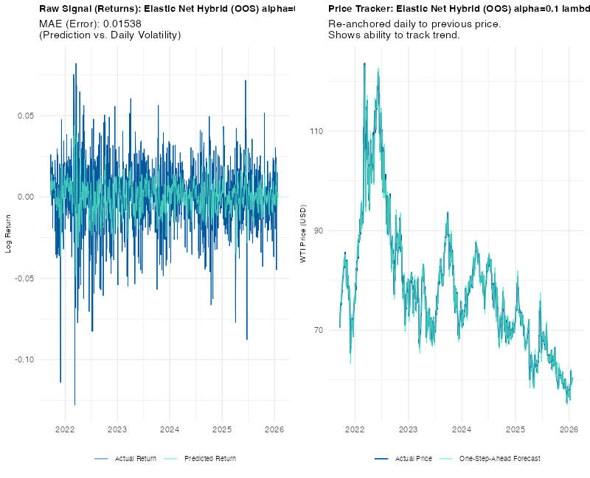
Elastic Net (hybrid)

Slide 18
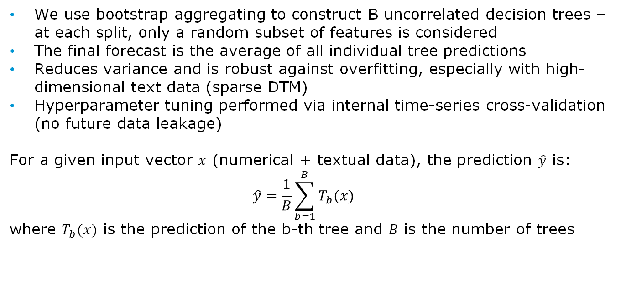
Random Forest
We use bootstrap aggregating to construct B uncorrelated decision trees – at each split, only a random subset of features is considered
The final forecast is the average of all individual tree predictions
Reduces variance and is robust against overfitting, especially with high-dimensional text data (sparse DTM)
Hyperparameter tuning performed via internal time-series cross-validation (no future data leakage)
For a given input vector $x$ (numerical + textual data), the prediction $\hat{y}$ is:
$$\hat{y}=\frac{1}{B}\sum_{b=1}^{B}{T_{b}(x)}$$
where $T_{b}(x)$ is the prediction of the b-th tree and $B$ is the number of trees

Slide 19
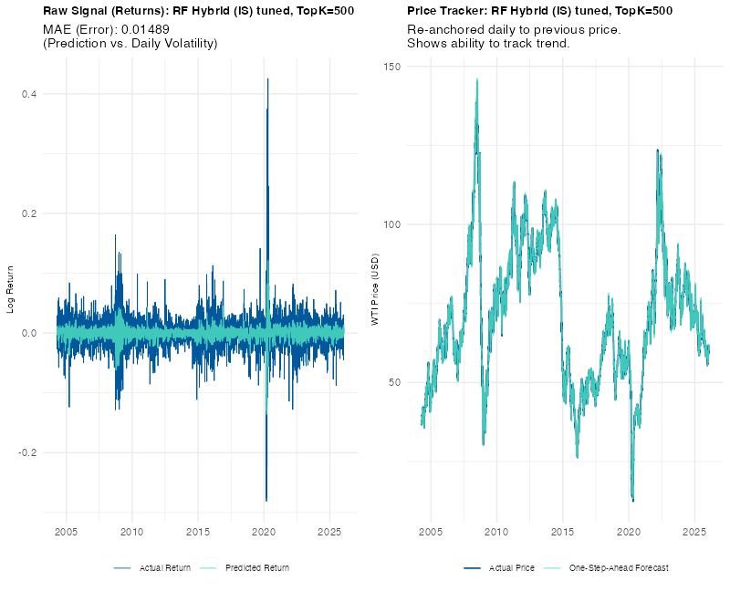
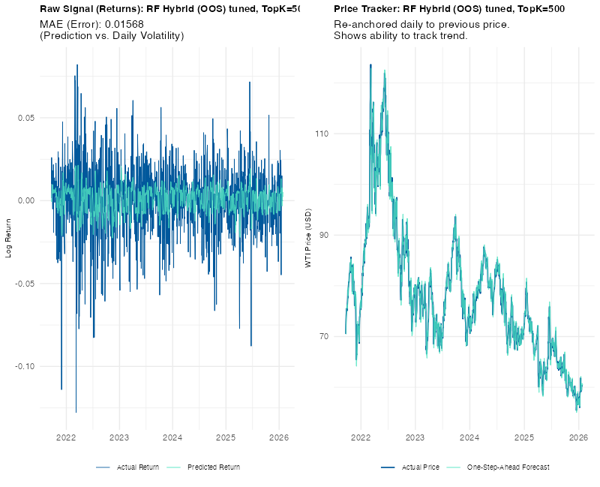
Random Forest
Time-series cross-validation selected a highly regularized configuration (Depth=12, MinNode=20) with a large ensemble of 2,000 trees and a 500-word vocabulary to stabilize predictions against noisy text data.

Slide 20
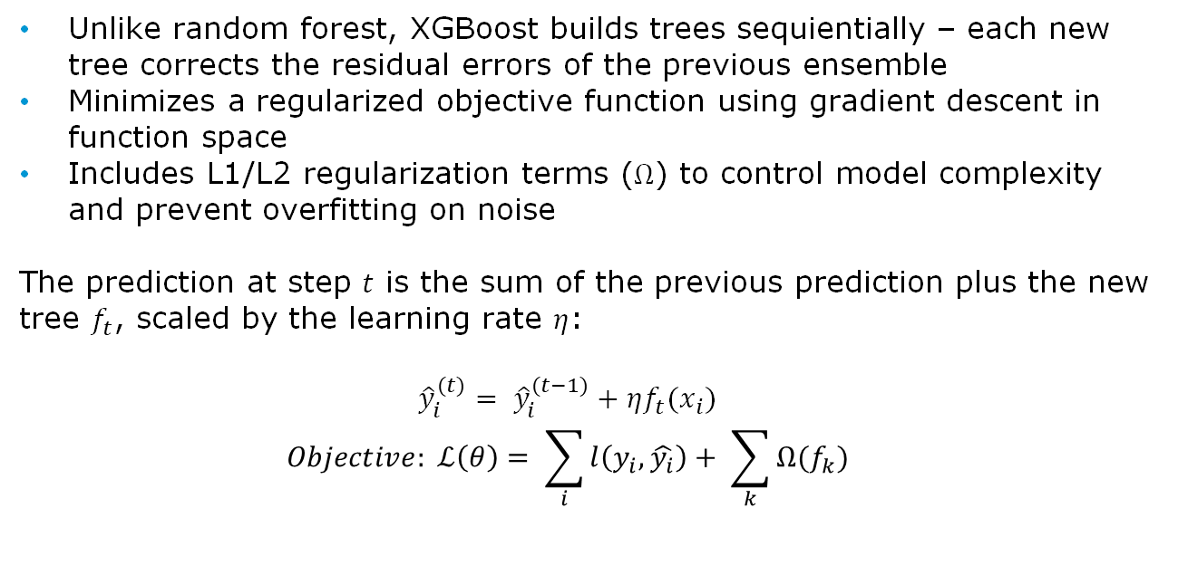
XGBoost (Gradient Boosting)
Unlike random forest, XGBoost builds trees sequientially – each new tree corrects the residual errors of the previous ensemble
Minimizes a regularized objective function using gradient descent in function space
Includes L1/L2 regularization terms ($Ω$) to control model complexity and prevent overfitting on noise
The prediction at step $t$ is the sum of the previous prediction plus the new tree $f_{t}$, scaled by the learning rate $η$:
$${\hat{y}}_{i}^{(t)}= {\hat{y}}_{i}^{(t−1)}+ηf_{t}(x_{i})$$
$$Objective: ℒ\left(θ\right)= \sum_{i}{l\left(y_{i}, \hat{y_{i}}\right)+ \sum_{k}{Ω(f_{k})}}$$

Slide 21
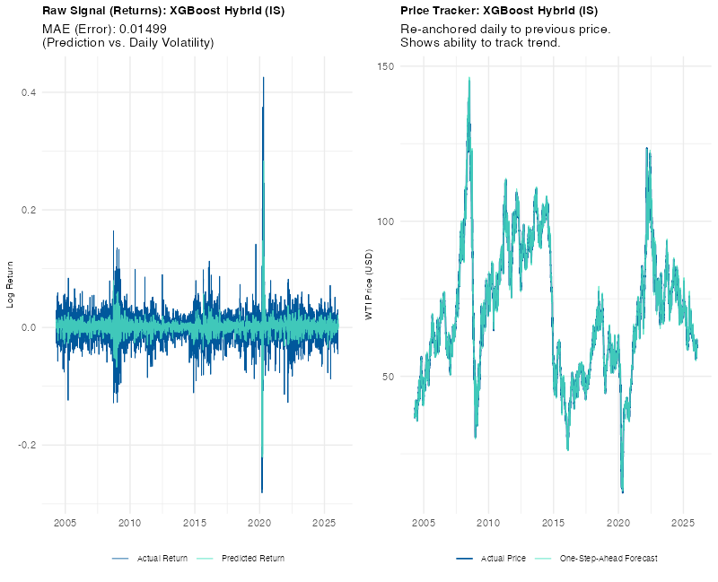
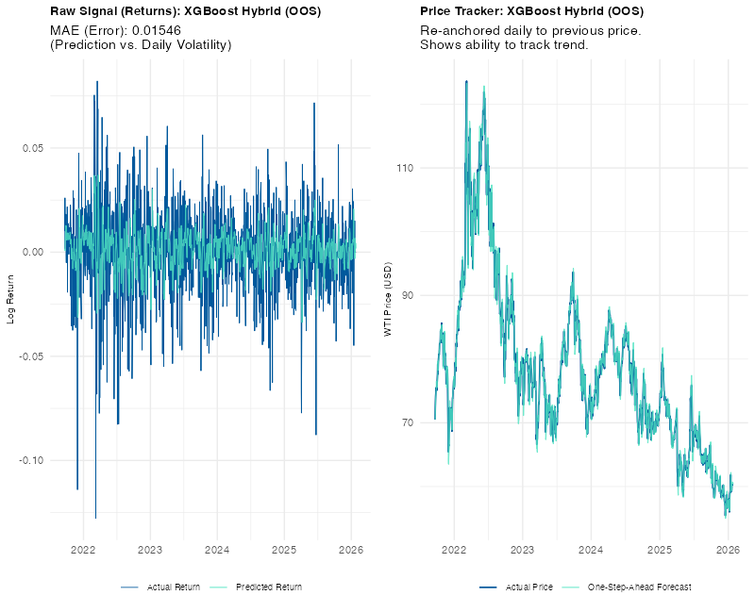
XGBoost
The model was tuned for maximum robustness, selecting a very conservative learning rate (η=0.01), shallow trees (Depth=3), and a strict 200-word vocabulary to prevent overfitting on the sparse textual features.

Slide 22
Overview of Results
Mean Absolute Error | Naïve | LASSO | Elastic Net | Random Forest | XGBoost
Text Only (in-sample) | 0.01696 | 0.01693 | 0.01695 | 0.01681 | 0.01654
Hybrid (in-sample) | 0.01696 | 0.01527 | 0.1542 | 0.01489 | 0.01499
Text Only (out-of-sample) | 0.01648 | 0.01646 | 0.01647 | 0.01649 | 0.01649
Hybrid (out-of-sample) | 0.01648 | 0.01537 | 0.01538 | 0.01568 | 0.01546
Combining text and macro data consistently beats the Naïve benchmark, proving sentiment adds predictive value.
The linear LASSO Hybrid model (MAE 0.01537) outperforms complex non-linear models (RF, XGBoost) on unseen data.
The best model reduces forecast error by ~6.7% compared to the market benchmark.
While Random Forest fits training data best (potential overfitting), LASSO generalizes best to the test set.

Slide 23
Limitations and Future Work
Limitations
Models predict only t+1, we did not test the ability to forecast longer-term trends
Document-term matrix ignores word order and context, and might therefore lose semantic nuance compared to modern NLP
Speeches and press releases are sporadic – on days without events, the text signal is zero
Future Research
Using the monthly OPEC oil market report, the monthly EIA short term energy outlook or the EIA weekly patroleum status report as alternative/additional data sources
Test predictive power over longer horizons
Focus on intraday volatility impact in the minutes/hours following a speech/press release

Slide 24
Conclusion
Combining textual sentiment with macroeconomic fundamentals consistently outperforms the Naïve benchmark, reducing the out-of-sample forecast error by ~6.7% (LASSO Hybrid).
Quantitative fundamentals remain the primary drivers of oil price trends, with Momentum (Lagged Returns), Volatility (VIX), and Currency Strength (DXY) identified as the strongest predictors across all models.
Qualitative text features—specifically those related to OPEC events (e.g., 'secretariat', 'vienna')—rank within the top predictors, providing a distinct "fine-tuning" signal that captures market reactions to specific policy announcements.
The linear LASSO model achieved the highest out-of-sample accuracy, outperforming complex non-linear models (Random Forest, XGBoost), suggesting that strict feature selection is more effective than model complexity in noisy financial environments.
The ability to systematically beat the random walk suggests that the oil market is not fully efficient and contains exploitable information asymmetries embedded in qualitative communications.

Slide 25
Thank you for your attention!

