Slide 1

Detecting Derogatory Slur Usage
with a Span-Aware Transformer
RAPT: Reclamation/Reappropriation-Aware Processing Transformer
Text Mining and Search (TM&S) — Course Project
Hrutuja Girish Kargirwar (925351) · Nastaran Janialiabadi (922779)

Slide 2



Same word, three different meanings
A classifier that only reacts to a word, not its context, will get most of these wrong.
Attack
Neutral / descriptive
Reclaimed
“you f***ing [slur]”
“the [slur] pill” (referring to hormones)
“we reclaim the word [slur]”
This project: classify DEG (derogatory) vs. non-DEG usage, from context — not just the word.

Slide 3
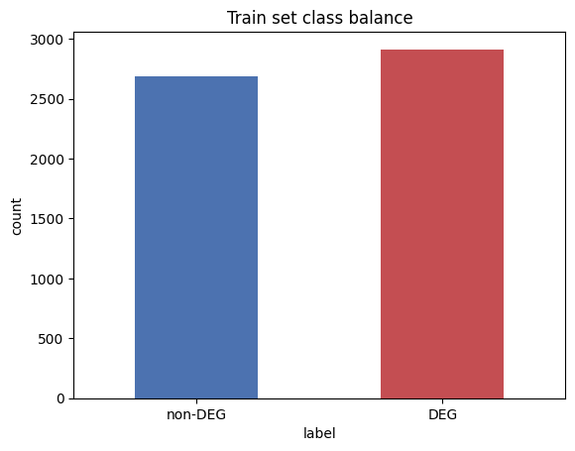
Dataset: the Slur Corpus
Kurrek, Saleem & Ruths (2020) — Workshop on Online Abuse and Harms, ACL
40,003
Reddit comments
3
slur terms covered
DEG vs. non-DEG
binary task (from 5 gold labels)
Train-split class balance — near-even, so macro-F1 is a fair metric.

Slide 4


Two required core tasks
Task 1: Classification
Task 2: Clustering
Is this use of the slur derogatory (DEG) or not?
Four models compared, two text representations.
Do the learned embeddings separate into DEG / non-DEG groups on their own — with no labels used?

Slide 5


Two representations need two pipelines
Classical → TF-IDF
Transformer → XLM-R
1. Tokenize
1. Normalize URLs only
2. Lowercase
2. Mark [SLUR] span
3. Remove stopwords
3. (nothing else)
4. Stem (Porter)
Needed: TF-IDF treats each word form as an independent feature.
Skipped on purpose: stemming/stopword removal would destroy the context (e.g. negation) the model relies on.

Slide 6


Four models, head to head
TF-IDF + Logistic Regression
TF-IDF + Linear SVM
CLS-only Transformer
RAPT (ours)
Classical, linear, interpretable
Second classical baseline
Plain XLM-R fine-tuning
Span-aware fusion — our contribution
MAIN CONTRIBUTION

Slide 7
Inside RAPT: two views of the same sentence
“ you f***ing [SLUR] tranny [/SLUR] get out ”
Shared XLM-R Encoder (self-attention)
h_slur
h_cls
Mean of token embeddings inside [SLUR]...[/SLUR] — local, term-specific view
[CLS] token embedding — whole-sentence context
h = [ h_slur ; h_cls ] → MLP
DEG or non-DEG

Slide 8

A real bug we found and fixed
The problem
The fix
Reddit comments are long — longer than 128 tokens.
Slur position was computed before truncation.
Slicing past the truncated end gave an empty tensor.
mean() of an empty tensor = NaN → model died from step 1.
If the slur span would be truncated away,
fall back to h_slur = h_cls instead of crashing.
Added gradient clipping as extra safety.
Result: RAPT trains normally, reaching
0.875 test macro F1 (next slides).

Slide 9
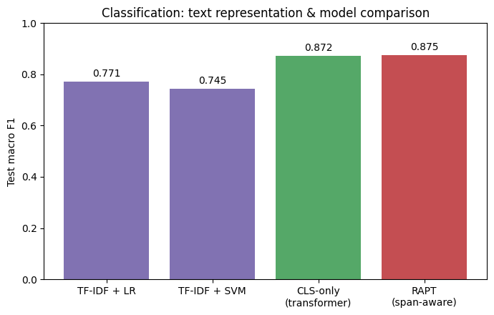
Classification results
+10 F1 points from representation alone — context beats bag-of-words

Slide 10
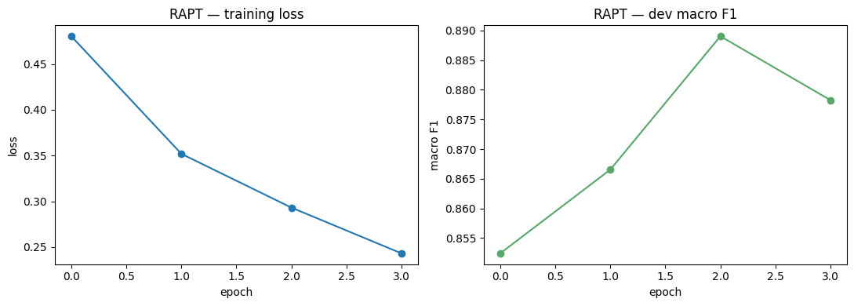
Training dynamics (RAPT)
Loss falls monotonically; dev F1 peaks at epoch 3 (0.889), dips slightly at epoch 4 — mild overfitting.
We keep the best checkpoint, not the last one — the CLS-only baseline follows a near-identical trajectory.

Slide 11
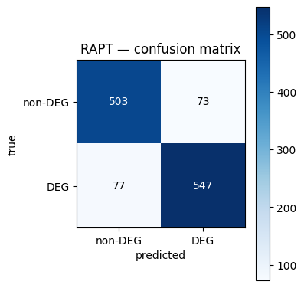
Where RAPT gets it wrong
503
correctly identified as non-DEG
547
correctly identified as DEG
73
false positives (flagged DEG, actually fine)
77
false negatives (missed a derogatory use)
Errors are close to symmetric — no strong bias toward over- or under-flagging.

Slide 12
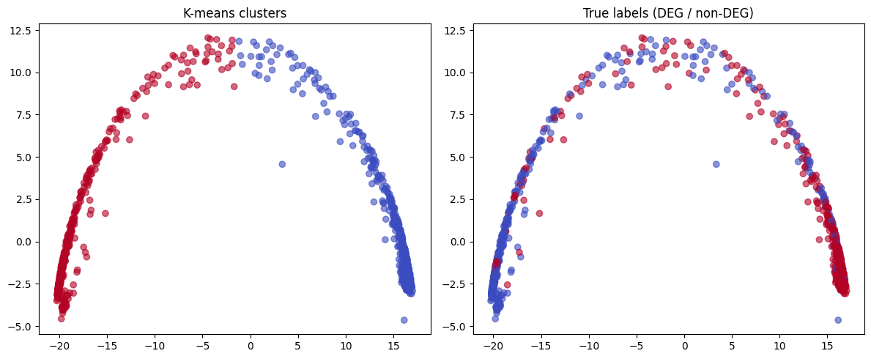
Task 2: do the embeddings self-organize?
0.501
Adjusted Rand Index
vs. true labels
0.796
Silhouette score
(cluster separation)
K-means clusters (left) vs. true DEG/non-DEG labels (right) — same PCA projection of RAPT's [CLS] embeddings, no labels used to cluster.
The classifier's learned embeddings carry a strong, separable derogatory/non-derogatory signal — even without ever using the labels to cluster.

Slide 13

An honest limitation: negation
“He is a [slur].”
predicted: DEG
“He is NOT a [slur].”
predicted: DEG (wrong)
The model leans on “slur present → derogatory” more than full grammatical parsing — a known failure mode in hate-speech classifiers (Röttger et al., HateCheck, 2021), not a code bug.

Slide 14




Conclusion
Contextual embeddings clearly beat classical TF-IDF (+10 F1 points).
RAPT's span-aware fusion adds a further modest gain (+0.3 F1) over plain [CLS] fine-tuning.
Clustering recovers real label structure (ARI 0.50) with zero label supervision.
A real truncation bug (NaN loss) was found and fixed — documented for reproducibility.
Negation handling remains an open limitation — flagged honestly as future work.

Slide 15
Thank you
Questions?
Hrutuja Girish Kargirwar (925351) · Nastaran Janialiabadi (922779)

