Slide 1
Design a LPF on Verilog

Slide 2
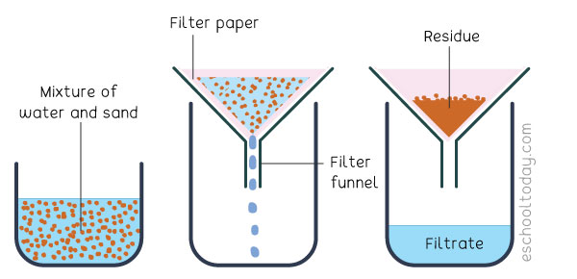
Filter..???
The preprocessing step, where the corruptive noise is removed before processing these signals using sophisticated devices.Useful in processing audio signals, EEG signals, seismological signals…etc.

Slide 3
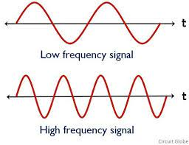
Low Pass Filter..???
A Low Pass Filter pass low frequency signals and filters out High Frequency signals

Slide 4
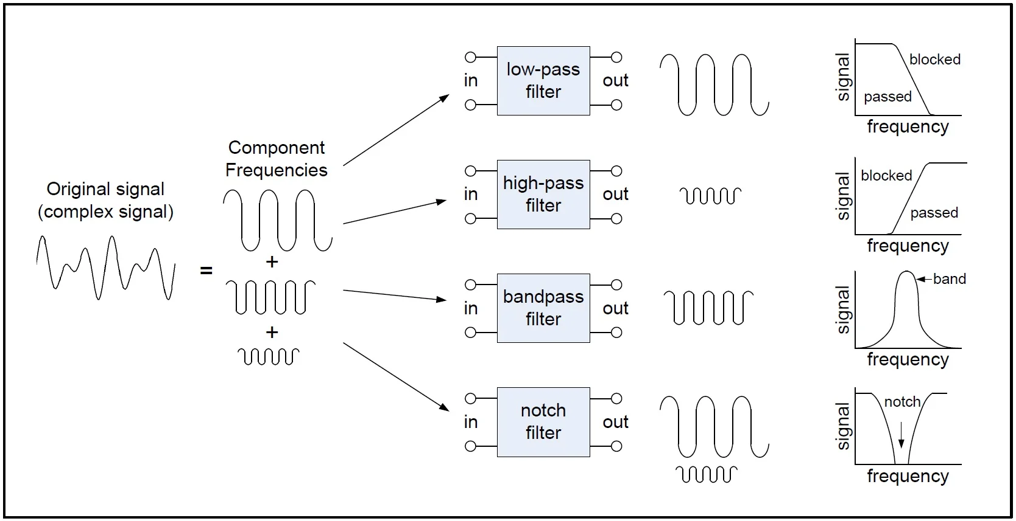

Slide 5
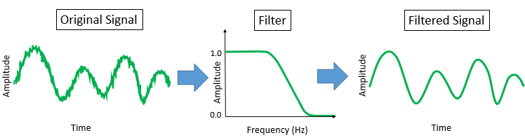

Slide 6
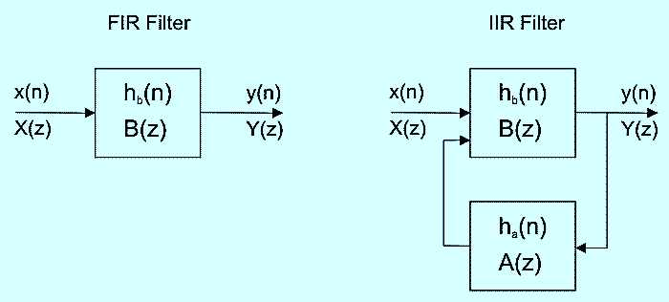
TYPES OF DIGITAL FILTERS
FIR (FINITE IMPULSE RESPONSE)(No Feedback)
IIR (INFINTE IMPULSE RESPONSE)(Feedback)

Slide 7
Creating a Digital Filter
Approximation
Realization
Study of arithmetic errors
Implementation

Slide 8
1.Approximation
A transfer function satisfy the desired specifications.
Methods to perform this can be classified in two ways, as
direct vs. indirect
closedform vs. iterative.
Nonrecursive filters are designed by using direct noniterative or iterative methods
whereas recursive filters are designed by using indirect noniterative methods or direct iterative methods.

Slide 9
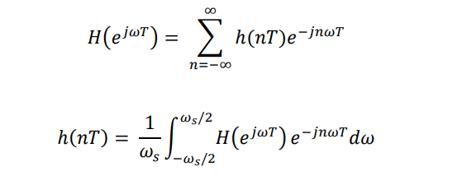
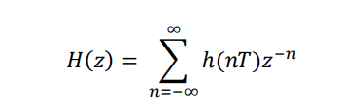
Approximation
The approximation problem for nonrecursive filters can be solved in two ways:
Applying the Fourier series
Using numerical analysis formulas

Slide 10
Key Observations
This filter is of infinite order and has infinite length in time domain since ℎ(𝑛𝑇) is defined for all real values of 𝑛. Such filters cannot be realized in reality.
This filter is non-causal since ℎ(𝑛𝑇) ≠ 0 for 𝑛 < 0 . Non-causal filters cannot be implemented in reality

Slide 11
How to solve?/
Truncate the signal in time domain to make it a N-length signal. I.e
However, this filter is still non-causal. To make it causal, we can delay ℎ(𝑛𝑇) by ( 𝑁−1 2 ) sampling periods. Through properties of Z transform,

Slide 12
Window Functions
Window Functions However, abruptly truncating the impulse response in time domain will produce unwanted oscillations near cut off frequencies in the passband and stopband. These are known as Gibbs’ oscillations. To reduce the oscillations, we can use a time domain window function 𝑤(𝑛𝑇) rather than directly truncating the signal. Usage of different windows will result in different oscillation properties of the windowed impulse response ℎ𝑤(𝑛𝑇) ℎ𝑤(𝑛𝑇) = 𝑤(𝑛𝑡)ℎ(𝑛𝑇)

Slide 13
The different kinds of window functions we can use are: 1. Rectangular Window 𝑤𝑅 (𝑛𝑇) = { 1, |𝑛| < 𝑁−1 2 0, 𝑜𝑡ℎ𝑒𝑟𝑤𝑖𝑠𝑒 2. Von Hann & Hamming Windows 𝑤𝐻(𝑛𝑇) = { 𝛼 + (1 − 𝛼) cos ( 2𝜋𝑛 𝑁 − 1 ) , |𝑛| < 𝑁 − 1 2 0, 𝑜𝑡ℎ𝑒𝑟𝑤𝑖𝑠𝑒 3. Blackman Window 𝑤𝐵(𝑛𝑇) = { 0.42 + 0.5 cos ( 2𝜋𝑛 𝑁 − 1 ) , |𝑛| < 𝑁 − 1 2 0, 𝑜𝑡ℎ𝑒𝑟𝑤𝑖𝑠𝑒 4. Dolph-Chebyshev Window 𝑇𝑘 (𝑥) is 𝑘th order Chebyshev Polynomial 𝑤𝐷𝐶(𝑛𝑇) = 1 𝑁 [ 1 𝑟 + 2 ∑ 𝑇𝑁−1 (𝑥0𝑐𝑜𝑠 ( 𝑖𝜋 𝑁 )) 𝑐𝑜𝑠 𝑁−1 2 𝑖=1 ( 2𝑛𝜋𝑖 𝑁 ) ]

Slide 14
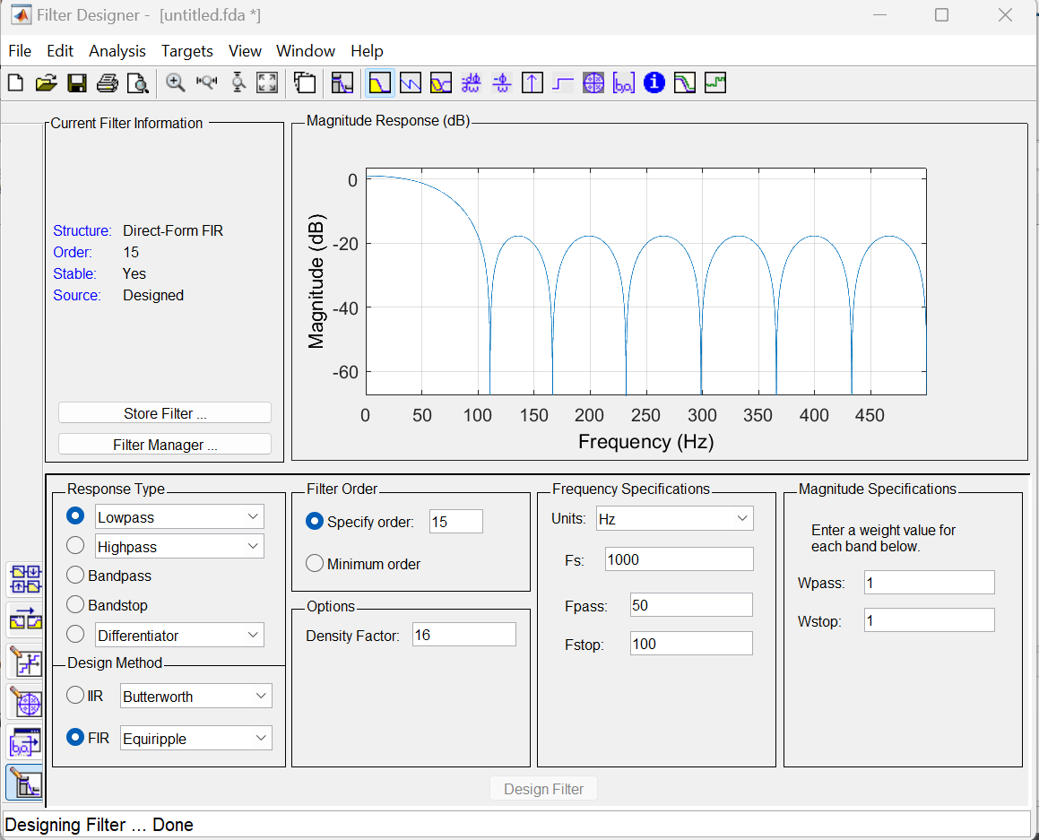

Slide 15

Numerator:
-0.057647118056141845310325066975565277971
0.02110257461684859198181030137675406877
0.037805268783872275628610282183217350394
0.062538520841603412181441967732098419219
0.091164983806777108443775148316490231082
0.118497200824061676982523749757092446089
0.139948226852041779366686569119337946177
0.151767210901748106355313439053134061396
0.151767210901748106355313439053134061396
0.139948226852041779366686569119337946177
0.118497200824061676982523749757092446089
0.091164983806777108443775148316490231082
0.062538520841603412181441967732098419219
0.037805268783872275628610282183217350394
0.02110257461684859198181030137675406877
-0.057647118056141845310325066975565277971

Slide 16
If we wnat to multiply a complex number its ver tedious job so we need to filter the signal
USeful Links:
https://www.mathworks.com/help/dsp/ug/generate-hdl-code-for-programmable-fir-filter.html

Slide 17
The design of filters involves the following stages:
1.Specification of the desired properties
2.Appproximation of specification using causula discret time systems
3. Realization of system

