Slide 1
Bandit-Based Material Screening
Why it matters
Every alloy test costs time, material and money
Uniform testing wastes budget on weak candidates
A bandit decides which alloy to test next, trading off exploring and exploiting
Original problem statement
“A multi-armed or contextual bandit that chooses which candidate alloys or compounds to 'test' next from a public dataset (e.g., Matbench).”
Application
Screening candidate steels for high yield strength (MPa) under a fixed test budget
Prepared by:
Gali Hrudya 100523729020 | Komari Pujyank 100523729031 | Sai Nanditha Azmera 100523729055
Notes:
Motivation: limited experimental budget. The statement is verbatim from the professor. I implemented the multi-armed variant.

Slide 2
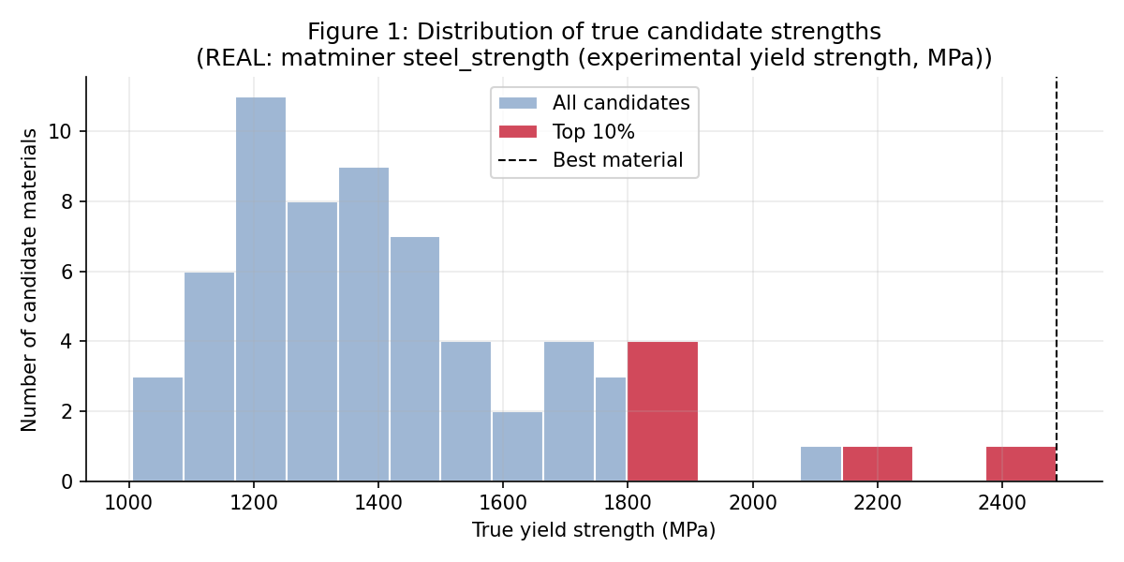
Environment and bandit formulation
Environment
60 candidate steels, hidden true strength, noisy tests
Arm / Action
Each steel is an arm; the action is which steel to test next
State
Stateless; belief summarised by counts and mean estimates
Reward
Observed strength = true mean + Normal noise (SD 100 MPa)
Horizon
300 tests, same for every algorithm
Pool: 60 real steels sampled from matminer steel_strength. Reported yield strengths are the hidden true means. Measurement noise is simulated.
Objective
Maximise reward, minimise regret, find the best steel
Notes:
State, action, reward, environment. No leakage: the agent only sees noisy rewards. Same noise table per seed for all algorithms.

Slide 3
Algorithms compared
Random
Epsilon-Greedy
P(a) = 1/K
Q ← Q + (r − Q) / N
No learning. Pure exploration. The baseline.
Exploit the best Q; explore at random with probability 0.1.
UCB1
Thompson Sampling
argmax Q + c√(2 ln t / N)
sample μ ~ N(m, 1/λ), play argmax
Optimism: rarely tested alloys get a bonus. c = 1 standard.
Sample beliefs; explore where uncertainty is high.
Notes:
Thompson uses a Gaussian posterior with known noise SD and prior N(1000, 500^2). UCB1 rewards are scaled to [0,1] by 2500 MPa. An extra UCB1 variant with c=0.1 is reported as a sensitivity check.

Slide 4
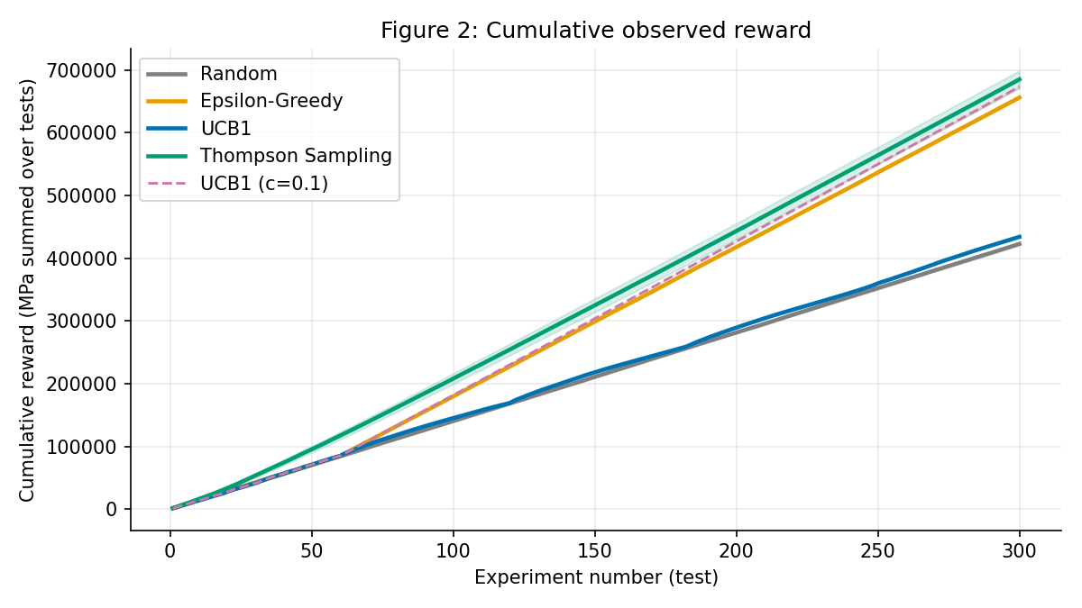
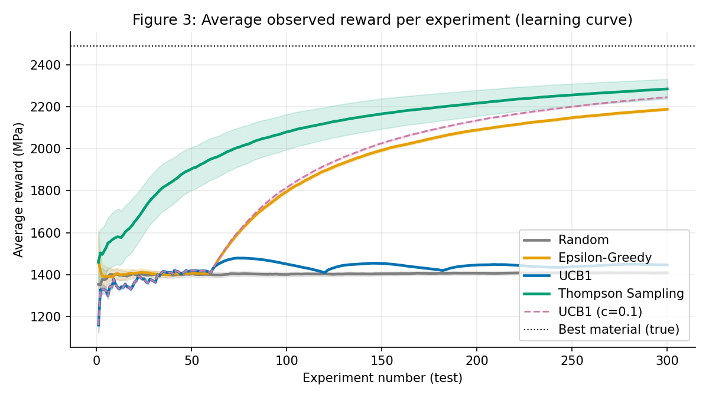
Results across 30 seeds
Algorithm | Cumulative reward (MPa) | Cumulative regret (MPa) | Best-steel ID
Random | 422,827 | 323,156 | 100%
Epsilon-Greedy | 656,257 | 89,898 | 100%
UCB1 | 434,094 | 312,026 | 100%
Thompson Sampling | 685,205 | 60,954 | 93%
Mean over 30 seeds, 300 tests, real steel pool, simulated noise. Oracle reward would be about 746,190. Plain UCB1 (c = 1) is still exploring at this budget.
Notes:
Thompson best on reward and regret but found the best steel in 93% of runs; the others found it in 100%, so identification does not separate methods here. UCB1 with c=1 is close to random at this budget; with c=0.1 it is close to Thompson on reward. Thompson is given the noise SD, which is part of its advantage.

Slide 5
Conclusion, limitations, ethics
Conclusion
Limitations
Ethics
Learning methods beat random testing
Thompson Sampling: highest reward and lowest regret; best steel found in 93% of runs
UCB1 needs a smaller exploration scale at this budget
Noise is simulated: dataset values treated as true means
Only 60 of 312 steels, one budget setting
Arms independent; no composition features used
Never present simulated values as measurements
Screening aid only; safety-critical use needs validation
Public data may favour well-studied alloys
Notes:
Data: real yield strengths of 60 steels sampled from matminer steel_strength; noise is simulated. Next steps: add composition features as context (contextual bandit) and try other budgets.

