Slide 1

MSPM’S
Deogiri Institute of Engineering and Management Studies,
Aurangabad
Department of Computer Science and Engineering
Subject: Theory of Computation
Topic: Password Generation
Submitted by
Hrugved Chavan (36136)
Dhiraj Upadhyay (36135)
Under the Guidance of
Dr. Sarika Chavan
Asst.Prof.Department of CSE
(Deogiri Institute Engineering and Management Studies)
2019-2020

Slide 2
INTRODUCTION
In search, we simply need to start from the first state of the automata and the first character of the text. At every step, we consider next character of text, look for the next state in the built FA and move to a new state. If we reach the final state, then the pattern is found in the text. The time complexity of the search process is O(n).

Slide 3
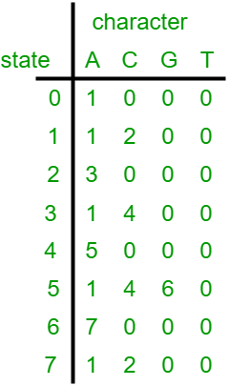
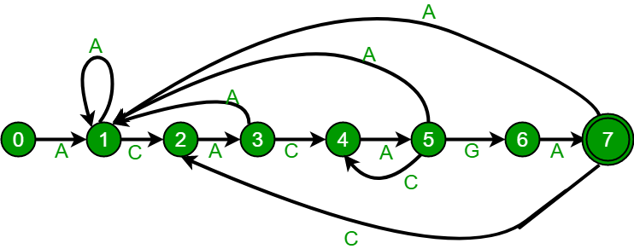

Slide 4
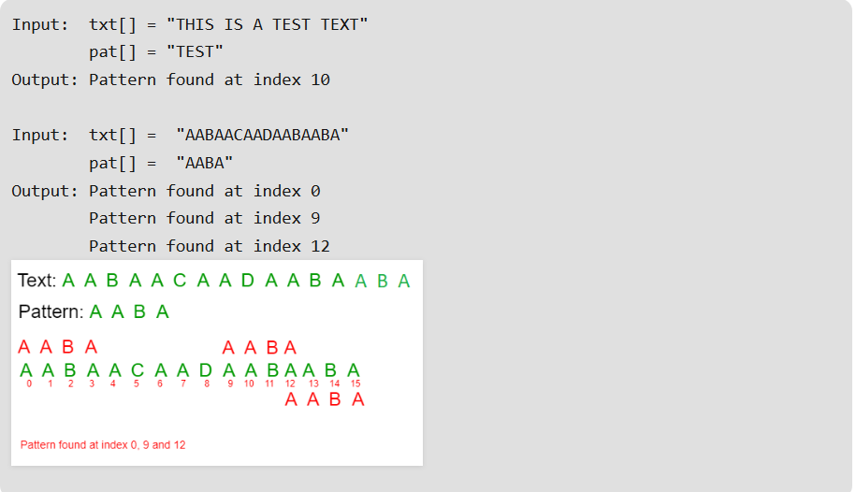
WORKING

Slide 5
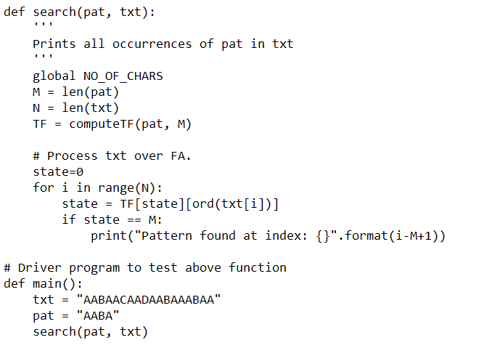

Slide 6
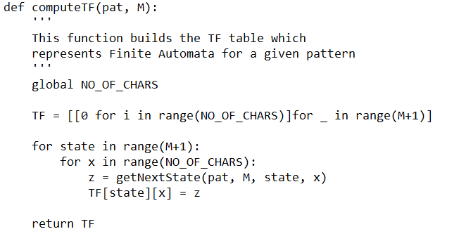

Slide 7
