Slide 1
Group No :19
Problem Statement : Music Genre Classification
Music genre classification is the task of automatically identifying the genre of a music track based on audio characteristics.
With millions of songs available online, manual categorization becomes inefficient.
Machine learning helps automatically classify music based on patterns in sound signals.
Applications:
➤Music streaming platforms
➤Recommendation systems

Slide 2
Objective
Goal: Build a machine learning model that predicts the genre of music using audio features.
Input: Audio file
Output: Predicted genre label
Learning type: Supervised Learning (Multi-class classification)
Genres: Blues, Classical, Country, Disco, HipHop, Jazz, Metal, Pop, Reggae, Rock

Slide 3
Dataset Description
Dataset Used: GTZAN dataset
Dataset characteristics:
1000 audio tracks
10 music genres
30 seconds per audio file
Balanced dataset (100 audio tracks per genre)
Feature extraction: Audio converted into spectrogram using Librosa library.
Spectrogram size: 128 × 1292 spectrogram representation.

Slide 4
Models Used
LEGEND:- K-KERNEL, S-STRIDE,
P-PADDING
Convolutional Neural Network | Residual Neural Network
Conv Block 1 Conv(1→16, K4, P2) → BN → ReLU → MaxPool(K5,S5) | Conv Block: (1→16, K4, P2) → BN → ReLU → MaxPool(K3, S3)
Conv Block 2 Conv(16→32, K4, P2)→ BN → ReLU → MaxPool(K5,S5) | Residual Block 1: [Conv(16→32, K3) → BN → ReLU → Conv(32→32, K3) → BN] + Skip(K1) Output: 32 channels
Classifier Flatten(8160) → FC(8160→256) → ReLU → Dropout(0.67) → FC(256→10) | Residual Block 2: [Conv(32→64,K3) → BN → ReLU → Conv(64→64, K3) → BN] + Skip(K1) Output: 64 channels
Output: genre probabilities | Residual Block 3: [Conv(64→128, K3) → BN → ReLU → Conv(128→128, K3) → BN] + Skip(K1) Output: 128 channels
 | Output Layers: AdaptiveAvgPool → Flatten → FC(128→10) Output: genre probabilities

Slide 5
Models Used
LEGEND:- K-KERNEL, S-STRIDE,
P-PADDING
Mobile Net v2 | RBF SVM
Conv Block Conv(1→32, K3, S2, P1) → BN → ReLU6 | Input Features Log Mel Spectrogram → Flatten
Inverted Residual Blocks [Expand → DepthwiseConv(K3) → BN → ReLU6 → Project] + Skip (when dims match) | Scaling StandardScaler() (mean=0, variance=1)
Block sequence: IR(32→16) → IR(16→24)×2 → IR(24→32)×3 → IR(32→64)×4 → IR(64→96)×3 → IR(96→160)×3 → IR(160→320) | Dimensionality Reduction PCA(variance retained = 92%) Reduces feature size while preserving information
Final Conv: Conv1×1(320→1280) → BN → ReLU6 Classifier GlobalAvgPool → FC(1280→10) | Classifier SVM(RBF kernel) Kernel K(x,y) = exp(-γ‖x − y‖²) [C = 1, γ = scale]
Output Genre probabilities | Output Predicted genre label

Slide 6
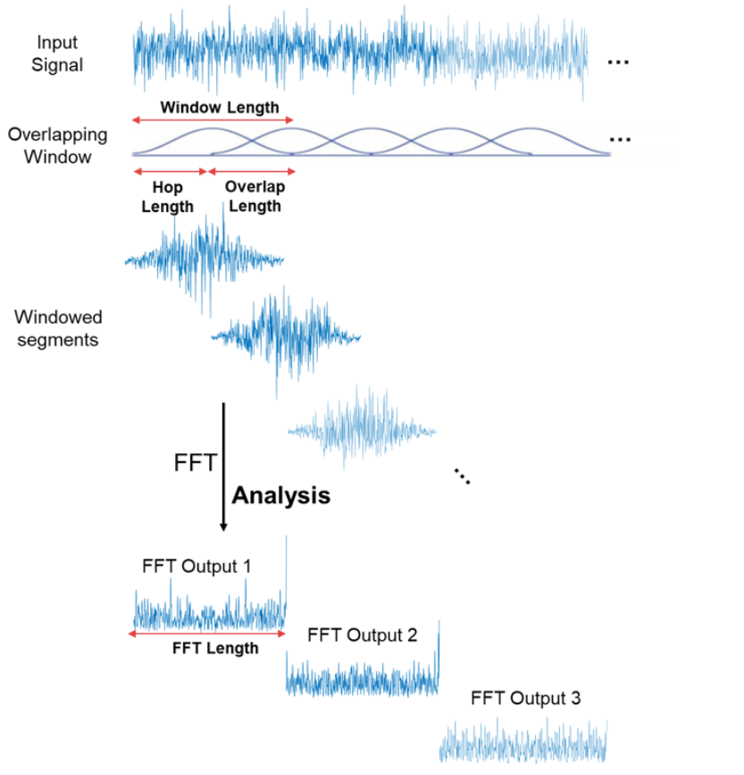
Efforts & Methodology
Feature Extraction using Short Time Fourier Transform
Audio signals are converted into frequency domain using Short-Time Fourier Transform (STFT) which is applied over small windows.
STFT analyzes frequency content over small time windows.
Steps:
1) Divide audio into small frames
2) Apply Fourier transform (FFT)
3) Obtain time-frequency representation
Window length is the number of audio samples taken at once to analyze the signal.
Hop length is how many samples we move forward before taking the next window.
*Smaller the hop length, greater is the overlap, smoother is the spectrogram but computation also increases.
Img Source: https://www.mathworks.com/help/dsp/ref/dsp.stft.html

Slide 7
Efforts & Methodology
Mel Spectrogram
Mel scale represents frequencies according to human hearing perception.
Humans perceive pitch logarithmically, not linearly.
Difference between 100 Hz → 200 Hz sounds big
Difference between 10000 Hz → 10100 Hz sounds very small
Mel scale adjusts frequency axis to reflect this perception. Without Mel scaling, the model would treat the pitch difference between 10 kHz and 10.1 kHz as similar to the difference between 100 Hz and 200 Hz, which is not correct according to human perception. This is why mel scale works well for sound analysis.
STFT output was converted into the Mel scale. Additionally, loudness normalization using decibel (log) scaling was applied, since humans perceive loudness logarithmically. Without log scaling, large amplitude values dominate the feature space, making the model sensitive to volume rather than meaningful spectral patterns. Finally, min–max normalization was applied.
Mel Spectrogram captures
Time Info
Frequency Info
Loudness
We directly passed the Mel spectrogram array as input to the model instead of converting it to an image, resulting in faster training and preprocessing.

Slide 8
Efforts & Methodology
Model Training Process
Initially in spectrogram generation, kept the hop-length equal to the window-size which led to no overlap between consecutive windows leading to information loss, then hop-length was set to be half of window-size
Initially defined model parameters and trained the network
Observed very low validation accuracy (~50%) despite very low loss (~0.01) → indication of poor generalization / overfitting
Modified hyperparameters (learning rate, output-channels, apply batch-normalization, kernel-size, apply max-pooling, varying stride) to improve generalization.
Stored the current max validation accuracy and saved model whenever current validation accuracy exceeded max validation accuracy
Repeated training–tuning cycle multiple times until achieving reasonable validation accuracy (~70–73%) with loss ~0.65–0.7
Final model was retrained multiple times, since optimization may converge to different local minima
Selected the model run achieving satisfactory performance (80%+ test accuracy)

Slide 9
Efforts & Methodology
Challenges Faced
1) GTZAN dataset contains only 100 samples per genre, which is relatively small for deep learning.
Deep learning models like CNN and ResNet usually perform better with large datasets.
2) The split was 85:10:5 (train:validate:test) due to the small dataset. Only 5 test samples per class were available due to which performance metrics fluctuate more
3) Since the model was trained on 30s samples, testing must also be done on 30s samples to match spectrogram dimensions. If larger samples (e.g., 1 min) were used, hop length and window size would need to be increased to maintain spectrogram dimensions, leading to loss of time-frequency resolution. 30s duration is sometimes insufficient to accurately classify genre.
4) Some music genres share similar characteristics.
Some examples include:
Rock and metal
Disco and pop
Blues and jazz
5) Validation accuracy was lower than test accuracy. The validation set has 100 samples and the test set has 50 samples, which are small sizes for this problem. Even few misclassifications can cause large changes in accuracy, which is what happened here.

Slide 10
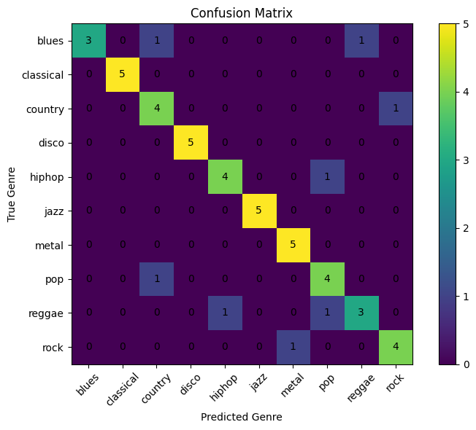
Result & Analysis
Model Accuracy Comparison
Model | Test Accuracy
RBF Kernel SVM | 48%
CNN | 72%
ResNet | 84%
MobileNet v2 | 62%
Confusion Matrix (ResNet) for Test Set

Slide 11
Why CNN models performed better than SVM
Result & Analysis
CNN performed better because it preserves local time-frequency structure and learns hierarchical features automatically.
SVM relies on flattened features and PCA, which removes spatial relationships and may discard useful information.
Additionally, SVM is more sensitive to noise and struggles with complex nonlinear class boundaries present in music data.

Slide 12
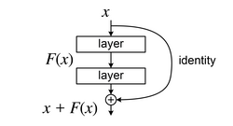
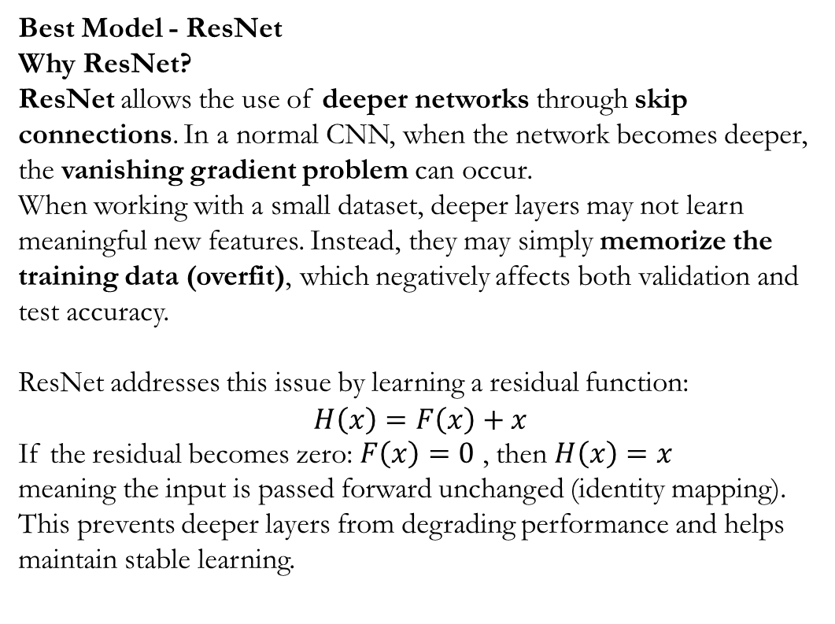
Result & Analysis
Best Model - ResNet
Why ResNet?
ResNet allows the use of deeper networks through skip connections. In a normal CNN, when the network becomes deeper, the vanishing gradient problem can occur.
When working with a small dataset, deeper layers may not learn meaningful new features. Instead, they may simply memorize the training data (overfit), which negatively affects both validation and test accuracy.
ResNet addresses this issue by learning a residual function:
$$H\left(x\right)=F\left(x\right)+x$$
If the residual becomes zero: $F\left(x\right)=0$ , then $H\left(x\right)=x$
meaning the input is passed forward unchanged (identity mapping). This prevents deeper layers from degrading performance and helps maintain stable learning.
Img Source: https://en.wikipedia.org/wiki/Residual_neural_network

Slide 13
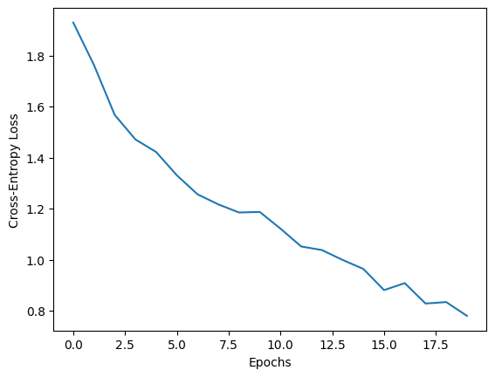
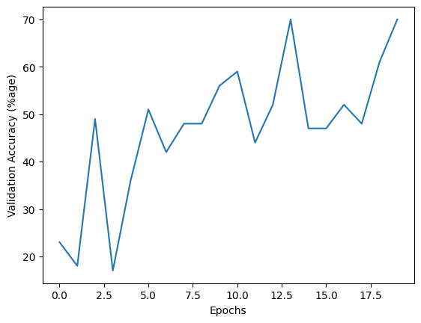
Result & Analysis
Graphs for the final ResNet Model
Metrics: Precision(average): 0.8517 | Recall(average): 0.8400 | F1-Score(average): 0.8380

Slide 14
Work Division
Preprocessing & Spectrogram generation: Hrujul, Priyam
Simple CNN: Priyam
Resnet: Hrujul
SVM: Arin
MobileNet v2: Tushar

