Slide 1
Automated lying and standing time from calf pen video
Three weeks of CH1 footage, one second at a time
Helmut Ulrich · Animal Science / AgriLife · September 2026
Notes:
Four parts: what the pipeline does, how the model was trained, how accurate it is, and what the first three weeks of data show.

Slide 2
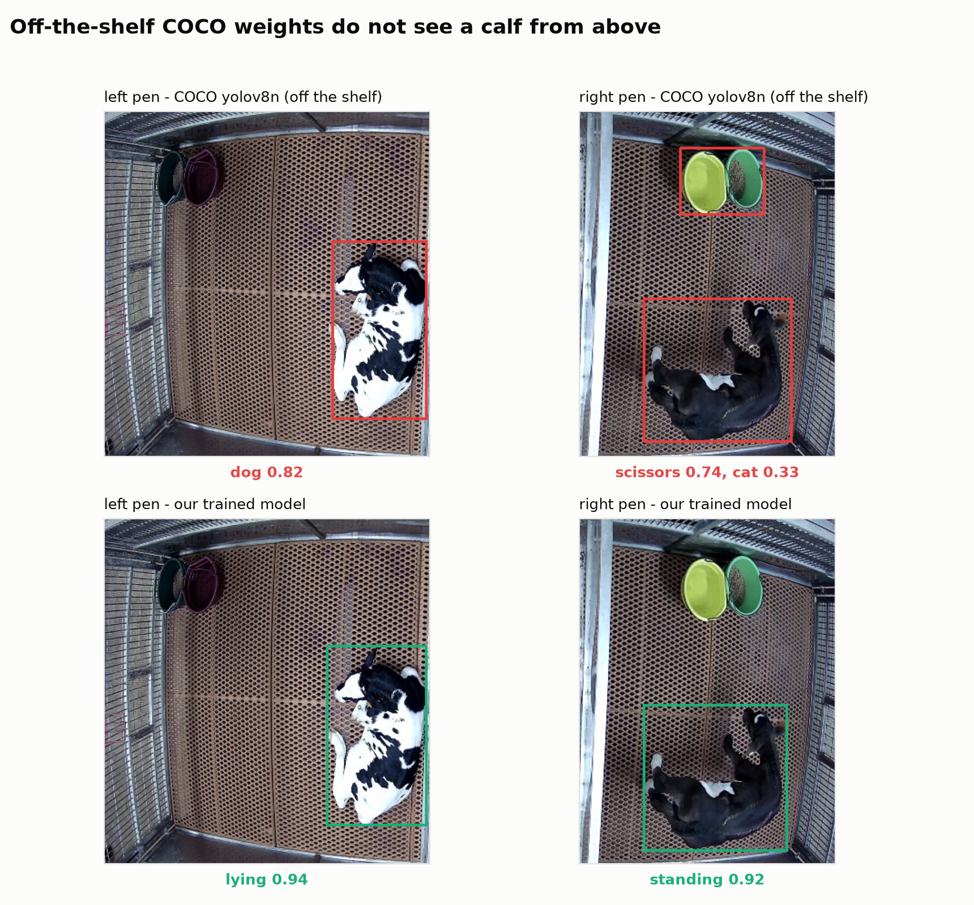
METHOD
What the pipeline does
Reads the wall-clock time out of every filename, so each frame keeps its real timestamp
Samples 1 frame per second and cuts the left and right pen apart - the two calves never mix
A trained model finds the calf and labels it lying or standing; a 5-frame majority vote removes flicker
Off-the-shelf COCO weights were useless from overhead - the white calf read as a dog, the black one as scissors - so the model was trained on our own labels
Same two frames: standard COCO weights above, our trained model below.
Notes:
The whole run: 1.8 M frames sampled, 3.7 M calf crops classified, 502 hours of video per pen, unattended on the lab server.

Slide 3
TRAINING DATA
Labelling: 286 by hand, 503 by machine
789
286
503
images labelled
drawn by hand
auto-labelled
4 segments across one day
in Roboflow, ~2 hours
16 uncertain ones checked by eye
Frames sampled every 20 s across pre-dawn, morning, afternoon and night, then near-duplicates dropped - a calf that has not moved in 20 minutes teaches nothing
One box per calf, two classes: lying and standing. Empty pens labelled as "no calf"
A first model trained on the 286 hand labels pre-labelled the rest; only the frames it was unsure about came back for human review
Notes:
Class balance: 581 lying, 178 standing, 31 empty. Standing is the rarer class, which is worth remembering when reading the metrics.

Slide 4
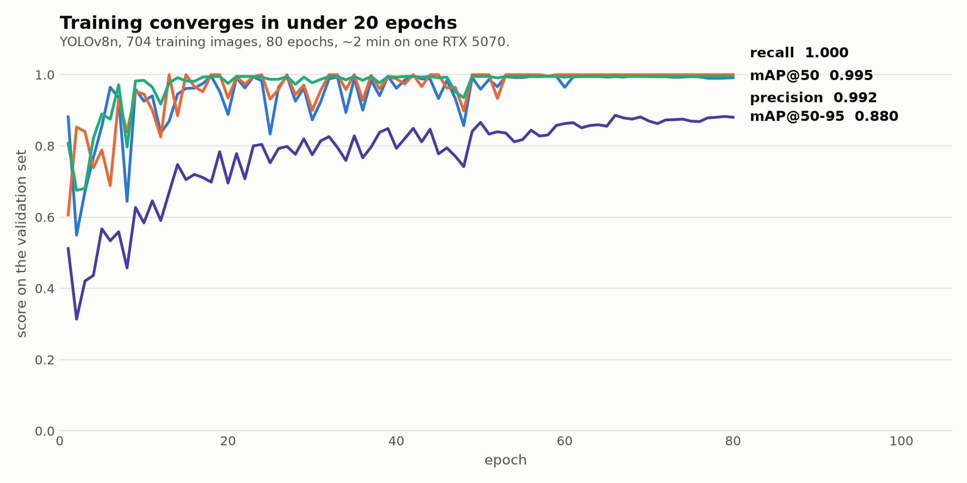
THE MODEL
Training
Architecture
YOLOv8n (3.2 M parameters)
Input
640 px, letterboxed
Split
704 train / 57 val / 28 test
Augmentation
flips + rotation
Hardware
one RTX 5070, ~2 min
Validation scores after every epoch. The held-out test split was only touched once, at the end.
Notes:
Validation and test images are human-labelled only - none of the machine-labelled frames are in them, so the model is not grading its own homework.

Slide 5
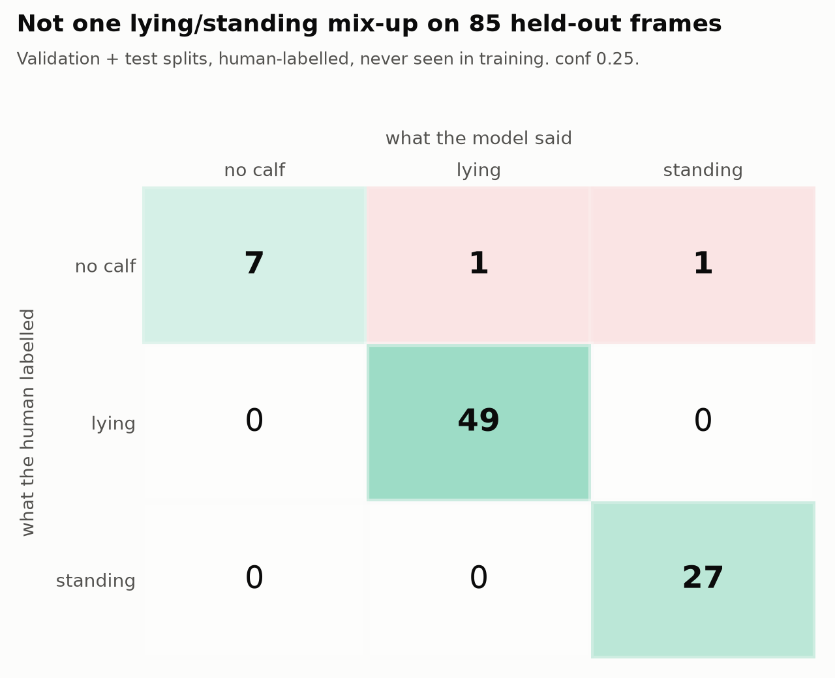
METRICS
Accuracy on frames the model never saw
Class | Precision | Recall | F1
lying | 0.96 | 1.00 | 0.98
standing | 0.96 | 1.00 | 0.98
no calf | 1.00 | 0.78 | 0.88
Overall 97.6% correct; mAP@50 0.97, mAP@50-95 0.87
Both errors are empty pens where it saw a calf that was not there
Caveat: 85 frames, all from one day and these two calves - the human validation is the real test
Notes:
Precision = when it says lying, how often it is right. Recall = of the frames that really are lying, how many it caught. Not one lying/standing mix-up, but small n.

Slide 6
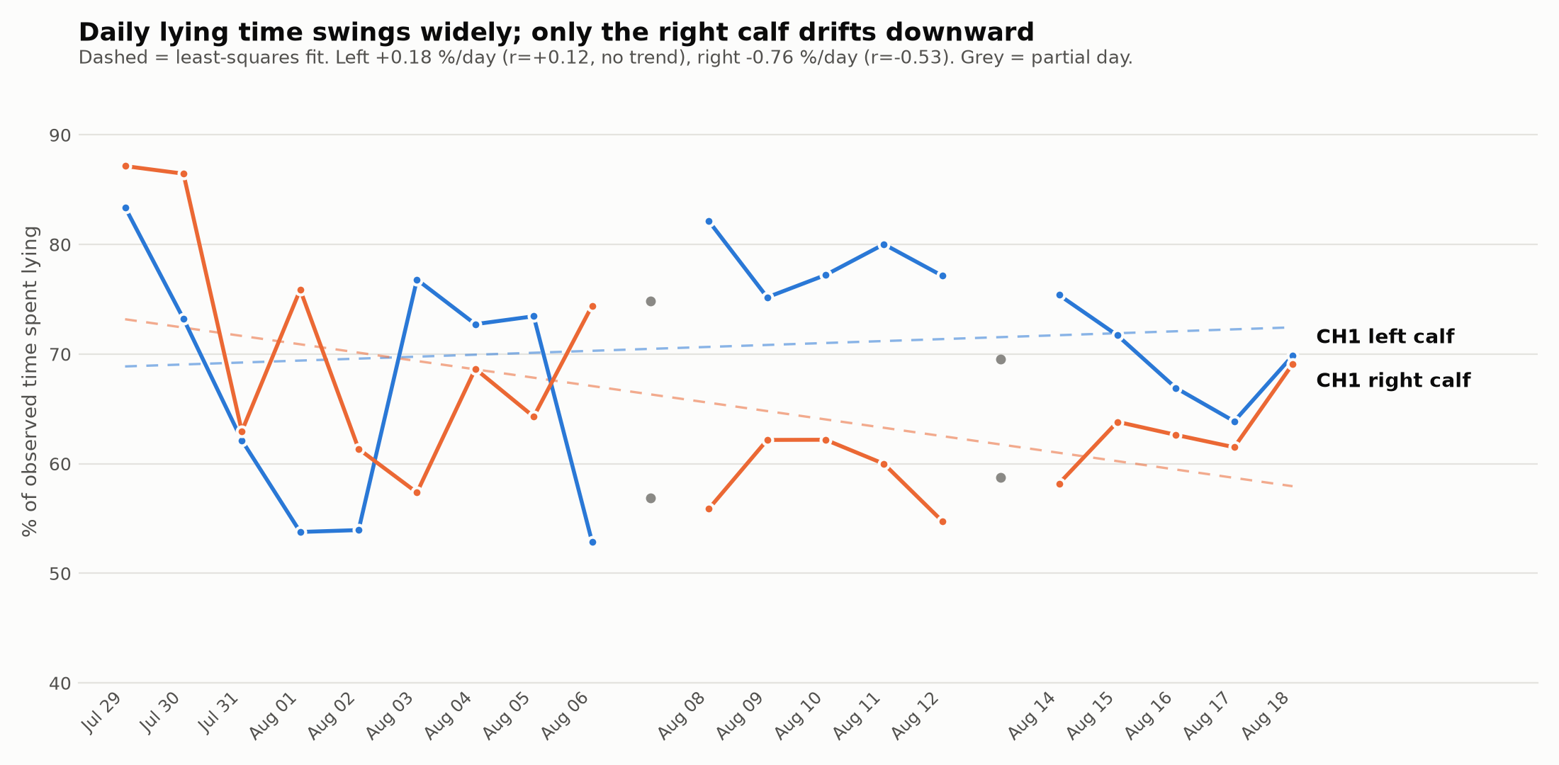
RESULTS
Daily lying time, 19 full days
Notes:
Both calves lie 50-87% of the day and the day-to-day swings are large. The right calf drifts down about 0.8 points a day (r = -0.53); the left shows no trend at all. With two animals this is a description, not a finding.

Slide 7
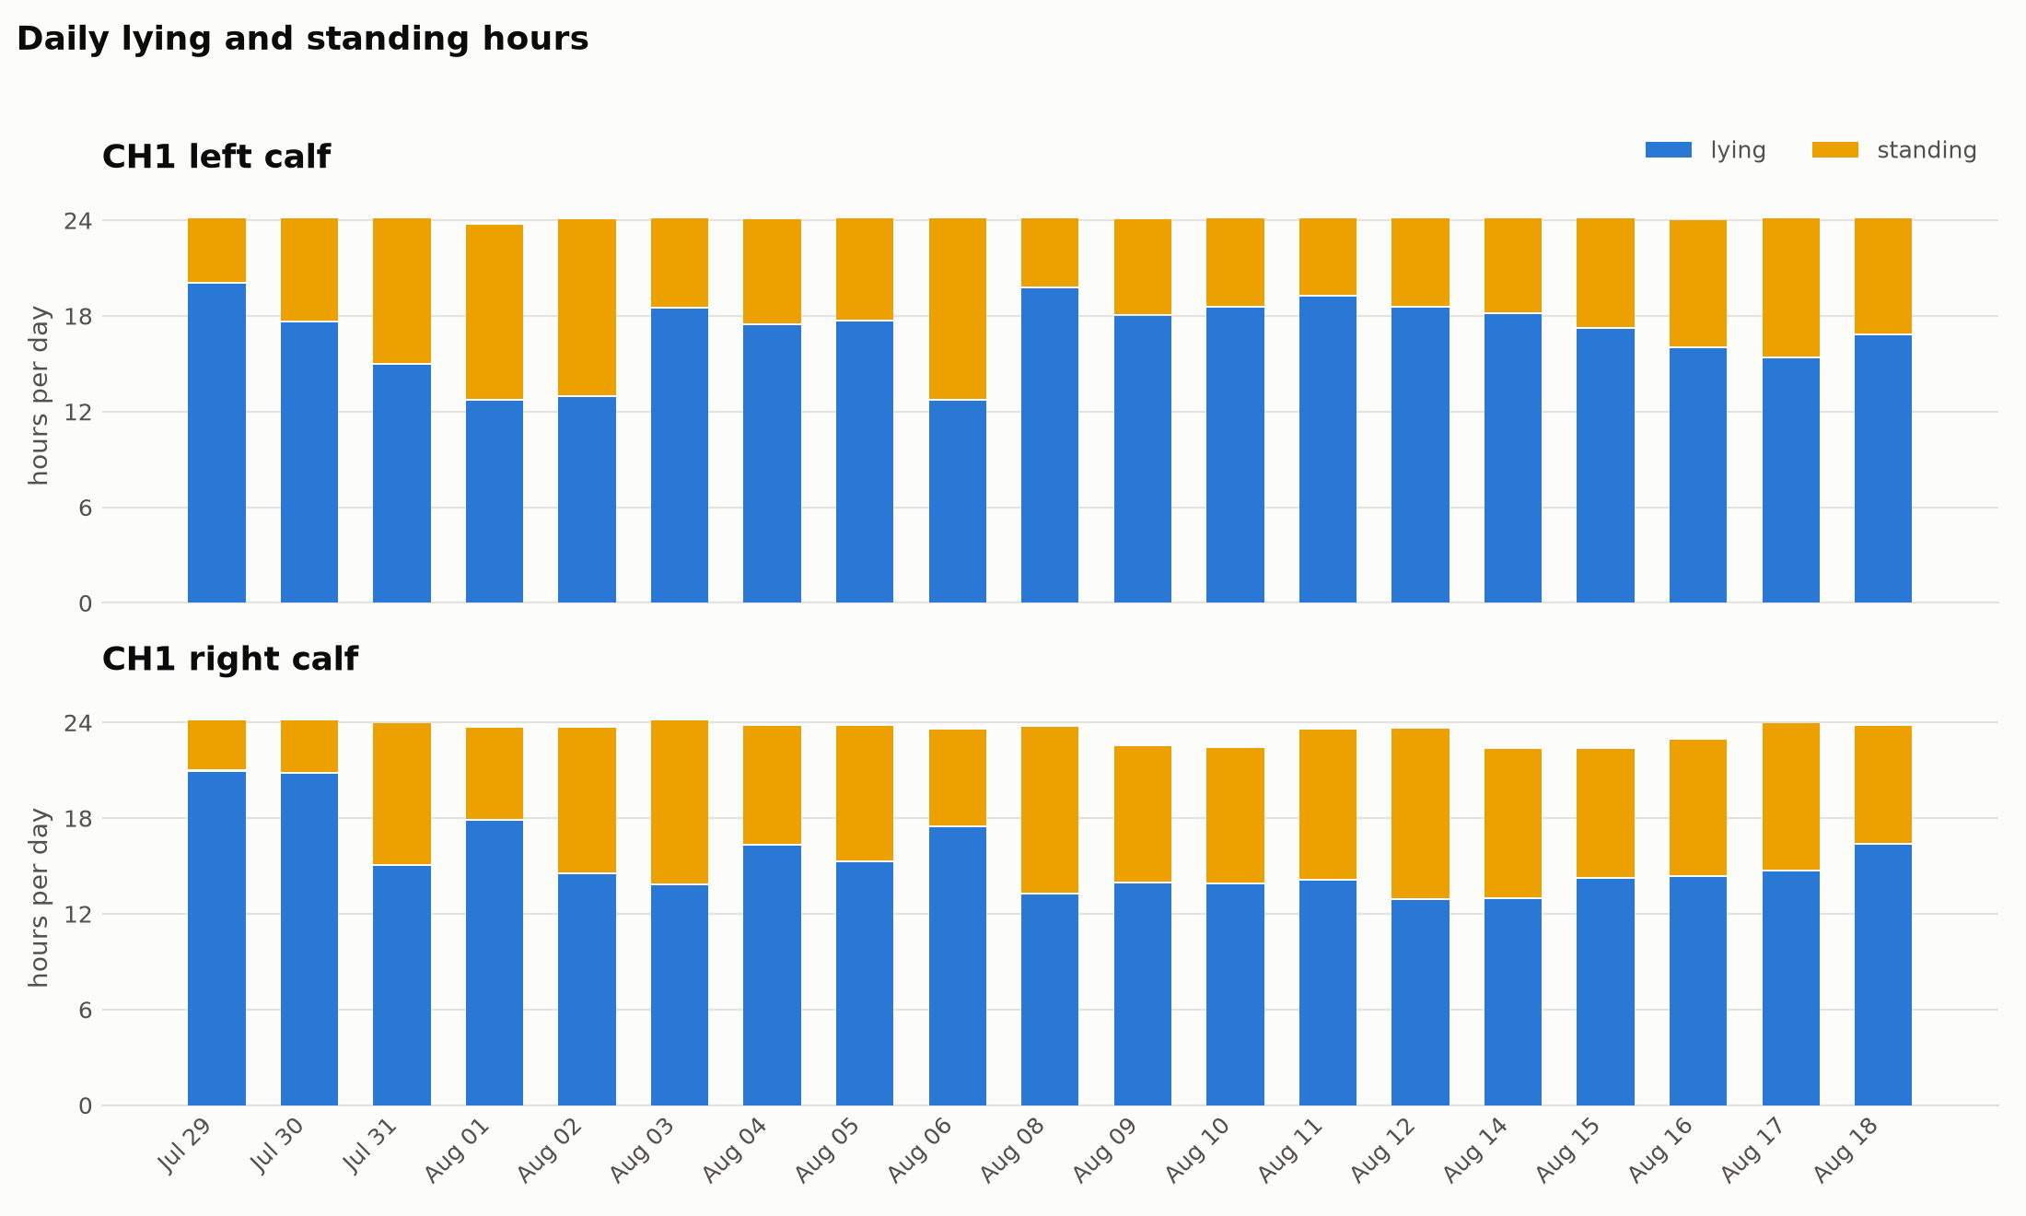
RESULTS
The same data as hours per day
Notes:
Left calf averages 16.9 h lying a day, right calf 15.4 h. Bars stop short of 24 h where footage is missing.

Slide 8
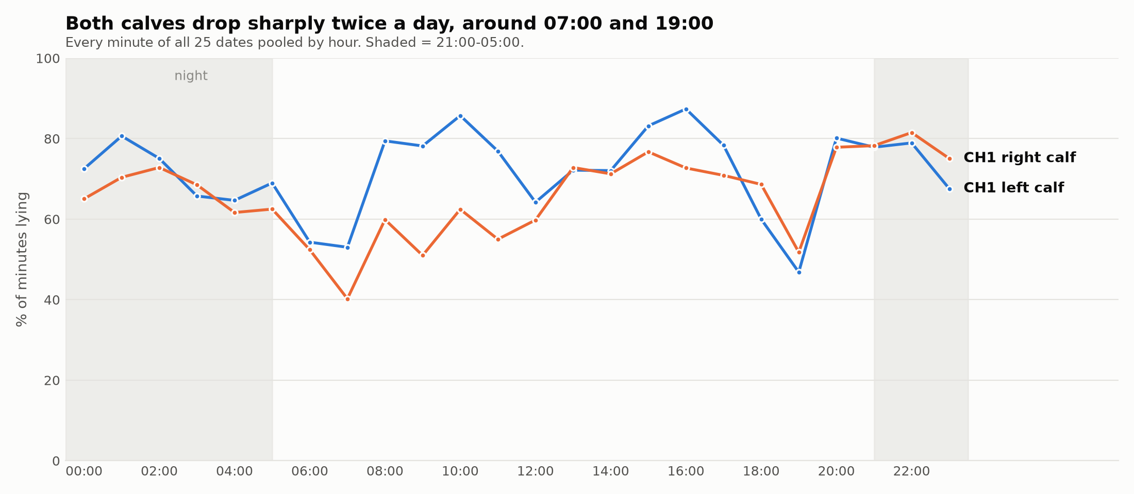
RESULTS
Lying follows the clock
Notes:
Pooled over every minute of all 25 dates. The two sharp dips, around 07:00 and 19:00, are the same on both calves and on every day - the obvious candidate is feeding, which the barn schedule can confirm. A classifier that was guessing would not produce a repeatable twice-daily pattern, so this doubles as a sanity check.

Slide 9
OUTPUT
Files
minute_activity.csv
for validation
channel, calf, timestamp (1 min), activity - plus the frame counts behind each minute
daily_summary_all.csv
the charts
per calf per day: lying / standing hours, observed hours, detection rate
bouts_all.csv
welfare metrics
every continuous lying or standing stretch over a minute
61,146 minutes across 25 dates, both calves.
Notes:
Each minute in minute_activity.csv also carries how many of its 60 frames agreed, so a disputed minute can be judged on the strength of the evidence. 7.6% of minutes fall below 80% agreement - those are the transitions, and the fairest place for a human to disagree.

