Slide 1
Forecasting Kolkata's PM2.5, 60 hours ahead
Air Quality Forecasting & Early Warning System | Checkpoint 2
A 48-hour forecast from our model, one block per hour, coloured by India's CPCB air-quality category
Rupam Hari
M.Tech CSE | 26CS60R04
Notes:
Introduce the project: an ML system that forecasts PM2.5 for Kolkata hour by hour, 60 hours ahead, and warns before the air becomes unhealthy. The coloured strip is a real 48-hour forecast from our system, each block one hour, coloured by CPCB category.

Slide 2
Kolkata's air turns unhealthy every winter
31 / 31
days in December 2025 above India's 24-hour limit of 60 µg/m³
116 vs 20
µg/m³: average in November vs July. The weather, not just emissions, drives this swing
4×
the WHO guideline (15 µg/m³) is exceeded on a typical winter day by more than four times
Notes:
PM2.5 is fine particulate matter, small enough to reach deep into the lungs. In Kolkata it is clean in the monsoon and very polluted in winter, when cold, still air traps emissions and north-westerly winds bring smoke from the Indo-Gangetic Plain. Every day of December 2025 broke the national 24-hour limit. Because this is weather-driven, it can be forecast.

Slide 3



Three objectives, and what weather apps miss
Collect and combine data
Predict future air quality
Early-warning dashboard
Hourly PM2.5 from OpenAQ (WBPCB monitor) merged with Open-Meteo weather and CAMS on one hourly timeline
Gradient-boosted quantile models forecast every hour 1–60 h ahead, with a calibrated 80 % range
Streamlit app: warning levels, 48-hour strip, daily outlook, explanations, track record
What Google Weather doesn't give, and this system does
Your station
not a ~45 km model grid
Uncertainty
80 % range per hour
Probability
of crossing your limit
Early warning
start, duration, peak
Explanation
wind, mixing, rain
Track record
accuracy vs baselines
Checkpoint-2 scope: Kolkata, one automatically chosen monitoring station, warnings shown in the dashboard.
Notes:
The three objectives from the proposal are all implemented end to end for Kolkata. Weather apps such as Google Weather show a single number from a global chemistry model (CAMS) on a coarse grid. Our system adds the six things in the bottom row: station-anchored forecasts, an uncertainty range, probabilities, early warnings with timing, explanations, and a published accuracy record.

Slide 4





From raw feeds to a calibrated forecast
Collect
Clean
Merge
Features
Model
Dashboard
OpenAQ station PM2.5
Open-Meteo weather
CAMS regional model
Remove bad readings
fill only short gaps
bridge station outages
One hourly UTC timeline
shown in IST
49 inputs per
(issue time, lead time)
3 quantile GBDTs
blend + calibrate
Warnings, charts,
explanations
12,908
250
92.4 %
6 h – 14 d
hourly readings downloaded (Feb 2025 – Oct 2026)
bad readings removed: out of range, low coverage, stuck sensor, spikes
of hours usable after cleaning; only gaps ≤ 3 h are interpolated
outages bridged with CAMS scaled to the station; flagged, never trained on
Notes:
Pipeline in six steps; one command, python pipeline.py all, runs fetch, train and forecast. Raw data are messy: quality rules remove impossible values, hours with too few readings, frozen sensors and isolated spikes. OpenAQ splits the same CPCB monitor across an old and a new sensor ID, which we join. When the Kolkata feed stops for hours or days, the missing hours are estimated from CAMS scaled to the station, so the forecast still starts from now. We train on archived forecast weather, not hindsight weather, so the model sees the same kind of inputs it gets live.

Slide 5




Weather decides how much air the pollution mixes into
Day: deep mixing
Sunshine stirs the lowest 1–3 km of air; pollution is diluted (lowest at 13:00–17:00)
Night: shallow lid
The mixed layer collapses to 100–300 m, trapping emissions; PM2.5 rises after sunset
Ventilation index
Wind speed × mixing height. Below ~2,000 m²/s the air is stagnant
Rain and wind direction
Rain washes particles out; north-west winds bring polluted air down the Indo-Gangetic Plain
Notes:
The physics in one picture: think of the city as a room with a smoky stove. The mixing height is the ceiling: high in the afternoon, very low at night. That is why PM2.5 rises every evening and peaks overnight, and why winter, with low ceilings, calm winds and no rain, is worst. Our features describe exactly these mechanisms.

Slide 6

One model forecasts every hour from 1 to 60
Recent PM2.5
lags, 3-day means, trends, relative to now
Median forecast
most likely PM2.5
Forecast weather
wind (u, v), mixing height, ventilation, rain, humidity, pressure
80 % range
q10 – q90, calibrated
Along the way
mean ventilation and total rain between now and the target hour
Gradient-boosted trees
3 models: 10th, 50th and 90th percentile
CAMS change
how much the regional model expects PM2.5 to change
Probability
P(PM2.5 > your threshold)
Calendar + lead time
hour of day, weekday, h = 1…60
Why gradient boosting: best on tabular data · learns thresholds and interactions · handles missing values · built-in quantile loss · fast on a CPU · explainable
Notes:
Direct multi-horizon design: each training example is an issue time and a lead time, with the lead time as an input, so there is no recursive feedback and errors don't compound (about 175,000 rows per year of data). Three quantile models give the median and an 80 % range; from these we compute the probability of crossing any threshold. Why gradient-boosted trees: they are the strongest family on tabular data of this size, learn conditions like low wind AND a low mixing layer AND night, tolerate missing values, support quantile loss natively, train quickly on a laptop, and can be explained with permutation importance and what-if runs. Linear models and ARIMA miss interactions; LSTMs need more data, a GPU and are harder to explain.

Slide 7
Beats "no change" at every lead time, and CAMS by 3×
Key fix: predict the change
The first model predicted the level and lost to "no change" (7.3 vs 4.4 µg/m³). Predicting the change from the latest reading fixed it.
19 % / 23 %
less error than "no change", day 1 / day 2
67–72 %
less error than CAMS, the model behind weather apps
78–81 %
of outcomes fall inside the 80 % range: calibrated
Notes:
Out-of-sample backtest: forecasts issued 30 April to 2 October 2026, a period the model never saw. The key lesson: our first model predicted absolute levels and was worse than simply repeating the latest reading, because 2026 was much cleaner than 2025 and the trees memorised last year. Predicting the change from the current reading, with scale-free features and blending toward 'same as now' at short lead times, fixed it. At 1 hour nothing beats persistence and we match it; from 6 hours on we are clearly better. CAMS has a constant bias at this station that our station-anchored model removes. The 80 % range is honest. Warning hit rates need a winter in the test set.

Slide 8
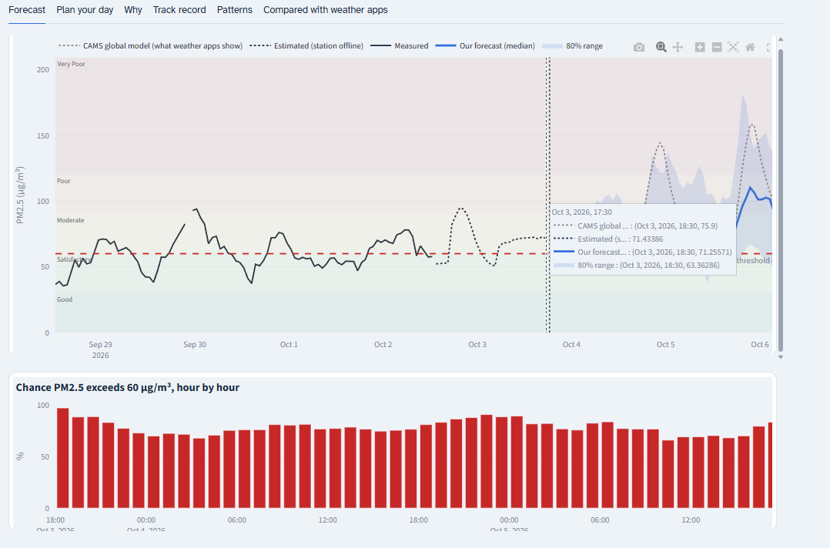
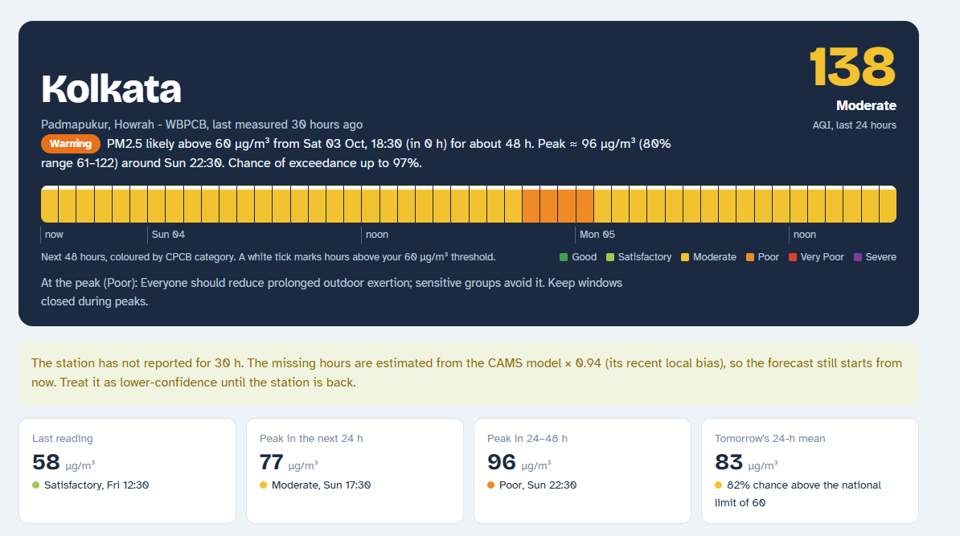
The early-warning dashboard
Header
CPCB AQI, warning level with start time and duration, 48-hour colour strip, health advice
Forecast tab
Measured vs forecast with its 80 % band, CAMS for comparison, hourly chance of exceeding your threshold
Other tabs: Plan your day · Why (drivers) · Track record · Patterns · Compared with weather apps
Notes:
The dashboard runs locally with Streamlit. The header answers the user's question immediately: how bad is the air, will it cross my threshold, when and for how long. The threshold comes from a profile in the sidebar, for example 60 µg/m³ for sensitive groups. The forecast tab shows measured PM2.5 in black, our forecast in blue with its uncertainty band widening further ahead, and CAMS in grey; below it, the probability of exceeding the threshold for each hour. The Why tab explains the drivers, and Track record shows the backtest.

Slide 9






Next steps toward the final submission
Validate warnings in winter
Deploy online
Retrain after Nov–Dec so the test period includes polluted months; report hit and false-alarm rates
Host the dashboard on a cloud server with scheduled hourly data updates
Multiple cities
Station choice
Extend the pipeline to other Indian cities, with city search in the dashboard
Let users pick the monitoring station instead of the automatic choice
Alert notifications
Model comparison
Telegram / e-mail messages when the warning level rises
LightGBM, random forest and LSTM on the same backtest; fire hotspots as an extra input
Notes:
The first priority is validating the warnings once winter data arrive, because the current test period had very few polluted hours. Then deployment, so the dashboard is reachable online and updates itself, followed by multiple cities, user-selected stations, push notifications, and a comparison with other model families.

Slide 10
Thank you
Questions?
Data: OpenAQ (WBPCB / CPCB monitors), Open-Meteo weather, Copernicus CAMS.
Notes:
Thank the panel and take questions.

