Slide 1
Air Quality Forecasting & Early Warning System
Hourly PM2.5 forecasts 1–60 hours ahead for Indian cities, with early warnings | Final checkpoint
Kolkata, the next 48 hours from our model: one block per hour, coloured by India's CPCB air-quality category
Team · M.Tech CSE
Pramiti Ghosh
26CS60R22
Rupam Hari
26CS60R04
Tamanash Kamilya
26CS60R05
Notes:
Introduce the team and the project in one sentence: a system that forecasts PM2.5, the most harmful air pollutant in Indian cities, for every hour up to 60 hours ahead, and warns people before the air becomes unhealthy. The strip is a real 48-hour Kolkata forecast from our model, one block per hour, coloured by India's official CPCB categories. Since the last checkpoint the system covers eight cities, lets users choose the station, sends Telegram and e-mail alerts, and runs online.

Slide 2
Kolkata's air turns unhealthy every winter
31 / 31
days in December 2025 above India's 24-hour limit of 60 µg/m³
108 vs 20
µg/m³: average in November vs July. Weather, not just emissions, drives the swing
7×
the WHO guideline (15 µg/m³) on an average winter day (Nov–Jan)
Notes:
PM2.5 means particles smaller than 2.5 micrometres, small enough to reach the lungs and the blood. In Kolkata the monsoon is clean and the winter very polluted: cold, still air traps emissions near the ground and north-westerly winds bring smoke down the Indo-Gangetic Plain. Every day of December 2025 broke the national limit. Emissions do not change that much between July and November; the weather does, and weather can be forecast, so pollution can be forecast too.

Slide 3




Three objectives: all delivered, and more
Collect and combine data
Predict 24–48 h ahead
Early warnings
Hourly PM2.5 from official monitors (OpenAQ) merged with Open-Meteo weather and the CAMS model on one hourly timeline
Gradient-boosted quantile models forecast every hour 1–60 h ahead, with a calibrated 80 % range
Dashboard warning levels with start, duration and peak; Telegram / e-mail alerts when the level rises
Added since checkpoint 2
8 cities
any place searchable
Compare cities
side-by-side view
Station choice
pick your monitor
Alerts
Telegram / e-mail
Online
Streamlit Cloud
Auto-update
every 3 hours
Notes:
All three objectives from the proposal are delivered end to end. Since checkpoint 2 we turned the single-city prototype into a complete product: eight cities with forecasts and any place searchable, a comparison view, the option to choose the monitoring station, alerts sent outside the app by Telegram or e-mail, an online deployment, and automatic updates every three hours.

Slide 4
Google Weather and IQAir give a number; we add the warning
 | Google Weather | IQAir | Our system
Data & scale | Models + sensors on a 500 m grid | Government monitors (plus low-cost sensors elsewhere); US AQI scale | Nearest official monitor; India's CPCB AQI and the 60 µg/m³ limit
Forecast | Hourly AQI, up to 4 days | Hourly and daily, up to 7 days | Hourly PM2.5 1–60 h, anchored to the latest reading
Uncertainty | One number per hour | One number per hour | 80 % range per hour, calibrated on past data
Warning | Colour category, health tips | Alert when air is bad, health tips | Chance of crossing your threshold; start, duration, peak
Why | Not explained | Not explained | Wind, mixing height, rain, regional pollution in µg/m³
Track record | Not published | Accuracy claimed, no figures | Published backtest for every city
Where they are stronger: every place on Earth, more stations and pollutants, a longer range, polished mobile apps. We add the decision layer on top: uncertainty, probability, timed warnings, reasons and a published track record.
Notes:
This was the checkpoint-1 question. Google Weather shows an hourly AQI forecast up to 4 days on a 500 m grid. IQAir shows real-time AQI and a machine-learning forecast of up to 7 days; in Indian cities its readings come from the same government monitors we use, and it reports them on the US AQI scale. Both give one number per hour. Neither tells you how uncertain it is, the chance of crossing a limit that matters to you, when a bad spell starts and how long it lasts, or why, and neither publishes its accuracy. We add exactly those layers, on India's CPCB scale. Be honest: they cover the world and look further ahead; we have not measured IQAir's forecast accuracy because it does not publish past forecasts.

Slide 5





From raw feeds to a calibrated forecast
Collect
Clean
Merge
Features
Model
Dashboard
OpenAQ station PM2.5
Open-Meteo weather
CAMS regional model
Remove bad readings
fill only short gaps
bridge station outages
One hourly UTC timeline
shown in local time
49 inputs per
(issue time, lead time)
3 quantile GBDTs
blend + calibrate
Warnings, charts,
explanations, alerts
13,585
257
92.1 %
6 h – 14 d
hourly readings at the Kolkata station since Feb 2025
bad readings removed: out of range, low coverage, stuck sensor, spikes
of hours usable after cleaning; only gaps ≤ 3 h are interpolated
outages bridged with CAMS scaled to the station; flagged, never trained on
Notes:
Six steps, the same for every city. One command, python pipeline.py all --city X, builds a city from scratch; update refreshes it in about a minute. The station is chosen automatically (active, reference-grade, long history, close) or by the user. OpenAQ often splits one CPCB monitor into an old and a new sensor ID, which we join. Real data are messy, so quality rules remove impossible values, hours with too few readings, frozen sensors and isolated spikes. When a station goes silent, the missing hours are estimated from CAMS scaled to that station's recent readings, so the forecast still starts from now; these estimates are shown as such and never used for training. We train on archived forecast weather, not hindsight weather, so the model learns with the same imperfect inputs it gets live.

Slide 6

One model forecasts every hour from 1 to 60
Recent PM2.5
lags, 3-day means, trends, relative to now
Median forecast
most likely PM2.5
Forecast weather
wind (u, v), mixing height, ventilation, rain, humidity, pressure
80 % range
q10 – q90, calibrated
Along the way
mean ventilation and total rain between now and the target hour
Gradient-boosted trees
3 models: 10th, 50th and 90th percentile
CAMS change
how much the regional model expects PM2.5 to change
Probability
P(PM2.5 > your threshold)
Calendar + lead time
hour of day, weekday, h = 1…60
Why gradient boosting: best on tabular data · learns thresholds and interactions · handles missing values · quantile loss built in · explainable
Notes:
Each training example is 'from this hour, predict h hours ahead', with h as an input, so one model gives the whole 60-hour curve and errors do not pile up as they would if we fed predictions back in. Three versions are trained, for the 10th, 50th and 90th percentile: the middle one is the forecast and the outer two give the 80 % range, from which we compute the probability of crossing any threshold. The model predicts the change from the current reading, not the level, which keeps it anchored to what the station measures today. Why gradient-boosted trees: the strongest family on tabular data of this size; they learn combinations such as low wind and a low mixing layer at night; they tolerate missing sensor values; they forecast percentiles directly; they train in minutes on a laptop and can be explained. With about 20 months of hourly data per city, deep networks would need more data and a GPU and would be harder to explain.

Slide 7
Beats "no change" at every lead time, and CAMS by far
Key fix: predict the change
Our first model predicted the level and lost to "no change" (7.3 vs 4.4 µg/m³). Predicting the change from the latest reading fixed it.
5.4 / 6.8
µg/m³ average error, day 1 / day 2
13 % / 21 %
less error than "no change", day 1 / day 2
77 %
of outcomes fall inside the 80 % range (day 1)
Notes:
Out-of-sample test: forecasts issued 2026-05-27 to 2026-10-01, a period the model never saw during training. Persistence means assuming the air later will be the same as now; it is the standard baseline and hard to beat in the first hours. Our error stays below persistence at every lead time and far below CAMS, the global model, which has a steady local bias. The key lesson: our first model predicted the level directly and lost to persistence, because one year was much cleaner than the previous one and the trees kept predicting last year's levels. Predicting the change from the current reading fixed that. The 80 % range is honest: about 80 % of real values fall inside it.

Slide 8
Tested in 8 cities: better than both baselines everywhere
3–27 %
less error than "no change" on day 1, depending on the city
29–82 %
less error than CAMS, the global model, on day 1
75–87 %
of outcomes inside the 80 % range: the uncertainty is honest
Smallest gains in Amritsar and Jaipur, where PM2.5 changed little during the test months, so "no change" was already a good guess.
Notes:
The same pipeline, unchanged, was built and tested for every city, each on its own nearest official station and its own held-out months. Bars show how much smaller our error is than the 'no change' baseline. The model beats persistence and CAMS in every city. Where gains are small, pollution was steady during the test months, so persistence was hard to beat. The 80 % range holds everywhere, so the probabilities can be trusted. Cities: Ahmedabad (IIMA Ventures); Amritsar (Golden Temple, Amritsar - PPCB); Delhi (Anand Vihar, New Delhi - DPCC); Gurugram (R K Puram, Delhi - DPCC); Jaipur (Police Commissionerate, Jaipur - RSPCB); Kanpur (Nehru Nagar, Kanpur - UPPCB); Kolkata (Padmapukur, Howrah - WBPCB); Siliguri (Ward-32 Bapupara, Siliguri - WBPCB).

Slide 9

Warnings: tested on real episodes, delivered to your phone
Warning levels
Warning scores: Delhi, 24–48 h ahead
Watch
chance of crossing your threshold reaches 30 %
Threshold | Event hours | Caught (POD) | False alarms (FAR) | CSI
60 µg/m³ | 6,886 | 60 % | 28 % | 0.48
90 µg/m³ | 2,422 | 33 % | 52 % | 0.24
120 µg/m³ | 624 | 10 % | 69 % | 0.08
Warning
chance reaches 60 %
Emergency
chance ≥ 50 % and expected peak above 250 µg/m³
Each comes with start time, duration and expected peak, for the user's own threshold (asthma, children, outdoor work, WHO-strict).
POD: share of polluted hours that were warned about. FAR: share of warnings that did not happen. CSI: overall hit score (1 = perfect).
Telegram / e-mail (alert.py)
Sent when the level rises, at most once per 12 h for the same warning. Runs every 3 hours.
Kolkata and Siliguri: no hour above 60 µg/m³ in the test months, so warnings there are validated only from this winter on.
Notes:
The dashboard turns the hourly probabilities into levels: Watch at a 30 % chance of crossing the user's threshold, Warning at 60 %, Emergency when the expected peak is above 250. Each warning states when it starts, how long it lasts and how bad the peak will be. Outside the app, alert.py sends a Telegram message or e-mail when the level rises, without repeating the same warning within 12 hours; the scheduled job runs it every three hours. We scored the warnings like weather services do. Delhi has the most polluted hours in its test period: at 60 µg/m³ the system warned about 60 % of the polluted hours, and 28 % of its warnings were false alarms. Higher thresholds are rarer and harder. Cities with no polluted test hours cannot be scored yet; that is what this winter's data will show.

Slide 10






A complete product, not a one-city prototype
8 cities with full forecasts
Any place, instantly
Delhi, Gurugram, Kanpur, Jaipur, Amritsar, Ahmedabad, Kolkata, Siliguri
Search a town: live readings from nearby monitors and the CAMS outlook right away
One-click forecast build
Choose the station
Builds the model for a new city in the background: download, train, forecast
Pick the monitor nearest to you, or let the system choose the best one
Compare cities
Always fresh
Side-by-side AQI, warnings and outlook for all cities
Online on Streamlit Cloud; a scheduled job updates every city every 3 hours
Notes:
What changed since checkpoint 2. The same pipeline now runs for eight cities. Any other town can be searched: the app immediately shows live readings from nearby monitors and the CAMS outlook, and one click builds a full forecast model for it in the background. Users can choose which monitoring station to use. A comparison view puts all cities side by side. The app is online, and a scheduled job refreshes every city every three hours and sends alerts.

Slide 11
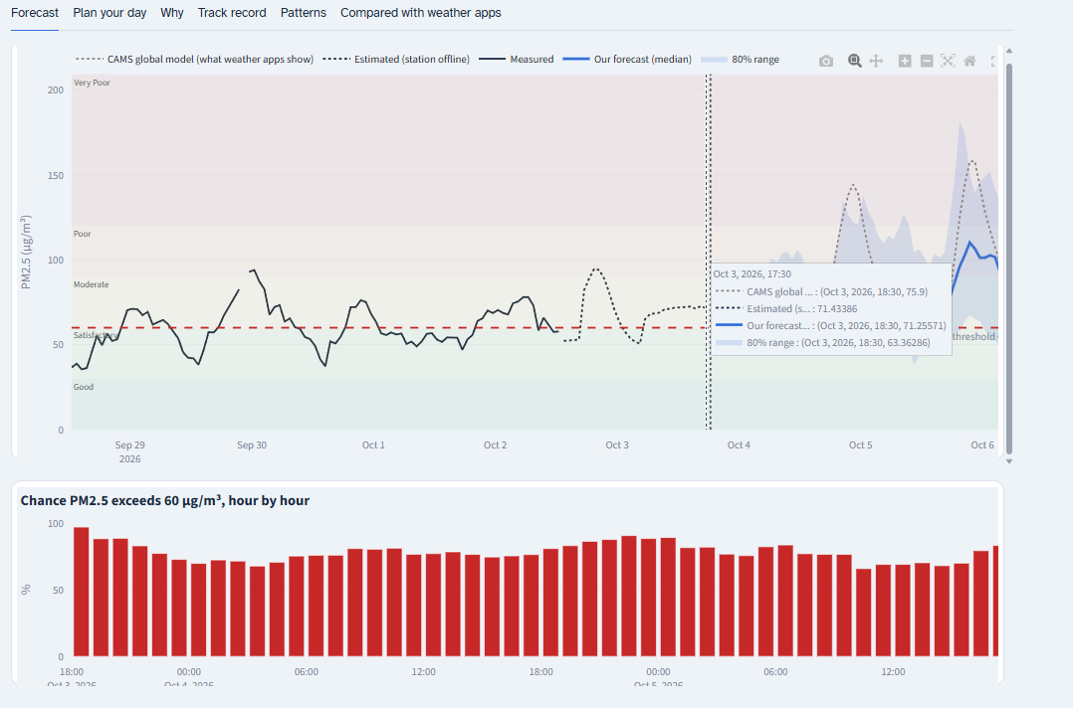
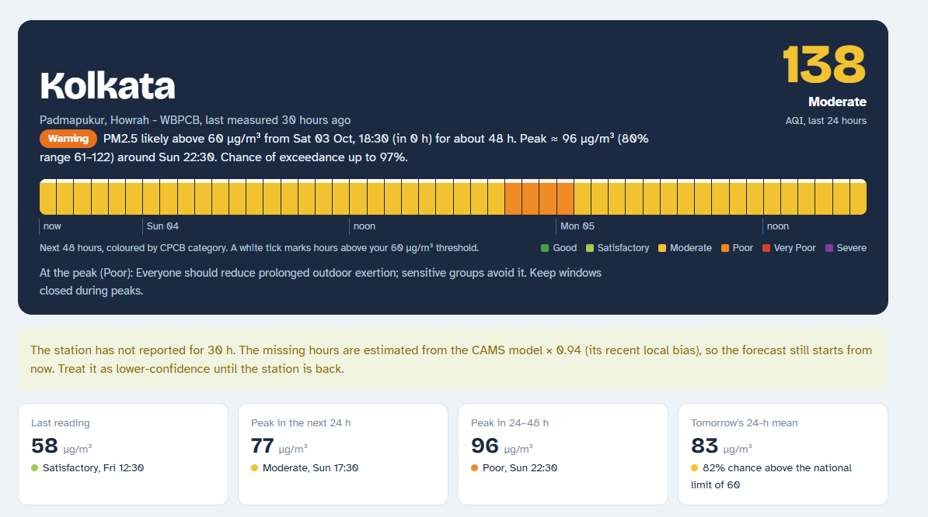
The dashboard: the warning, then the forecast
Header
CPCB AQI, warning level with start, duration and peak, 48-hour colour strip, health advice
Forecast
Measured vs forecast with its 80 % band and CAMS; below it, the hourly chance of crossing your threshold
Notes:
The header answers the user's question at once: how bad is the air, will it cross my threshold, when and for how long. The threshold comes from the profile chosen in the sidebar. The forecast tab shows measured PM2.5, our forecast with its uncertainty band widening further ahead, CAMS for comparison, and the hourly probability of exceeding the threshold.

Slide 12
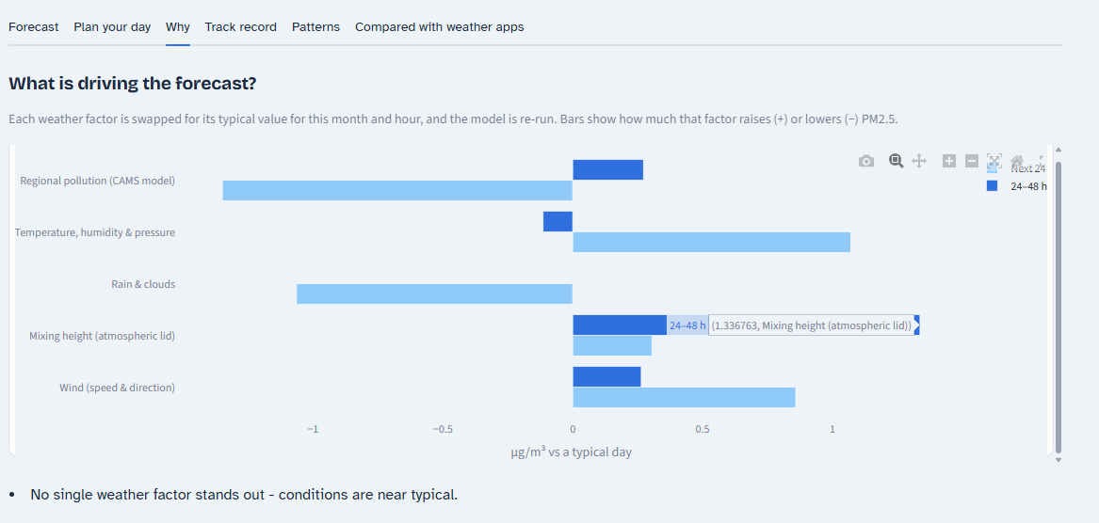
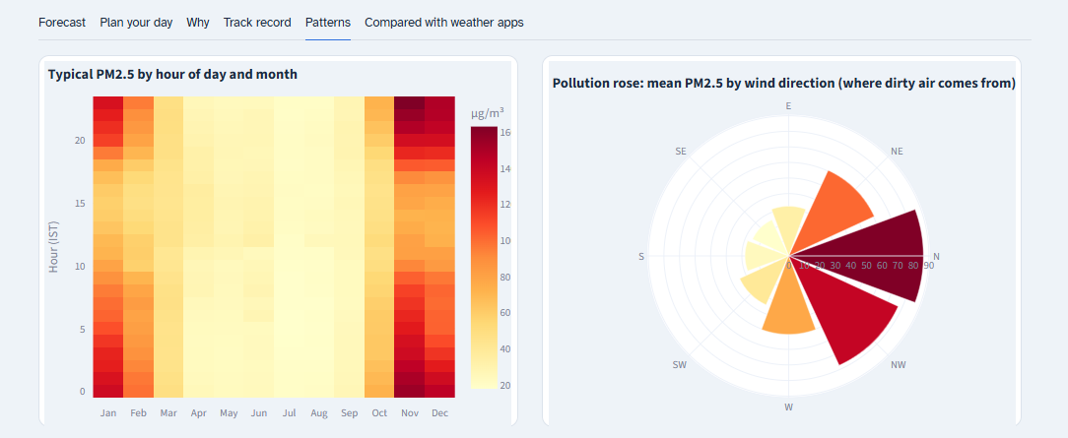
Explaining the forecast and the city's patterns
Why
How much wind, mixing height, rain and regional pollution push the forecast up or down, in µg/m³
Patterns
Hour × month heatmap and the pollution rose: which hours, months and wind directions bring dirty air
Also: Plan your day (best outdoor window) · Track record (published accuracy) · Compared with weather apps
Notes:
The Why tab re-runs the forecast with each weather factor replaced by its typical value and shows how much the forecast moves, so the reasons are concrete numbers. The Patterns tab shows when and from where pollution comes: worst on winter nights, and with north-westerly winds from the Indo-Gangetic Plain. Other tabs suggest the cleanest time to go outdoors and publish the model's track record.

Slide 13




Online and always up to date
GitHub repository
GitHub Actions, every 3 h
Streamlit Community Cloud
Users
Code, data, trained models
Update all cities, re-forecast, check alerts, commit
Redeploys on every commit; serves the dashboard
Browser or phone; Telegram / e-mail alerts
Free to run
Streamlit Community Cloud + GitHub Actions free tiers
Keys stay secret
OpenAQ and Telegram keys stored as encrypted secrets
Fails safely
a city whose feed is down is skipped; outages are bridged and flagged
Notes:
How it runs without anyone pressing a button. The code, data and trained models live in a GitHub repository. Every three hours a GitHub Actions job downloads the latest readings and weather for every city, re-forecasts, checks whether the warning level has risen and sends a Telegram or e-mail alert if so, then commits the new files. Streamlit Community Cloud redeploys automatically on every commit. Everything runs on free tiers; API keys are stored as encrypted secrets; if one city's feed is down, the others still update, and station outages are bridged and clearly flagged.

Slide 14


Limitations and future work
Limitations
Future work
Depends on the OpenAQ feed: outages are bridged with CAMS, at lower confidence
One station per city: it represents its neighbourhood, not the whole city
PM2.5 only; warnings validated on few polluted hours outside Delhi so far
Validate warnings on this winter's data in every city
More pollutants (PM10, NO₂, O₃) and fire hotspots as an input
Blend several stations per city; compare against IQAir's forecasts
Thank you · Questions? Data: OpenAQ, Open-Meteo, Copernicus CAMS
Notes:
Be upfront about limitations: the system depends on the OpenAQ feed, and outages are bridged with CAMS at lower confidence; one station represents its neighbourhood, not a whole city; we forecast PM2.5 only; and outside Delhi there have been few polluted hours to score the warnings on. Future work follows directly: validate this winter, add more pollutants and fire hotspots, combine several stations per city, and compare against IQAir's forecasts by recording them daily. Thank the panel and take questions.

