Slide 1
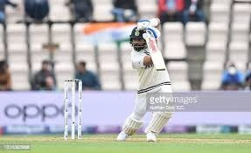
EE604 COURSE PROJECT / 2026
Cricket Shot
Recognition
Gradient features and a frozen CNN
A controlled four-class image study
Hrushikesh Roop Avvari (230249) / Voora Rakesh (231174)
Gokavarapu Manikanta Sri Akshith (230418)
Lokesh Kumar Moond (230606) / Bollu Sharath chandra (230303)
https://github.com/hrushikeshroop/cricket-shot-recognition-ee604
Notes:
Introduce one-image classification. HOG and frozen features connect directly to lectures 10 and 15. The two-view difference is a small extension to test, not a new backbone. Cover image: selected held-out source image, https://www.kaggle.com/datasets/aneesh10/cricket-shot-dataset v2.

Slide 2
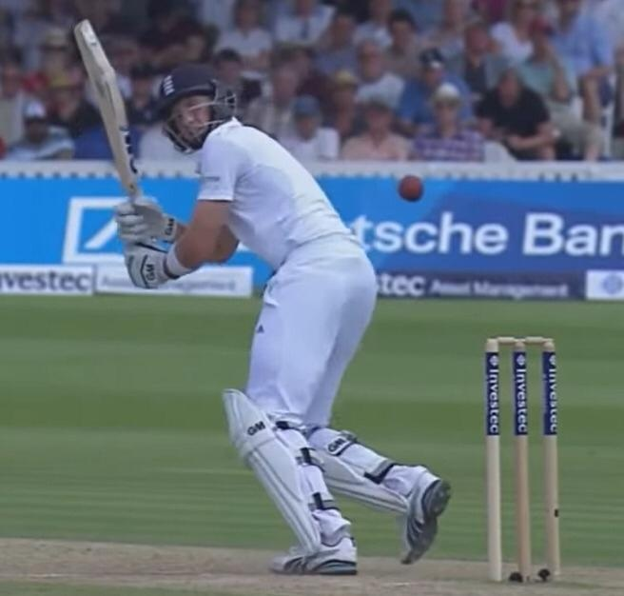
Problem, labels and constraints
Input: one selected cricket image. Output: one of four dataset labels.
Drive
Leg glance / flick
Pull
Sweep
CPU inference, offline after setup.
No batter detection, contact localization or technique grading.
Unknown shots can still receive confident scores.
CRICKET SHOT RECOGNITION / EE604
2
Notes:
The user supplies the image. Drive and leg glance/flick are combined upstream classes. A full match is outside scope. Classification is multiclass with one target, not multilabel sigmoid prediction. Source: dataset v2; lectures 15 pages 16-19.

Slide 3
Course foundation and prior work
Use established feature extraction, then test one modest extension
Foundation | Source | Our use
Gradient histograms | Lecture 10; Dalal / Triggs (2005) | Explicit HOG baseline
Frozen pretrained features | Lecture 15, pp. 11-14 | MobileNetV2 + linear classifier
Cricket recognition | KUCricShot (2023); Kang (2025) | Prior task studies; different data
Two-view difference | Course implementation | Compare with simple concatenation
No claim of a new backbone or an unprecedented combination. Novelty remains limited.
CRICKET SHOT RECOGNITION / EE604
3
Notes:
Lecture 8 part 2 page 9 distinguishes local/global features; our crop is a regional descriptor, not a keypoint. Lecture 14 part 2 pp 2-3 and 27 cover extractor/classifier and softmax. MobileNetV2 is our architecture choice, not claimed taught by name. Sources: https://lear.inrialpes.fr/people/triggs/pubs/Dalal-cvpr05.pdf ; https://arxiv.org/abs/1801.04381 ; https://github.com/AtanuCSE/CricketShotDetection ; https://arxiv.org/abs/2510.09187 . Do not compare published percentages across datasets.

Slide 4
Images and fixed visual-group split
4,724 original files; 4,723 exact representatives in 363 visual groups
Class | Train | Validation | Test
Drive | 734 | 244 | 245
Glance / flick | 672 | 224 | 224
Pull | 756 | 252 | 252
Sweep | 672 | 224 | 224
221 training groups / 72 validation groups / 70 test groups
No shared group or decoded hash. Match and player identities remain unknown.
CRICKET SHOT RECOGNITION / EE604
4
Notes:
Data: https://www.kaggle.com/datasets/aneesh10/cricket-shot-dataset v2. Unknown license in downloaded metadata; no original annotations claimed. Fixed seed 604 folds; this is one holdout, not five-fold cross-validation. Test images are clustered copies and must not be described as 945 independent photographs.

Slide 5
Evaluation choices and their limits
All five methods share images, labels, visual groups and split identities
Choice | Data used | What remains fixed
Fit classifier coefficients | Training only | Frozen CNN; deterministic HOG
Choose C: 0.1, 1, 10, 100 | Validation macro F1 | Smallest C wins ties
Temperature and review | Original validation reuse | Keep original settings
Final comparison | Same 945 test identities | No new split or seed search
Exploratory: grouping changed after preliminary evaluation; HOG was added after old results were known.
CRICKET SHOT RECOGNITION / EE604
5
Notes:
One validation set was reused for regularization, calibration and threshold selection. This can overfit validation. We disclose it rather than create a new split and pretend the original test was untouched. Initial hash-only contrast result was 96.3%; stronger transformed-copy grouping yields 65.5%. Both results and original individual predictions remain available.

Slide 6
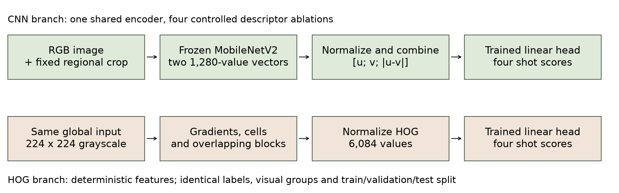
Implemented pipeline
Only the small cricket classifiers learn from the training images
The fixed crop is a regional view. It does not detect or segment the batter.
CRICKET SHOT RECOGNITION / EE604
6
Notes:
Explain the two branches. HOG and CNN global inputs have identical aspect-preserving 224 square geometry. CNN has two view passes; its global, crop and fused heads share features. HOG uses luminance, unsigned gradients, cells, blocks and per-image normalization. No StandardScaler or PCA learns from test. Source: actual implemented pipeline; lecture mapping in docs/course_mapping.md.

Slide 7
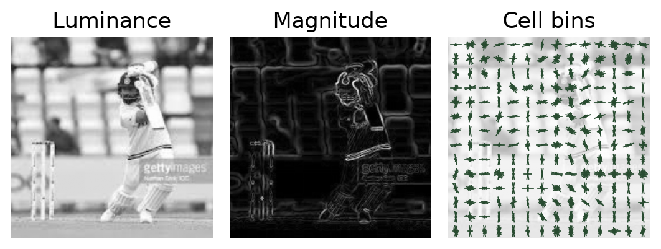
HOG: gradients, cells and blocks
Lecture 10: accumulate gradient magnitude in orientation bins
Step | Fixed setting
Input | 224 x 224 luminance
Orientation votes | 9 unsigned bins; linear bin weights
Cells | 16 x 16 pixels; 14 x 14 cells
Blocks | 2 x 2 cells; stride 1 cell
Normalize / concatenate | L2 blocks, then 6,084-value L2 vector
Votes use magnitude, not frequency. No learned feature scaling; no test-based HOG tuning.
CRICKET SHOT RECOGNITION / EE604
7
Notes:
Trace gx and gy central differences, sqrt(gx²+gy²), atan2 modulo 180. A 50-degree gradient of magnitude 90 votes 45 to the 40-degree bin and 45 to 60. No spatial vote interpolation. Each 36-value block divides by sqrt(sum(h²)+1e-10). 13*13*36=6084. This is a documented HOG variant, not the exact signed-angle lecture example or original pedestrian detector. Lecture 10 pp 7-23; original method https://lear.inrialpes.fr/people/triggs/pubs/Dalal-cvpr05.pdf .

Slide 8
CNN views and the contrast feature
Frozen ImageNet MobileNetV2 gives two 1,280-value pooled embeddings
Representation | Normalized classifier input | Dimension
Global | u | 1,280
Fixed regional crop | v | 1,280
Concatenation | [u; v] | 2,560
Contrast | [u; v; abs(u-v)] | 3,840
Absolute difference is nonlinear; signed difference would be redundant
for a linear head on concatenation. This motivates a test, not a success claim.
CRICKET SHOT RECOGNITION / EE604
8
Notes:
Both vectors are normalized before joining; the joined descriptor is normalized again. Contrast W has (4,3840) shape plus four biases. It learns weighted multiclass cross-entropy with L2 regularization. No bat-motion interpretation is assigned to feature coordinates. Actual inputs are displayed in the demo. MobileNetV2: https://arxiv.org/abs/1801.04381 ; ONNX weights: https://github.com/onnx/models .

Slide 9
Recognition results
Same corrected split; every test image contributes, including review cases
Feature | C | Val. F1 | Test acc. | Test F1
HOG | 0.1 | 49.4% | 35.3% | 34.5%
CNN global | 10 | 77.1% | 63.0% | 62.9%
CNN crop | 10 | 74.8% | 62.4% | 61.7%
Concatenation | 10 | 79.6% | 65.2% | 64.6%
Contrast | 10 | 77.8% | 65.5% | 64.9%
HOG is a controlled baseline. Pretrained features help here; contrast adds only three correct images.
CRICKET SHOT RECOGNITION / EE604
9
Notes:
HOG fixed settings, validation-selected C and predictions are saved under results/hog. Do not try a new descriptor after seeing the 35.3% test score to improve a headline. CNN heads/predictions are retained unchanged. This comparison does not isolate color versus pretraining versus architecture; no general statement that all HOG methods are inferior. Evidence: results/revision/comparison.csv and saved individual probabilities.

Slide 10
Uncertainty comes from 70 visual groups
Whole-group bootstrap, 2,000 paired draws, fixed model and split
Feature | Accuracy | Conditional 95% interval
HOG | 35.3% | 25.9 to 48.1%
CNN global | 63.0% | 49.5 to 74.2%
CNN crop | 62.4% | 45.3 to 76.7%
Concatenation | 65.2% | 48.9 to 77.9%
Contrast | 65.5% | 49.9 to 77.6%
Contrast minus concatenation: +0.32 points; interval -1.46 to +2.38. No clear advantage.
CRICKET SHOT RECOGNITION / EE604
10
Notes:
Draw groups with replacement and keep all images within each drawn group. Reuse draws between methods for paired differences. Statistics are image-weighted in each resample. Intervals omit training/split variability and unknown match correlation. They are not a hypothesis-test certificate of equality. Contrast 619/945, concatenation 616/945. Data and calculations: scripts/analyze_revision.py.

Slide 11
Class errors
Contrast confusion counts; rows are dataset labels
True / predicted | Drive | Glance/flick | Pull | Sweep
Drive | 161 | 27 | 36 | 21
Glance / flick | 80 | 102 | 15 | 27
Pull | 36 | 13 | 197 | 6
Sweep | 1 | 15 | 49 | 159
Macro F1 averages the four class F1 scores equally. Review does not remove mistakes from this table.
CRICKET SHOT RECOGNITION / EE604
11
Notes:
Read an off-diagonal entry and explain precision versus recall. Glance/flick is difficult under this protocol. HOG predicts pull for 110 of 224 sweep images. Fixed geometry, similar stances and background are plausible issues, not proven causes for each error. Evidence: saved prediction arithmetic in comparison.json.

Slide 12
Scores, calibration and secondary review
Temperature scaling worsened the recorded test calibration
Contrast scores | NLL | ECE
Unscaled | 0.859 | 0.043
Scaled | 0.898 | 0.094
557 / 945 accepted
433 accepted predictions correct
58.9% coverage / 77.7% accuracy
Keep T = 0.802 and threshold = 0.70 unchanged.
The 90% validation target did not transfer to test.
Softmax is a relative class score. Agreement is not a guarantee or an unknown-shot detector.
CRICKET SHOT RECOGNITION / EE604
12
Notes:
NLL and ECE worsen; do not say calibration improved. ECE uses ten equal-width confidence bins. The same validation set selected C, temperature and threshold. The gate needs global/crop/contrast agreement; the heads are correlated. HOG scores are unscaled and do not affect review. Sources: https://proceedings.mlr.press/v70/guo17a.html ; https://arxiv.org/abs/1705.08500 .

Slide 13
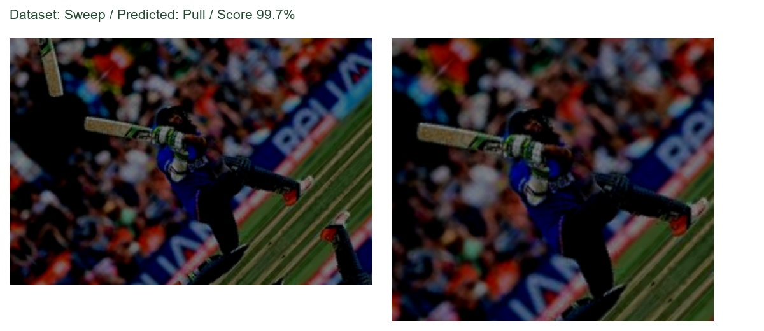
A confident error stays in the demo
Selected after evaluation, alongside successful and disagreement examples
Inspect the upstream label, predicted label and actual input views. Confidence can be wrong.
CRICKET SHOT RECOGNITION / EE604
13
Notes:
Use image_04199, the preserved confident failure. Do not invent its exact cause or silently relabel it. The selected picture is an illustration, not an estimate of failure frequency. Real data source: aneesh10/cricket-shot-dataset v2. Follow with the view-disagreement image_00014.

Slide 14
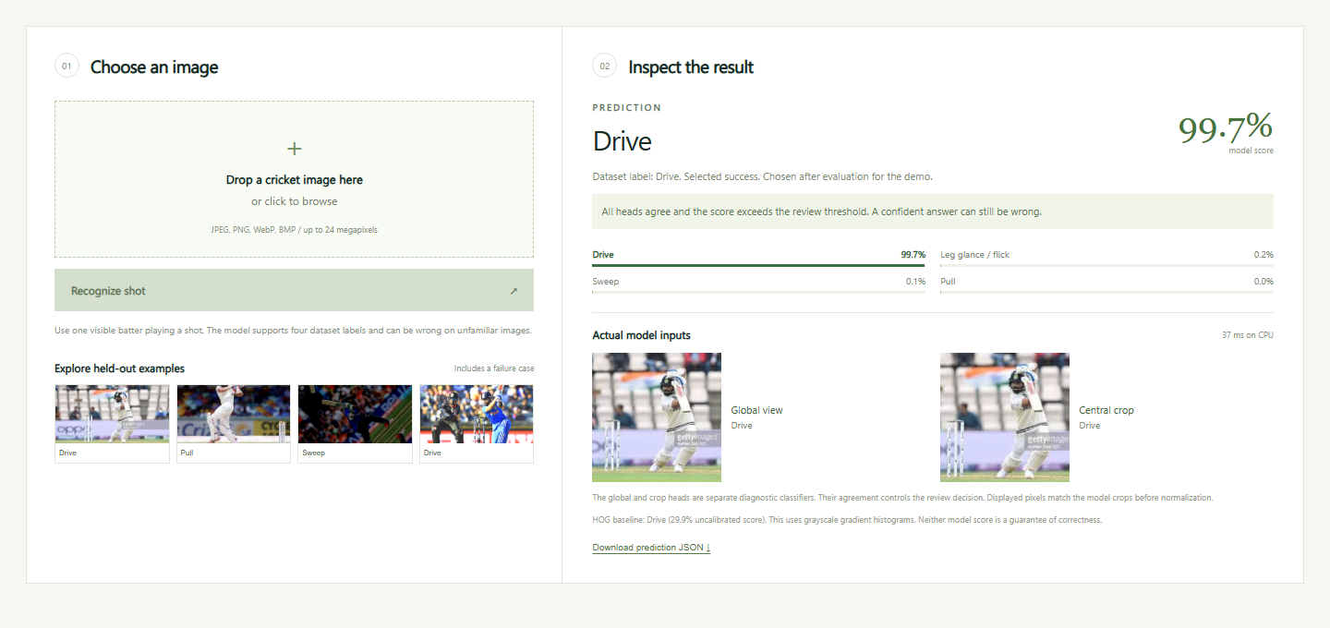
Local image demonstration
Upload an image, compare CNN and HOG, inspect the review reason, export JSON
CRICKET SHOT RECOGNITION / EE604
14
Notes:
Run setup.bat on a fresh machine, then run_demo.bat. Default URL http://127.0.0.1:6040. Revision verification may use 6060 to avoid another local service. Show success image_00210, confident error image_04199 and disagreement image_00014. Selected examples are honestly labeled. JSON preserves temperature-scaled score semantics. Screenshot must come from the revised running app, not a mockup.

Slide 15
What we can defend
An implemented comparison with useful negative findings
Course foundation
HOG and frozen features, each followed by a trained multiclass head.
Limited extension
Contrast gains three test images; uncertainty spans no gain.
The audit corrects optimism, and calibration fails to transfer.
Next useful step: independently labeled data with known match and player identities.
CRICKET SHOT RECOGNITION / EE604
15
Notes:
Novelty remains a weakness, not a promise of marks. Do not claim a new architecture, detector or state-of-the-art result. Mention unknown upstream license, possible missed copies and unverified labels. Course mapping and viva guide contain actual page references and a tensor-shape trace. Team identities and the real repository URL are on the cover.

Slide 16
Backup: video pilot and duplicate audit
Separate eight-class data and reused pilot holdout; not the main recognition claim
Video model | Accuracy | Macro F1
Full frame | 18.1% | 17.7%
Fixed crop | 30.2% | 21.3%
Majority baseline | 30.2% | 5.8%
562 clips / 25 source groups / 116 test clips from five groups
Image audit: hashes, transforms, ORB/RANSAC links; all connected copies stay together.
CRICKET SHOT RECOGNITION / EE604
16
Notes:
Use only for questions. Equal 30.2% majority accuracy means weak video recognition, despite higher macro F1. Fixed crop followed pilot test feedback. Source: https://www.kaggle.com/datasets/amittalmale/cricket-shots . Image audit: pHash <=6 bits with thumbnail MAD, rotations/mirrors, then 15 feature neighbors within cosine .20. ORB binary matching, .72 ratio, >=16 matches, >=12 RANSAC inliers, >=65% inlier fraction, >=8% hull coverage. These are evaluation tools, not a novel shot classifier. Other sources: https://github.com/onnx/models ; https://github.com/scikit-learn/scikit-learn ; https://github.com/microsoft/onnxruntime ; https://github.com/opencv/opencv ; https://arxiv.org/abs/1608.00859 . Full URLs, saved evidence and complete code appendix accompany the report.

