Slide 1
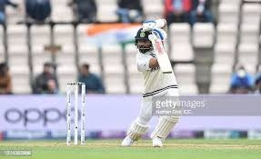
EE604 COURSE PROJECT / 2026
Cricket Shot
Recognition
Gradient features and a frozen CNN
A controlled four-class image study
Hrushikesh Roop Avvari (230249) / Voora Rakesh (231174)
Gokavarapu Manikanta Sri Akshith (230418)
Lokesh Kumar Moond (230606) / Bollu Sharath chandra (230303)
https://github.com/hrushikeshroop/cricket-shot-recognition-ee604
Notes:
Introduce one-image classification. HOG and frozen features connect directly to lectures 10 and 15. The two-view difference is a small extension to test, not a new backbone. Cover image: selected held-out source image, https://www.kaggle.com/datasets/aneesh10/cricket-shot-dataset v2.

Slide 2
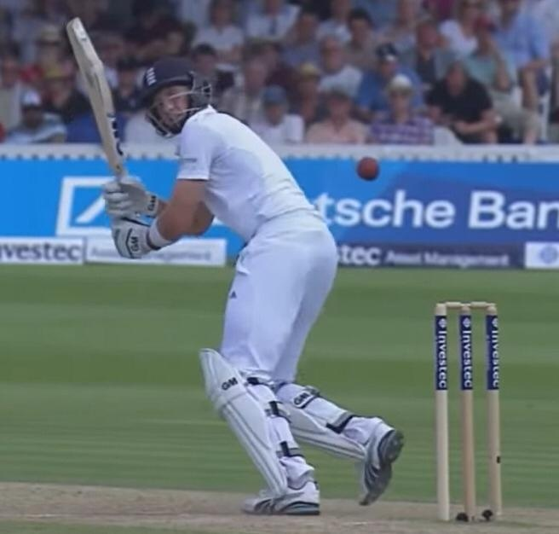
Problem, labels and constraints
Input: one selected cricket image. Output: one of four dataset labels.
Drive
Leg glance / flick
Pull
Sweep
CPU inference, offline after setup.
No batter detection, contact localization or technique grading.
Unknown shots can still receive confident scores.
CRICKET SHOT RECOGNITION / EE604
2
Notes:
The user supplies the image. Drive and leg glance/flick are combined upstream classes. A full match is outside scope. Classification is multiclass with one target, not multilabel sigmoid prediction. Source: dataset v2; lectures 15 pages 16-19.

Slide 3
Previous cricket-recognition methods
Video sequence studies provide context for our narrower image task
Study | Input and main method | Difference in this project
Sen et al. (2021) | Ten-class video CNN / VGG16 features + GRU | One image, four labels Frozen MobileNetV2 + linear heads
Kang (2025 preprint) | Ten-class video EfficientNet-B0 + bidirectional GRU and temporal attention | Two spatial views Explicit abs-difference ablation No temporal sequence model
Course links: HOG (Lecture 10) and frozen features / classification (Lecture 15).
Different data, labels and splits prevent direct comparison of published percentages.
CRICKET SHOT RECOGNITION / EE604
3
Notes:
Sen et al.: CricShotClassify, Sensors 21(8), 2846 (2021), https://www.mdpi.com/1424-8220/21/8/2846 . CNN frame features and GRU, including frozen and partly fine-tuned VGG16 variants. Kang: https://arxiv.org/abs/2510.09187 , a preprint comparing sequence models and proposing EfficientNet-B0 with bidirectional GRU and temporal attention. No code or datasets from either paper were imported. KUCricShot authors' repository https://github.com/AtanuCSE/CricketShotDetection describes a separate four-shot, 1278-example dataset, also unused. Lecture 8 part 2 p9 distinguishes local/global features. Lecture 14 part 2 pp2-3 and 27 covers extractor/classifier and softmax. We implement an image comparison, not a new backbone or a priority claim.

Slide 4
Images and fixed visual-group split
4,724 original files; 4,723 exact representatives in 363 visual groups
Class | Train | Validation | Test
Drive | 734 | 244 | 245
Glance / flick | 672 | 224 | 224
Pull | 756 | 252 | 252
Sweep | 672 | 224 | 224
221 training groups / 72 validation groups / 70 test groups
No shared group or decoded hash. Match and player identities remain unknown.
CRICKET SHOT RECOGNITION / EE604
4
Notes:
Data: https://www.kaggle.com/datasets/aneesh10/cricket-shot-dataset v2. Unknown license in downloaded metadata; no original annotations claimed. Fixed seed 604 folds; this is one holdout, not five-fold cross-validation. Test images are clustered copies and must not be described as 945 independent photographs.

Slide 5
Evaluation choices and their limits
All five methods share images, labels, visual groups and split identities
Choice | Data used | What remains fixed
Fit classifier coefficients | Training only | Frozen CNN; deterministic HOG
Choose C: 0.1, 1, 10, 100 | Validation macro F1 | Smallest C wins ties
Temperature and review | Original validation reuse | Keep original settings
Final comparison | Same 945 test identities | No new split or seed search
Exploratory: grouping changed after preliminary evaluation; HOG was added after old results were known.
CRICKET SHOT RECOGNITION / EE604
5
Notes:
One validation set was reused for regularization, calibration and threshold selection. This can overfit validation. We disclose it rather than create a new split and pretend the original test was untouched. Initial hash-only contrast result was 96.3%; stronger transformed-copy grouping yields 65.5%. Both results and original individual predictions remain available.

Slide 6
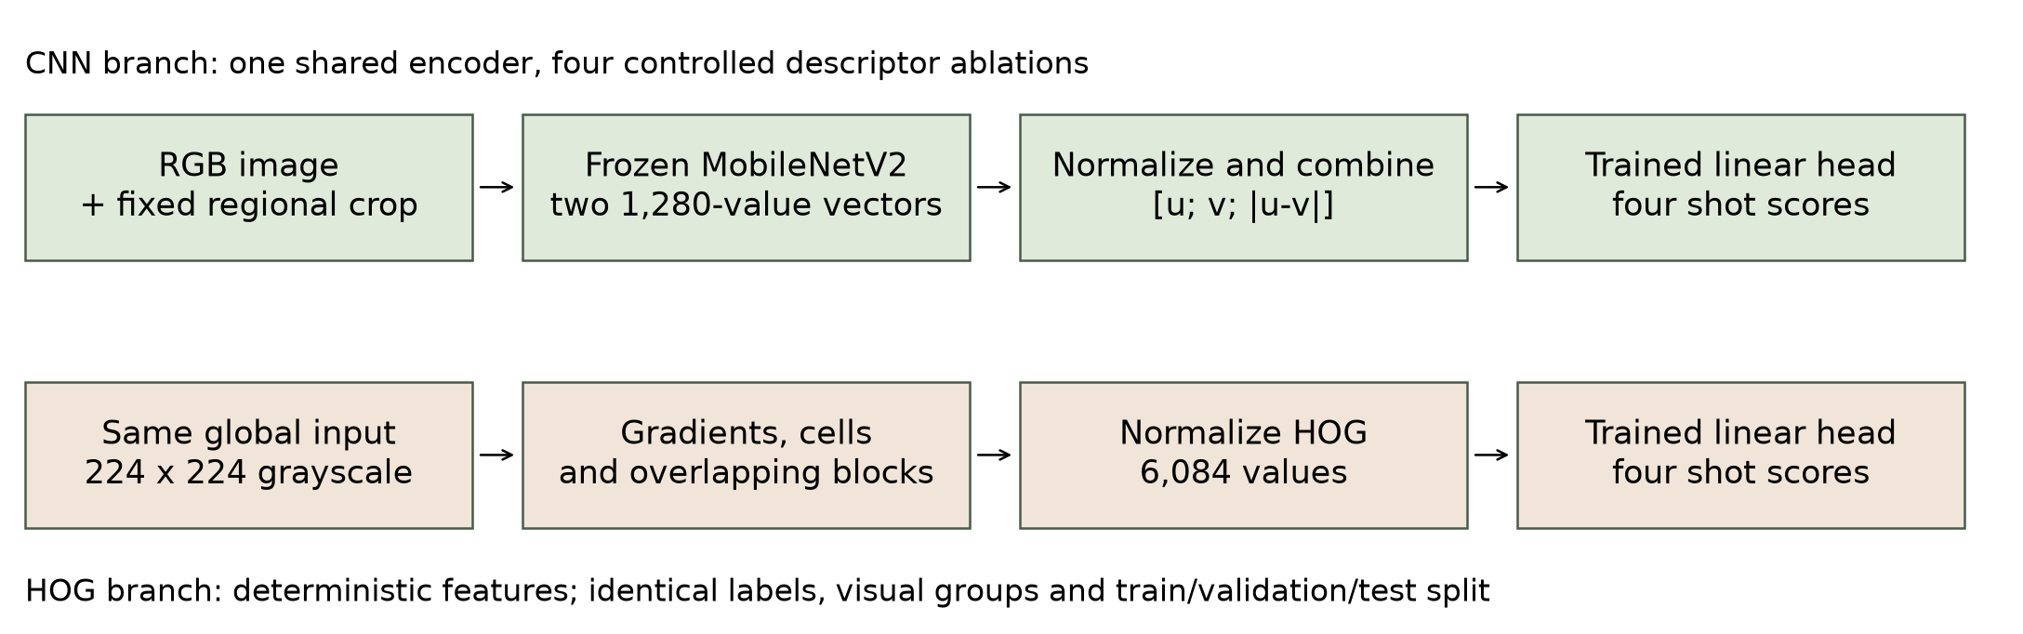
Implemented pipeline
Only the small cricket classifiers learn from the training images
Central crop assumes a centered batter. It can remove the bat or useful scene context.
CRICKET SHOT RECOGNITION / EE604
6
Notes:
Explain the two branches. HOG and CNN global inputs have identical aspect-preserving 224 square geometry. The fixed crop reduces some background without training a detector, but can miss an off-center batter. Keeping the global view preserves a second source of context, although square center fitting also removes peripheral pixels. MobileNetV2 is an efficient ImageNet backbone selected for CPU use; freezing limits cricket fitting to small heads on only 221 training groups. This is design reasoning, not proof that freezing or this model is optimal. CNN has two view passes; its heads share features. Source: actual implemented pipeline, https://arxiv.org/abs/1801.04381 , and docs/model_card.md.

Slide 7
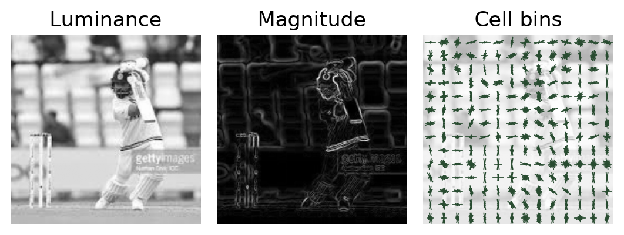
HOG: gradients, cells and blocks
Lecture 10: accumulate gradient magnitude in orientation bins
Step | Fixed setting
Input | 224 x 224 luminance
Orientation votes | 9 unsigned bins; linear bin weights
Cells | 16 x 16 pixels; 14 x 14 cells
Blocks | 2 x 2 cells; stride 1 cell
Normalize / concatenate | L2 blocks, then 6,084-value L2 vector
Votes use magnitude, not frequency. No learned feature scaling; no test-based HOG tuning.
CRICKET SHOT RECOGNITION / EE604
7
Notes:
Trace gx and gy central differences, sqrt(gx²+gy²), atan2 modulo 180. A 50-degree gradient of magnitude 90 votes 45 to the 40-degree bin and 45 to 60. No spatial vote interpolation. Each 36-value block divides by sqrt(sum(h²)+1e-10). 13*13*36=6084. This is a documented HOG variant, not the exact signed-angle lecture example or original pedestrian detector. Lecture 10 pp 7-23; original method https://lear.inrialpes.fr/people/triggs/pubs/Dalal-cvpr05.pdf .

Slide 8
CNN views and the contrast feature
Frozen ImageNet MobileNetV2 gives two 1,280-value pooled embeddings
Representation | Normalized classifier input | Dimension
Global | u | 1,280
Fixed regional crop | v | 1,280
Concatenation | [u; v] | 2,560
Contrast | [u; v; abs(u-v)] | 3,840
Absolute difference is nonlinear; signed difference would be redundant
for a linear head on concatenation. This motivates a test, not a success claim.
CRICKET SHOT RECOGNITION / EE604
8
Notes:
Both vectors are L2-normalized before joining so their raw magnitudes do not set the relative block scale; the joined descriptor is normalized again. Equal norm does not imply equal usefulness. No normalization ablation was conducted. A linear head on concatenation can compute signed u-v but cannot generally compute abs(u-v); the explicit block supplies this nonlinear relation. This is the motivation to test, not proof of improvement. Contrast W has (4,3840) shape plus four biases, 15364 stored parameters, trained with weighted multiclass cross-entropy and L2 regularization. No bat-motion interpretation is assigned to coordinates. MobileNetV2: https://arxiv.org/abs/1801.04381 ; weights: https://github.com/onnx/models .

Slide 9
Recognition results
Same corrected split; every test image contributes, including review cases
Feature | C | Val. F1 | Test acc. | Test F1
HOG | 0.1 | 49.4% | 35.3% | 34.5%
CNN global | 10 | 77.1% | 63.0% | 62.9%
CNN crop | 10 | 74.8% | 62.4% | 61.7%
Concatenation | 10 | 79.6% | 65.2% | 64.6%
Contrast | 10 | 77.8% | 65.5% | 64.9%
HOG is a controlled baseline. Pretrained features help here; contrast adds only three correct images.
CRICKET SHOT RECOGNITION / EE604
9
Notes:
HOG fixed settings, validation-selected C and predictions are saved under results/hog. Do not try a new descriptor after seeing the 35.3% test score to improve a headline. CNN heads/predictions are retained unchanged. This comparison does not isolate color versus pretraining versus architecture; no general statement that all HOG methods are inferior. Evidence: results/revision/comparison.csv and saved individual probabilities.

Slide 10
Where contrast changes decisions
17 concatenation errors corrected, but 14 correct decisions lost
Post-hoc subset | Images | Concat. correct | Contrast correct
Global / crop agree | 713 | 499 | 499
Global / crop disagree | 232 | 117 | 120
All test images | 945 | 616 | 619
Selected examples: drive image_00696 is corrected;
drive image_00017 changes from correct to incorrect.
Paired group interval: -1.46 to +2.38 points. A reliable gain is not established.
CRICKET SHOT RECOGNITION / EE604
10
Notes:
This descriptive analysis uses unchanged saved test predictions. Cases are first IDs in gain/loss categories, selected after evaluation. image_00696: label drive; global drive, crop pull, concat pull, contrast drive. image_00017: label drive; global drive, crop glance/flick, concat drive, contrast glance/flick. Agreement subsets do not identify a causal mechanism or validate a new selection rule. For uncertainty, resample the 70 visual groups, retaining all their images, in 2000 paired draws with seed17; image-weighted statistics. The interval omits training/split variability and unknown match correlation. Complete individual-method intervals remain in report and results/revision/comparison.json; case evidence is in view_diagnostics.json.

Slide 11
Class errors
Contrast confusion counts; rows are dataset labels
True / predicted | Drive | Glance/flick | Pull | Sweep
Drive | 161 | 27 | 36 | 21
Glance / flick | 80 | 102 | 15 | 27
Pull | 36 | 13 | 197 | 6
Sweep | 1 | 15 | 49 | 159
Macro F1 averages the four class F1 scores equally. Review does not remove mistakes from this table.
CRICKET SHOT RECOGNITION / EE604
11
Notes:
Read an off-diagonal entry and explain precision versus recall. Glance/flick is difficult under this protocol. HOG predicts pull for 110 of 224 sweep images. Fixed geometry, similar stances and background are plausible issues, not proven causes for each error. Evidence: saved prediction arithmetic in comparison.json.

Slide 12
Scores, calibration and secondary review
Temperature scaling worsened the recorded test calibration
Contrast scores | NLL | ECE
Unscaled | 0.859 | 0.043
Scaled | 0.898 | 0.094
Confidence alone
62.2% coverage / 77.6% accuracy
With agreement
58.9% coverage / 77.7% accuracy
Agreement rejects more images for negligible accuracy benefit.
Keep T = 0.802 and threshold = 0.70 unchanged.
Softmax is a relative class score. Agreement is not a guarantee or an unknown-shot detector.
CRICKET SHOT RECOGNITION / EE604
12
Notes:
NLL and ECE worsen. ECE uses ten equal-width confidence bins. The same validation set selected C, temperature and threshold; the 90% validation target did not transfer to test. The gate needs global/crop/contrast agreement; the heads are correlated. It accepts557/945 with433 correct. Its measured benefit over confidence alone is tiny. Retain it as visible triage for conflicting views; diagnostic heads use the same two encoder outputs, adding no encoder pass. HOG scores are unscaled and do not affect review. Sources: https://proceedings.mlr.press/v70/guo17a.html ; https://arxiv.org/abs/1705.08500 .

Slide 13
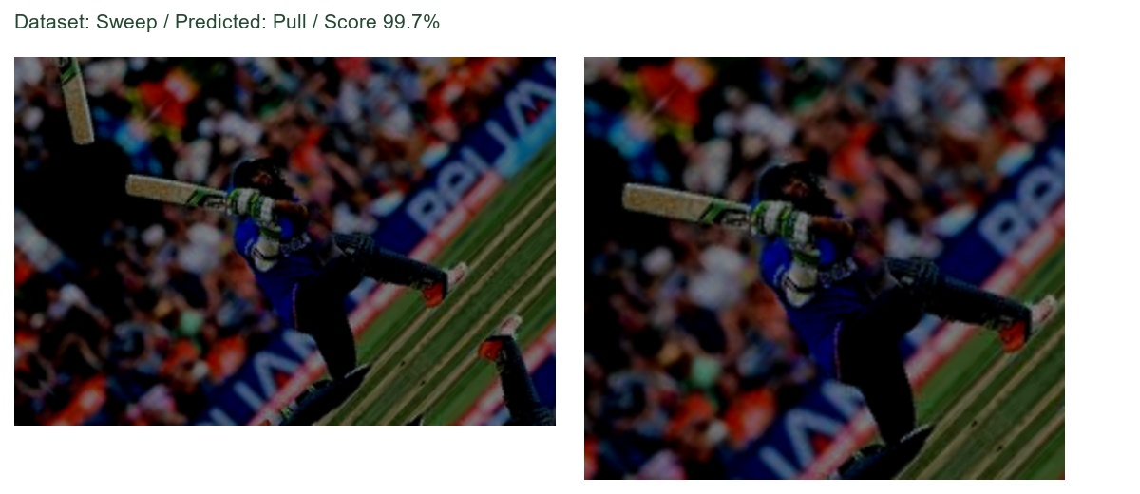
A confident error stays in the demo
Selected after evaluation, alongside successful and disagreement examples
Inspect the upstream label, predicted label and actual input views. Confidence can be wrong.
CRICKET SHOT RECOGNITION / EE604
13
Notes:
Use image_04199, the preserved confident failure. Do not invent its exact cause or silently relabel it. The selected picture is an illustration, not an estimate of failure frequency. Real data source: aneesh10/cricket-shot-dataset v2. Follow with the view-disagreement image_00014.

Slide 14
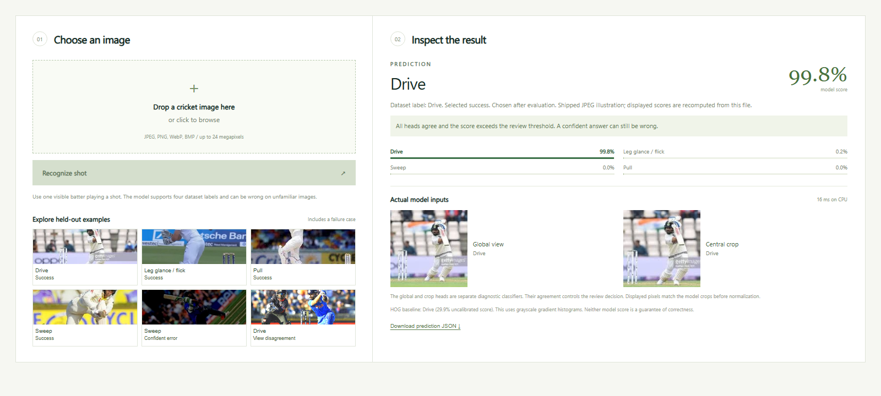
Local image demonstration
Upload an image, compare CNN and HOG, inspect the review reason, export JSON
CRICKET SHOT RECOGNITION / EE604
14
Notes:
Run setup.bat on a fresh machine, then run_demo.bat. Install and rehearse before going offline. Default URL http://127.0.0.1:6040. Five shipped JPEG illustrations cover all four successful class labels plus confident error image_04199. The full local package also has original disagreement image_00014; public clones can restore it optionally. Fresh scores are computed from actual input files; JPEG inputs may differ from original benchmark pixels. All examples were selected after evaluation. Show actual views and HOG, then export JSON. Screenshot source is the running app.

Slide 15
What we can defend
An implemented comparison with useful negative findings
Course foundation
HOG and frozen features, each followed by a trained multiclass head.
Implemented extension and evidence
Explicit spatial-view difference, tested against concatenation.
17 decisions gained and 14 lost, with no reliable advantage.
Next useful step: independently labeled data with known match and player identities.
CRICKET SHOT RECOGNITION / EE604
15
Notes:
The implemented contribution is the controlled comparison and inspectable integration of two-view absolute differences and diagnostic agreement. Components are established; HOG itself is not new. The measured gain is uncertain, so do not claim a new architecture, detector or state-of-the-art result. The audit also corrects an optimistic initial result, and calibration fails to transfer. Mention possible missed copies and unverified labels. See docs/model_card.md for the limits, docs/demo_guide.md for the demonstration sequence, and results/revision/worked_trace.json for a measured trace. Team identities and repository URL are on the cover.

Slide 16
Backup: learned view weighting
A 42-parameter gate over global, crop and contrast scores
Fusion | Val. F1 | Test acc. | Test F1
Uniform weights | 78.6% | 65.1% | 64.5%
Learned constant | 78.8% | 65.4% | 64.8%
Learned adaptive | 78.8% | 65.4% | 64.8%
Training: five separate visual-group folds provide gate inputs.
Validation selects L2 = 10 before this test evaluation.
Adaptive and constant weights make identical test decisions (618/945).
No improvement over simpler fusion. The demo retains contrast (619/945).
CRICKET SHOT RECOGNITION / EE604
16
Notes:
Exploratory follow-up after original test results were known. Established mixture-of-experts idea: Jacobs et al. (1991), https://www.cs.toronto.edu/~hinton/absps/jjnh91.pdf . Three experts with C=10 and T=1. No new CNN pass or CNN training. Gate inputs: each expert entropy/log4, maximum and margin; pairwise total variation; embedding cosine distance. Training-only out-of-fold means/std standardize 13 inputs, std lower bound .05. Slopes/intercepts give42 coefficients. Class-balanced NLL, L2 slopes, unpenalized biases. Search L2 .01,.1,1,10, validation macro F1, stronger regularization wins ties. Constant control learns .176 global, nearly zero crop, .824 contrast. Adaptive and constant test predictions are identical. Adaptive minus contrast: -0.11 accuracy points, paired visual-group 95% interval [-.79,+.68]. Concat validation F1=79.6%, so the frozen deployment rule rejects this gate. This is not nested CV: C was selected in the earlier validation study. Stored fold lists, OOF scores, protocol, selection and test predictions are in results/fusion. No new architecture or reliable gain is claimed.

Slide 17
Backup: video pilot and duplicate audit
Separate eight-class data and reused pilot holdout; not the main recognition claim
Video model | Accuracy | Macro F1
Full frame | 18.1% | 17.7%
Fixed crop | 30.2% | 21.3%
Majority baseline | 30.2% | 5.8%
562 clips / 25 source groups / 116 test clips from five groups
Image audit: hashes, transforms, ORB/RANSAC links; all connected copies stay together.
CRICKET SHOT RECOGNITION / EE604
17
Notes:
Use only for questions. Equal 30.2% majority accuracy means weak video recognition, despite higher macro F1. Fixed crop followed pilot test feedback. Source: https://www.kaggle.com/datasets/amittalmale/cricket-shots . Image audit: pHash <=6 bits with thumbnail MAD, rotations/mirrors, then 15 feature neighbors within cosine .20. ORB binary matching, .72 ratio, >=16 matches, >=12 RANSAC inliers, >=65% inlier fraction, >=8% hull coverage. These are evaluation tools, not a novel shot classifier. Other sources: https://github.com/onnx/models ; https://github.com/scikit-learn/scikit-learn ; https://github.com/microsoft/onnxruntime ; https://github.com/opencv/opencv ; https://arxiv.org/abs/1608.00859 . Full URLs, saved evidence and complete code appendix accompany the report.

