Slide 1
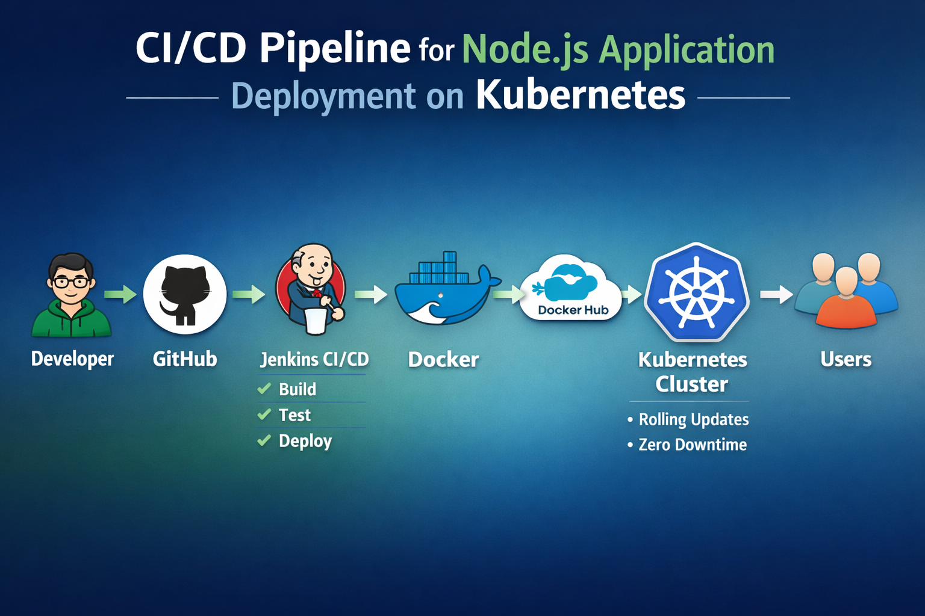


Slide 2
Agenda
Project Overview
Architecture & Tools
CI/CD Pipeline Flow
Docker & Kubernetes Implementation
Deployment Strategy (Rolling Update)
Auto Rollback Strategy
Rollback Testing & Verification
Challenges & Optimization
Results
Future Scope

Slide 3
What is the concept of CICD pipeline for Node JS Application
This project implements a complete CI/CD pipeline to automate the build and deployment of a Node.js application using Docker and Kubernetes (Minikube).
The pipeline uses Jenkins to build and version Docker images, push them to Docker Hub, and deploy them to a Kubernetes cluster with rolling updates and zero downtime.
The project demonstrates containerization, automated deployment and performance optimization through resource tuning.

Slide 4
Why CICD pipeline for Node js application
Automate build and deployment
Use containerization (Docker)
Deploy on Kubernetes
Achieve zero downtime
Implement rolling updates
Auto rollback on deployment failure
Ensure production stability at all times

Slide 5
Architecture
Developer
Writes a code and push on GitHub
GitHub
Stores application source code.
Triggers Jenkins pipeline on code changes
Jenkins (CI/CD Automation)
Pulls latest code from GitHub
Builds Docker image
Tags image with build number
Pushes image to Docker Hub
Deploys updated image to Kubernetes
Docker (Containerization)
Packages application with dependencies
Creates portable Docker image
Docker Hub
Stores the versioned docker images
Kubernetes pulls updated image from here
Kubernetes – Minikube (Container Orchestration)
Manages Pods and Deployments
Performs rolling updates
Ensures zero downtime
Handles scaling
End User
Access the application via Kubernetes Service

Slide 6
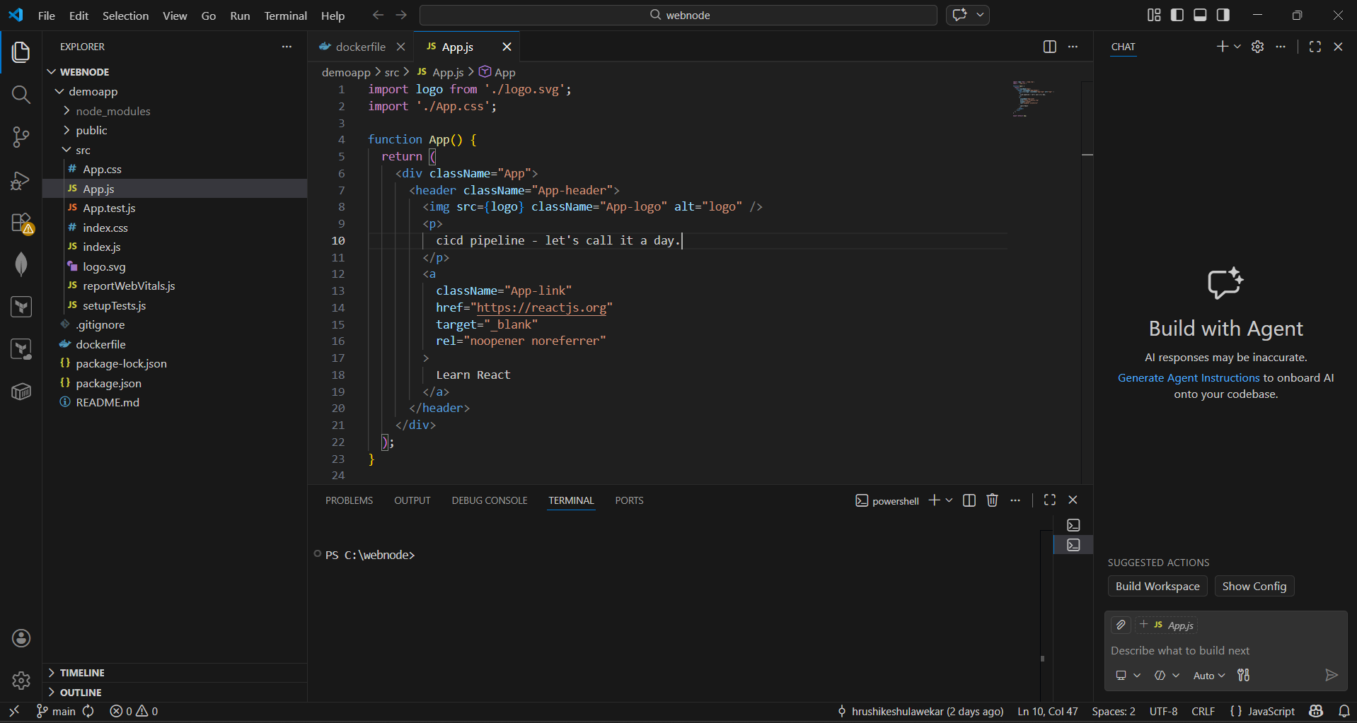
Implementation steps
Create Node js application and dockerfile for application

Slide 7
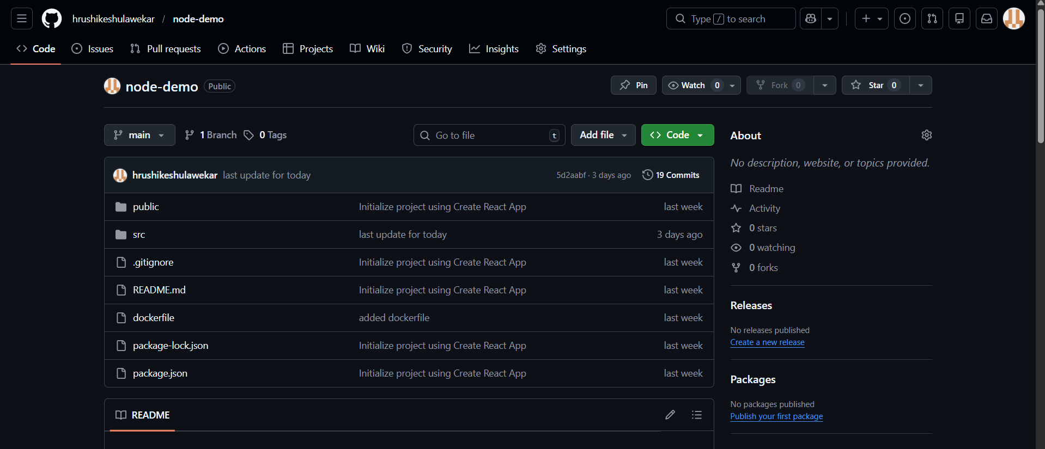
create repository and push the code

Slide 8
Install Git, Jenkins, docker, Kubernetes, Minikube in virtual machine

Slide 9
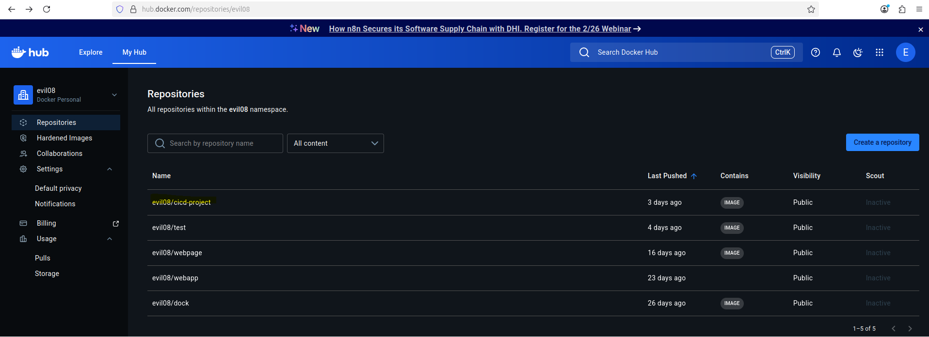
Create docker hub and make repository for our image

Slide 10
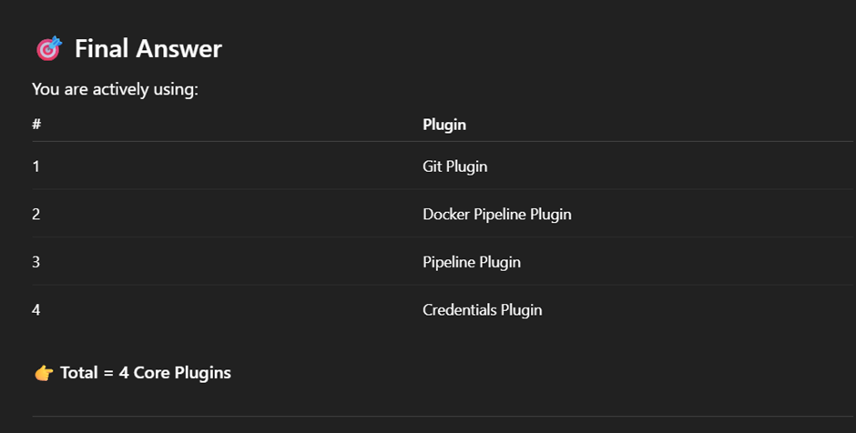
Set Jenkins username and password and install all suggested plugins also install following plugins

Slide 11
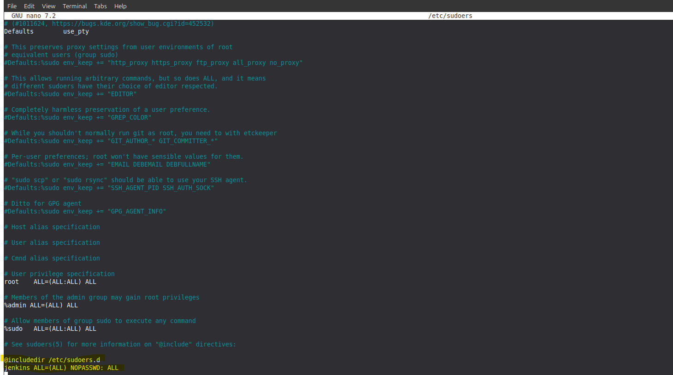
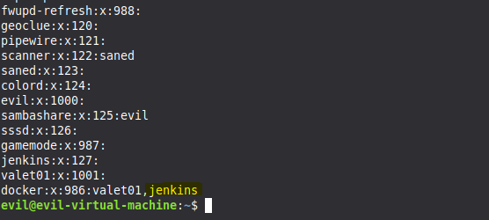
Give administrative privilege to Jenkins

Slide 12
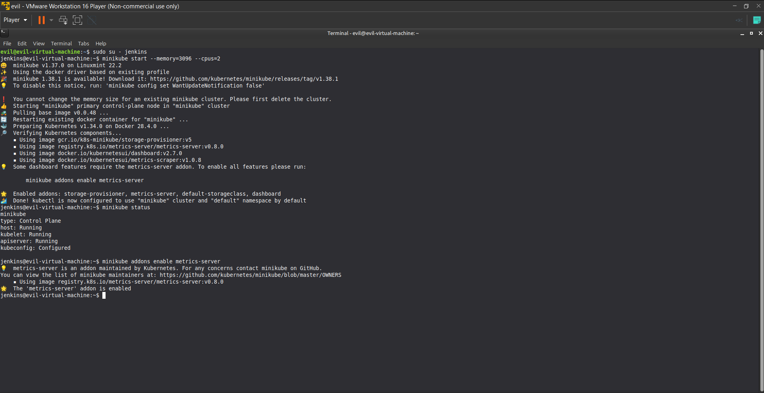
Start Minikube and enable metrics-server

Slide 13
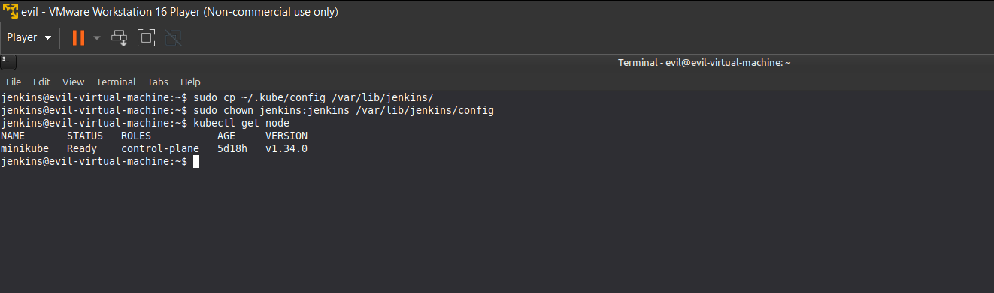
Make sure jenkins access the kubectl

Slide 14
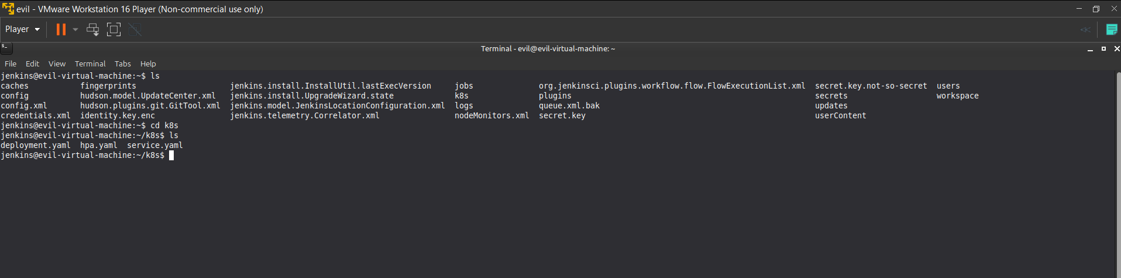
in Jenkins account create yaml files.
mkdir k8s
cd k8s
nano deployment.yaml
nano service.yaml
nano hpa.yaml

Slide 15
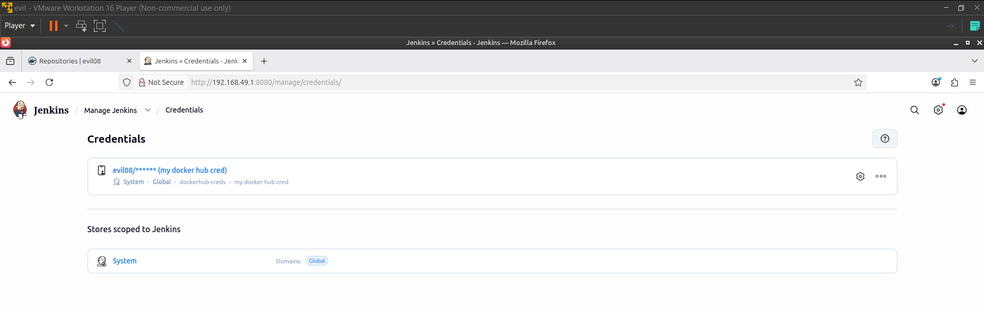
Set the docker hub credentials on jenkins.

Slide 16
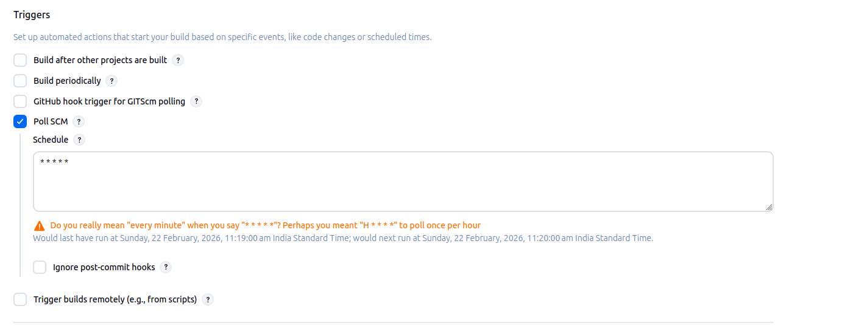
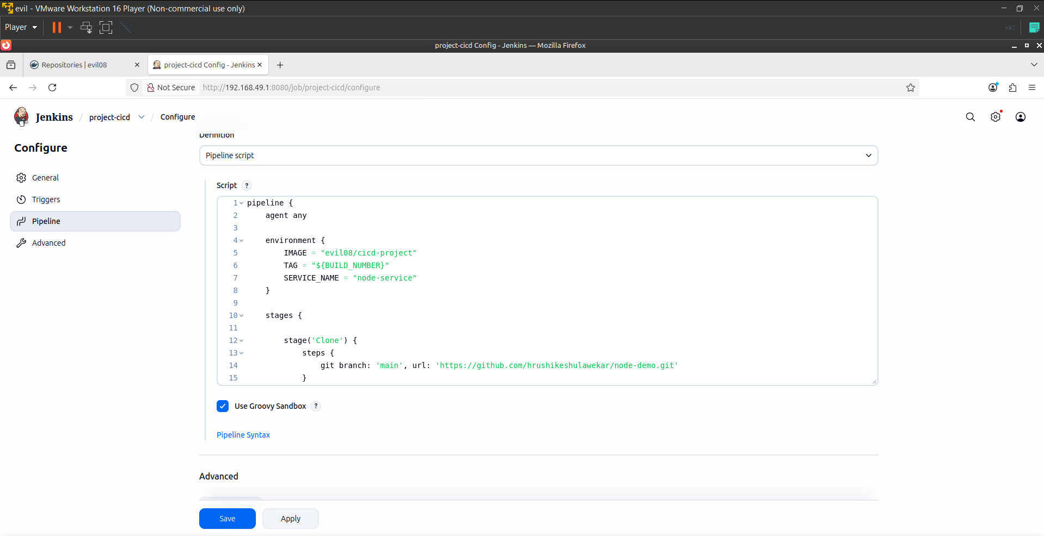
Select new as a pipeline in jenkins give it name
Select trigger and write groovy script in pipeline
Click on save

Slide 17
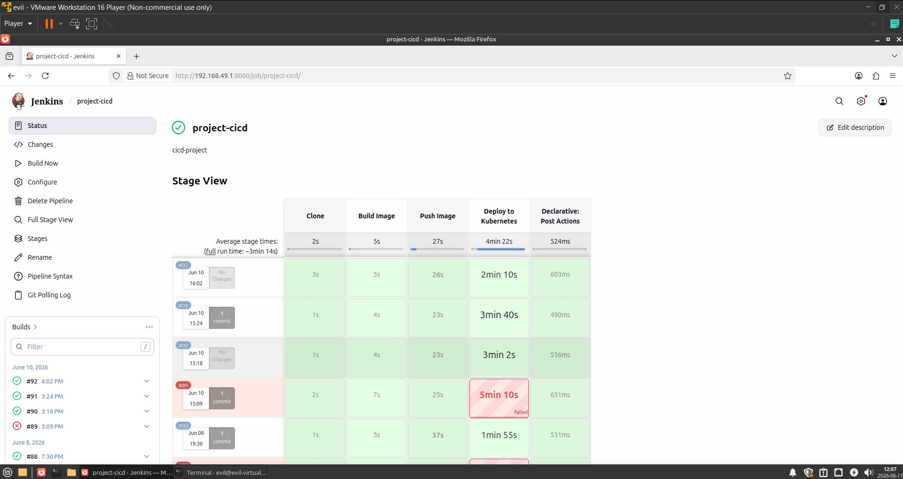
click on build first time manually.

Slide 18
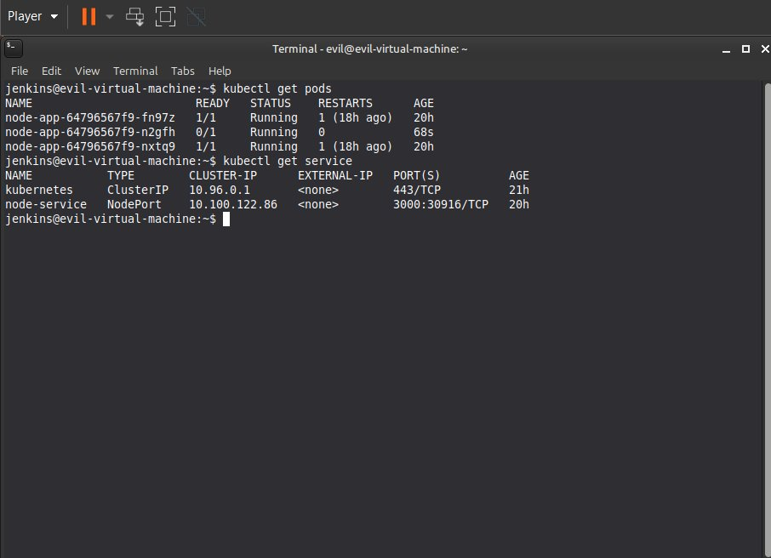
After completing pipeline just check pods and service status

Slide 19
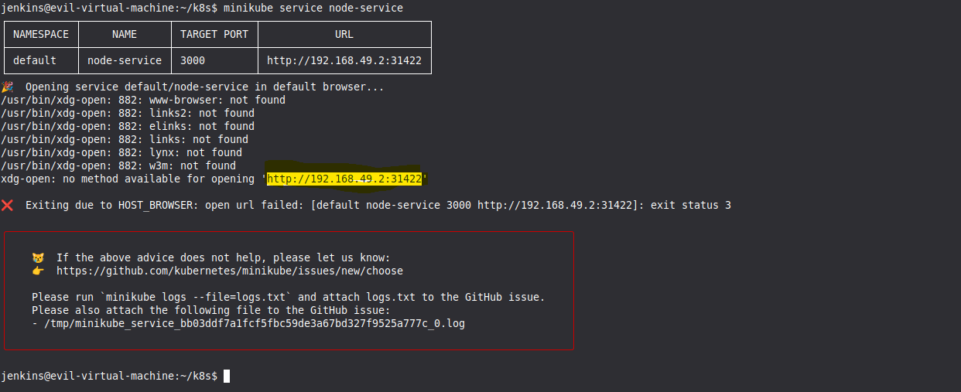
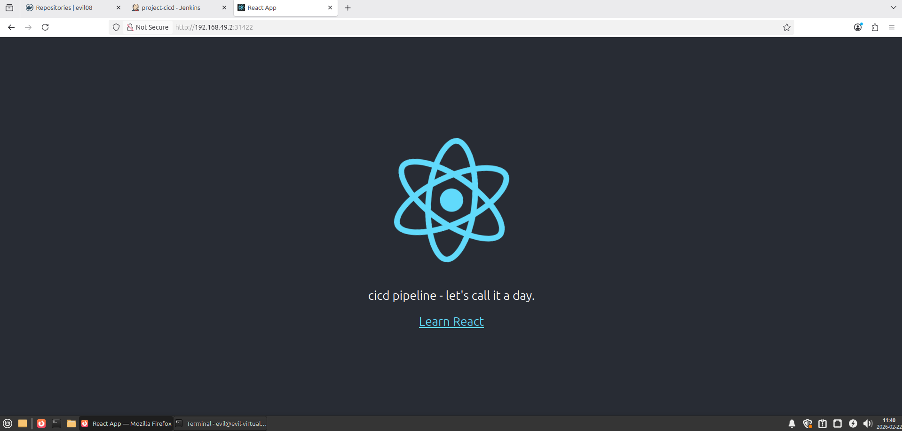
Launch our service

Slide 20
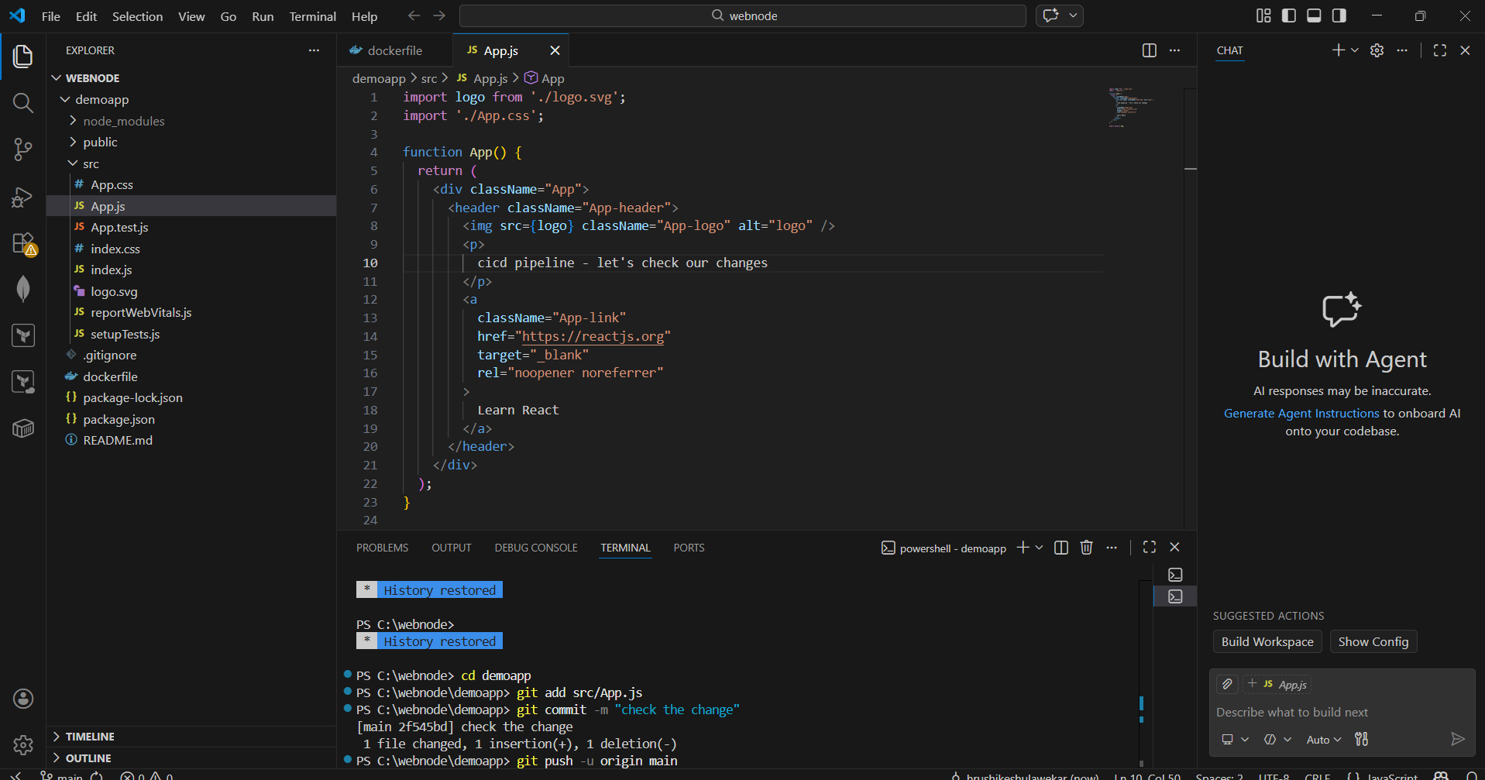
Now make changes in code, commit and push.

Slide 21
check pipeline build, working automatically or not?

Slide 22
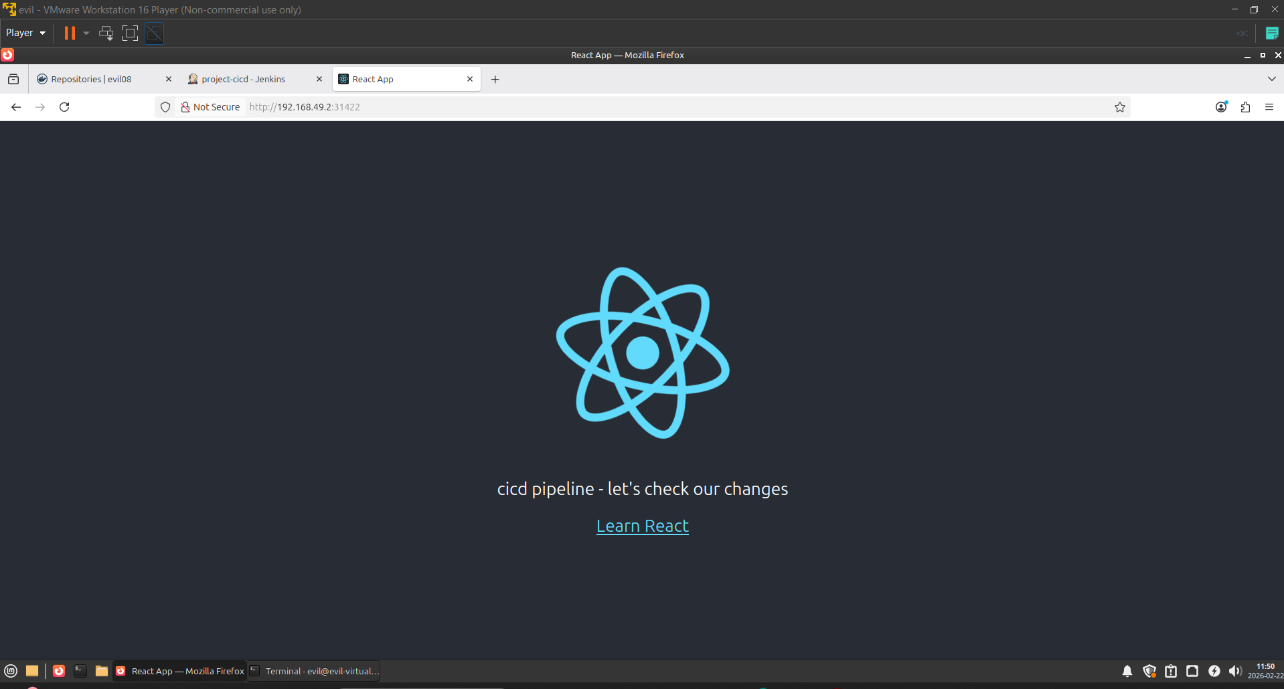
Refresh your web page and check

Slide 23
Advantages
Automated Deployment
Faster Release Cycle
Zero Downtime Updates
Version Control
Scalability
Production-Like DevOps Workflow

Slide 24
Challenges
Slow Deployment Time – initial deployment takes 7 to 11 min time
Large Docker Image Size (>1GB)
Limited CPU allocation caused slower pod startup.
Deployment waited for old pods to terminate before new pods were fully ready.
Ensuring the correct image version was deployed every time.
Understanding pod status, rollout status, and Replica Sets required troubleshooting.
Rollback timeout: 5 replicas on Minikube caused CrashLoopBackOff during rollback — fixed by reducing to 2 replicas and increasing timeout to 300s.
React frontend crashes (throw new Error) do not trigger K8s rollback — only server-side process crashes do.

Slide 25
Auto Rollback Strategy
How Rollback Works
1. Capture revision BEFORE deploy
2. Deploy new image to Kubernetes
3. Wait for rollout (timeout: 300s)
4. On timeout/failure: kubectl rollout undo
5. Verify rollback itself succeeded
6. Pipeline marked FAILURE with rollback info
Safety Guards Built In
kubectl access verified before deploy
First deploy guard (revision == 0)
Rollback itself verified with 300s wait
revisionHistoryLimit: 3 in deployment.yaml
No concurrent builds (disableConcurrentBuilds)
Local Docker image cleaned up on every run

Slide 26
Rollback Pipeline Code (Jenkinsfile)
// 1. Capture revision BEFORE deploying
def currentRevision = sh(script: "kubectl get deployment/node-app ...
// 2. Wait for rollout with timeout
def rolloutStatus = sh(script: "kubectl rollout status ... --timeout=300s", returnStatus: true)
// 3. On failure: rollback
if (rolloutStatus != 0) {
sh "kubectl rollout undo deployment/node-app -n default"
// verify rollback itself succeeded...
error("Deployment FAILED. Rolled back to revision ${currentRevision}.")
}

Slide 27
Rollback Testing & Verification
Test 1: Timeout
5 replicas on Minikube exhausted CPU — rollout timed out, rollback triggered
Fix: replicas=2, timeout=300s
Test 2: CrashLoop
process.exit(1) in server.js caused CrashLoopBackOff — rollback triggered
Reverted to previous build ✓
Test 3: Wrong Port
Wrong containerPort in deployment.yaml — pod never became ready, rollback triggered
Most reliable rollback test ✓
Complete Pipeline Flow with Rollback
Clone → Build → Push → Deploy → SUCCESS ✔
On Deploy Failure:
Clone → Build → Push → Deploy FAIL → Auto Rollback ↺ → FAILURE

Slide 28
Conclusion
This project successfully implemented a complete CI/CD pipeline integrating Docker and Kubernetes for automated application deployment.
It achieved zero downtime using rolling updates, improved deployment performance through resource optimization, and added production-grade auto rollback on deployment failure.
Rollback was tested and verified using CrashLoopBackOff simulation and wrong port injection, confirming the pipeline safely reverts to the last stable build automatically.
The project demonstrates practical understanding of DevOps practices, containerization, version control, Kubernetes orchestration, and fault-tolerant deployment in a real-world workflow.

Slide 29
Thank you
Hrushikesh Ulawekar

