Slide 1
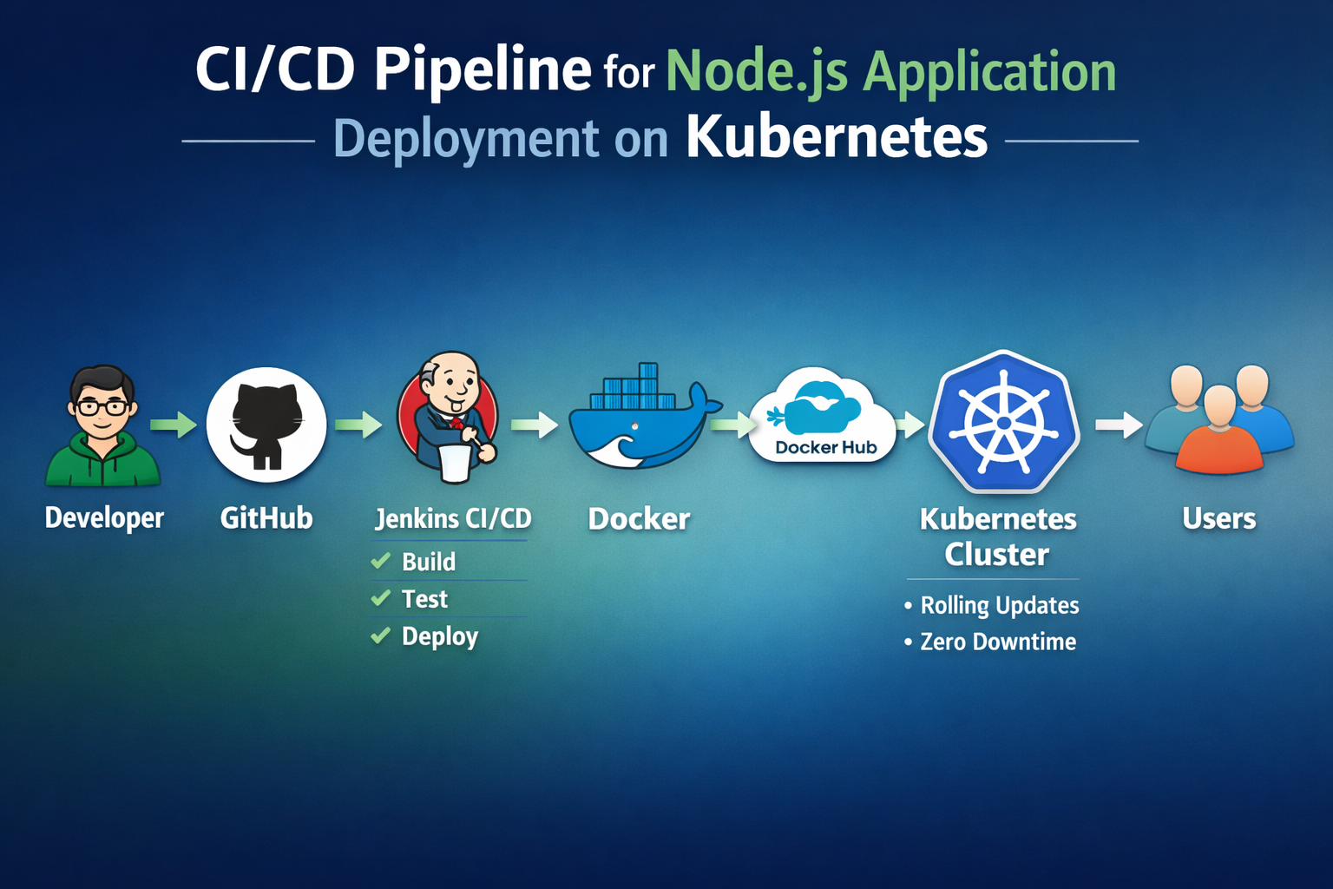


Slide 2
Agenda
Project Overview
Architecture & Tools
CI/CD Pipeline Flow
Docker & Kubernetes Implementation
Deployment Strategy (Rolling Update)
Challenges & Optimization
Results
Future Scope

Slide 3
What is the concept of CICD pipeline for Node JS Application
This project implements a complete CI/CD pipeline to automate the build and deployment of a Node.js application using Docker and Kubernetes (Minikube).
The pipeline uses Jenkins to build and version Docker images, push them to Docker Hub, and deploy them to a Kubernetes cluster with rolling updates and zero downtime.
The project demonstrates containerization, automated deployment and performance optimization through resource tuning.

Slide 4
Why CICD pipeline for Node js application
Automate build and deployment
Use containerization (Docker)
Deploy on Kubernetes
Achieve zero downtime
Implement rolling updates

Slide 5
Architecture
Developer
Writes a code and push on GitHub
GitHub
Stores application source code.
Triggers Jenkins pipeline on code changes
Jenkins (CI/CD Automation)
Pulls latest code from GitHub
Builds Docker image
Tags image with build number
Pushes image to Docker Hub
Deploys updated image to Kubernetes
Docker (Containerization)
Packages application with dependencies
Creates portable Docker image
Docker Hub
Stores the versioned docker images
Kubernetes pulls updated image from here
Kubernetes – Minikube (Container Orchestration)
Manages Pods and Deployments
Performs rolling updates
Ensures zero downtime
Handles scaling
End User
Access the application via Kubernetes Service

Slide 6
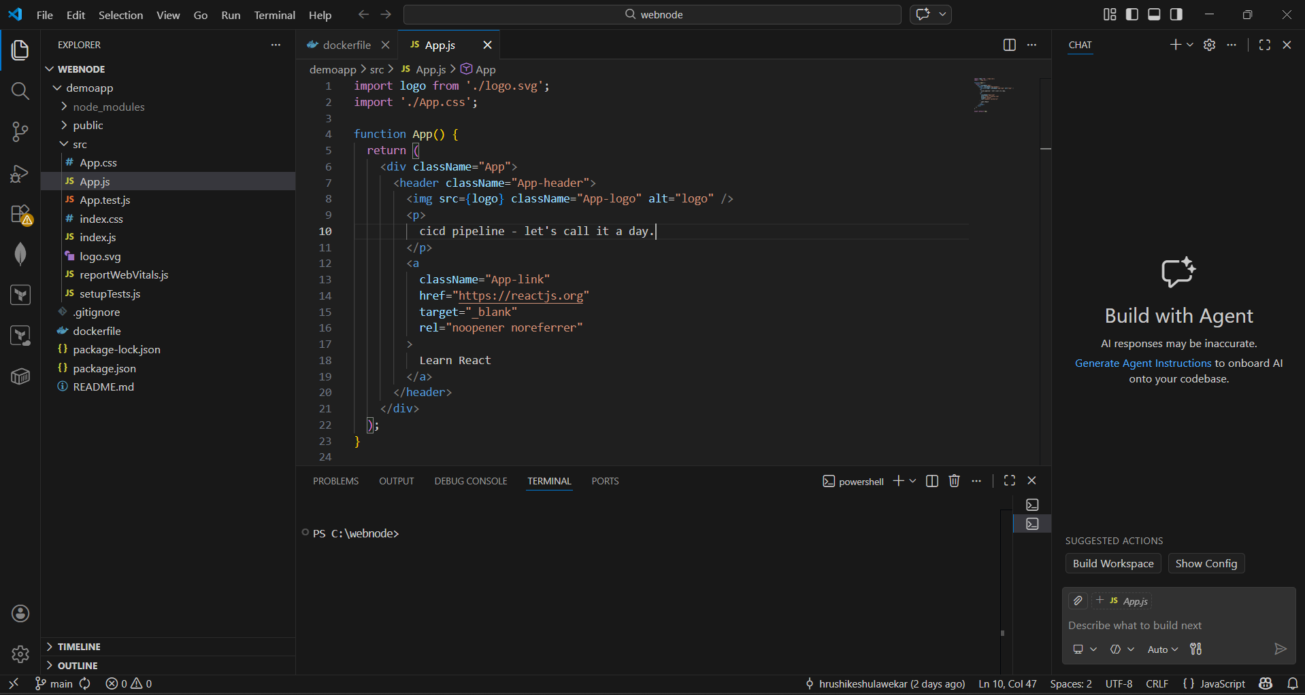
Implementation steps
Create Node js application and dockerfile for application

Slide 7
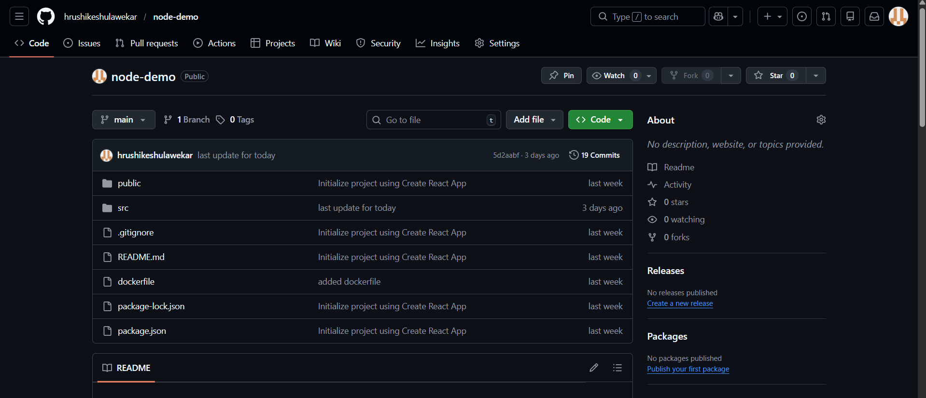
create repository and push the code

Slide 8
Install Git, Jenkins, docker, Kubernetes, Minikube in virtual machine

Slide 9
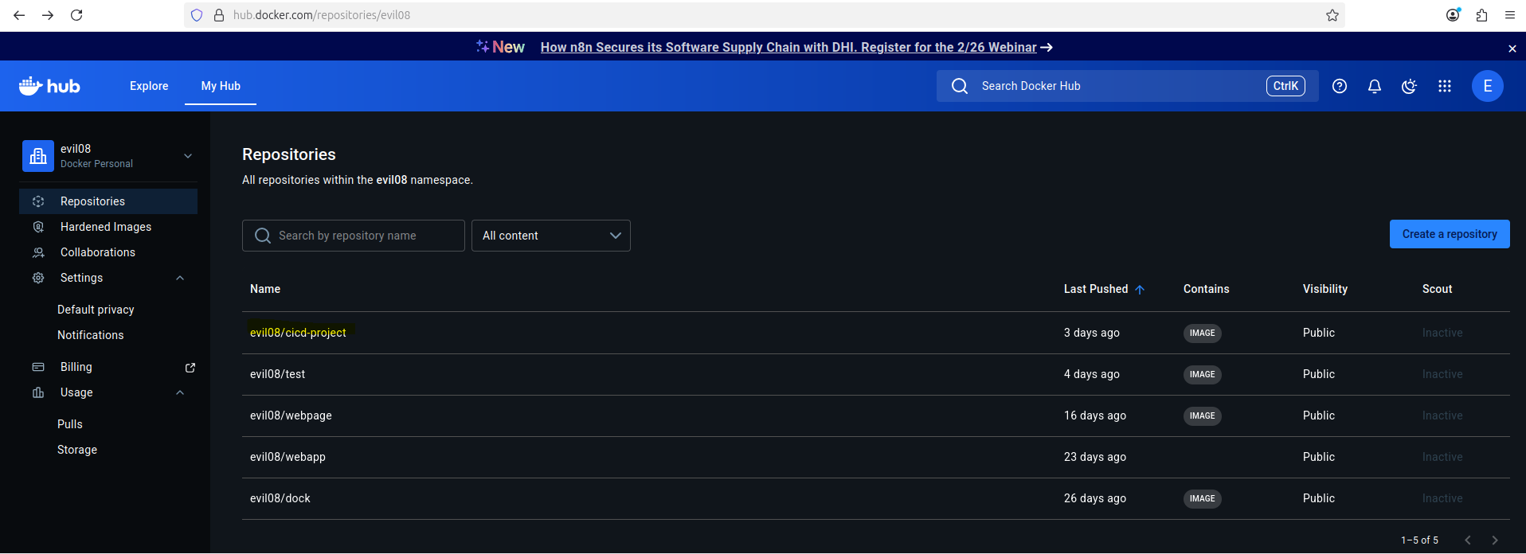
Create docker hub and make repository for our image

Slide 10
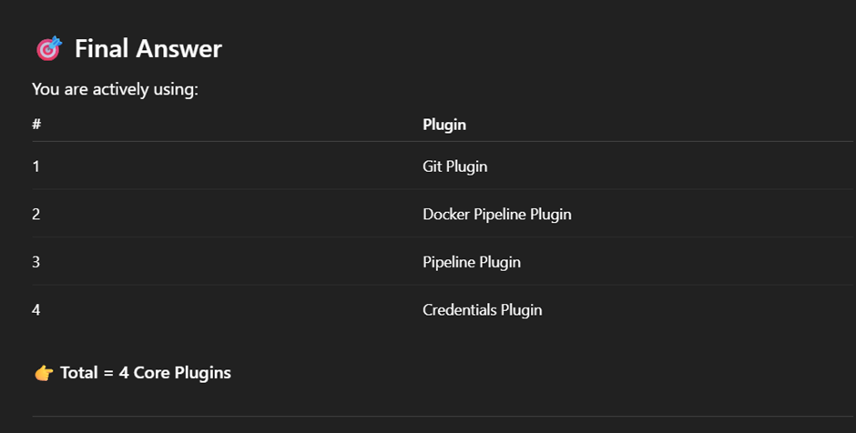
Set Jenkins username and password and install all suggested plugins also install following plugins

Slide 11
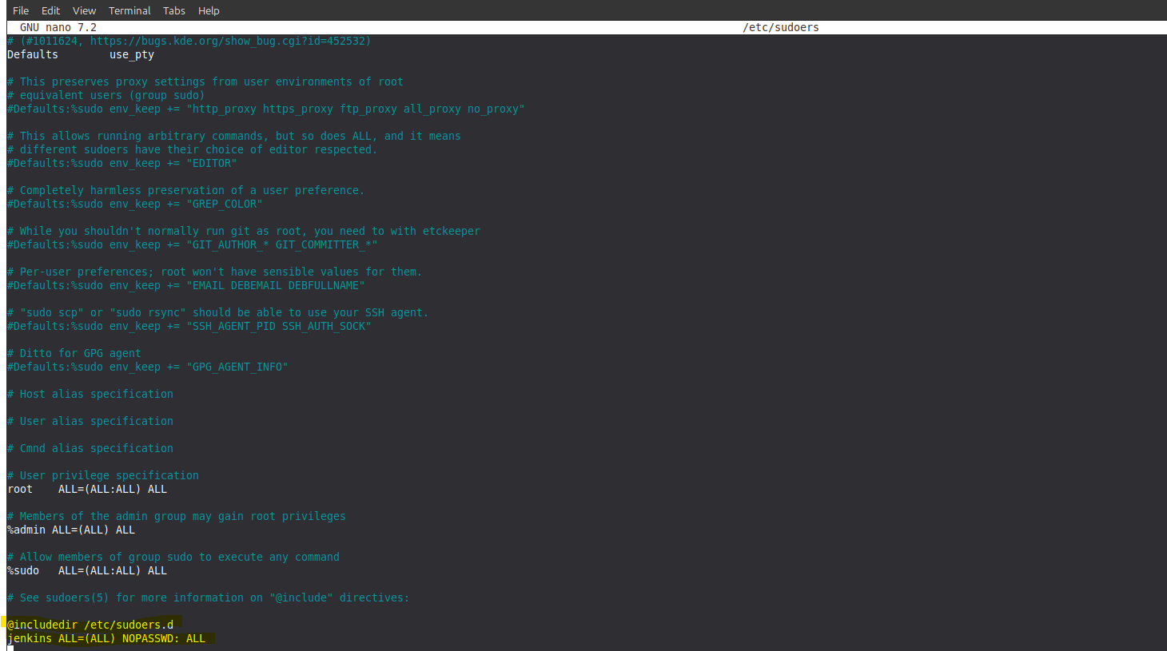
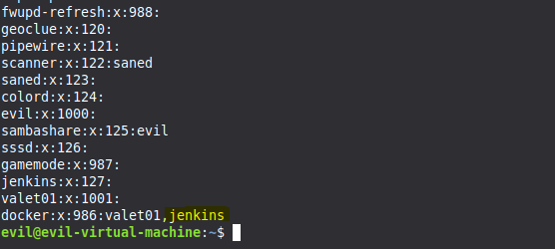
Give administrative privilege to Jenkins

Slide 12
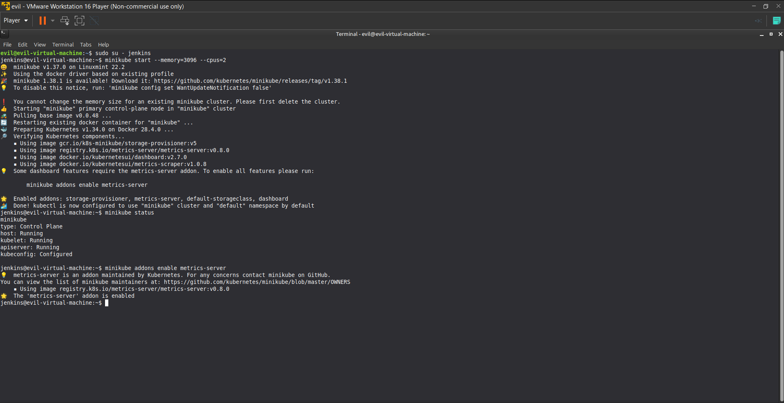
Start Minikube and enable metrics-server

Slide 13
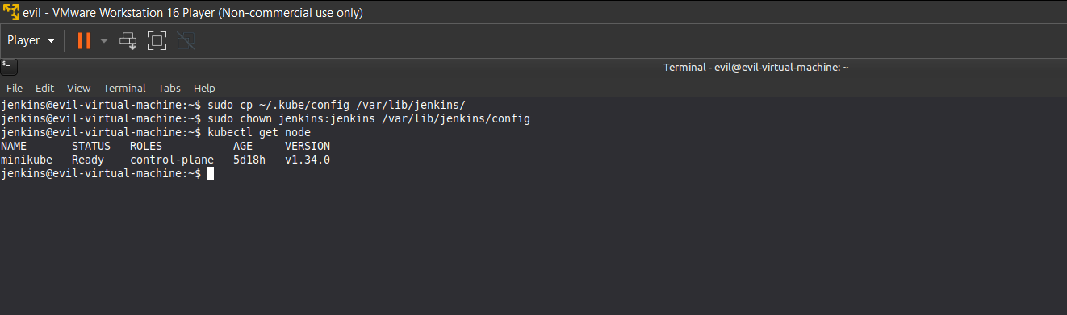
Make sure jenkins access the kubectl

Slide 14
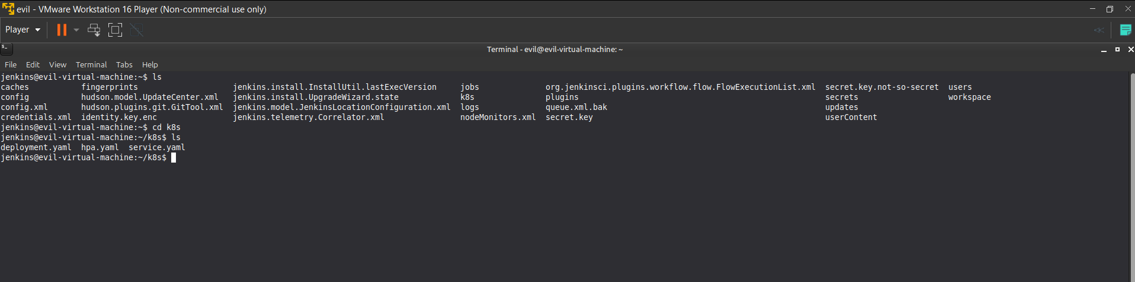
in Jenkins account create yaml files.
mkdir k8s
cd k8s
nano deployment.yaml
nano service.yaml
nano hpa.yaml

Slide 15
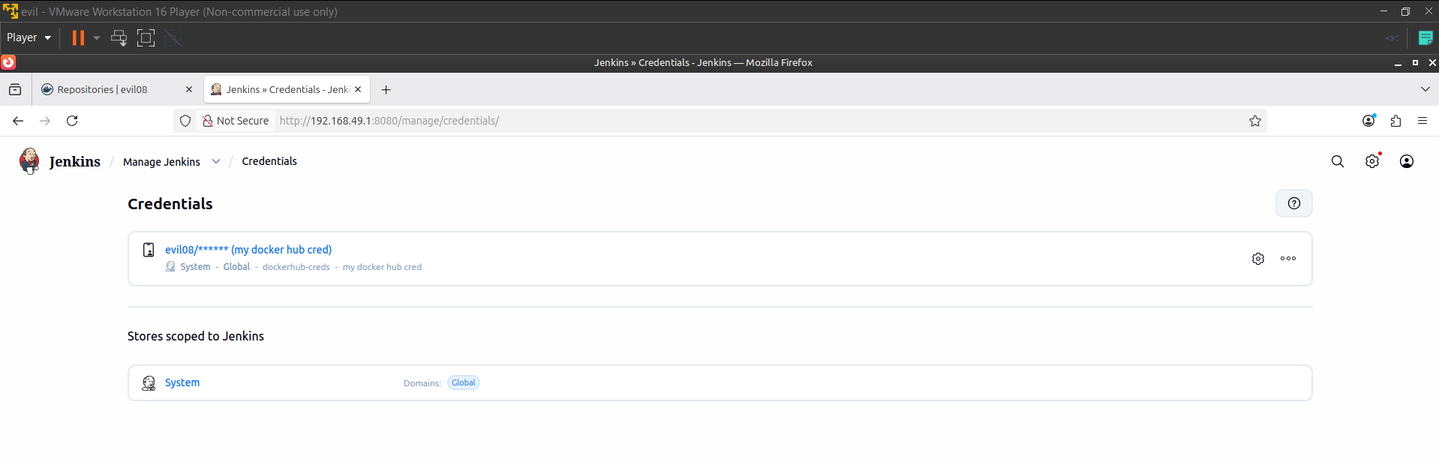
Set the docker hub credentials on jenkins.

Slide 16
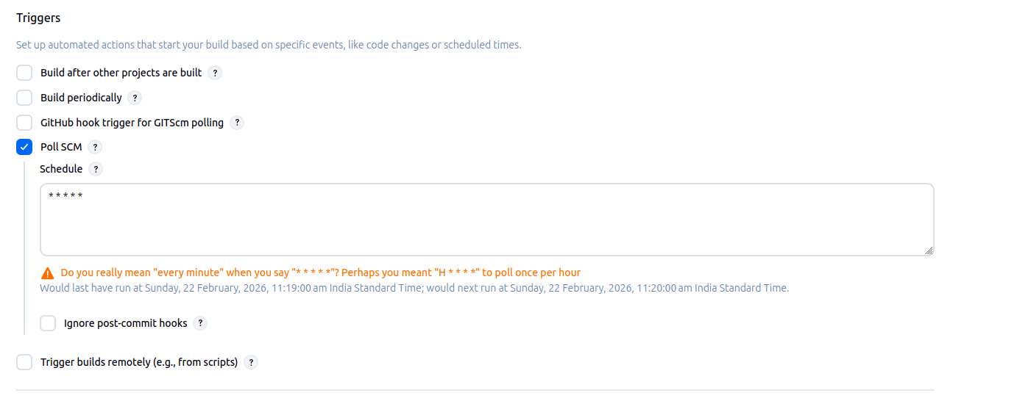
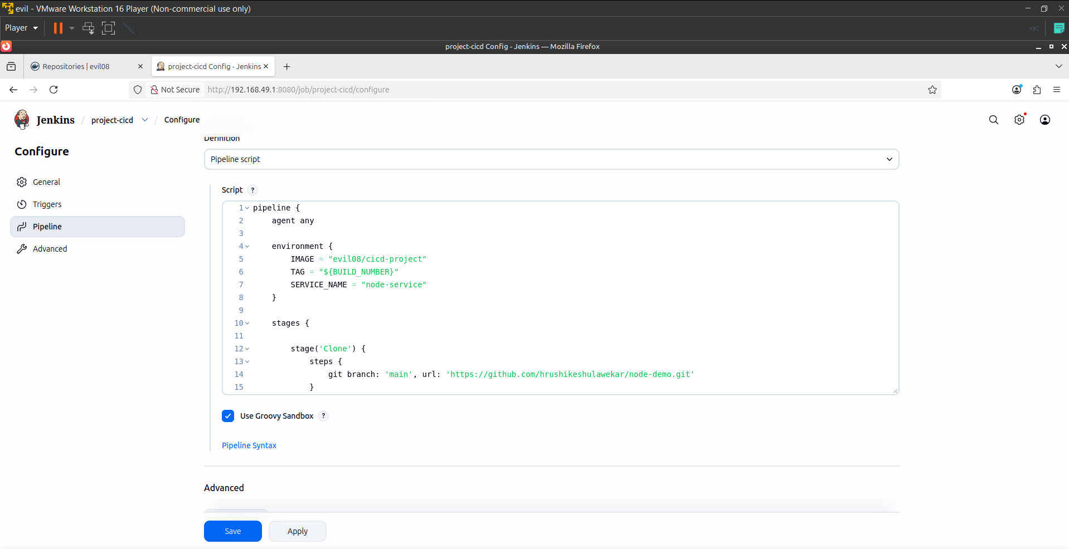
Select new as a pipeline in jenkins give it name
Select trigger and write groovy script in pipeline
Click on save

Slide 17
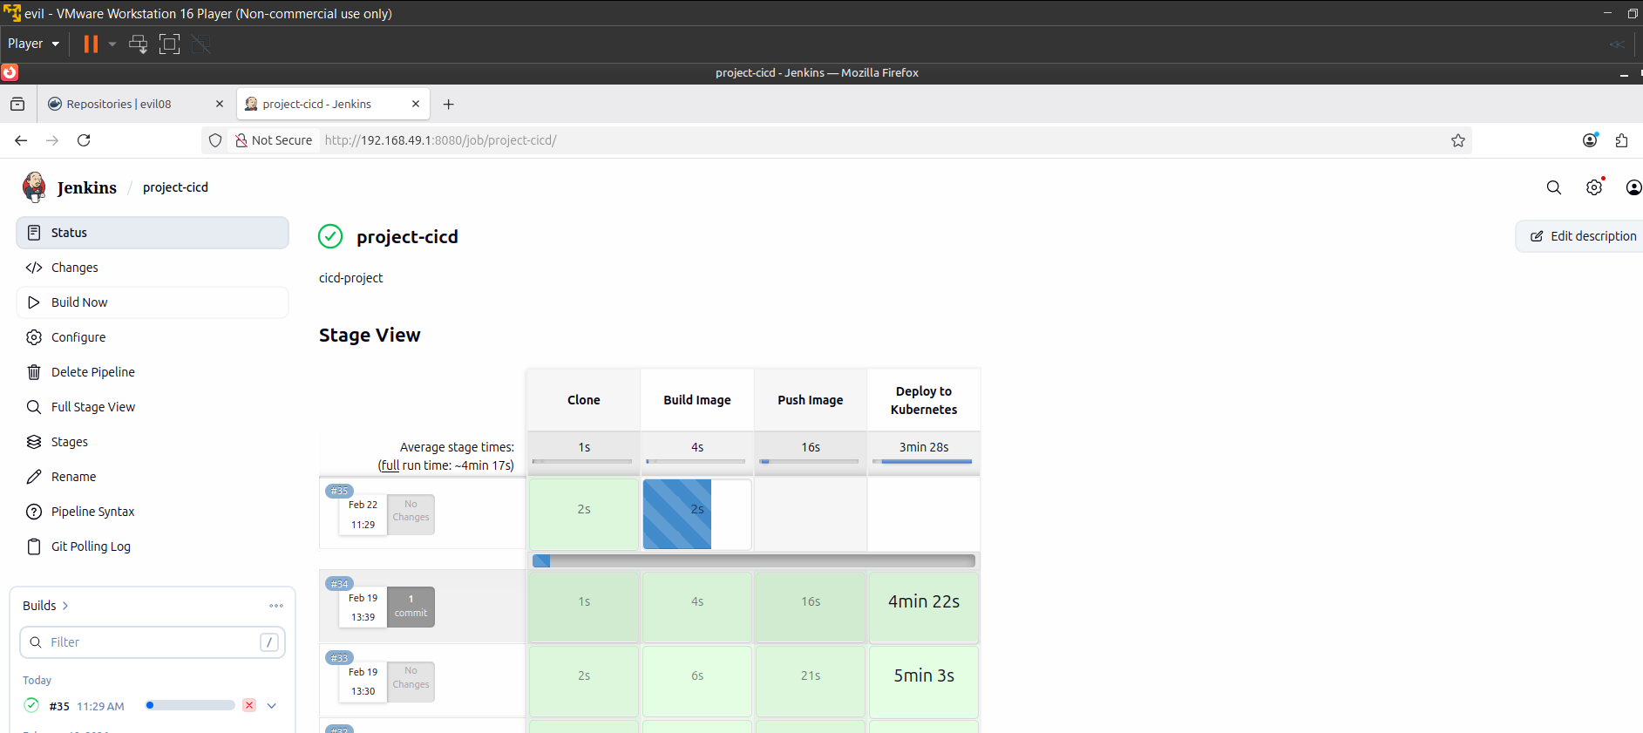
click on build first time manually.

Slide 18
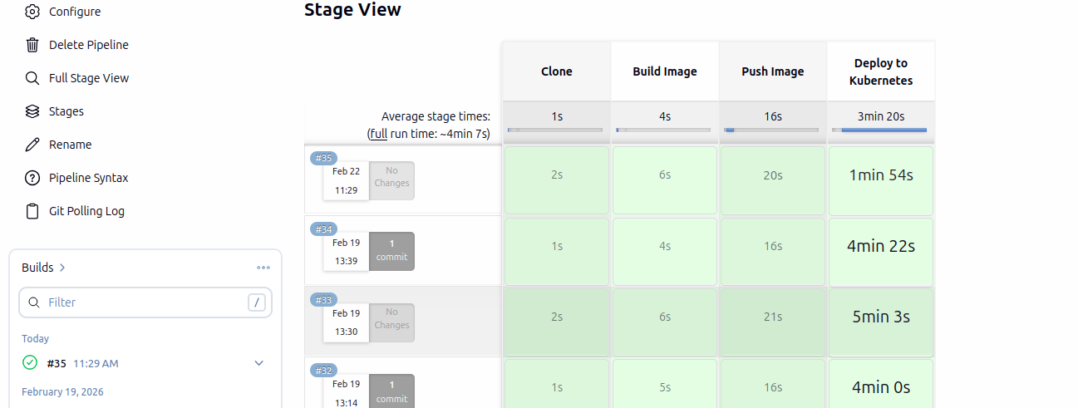
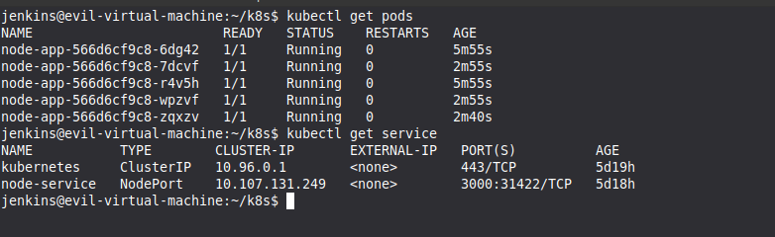
After completing pipeline just check pods and service status

Slide 19
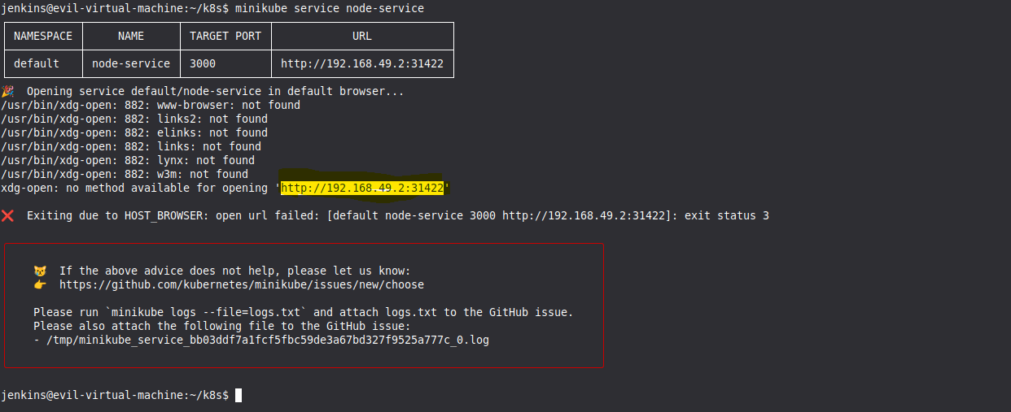
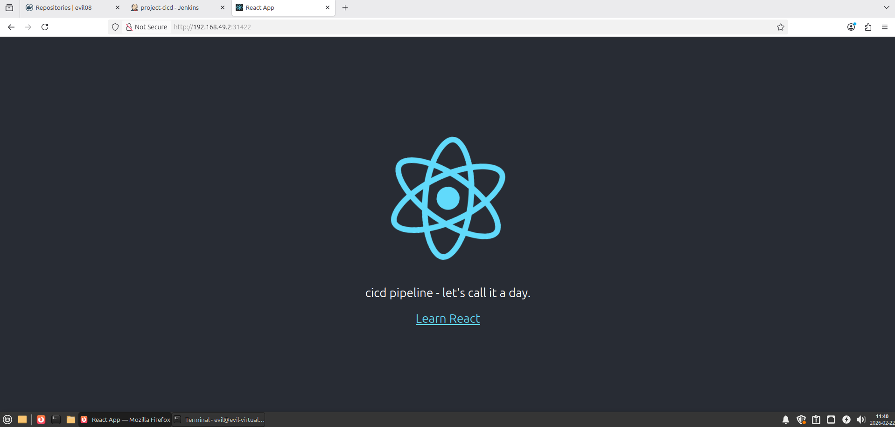
Launch our service

Slide 20
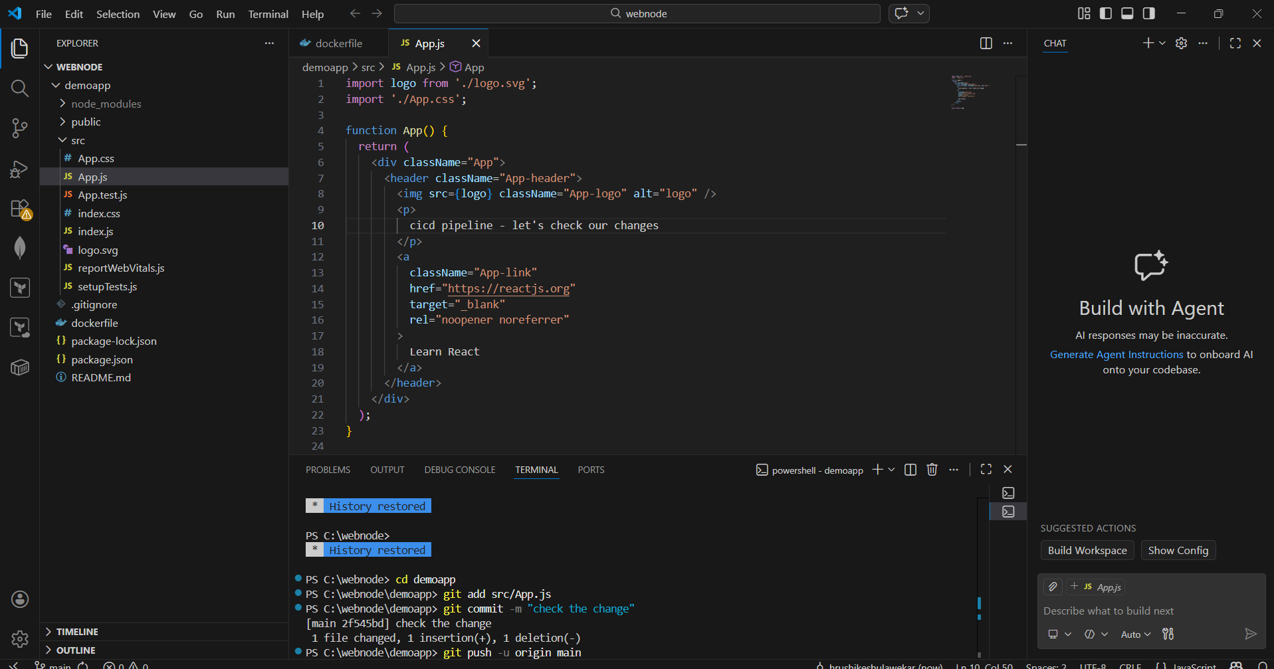
Now make changes in code, commit and push.

Slide 21
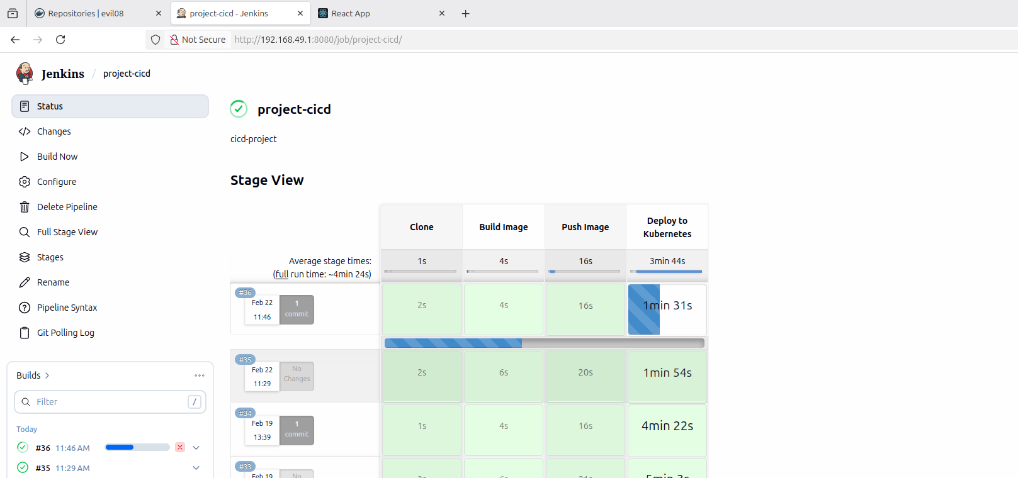
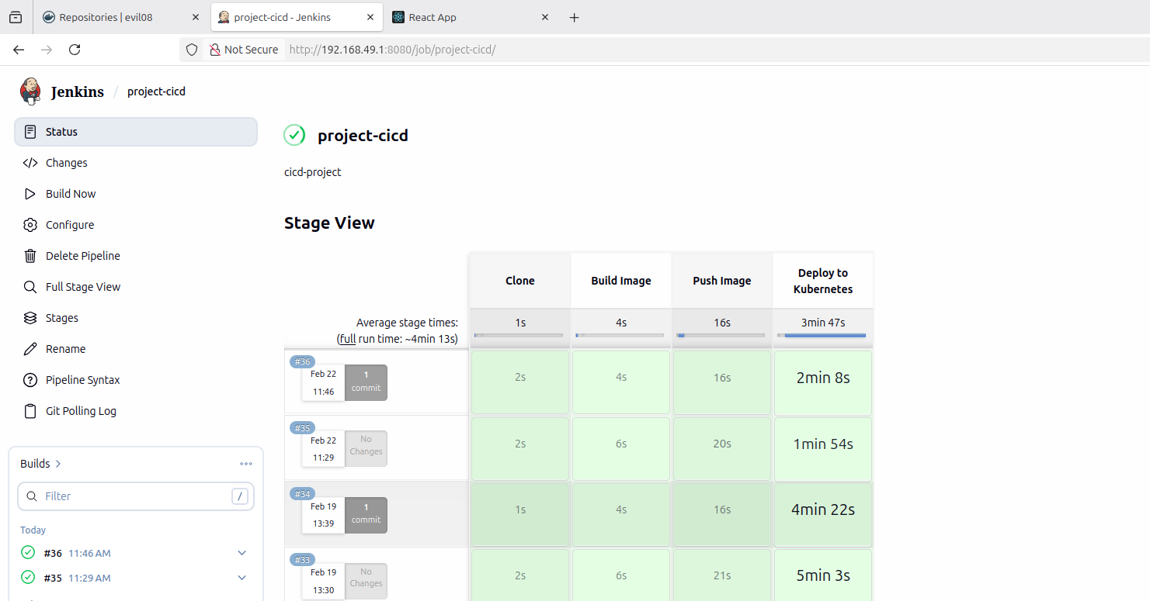
check pipeline build, working automatically or not?

Slide 22
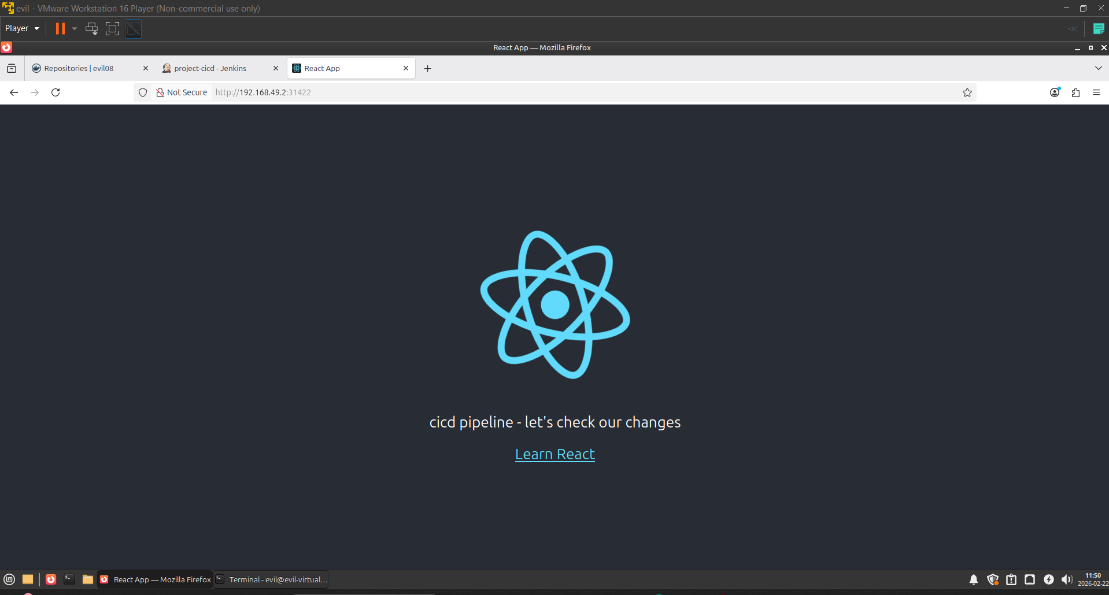
Refresh your web page and check

Slide 23
Advantages
Automated Deployment
Faster Release Cycle
Zero Downtime Updates
Version Control
Scalability
Production-Like DevOps Workflow

Slide 24
Challenges
Slow Deployment Time – initial deployment takes 7 to 11 min time
Large Docker Image Size (>1GB)
Limited CPU allocation caused slower pod startup.
Deployment waited for old pods to terminate before new pods were fully ready.
Ensuring the correct image version was deployed every time.
Understanding pod status, rollout status, and Replica Sets required troubleshooting.

Slide 25
Conclusion
This project successfully implemented a complete CI/CD pipeline integrating Docker and Kubernetes for automated application deployment.
It achieved zero downtime using rolling updates and improved deployment performance through resource optimization.
The project demonstrates practical understanding of DevOps practices, containerization, version control and Kubernetes orchestration in a real-world workflow.

Slide 26
Thank you
Hrushikesh Ulawekar

