Slide 1






DEVOPS · CONTAINERIZATION · ORCHESTRATION
CI/CD Pipeline for Node.js Application
Deployment on Kubernetes
Automated build, containerization, and zero-downtime deployment of a React/Node.js application using Jenkins, Docker, and Minikube — with production-grade auto-rollback on failure.
Developer
GitHub
Jenkins
Docker
Kubernetes
Users
Hrushikesh Ulawekar
github.com/hrushikeshulawekar

Slide 2









AGENDA
What we'll walk through
01
Project Overview
06
Auto Rollback Strategy
02
Architecture & Tools
07
Rollback Testing & Verification
03
CI/CD Pipeline Flow
08
Challenges & Optimization
04
Docker & Kubernetes Implementation
09
Results
05
Deployment Strategy — Rolling Updates
10
Future Scope

Slide 3
PROJECT OVERVIEW
What is this CI/CD pipeline?
This project implements a complete CI/CD pipeline that automates the build, test, and deployment of a Node.js application using Docker and Kubernetes (Minikube) — turning a manual, error-prone release process into a single repeatable workflow.
Automated CI/CD
Zero-Downtime Deploys
Performance Tuning
Jenkins pulls source, builds and versions Docker images, and pushes them to Docker Hub on every commit.
Updated images roll out to a Kubernetes cluster using rolling updates — users never see a service interruption.
Containerization and resource tuning demonstrate practical, production-style optimization decisions.
PROJECT OVERVIEW
03

Slide 4



MOTIVATION
Why a CI/CD pipeline for this app?
Automate build & deployment
Implement rolling updates
Replace manual builds with a single repeatable Jenkins pipeline.
Replace pods gradually instead of all at once.
Use containerization (Docker)
Auto rollback on failure
Package the app with all dependencies into a portable image.
Automatically revert to the last stable version.
Deploy on Kubernetes
Ensure production stability
Run and manage containers at scale with Minikube.
Guard rails keep the cluster healthy at all times.
Achieve zero downtime
Users keep using the app uninterrupted during releases.
PROJECT OVERVIEW
04

Slide 5
ARCHITECTURE & TOOLS
How the pieces fit together
Developer
GitHub
Jenkins (CI/CD)
Docker Hub
Kubernetes (Minikube)
End User
Writes code
Pushes to GitHub
Stores source code
Triggers Jenkins on push
Pulls latest code
Builds & tags image
Pushes to Docker Hub
Deploys to cluster
Stores versioned images
Source for K8s pulls
Manages pods/deployments
Rolling updates
Zero downtime
Handles scaling
Accesses app via
Kubernetes Service
Docker (Containerization) packages the app with its dependencies into a portable image that flows between every stage above.
ARCHITECTURE & TOOLS
05

Slide 6




PIPELINE FLOW
From commit to running pods
Clone
Build
Push
Deploy
Success
Pull latest commit
Docker image build
Tag & push to Docker Hub
Rolling update to cluster
New version live
ON DEPLOY FAILURE
Clone
Build
Push
Deploy Fails
Auto Rollback
Marked FAILURE
CI/CD PIPELINE FLOW
06

Slide 7
DOCKER & KUBERNETES IMPLEMENTATION
Implementation roadmap
Thirteen steps, from local app to a self-healing pipeline. The following slides walk through each one.
1
Create Node.js app & Dockerfile
6
Grant Jenkins admin privileges
11
Create the Jenkins pipeline job
2
Push code to GitHub
7
Start Minikube & enable metrics-server
12
Run the first manual build
3
Install Git, Docker, Kubernetes, Minikube
8
Connect Jenkins to kubectl
13
Verify pods, service & automatic builds
4
Create Docker Hub repository
9
Write Kubernetes YAML manifests
5
Install Jenkins plugins
10
Add Docker Hub credentials to Jenkins
DOCKER & KUBERNETES IMPLEMENTATION
07

Slide 8
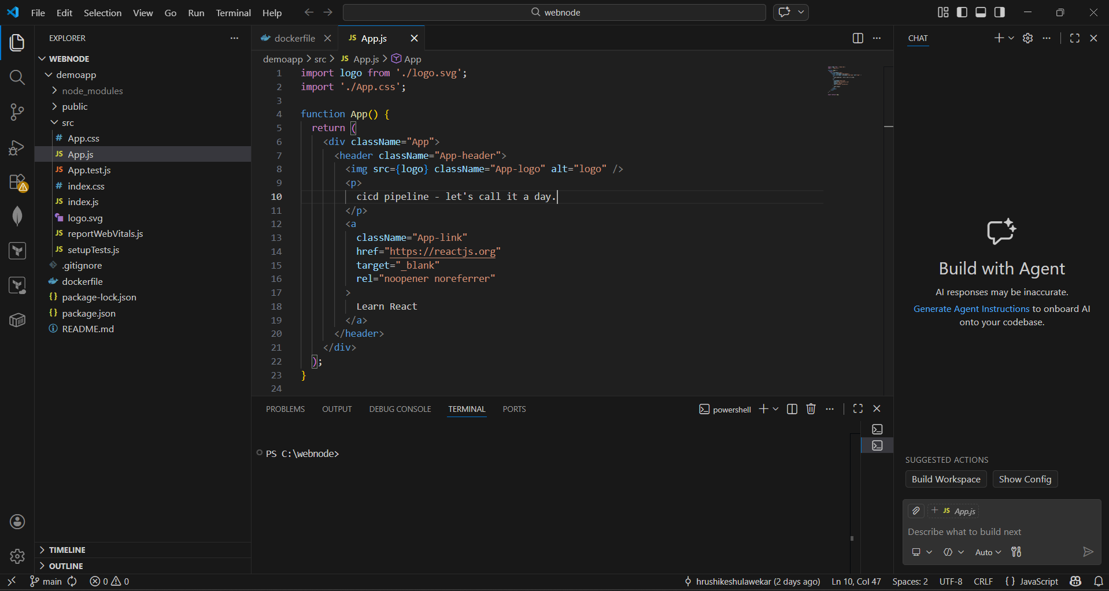
STEP 1 OF 13
Create the Node.js app & Dockerfile
Scaffold the React/Node.js application locally, then write a Dockerfile that defines how the app is built and run inside a container — the foundation every later stage builds on.
DOCKER & KUBERNETES IMPLEMENTATION
08

Slide 9
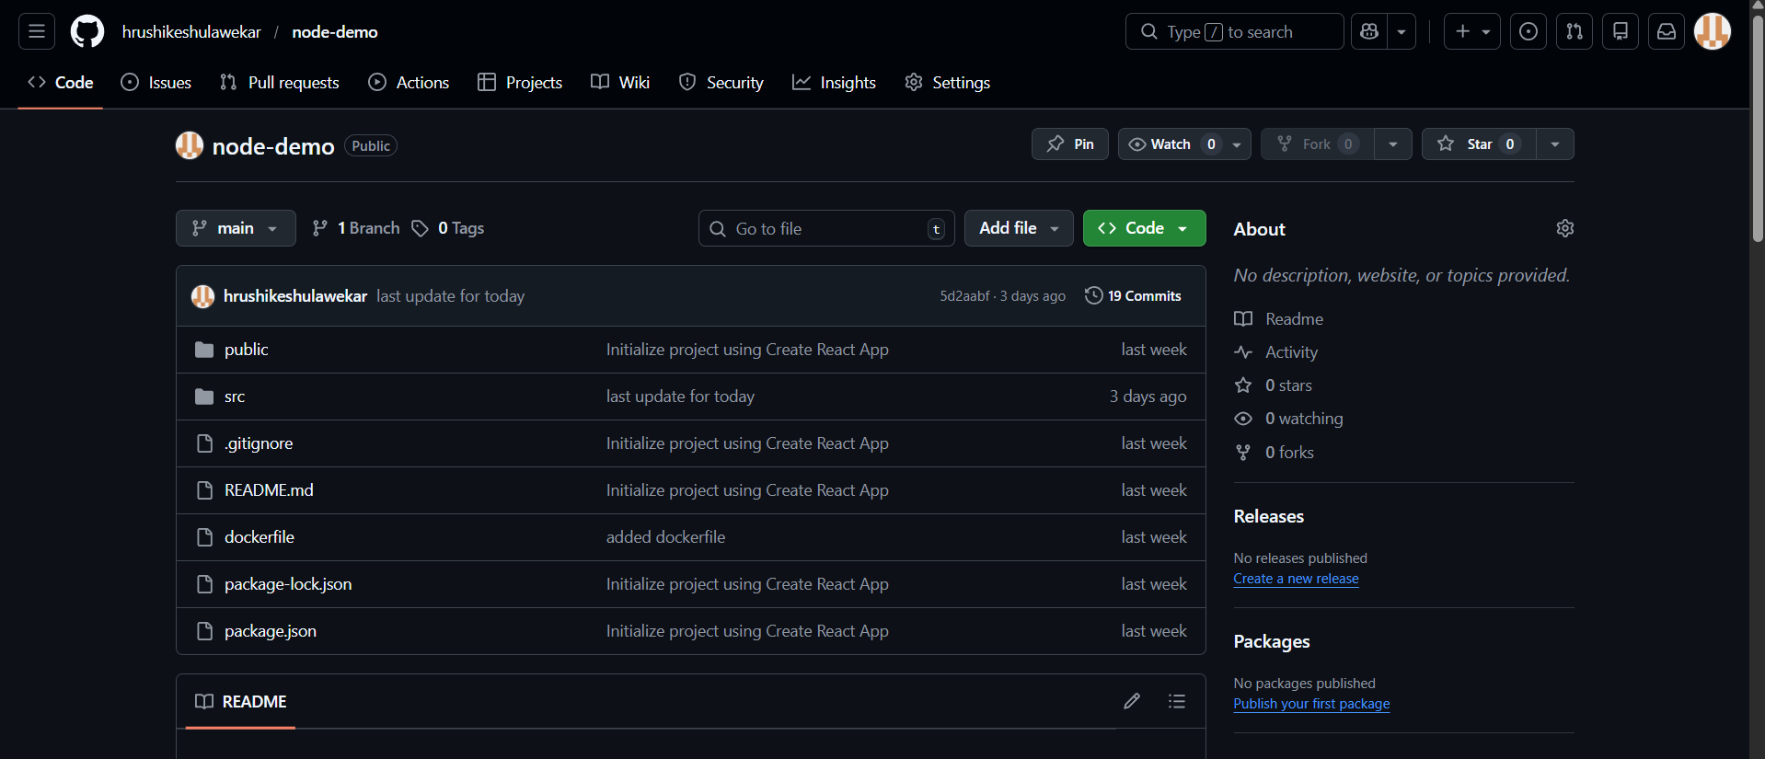
STEP 2 OF 13
Push the code to GitHub
Create a repository and push the application source so Jenkins has a single source of truth to pull from on every build, and so changes are version-controlled from day one.
DOCKER & KUBERNETES IMPLEMENTATION
09

Slide 10

STEP 3 OF 13
Install the toolchain
All five tools are installed on the virtual machine before any pipeline work begins.
Git
Jenkins
Docker
Kubernetes
Minikube
Version control
CI/CD automation
Containerization
Orchestration
Local K8s cluster
DOCKER & KUBERNETES IMPLEMENTATION
10

Slide 11
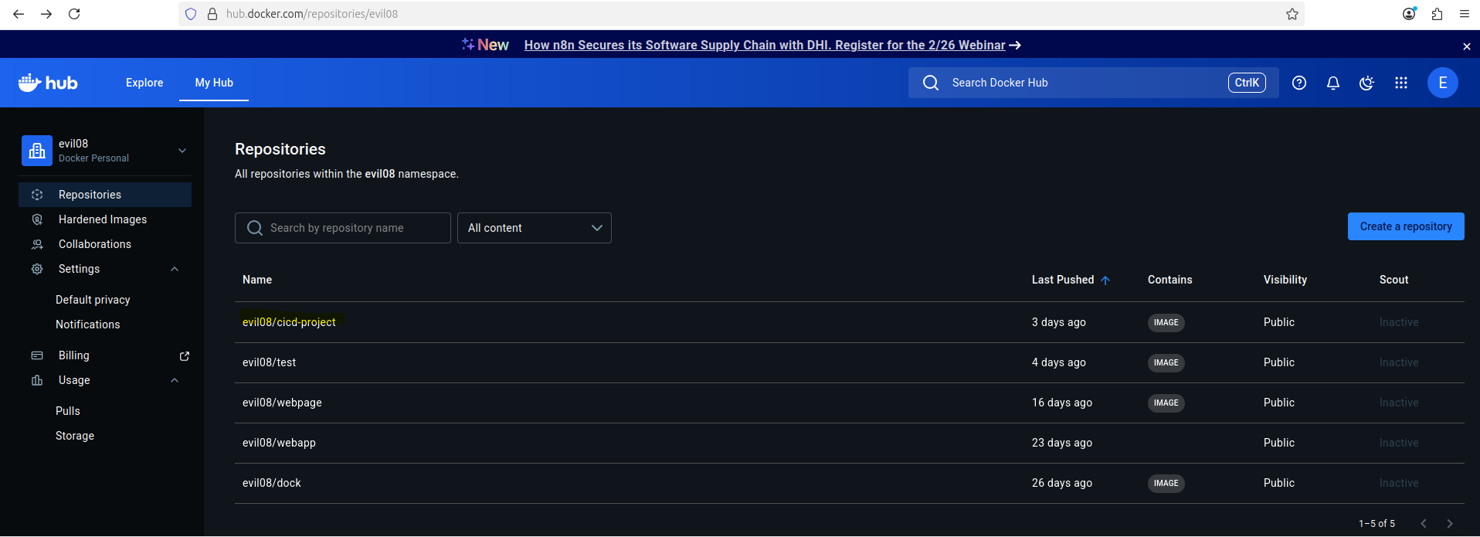
STEP 4 OF 13
Create the Docker Hub repository
Set up a Docker Hub repository to act as the registry for every image Jenkins builds — versioned, pullable, and ready for Kubernetes to deploy from.
DOCKER & KUBERNETES IMPLEMENTATION
11

Slide 12
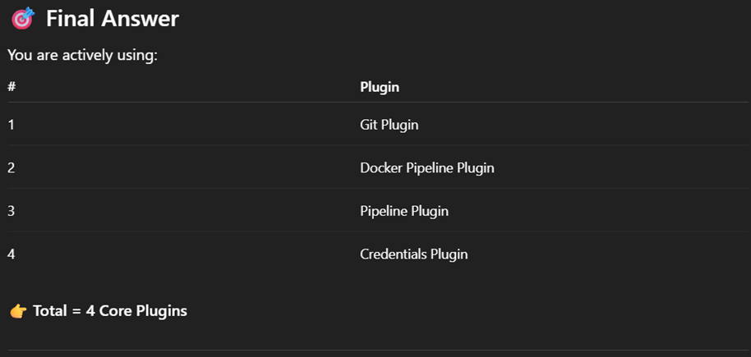
STEP 5 OF 13
Install Jenkins & required plugins
Set the Jenkins username and password, install the suggested plugin set, then add four core plugins the pipeline depends on: Git, Docker Pipeline, Pipeline, and Credentials.
DOCKER & KUBERNETES IMPLEMENTATION
12

Slide 13
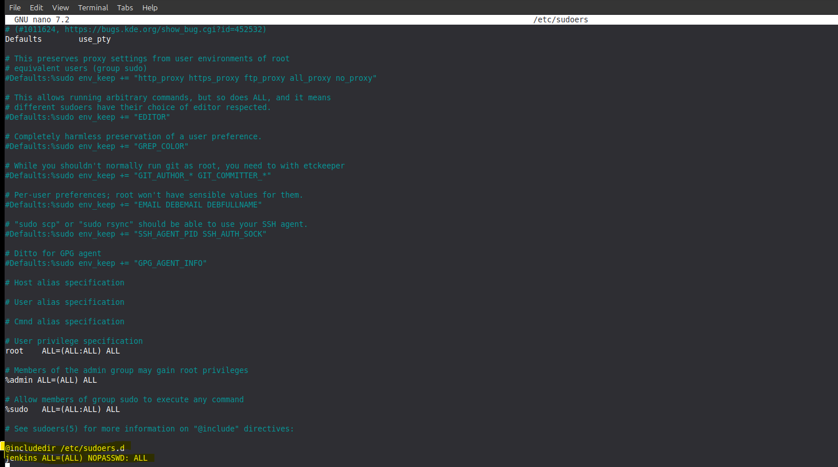
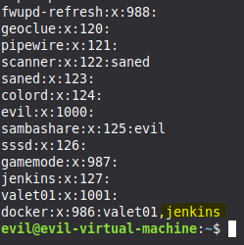
STEP 6 OF 13
Grant Jenkins administrative privilege
Jenkins needs sudo-level access so it can run Docker builds and call kubectl directly — done by adding the jenkins user to the right system groups.
DOCKER & KUBERNETES IMPLEMENTATION
13

Slide 14
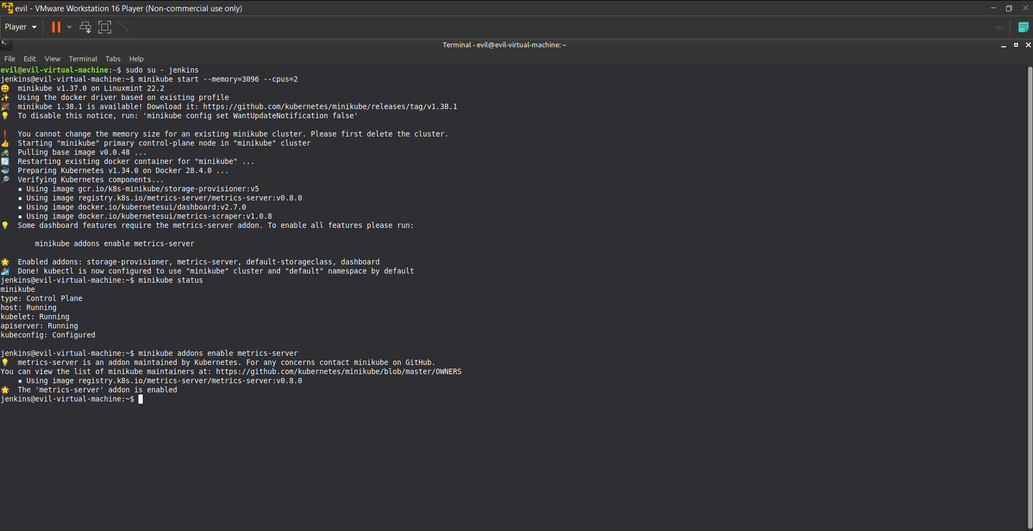
STEP 7 OF 13
Start Minikube & enable metrics-server
Bring up the local Kubernetes cluster and enable the metrics-server addon, which is required later for autoscaling (HPA) and for inspecting live resource usage.
DOCKER & KUBERNETES IMPLEMENTATION
14

Slide 15
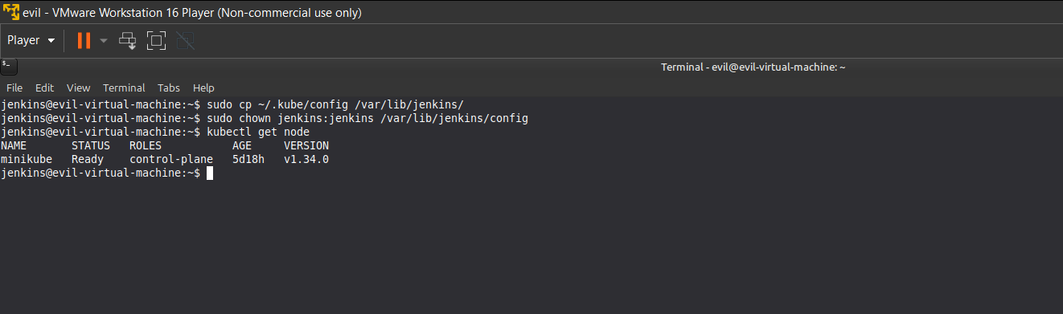
STEP 8 OF 13
Connect Jenkins to kubectl
Copy the kubeconfig into Jenkins' home directory and fix ownership, so the Jenkins user can run kubectl commands against the Minikube cluster during deployment.
DOCKER & KUBERNETES IMPLEMENTATION
15

Slide 16

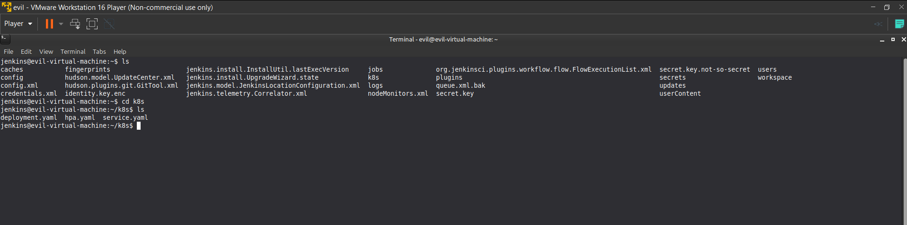
STEP 9 OF 13
Write the Kubernetes YAML manifests
Inside the Jenkins workspace, a k8s/ directory holds the three manifests that define how the app runs on the cluster.
deployment.yaml
service.yaml
hpa.yaml
Pod spec, replicas, image, rolling update strategy
Stable network endpoint exposing the app
Horizontal Pod Autoscaler thresholds
DOCKER & KUBERNETES IMPLEMENTATION
16

Slide 17
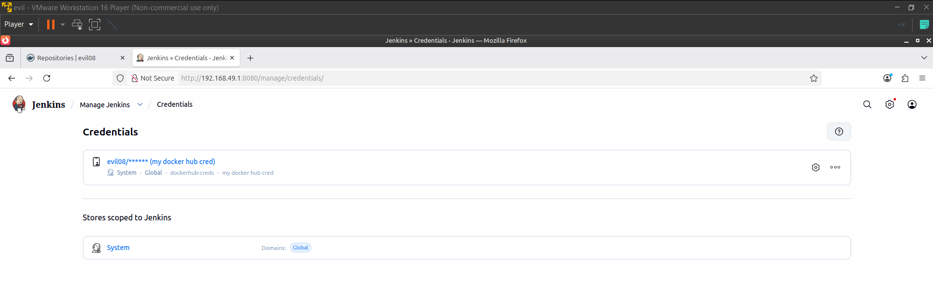
STEP 10 OF 13
Add Docker Hub credentials to Jenkins
Store the Docker Hub username and access token as a Jenkins credential so the pipeline can authenticate and push images without hardcoding secrets in the Jenkinsfile.
DOCKER & KUBERNETES IMPLEMENTATION
17

Slide 18
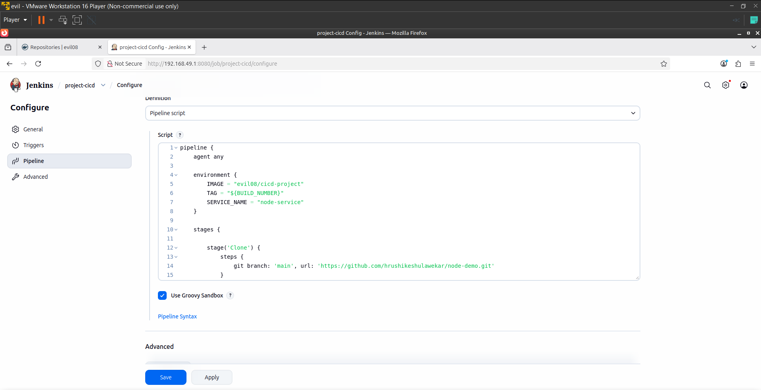
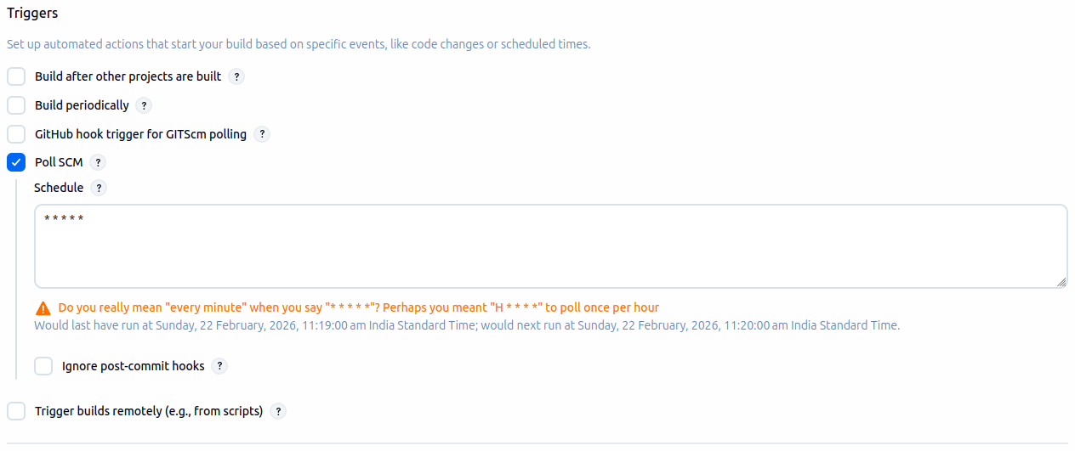
STEP 11 OF 13
Create the Jenkins pipeline job
1
Create a New Item → Pipeline, and give it a name
2
Configure the trigger and write the Groovy script in the pipeline definition
3
Save the configuration
DOCKER & KUBERNETES IMPLEMENTATION
18

Slide 19
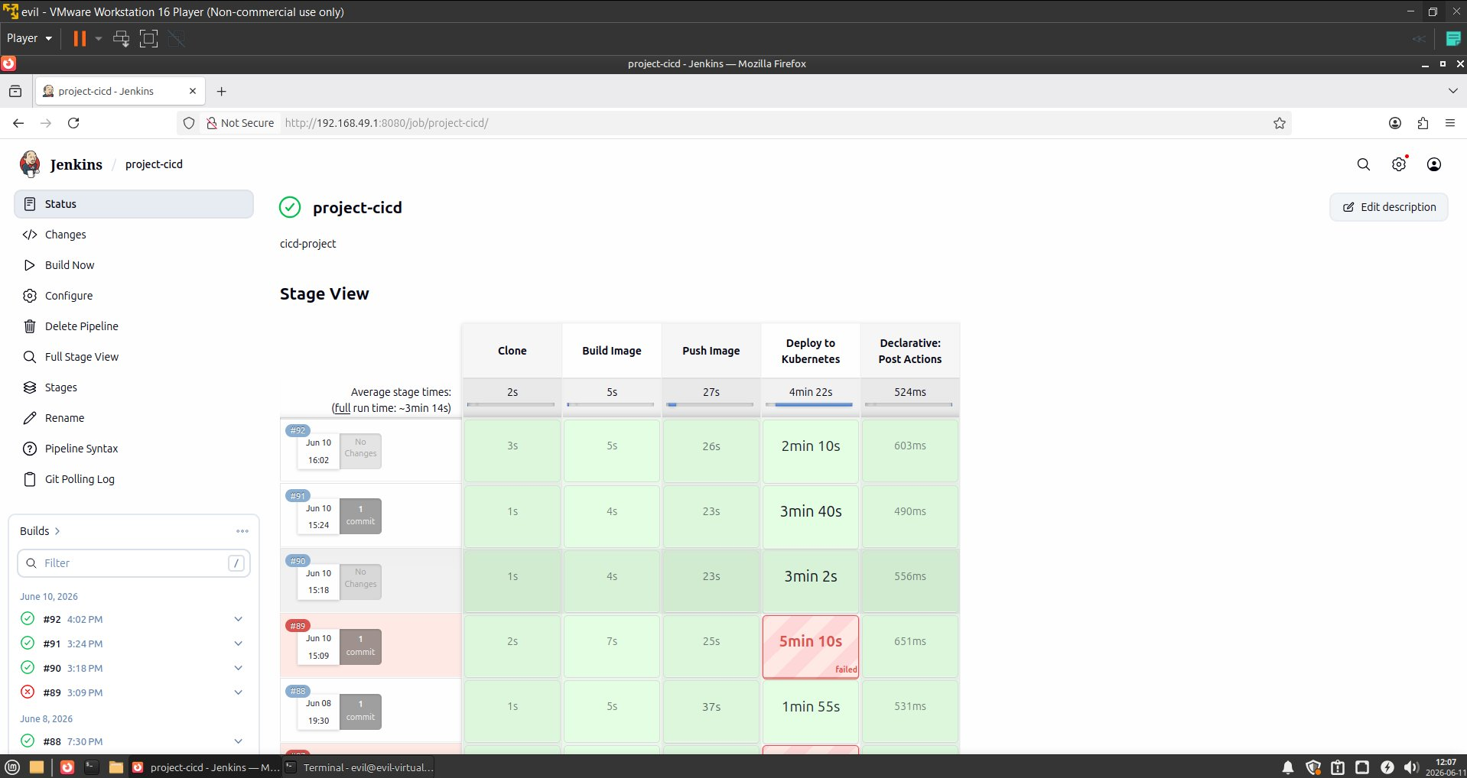
STEP 12 OF 13
Run the first build manually
Trigger the pipeline by clicking Build Now. Watching the first run end-to-end confirms every stage — clone, build, push, deploy — is wired correctly before trusting automatic triggers.
DOCKER & KUBERNETES IMPLEMENTATION
19

Slide 20
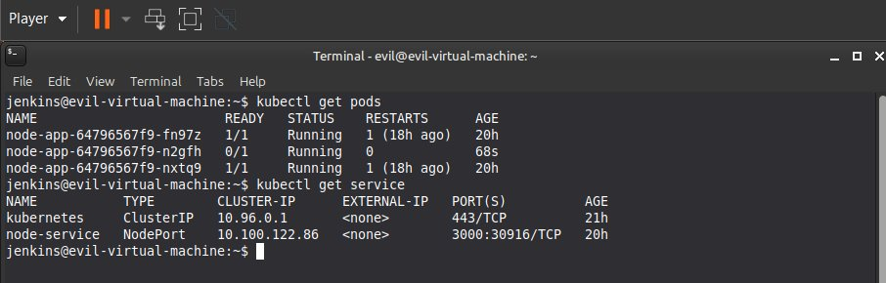
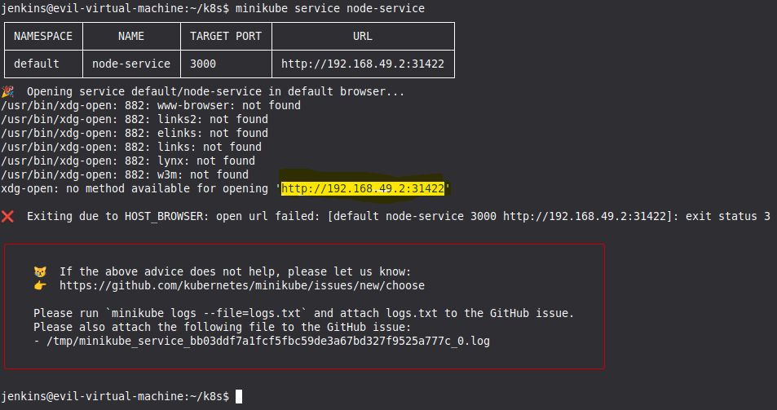
STEP 13 OF 13
Verify pods, service & expose the app
Once the pipeline completes, confirm the pods are Running and the service has a reachable endpoint, then launch it.
kubectl get pods / svc
minikube service
Pods Running, service reachable. node-service exposes the app on a NodePort — opening the printed URL confirms the deployment is live end to end.
DOCKER & KUBERNETES IMPLEMENTATION
20

Slide 21

RESULTS
What this pipeline delivers
Automated Deployment
Faster Release Cycle
Zero Downtime Updates
No manual build or deploy steps — a push is all it takes.
Minutes from commit to running pods instead of hours.
Rolling updates replace pods gradually with no outage.
Version Control
Scalability
Production-Like Workflow
Every image is tagged and traceable to a build number.
HPA and replica counts scale the app under load.
Mirrors real DevOps practice end-to-end, not just theory.
RESULTS
21

Slide 22


CHALLENGES & OPTIMIZATION
Performance challenges & fixes
Initial deployment took 7–11 minutes
Identified large image size and resource limits as root causes
Large Docker image size (over 1GB)
Trimmed build context and base image layers
Limited CPU allocation slowed pod startup
Tuned resource requests/limits for faster scheduling
Old pods stayed up until new pods were fully ready
Tuned rolling update maxSurge / maxUnavailable
CHALLENGES & OPTIMIZATION
22

Slide 23


CHALLENGES & OPTIMIZATION
Operational lessons learned
Ensuring the right image version deploys
Reading pod & rollout status
Every build had to be traced to a specific tag to be certain Kubernetes pulled the version that was just built, not a stale cached one.
Understanding pod status, rollout status, and ReplicaSets was essential groundwork before troubleshooting could even begin.
Rollback timeout on Minikube
Frontend errors don't trigger rollback
5 replicas exhausted Minikube's CPU and caused CrashLoopBackOff during rollback — fixed by reducing to 2 replicas and raising the timeout to 300s.
A thrown React error (throw new Error) doesn't crash the container, so it never triggers a Kubernetes rollback — only server-side process crashes do.
CHALLENGES & OPTIMIZATION
23

Slide 24

AUTO ROLLBACK STRATEGY
Failing safe, automatically
HOW ROLLBACK WORKS
SAFETY GUARDS BUILT IN
1
Capture the current revision BEFORE deploying
kubectl access verified before every deploy
2
Deploy the new image to Kubernetes
First-deploy guard (skips rollback when revision == 0)
3
Wait for rollout, with a 300-second timeout
Rollback itself verified with a 300s wait
4
On timeout or failure: kubectl rollout undo
revisionHistoryLimit: 3 set in deployment.yaml
5
Verify the rollback itself succeeded
No concurrent builds — disableConcurrentBuilds()
6
Pipeline is marked FAILURE, with rollback details logged
Local Docker image cleaned up after every run
AUTO ROLLBACK STRATEGY
24

Slide 25
AUTO ROLLBACK STRATEGY
The rollback logic, in the Jenkinsfile
A condensed view of the three-part rollback block: capture, wait, and undo on failure.
Jenkinsfile
// 1. Capture revision BEFORE deploying
def currentRevision = sh(script: "kubectl get deployment/node-app ...")
// 2. Wait for rollout, with a timeout
def rolloutStatus = sh(script: "kubectl rollout status ... --timeout=300s", returnStatus: true)
// 3. On failure: roll back automatically
if (rolloutStatus != 0) {
sh "kubectl rollout undo deployment/node-app -n default"
// verify the rollback itself succeeded...
error("Deployment FAILED. Rolled back to revision ${currentRevision}.")
}
AUTO ROLLBACK STRATEGY
25

Slide 26
ROLLBACK TESTING & VERIFICATION
Three failure modes, three confirmed rollbacks
01
02
03
Timeout
CrashLoop
Wrong Port
5 replicas on Minikube exhausted CPU — rollout timed out and rollback triggered.
process.exit(1) in server.js caused CrashLoopBackOff — rollback triggered immediately.
Wrong containerPort in deployment.yaml — pod never became ready, rollback triggered.
Fix: replicas = 2, timeout = 300s
Reverted to previous build ✓
Most reliable rollback test ✓
COMPLETE PIPELINE FLOW WITH ROLLBACK
On success:
Clone
Build
Push
Deploy
SUCCESS
On failure:
Clone
Build
Push
Deploy FAIL
Auto Rollback
FAILURE
ROLLBACK TESTING & VERIFICATION
26

Slide 27
CONCLUSION
What this project demonstrates
A complete CI/CD pipeline integrating Docker and Kubernetes for fully automated application deployment.
Zero downtime using rolling updates, with deployment performance improved through resource tuning.
Production-grade auto rollback on deployment failure, added and verified — not just designed on paper.
Rollback tested with CrashLoopBackOff simulation and wrong-port injection, confirming automatic recovery to the last stable build.
Overall, the project demonstrates practical, working knowledge of DevOps practices, containerization, version control, Kubernetes orchestration, and fault-tolerant deployment in a real-world workflow.
CONCLUSION
27

Slide 28
Thank You
CI/CD Pipeline for Node.js Application Deployment on Kubernetes
Hrushikesh Ulawekar
github.com/hrushikeshulawekar

