Slide 1

Introduction of Machine Learning
- Yash Patel (Data Scientist)

Slide 2
Agenda
Definition of Machine learning
Applications of machine learning
Types of machine learning
Machine learning pipeline
Various types of Data and Format

Slide 3
Definition of Machine learning
Machine learning is a system of computer algorithms that can learn from past data or information and improve on their own without having to be explicitly programmed. Machine learning is a branch of artificial intelligence that combines data with statistical tools to forecast an outcome that can be used to generate actionable insights.
A Machine Learning system learns from previous data, constructs prediction models, and forecasts the output for fresh data. The amount of data influences the accuracy of projected output since a large amount of data helps to construct a better model that predicts the output more precisely.
Features of machine learning:
Machine learning uses data to detect various patterns in a given dataset.
It can learn from past data and improve automatically.
It is a data-driven technology.
Machine learning is much similar to data mining as it also deals with the huge amount of the data.

Slide 4
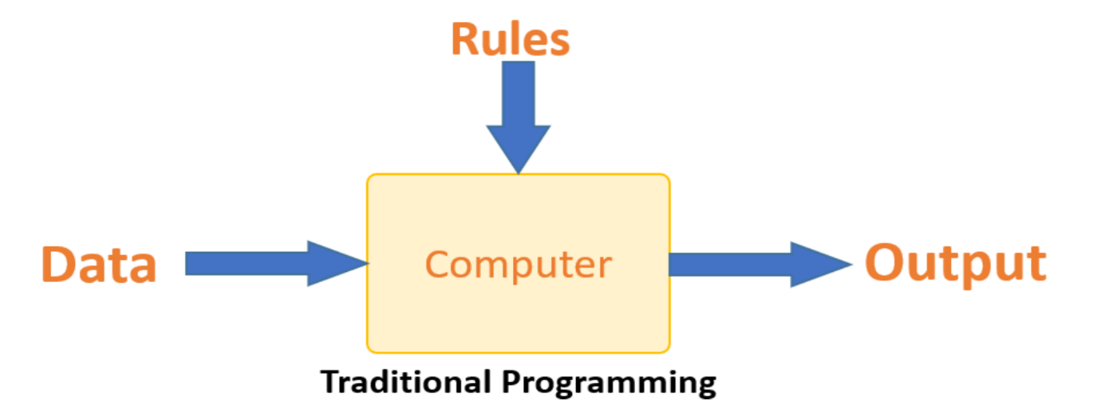
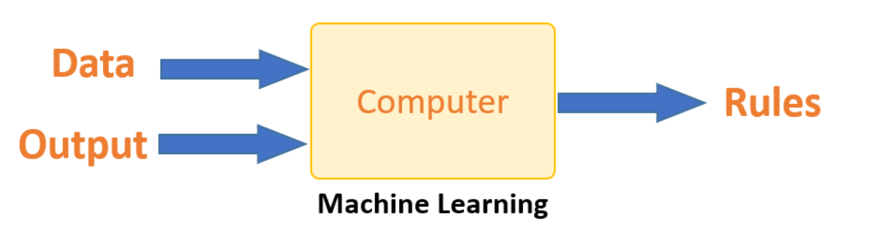
Machine Learning vs. Traditional Programming
In traditional programming, a programmer codes all the rules in consultation with an expert in the industry for which software is being developed. Each rule is built on a logical foundation, and the machine will execute the output that follows the logical statement. As the system becomes more complex, more rules must be written. It can quickly become unsustainable to maintain.
The problem in traditional programming is supposed to be solved by machine learning. The computer creates a rule after learning how the input and output data are related. Every time there is new data, the programmers do not need to write new rules. The algorithms change as a result of new information and experiences, increasing their efficacy over time.

Slide 5
Applications of Machine learning
Image Recognition:
Image recognition is one of the most common applications of machine learning. It is used to identify objects, persons, places, digital images, etc. The popular use case of image recognition and face detection is, Automatic friend tagging suggestion: Facebook provides us a feature of auto friend tagging suggestion. Whenever we upload a photo with our Facebook friends, then we automatically get a tagging suggestion with name, and the technology behind this is machine learning's face detection and recognition algorithm. It is based on the Facebook project named "Deep Face," which is responsible for face recognition and person identification in the picture.
Speech Recognition:
While using Google, we get an option of "Search by voice," it comes under speech recognition, and it's a popular application of machine learning. Speech recognition is a process of converting voice instructions into text, and it is also known as "Speech to text", or "Computer speech recognition." At present, machine learning algorithms are widely used by various applications of speech recognition. Google assistant, Siri, Cortana, and Alexa are using speech recognition technology to follow the voice instructions.

Slide 6
Applications of Machine learning
Stock Market trading:
Machine learning is widely used in stock market trading. In the stock market, there is always a risk of up and downs in shares, so for this machine learning's long short term memory neural network is used for the prediction of stock market trends.
Medical Diagnosis:
In medical science, machine learning is used for diseases diagnoses. With this, medical technology is growing very fast and able to build 3D models that can predict the exact position of lesions in the brain. It helps in finding brain tumors and other brain-related diseases easily.
Automatic Language Translation:
Nowadays, if we visit a new place and we are not aware of the language then it is not a problem at all, as for this also machine learning helps us by converting the text into our known languages. Google's GNMT (Google Neural Machine Translation) provide this feature, which is a Neural Machine Learning that translates the text into our familiar language, and it called as automatic translation. The technology behind the automatic translation is a sequence to sequence learning algorithm, which is used with image recognition and translates the text from one language to another language.

Slide 7
Applications of Machine learning
Traffic prediction:
If we want to visit a new place, we take help of Google Maps, which shows us the correct path with the shortest route and predicts the traffic conditions. It predicts the traffic conditions such as whether traffic is cleared, slow-moving, or heavily congested with the help of two ways:
Real Time location of the vehicle form Google Map app and sensors
Average time has taken on past days at the same time.
Everyone who is using Google Map is helping this app to make it better. It takes information from the user and sends back to its database to improve the performance.
Product recommendations:
Machine learning is widely used by various e-commerce and entertainment companies such as Amazon, Netflix, etc., for product recommendation to the user. Whenever we search for some product on Amazon, then we started getting an advertisement for the same product while internet surfing on the same browser and this is because of machine learning. Google understands the user interest using various machine learning algorithms and suggests the product as per customer interest.
As similar, when we use Netflix, we find some recommendations for entertainment series, movies, etc., and this is also done with the help of machine learning.

Slide 8
Applications of Machine learning
Virtual Personal Assistant:
We have various virtual personal assistants such as Google assistant, Alexa, Cortana, Siri. As the name suggests, they help us in finding the information using our voice instruction. These assistants can help us in various ways just by our voice instructions such as Play music, call someone, Open an email, Scheduling an appointment, etc. These virtual assistants use machine learning algorithms as an important part. These assistant record our voice instructions, send it over the server on a cloud, and decode it using ML algorithms and act accordingly.
Online Fraud Detection:
Machine learning is making our online transaction safe and secure by detecting fraud transaction. Whenever we perform some online transaction, there may be various ways that a fraudulent transaction can take place such as fake accounts, fake ids, and steal money in the middle of a transaction. So to detect this, Feed Forward Neural network helps us by checking whether it is a genuine transaction or a fraud transaction.
For each genuine transaction, the output is converted into some hash values, and these values become the input for the next round. For each genuine transaction, there is a specific pattern which gets change for the fraud transaction hence, it detects it and makes our online transactions more secure.

Slide 9
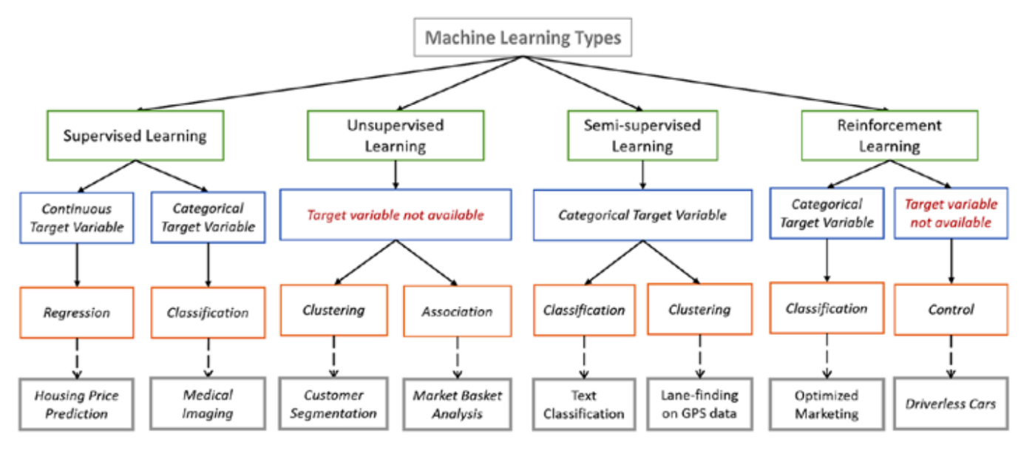
Types of Machine learning

Slide 10
Supervised Machine Learning
Supervised Machine Learning is a learning method that uses labelled training data to predict outcomes for unlabeled data. Supervised learning involves training the computer with data that has been "labelled," which implies that part of the data has already been marked with correct responses.
Supervised learning is a process of providing input data as well as correct output data to the machine learning model. The aim of a supervised learning algorithm is to find a mapping function to map the input variable(x) with the output variable(y).
Features of Supervised machine learning:
Text categorization
Face Detection
Signature recognition
Customer discovery
Spam detection
Weather forecasting
Predicting housing prices based on the prevailing market price
Stock price predictions

Slide 11
Supervised Machine Learning
Advantages of Supervised machine learning:
With the help of supervised learning, the model can predict the output on the basis of prior experiences.
In supervised learning, we can have an exact idea about the classes of objects.
Supervised learning model helps us to solve various real-world problems such as fraud detection, spam filtering, etc.
Disadvantages of Supervised machine learning:
Supervised learning models are not suitable for handling the complex tasks.
Supervised learning cannot predict the correct output if the test data is different from the training dataset.
Training required lots of computation times.
In supervised learning, we need enough knowledge about the classes of object.

Slide 12
Supervised Machine Learning
Types of Supervised machine learning:
Regression
Classification
Regression :
Regression analysis uses one or more independent variables to model the relationship between a dependent (target) and independent (predictor) variables. More specifically, regression analysis enables us to comprehend how, when other independent variables are held constant, the value of the dependent variable changes in relation to an independent variable. It forecasts real, continuous values like temperature, age, salary, and cost, among others.
Regression is a supervised learning technique which helps in finding the correlation between variables and enables us to predict the continuous output variable based on the one or more predictor variables.

Slide 13
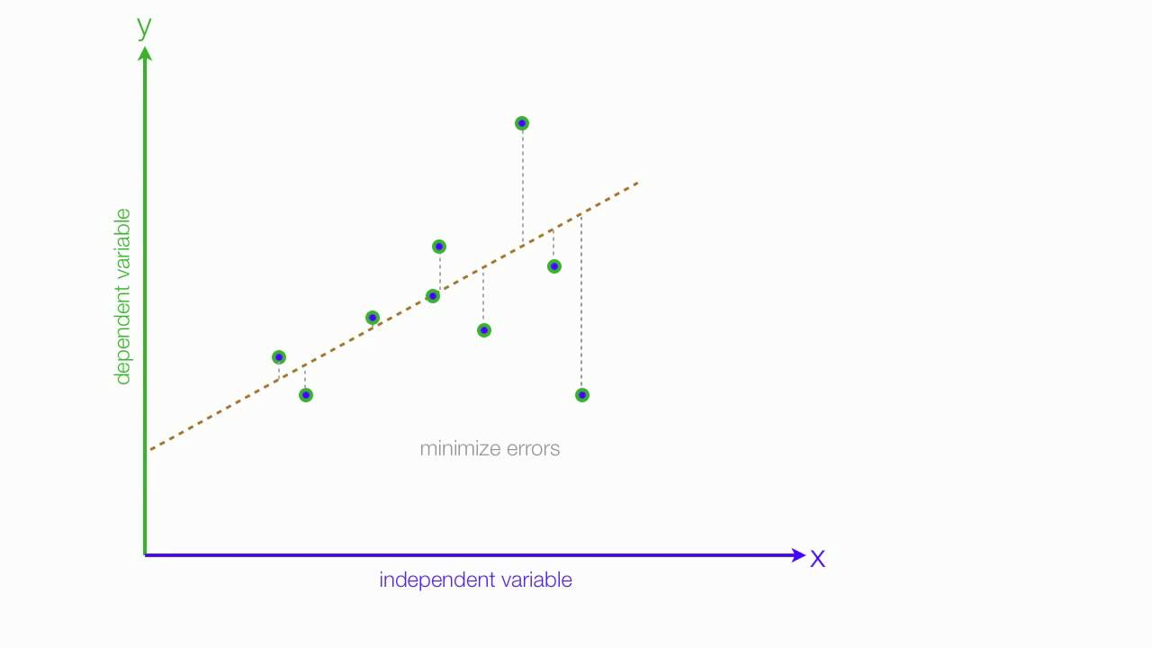
Supervised Machine Learning
Regression :
Regression is a supervised learning technique which helps in finding the correlation between variables and enables us to predict the continuous output variable based on the one or more predictor variables.
Regression shows a line or curve that passes through all the datapoints on target-predictor graph in such a way that the vertical distance between the datapoints and the regression line is minimum. The distance between datapoints and line tells whether a model has captured a strong relationship or not.

Slide 14
Supervised Machine Learning
Regression :
Features of Regression analysis:
Regression estimates the relationship between the target and the independent variable.
It is used to find the trends in data.
It helps to predict real/continuous values.
By performing the regression, we can confidently determine the most important factor, the least important factor, and how each factor is affecting the other factors.

Slide 15
Supervised Machine Learning
Classification :
The Classification method is a Supervised Learning approach that uses training data to identify the category of fresh observations. A software in Classification learns from a given dataset or observations and then classifies additional observations into one of many classes or groupings. For example, Yes or No, 0 or 1, Spam or Not Spam, cat or dog, and so on.
Classes can also be referred to as targets/labels or categories. In contrast to regression, the outcome variable of Classification is a category rather than a value, such as "Green or Blue", "fruit or Animal", and so on. Because the Classification method is a Supervised learning approach, it requires labelled input data, which implies it comprises input and output.
Applications of classification:
Email Spam Detection
Speech Recognition
Identifications of Cancer tumor cells
Drugs Classification
Biometric Identification

Slide 16
Unsupervised Machine Learning
Unsupervised learning, is the method that trains machines to use data that is neither classified nor labeled. It means no training data can be provided and the machine is made to learn by itself. The machine must be able to classify the data without any prior information about the data.
Unsupervised learning is a machine learning technique in which models are not supervised using training dataset. Instead, models itself find the hidden patterns and insights from the given data.
The goal of unsupervised learning is to find the underlying structure of dataset, group that data according to similarities, and represent that dataset in a compressed format.
Feature of Unsupervised machine learning:
Unsupervised learning is helpful for finding useful insights from the data.
Unsupervised learning is much similar as a human learns to think by their own experiences, which makes it closer to the real AI.
Unsupervised learning works on unlabeled and uncategorized data which make unsupervised learning more important.
In real-world, we do not always have input data with the corresponding output so to solve such cases, we need unsupervised learning.

Slide 17
Unsupervised Machine Learning
Applications of Unsupervised machine learning:
Fraud detection
Malware detection
Identification of human errors during data entry
Conducting accurate basket analysis
Advantages of Unsupervised Machine Learning
Unsupervised learning is used for more complex tasks as compared to supervised learning because, in unsupervised learning, we don't have labeled input data.
Unsupervised learning is preferable as it is easy to get unlabeled data in comparison to labeled data.
Disadvantages of Unsupervised Machine Learning
Unsupervised learning is intrinsically more difficult than supervised learning as it does not have corresponding output.
The result of the unsupervised learning algorithm might be less accurate as input data is not labeled, and algorithms do not know the exact output in advance.

Slide 18
Unsupervised Machine Learning
Types of unsupervised machine learning :
Clustering
Association Rules
Clustering :
Clustering is a way of organizing things into clusters so that objects with the highest similarities stay in one group while having little or no similarities with objects in another group. Cluster analysis discovers similarities between data items and categorizes them based on the existence or absence of such similarities.
Association Rules :
An association rule is a type of unsupervised learning strategy used to discover links between variables in a big database. It determines the collection of elements in the dataset that appear together. The association rule improves the effectiveness of marketing strategy. People who purchase X (say, bread) are more likely to purchase Y (Butter/Jam). Market Basket Analysis is a common example of an Association rule.

Slide 19
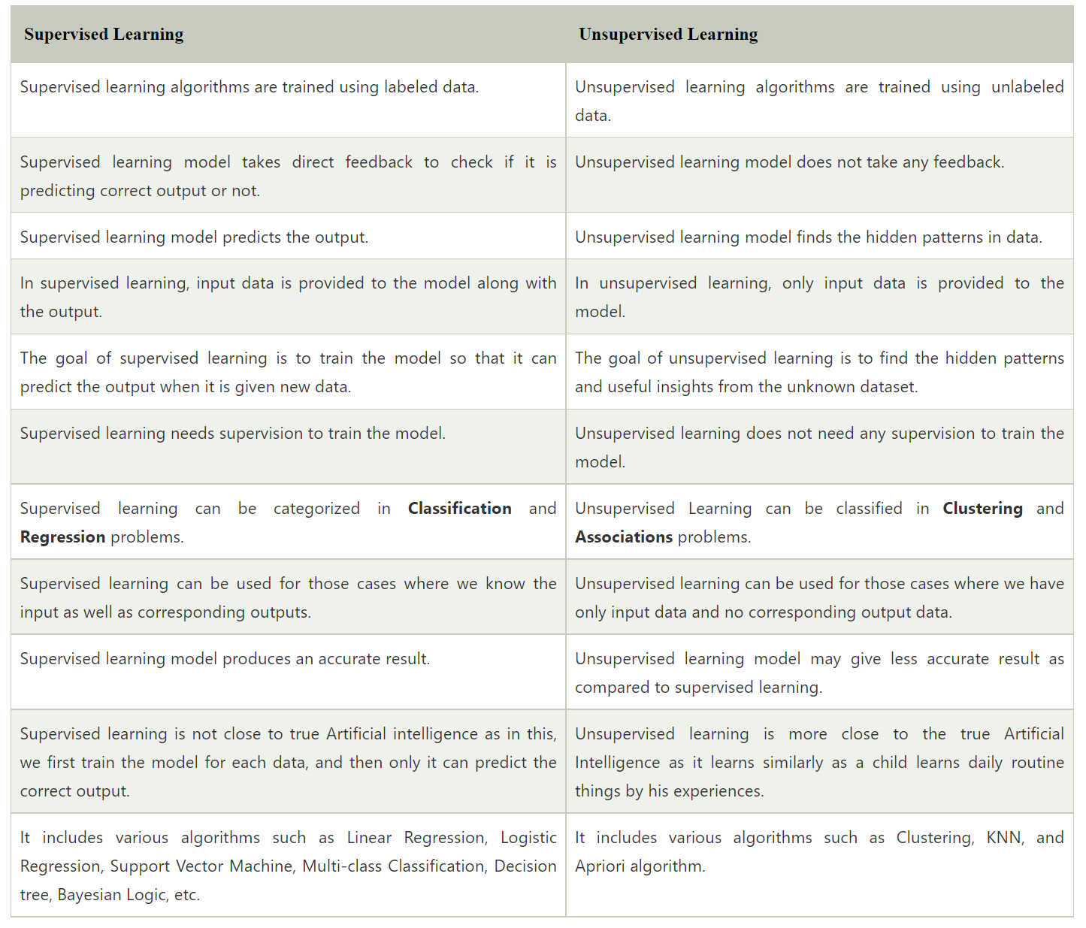
Supervised Machine Learning vs. Unsupervised Machine Learning

Slide 20
Reinforcement Machine Learning
Reinforcement Learning is a feedback-based Machine learning technique in which an agent learns to behave in an environment by performing the actions and seeing the results of actions. For each good action, the agent gets positive feedback, and for each bad action, the agent gets negative feedback or penalty.
In Reinforcement Learning, the agent learns automatically using feedbacks without any labeled data, unlike supervised learning. Since there is no labeled data, so the agent is bound to learn by its experience only.
RL solves a specific type of problem where decision making is sequential, and the goal is long-term, such as game-playing, robotics, etc.
The agent interacts with the environment and explores it by itself. The primary goal of an agent in reinforcement learning is to improve the performance by getting the maximum positive rewards.
The agent learns with the process of hit and trial, and based on the experience, it learns to perform the task in a better way.
Reinforcement learning is a type of machine learning method where an intelligent agent (computer program) interacts with the environment and learns to act within that.

Slide 21
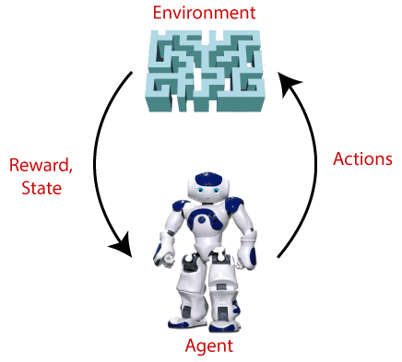
Reinforcement Machine Learning
Features of Reinforcement Machine Learning:
In RL, the agent is not instructed about the environment and what actions need to be taken.
It is based on the hit and trial process.
The agent takes the next action and changes states according to the feedback of the previous action.
The agent may get a delayed reward. The environment is stochastic, and the agent needs to explore it to reach to get the maximum positive rewards.
Steps of Reinforcement Machine Learning:
Main points in Reinforcement learning – Input: The input should be an initial state from which the model will start
Output: There are many possible outputs as there are a variety of solutions to a particular problem
Training: The training is based upon the input, The model will return a state and the user will decide to reward or punish the model based on its output.
The model keeps continues to learn.
The best solution is decided based on the maximum reward.

Slide 22
Machine Learning Pipeline / Workflow
Problem statement analysis
Exploratory data analysis - EDA
Data gathering & Data preparing
Data splitting
Data exploration
Model selection
Data cleaning / preprocessing
Model training
Feature engineering
Model evaluation
Data scaling / normalizing
Prediction
STAGE 1
STAGE 2

Slide 23
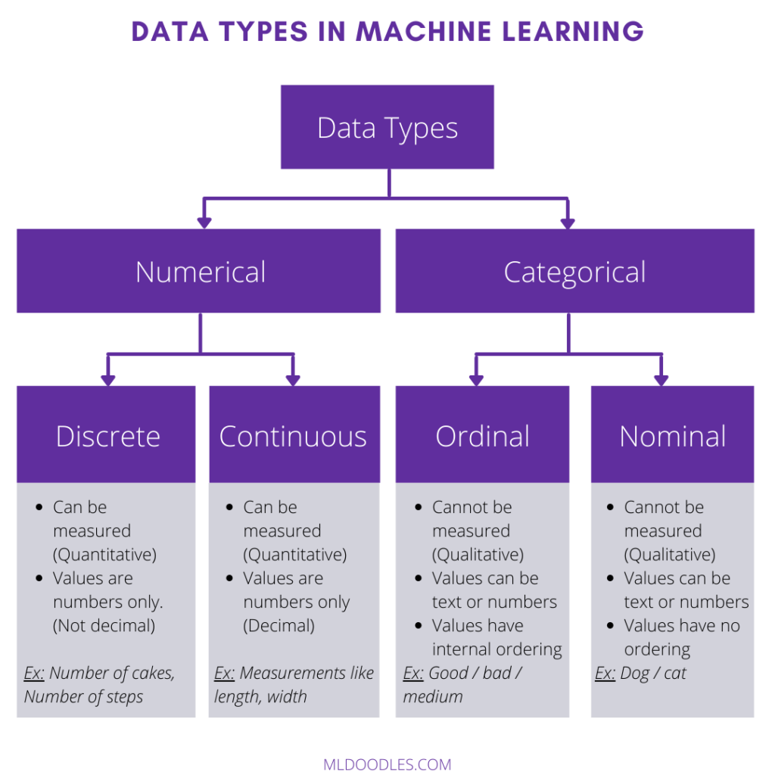
Various types of Data and Format

