Slide 1
Introduction to Artificial Neural Networks
- Yash Patel

Slide 2
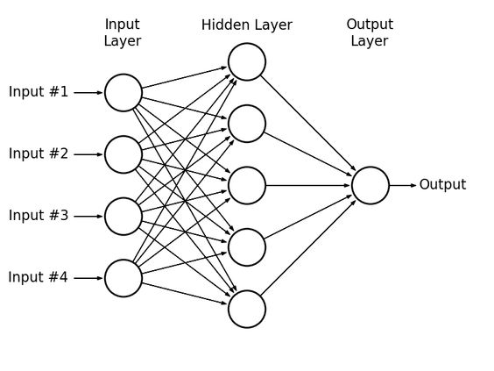
Overview of Neural Networks
Neural networks are a subset of machine learning models inspired by the human brain. They are designed to recognize patterns and relationships in data to make predictions or decisions.
Neural networks are pivotal in AI advancements, enabling breakthroughs in image and speech recognition, autonomous driving, medical diagnostics, and more.

Slide 3
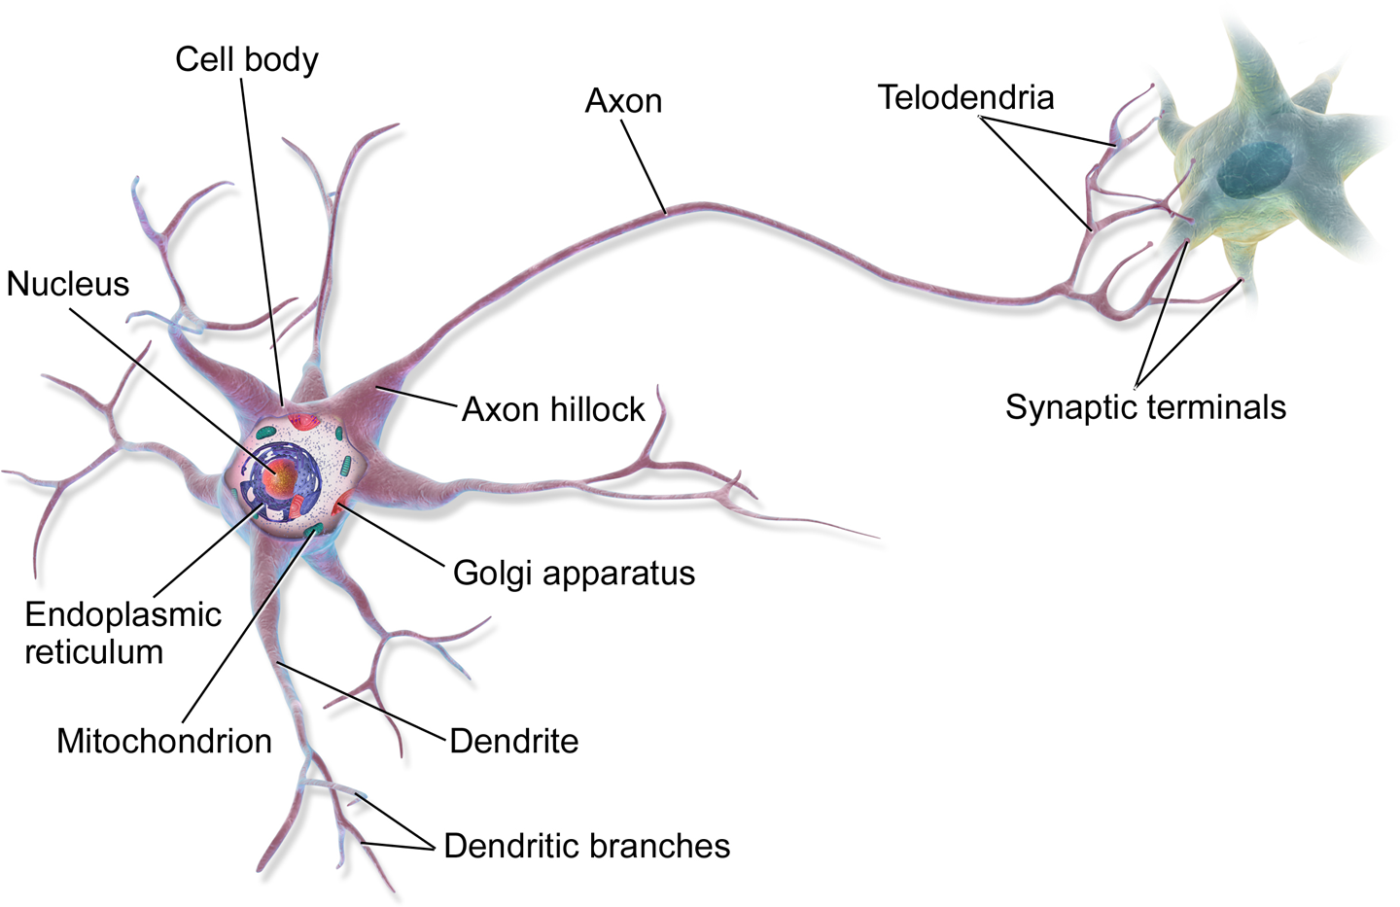
Biological Neural Networks
Human Brain Overview:
Structure: The brain comprises around 86 billion neurons interconnected by trillions of synapses.
Neurons: Neurons are specialized cells that transmit information via electrical and chemical signals.

Slide 4
Biological Neural Networks
Neural Communication:
Synapses: Synapses are the points of communication between neurons.
Transmission: Signals are transmitted through action potentials (electrical impulses) and neurotransmitters (chemical messengers).
Example:
Reflex Action: When you touch a hot object, neurons quickly transmit signals to your brain, causing you to pull your hand away.

Slide 5
Key Components of Biological Neurons
Neuron Structure:
Dendrites: Branch-like structures that receive messages from other neurons.
Cell Body (Soma): Contains the nucleus and processes incoming signals.
Axon: A long, thin structure that transmits signals away from the cell body to other neurons or muscles.
Synapse: The gap between neurons where information is transmitted from one neuron to another.
Action Potentials: Electrical impulses that travel along the axon.
Synaptic Transmission: Neurotransmitters are released from the axon terminal and cross the synaptic gap to bind to receptors on the receiving neuron's dendrites.
Example:
Learning: Repeated activation of synapses strengthens them, which is a basis for learning and memory.

Slide 6
Inspiration from Biology
Analogies Between Biological and Artificial Networks:
Learning: Both systems can learn and adapt from experience or data.
Connections: Both use a network of interconnected nodes (neurons in biological networks, artificial neurons in ANNs).
Adaptability: Both can adapt and improve their performance over time.
Differences:
Complexity: Biological networks are vastly more complex and efficient.
Learning Speed: ANNs can be trained faster, requiring significant computational resources, while biological learning involves more intricate processes.
Example:
Pattern Recognition: Just as the human brain can recognize faces, ANNs can be trained to recognize patterns in images, such as identifying handwritten digits.

Slide 7
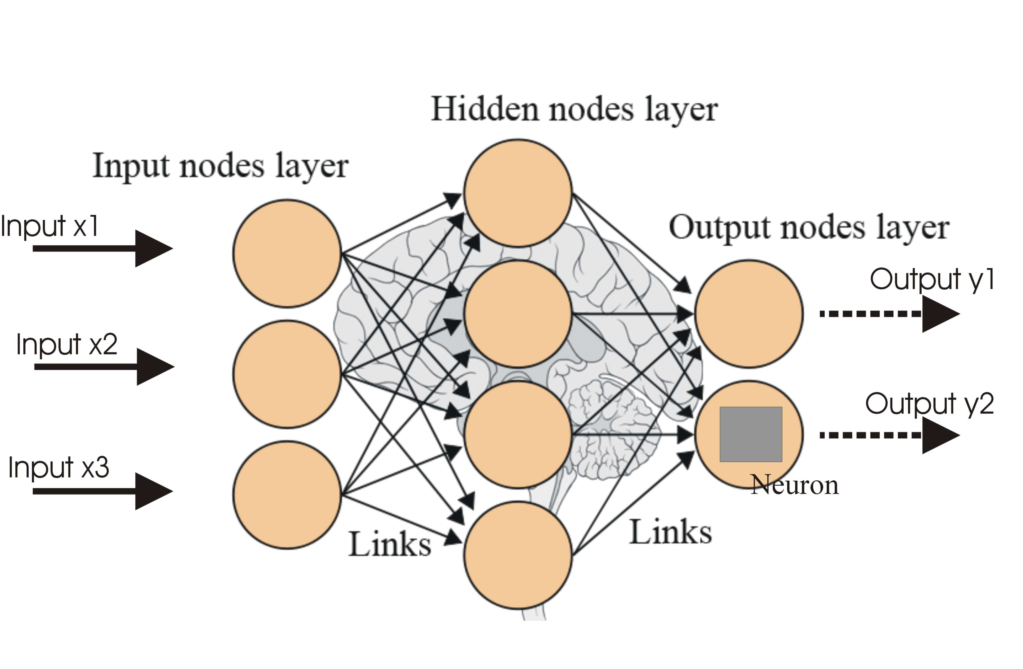
Artificial Neural Networks (ANNs)
What is an ANN?
Definition: ANNs are computational models designed to simulate the way human brains process information. They consist of layers of interconnected nodes (artificial neurons).
Historical Background: Warren McCulloch and Walter Pitts introduced the concept of ANNs in 1943, proposing a simplified model of biological neurons.
Example:
Predictive Text: ANNs power the predictive text feature on smartphones, learning from previous inputs to suggest the next word.

Slide 8
Structure of ANNs
Layers of an ANN:
Input Layer: Receives the initial data. Each neuron represents an input feature.
Hidden Layers: Intermediate layers where computation and pattern extraction occur. The number of hidden layers and neurons can vary, creating deep neural networks for more complex tasks.
Output Layer: Produces the final result or prediction.
Neurons and Connections:
Weights: Parameters that transform the input data. They are adjusted during training to minimize error.
Biases: Additional parameters to adjust the output along with the weights.
Activation Functions: Functions that determine whether a neuron should be activated. Common activation functions include sigmoid, tanh, and ReLU.

Slide 9
Structure of ANNs
Example:
Handwritten Digit Recognition: A neural network can take an image of a handwritten digit as input, process it through multiple layers, and output the predicted digit.
TensorBoard Link

Slide 10
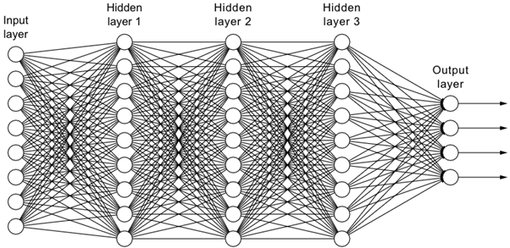
Types of ANNs
Feedforward Neural Networks:
Structure: Information moves in one direction—from input to output without any cycles.
Use Cases: Commonly used for tasks like image and speech recognition.
Perceptron
Deep Feed Forword Neural Network

Slide 11
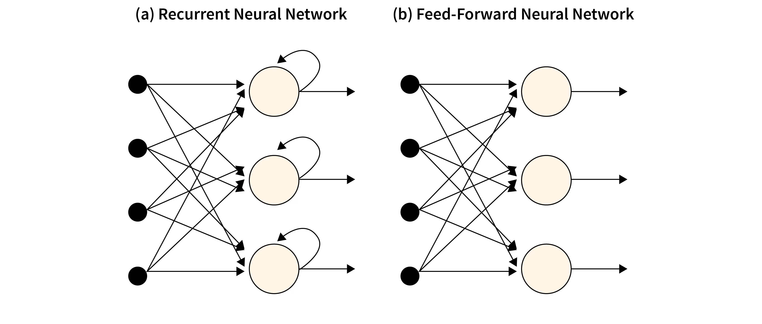
Types of ANNs
Recurrent Neural Networks (RNNs):
Differences: Unlike feedforward networks, RNNs have connections that form directed cycles, allowing them to maintain a memory of previous inputs.
Use Cases: Suitable for sequential data tasks such as language modeling and time-series prediction.

Slide 12
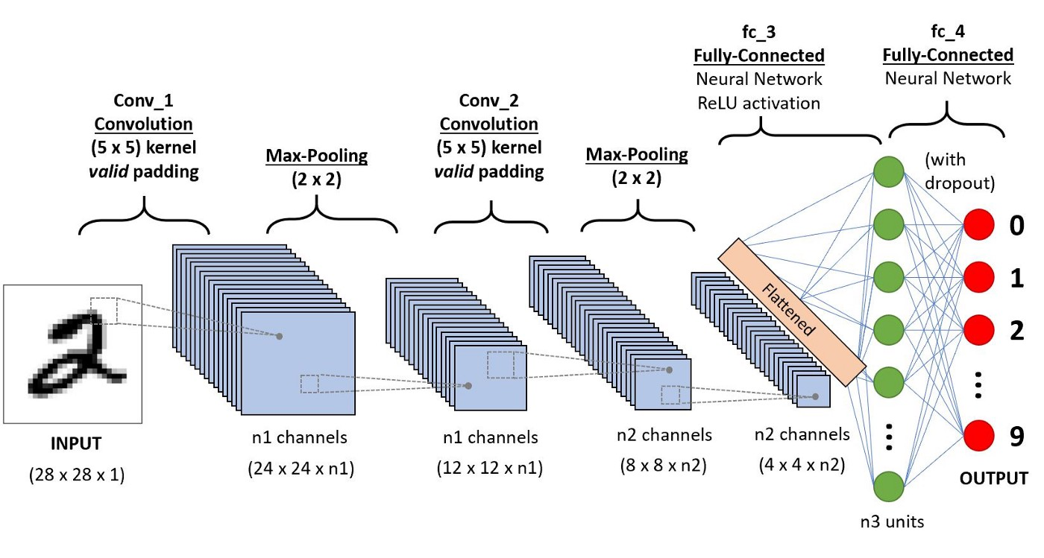
Types of ANNs
Convolutional Neural Networks (CNNs):
Specialization: Designed specifically for processing structured grid data like images. They use convolutional layers to automatically and adaptively learn spatial hierarchies of features.
Components: Key components include convolutional layers, pooling layers, and fully connected layers.

Slide 13
Applications of Artificial Neural Networks (ANNs)
Image and Video Recognition
Facial Recognition:
Description: ANNs are used in facial recognition systems to identify and verify individuals based on their facial features.
Example: Unlocking smartphones using facial recognition technology (e.g., Apple's Face ID).
Object Detection:
Description: Convolutional Neural Networks (CNNs) are particularly effective in identifying and classifying objects within images and videos.
Example: Autonomous vehicles use object detection to recognize other vehicles, pedestrians, and road signs.
Medical Imaging Diagnostics:
Description: ANNs assist in analyzing medical images such as X-rays, MRIs, and CT scans to detect abnormalities.
Example: Identifying tumors in mammograms for early breast cancer detection.

Slide 14
Applications of Artificial Neural Networks (ANNs)
Natural Language Processing (NLP)
Language Translation:
Description: Recurrent Neural Networks (RNNs) and Transformer models are used for translating text from one language to another.
Example: Google Translate, which provides instant translation of text and speech.
Sentiment Analysis:
Description: ANNs analyze text data to determine the sentiment behind it, whether positive, negative, or neutral.
Example: Businesses use sentiment analysis to gauge customer feedback on social media.
Chatbots and Virtual Assistants:
Description: Neural networks power chatbots and virtual assistants to understand and respond to human language.
Example: Amazon's Alexa and Apple's Siri, which can perform tasks and answer questions.

Slide 15
Applications of Artificial Neural Networks (ANNs)
Autonomous Vehicles
Perception:
Description: ANNs help autonomous vehicles interpret and understand their surroundings using sensor data.
Example: Self-driving cars from companies like Tesla use neural networks for lane detection and obstacle recognition.
Decision Making:
Description: Neural networks assist in making real-time driving decisions based on sensory input and mapping data.
Example: Deciding when to change lanes or stop at a traffic signal.

Slide 16
Applications of Artificial Neural Networks (ANNs)
Healthcare
Predictive Diagnostics:
Description: ANNs predict disease outcomes and recommend treatments based on patient data.
Example: Predicting the likelihood of heart disease based on patient health records.
Personalized Medicine:
Description: Neural networks help create personalized treatment plans by analyzing patient data and genetic information.
Example: Tailoring cancer treatment based on individual genetic profiles.

Slide 17
Applications of Artificial Neural Networks (ANNs)
Finance
Fraud Detection:
Description: ANNs identify suspicious activities and patterns that may indicate fraudulent transactions.
Example: Credit card companies use neural networks to detect and prevent fraudulent transactions.
Market Prediction:
Description: Neural networks analyze financial data to predict market trends and stock prices.
Example: Hedge funds and trading firms use ANNs to develop trading algorithms.

Slide 18
Applications of Artificial Neural Networks (ANNs)
Entertainment
Recommendation Systems:
Description: ANNs power recommendation engines that suggest movies, music, and products based on user preferences.
Example: Netflix and Spotify use neural networks to recommend content to users.

Slide 19
Learning Process in Artificial Neural Networks (ANNs)
Supervised Learning
Definition:
Supervised learning involves training the network on a labeled dataset, where each input is paired with a correct output. The network learns to map inputs to the correct outputs by minimizing the difference between its predictions and the actual outputs.
Steps:
Dataset Preparation: Collect and preprocess a labeled dataset.
Initialization: Initialize the weights and biases of the network randomly.
Forward Propagation: Pass the input data through the network to obtain predictions.
Loss Calculation: Compute the loss (error) between the predicted and actual outputs.
Backpropagation: Calculate the gradient of the loss with respect to each weight and bias.
Weight Update: Adjust the weights and biases using an optimization algorithm like gradient descent.
Iteration: Repeat steps 3-6 for a specified number of epochs or until the loss converges.
Example:
Image Classification: Training a neural network to classify images of cats and dogs by providing labeled images and adjusting the network's parameters to minimize classification errors.

Slide 20
Learning Process in Artificial Neural Networks (ANNs)
Unsupervised Learning
Definition:
Unsupervised learning involves training the network on an unlabeled dataset. The network identifies patterns and structures in the data without predefined labels.
Steps:
Dataset Preparation: Collect and preprocess an unlabeled dataset.
Initialization: Initialize the weights and biases of the network randomly.
Forward Propagation: Pass the input data through the network to identify patterns.
Clustering/Dimensionality Reduction: Use techniques like clustering (e.g., k-means) or dimensionality reduction (e.g., autoencoders) to find structure in the data.
Iteration: Repeat steps 3-4 until the network converges on a stable structure.
Example:
Customer Segmentation: Using unsupervised learning to group customers based on purchasing behavior without prior knowledge of the categories.

Slide 21
Learning Process in Artificial Neural Networks (ANNs)
Reinforcement Learning
Definition:
Reinforcement learning involves training the network through interactions with an environment. The network learns to perform actions that maximize cumulative rewards.
Steps:
Environment Setup: Define the environment and the possible actions the network can take.
Initialization: Initialize the network's parameters randomly.
Action Selection: The network selects an action based on the current state of the environment.
Reward Feedback: The environment provides feedback in the form of rewards or penalties based on the action taken.
Policy Update: Adjust the network's parameters to increase the likelihood of actions that yield higher rewards.
Iteration: Repeat steps 3-5 over multiple episodes to refine the network's policy.
Example:
Game Playing: Training a neural network to play games like chess or Go, where the network learns strategies through trial and error to maximize its score.

Slide 22
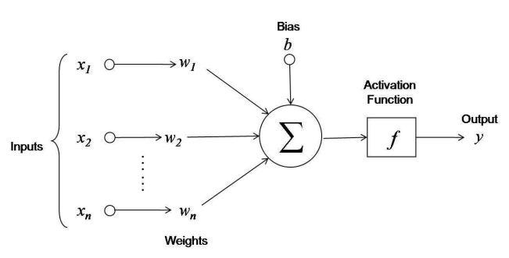
Key Concepts in the Learning Process
Forward Propagation:
Description: The process of passing input data through the network to compute the output.
Example: In image classification, the input image is processed through multiple layers to produce a class label.
Loss Function:
Description: A function that measures the difference between the network's predictions and the actual outputs. Common loss functions include Mean Squared Error (MSE) for regression and Cross-Entropy Loss for classification.
Example: In binary classification, the Cross-Entropy Loss penalizes incorrect predictions more heavily.

Slide 23
Key Concepts in the Learning Process
Backpropagation:
Description: An algorithm for computing the gradient of the loss function with respect to each weight by applying the chain rule of calculus. This information is used to update the weights.
Example: In a neural network, backpropagation adjusts the weights in each layer to reduce the overall error.
Gradient Descent:
Description: An optimization algorithm that updates the network's weights to minimize the loss function. Variants include Stochastic Gradient Descent (SGD), Mini-batch Gradient Descent, and Adam.
Example: In training, gradient descent adjusts the weights iteratively to find the optimal set that minimizes the loss.
Activation Functions:
Description: Functions applied to each neuron's output to introduce non-linearity, allowing the network to learn complex patterns. Common activation functions include Sigmoid, Tanh, and ReLU.
Example: ReLU (Rectified Linear Unit) is widely used in deep networks due to its ability to mitigate the vanishing gradient problem.

Slide 24
Example: Training a Neural Network for Handwritten Digit Recognition
Dataset: Use the MNIST dataset containing images of handwritten digits (0-9) with corresponding labels.
Initialization: Randomly initialize the network's weights and biases.
Forward Propagation: Pass each image through the network to obtain a predicted digit.
Loss Calculation: Compute the Cross-Entropy Loss between the predicted digit and the actual digit.
Backpropagation: Calculate the gradient of the loss with respect to each weight and bias.
Weight Update: Use gradient descent to adjust the weights and biases, reducing the loss.
Iteration: Repeat the process for multiple epochs until the network accurately recognizes digits.

